Slide 1



Mid-Term
Data Process Programming
Student: Shukirillaev Mukhammad Sodik Sherzodbek Ugli
Department:Computer Engineering

Slide 2
Question 1:
What are the main steps in the data processing cycle?
1. Collection: Gather raw data from sources.
2. Preparation: Clean and organize the data.
3. Input: Convert data into machine-readable form.
4. Processing: Perform calculations and analysis.
5. Storage: Save processed data for future use.
6. Output: Present results as reports or visuals.
if you want:
7. Feedback: Use results to improve future processes.

Slide 3
Question 2:
Explain the importance of data cleaning in the data
processing pipeline. Provide examples of at least three
common data cleaning tasks.
Data cleaning ensures accuracy, consistency, and reliability of data before analysis. Without cleaning, results can be misleading or incorrect, affecting decision-making.
Common Data Cleaning Tasks:
1. Removing duplicates: deleting repeated entries.
2. Handling missing values: filling in, estimating, or removing incomplete data.
3. Correcting errors: fixing typos, wrong formats, or invalid entries.

Slide 4
Question 3:
Demonstrate how to reshape a 1D NumPy array into a 2D array with 3 rows.

Slide 5
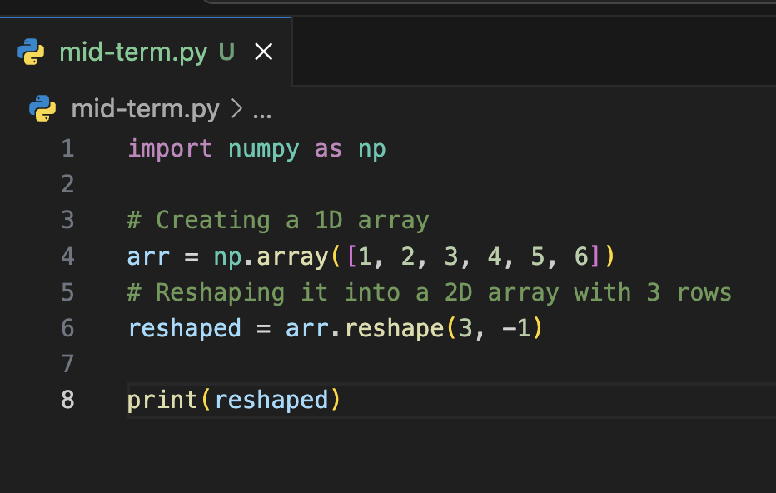
Code:

Slide 6
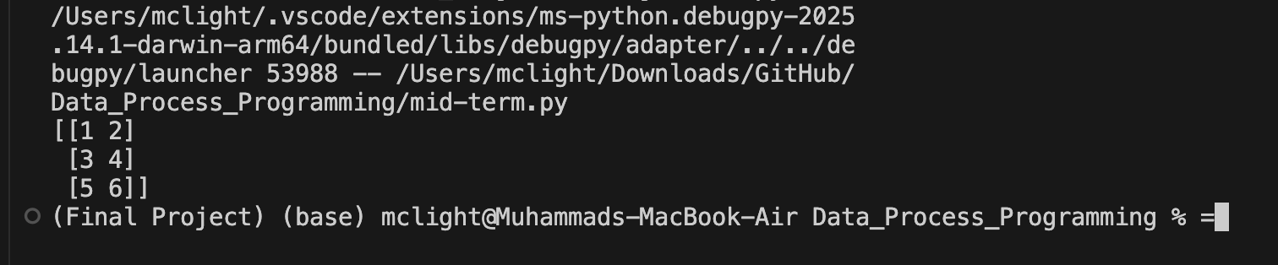
Result

Slide 7
Question 4:
Create a 5×5 NumPy array of random numbers,
convert it into a Pandas DataFrame,
and then:
Rename the columns as A, B, C, D, and E.
Find the column with the highest average value and print
its name.

Slide 8
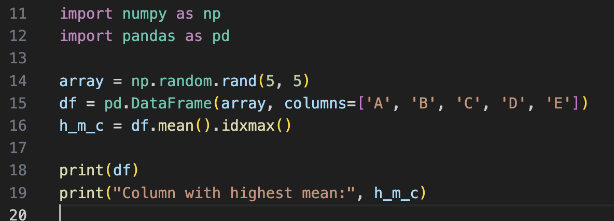
Code:

Slide 9
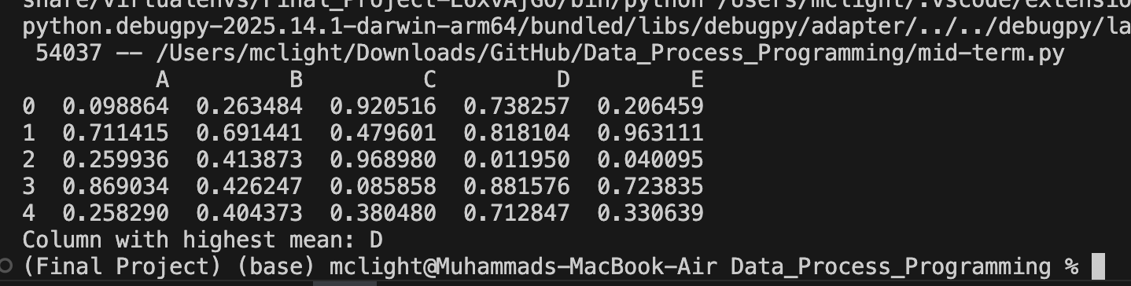
Result
d

Slide 10
Question 5:
Given a CSV file named employees.csv containing the
columns:
Name, Department, Salary, and JoiningDate,
write a Pandas program to:
Load the file into a DataFrame and convert JoiningDate to
datetime.
Remove rows with missing Salary values.
Group the data by Department and calculate the average
salary for each department.
Print the department with the highest average salary

Slide 11
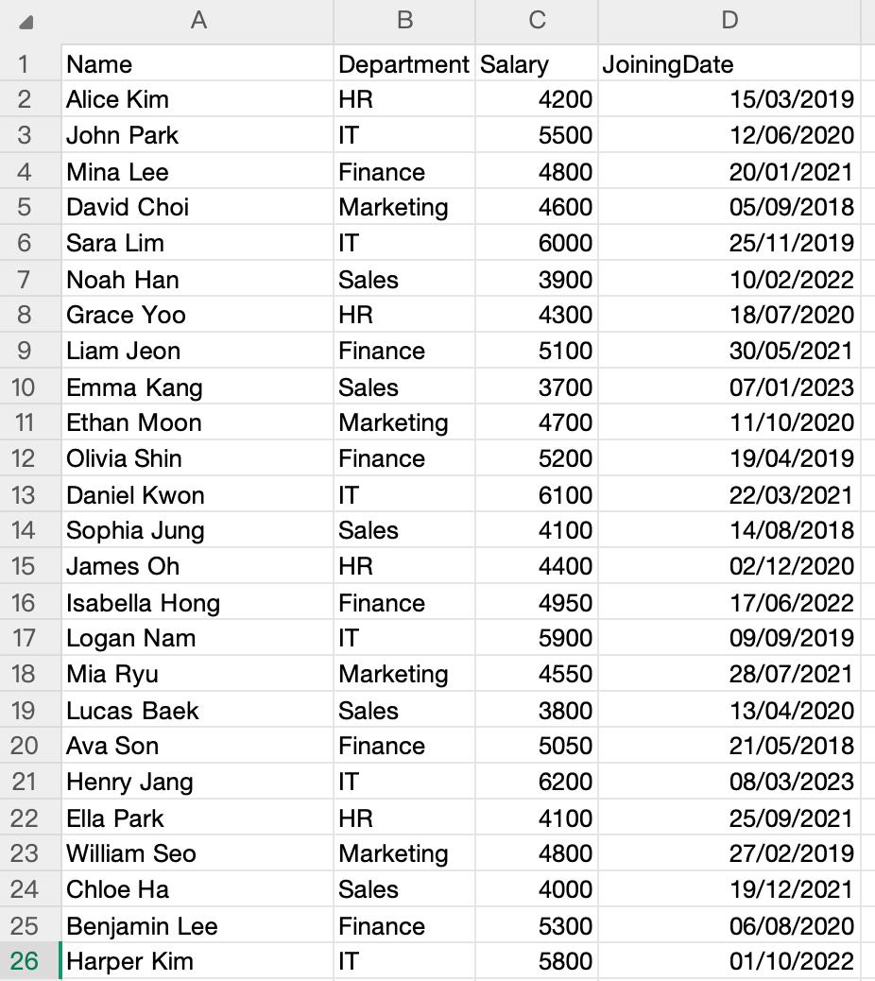
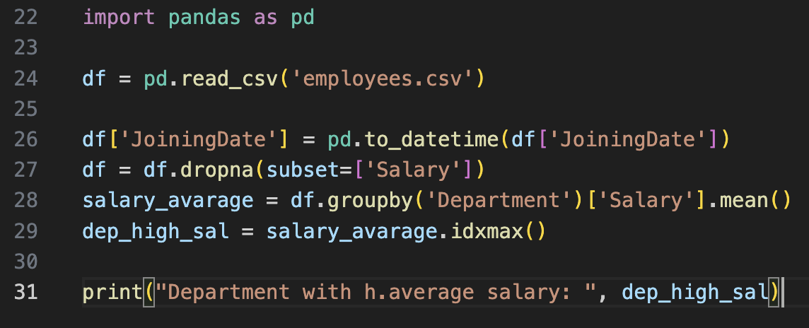
Code:
csv file

Slide 12
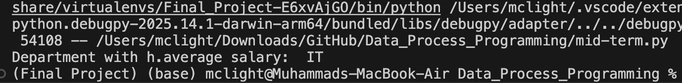
Result
d

Slide 13
Thank you for your attention, Teacher! ❤️

