Slide 1

Python
Group 1

Slide 2

Group Members
01.
Muhammadsodiq
02.
Yusufjon
03.
Abdullor
04.
Lazizbek
05.
Ro’ziboy

Slide 3

1. Create two variables a=12, b=4. Print their sum, difference, product, and quotient.
2. Convert the string "1234" into an integer and add 66 to it.
1-2
Question
Abdulloh

Slide 4

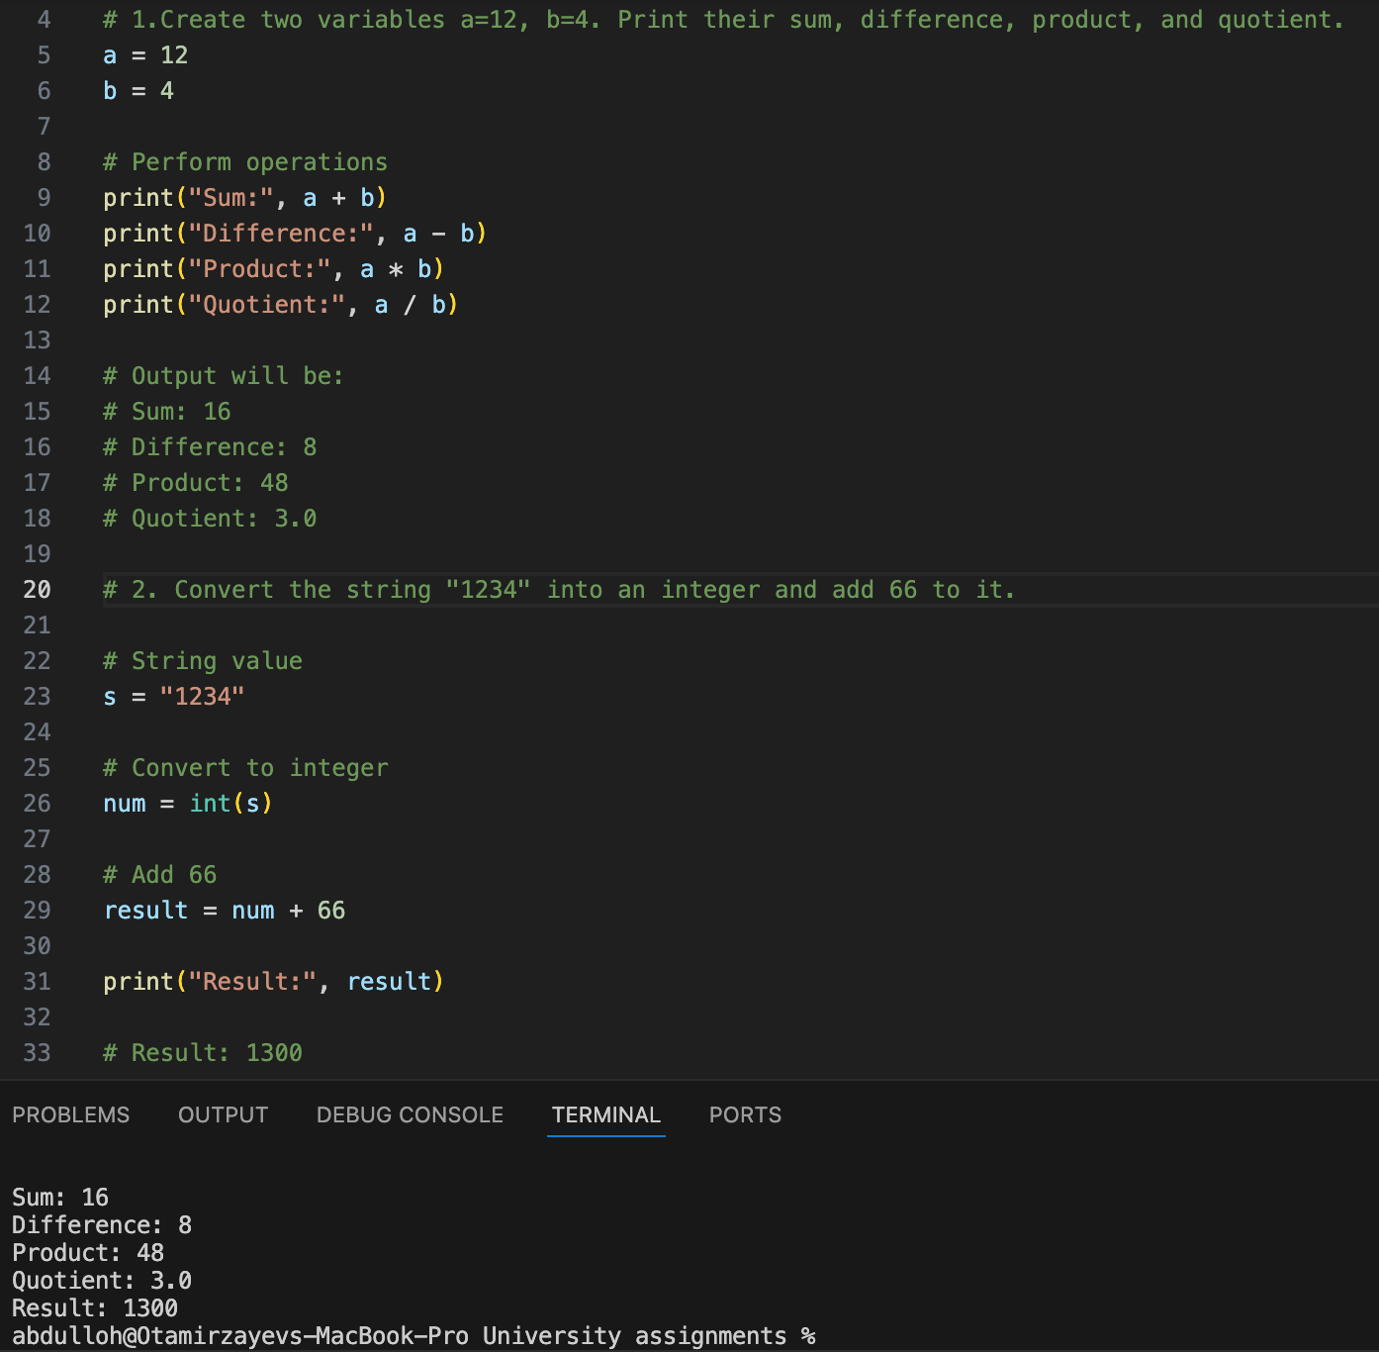


1, 2 - questions

Slide 5
3. Ask the user to enter a number. If it is even, print "Even", otherwise print "Odd".
4. Use a for loop to print numbers from 1 to 10.
3-4
Question
Lazizbek

Slide 6
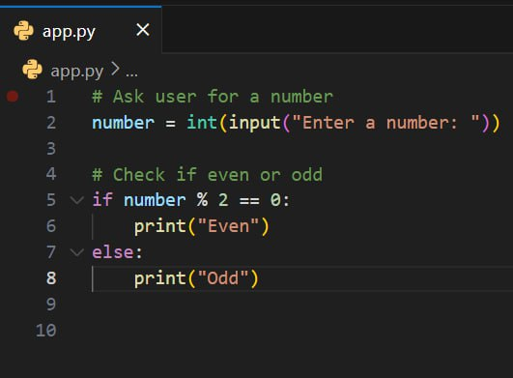
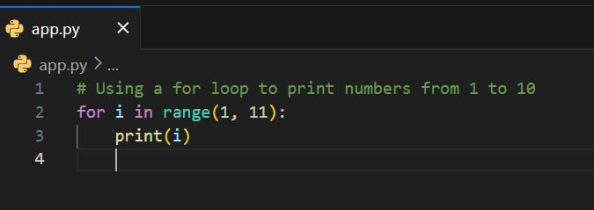
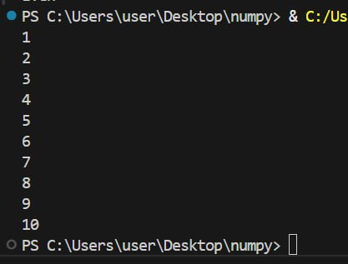
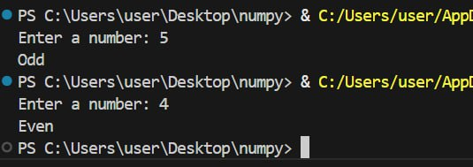
3, 4 - questions

Slide 7
5. Use a while loop to calculate the sum of numbers from 1 to 50.
6. Write a function that returns the factorial of a given number.
5-6
Question
Muhammad

Slide 8
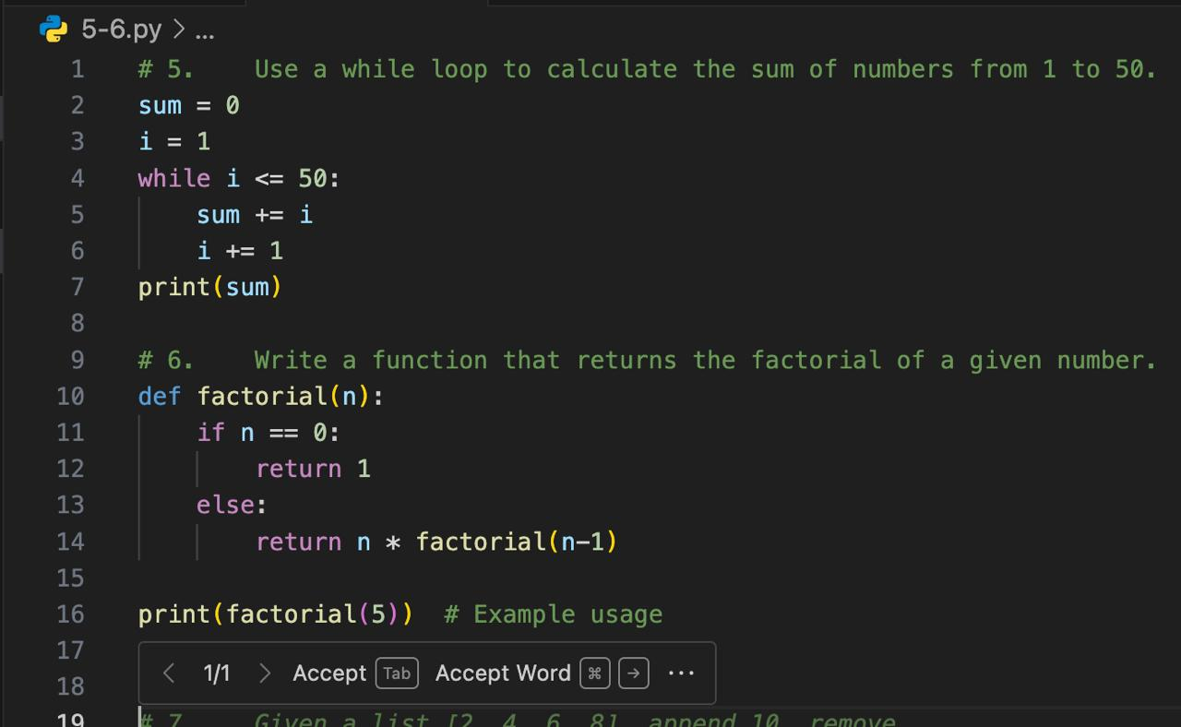
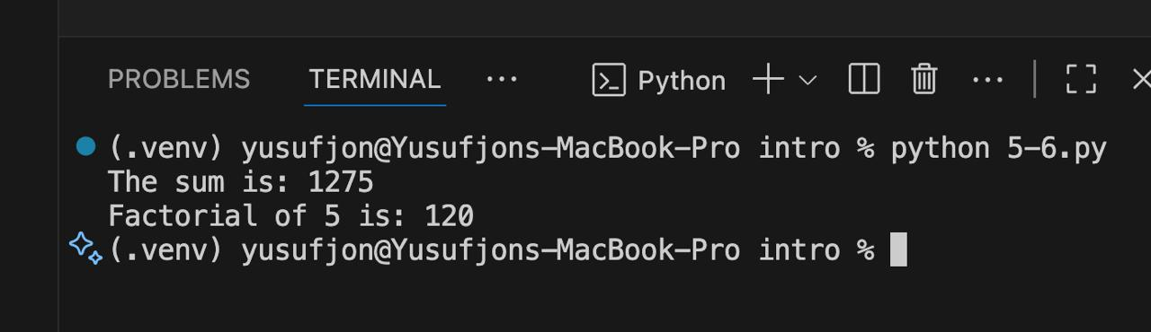
5, 6 - questions

Slide 9
7. Given a list [2, 4, 6, 8], append 10, remove 4, and print the result.
8. Create a dictionary {"name": "John", "age": 22}. Add "major": "CS" and print it.
7-8
Question
Yusufjon

Slide 10
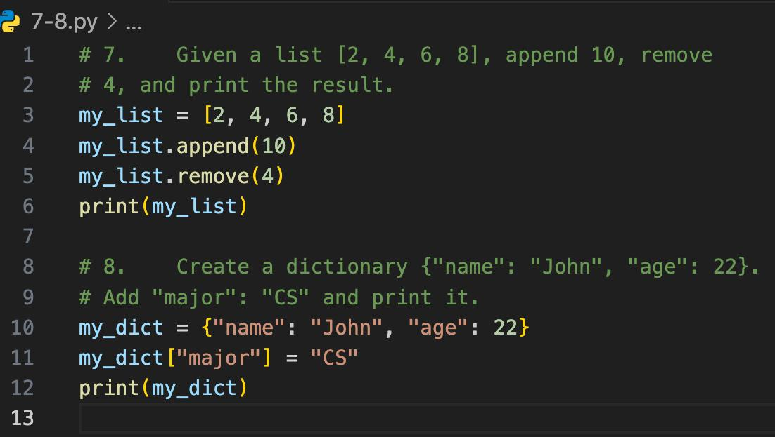
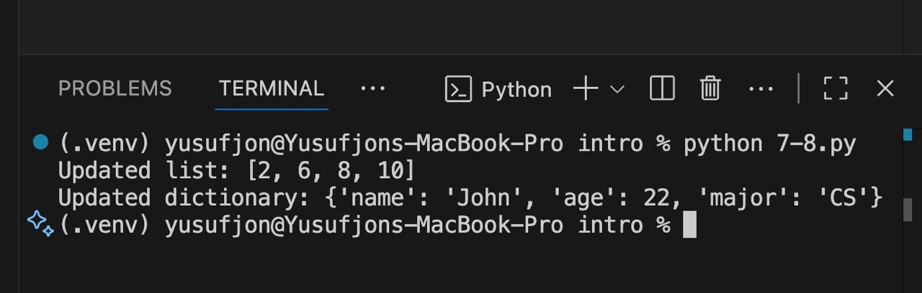
7, 8 - questions

Slide 11
THANK YOU
FOR YOUR ATTENTION!

