Slide 1

Data Process Programming
Flight Delay Analisys System
Student: Shukirillaev Mukhammadsodik ID: 202438379

Slide 2
Objective
Part 1: Clean and process the flight dataset
Part 2: Identify the major causes of flight delays
Part 3: Explore how factors like distance or weather influence delays

Slide 3
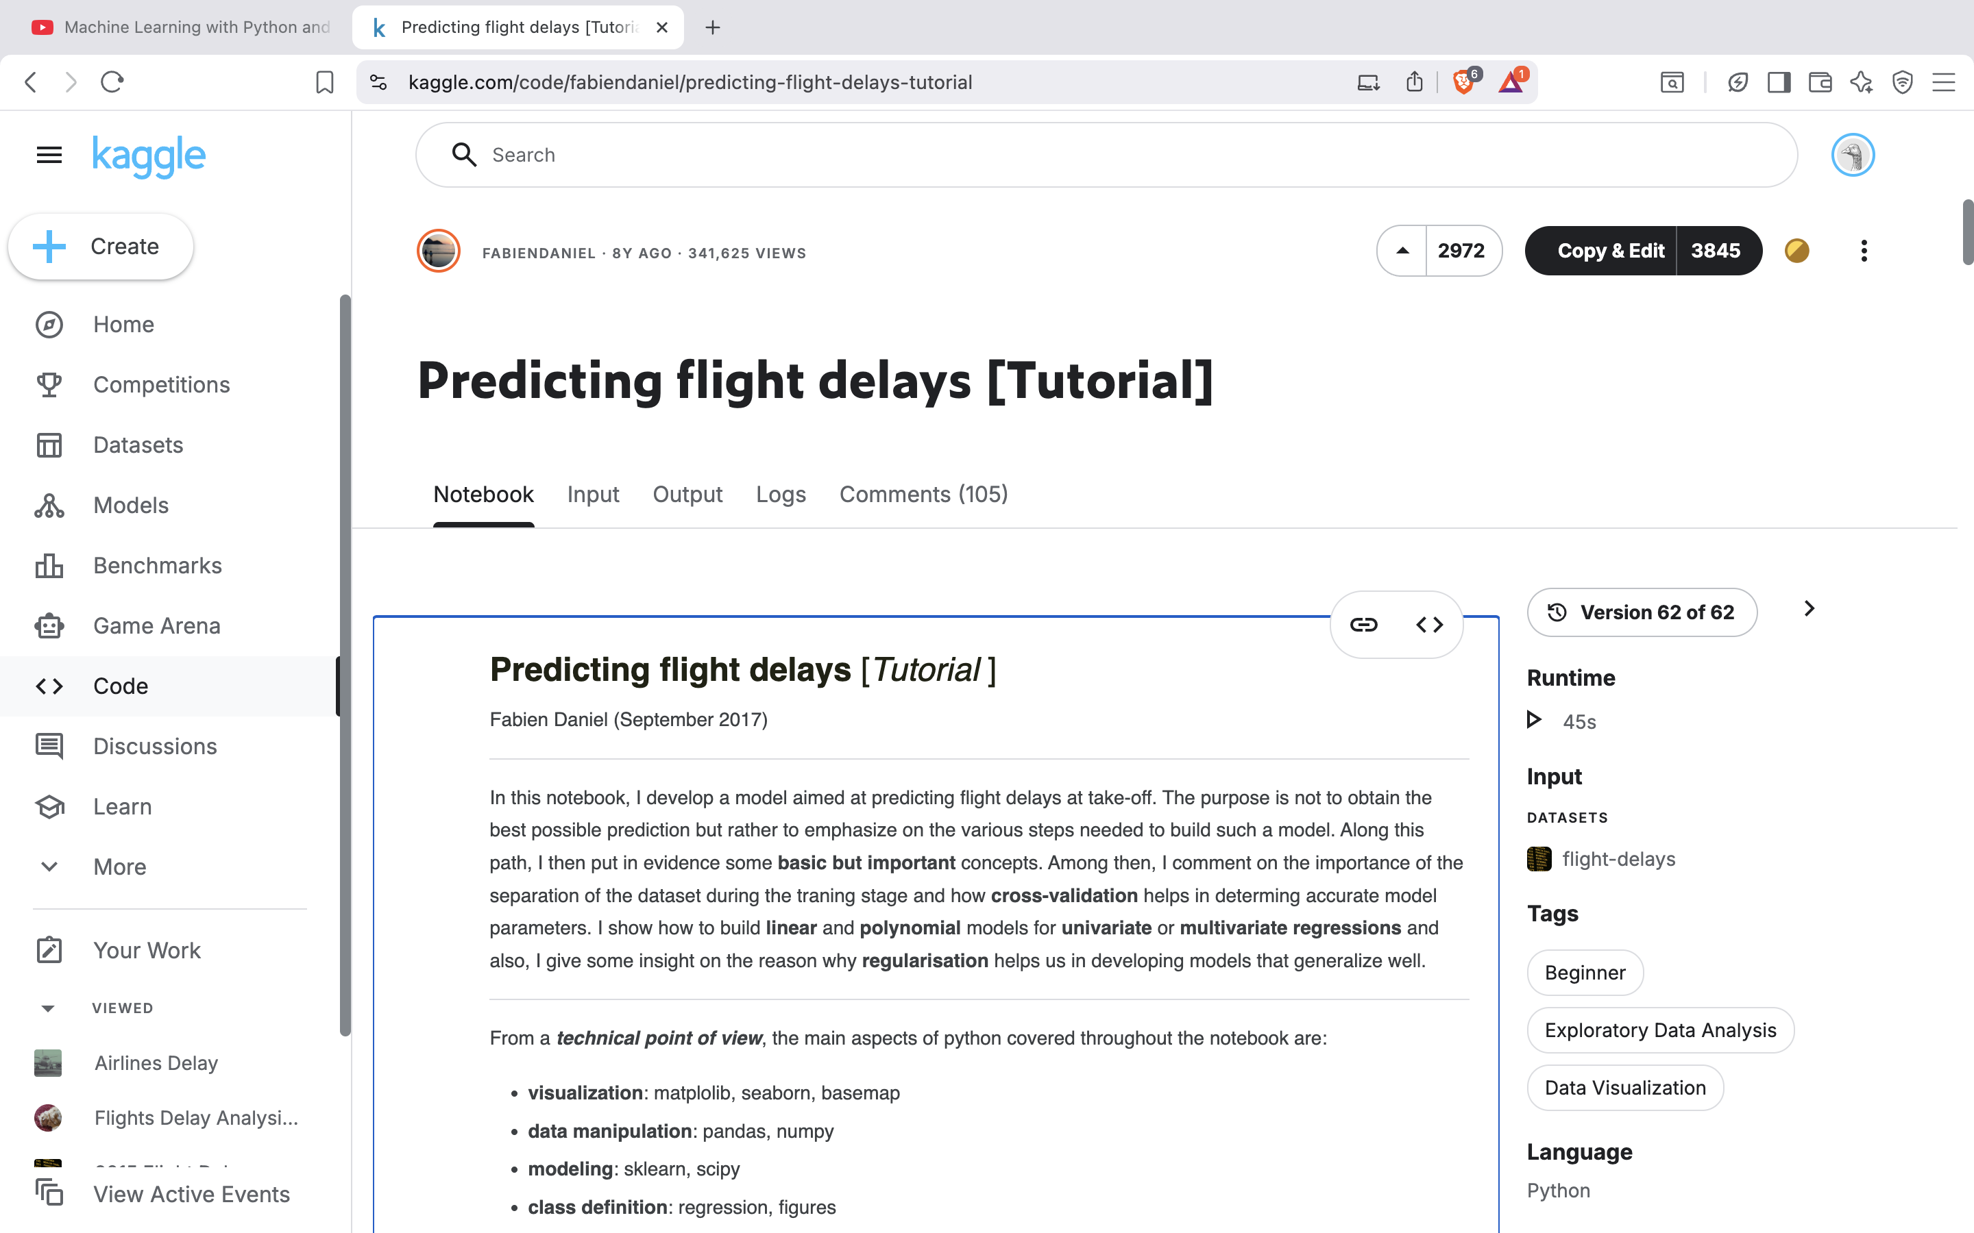
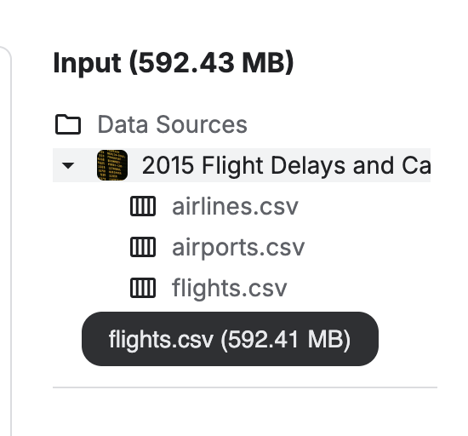
Data Preparation
Dataset Overview: Where I got the dataset?
Link: https://www.kaggle.com/code/fabiendaniel/predicting-flight-delays-tutorial

Slide 4
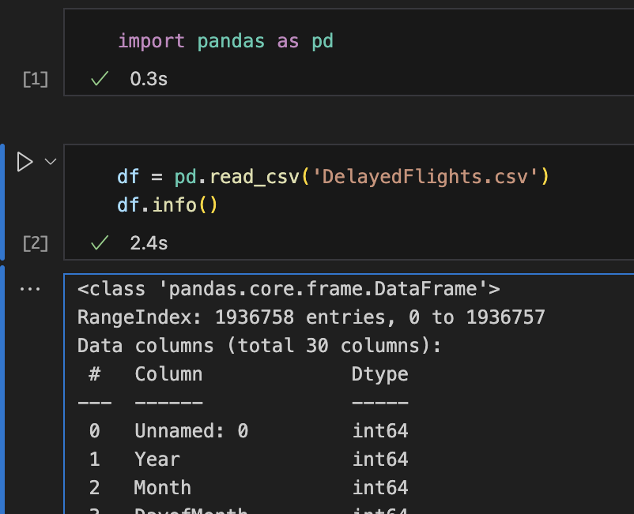
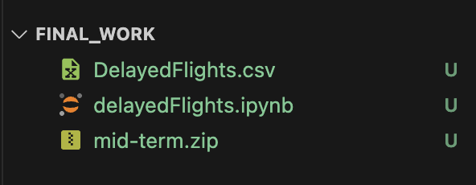
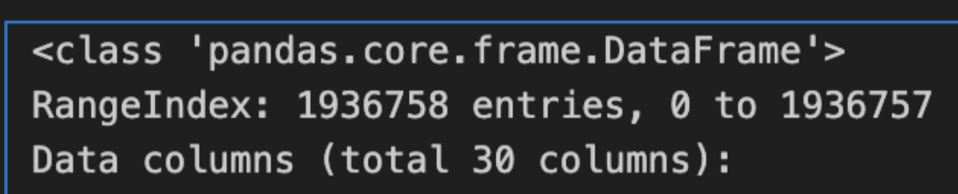
Data Preparation
What’s inside?

Slide 5
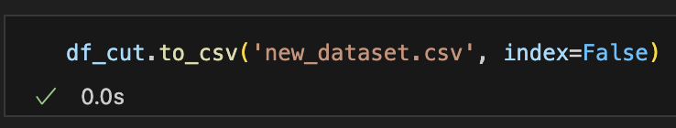
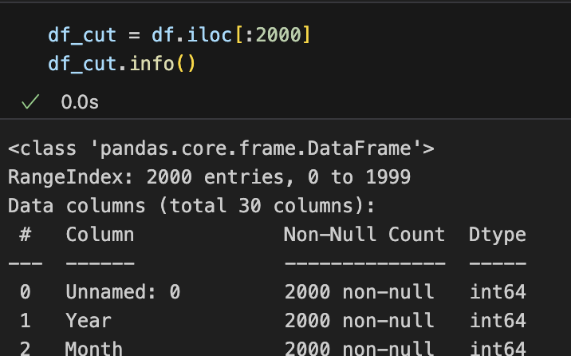
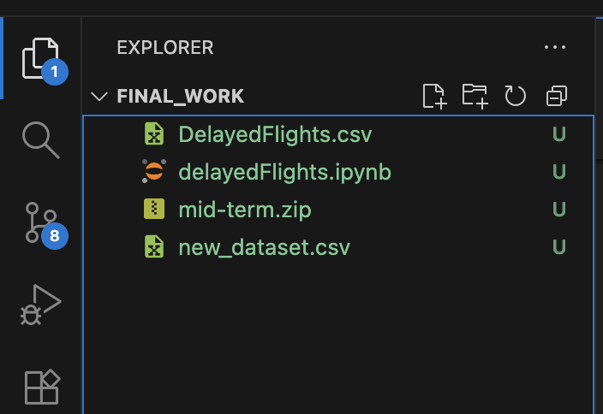
Data Preparation
Trimming & Creating a new file to work with

Slide 6
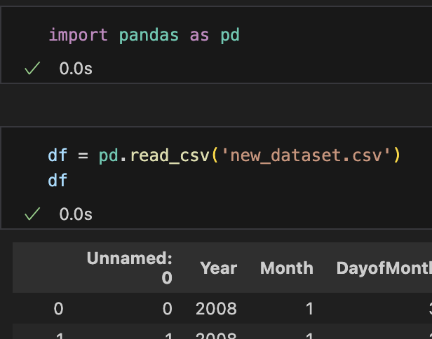
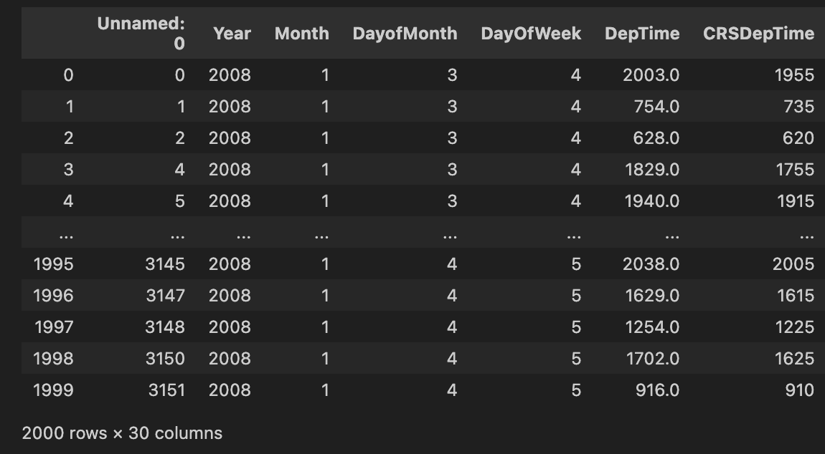
Data Preparation
Working on a new file:

Slide 7
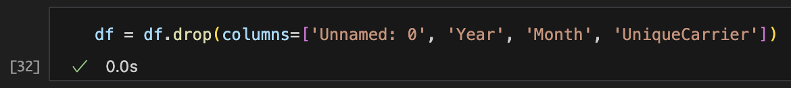
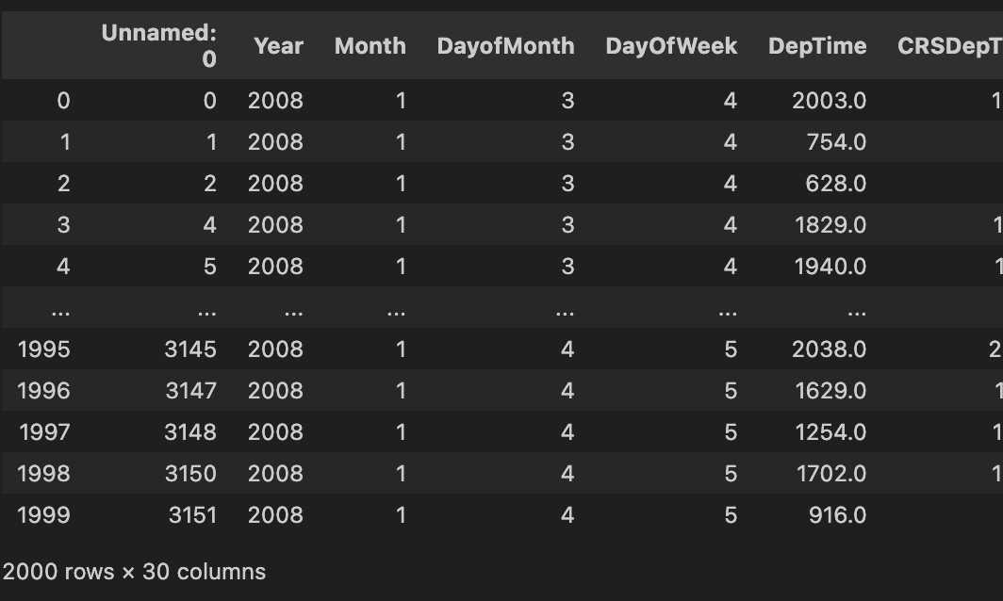
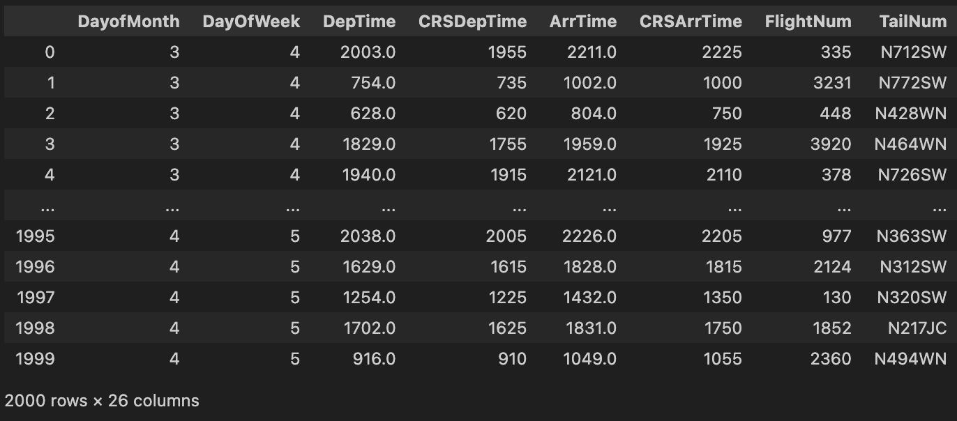
Data Preparation
I removed unnecessary columns such as ‘Year’, ‘Month’, and ‘UniqueCarrier’ since they had the same values for all flights.
I also checked for missing values and handled them properly.

Slide 8
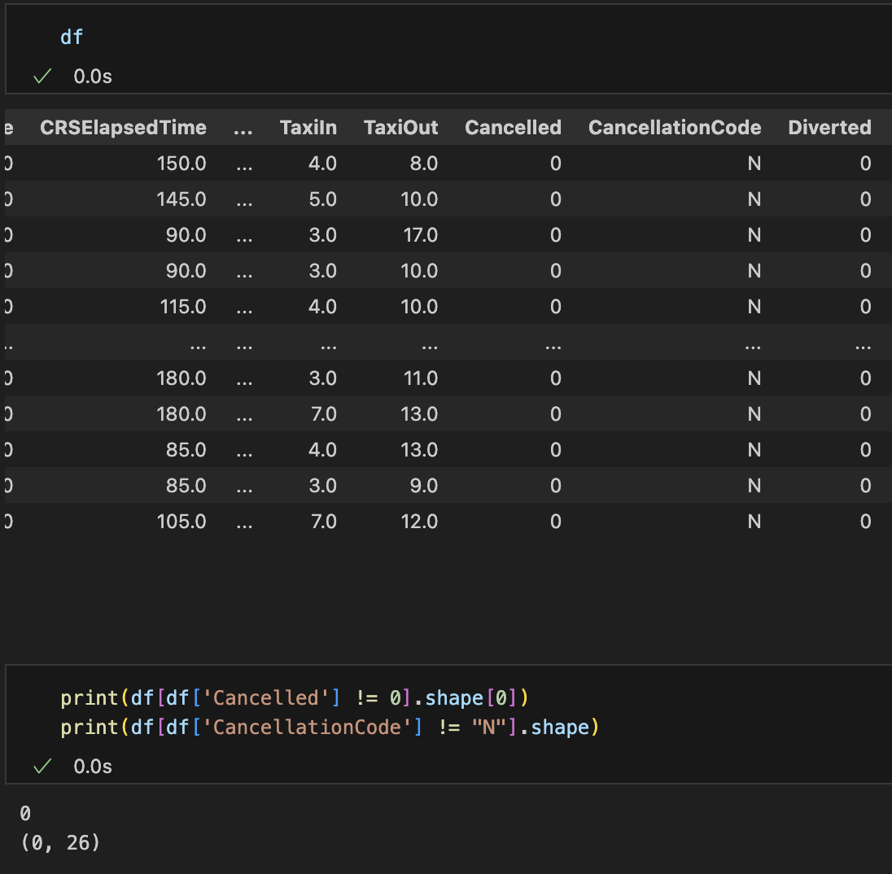
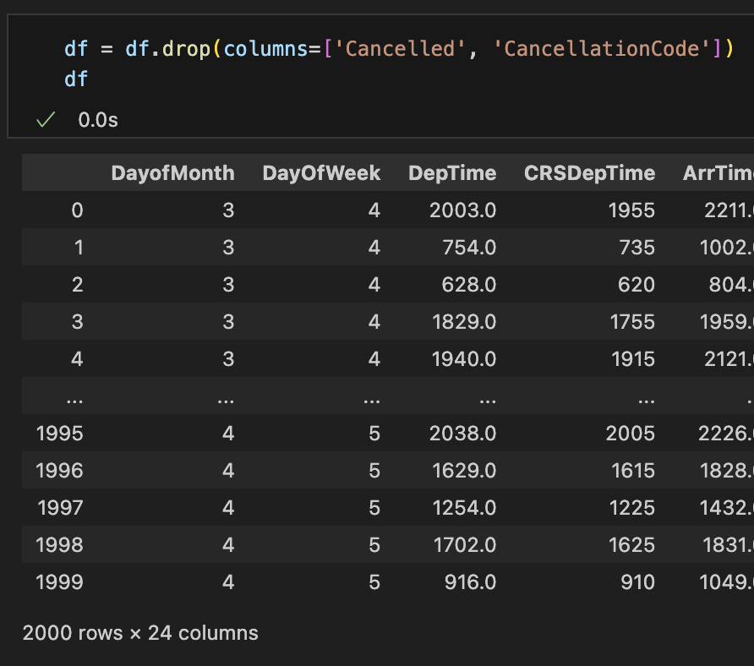
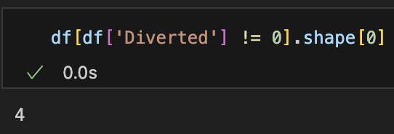
What are we gonna do with the same values?

Slide 9
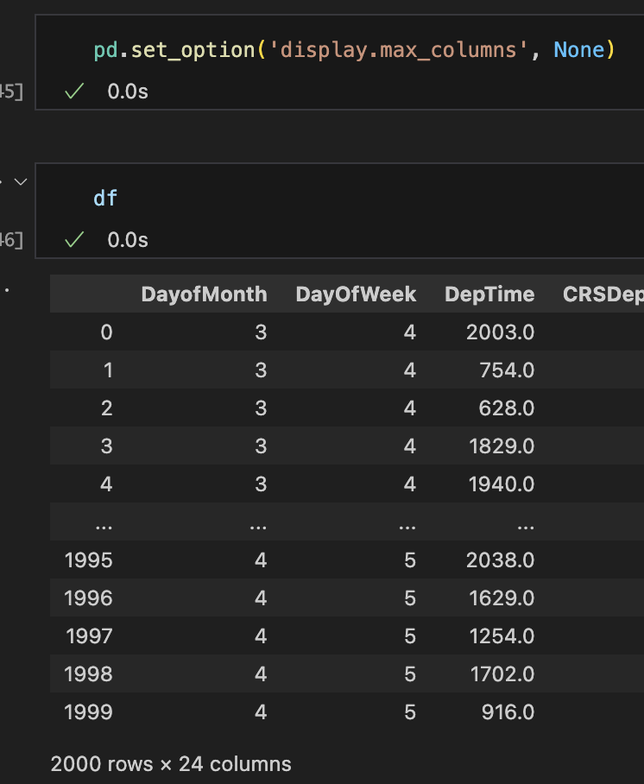
Data Preparation
Let’s check if the are more columns to get rid of

Slide 10
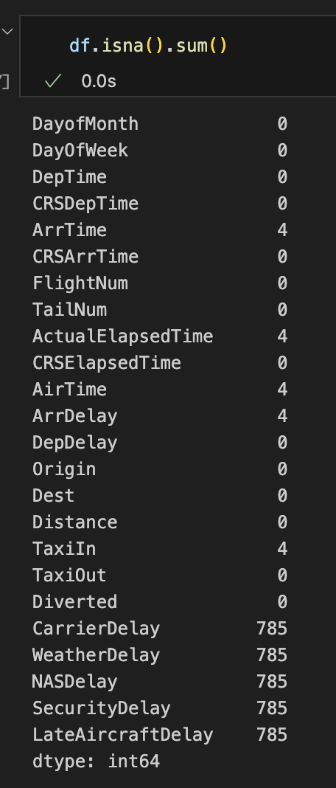
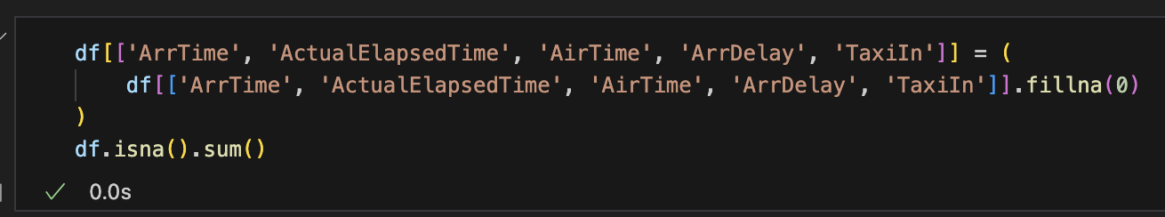
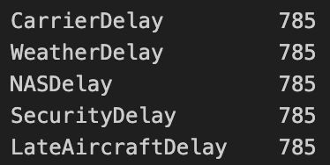
Data Preparation
The first few (only 4 missing) can safely be filled or dropped.

Slide 11
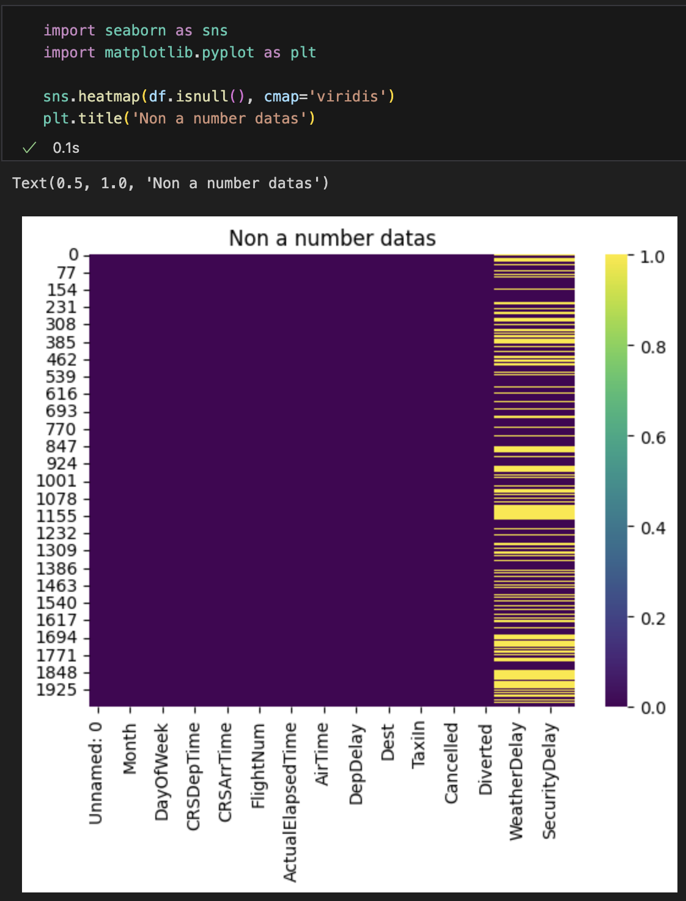
Data Preparation
Visualizing the missing values using Seaborn

Slide 12
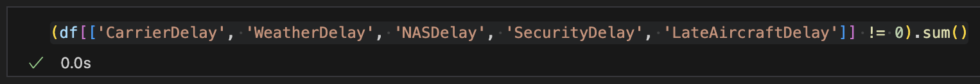
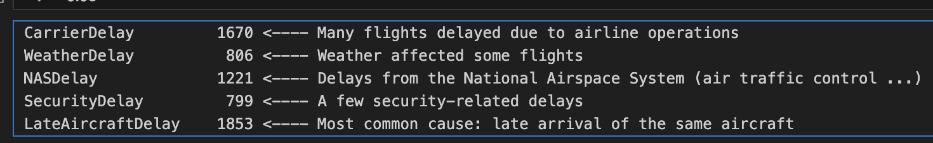
Data Preparation
Most flight delays came from late aircraft arrivals and airline issues, while weather and security delays were rare. This shows that delays mostly happen because of internal scheduling problems, not external conditions.

Slide 13
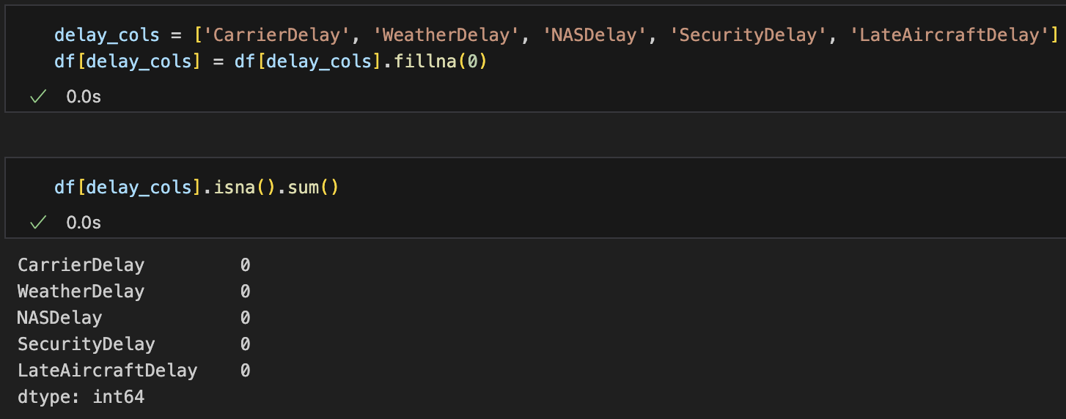
Data Preparation
We replaced missing delay values with 0 because in this dataset, missing means no delay. This helps make the analysis accurate and prevents errors when calculating averages.

Slide 14
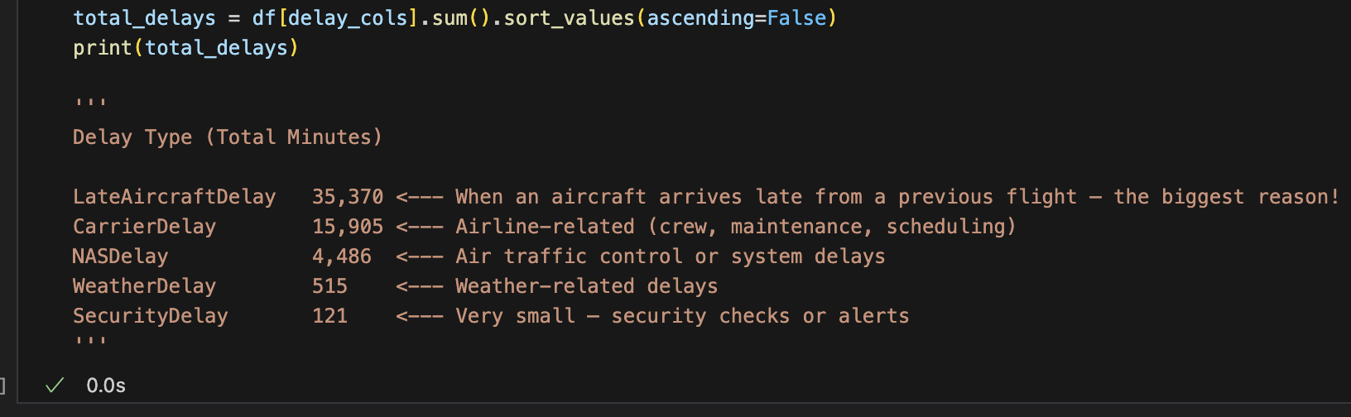
Part 2: Identify the major causes of flight delays
This code adds up all delay minutes by cause and shows which reason caused the most total delay.

Slide 15
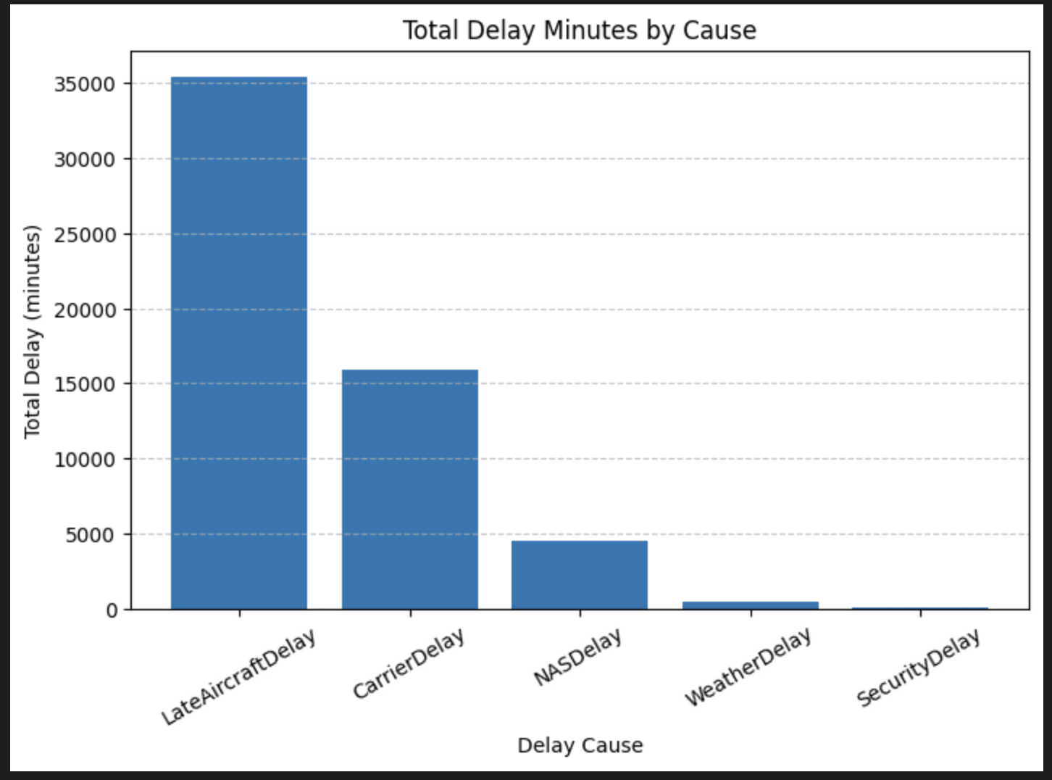
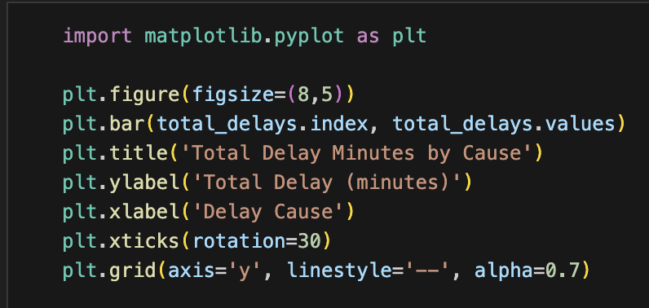
Part 2: Identify the major causes of flight delays
Insight from the plot
Late aircraft arrivals and carrier operational issues are the dominant causes of flight delays, together accounting for nearly 90% of total delay time.

Slide 16
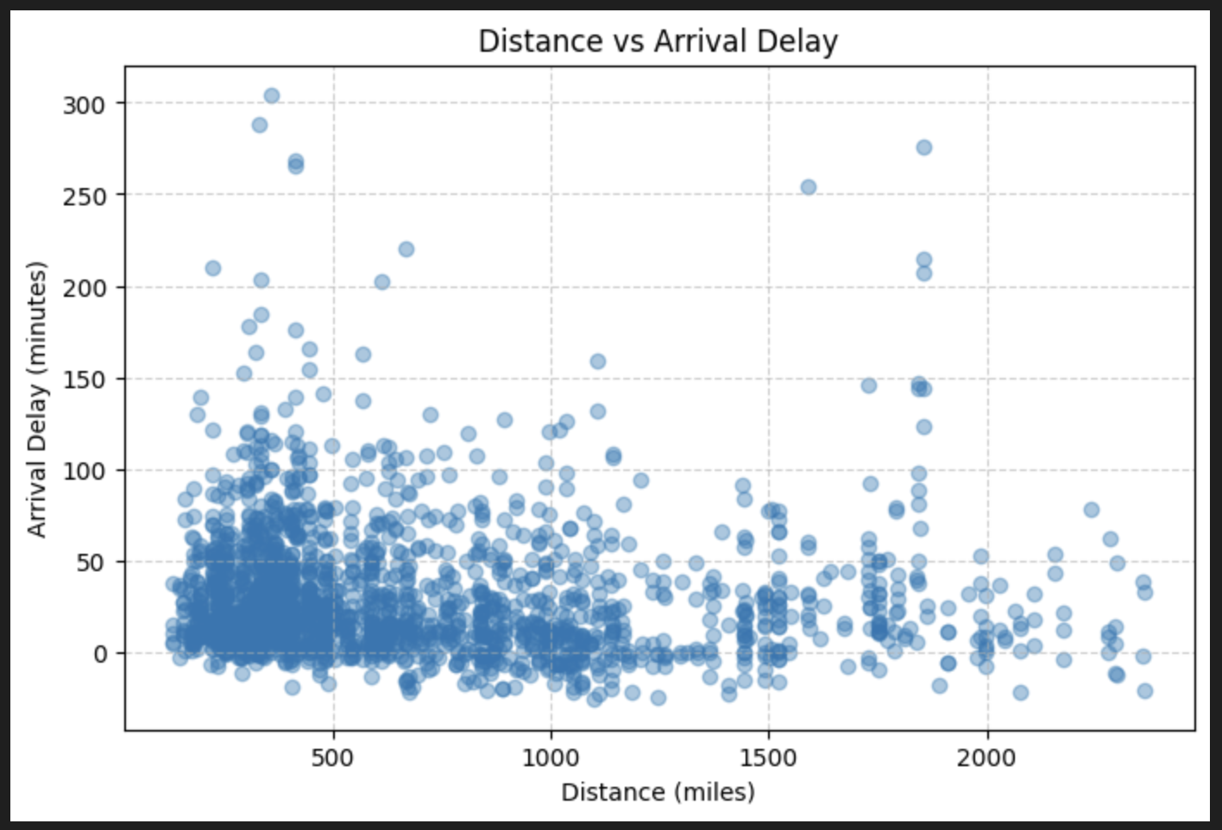
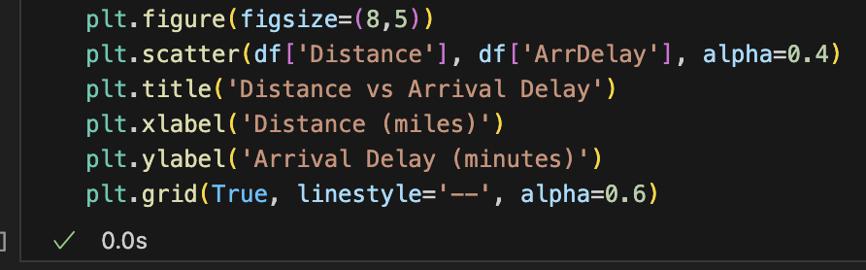
Part 3: Exploring how other factors effect delays
This is plot representing Distance vs Arrival Delay

Slide 17
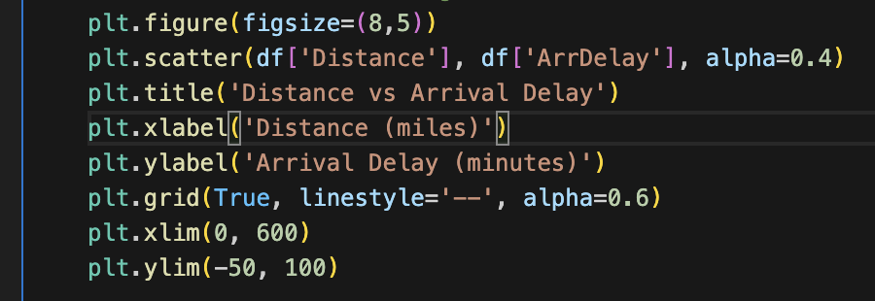
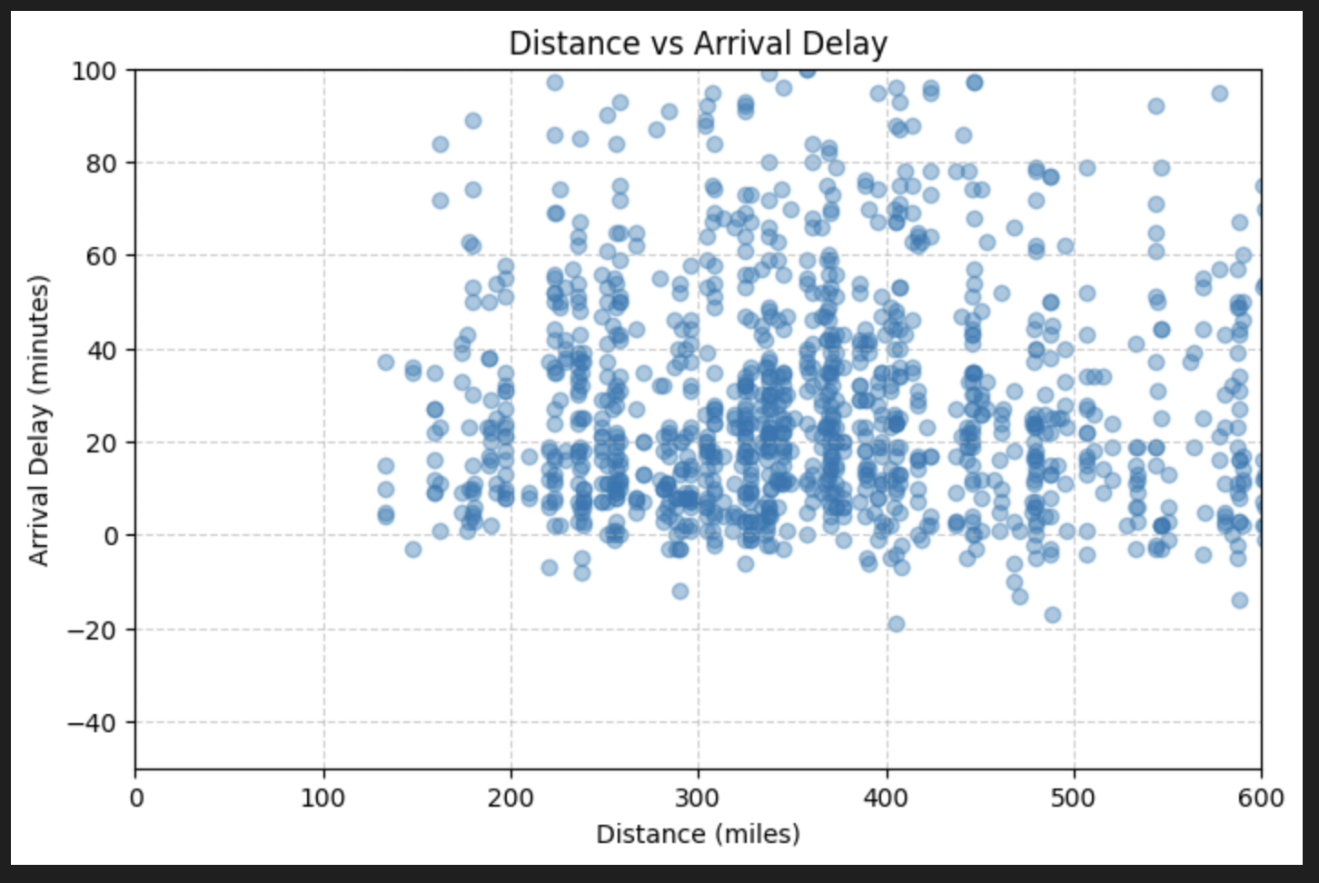
Part 3: Exploring how other factors effect delays
Let’s see the most busy part closer

Slide 18
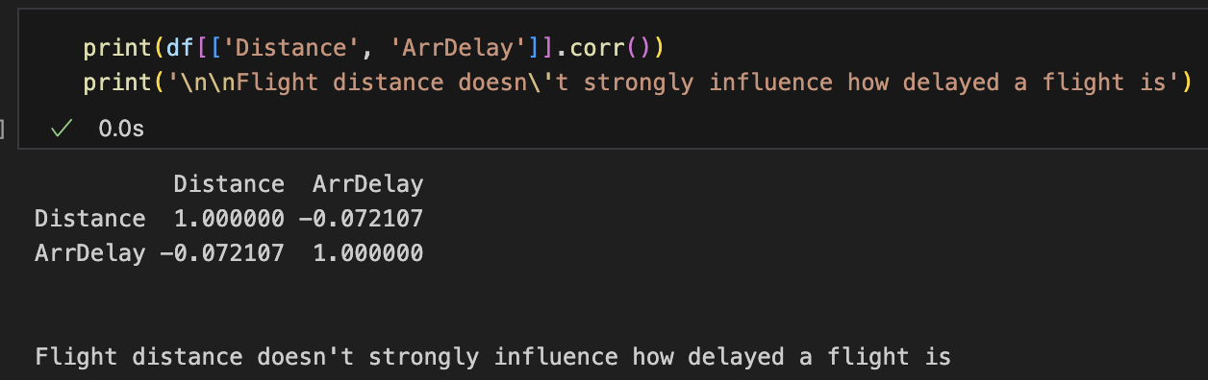
Part 3: Exploring how other factors effect delays
The correlation of Distance to Arrival delay in numbers

Slide 19
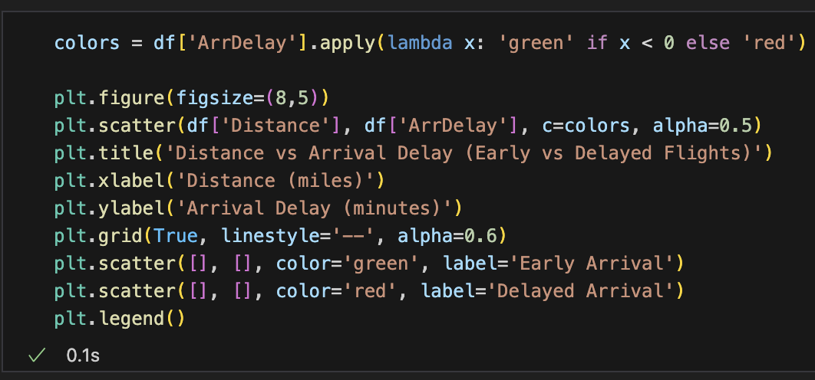
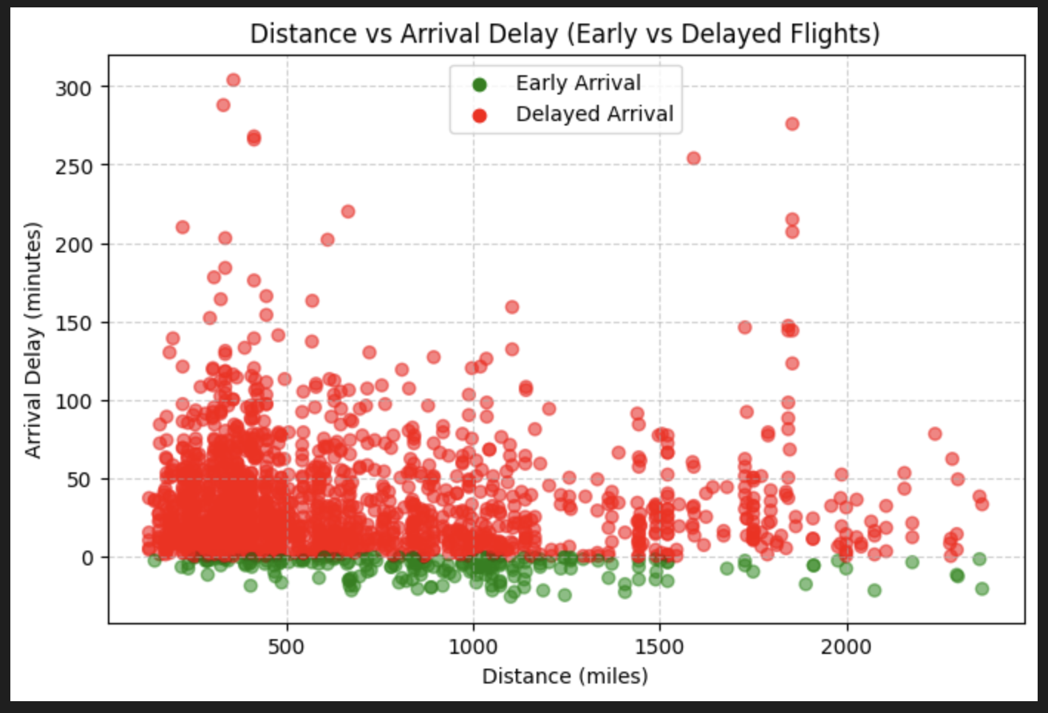
Part 3: Exploring how other factors effect delays
The correlation of Distance to Arrival delay in numbers

Slide 20
Conclusion regarding all the data above
Late aircraft and carrier delays make up the majority (~90%) of total delay time.
So:
Delays are not primarily caused by distance, weather, or security checks.
Instead, they're due to how airlines manage their own flight operations
Late Aircraft Delays
These happen when the previous flight of the same airplane arrives late, causing a chain reaction.
- Turnaround time (unloading, cleaning, refueling) becomes rushed or extended.
- If a plane is late in the morning, every next flight using that aircraft risks being delayed.
- The longer the day goes on: the bigger the cumulative delay.
In short: It's a DOMINO effect of poor schedule recovery.
Carrier Delays
These come from issues within the airline's control, such as:
- Crew or maintenance problems
- Baggage handling delays
- Waiting for connecting passengers
- Logistical mismanagement (like gate availability or boarding delays)
In short: It's operational inefficiency or human/system errors within the airline.
LateAircraftDelay 35370.0
CarrierDelay 15905.0
NASDelay 4486.0
WeatherDelay 515.0
SecurityDelay 121.0

Slide 21
THANK YOU!

