Slide 1
Linear Models
20220914
Professor Umirzakova Sabina

Slide 2
Content
Linear regression
Logistic regression

Slide 3
Introduction to Machine Learning
Machine Learning is a part of Artificial Intelligence (AI), where the model will learn from the data and can predict the outcome.
Machine Learning is a study of statistical computer algorithm that improves automatically from the data. Unlike computer algorithms, rely on human beings.

Slide 4
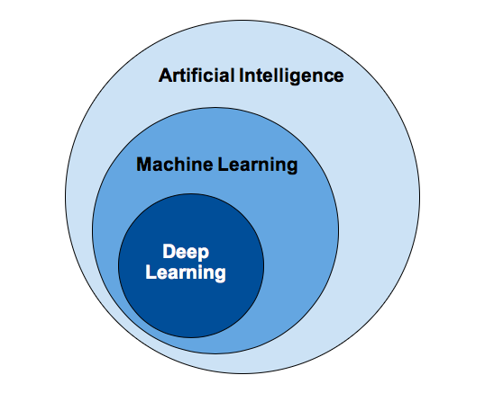
Why need Machine Learning

Slide 5
Types of Machine Learning Algorithms
Supervised Machine Learning
Unsupervised Machine Learning
Semi-Supervised Learning
Reinforcement Learning

Slide 6
Supervised Machine Learning
Supervised learning is a category of machine learning that uses labeled datasets to train algorithms to predict outcomes and recognize patterns.
Supervised learning problems can be further grouped into Regression and Classification problems.
Regression: Regression algorithms are used to predict a continuous numerical output. For example, a regression algorithm could be used to predict the price of a house based on its size, location, and other features.
Classification: Classification algorithms are used to predict a categorical output. For example, a classification algorithm could be used to predict whether an email is spam or not.

Slide 7
Regression
Regression analysis is a statistical method that helps us to understand the relationship between dependent and one or more independent variables.
Dependent Variable
This is the Main Factor that we are trying to predict.
Independent Variable
These are the variables that have a relationship with the dependent variable.

Slide 8
Regression Analysis in Machine learning
More specifically, Regression analysis helps us to understand how the value of the dependent variable is changing corresponding to an independent variable when other independent variables are held fixed.
It predicts continuous/real values such as temperature, age, salary, price, etc.
We can understand the concept of regression analysis using the below example:

Slide 9
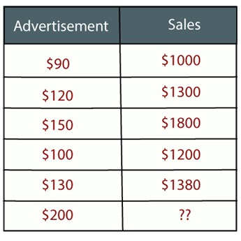
Regression Analysis in Machine learning
Regression is a supervised learning technique which helps in finding the correlation between variables and enables us to predict the continuous output variable based on the one or more predictor variables.
It is mainly used for prediction, forecasting, time series modeling, and determining the causal-effect relationship between variables.
https://www.youtube.com/watch?v=7Ir7ZDMxsfk

Slide 10
Why do we use Regression Analysis
Regression analysis helps in the prediction of a continuous variable.
There are various scenarios in the real world where we need some future predictions such as weather condition, sales prediction, marketing trends, etc., for such case we need some technology which can make predictions more accurately.
So for such case we need Regression analysis which is a statistical method and used in machine learning and data science.

Slide 11
Based on height calculate weight
Height | Weight
150 sm | 50 kg
160 sm | 60 kg
170 sm | 70 kg
180 sm | 80 kg
190 sm | 90 kg

Slide 12
y
90
80
70
Weight
60
50
150
160
170
180
190
x
Height
https://www.youtube.com/watch?v=-JTKf-a1JpU&t=24s

Slide 13
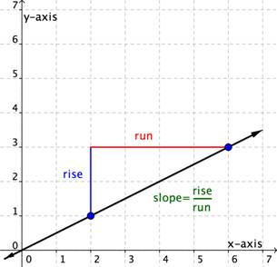
Slope
In Mathematics, a slope of a line is the change in y coordinate with respect to the change in x coordinate.
The net change in y-coordinate is represented by Δy and the net change in x-coordinate is represented by Δx.
m = change in y/change in x
Slope, m = Change in y-coordinates/Change in x-coordinates
m = (y₂ – y₁)/(x₂ – x₁)
https://www.youtube.com/watch?v=qXX47hS2KLw

Slide 14
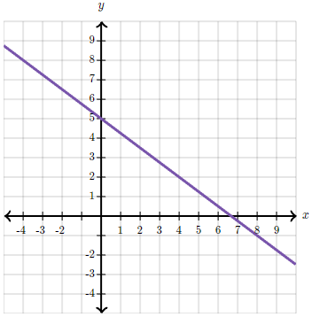
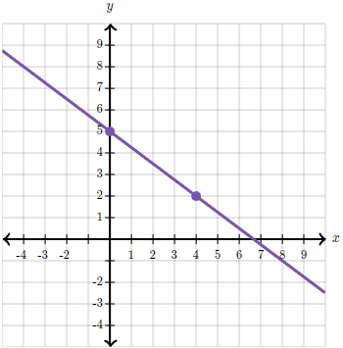
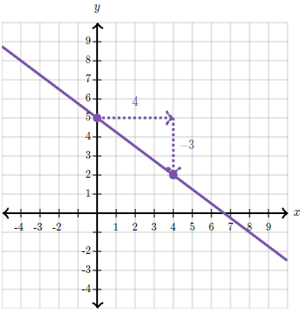
Slope
We're given the graph of a line and asked to find its slope
The line appears to go through the points (0,5) and (4,2)
Slope = (2 – 5)/(4 – 0)=-3/4
https://www.khanacademy.org/math/algebra/x2f8bb11595b61c86:linear-equations-graphs/x2f8bb11595b61c86:slope/a/slope-review

Slide 15
Prediction
We look at data we already know, and then guess or estimate something we don’t know yet.
Example:
1. If for the past 5 days, the temperature at 8 AM was around 20°C,
We can predict that tomorrow at 8 AM, it will also be close to 20°C.
2. If people usually buy more ice cream in summer,
A shop can predict that sales will go up when it gets hot.

Slide 16
Linear Regression
Simple Linear Regression is one of the most basic and commonly used algorithms in machine learning.
It models the relationship between two variables by fitting a linear equation to observed data. The two variables in this context are:
Independent Variable (X): Also called the predictor or explanatory variable.
Dependent Variable (Y): Also called the response or target variable.
The goal of Simple Linear Regression is to find the linear relationship between X and Y so that we can predict Y based on a given X.

Slide 17
Example: Salary
Predict a person salary (Y) based on their years of experience (X). After fitting the regression model, the equation might look something like: Salary=5000+2000×Years of Experience
This equation indicates that the base salary is 5000, and for every additional year of experience, the salary increases by 2000.

Slide 18
Example: Salary
Assumptions of Simple Linear Regression:
Linearity: The relationship between X and Y is linear.
Independence: Observations are independent of each other.
Homoscedasticity: Constant variance of the errors.
Normality: The errors should be normally distributed.

Slide 19
Example: Predicting House Prices
Predict the price of a house (Y) based on its square footage (X).
After running a simple linear regression, you might get an equation like:
Price=50,000+300×Square Footage
Interpretation: The base price of a house is $50,000, and for each additional square foot, the price increases by $300.
Prediction: For a house with 2,000 square feet, the predicted price would be:
Price=50,000+300×2000=650,000

Slide 20
Example: Predicting Students Score based on Study Hours
Predict a student exam score (Y) based on how many hours they studied (X). The regression equation might look like:
Score=40+5×Hours Studied
Interpretation: The base score (if a student studies for 0 hours) is 40, and for each additional hour of study, the score increases by 5 points.
Prediction: If a student studies for 8 hours, the predicted score would be:
Score=40+5×8=80

Slide 21
Example: Predicting Weight from Height
Predicting a person weight (Y) based on their height (X).
The equation could be:
Weight=50+0.5×Height
Interpretation: The base weight is 50 kg, and for every additional 1 cm in height, the weight increases by 0.5 kg.
Prediction: For a person who is 170 cm tall, the predicted weight would be:
Weight=50+0.5×170=135 kg

Slide 22
Linear Regression in ML
Linear Regression (LR) means simply finding the best fitting line that explains the variability between the dependent and independent features very well or we can say it describes the linear relationship between independent and dependent features, and in linear regression, the algorithm predicts the continuous features (e.g. Salary, Price ), rather than deal with the categorical features (e.g. cat, dog).

Slide 23
Linear Regression
Linear Regression in machine learning is a way to predict a number based on other related numbers.
Linear Regression helps find the exact relationship between these numbers.
It draws a straight line through your data points that best represents how changes in the number of items affect your total spending.
Once you have this line, you can use it to predict future spending based on the number of items you plan to buy.
In simple terms, it is like finding the best-fit line in a scatter plot to make predictions.

Slide 24
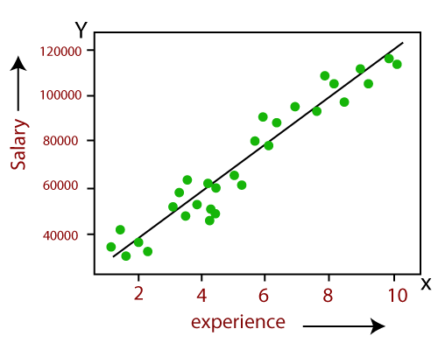
Linear Regression
Here we are predicting the salary of an employee on the basis of the year of experience. Y= aX+b
Here, Y = dependent variables (target variables), X= Independent variables (predictor variables), a and b are the linear coefficients.

Slide 25
Linear Regression in Machine Learning
Mathematically, we can represent a linear regression as:
Here,
Y= Dependent Variable (Target Variable)
X= Independent Variable (predictor Variable)
b0= intercept of the line (Gives an additional degree of freedom)
b1 = Linear regression coefficient (scale factor to each input value).
ε = random error
The values for x and y variables are training datasets for Linear Regression model representation.
y= b₀+b₁x+ ε

Slide 26

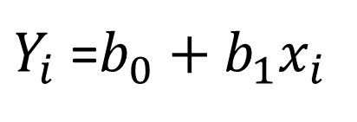


Representation of Linear Regression
Estimate Line
Predicted value
Estimate of the regression slope
Residuals
Value of x for observation i
$Y_{i}$ =$b_{0}+b_{1}x_{i}$
Actual response
Predicted response
Estimate of the regression
y
$$b_{1}$$
$$b_{0}$$
$$x_{i}$$
x

Slide 27

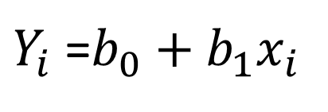
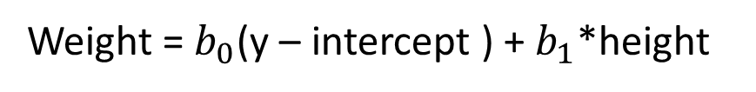
y
90
$Y_{i}$ =$b_{0}+b_{1}x_{i}$
80
70
Weight
Weight = $b_{0}$(y – intercept ) + $b_{1}$*height
60
50
$$b_{0}$$
Weight: dependent variable
Height: Independent variable
150
160
170
180
190
x
Height
https://www.youtube.com/watch?v=gPfgB4ew3RY

Slide 28
Types of Linear Regression
Linear regression can be further divided into two types of the algorithm:
Simple Linear Regression: If a single independent variable is used to predict the value of a numerical dependent variable, then such a Linear Regression algorithm is called Simple Linear Regression.
Multiple Linear regression: If more than one independent variable is used to predict the value of a numerical dependent variable, then such a Linear Regression algorithm is called Multiple Linear Regression.

Slide 29
Best fit line
The best fit line gives the most accurate prediction while performing Linear Regression.
A line is considered to be best fit line when the square of the summation of all the errors is minimum.
So we can say that the distance between the best fit point and the actual point should be minimum.

Slide 30
Best fit line
Model will find the loss between all the actual and predicted values respectively. And it selects the line which has an average error of all points lower.
Steps
Our model will fit all possible lines and find an overall average error between the actual and predicted values for each line respectively.
Selects the line which has the lowest overall error. And that will be the best fit line.

Slide 31
Best fit line
y
y
y
x
x
x
So we can say that the distance between the best fit point and the actual point should be minimum.
https://www.youtube.com/watch?v=PaFPbb66DxQ

Slide 32
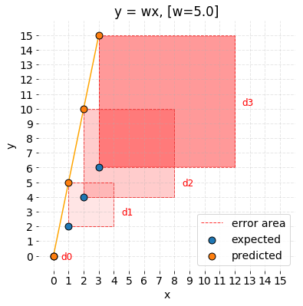
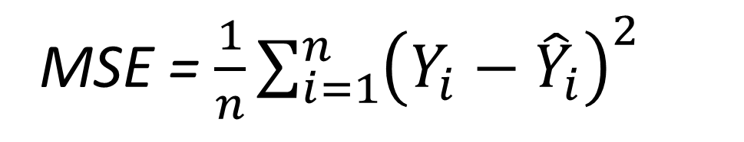
Mean Squared Error
LAW KERYN SOK LUN
Regarding MSE, each partial error is equivalent to the area of the square created out of the geometrical distance between the measured points. All regional areas are summed up and averaged.
MSE formula:
i = index of sample
ŷ = predicted value
y = expected value
n = number of samples in the data set
MSE = $\frac{1}{n}\sum_{i=1}^{n}{{\left(Y_{i}−{\hat{Y}}_{i}\right)}^{2}}$

Slide 33
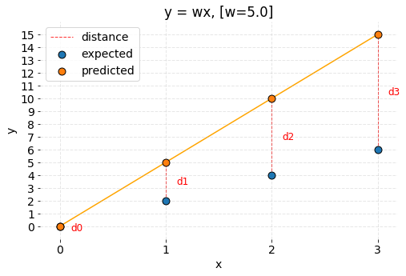
Cost Function
WONG JUN LIN

Slide 34
y
y
x
x
After measuring distance, if distance so long what we should do?

Slide 35
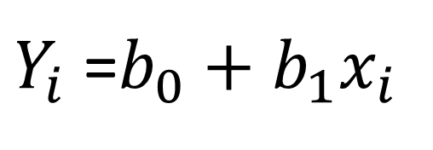
Gradient Descent
LIM XIN YU
YONG EVANS CHENG YU
Cost function should be minimized such that we can get best fit line.
To update b₀ and b₁ values in order to reduce Cost function (minimizing MSE value) and achieving the best fit line the model uses Gradient Descent. The idea is to start with random b₀ and b₁ values and then iteratively updating the values, reaching minimum cost.
$Y_{i}$ =$b_{0}+b_{1}x_{i}$

Slide 36
Linear Regression workflow
Calculate distance between predicted point and estimated point
Optimization: Find best fit line

Slide 37
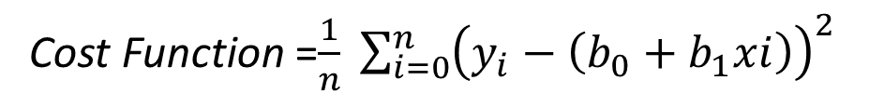
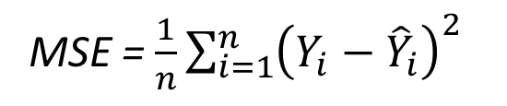
Linear Regression workflow
1. Find the difference between the actual y and predicted y, for a given x.
2. Square this difference.
3. Find the mean of the squares for every value in X.
4. Here yᵢ is the actual value and ȳᵢ is the predicted value. Lets substitute the value of ȳᵢ:
MSE = $\frac{1}{n}\sum_{i=1}^{n}{{\left(Y_{i}−{\hat{Y}}_{i}\right)}^{2}}$
Cost Function =$\frac{1}{n} \sum_{i=0}^{n}{{\left(y_{i}−\left(b_{0}+b_{1}xi\right)\right)}^{2}}$

Slide 38
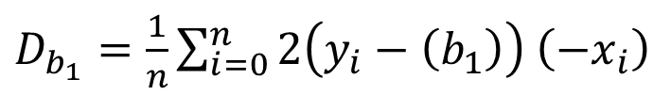

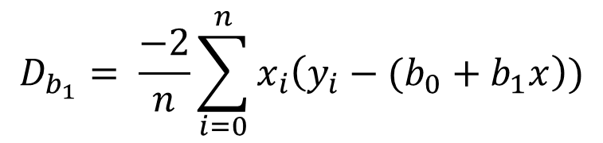
Linear Regression workflow
5. Initially let $b_{1}$ = 0 and $b_{0}$ = 0. Let L be our learning rate. This controls how much the value of $b_{1}$ changes with each step. L could be a small value like 0.0001 for good accuracy.
6. Calculate the partial derivative of the loss function with respect to m, and plug in the current values of x, y, m and c in it to obtain the derivative value D.
$D_{b_{1}}=\frac{1}{n}\sum_{i=0}^{n}{2\left(y_{i}−\left(b_{1}\right)\right)}$ $\left(−x_{i}\right)$
$$D_{b_{1}}= \frac{−2}{n}\sum_{i=0}^{n}{x_{i}\left(y_{i}−(b_{0}+b_{1}x\right))}$$

Slide 39
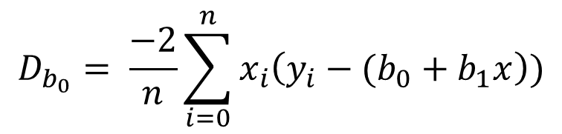

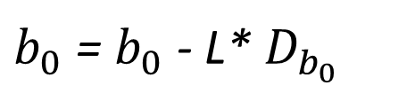
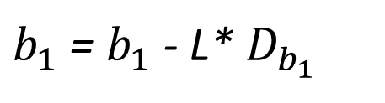
Linear Regression workflow
7. $D_{b_{1}}$ is the value of the partial derivative with respect to $b_{1}$. Similarly lets find the partial derivative with respect to $b_{0}$, $D_{b_{0}}$ :
8. Now we update the current value of $b_{1}$ and $b_{0}$ using the following equation:
$$D_{b_{0}}= \frac{−2}{n}\sum_{i=0}^{n}{x_{i}\left(y_{i}−(b_{0}+b_{1}x\right))}$$
$b_{1}$ = $b_{1}$ - L* $D_{b_{1}}$
$b_{0}$ = $b_{0}$ - L* $D_{b_{0}}$

Slide 40

Linear Regression workflow
9. This process repeat until loss function is a very small value or ideally 0 (which means 0 error or 100% accuracy). The value of $b_{1}$ and $b_{0}$ that we are left with now will be the optimum values.

Slide 41
Presenter:
202239135 DO VAN VINH
What is AI and Machine Learning

Slide 42
Presenter:
202339188 SAYIDJONOV SHOHRUKH SHERALI UGLI
Supervised Learning

Slide 43
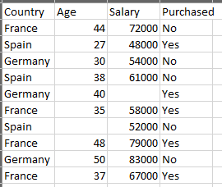
Working With data

Slide 44
Data Preprocessing in Machine learning
A real-world data generally contains noises, missing values, and maybe in an unusable format which cannot be directly used for machine learning models.
Data preprocessing is required tasks for cleaning the data and making it suitable for a machine learning model which also increases the accuracy and efficiency of a machine learning model.

Slide 45
Data Preprocessing in Machine learning
Getting the dataset
Importing libraries
Importing datasets
Finding Missing Data
Encoding Categorical Data
Splitting dataset into training and test set
Feature scaling

Slide 46
Get the Dataset
To create a machine learning model, the first thing we required is a dataset as a machine learning model completely works on data. The collected data for a particular problem in a proper format is known as the dataset.
Dataset may be of different formats for different purposes.
To use the dataset in our code, we usually put it into a CSV file. However, sometimes, we may also need to use an HTML or xlsx file.

Slide 47
What is a CSV File
CSV stands for "Comma-Separated Values" files; it is a file format which allows us to save the tabular data, such as spreadsheets.
It is useful for huge datasets and can use these datasets in programs.

Slide 48
Importing Libraries
In order to perform data preprocessing using Python, we need to import some predefined Python libraries.
There are three specific libraries that we will use for data preprocessing, which are:
Numpy: Numpy Python library is used for including any type of mathematical operation in the code.
It is the fundamental package for scientific calculation in Python.
It also supports to add large, multidimensional arrays and matrices.
import numpy as np

Slide 49
Importing Libraries
Matplotlib: The second library is matplotlib, which is a Python 2D plotting library, and with this library, we need to import a sub-library pyplot.
import matplotlib.pyplot as plt
Pandas: The last library is the Pandas library, which is one of the most famous Python libraries and used for importing and managing the datasets.
It is an open-source data manipulation and analysis library.
import pandas as pd

Slide 50
Importing the Datasets
Now to import the dataset, we will use read_csv() function of pandas library, which is used to read acsvfile and performs various operations on it. Using this function, we can read a csv file locally as well as through an URL.
data_set= pd.read_csv(‘your_own_path//////Dataset.csv')

Slide 51
Extracting dependent and independent variables
In machine learning, it is important to distinguish the matrix of features independent variables and dependent variables from dataset.
In our dataset, there are three independent variables that are Country, Age, and Salary, and one is a dependent variable which is Purchased.

Slide 52
Extracting independent variable
To extract an independent variable, we will use iloc[ ] method of Pandas library.
It is used to extract the required rows and columns from the dataset.
x= data_set.iloc[:,:-1].values
the first colon(:) is used to take all the rows, and the second colon(:) is for all the columns.
Here we have used :-1, because we do not want to take the last column as it contains the dependent variable.
So by doing this, we will get the matrix of features.

Slide 53
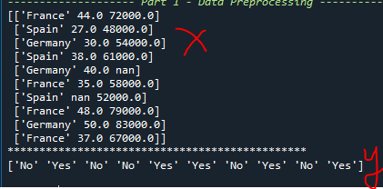
Extracting dependent variable
To extract dependent variables, again, we will use Pandas .iloc[] method.
y= data_set.iloc[:,3].values
Here we have taken all the rows with the last column only. It will give the array of dependent variables.
By executing the above code, we will get output as:
Output:

Slide 54


Handling Missing data

Slide 55

Handling Missing data
There are mainly two ways to handle missing data, which are:
By deleting the particular row
By calculating the mean
To handle missing values, we will use Scikit-learn library in our code, which contains various libraries for building machine learning models. Here we will use Imputer class of sklearn.preprocessing library.
Fitting imputer object to the independent variables x.
Replacing missing data with the calculated mean value

Slide 56
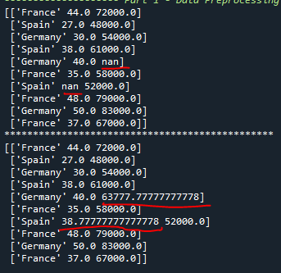
Output:

Slide 57
Encoding Categorical data
Categorical data is data which has some categories such as, in our dataset; there are two categorical variable, Country, and Purchased.
Since machine learning model completely works on mathematics and numbers, but if our dataset would have a categorical variable, then it may create trouble while building the model.
So it is necessary to encode these categorical variables into numbers.
For Country variable:
we will use LabelEncoder() class from preprocessing library.

Slide 58

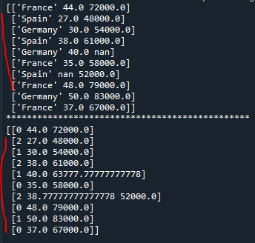
Encoding Categorical data

Slide 59
Dummy Variables
In our case, there are three country variables, and as we can see in the above output, these variables are encoded into 0, 1, and 2.
By these values, the machine learning model may assume that there is some correlation between these variables which will produce the wrong output.
So to remove this issue, we will use dummy encoding.

Slide 60
Dummy Variables
Dummy variables are those variables which have values 0 or 1.
The 1 value gives the presence of that variable in a particular column, and rest variables become 0.
With dummy encoding, we will have a number of columns equal to the number of categories.
In our dataset, we have 3 categories so it will produce three columns having 0 and 1 values.
For Dummy Encoding, we will use OneHotEncoder class of preprocessing library.

Slide 61
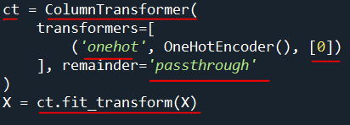
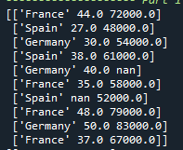
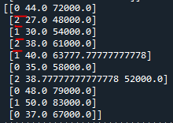
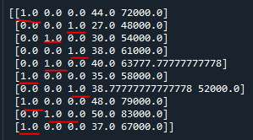
Dummy Variables
Apply OneHotEncoder to the first column
Leave the other columns as they are

Slide 62
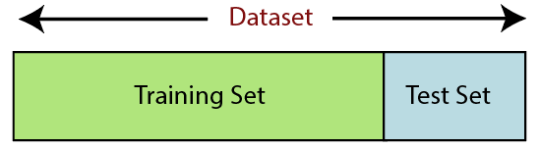
Splitting the Dataset into the Training set and Test set
Training Set: A subset of dataset to train the machine learning model, and we already know the output.
Test set: A subset of dataset to test the machine learning model, and by using the test set, model predicts the output.

Slide 63


Splitting the Dataset into the Training set and Test set
For splitting the dataset, we will use the below lines of code:
In the above code, the first line is used for splitting arrays of the dataset into random train and test subsets.
In the second line, we have used four variables for our output that are
x_train: features for the training data
x_test: features for testing data
y_train: Dependent variables for training data
y_test: Independent variable for testing data

Slide 64
Splitting the Dataset into the Training set and Test set
In train_test_split() function, we have passed four parameters in which first two are for arrays of data, and test_size is for specifying the size of the test set.
The test_size maybe .5, .3, or .2, which tells the dividing ratio of training and testing sets.
The last parameter random_state is used to set a seed for a random generator so that you always get the same result, and the most used value for this is 42.

Slide 65
WHAT IS BEST FIT LINE

Slide 66
WHAT IS LINEAR REGRESSION

Slide 67
WHAT IS COST FUNCTION

Slide 68
WHAT COST FUNCTION USED FOR LINEAR REGRESSION

Slide 69
WHAT IS USED FOR MINIMIZING ERROR IN COST FUNCTION

Slide 70
Yes (1)
Malignant?
0.5
No (0)
Tumor size
Positive class
Negative class

Slide 71
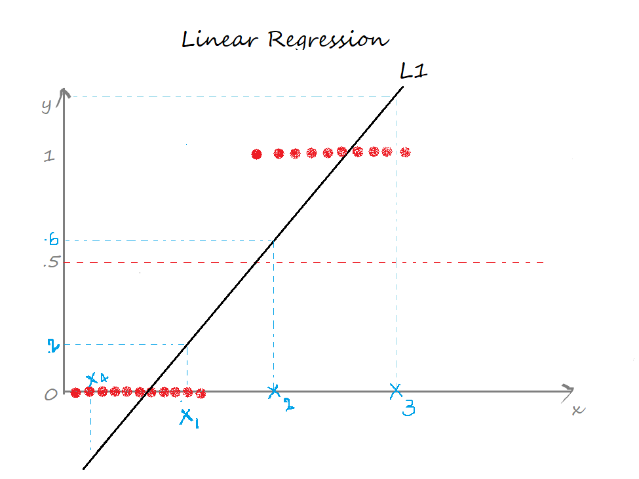
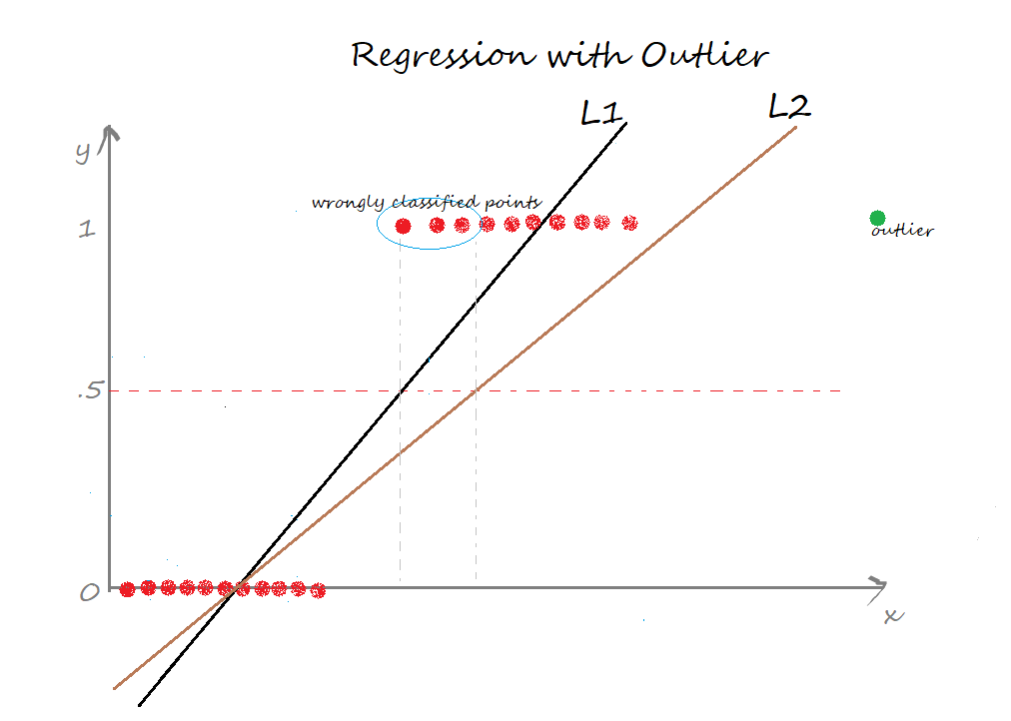

Slide 72
Linear Regression
Classification
Home Price
Weather
Stock Price
Email spam or not
Will customer buy
life insurance?
3. Which Party a person
is going to vote for?
Predicted Values is Continues
Prediction value is categorical

Slide 73
Classification
When the output variable is categorical, such as Yes-No, Male-Female, True-False, Normal – Abnormal, and so on, classification methods are used.

Slide 74
Classification Types
Will customer buy life insurance?
1. Yes
2. No
BINARY CLASSIFICATION
Which party a person is going to vote for?
Democratic
Republic
Independent
MULTICLASS CLASSIFICATION

Slide 75
Logistic Regression
Logistic regression is an example of supervised learning. It is used to calculate or predict the probability of a binary (yes/no) event occurring.
An example of logistic regression could be applying machine learning to determine if a person is likely to be infected with COVID-19 or not. Since we have two possible outcomes to this question - yes they are infected, or no they are not infected - this is called binary classification.
Hence, linear regression is an example of a regression model and logistic regression is an example of a classification model.

Slide 76
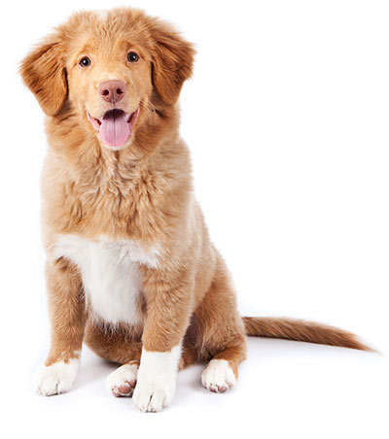
Logistic Regression vs Linear Regression
It is a dog?
Maybe it is a dog
Linear regression
Logistic regression
YES

Slide 77
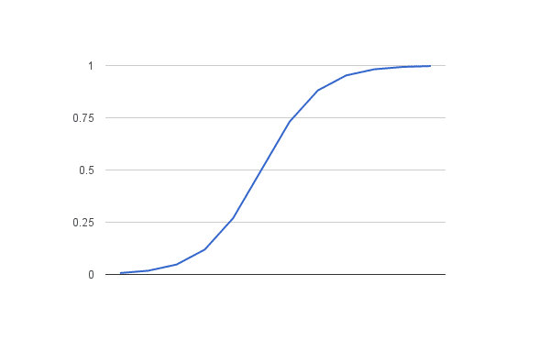
Logistic Regression
In Logistic regression, instead of fitting a regression line, we fit an "S" shaped logistic function, which predicts two maximum values (0 or 1).
Logistic regression uses the concept of predictive modeling as regression; therefore, it is called logistic regression, but is used to classify samples; Therefore, it falls under the classification algorithm.

Slide 78
Logistic Regression values
The value of the logistic regression must be between 0 and 1, which cannot go beyond this limit, so it forms a curve like the "S" form. The S-form curve is called the Sigmoid function or the logistic function.
In logistic regression, we use the concept of the threshold value, which defines the probability of either 0 or 1. Such as values above the threshold value tends to 1, and a value below the threshold values tends to 0.

Slide 79
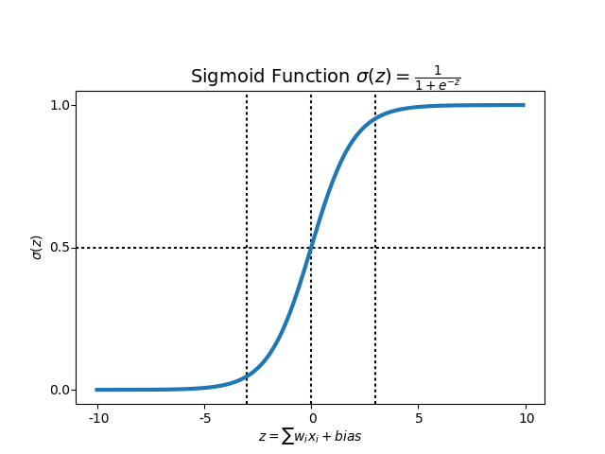
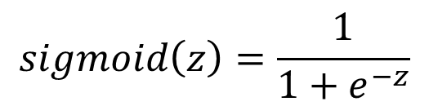
Sigmoid Function
In order to map predicted values to probabilities, we use the Sigmoid function. The function maps any real value into another value between 0 and 1
$$sigmoid\left(z\right)=\frac{1}{1+e^{−z}}$$
Where e = 2.71828
Sigmoid function converts input into range 0 to 1

Slide 80
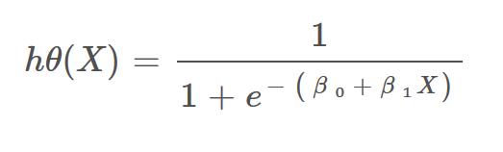
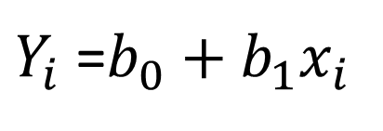
$Y_{i}$ =$b_{0}+b_{1}x_{i}$

Slide 81
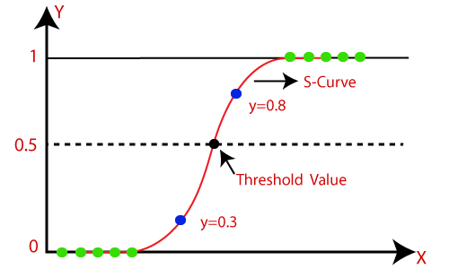
Threshold
Class 1 = Prediction < 0.5 (dog)
Class 0 = Prediction = or > 0.5 (cat)
For Example, We have 2 classes, let’s take them like cats and dogs(1 — dog , 0 — cats). We basically decide with a threshold value above which we classify values into Class 1 and of the value goes below the threshold then we classify it in Class 2.

Slide 82
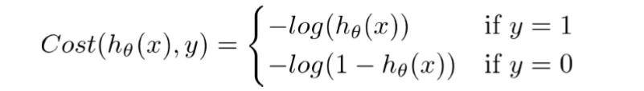
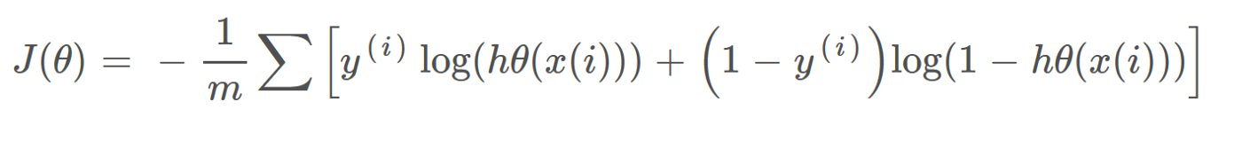
Cost Function
−log(hθ(x)) if y = 1
−log(1−hθ(x)) if y = 0
If it is wrong we getting some penalty

Slide 83
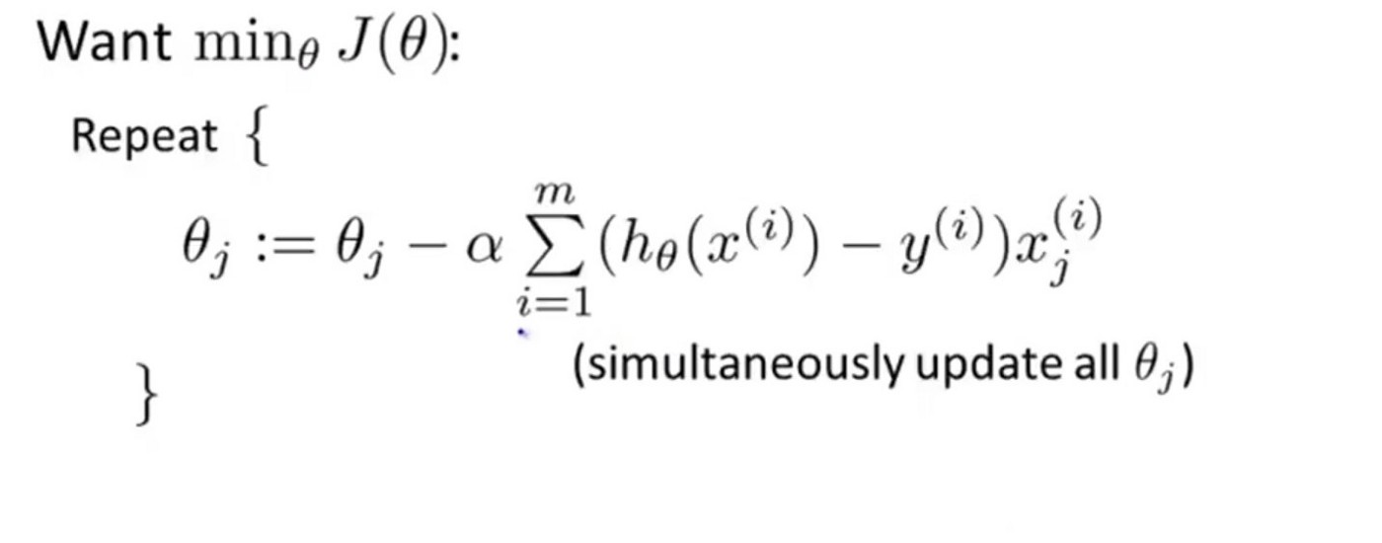
Gradient Descent
Try to update cost function:

Slide 84
Reduce cost function

Slide 85
Home Work explanation
Using Iris.csv dataset:
1) read dataset based on pandas
2) dataset description
3) calculate missing values on the dataset
4) replace missing values
5) prepare a bar chart

Slide 86
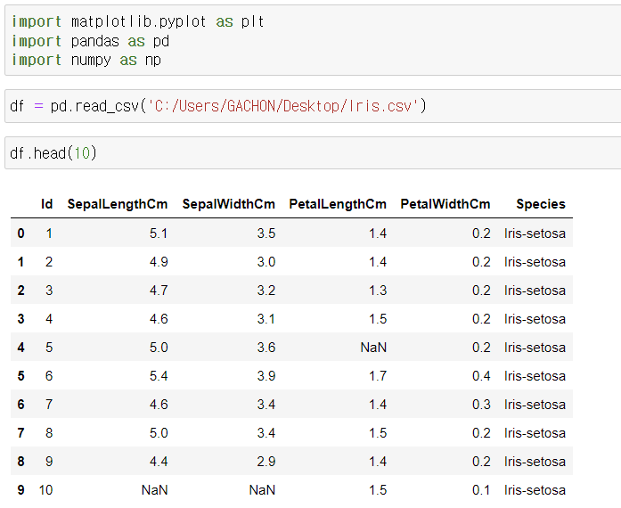
Read dataset based on pandas

Slide 87
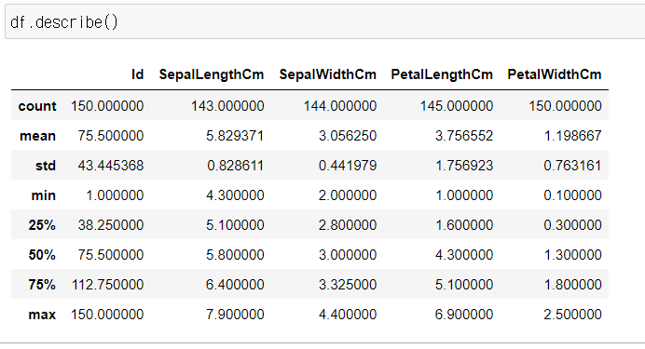
Dataset description

Slide 88
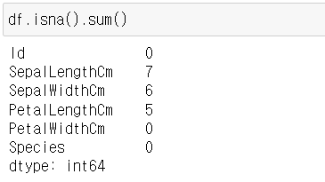
Calculate missing values on the dataset

Slide 89
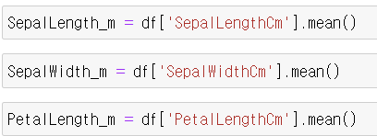
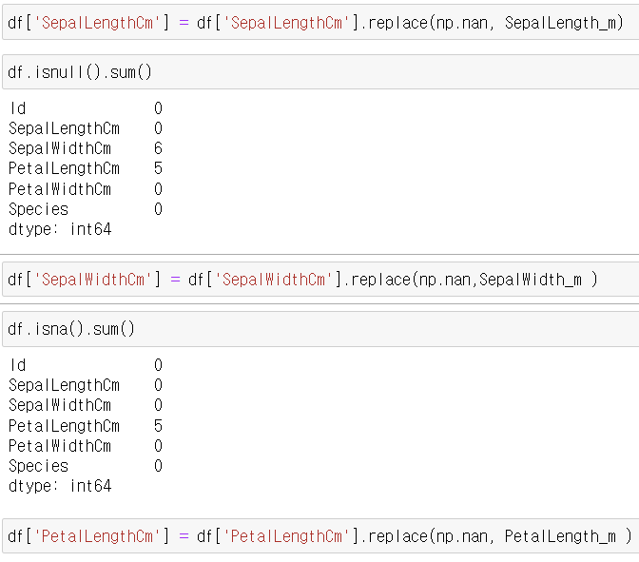

Replace missing values
1)
2)
3)

Slide 90

Prepare a bar chart

Slide 91


Line Plot

Slide 92


Scatter plot

Slide 93


Histogram

Slide 94

Box Plot

Slide 95

Pie chart

