Slide 1
Introduction to Machine Learning. Basic Concepts and Learning.
Instructor: Sabina Umirzakova
sabinatuit@gachon.ac.kr

Slide 2
Grading
Attendance | 10%
Midterm Exam | 30%
Assignments | 20%
Final exam | 40%
Homework and Programming projects will be posted online on the class webpage
Those who miss 4 classes will be awarded F

Slide 3
What you will learn
A degree in this field typically covers how to develop self-learning computer systems by combining algorithms and statistical models.
Without accepting instructions from programmers, these computer systems do tasks based on data and self-generated feedback (trial and error).

Slide 4
Why do you need this course
Studying Machine Learning opens a world of opportunities to develop cutting edge applications in various areas, such as cybersecurity, image recognition, medicine, and face recognition.
If you are in search of the most in-demand and most-exciting career in the next few decades, a degree specializing in Machine Learning is a good start.

Slide 5
Lectures
We meet at 10:00 am, every Mon, floor 3, room 303
Read the syllabus and policies carefully
Reading and labs will be posted online

Slide 6

Lab Activity
It will involve:
Applying what we learned in theory
Clean design and coding
Clear documentation

Slide 7
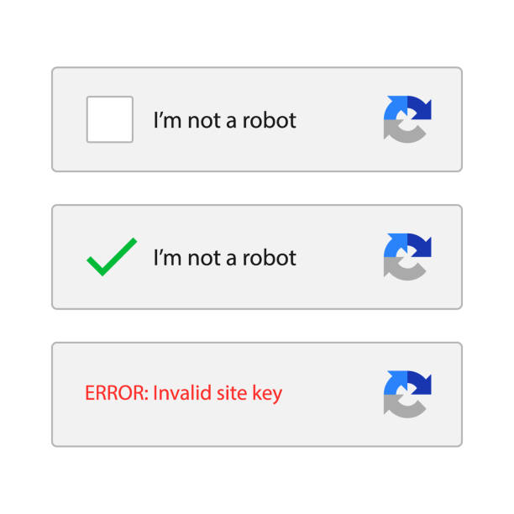
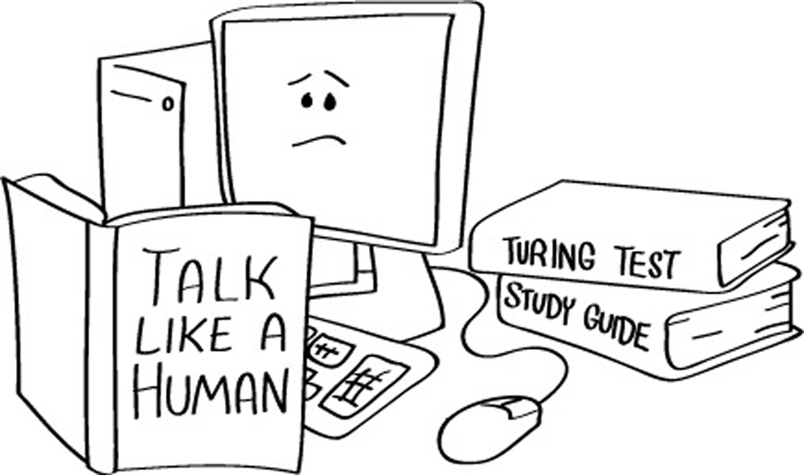
What is artificial intelligence (AI)?
The ultimate goal of artificial intelligence is to build systems able to reach human intelligence levels
ARTIFICIAL INTELLIGENCE DEFINED: FOUR TYPES OF APPROACHES
Thinking humanly: mimicking thought based on the human mind.
Thinking rationally: mimicking thought based on logical reasoning.
Acting humanly: acting in a manner that mimics human behavior.
Acting rationally: acting in a manner that is meant to achieve a particular goal.

Slide 8
Goals of Artificial Intelligence
Replicate human intelligence
Solve Knowledge-intensive tasks
An intelligent connection of perception and action
Building a machine which can perform tasks that requires human intelligence such as:
Proving a theorem
Playing chess
Plan some surgical operation
Driving a car in traffic
Creating some system which can exhibit intelligent behavior, learn new things by itself, demonstrate, explain, and can advise to its user.

Slide 9
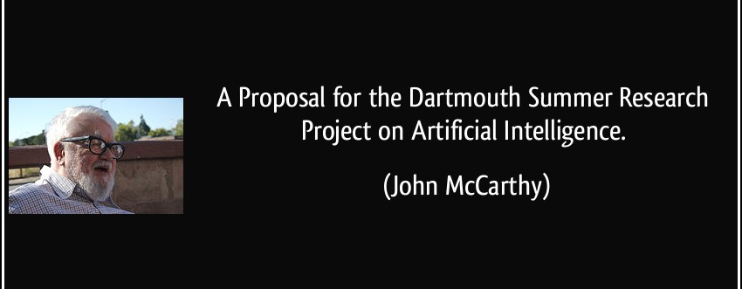
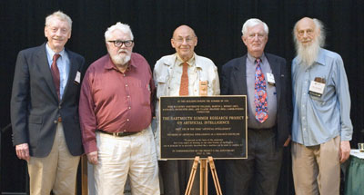
Brief history of AI

Slide 10
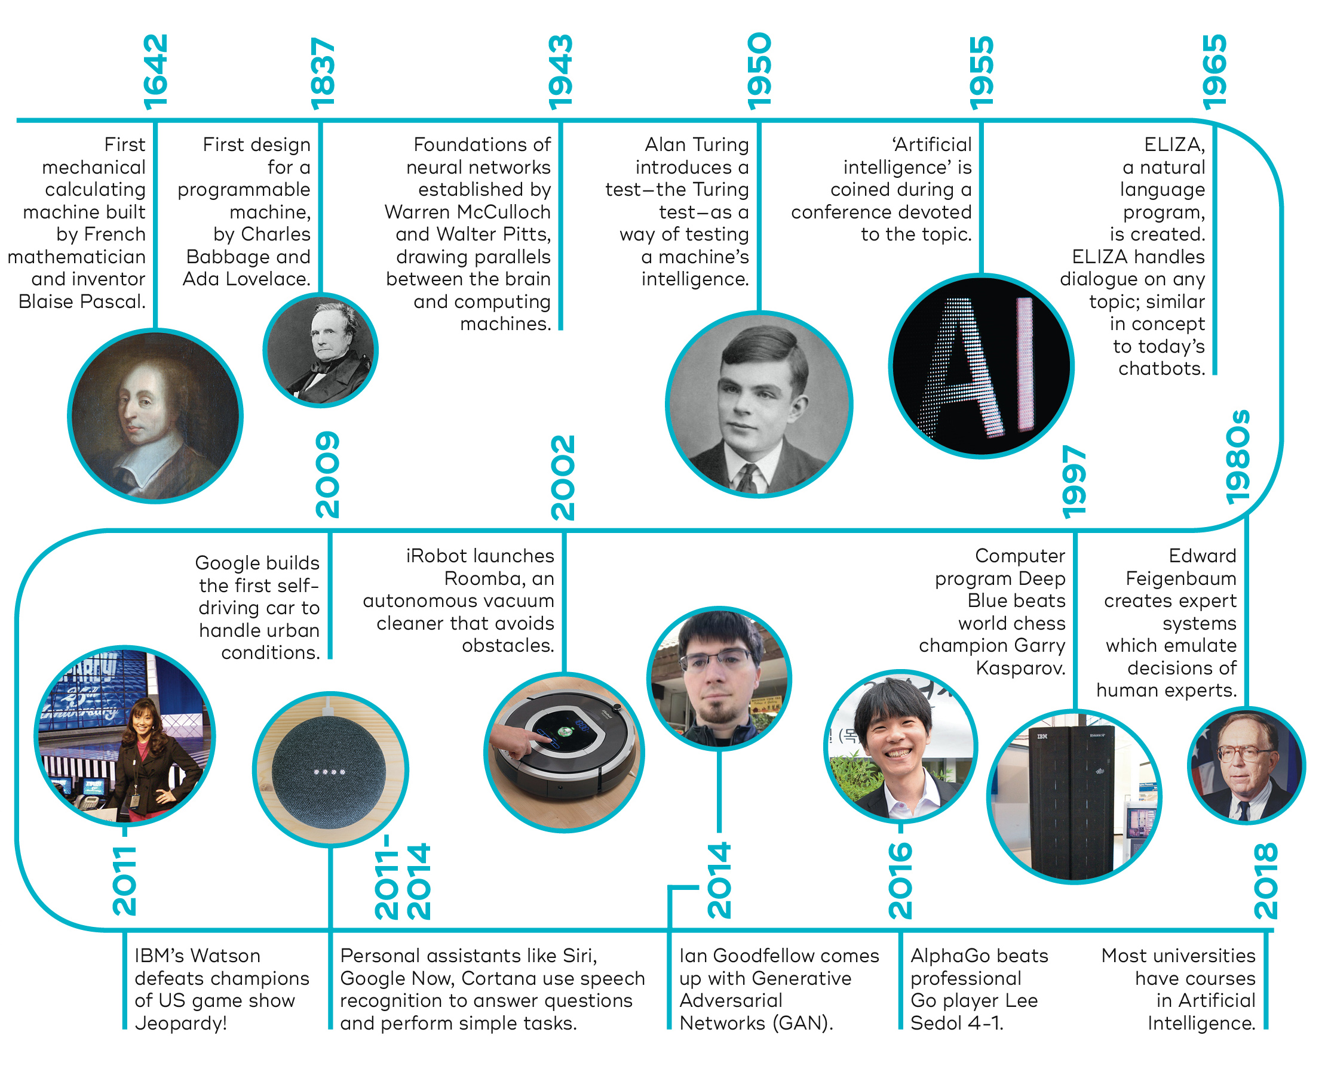
Brief history of AI
https://www.youtube.com/watch?v=eSj80Zr6TEE&ab_channel=365DataScience

Slide 11
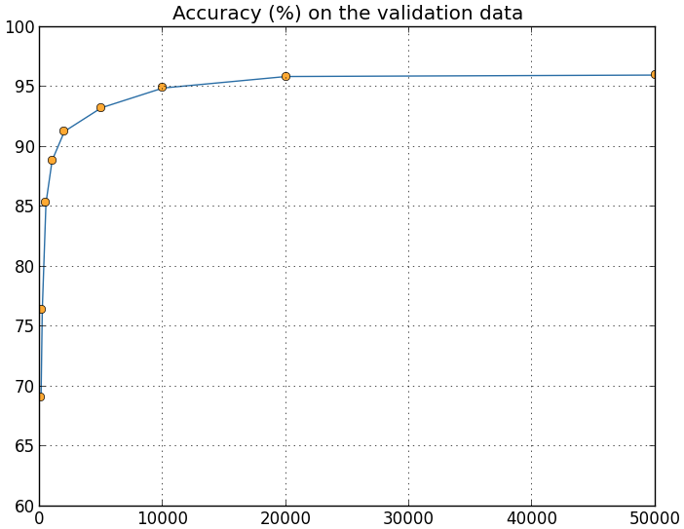
Why are things working today?
More compute power
More data
Better algorithms / models
Accuracy
Amount of Training Data

Slide 12
Advantages of Artificial Intelligence
High Accuracy with less errors
High-Speed
High reliability
Useful for risky areas
Digital Assistant
Useful as a public utility

Slide 13
Disadvantages of Artificial Intelligence
High Cost
Can't think out of the box
No feelings and emotions
Increase dependency on machines
No Original Creativity

Slide 14
Q&A
What is AI?

Slide 15
What is machine learning (ML)?
Machine Learning – is the scientific study of algorithms and statistical models that computer systems use to learn from observations, without being explicitly programmed
In this context, learning refers to:
recognizing complex patterns in data
making intelligent decisions based on data observations

Slide 16
Programming
https://www.youtube.com/watch?v=ukzFI9rgwfU&ab_channel=Simplilearn
Traditional Programming
Data
Computer
Output
Program
Machine Learning
Data
Computer
Program
Output

Slide 17
Differences between AI and ML
AI | ML
The art of making machines intelligent is AI. | ML is a part of AI. It is a process of learning from the input data without any help from programming.
AI robots perform tasks to make the system successful rather than training and retraining. | The machines retrain themselves for accuracy and reduction of error.
AI computers are programmed extensively. | ML mechanism does not involve programming, rather it learns from data.

Slide 18
What problems solved with machine learning
Identifying Spam
Making Product Recommendations
Image & Video Recognition
Fraudulent Transactions
Virtual Personal Assistant
Customer Service Automation

Slide 19
When to Use Machine Learning
It is important to remember that ML is not a solution for every type of problem.
There are certain cases where robust solutions can be developed without using ML techniques.
For example, you don’t need ML if you can determine a target value by using simple rules, computations, or predetermined steps that can be programmed without needing any data-driven learning.

Slide 20
When to Use Machine Learning
Use machine learning for the following situations:
You cannot code the rules: Many human tasks (such as recognizing whether an email is spam or not spam) cannot be adequately solved using a simple (deterministic), rule-based solution. A large number of factors could influence the answer. When rules depend on too many factors and many of these rules overlap or need to be tuned very finely, it soon becomes difficult for a human to accurately code the rules. You can use ML to effectively solve this problem.
You cannot scale: You might be able to manually recognize a few hundred emails and decide whether they are spam or not. However, this task becomes tedious for millions of emails. ML solutions are effective at handling large-scale problems.

Slide 21
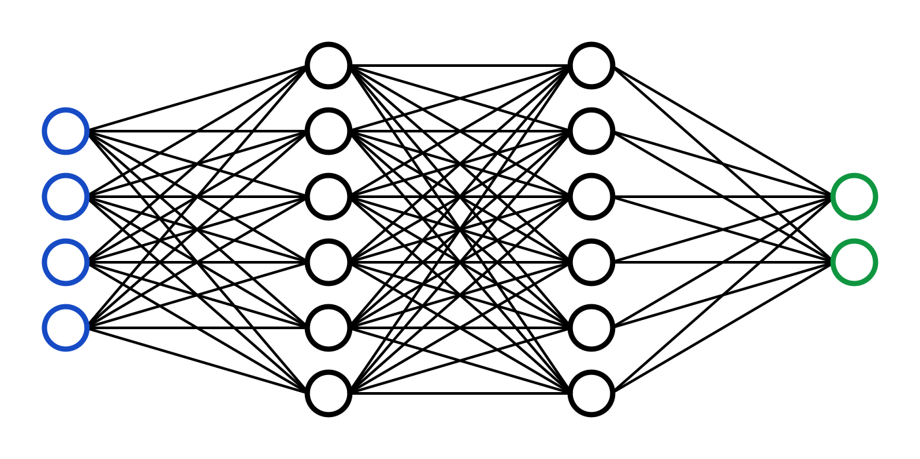
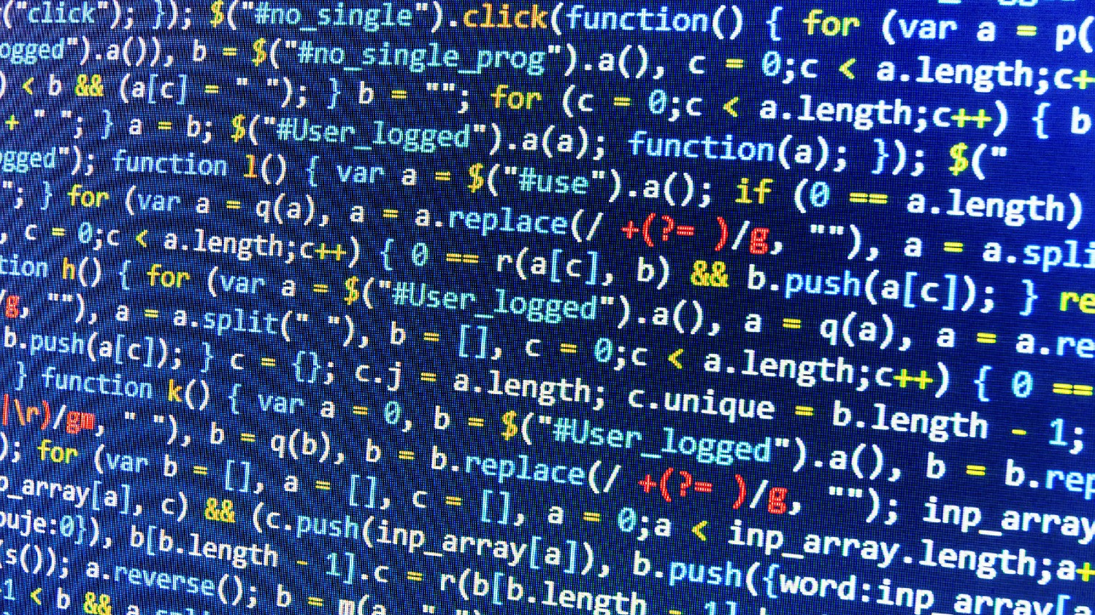
The essence of machine learning
A pattern exists
We cannot express it programmatically
We have data on it

Slide 22
ML representation
Every machine learning algorithm has three components:
Representation / Model Class
Evaluation / Objective Function
Optimization

Slide 23
Where does ML fit in?
Biology
Neuroscience
Applied Math
Machine Learning
Computer Science
Statistics

Slide 24
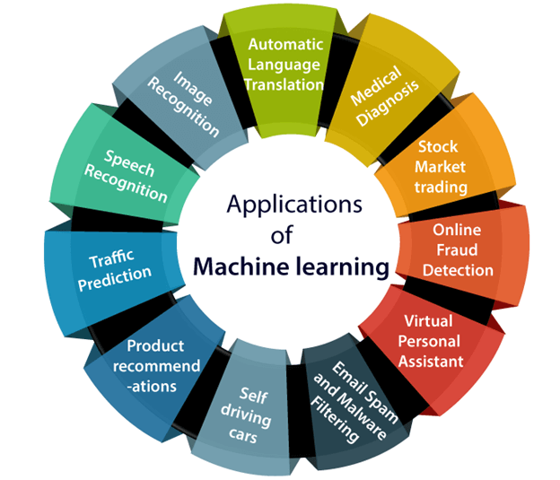
Applications of Machine learning
http://www.test.com/

Slide 25
Q&A
Differences between AI and ML

Slide 26



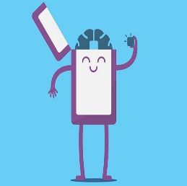




How does Machine Learning works
Training data
Accuracy
Training ML algorithm
Unacceptable
Acceptable
Model input data
Successfully model
New input data
ML algorithm
Prediction

Slide 27
How does Machine Learning works
A Machine Learning system learns from historical data, builds the prediction models, and whenever it receives new data, predicts the output for it. The accuracy of predicted output depends upon the amount of data, as the huge amount of data helps to build a better model which predicts the output more accurately.
Lear from data
Training
Machine learning algorithm
Building logical models
Output
Input data
New data

Slide 28
How does Machine Learning works
Suppose we have a complex problem, where we need to perform some predictions, so instead of writing a code for it, we just need to feed the data to generic algorithms, and with the help of these algorithms, machine builds the logic as per the data and predict the output.
Machine learning has changed our way of thinking about the problem

Slide 29
Features of Machine Learning
Machine learning uses data to detect various patterns in a given dataset.
It can learn from past data and improve automatically.
It is a data-driven technology.
Machine learning is much similar to data mining as it also deals with the huge amount of the data.

Slide 30
The importance of Machine Learning
Rapid increment in the production of data
Solving complex problems, which are difficult for a human
Decision making in various sector including finance
Finding hidden patterns and extracting useful information from data.

Slide 31
Q&A
What is ML?

Slide 32
Q&A
How does Machine Learning works

Slide 33
Q&A
When to Use Machine Learning

Slide 34
Q&A
Main difference between traditional programming and ML programming

Slide 35
Q&A
Why ML is important

Slide 36
Q&A
Where does ML fit in?

