Slide 1
Mobile Programming 1-Assignment
Computer Engineering Department
Shukirillaev Mukhammadsodik, 202438379

Slide 2
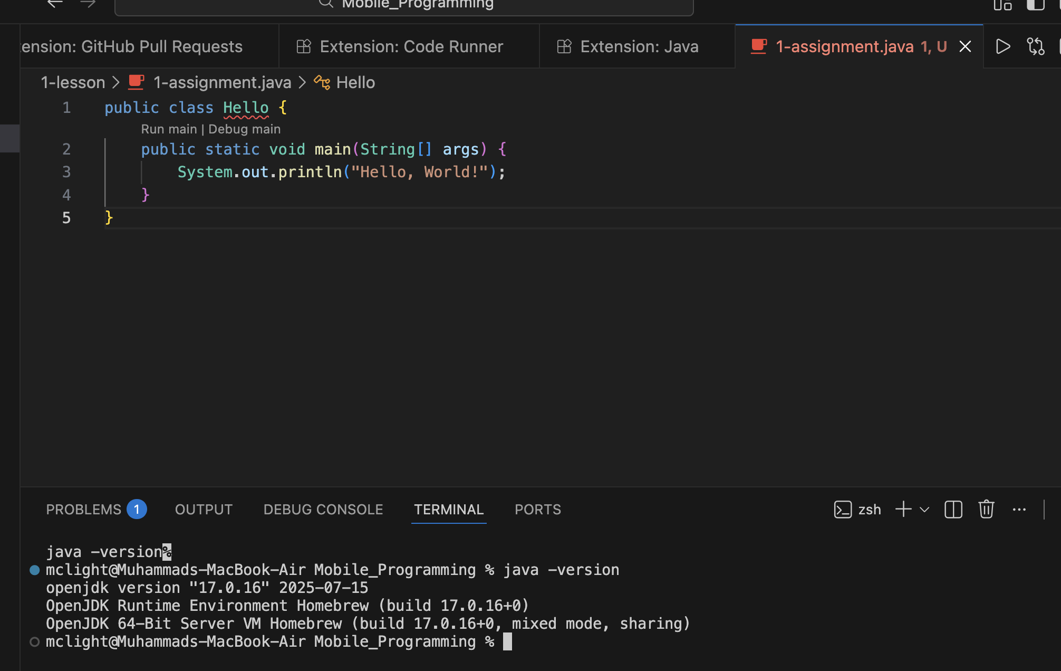
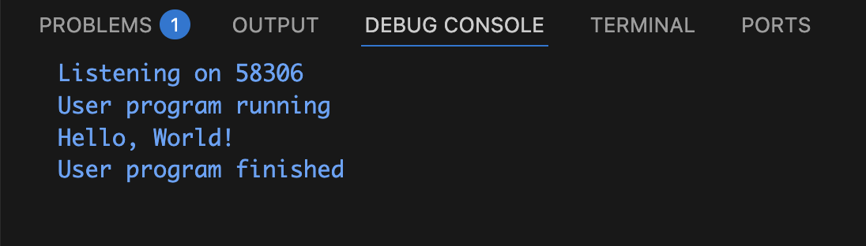
Installing & Running first program

