Slide 1
Mobile Programming 2-Assignment
Computer Engineering Department
Shukirillaev Mukhammadsodik, 202438379

Slide 2
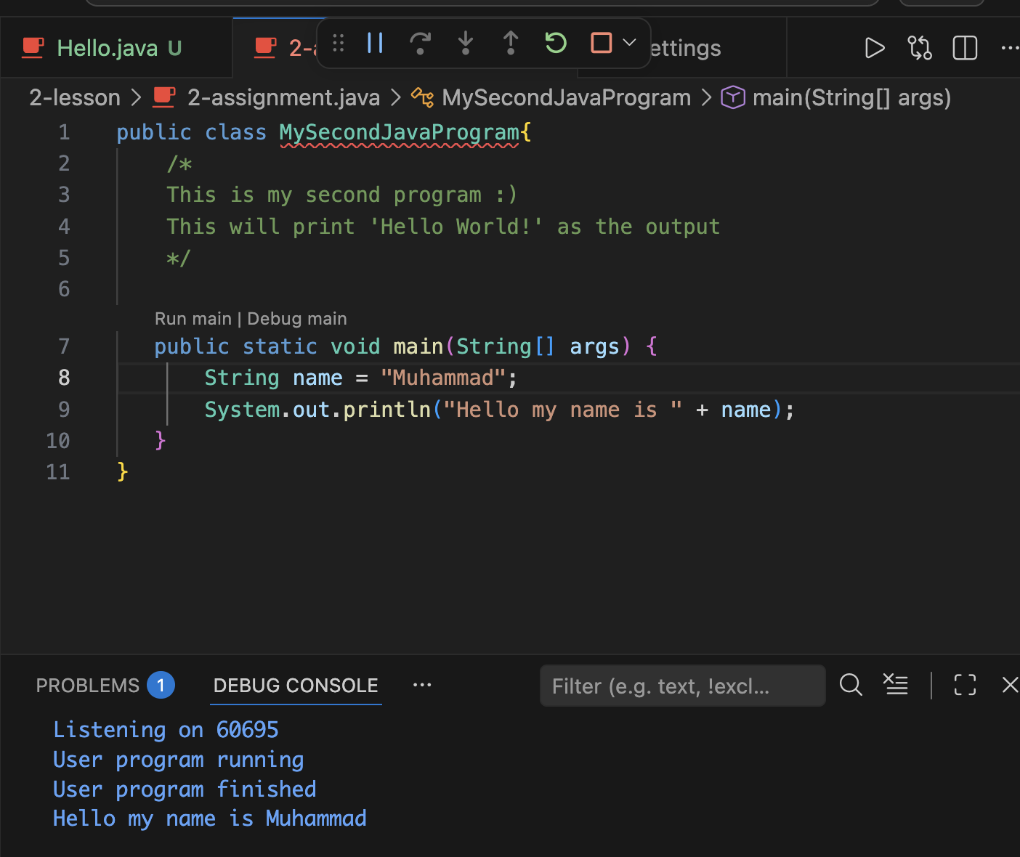
1-Task. Printing name
Output:

Slide 3
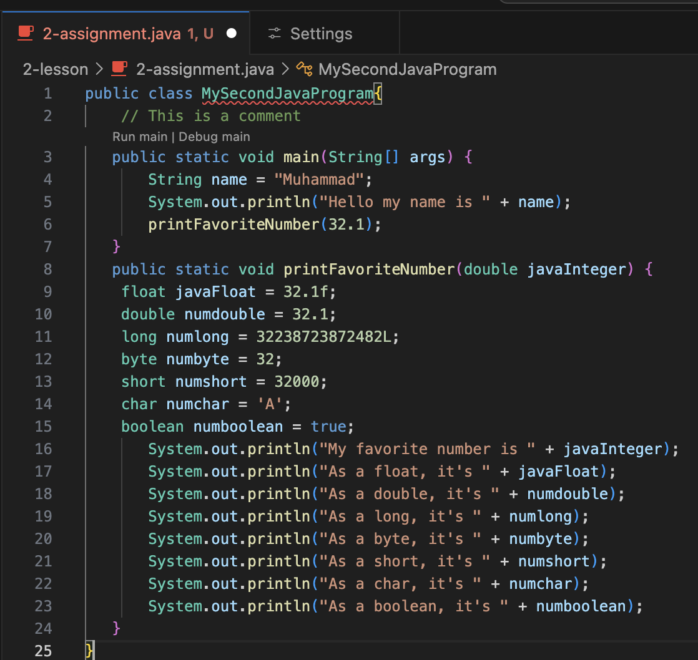
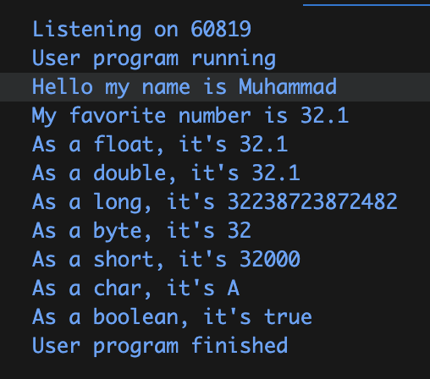
2-Task. Data Types
Output:

