Slide 1
Mobile Programming 4-Assignment
Computer Engineering Department
Shukirillaev Mukhammadsodik, 202438379

Slide 2
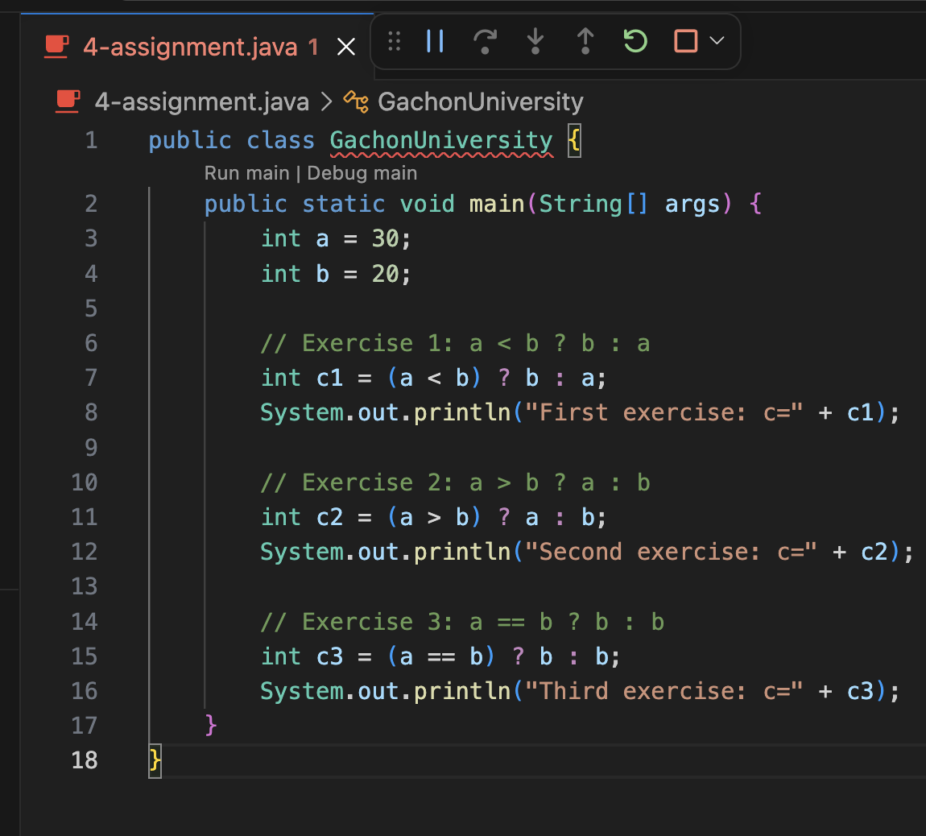
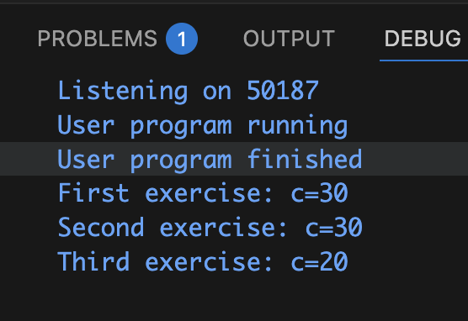
Task. Assignment Operators 1~3
Output:

Slide 3
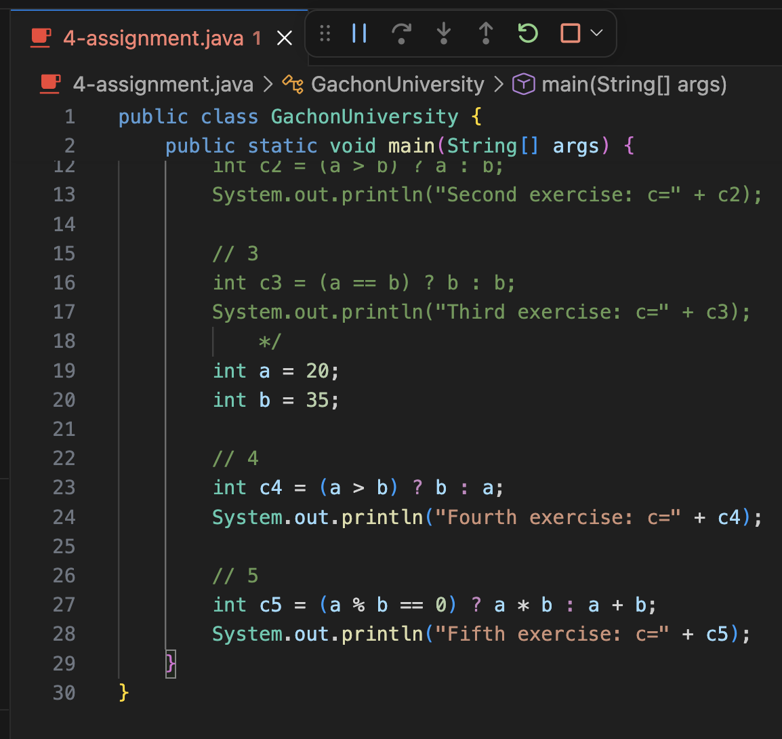
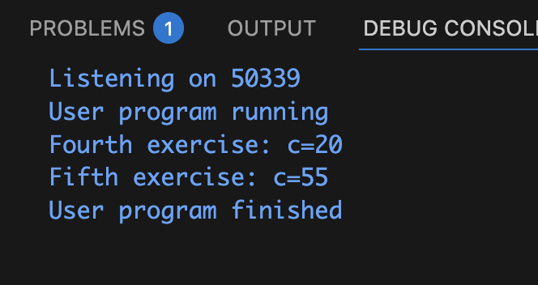
Task. Assignment Operators 4~5
Output:

