Slide 1
Mobile Programming 4.2-Assignment
Computer Engineering Department
Shukirillaev Mukhammadsodik, 202438379

Slide 2
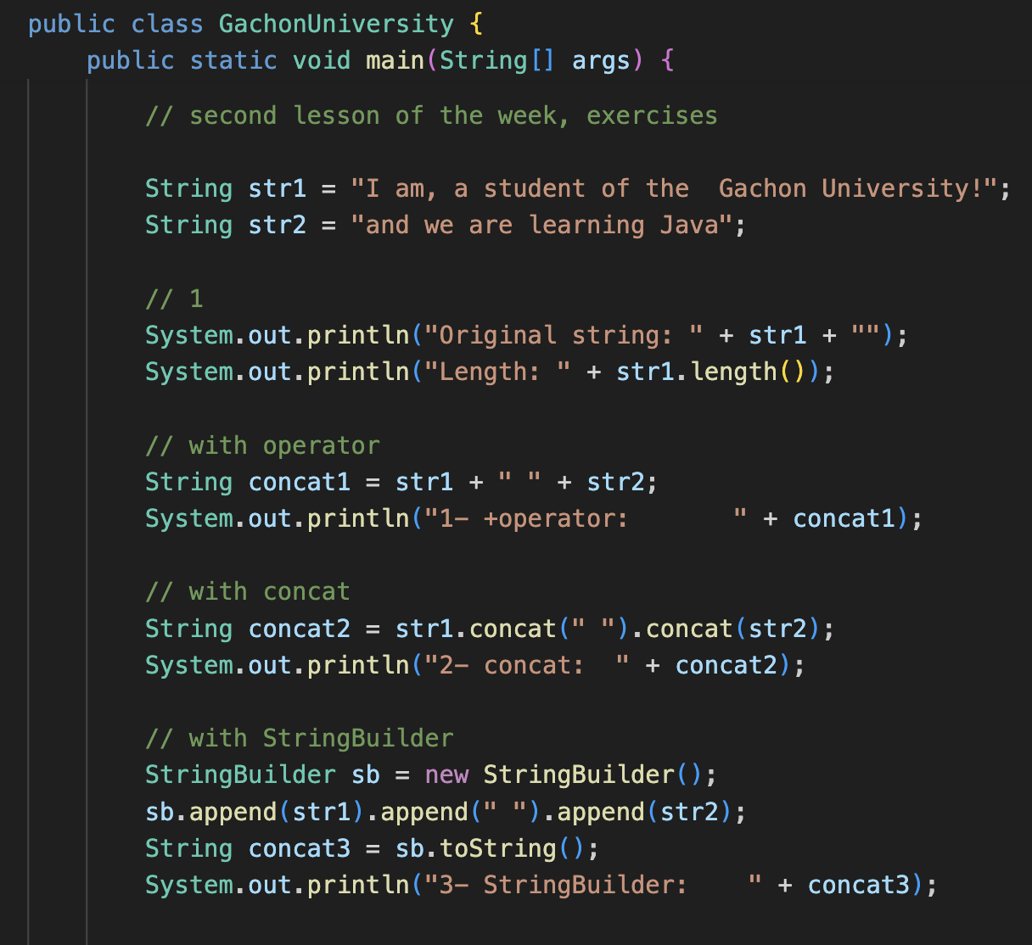

Task:.. Concat, operator, StringBuilder
Output:

Slide 3
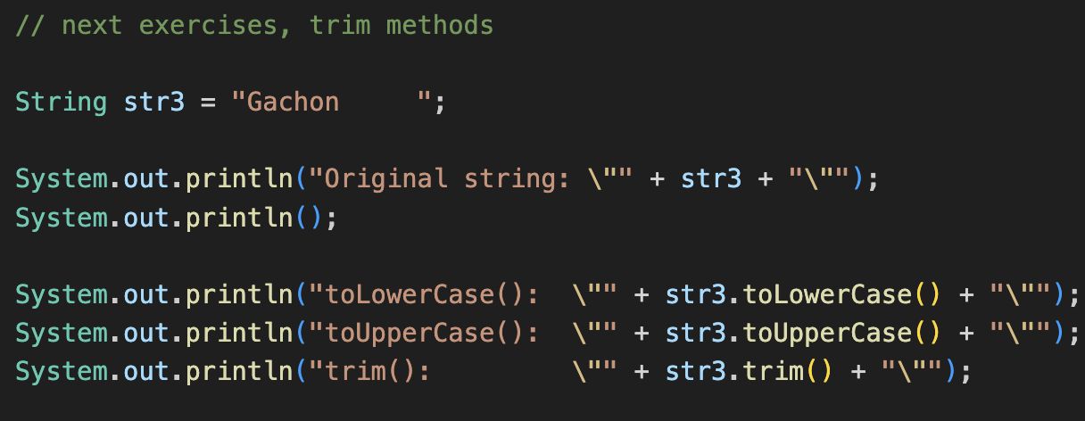

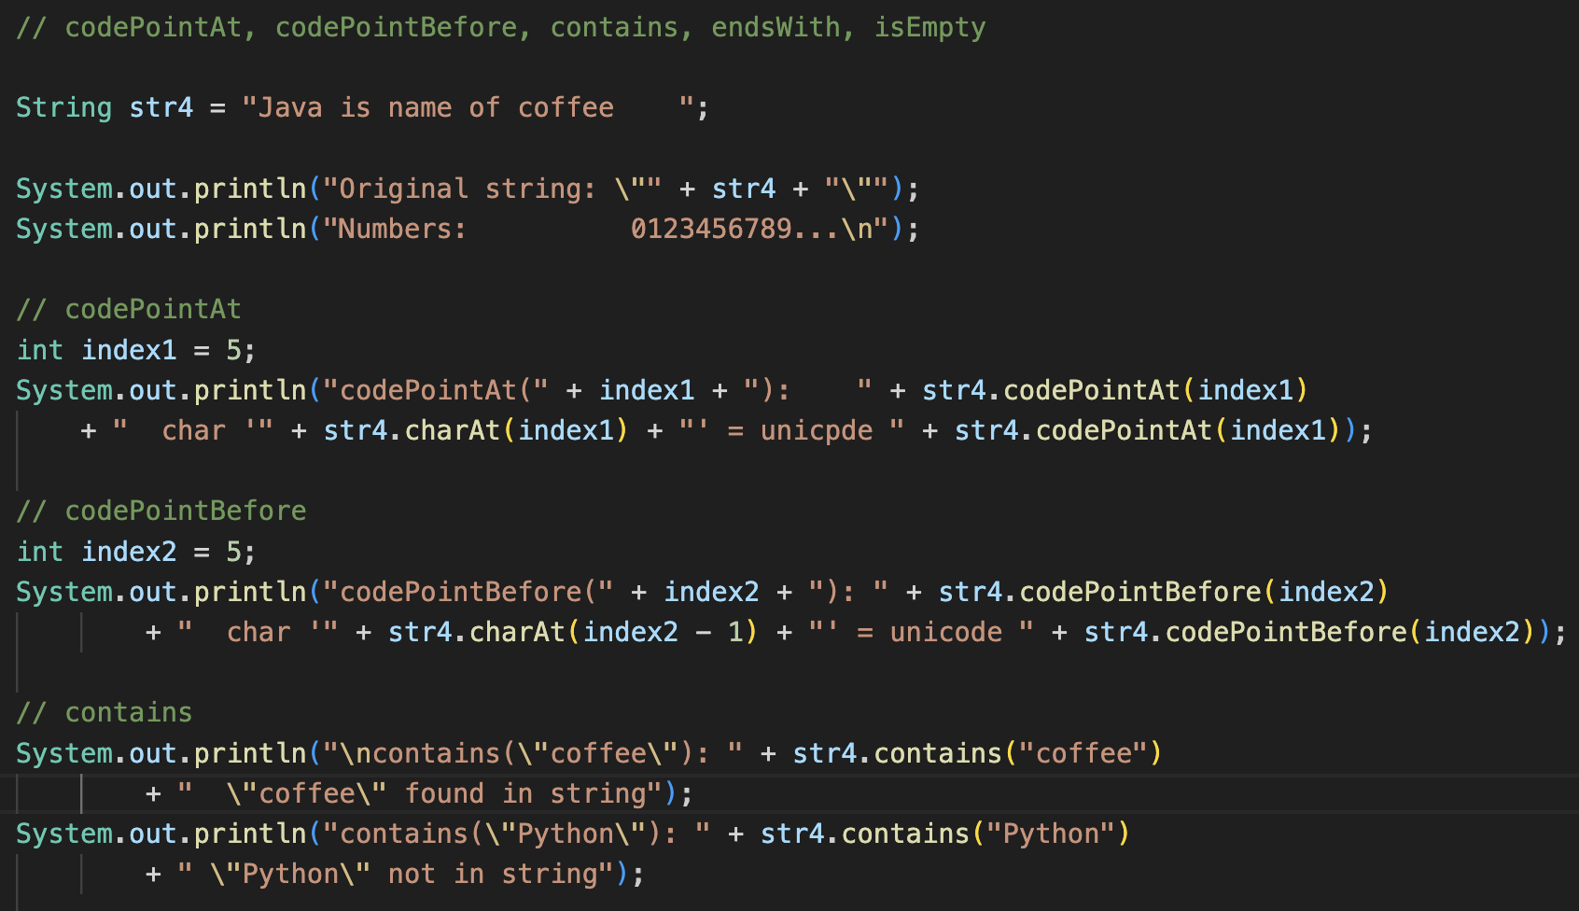
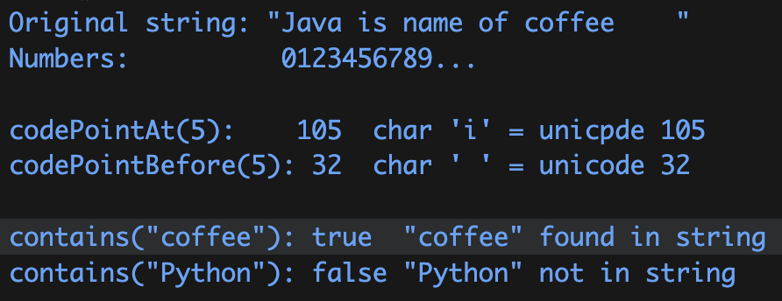
Tasks
Outputs:

Slide 4
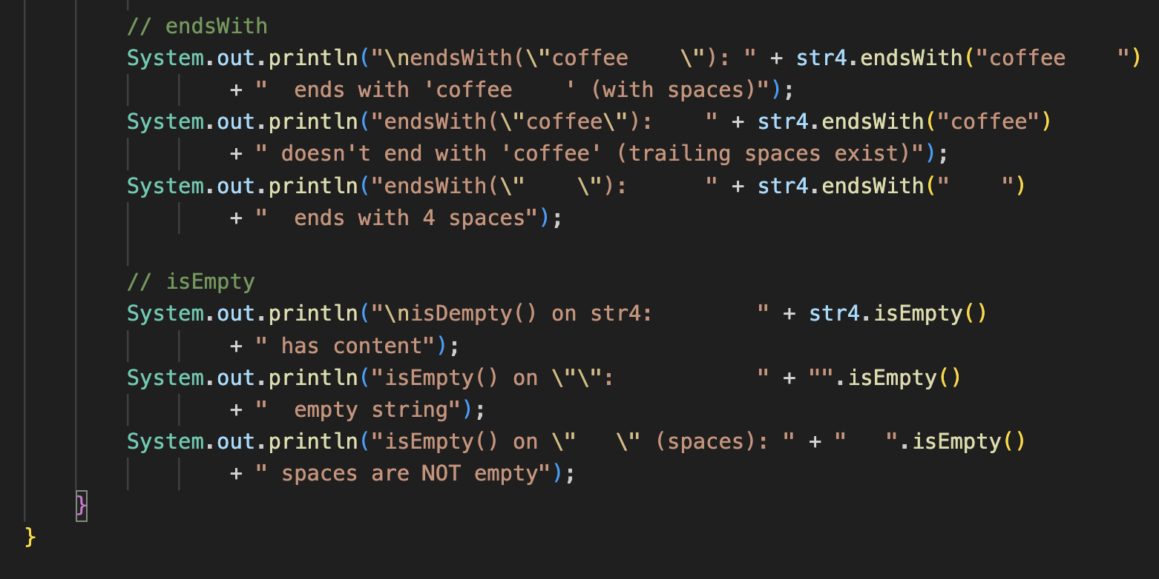

Tasks.
Output:

