Slide 1
Mobile Programming 5-Assignment
Computer Engineering Department
Shukirillaev Mukhammadsodik, 202438379

Slide 2
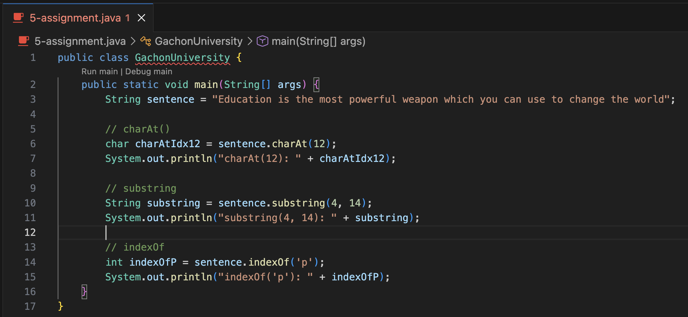
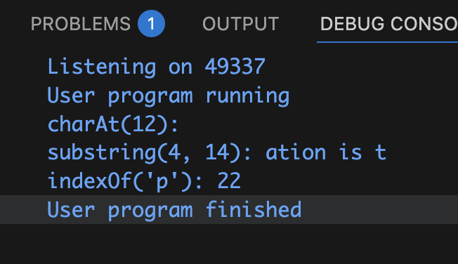
Task. Printing index, substring, char:
Output:

Slide 3
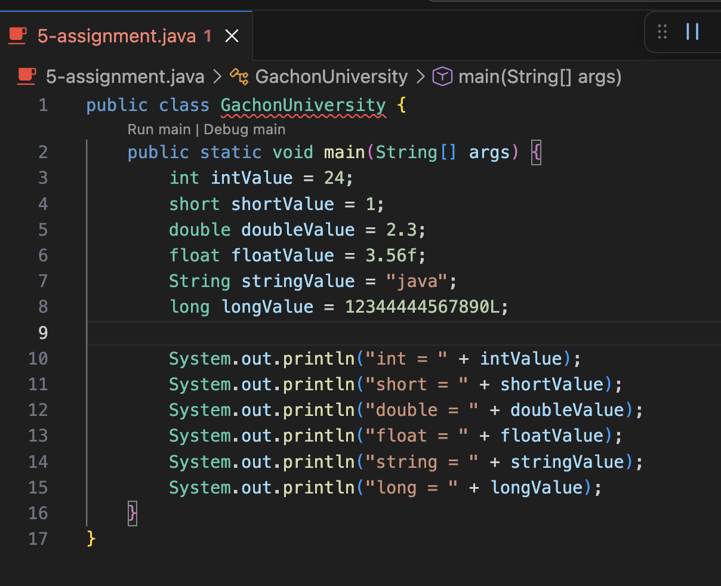
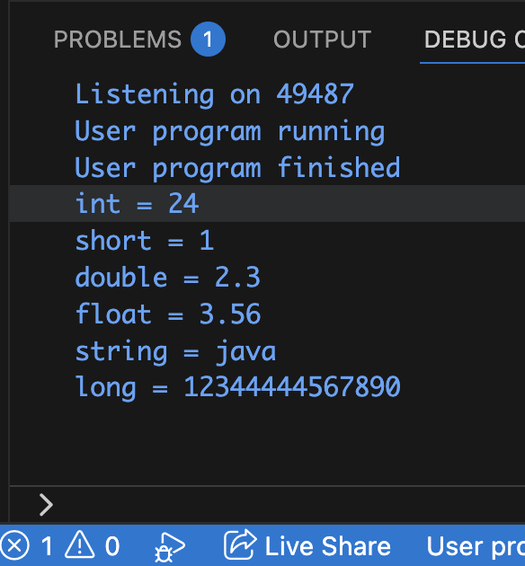
Task: Make a programm which intakes all data types and print them with name of the data type
Output:

Slide 4
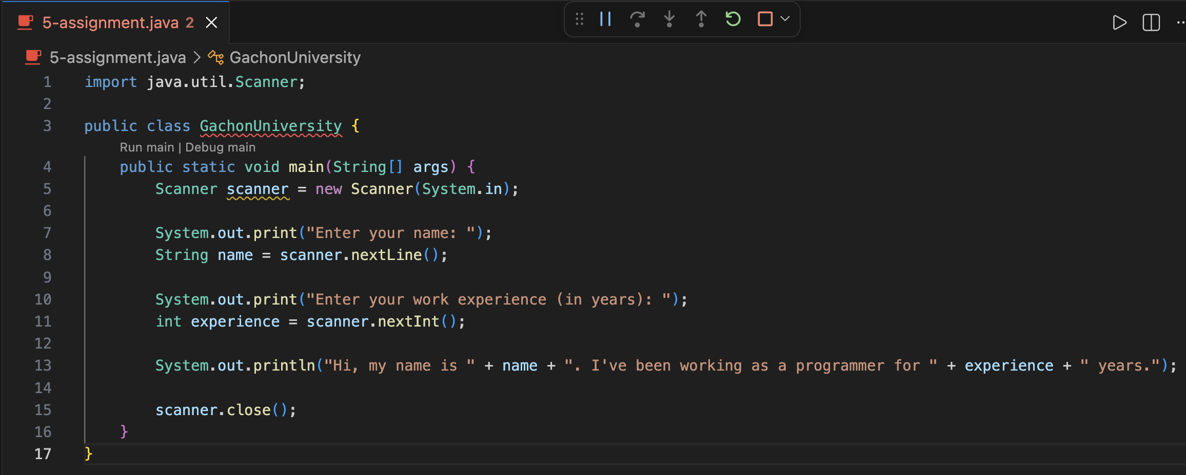
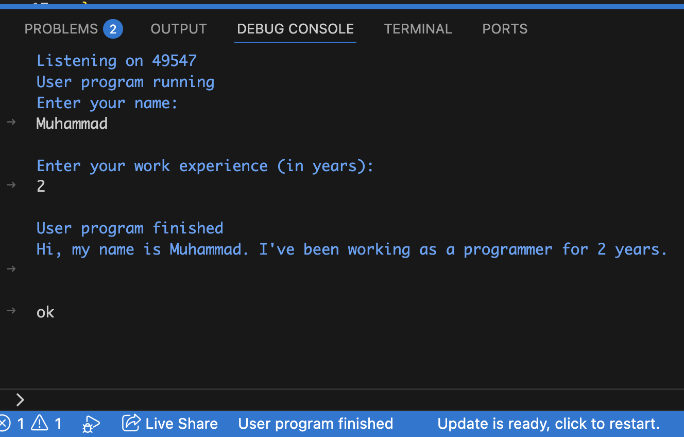
Task: You are given the program that receives: a string: person’s name, integer: work experience.
Output:

Slide 5
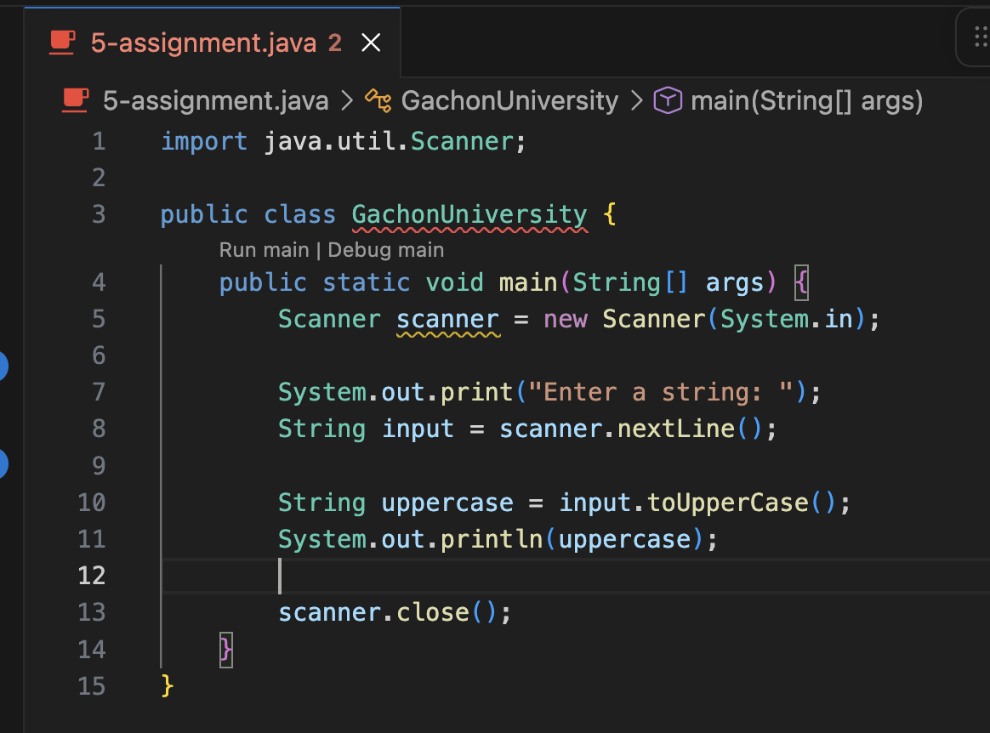
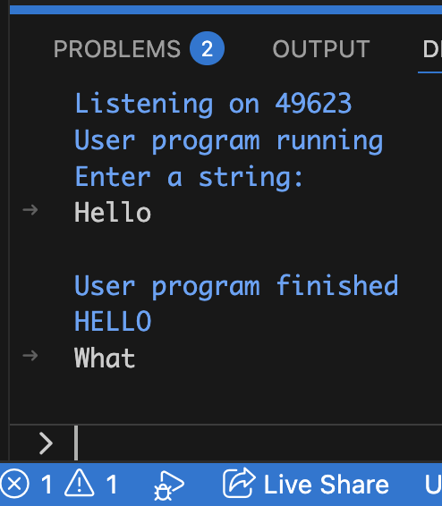
Task: The entry is a string. You need to extract this string in uppercase.
Output:

Slide 6
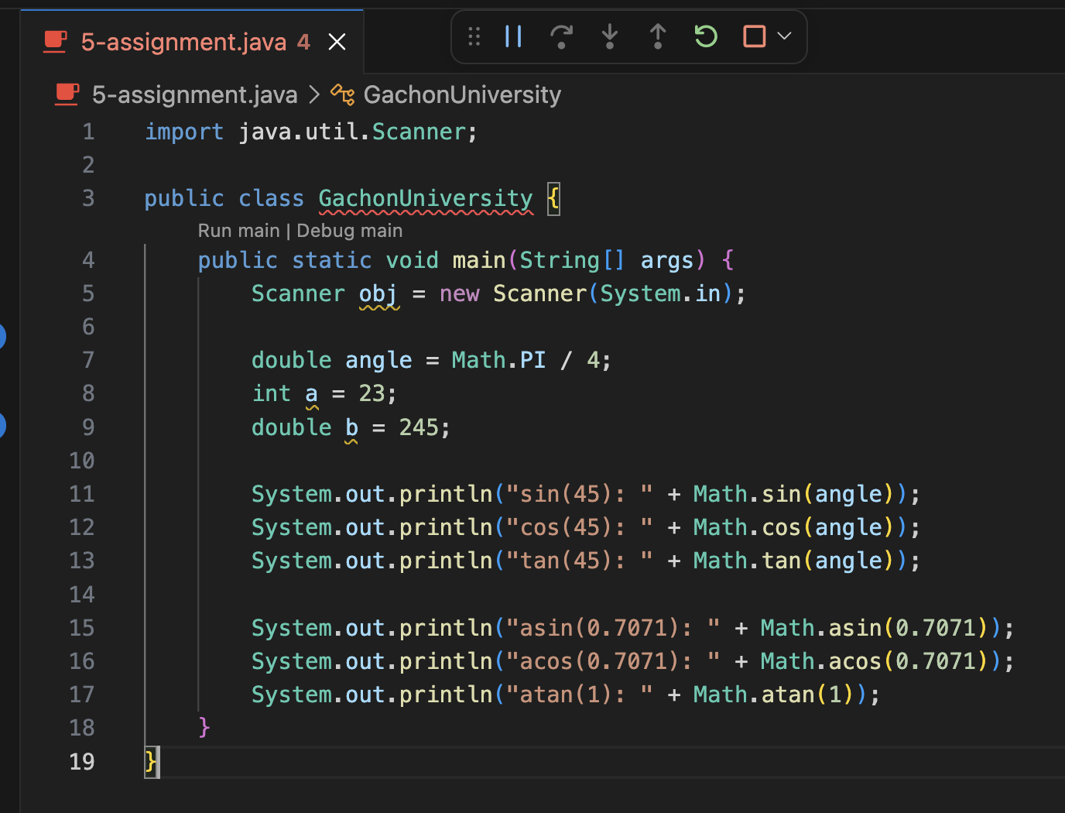
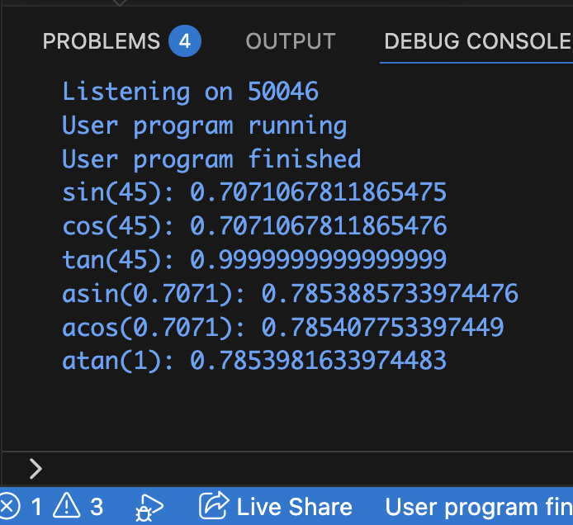
Task: Checking the output
Output:

