Slide 1
Mobile programming
Lecture 5

Slide 2
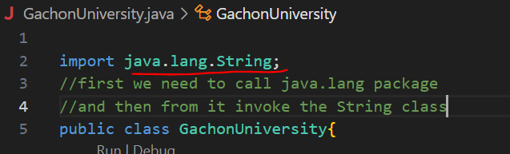
Recall!
Java - Strings Class
Concatenating Strings

Slide 3
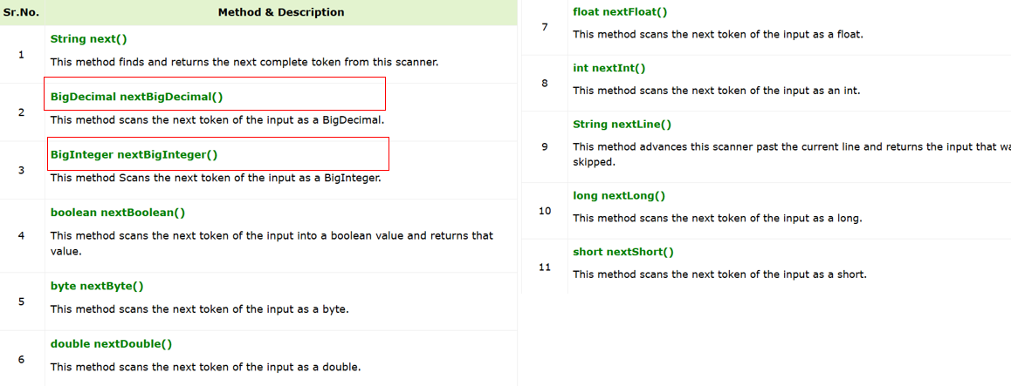
User Input in Java. Scanner class

Slide 4
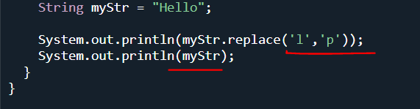

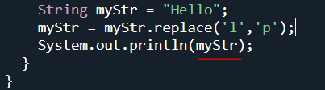

Java String replace() Method
Here we just used the method for vision but not changed the myStr itself.
But here changed the myStr by giving new value

Slide 5


(pre-increment ,pre-decrement) and (post-increment ,post-decrement)
++n, --n - pre-increment and pre-decrement
n++, n-- - post-increment and post-decrement
first add then comes num
first num comes and then add

Slide 6
Math library
we dont need to import the Math library, we can write like this:
[library name].[method name]
Let's look at the most popular methods:
abs(a) - returns the absolute value (by module) a
min(a, b), max(a, b)- returns a minimum and maximum of two numbers respectively
sin(a), cos(a), tan(a), asin(a), acos(a), atan(a)- trigonometric and inverse trigonometric functions from a
toDegrees(a), toRadians(a) - translation from radiant to degrees and vice versa
pow(a, b) - Set the number a to b
sqrt(a), cbrt(a) - extraction of the square and cubic root from a
round(a) - rounding of the real number by mathematical rounding
floor(a), ceil(a) - Rounding the actual number down and up

Slide 7
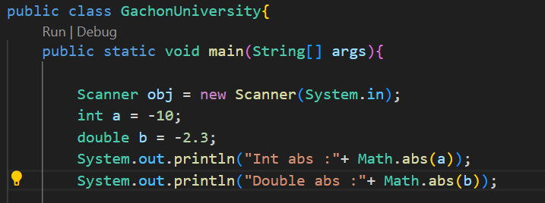

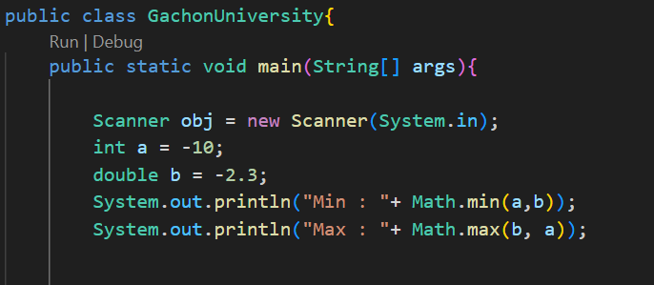

automatically convertes the a into double

Slide 8
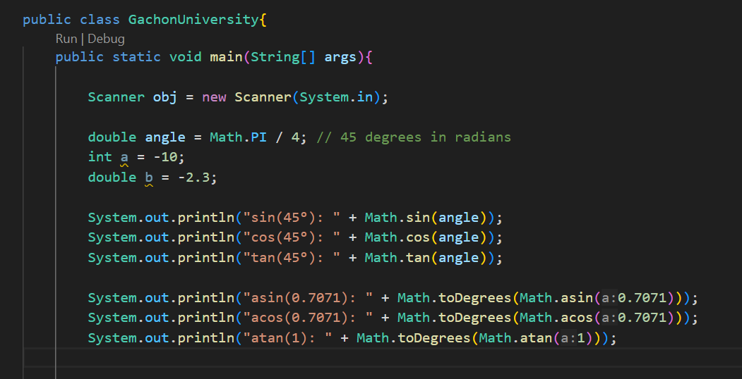
Please, Type the code and see the results!

Slide 9
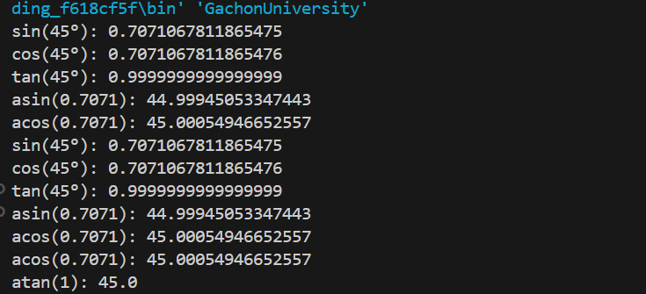
Check the results

Slide 10
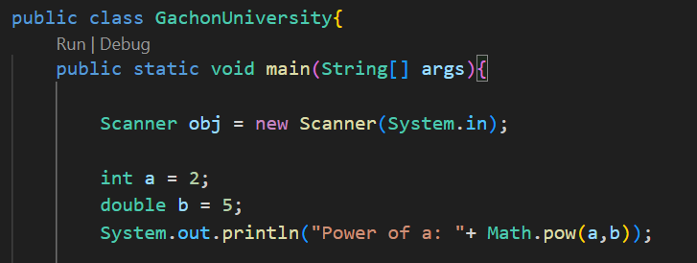

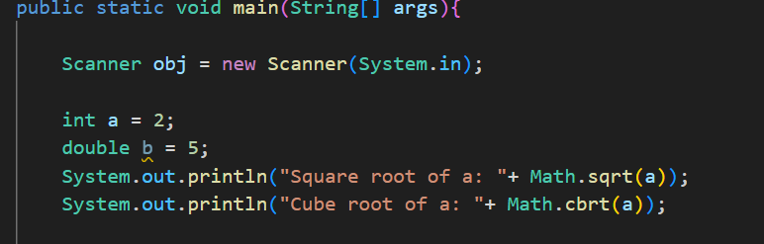


Slide 11
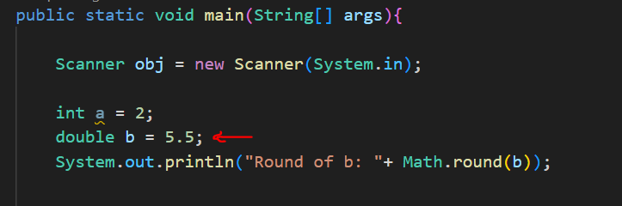

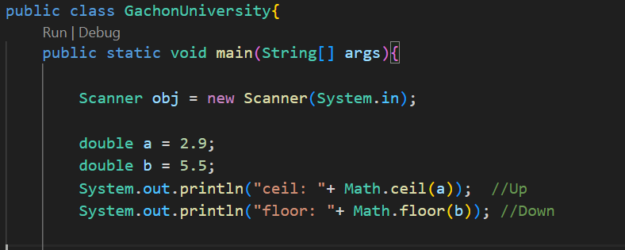


Slide 12
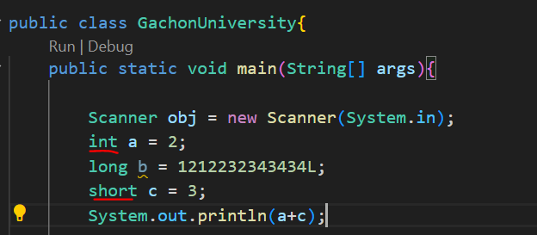

Type Casting
Here is the hierarchy of widening type casting in Java:
1. automatically:

Slide 13
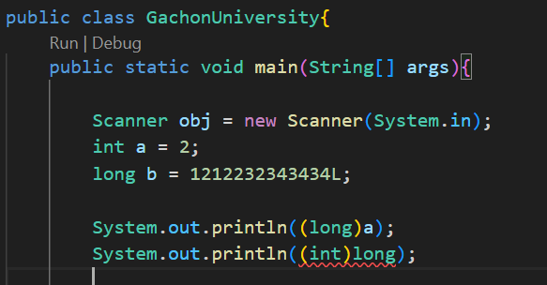
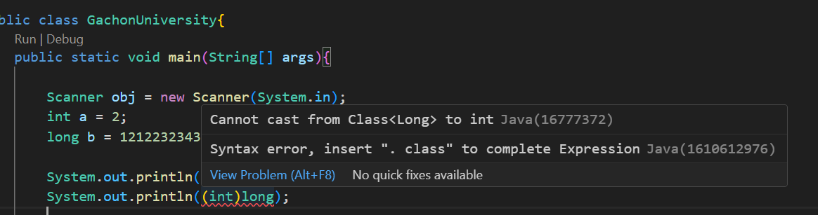
2. Manually:
you cant convert higher data types into smaller ones

Slide 14
DONT FORGET!
To change the variable into another one, we write on the right side of the variable the name of the data type:
(int)num;
(short)num;
(long)num;
(double)num;
(float)num;
(long)num;

Slide 15
Task: cube
Write a program that calculates the cube’s volume and area of its full surface by the input value of the rib length.
a = 25
Note: The cube volume and area of the complete surface can be calculated by the formulas V = a**3, S = 6 * a**2

Slide 16
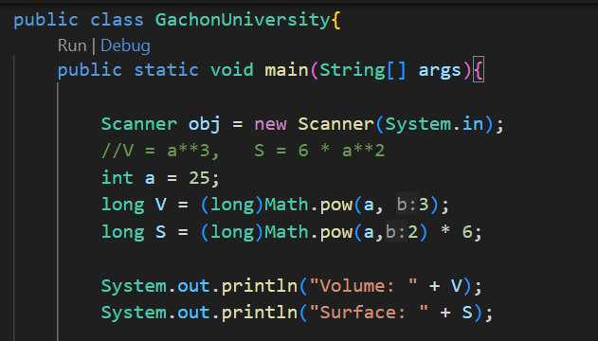

Check the res

Slide 17
Task: Last digit
The integer n is given. Enter its last digit.
n = 2103801
answer: 1
hint: you need to change your number into string and use charAt().
String stringNum = String.valueOf(num);

Slide 18
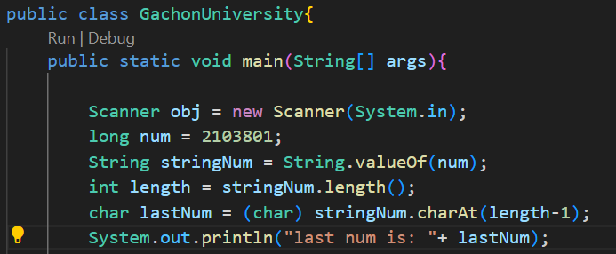

Check!

Slide 19
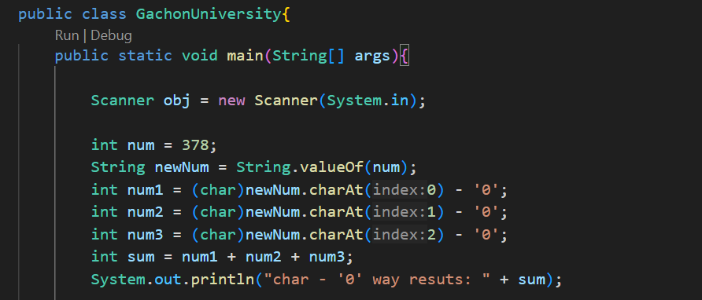
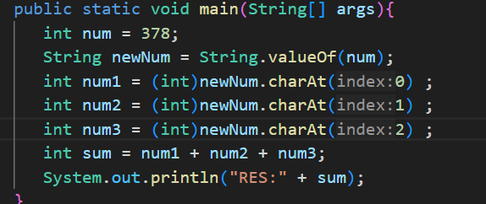

Way of the solve :
The sum of three digits. Given a three-digit number N. Find the sum of its digits.
N = 378
1. Approach:
by using String.valueOf() convert number into string and starting the getting the numbers of each index by using new method char - ‘0’.
PLease first try this method
and tell me the answer !
Now try this one !

Slide 20

lets analyse first error!
This line converts the character '3' to its ASCII value, which is 51, not the numeric 3 you want. The same happens for '7' → 55, and '8' → 56. So the total is: one type of the Unicode: ASCII for USA
Why does char - '0' work?
Because characters like '0', '1', ..., '9' are stored as sequential values in ASCII. '3' - '0' gives 3 because '0' is ASCII 48 and '3' is 51 → 51 - 48 = 3.

Slide 21
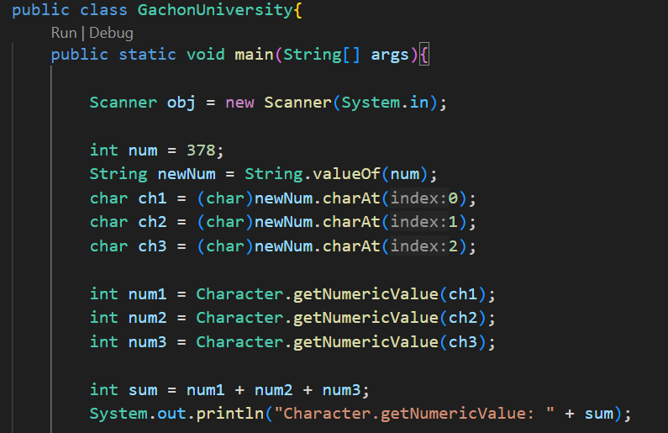

2. Approach is use new methos Character.getNumericalValue() and follow the same flow as approach 1.

Slide 22
Task: You are given the positive valid number X is given. Print out its fractional part.
X = 3.73001
answer = 0.73001
Note: dont use 3.73001 - 0.73001 this answer will not be accapted. Find out another way.

Slide 23
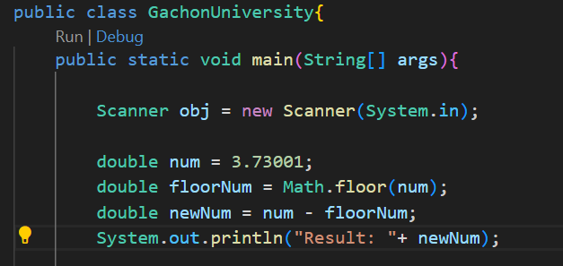

Check!

Slide 24
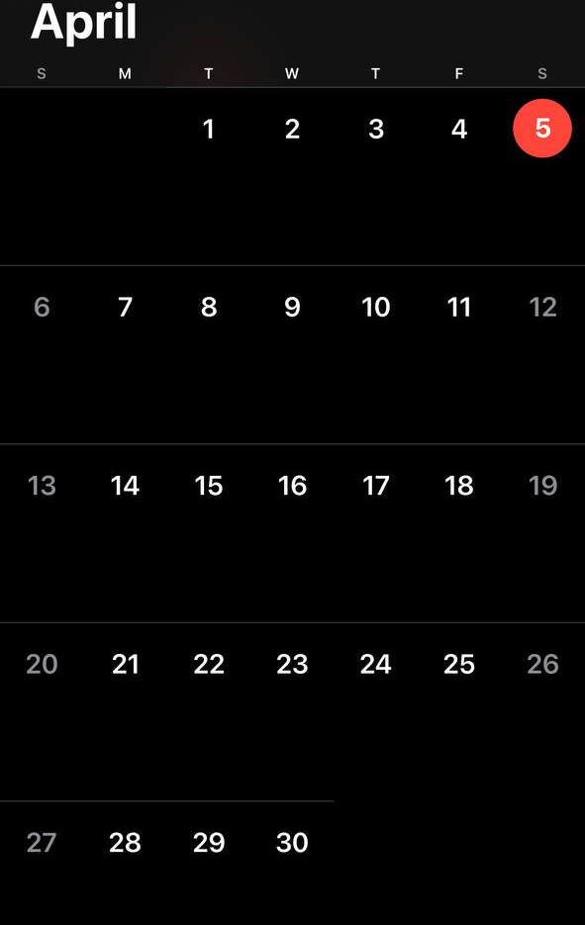
ONLINE NOT OFFLINE
on 16 April is our mid term it’s gonna be online , from lectures [1-6] will be taken questions. The mid term will hold like test there are will be 20 question with 3 options. Likely there can be Pseudocode questions either, please prepare well!
the Mortage calculator project

Slide 25
PROJECT Explanation: The Mortage calculator for payments
What is Mortage and Mortage Calculator?
A mortgage is a type of loan used to buy property, like a house or apartment. Instead of paying the full price upfront, you borrow money from a bank or lender, and then pay it back over time (usually 15 to 30 years) with interest.
Every month, you pay a mortgage payment, which usually includes:
Principal (the actual money you borrowed)
Interest (the cost of borrowing that money)
Sometimes also property taxes and insurance

Slide 26
What is a Mortgage Calculator?
A mortgage calculator is a tool that helps you estimate your monthly mortgage payment based on:
Loan amount (how much you borrow)
Down payment (how much you pay upfront)
Interest rate (e.g. 6.5%)
Loan term (e.g. 30 years)
Sometimes property tax and insurance

Slide 27
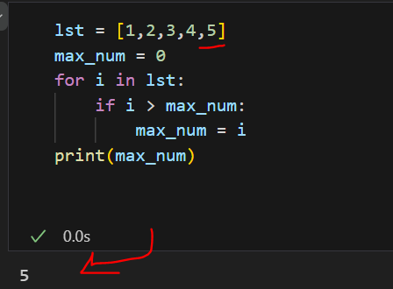
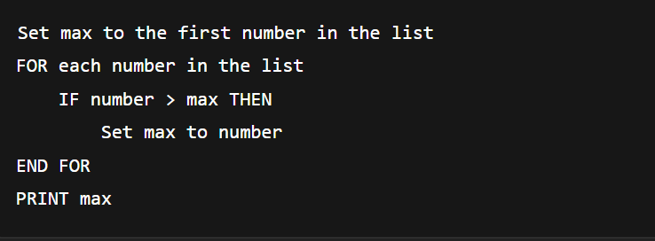
What Is Pseudocode?
"Pseudo" means "false," so pseudocode = "false code."
It’s not meant to run on a computer.
It focuses on logic and structure, not implementation details.
It uses simple keywords like IF, ELSE, WHILE, FOR, PRINT, etc.
How It Fits in Algorithm Design
Define the problem
Break it into steps
Write pseudocode to outline those steps
Convert pseudocode into real code
Test and refine the code

Slide 28
Why Use Pseudocode in Algorithm Design?
Clarity: Helps you understand and design the steps of a solution clearly.
Language-Independent: You don’t have to worry about syntax errors or language-specific rules.
Communication: Makes it easier to share and discuss with others, even non-programmers.
Planning Tool: Acts like a blueprint before you write actual code.
Debugging Logic: You can spot logical errors early before diving into code.

Slide 29
Note: Your task is find the mortage and write Pseudocode
ALL INFO in pdf format I WILL UPLOAD ON 23 RD APRIL BEFORE the deadline starts AND YOU WLL BE GIVEN 1:30 HOURs

