Slide 1
Mobile Programming 3-Assignment
Computer Engineering Department
Shukirillaev Mukhammadsodik, 202438379

Slide 2
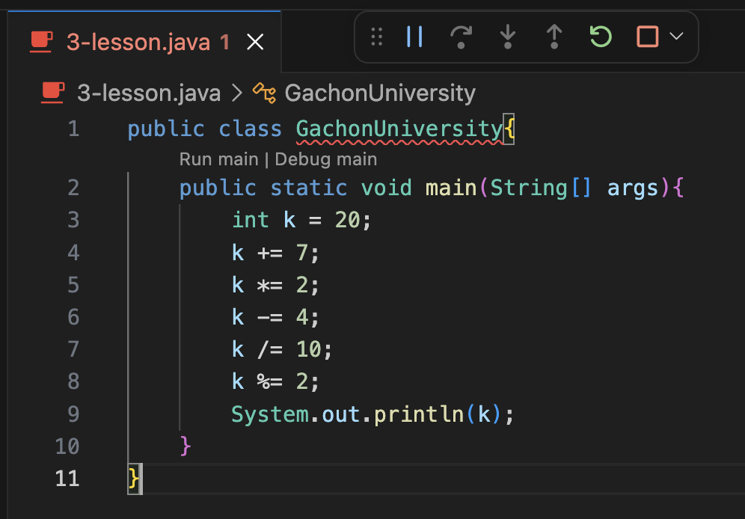
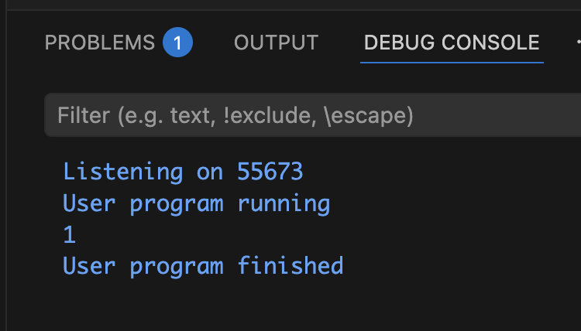
1-Task. k = 20
Output:

