Slide 1
Mobile Programming 5.2-Assignment
Computer Engineering Department
Shukirillaev Mukhammadsodik, 202438379

Slide 2
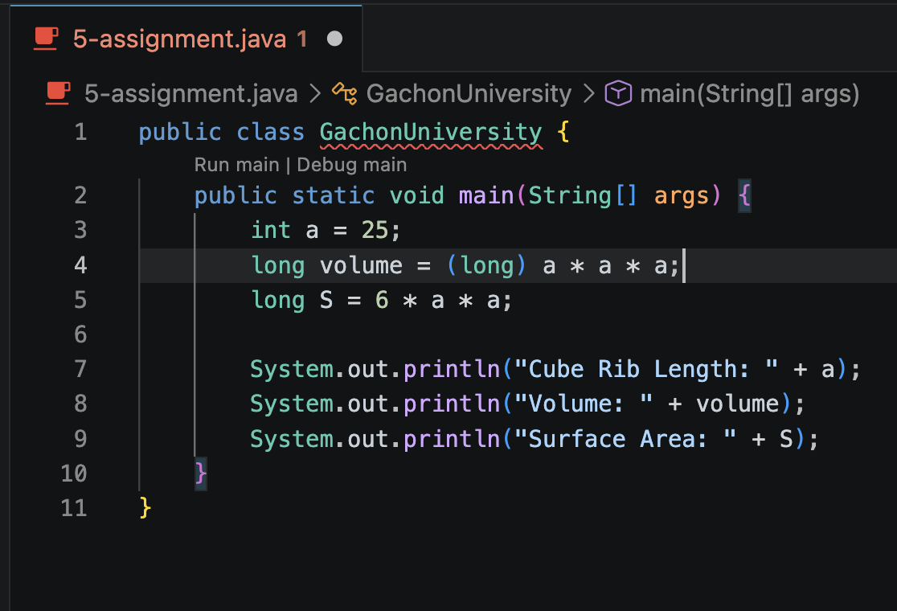
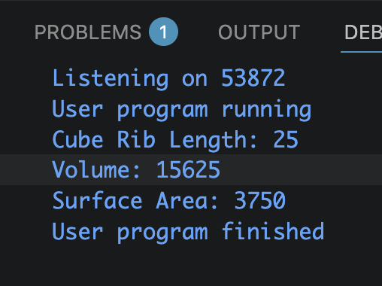
Task. Write a program that calculates the cube’s volume and area of its full surface by the input value of the rib length.
Output:

Slide 3
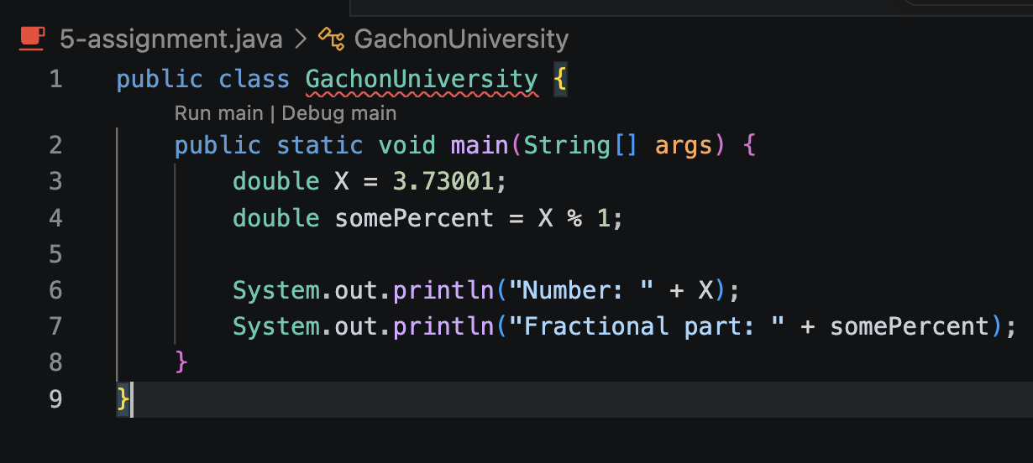
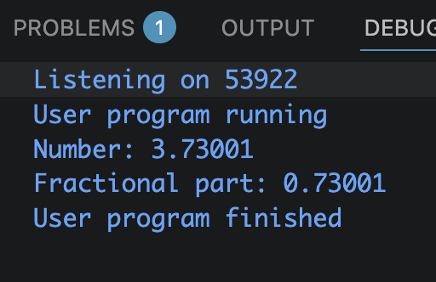
Task. You are given the positive valid number X is given. Print out its fractional part.
Output:

