Slide 1
Mobile Programming
8-Assignment
Computer Engineering Department
Shukirillaev Mukhammadsodik, 202438379

Slide 2
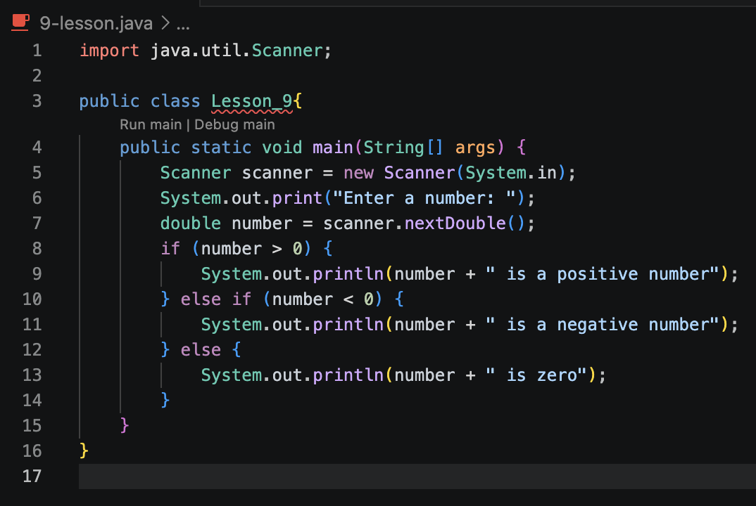
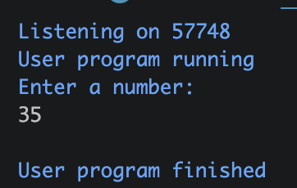
Task 1. Write a Java program to get a number from the user and print whether it is positive or negative.
Output:

Slide 3
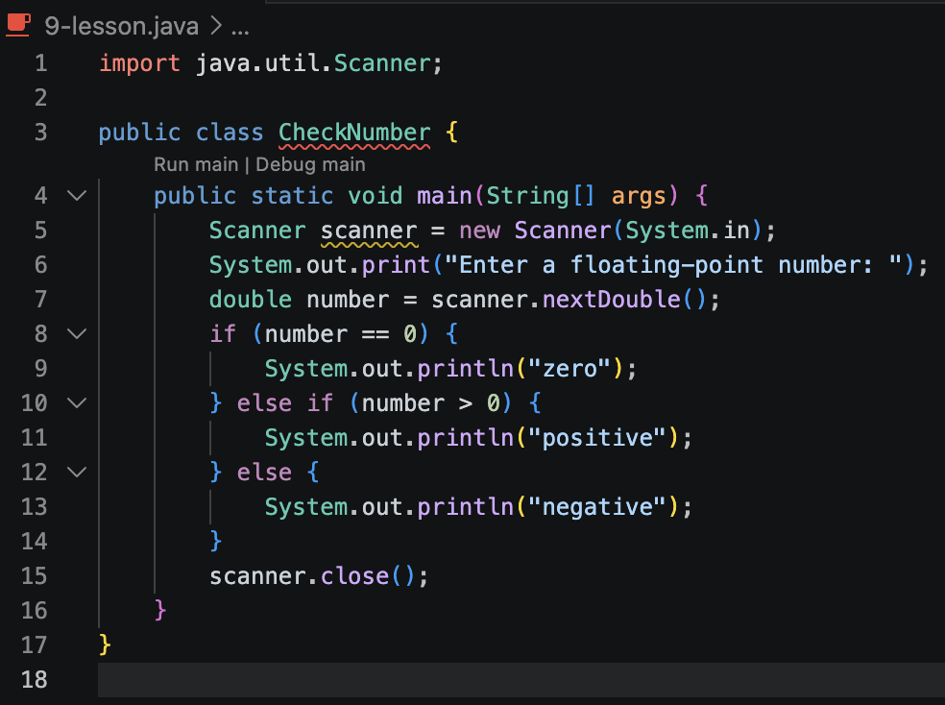
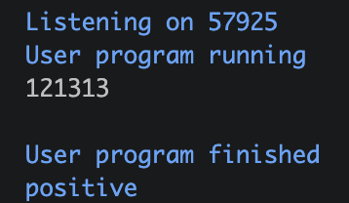
Task 2.
Output:

Slide 4
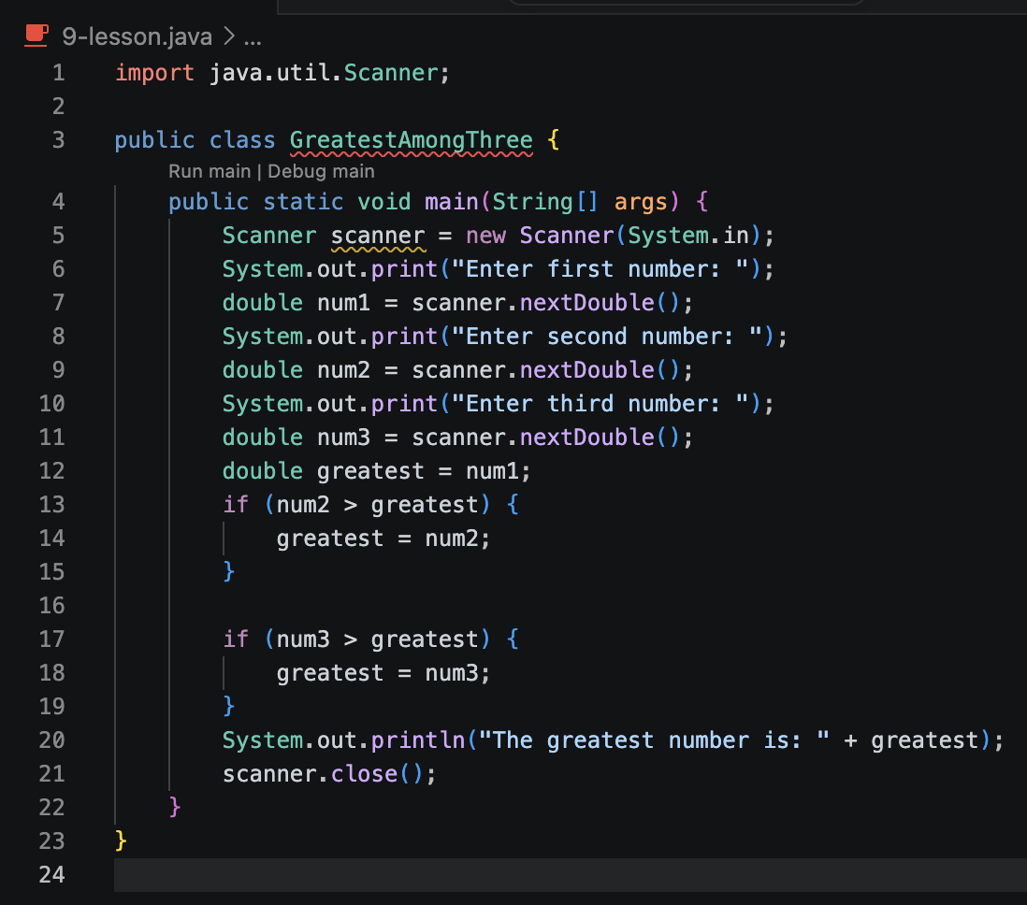
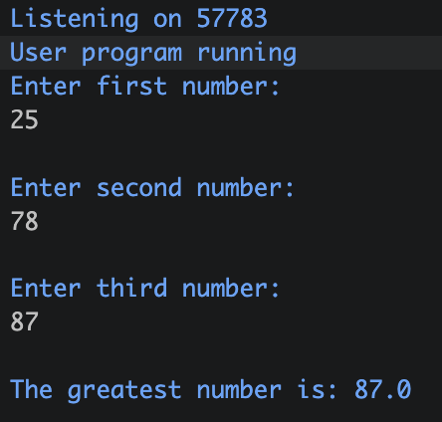
Task 3.
Output:

Slide 5
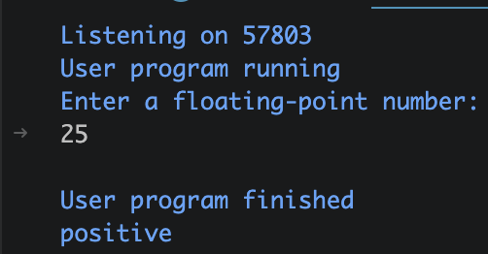
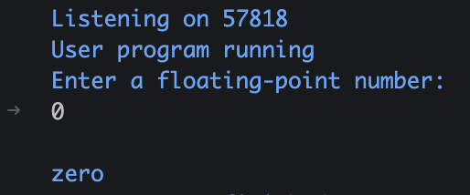
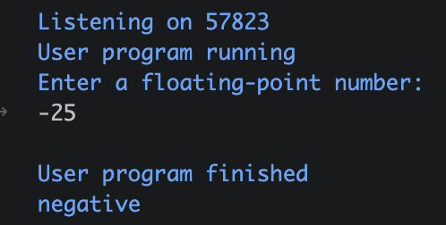
Task 4.
Output:

