Slide 1



Assignment-2
Software Engineering
Student: Shukirillaev Mukhammad Sodik Sherzodbek Ugli
Department:Computer Engineering

Slide 2
Question 1:

Slide 3
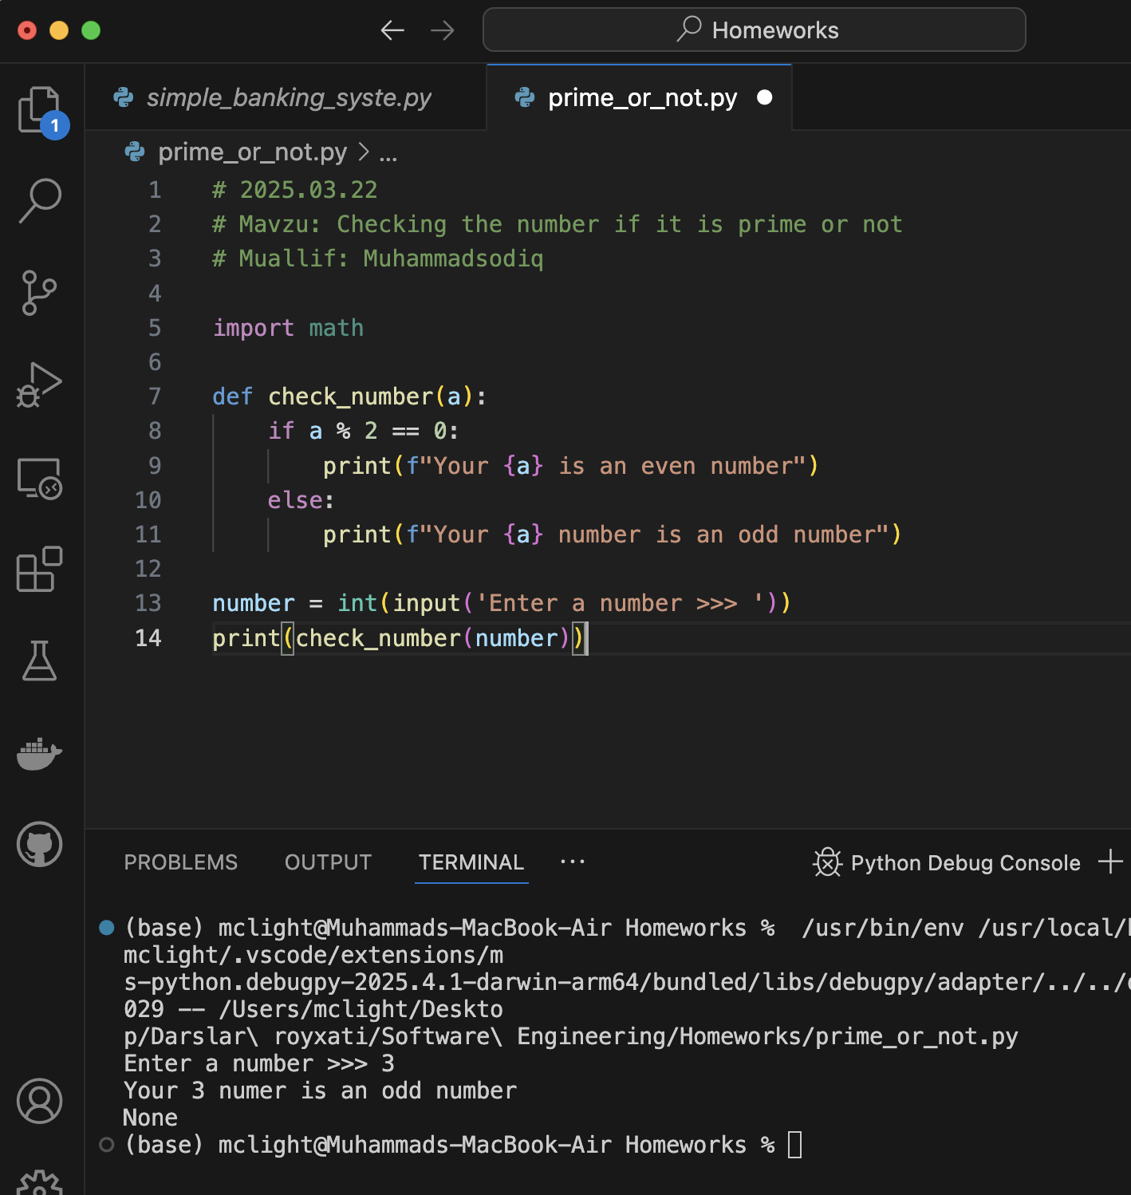
Code:

