Slide 1

Software engineering
Student Gradding System using the Waterfall Model
Shukirillaev Mukhammadsodik Sherzodbek ugli

Slide 2
What is Waterfall Model?
The Waterfall Model is a linear, step-by-step approach to software development.
Each phase is completed before moving to the next.
It is best suited for projects with clear, fixed requirements.
In this project, I used the Waterfall Model to develop a Student Grading System.

Slide 3
Requirement Analysis
The program should:
Store 5 students and their exam scores.
Calculate each student’s average score.
Assign a letter grade (A-F) based on the average.
Display the results in a structured format.
• Input: Predefined student names and scores
• Output: Name, average score, and grade

Slide 4
System Design
The program follows 3 main functions:
calculate_average(scores): Computes the average score.
assign_grade(average): Assigns a grade (A-F).
display_results(): Prints the student report.
• The data is stored in a list of dictionaries (predefined student info).

Slide 5
Implementation
The program is written in Python and follows these steps:
1️. The list of 5 students and their scores is stored.
2️. The program calculates the average score for each student.
3️. A grade (A-F) is assigned based on the average.
4️. The results are displayed in the console.

Slide 6
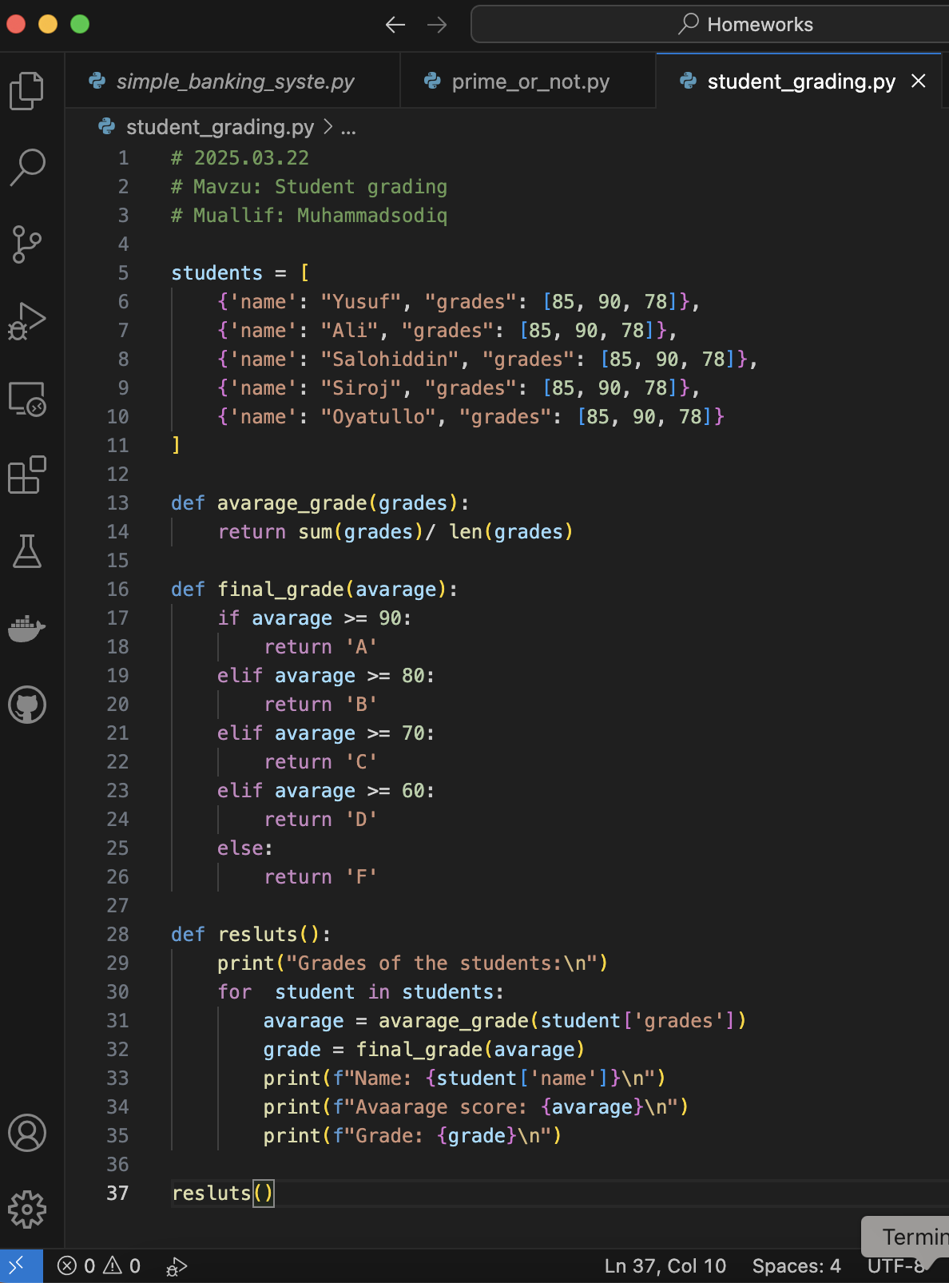
CODE: INPUT

Slide 7
Testing
Test cases were performed with different data:
Yusuf (85, 90, 78) → Avg: 84.33 → Grade: B
Salohiddin (95, 92, 88) → Avg: 91.67 → Grade: A
Oyatullo (50, 55, 45) → Avg: 50.00 → Grade: F
• Results matched expectations. The program correctly calculates and assigns grades.

Slide 8
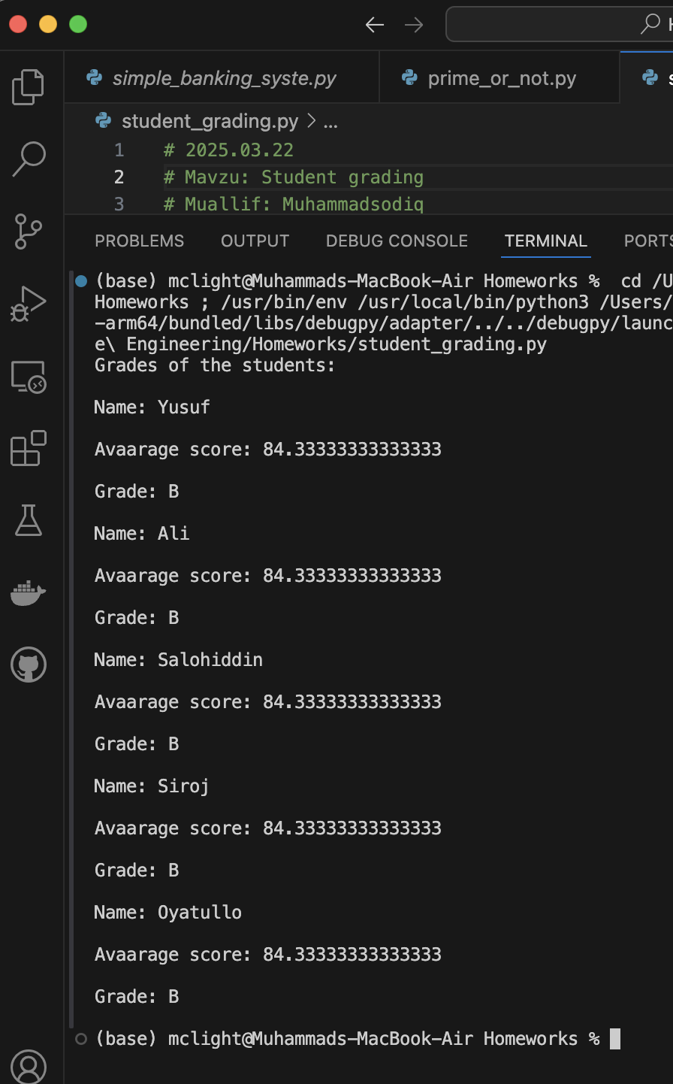
CODE: OUTPUT

Slide 9
Deployment & Maintenance
The program is ready to use and can be improved by:
1. Allowing user input instead of predefined students.
2. Adding more subjects or tests.
3. Creating a GUI version using Tkinter.
4. Exporting results to a file or database.

Slide 10
Conclusion
• The Waterfall Model helped break the project into clear, structured phases.
• It ensured that each step was completed before moving forward.
• The program works as expected and can be expanded in the future.
• This project provided hands-on experience in software development planning.

Slide 11
THANK YOU!

