Slide 1



Assignment-4
Web Programming
Student: Shukirillaev Mukhammad Sodik Sherzodbek Ugli
Department:Computer Engineering

Slide 2
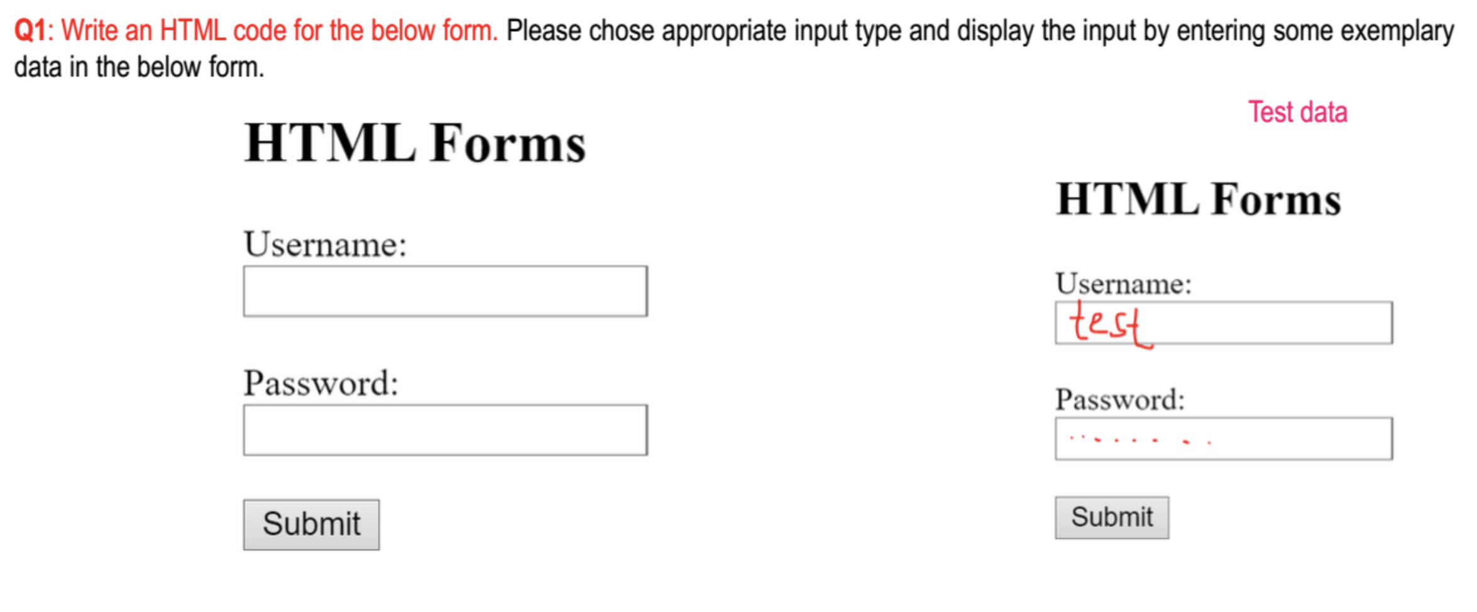
Question 1:

Slide 3
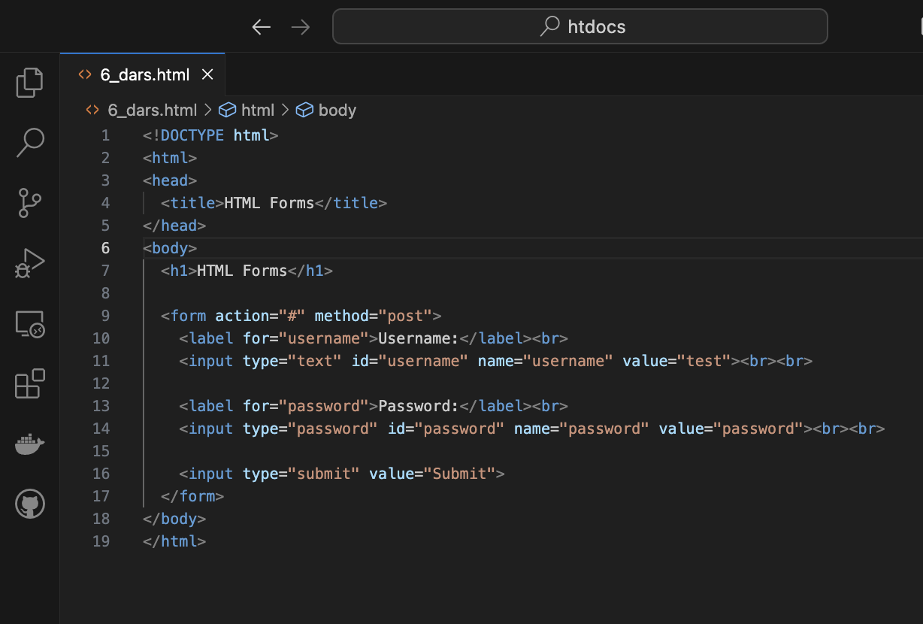
Code:

Slide 4
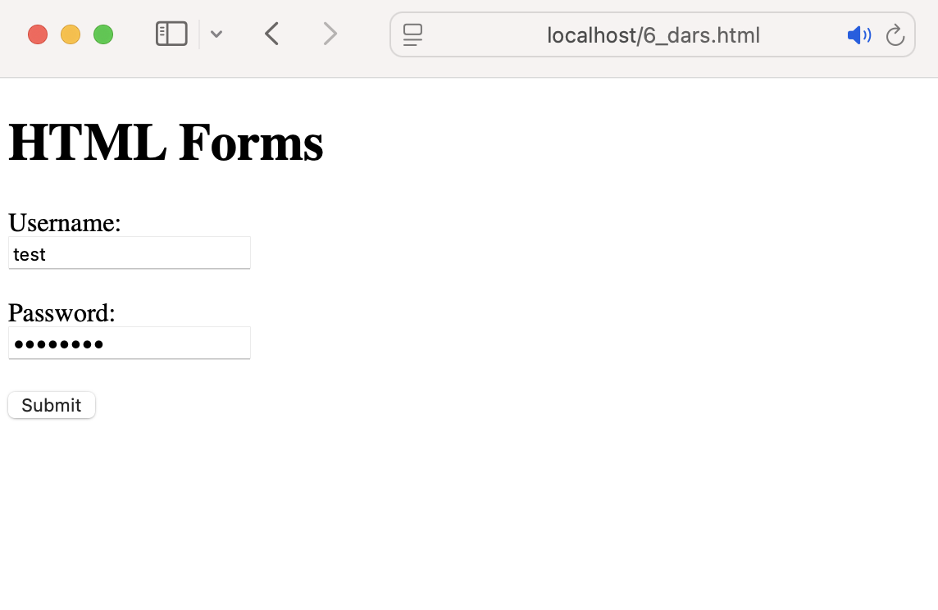
Result

Slide 5
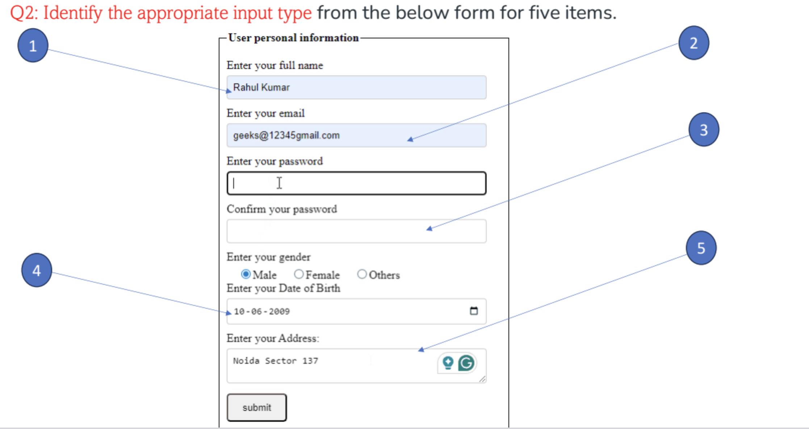
Question 2:

Slide 6
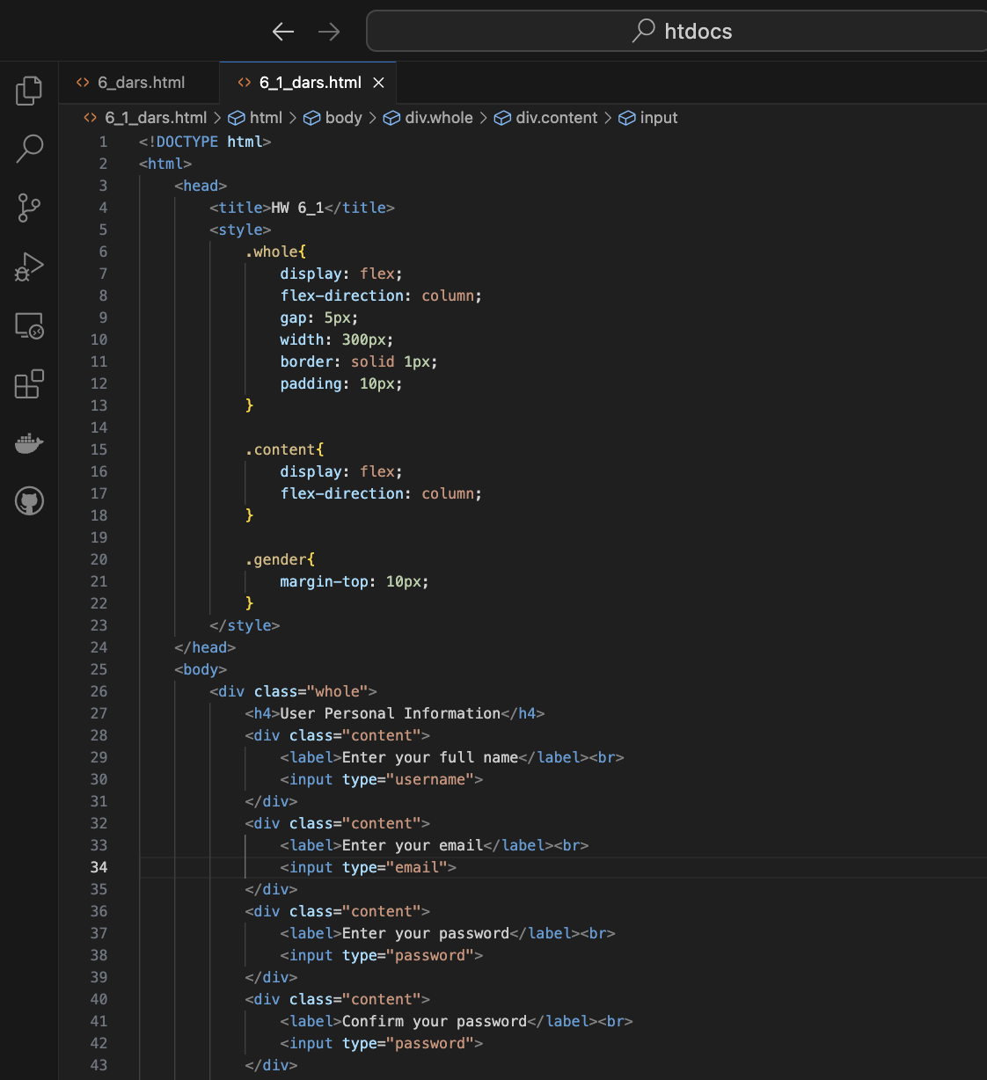
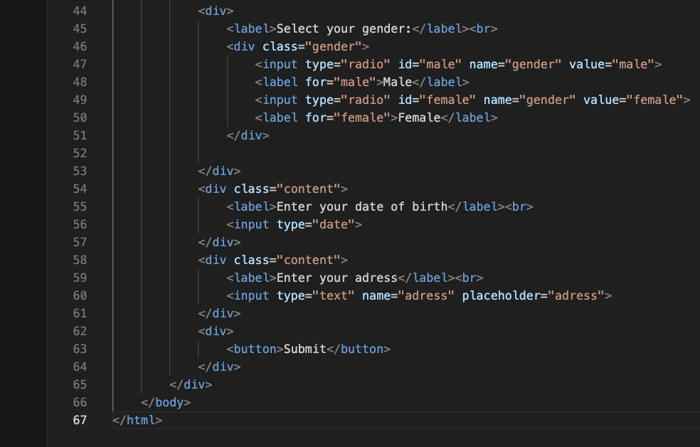
Code:

Slide 7
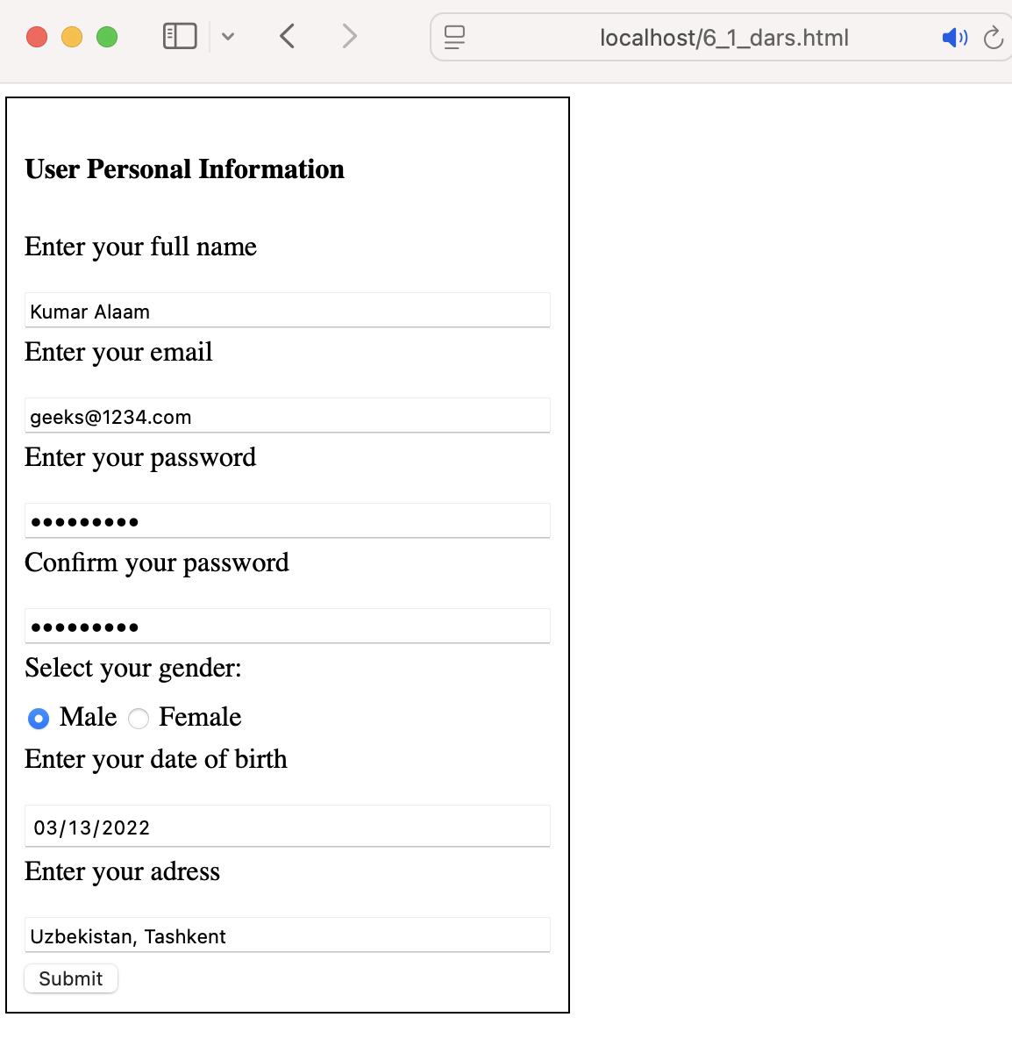
Result
1. Full Name -> input type “text”
2. Email -> input type “email”
3. Password -> input type “password”
4. Date of Birth ->
input type “date”
5. Adress -> input type “text”

Slide 8
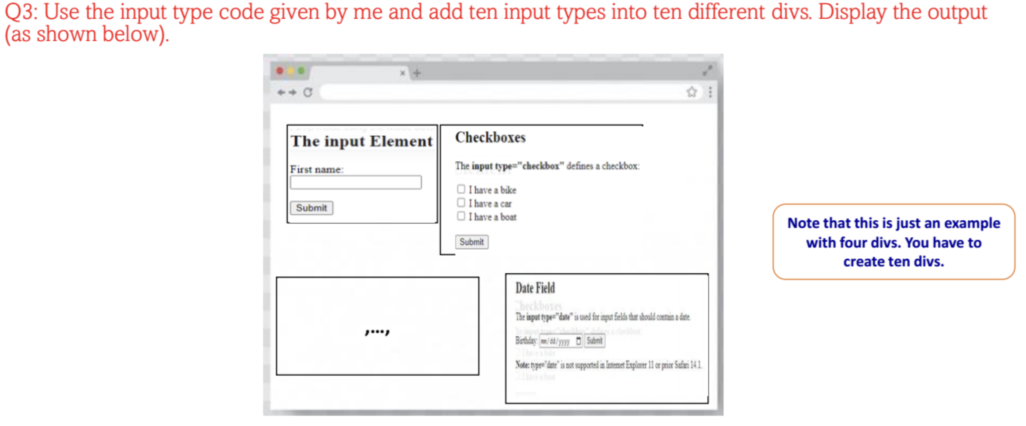
Question 3:

Slide 9
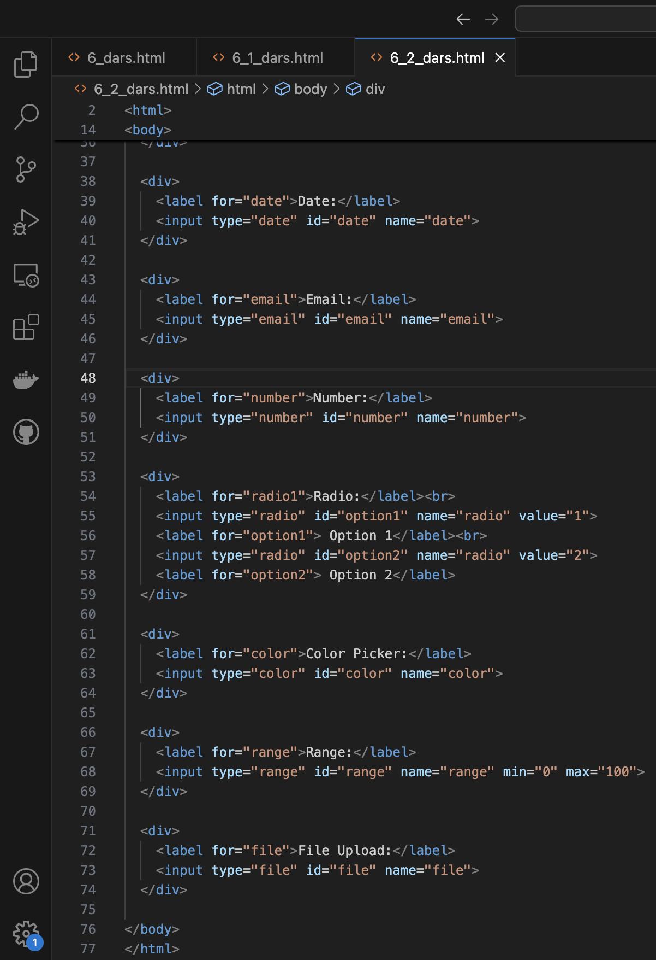
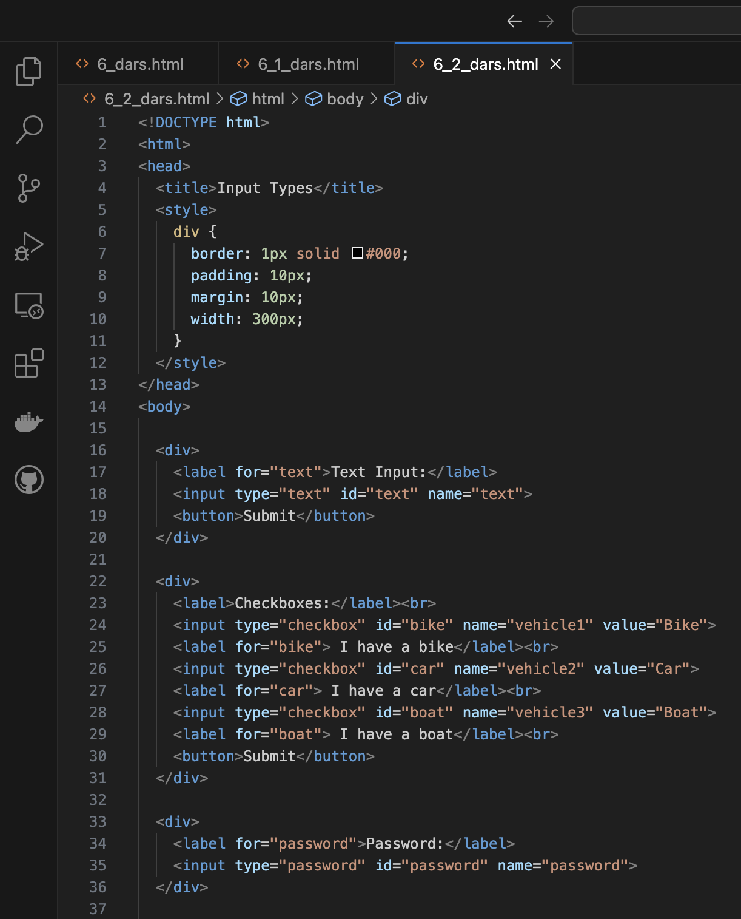
Code:

Slide 10
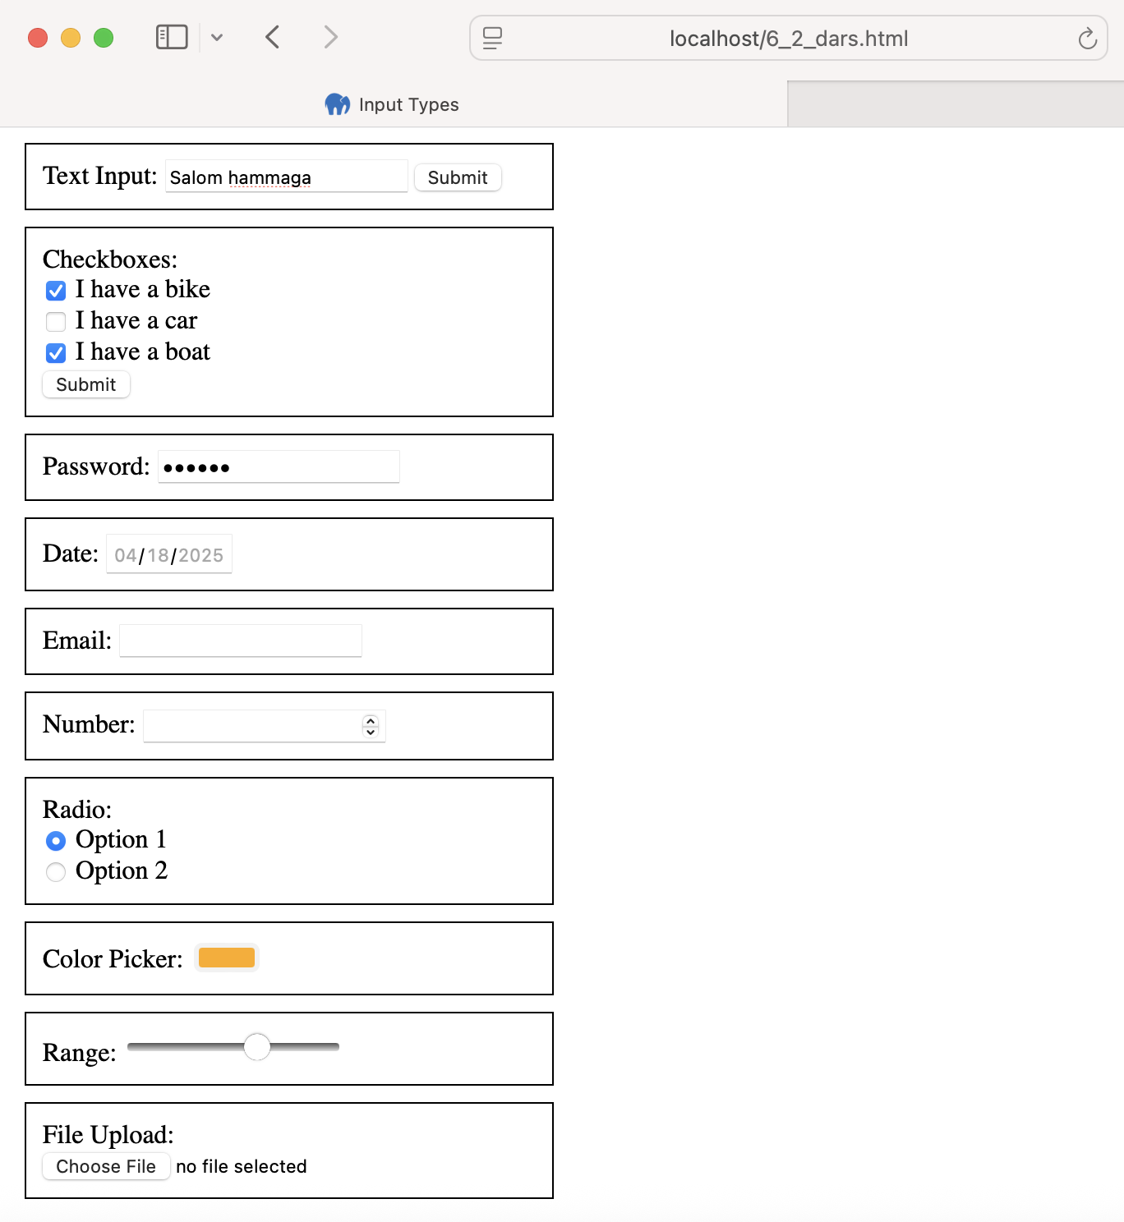
Result
d

Slide 11
Question 4:

Slide 12
Answer:
Forms are used in web development to let users enter and send information—like signing up, logging in, or posting a comment. They connect the user to the server, allowing real interaction with a website.

