Slide 1



Assignment-6
Web Programming
Student: Shukirillaev Mukhammad Sodik Sherzodbek Ugli
Department:Computer Engineering

Slide 2
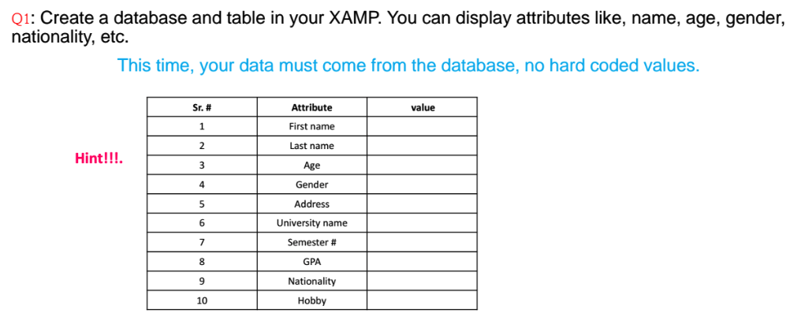
Question 1:

Slide 3
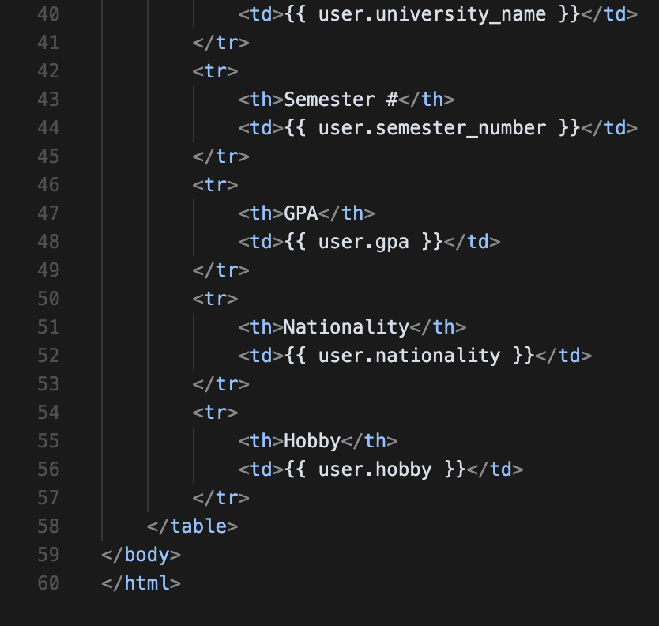
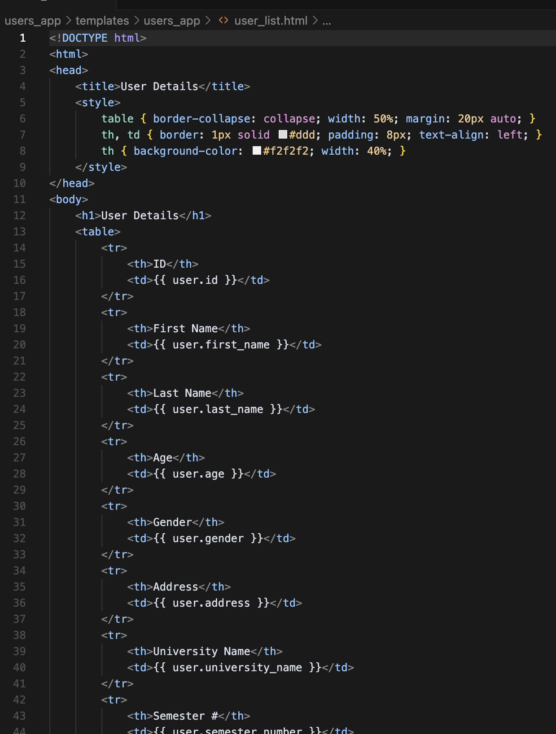
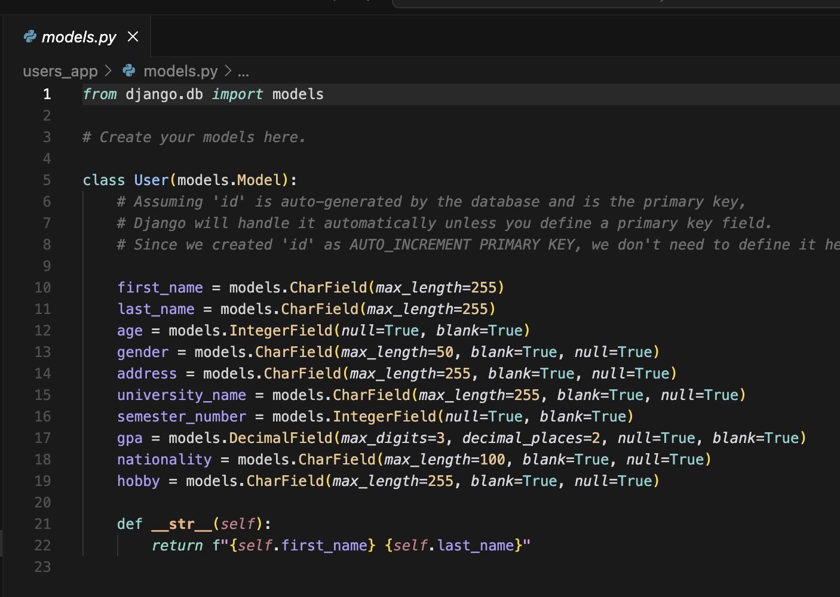
Code:
https://github.com/McLight-Note/Web-Programming-UNI/tree/main/Assignments/9-dars
Here is the Github for all the codes, need to take a lot of screenshots. Instead i posted a link here!

Slide 4
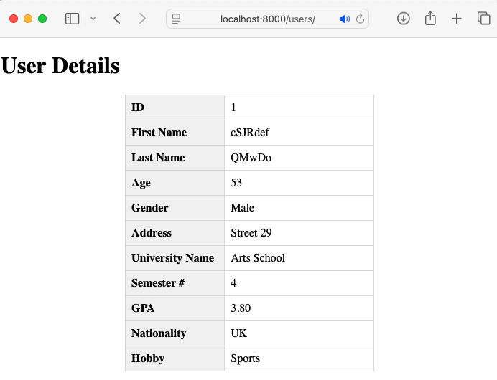
Result

Slide 5
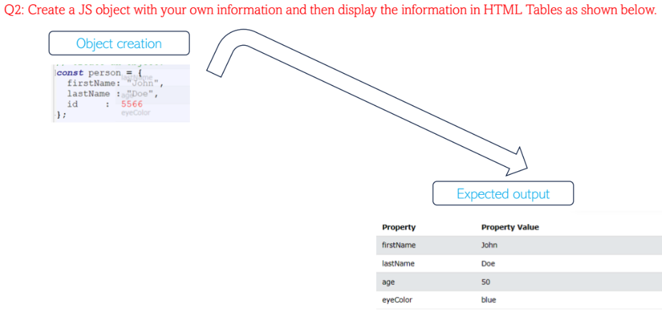
Question 2:

Slide 6
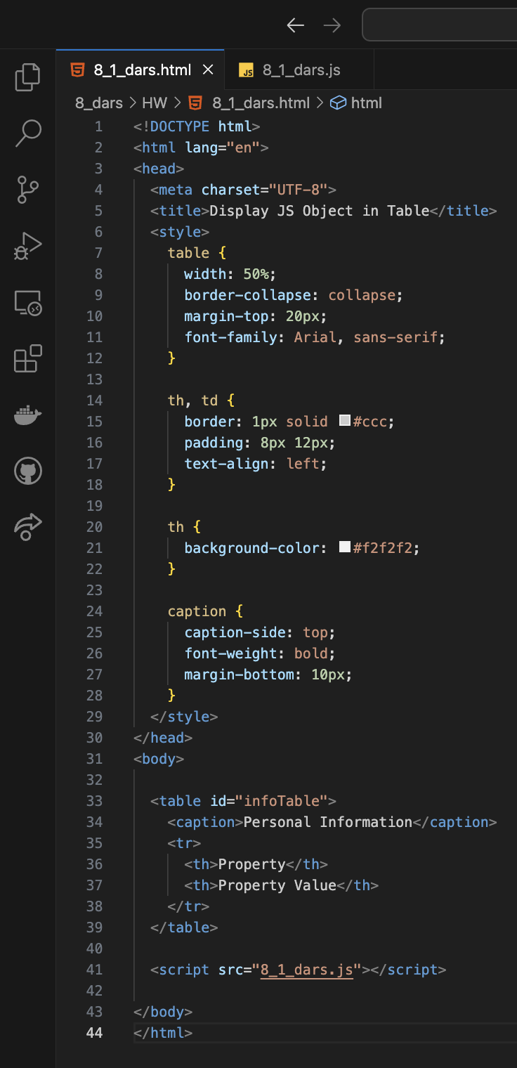
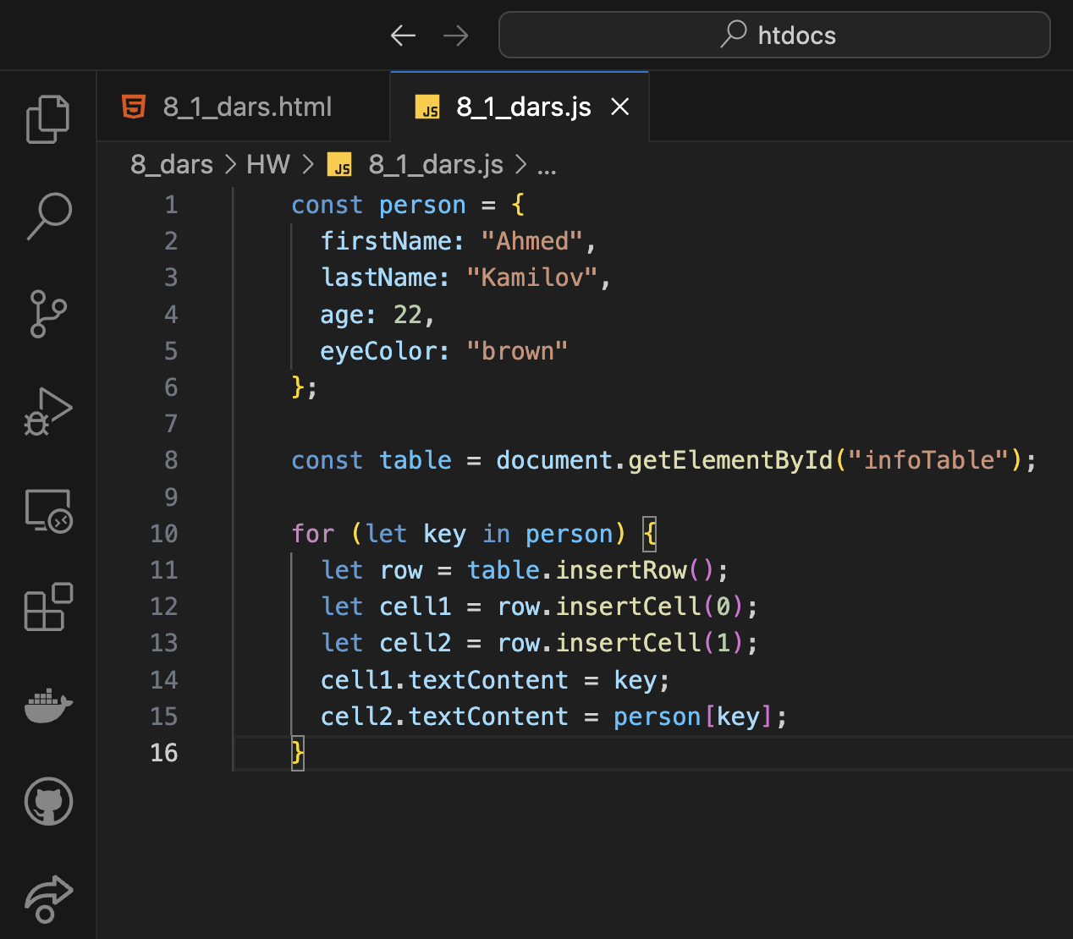
Code:

Slide 7
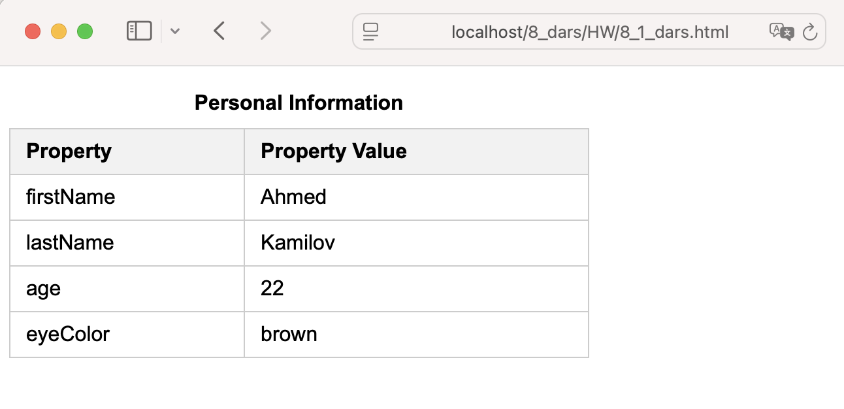
Result

Slide 8
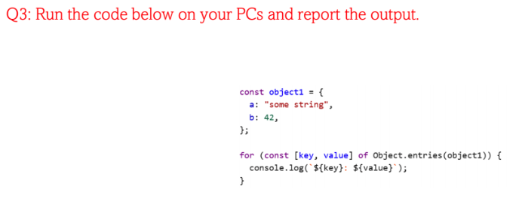
Question 3:

Slide 9
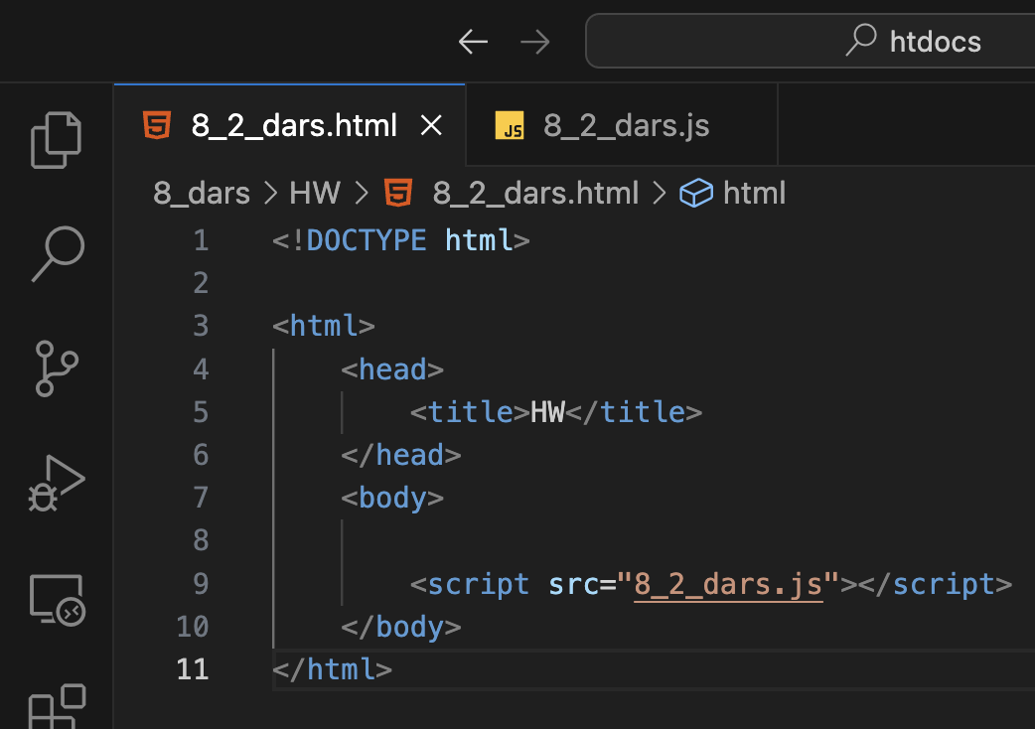
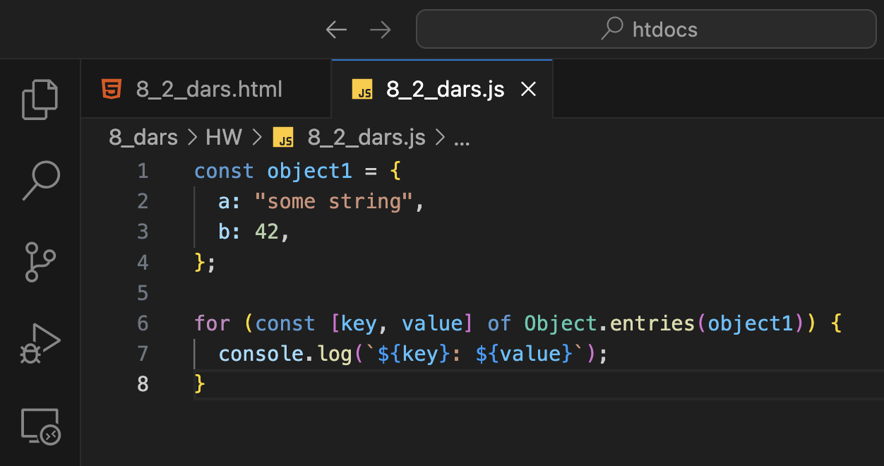
Code:

Slide 10
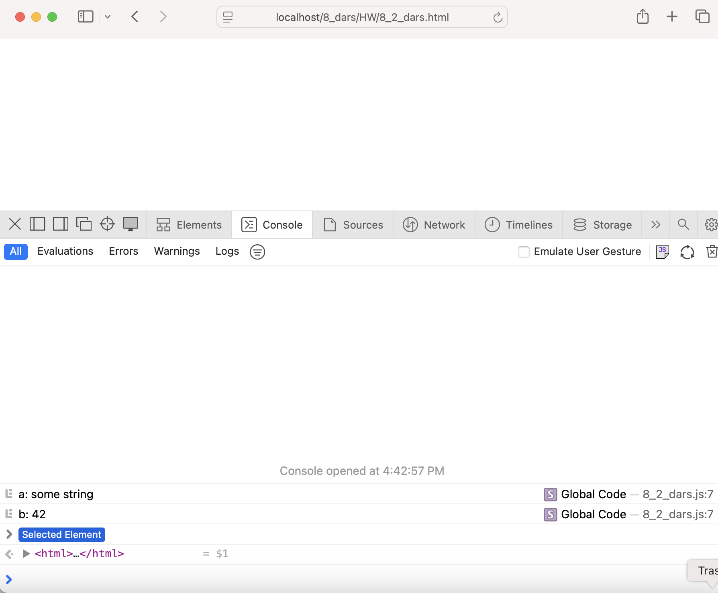
Result
d
The code loops through each key-value pair in the object using Object.entries and prints them to the console in the format key: value.

Slide 11
Question 4:

Slide 12
Answer:
JS functions bring logic and behavior to a website, making it more than just a static page.

Slide 13
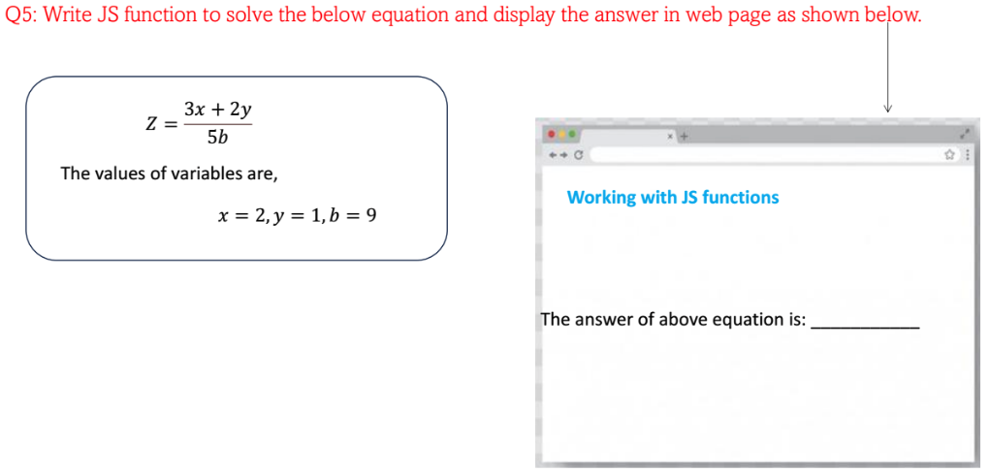
Question 5:

Slide 14
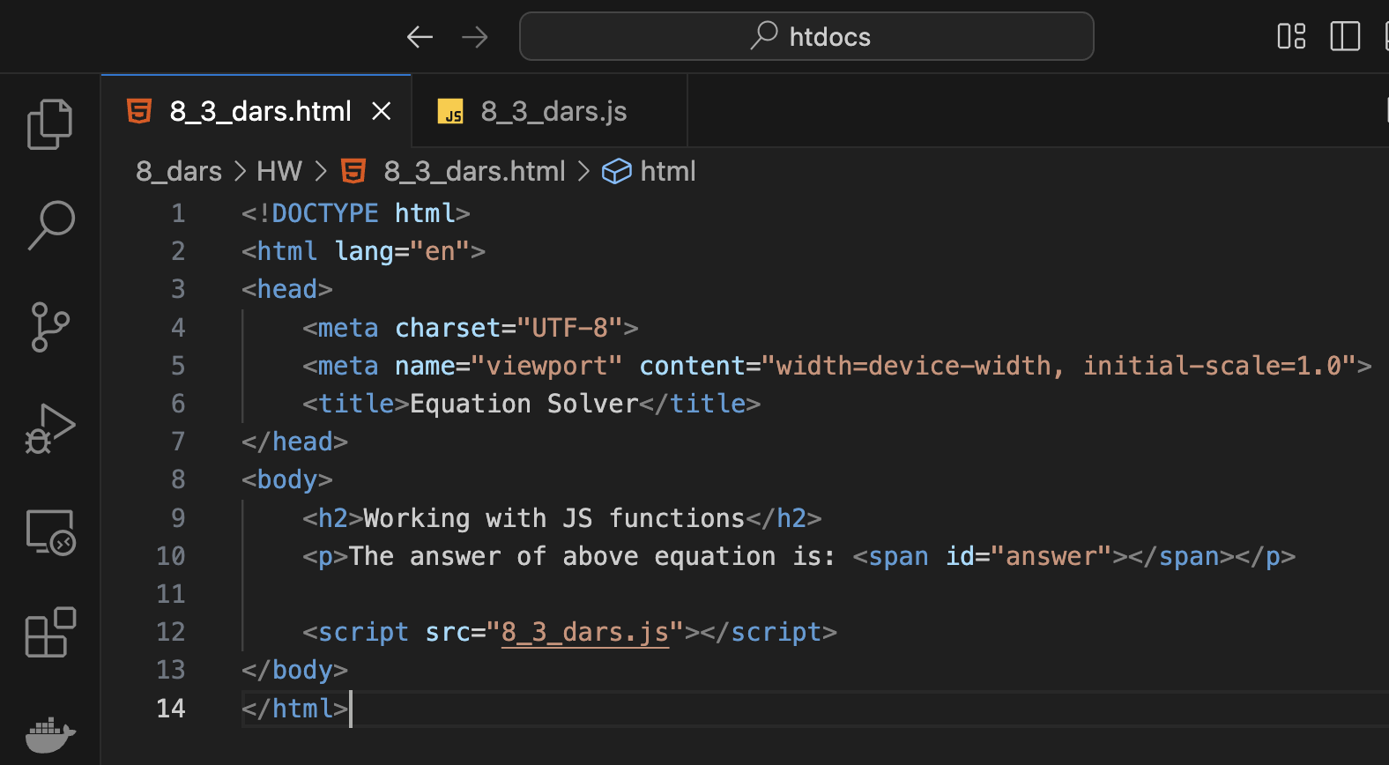
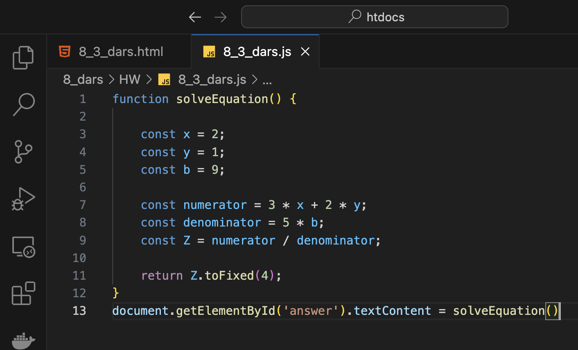
Code:

Slide 15
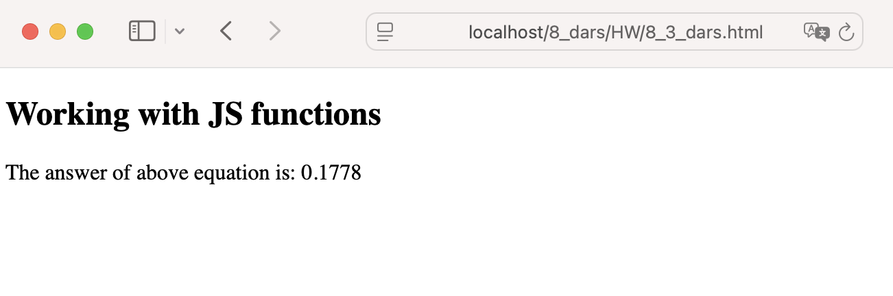
Result
d

