Slide 1



Assignment-2
Web Programming
Student: Shukirillaev Mukhammad Sodik Sherzodbek Ugli
Department:Computer Engineering

Slide 2
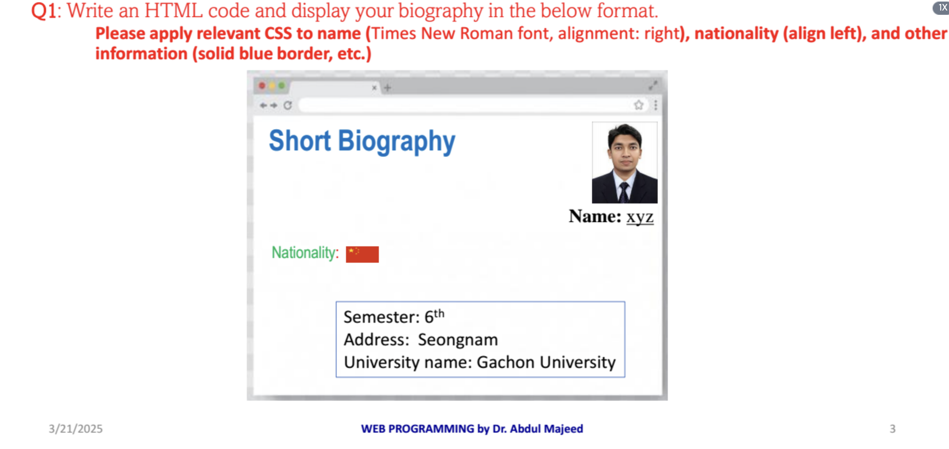
Question 1:

Slide 3
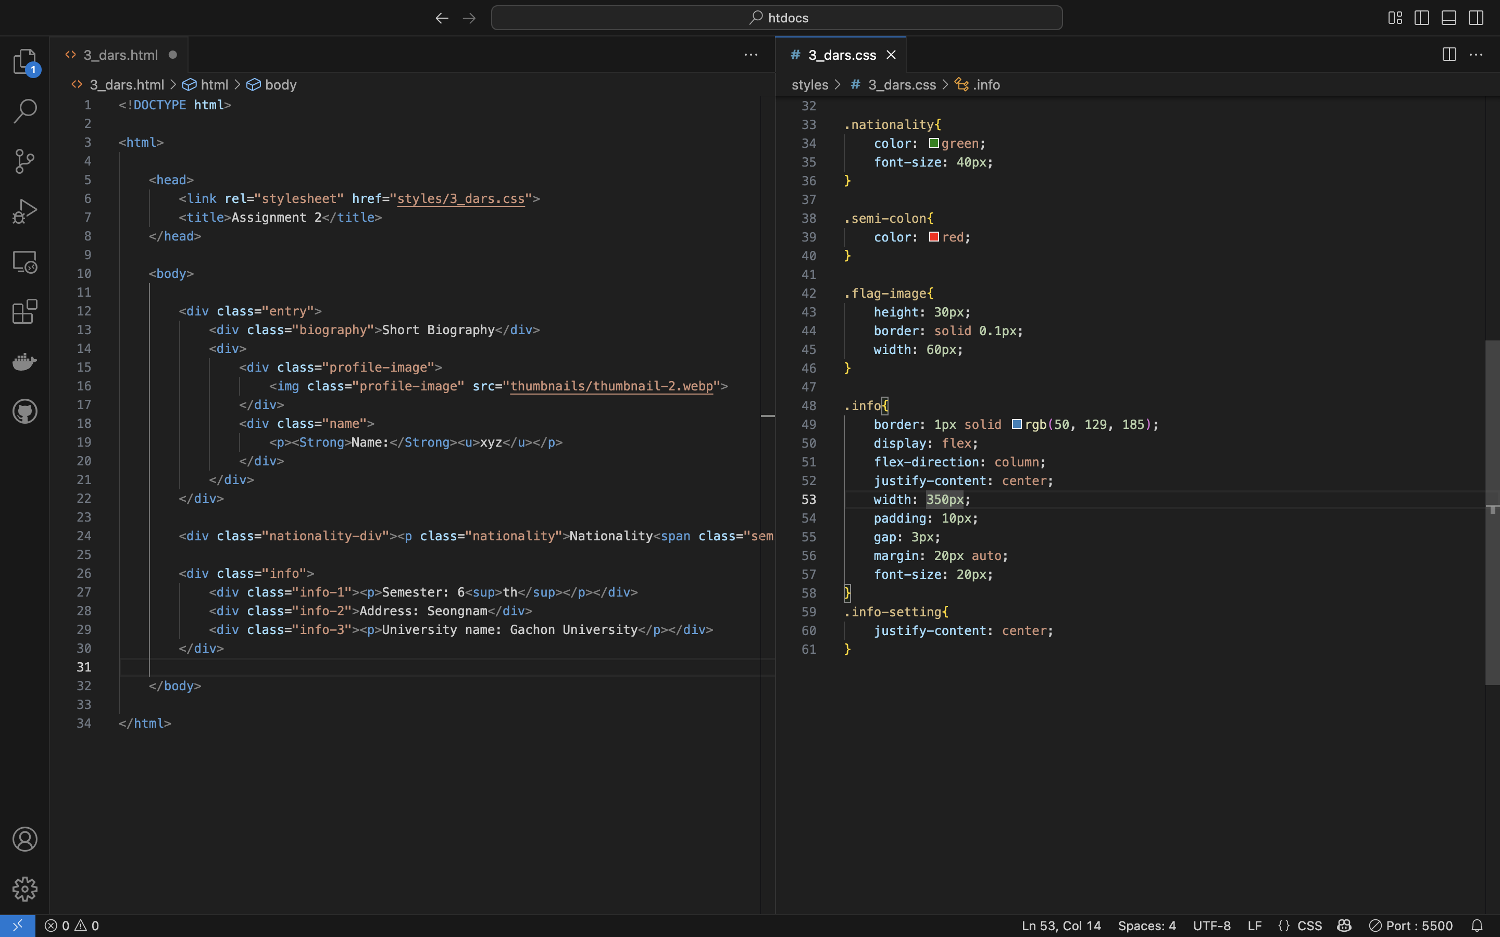
Code:

Slide 4

Result

Slide 5
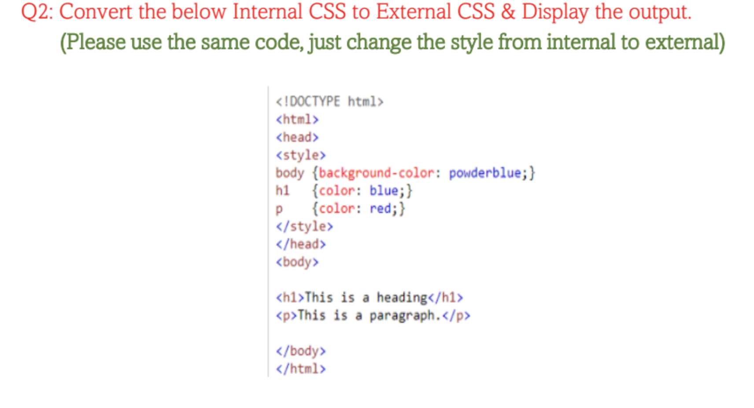
Question 2:

Slide 6
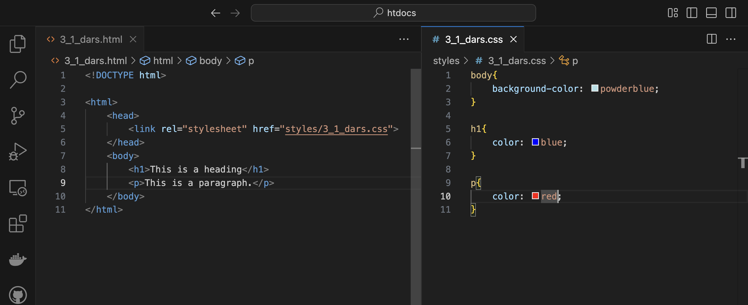
Code:

Slide 7
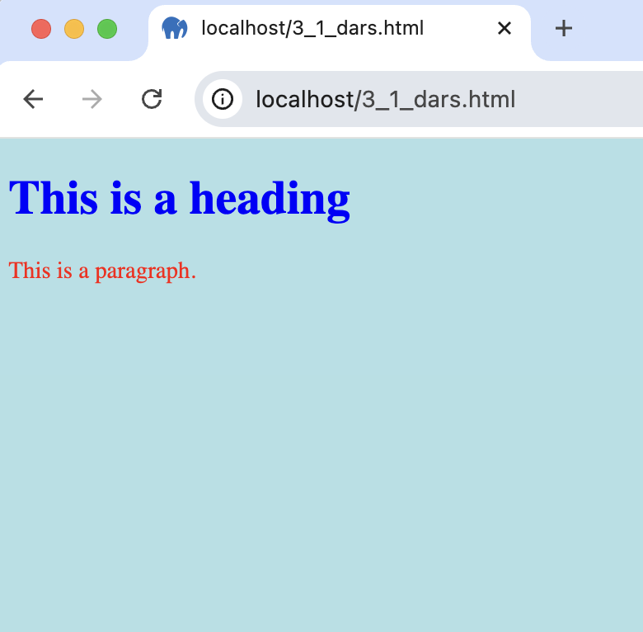
Result

Slide 8
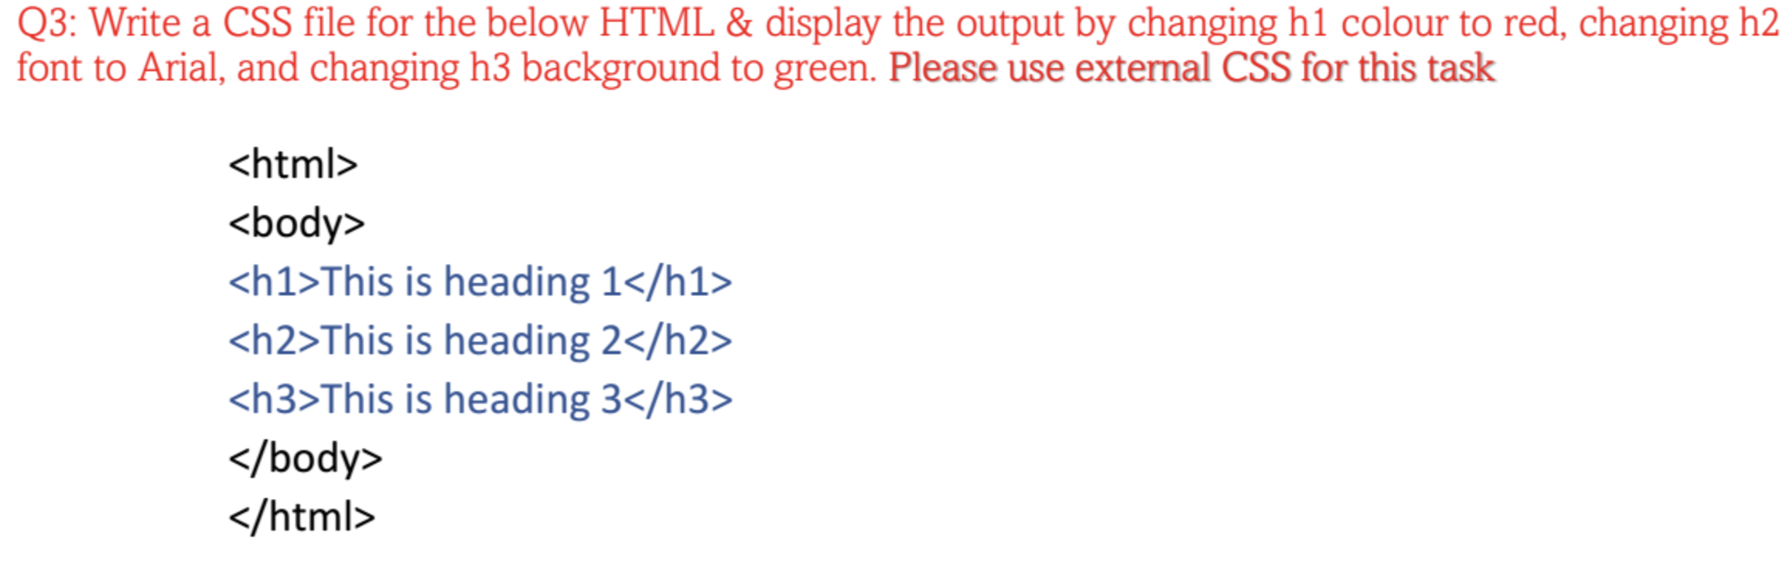
Question 3:

Slide 9
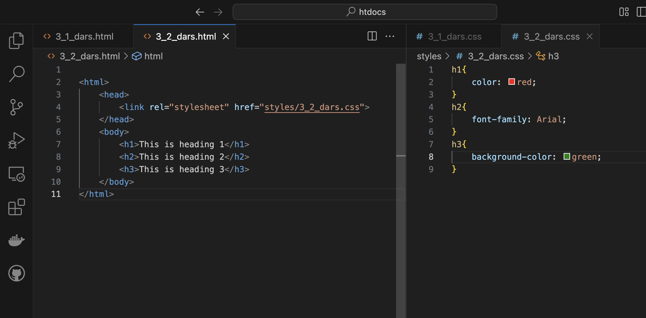
Code:

Slide 10

Result
d

Slide 11
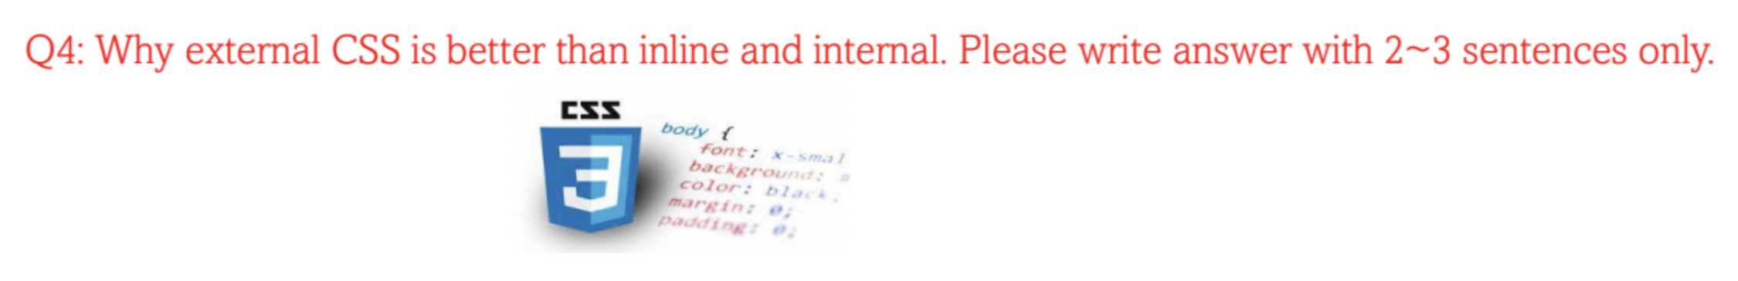
Question 4:

Slide 12
Answer:
External CSS is better because it keeps styles separate from HTML, making the code cleaner and easier to manage. It also improves performance. Inline and internal CSS are fine for quick fixes but become messy and hard to maintain in big projects.

