Slide 1
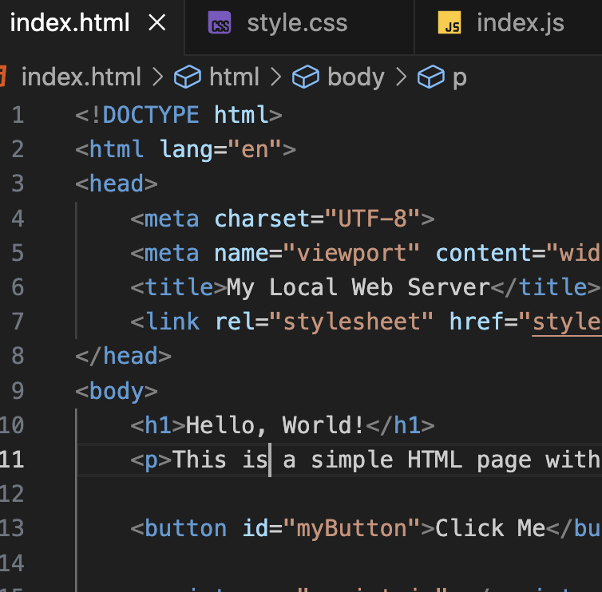
Running local server
Student: Shukirilaev Mukhammad ID: 202438379

Slide 2
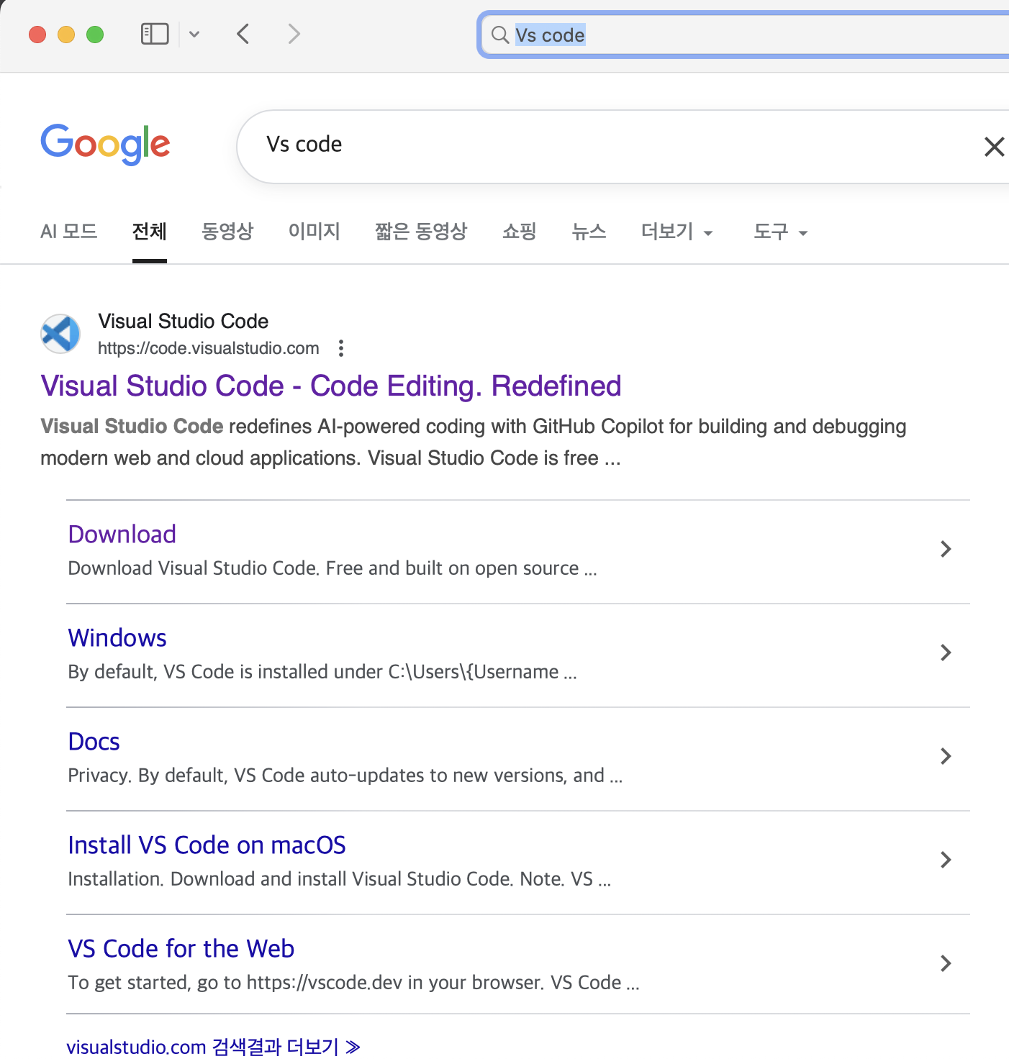
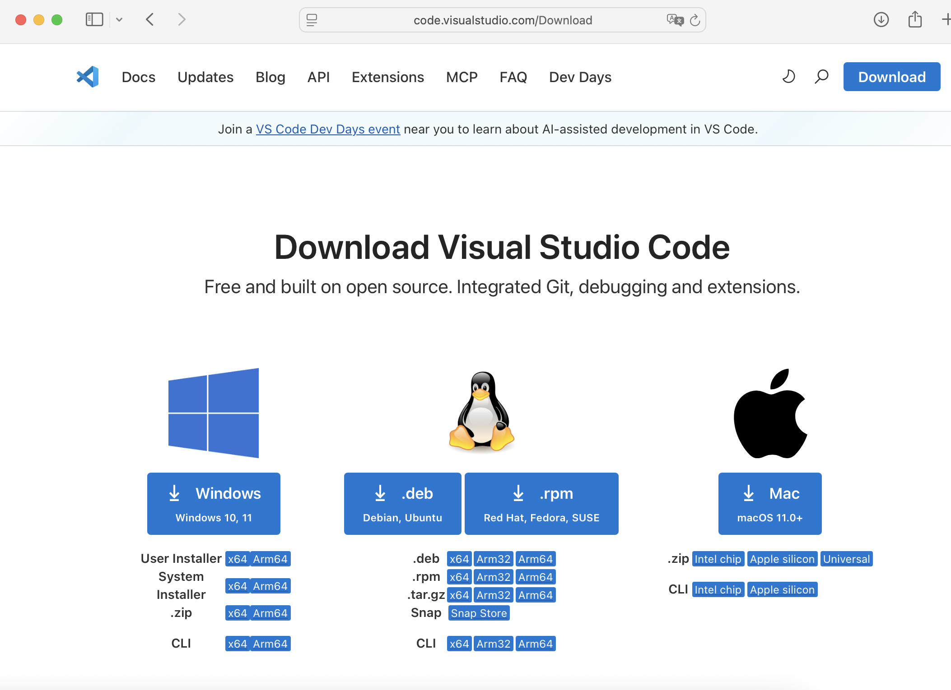


Installing VS Code
Install through these websites
2
of
7

Slide 3
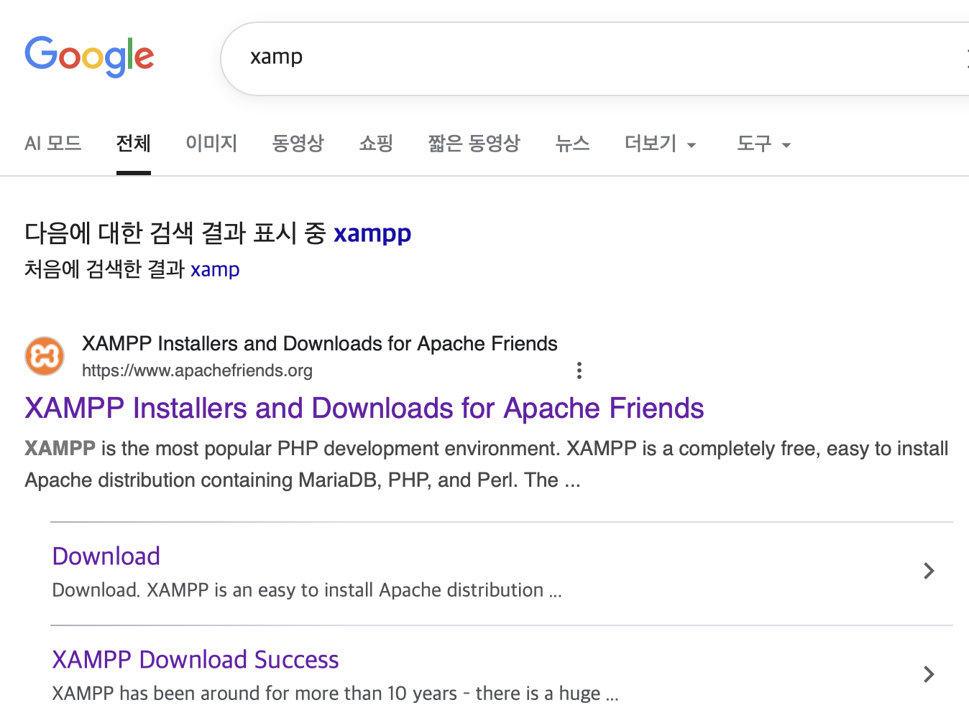
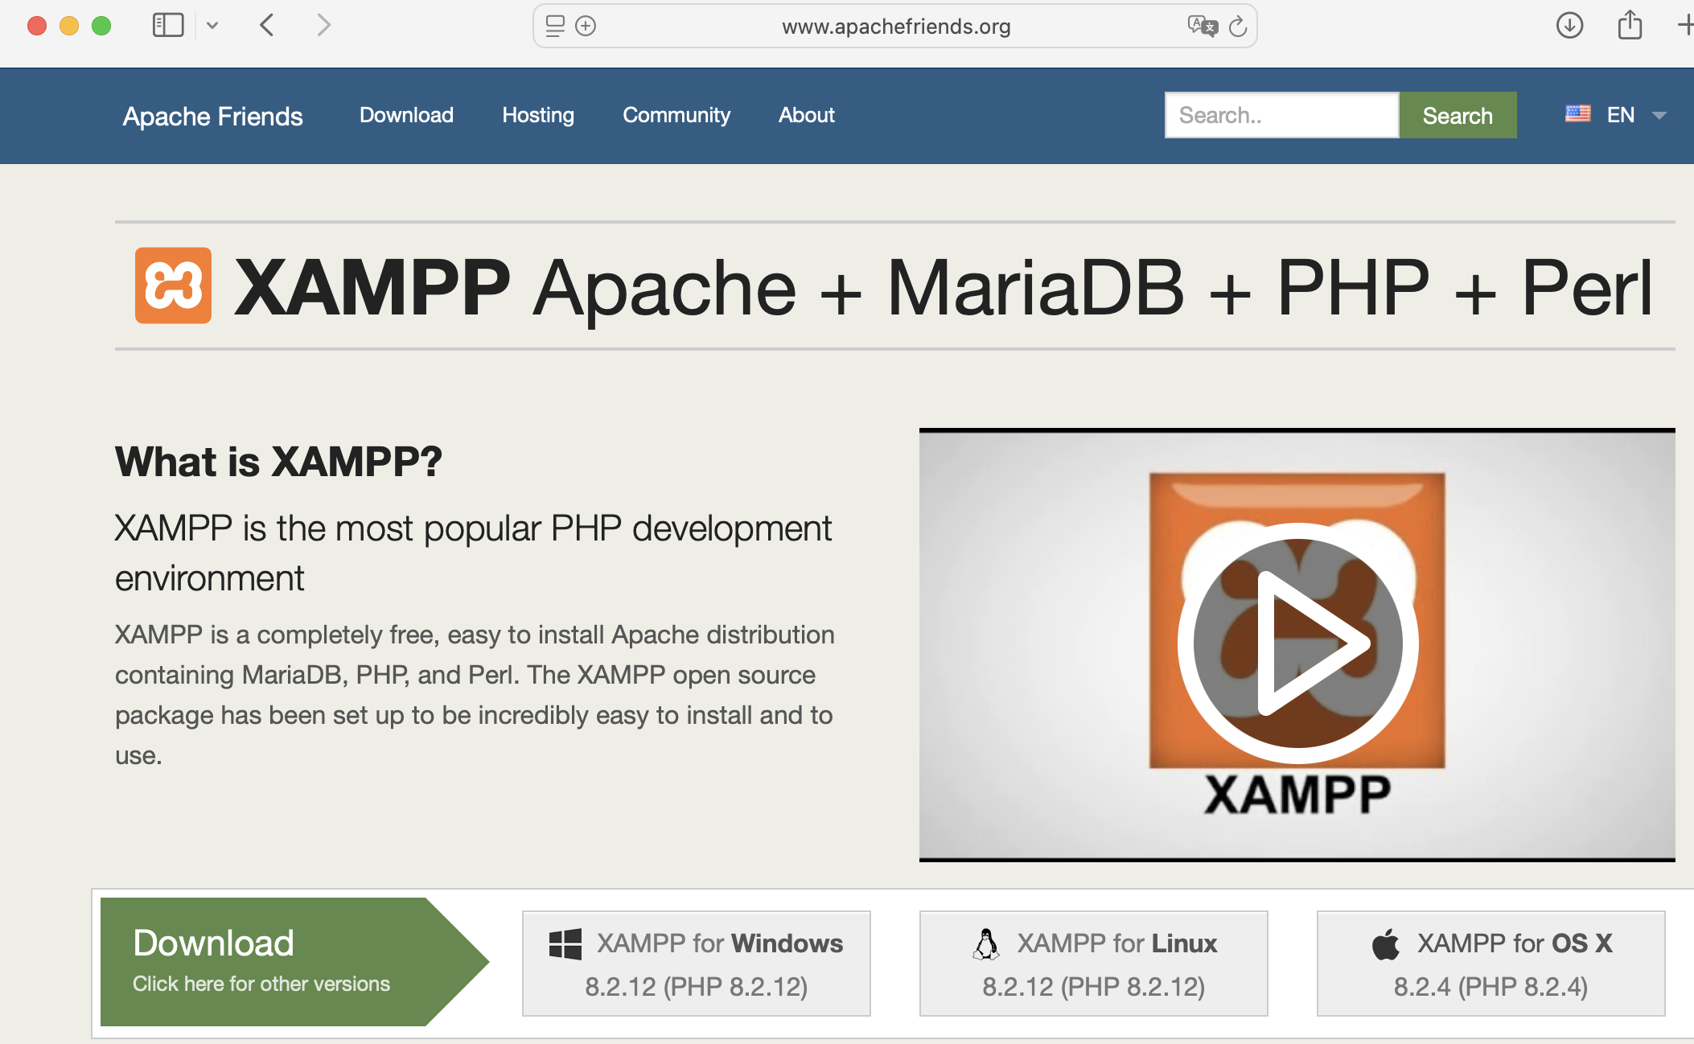
Installing XAMP
3
of
7

Slide 4
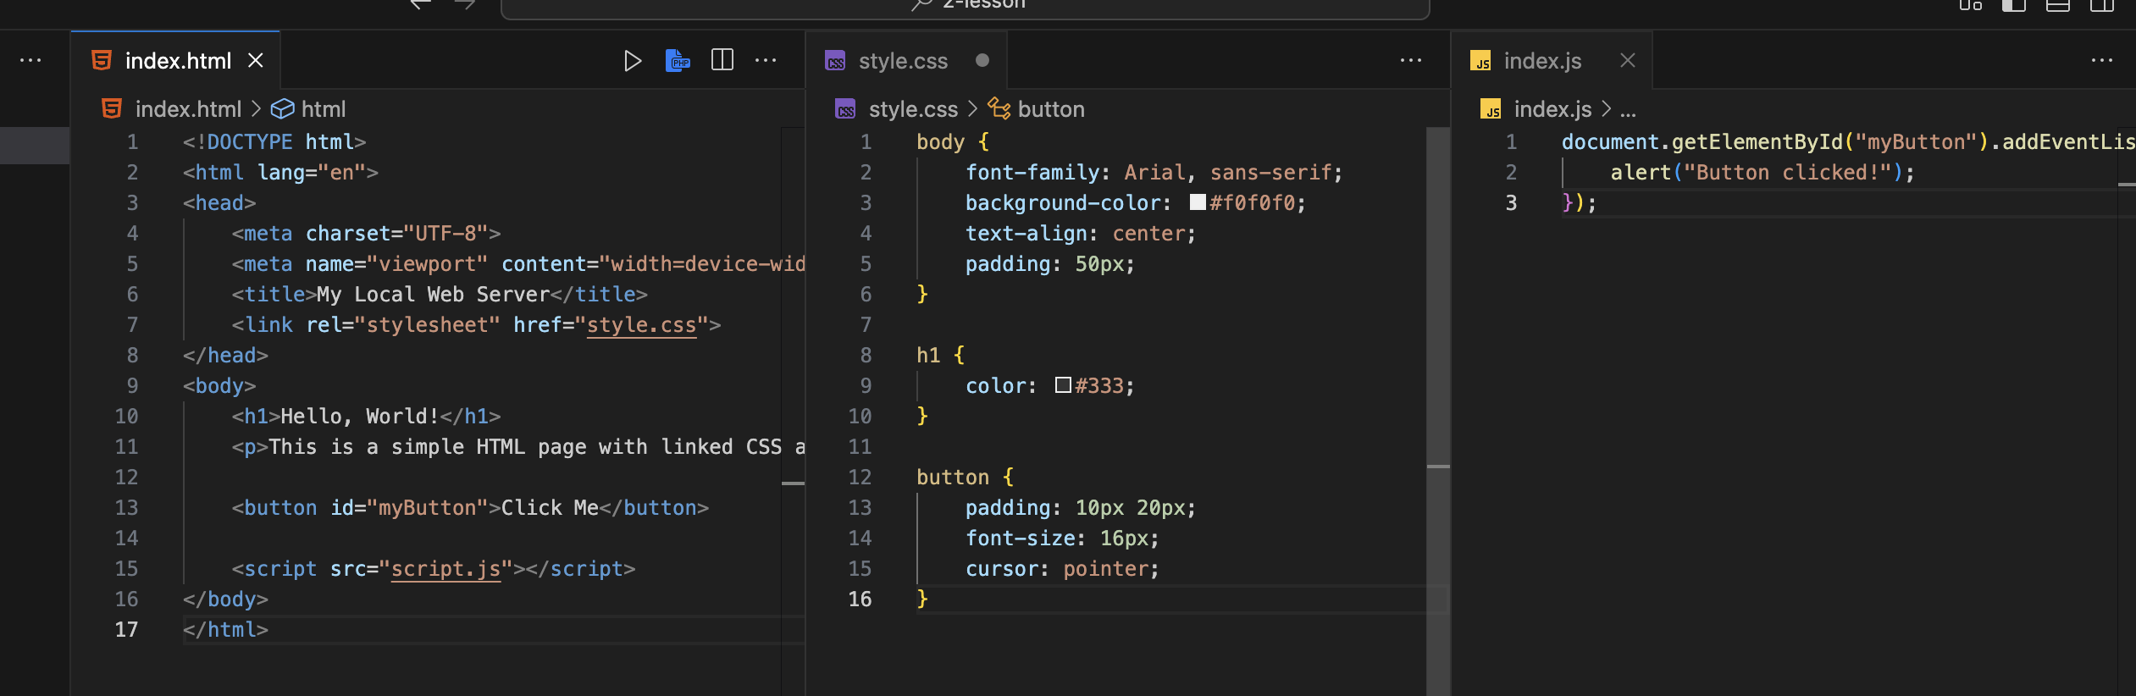
Write some code on VS Code
Here is the simple connected HTML, CSS & JavaScript code
4
of
7

Slide 5
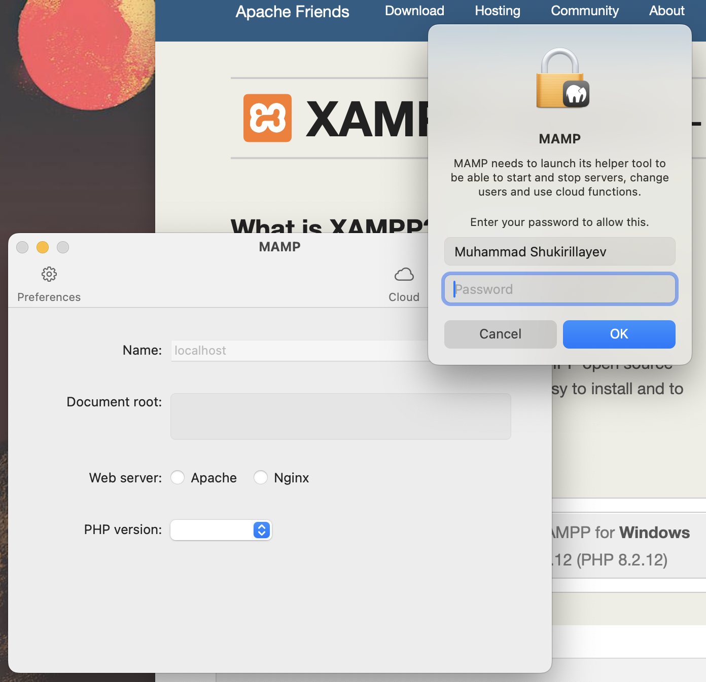
Starting XAMP
It asks for the password due to the security measures;
After typing the password it starts the local server;
5
of
7

Slide 6
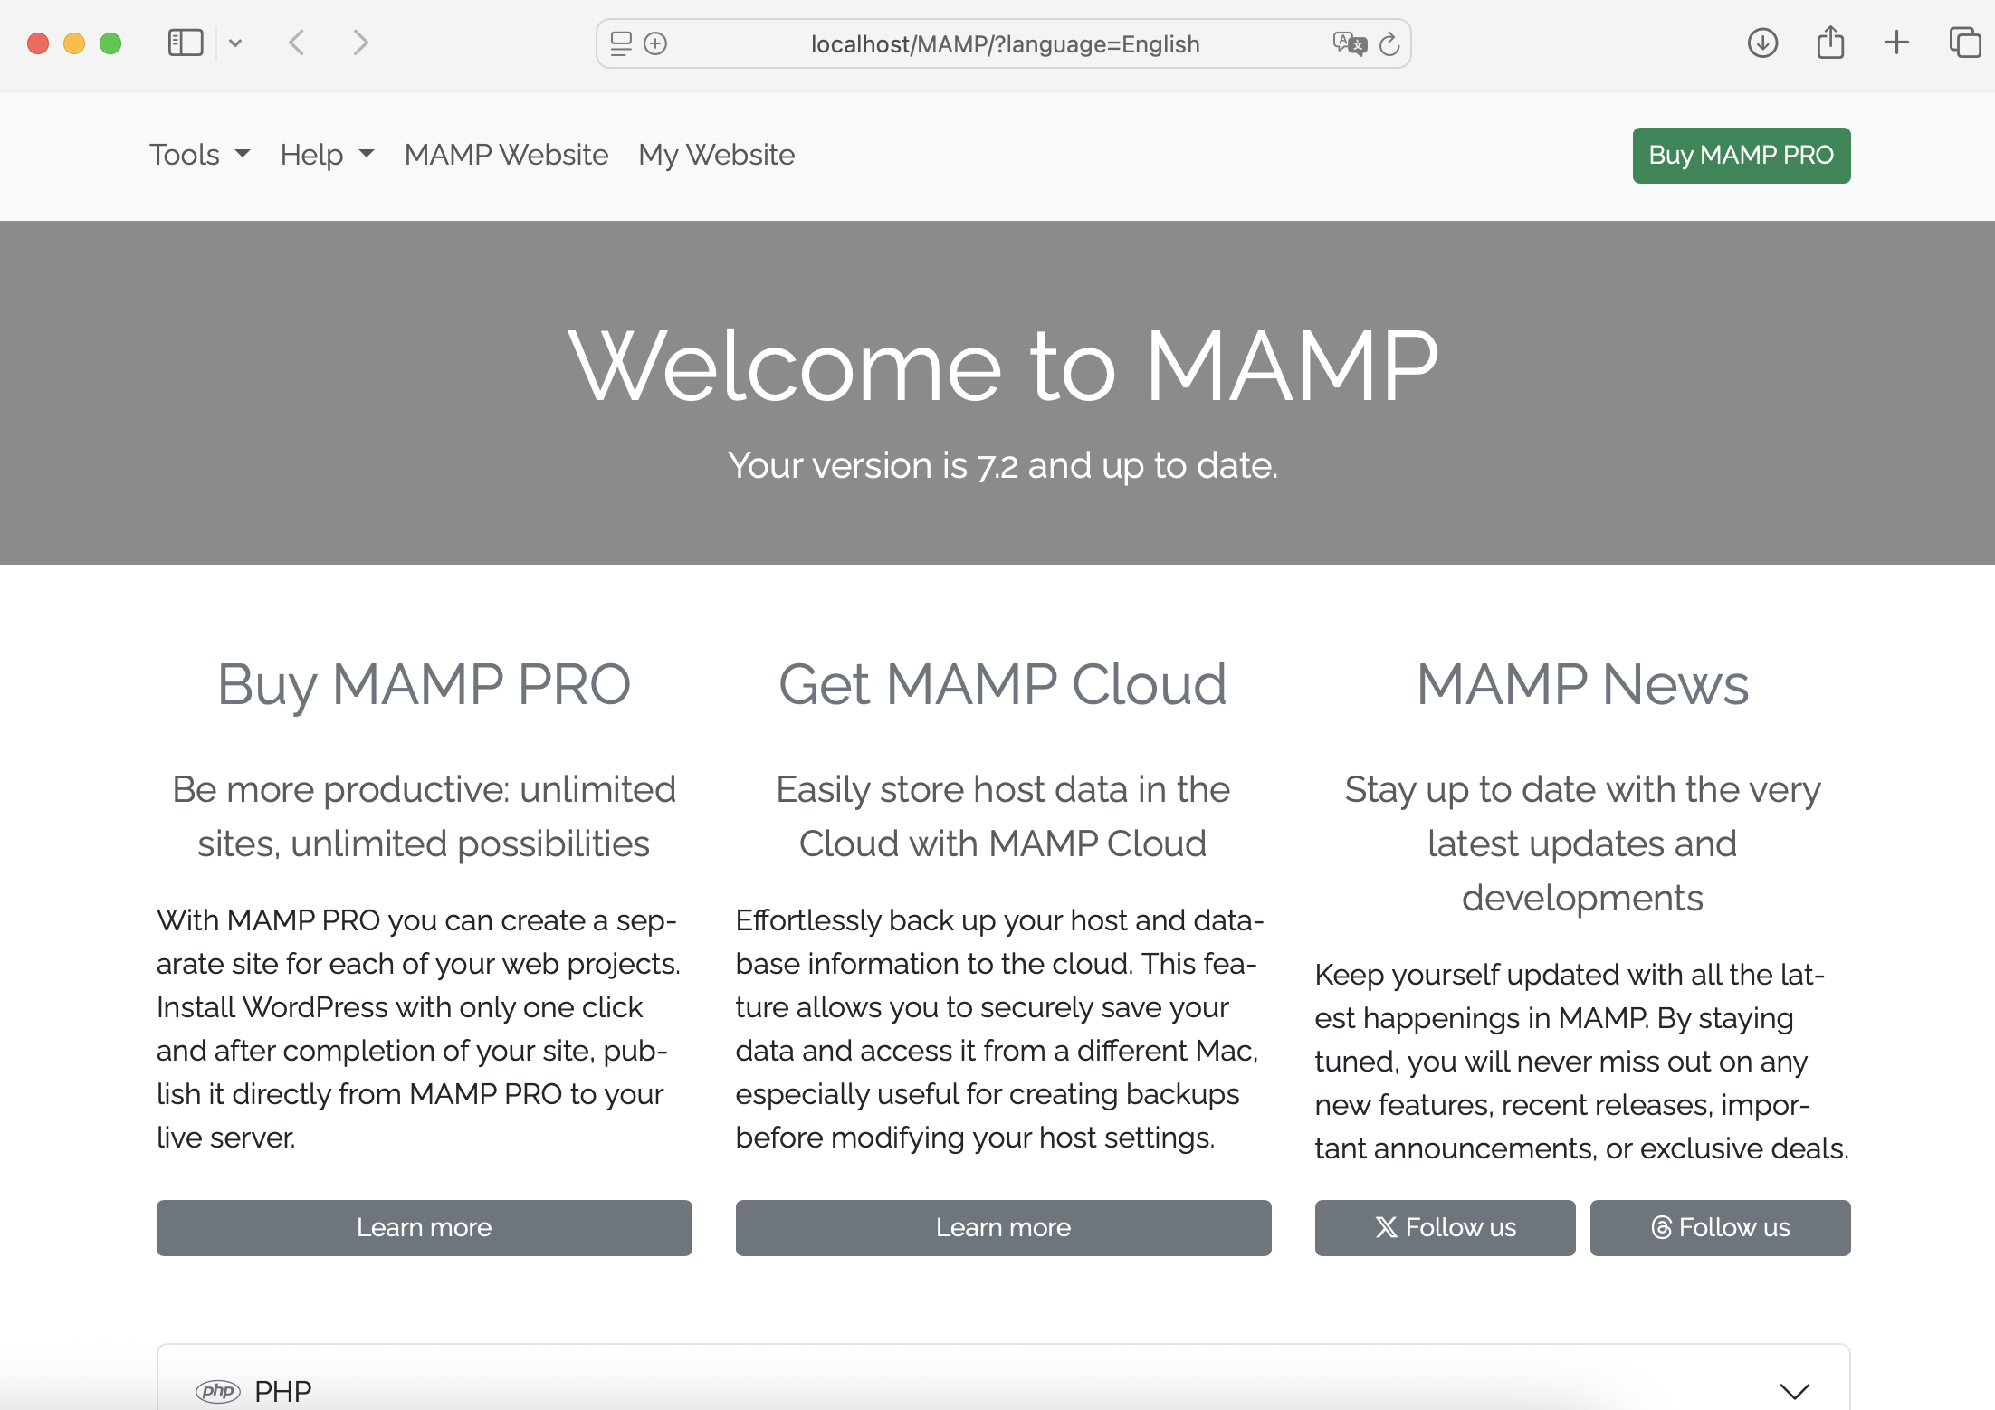
Local server has started
6
of
7

Slide 7
ANY QUESTIONS?
WPS
7
of
7
Company Slogan

Slide 8
THANKS FOR WATCHING

