Slide 1
Web Server Programming
Topic: Asynchronous Communication
Lecturer: Shakhnoza Muksimova

Slide 2
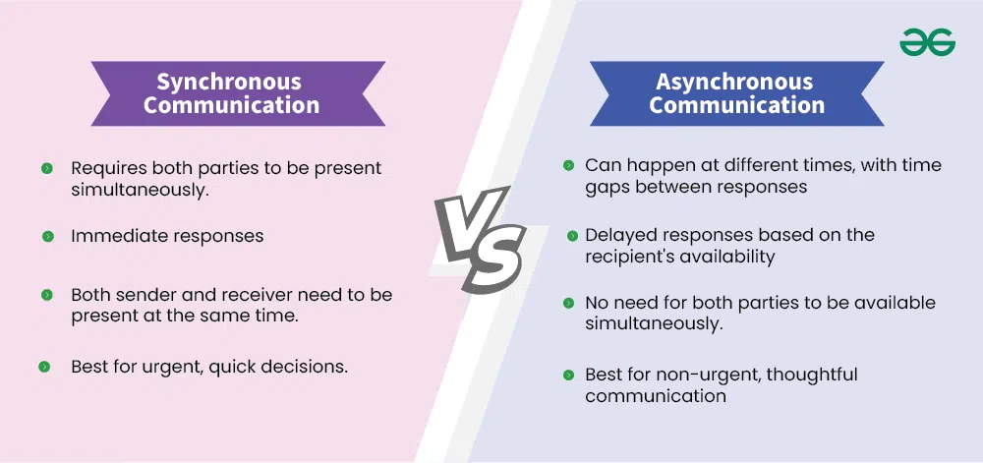
Synchronous vs. Asynchronous Communication - System Design
In system design, understanding the difference between synchronous and asynchronous communication is crucial for building efficient and scalable systems. Synchronous communication requires the sender to wait for an immediate response, making it suitable for real-time interactions. Asynchronous communication, on the other hand, allows the sender to proceed without waiting, enabling better scalability and flexibility in distributed systems.

Slide 3

What is Synchronous Communication?
Synchronous communication is a type of interaction in which the sender sends a request and waits for an immediate response before proceeding. In system design, this means that the requesting component (or service) must pause its execution until the receiving component processes the request and returns a result.
Synchronous communication is often used in real-time scenarios where immediate feedback is necessary, such as in APIs, database queries, or tightly coupled systems.
While it ensures consistency and simplicity, it can introduce latency or slow down performance if the response time is delayed.

Slide 4
Code Example: Synchronous
function printNumbers(numbers) {
for (let i = 0; i < numbers.length; i++) {
console.log(numbers[i]);
}
console.log("Done!");
}
printNumbers([1, 2, 3]);

Slide 5
Advantages of Synchronous Communication
Immediate feedback and interaction.
Encourages clearer and faster decision-making.

Slide 6
Disadvantages of Synchronous Communication
Requires all parties to be available at the same time.
Can lead to interruptions and be time-consuming.

Slide 7
What is Asynchronous Communication?
Asynchronous communication is a method in which the sender sends a request and continues its execution without waiting for an immediate response. In system design, this allows the requesting component (or service) to proceed with other tasks while the receiving component processes the request independently. Once the response is ready, it can be delivered via callbacks, message queues, or event-driven mechanisms.
Asynchronous communication is commonly used in distributed systems, microservices, and applications requiring high scalability and flexibility.
It reduces latency and improves system performance by decoupling the sender and receiver, though it may add complexity in managing responses.

Slide 8
Code Example: Asynchronous
function fetchData(url) {
return new Promise((resolve, reject) => {
// Send async HTTP request
fetch(url)
.then(response => response.json())
.then(data => resolve(data))
.catch(error => reject(error));
});
}
async function main() {
const data = await fetchData('[https://example.com/api](https://example.com/api)');
console.log(data);
}
main();

Slide 9
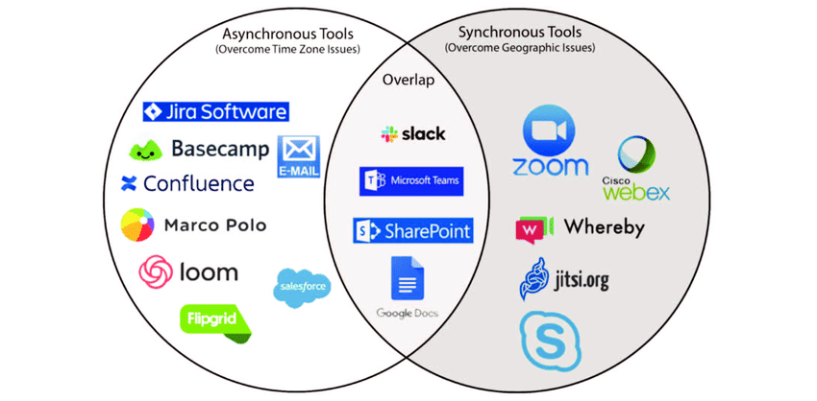

Slide 10
Advantages of Asynchronous Communication
Flexibility – people can respond at their convenience.
Reduces pressure for instant replies, allowing more thoughtful responses.

Slide 11
Disadvantages of Asynchronous Communication
Slower communication process.
May lead to misunderstandings or delays in decision-making.

Slide 12
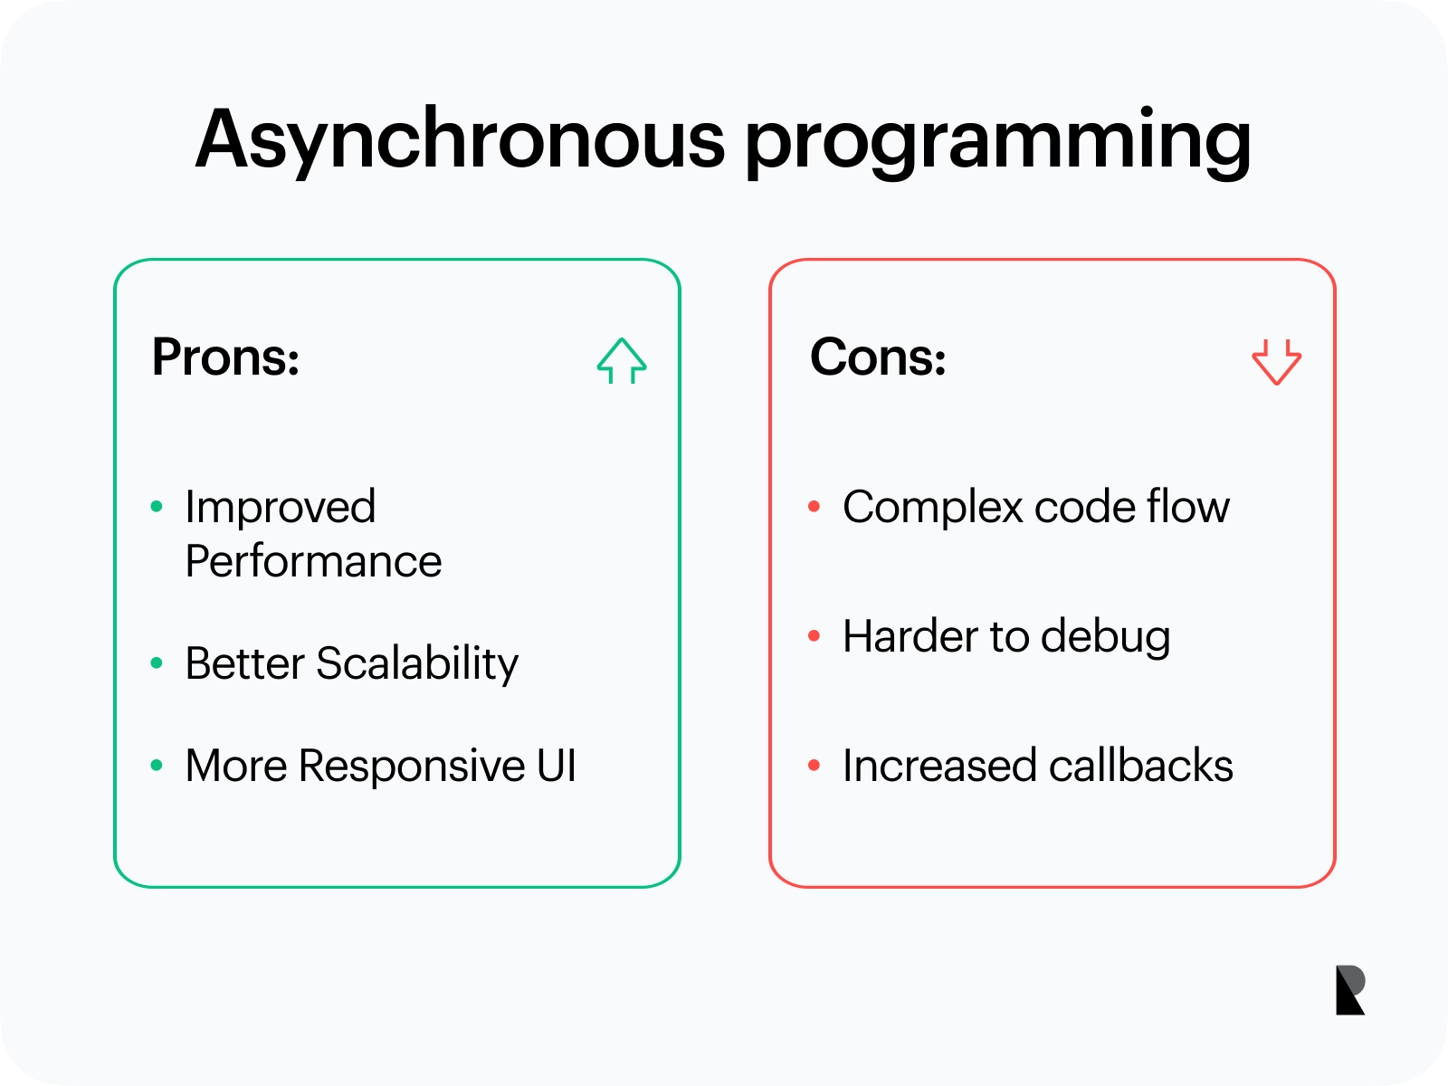
Asynchronous Programming – Pros
Better Performance: Tasks run concurrently without blocking each other, improving speed and resource efficiency.
Higher Scalability: Non-blocking I/O allows handling more users and requests with the same hardware.
Responsive UI: Asynchronous calls keep the interface active while background operations (like network or disk access) complete.
Asynchronous Programming – Cons
Complex Flow: Execution order is harder to follow due to callbacks and async events.
Difficult Debugging: Non-sequential behavior makes errors harder to trace.
Callback Overload: Too many nested callbacks can make code messy and hard to maintain.

Slide 13
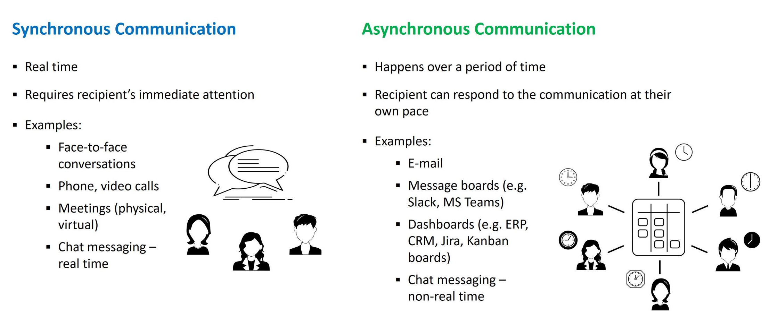
Synchronous vs Asynchronous Communication

Slide 14
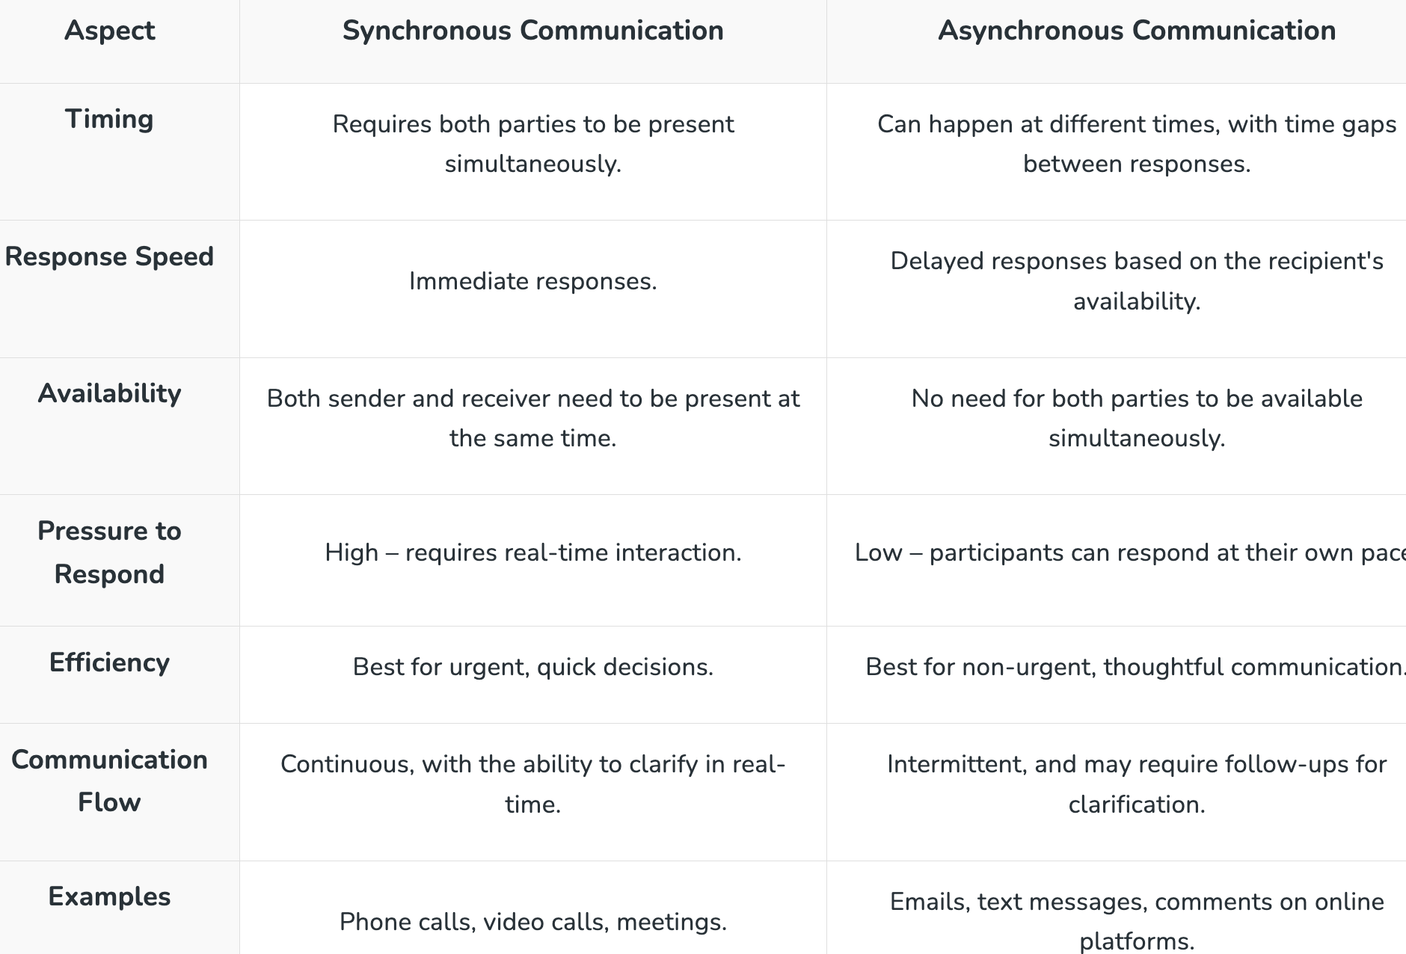
Differences between Synchronous and Asynchronous Communication

Slide 15
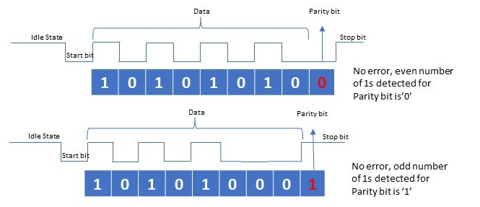
Frame Structure components
Start Bit: A single bit that transitions to signal the beginning of a character and enables the receiver's clock to synchronize with the incoming data.
Data Bits: The actual data being transmitted, which is usually 7 or 8 bits long.
Parity Bit (Optional): An extra bit added to the data for basic error detection. It can be configured for even, odd, or no parity.
Stop Bit(s): One or two bits that signal the end of the character frame and give the receiver time to reset its state before the next start bit arrives. The stop bit period can't be shorter than the specified amount, usually 1 to 2 bit times.

Slide 16
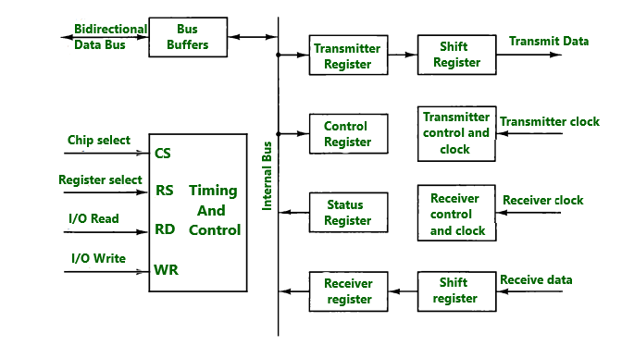
Asynchronous Communication Interface
Parts of the Interface : The interface is initialized by the help of control bit loaded into the control register. The transmitter register accepts the data byte from CPU through data bus which is then transferred to shift register for serial transmission. The serial information is received into another shift register and is transferred to the receiver register when a complete data byte is accumulated. The bits in status register are used to check any errors during transmission and for input and output flags which can be read by the CPU. The chip select (CS) input is used to select interface through address bus. The register select (RS) is associated with Read (RD) and write (WR) controls. Two registers are read and write only. The register selected is the function of RS value and RD and WR.

Slide 17
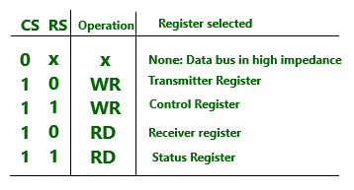
Working of the interface : The interface is initialized by the CPU by sending a byte to the control register. Two bits in the status register are used as flags and one bit is used to indicate whether the transmission register is empty and another bit is used to indicate whether the receiver register is full. Working of the transmitter portion : The CPU reads the status register and checks the transmitter. If the transmitter is empty then CPU transfers the character to transmitter. The first bit in transmitter is set to 0 to generate a start bit. The parallel transfer of character takes place from the transmitter register to the shift register. The transmitter is then marked empty. The CPU can transfer another character to transmitter register after checking the flag in status register. Working of receiver portion : The receive data input is in 1-state when line is idle. The receiver control monitors the receive data line to detect the occurrence of a start bit. The character bits are then shifted to the shift register once the start bit has been detected. When the stop bit is received, the character is transferred in parallel from shift register to the receiver register. The interface checks for any errors during transmission and sets appropriate bits in the status register. The three possible errors that the interface checks are the parity error, framing error and over run error.

