Slide 1



Assignment
Web Server Programming
Student: MukhammadSodik, Roziboy
Department:Computer Engineering

Slide 2
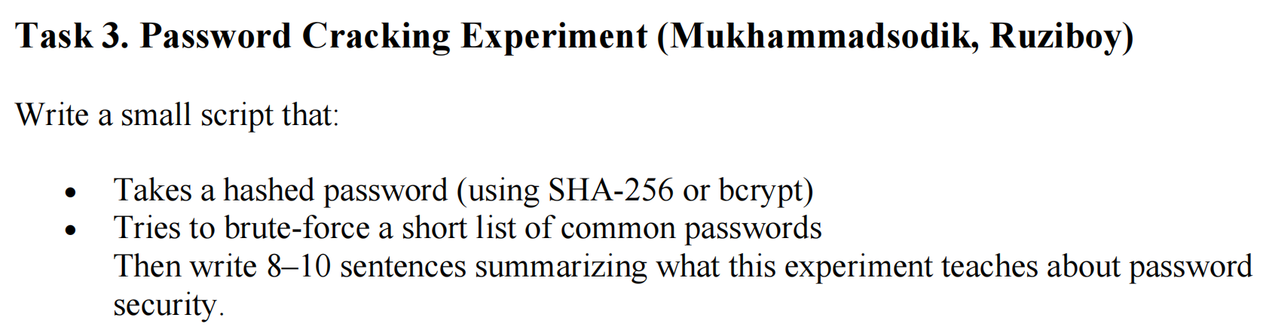
Question:

Slide 3
What is bcrypt hash?
A bcrypt hash is what you get when you take a password and run it through the bcrypt algorithm.
Example:
$2b$12$X9f1u0e9yC8jE4Pki6mY4uTGH1yO9n1rN8
Salted:
Bcrypt automatically adds a random salt. This ensures no two hashes are ever identical.
Slow on purpose:
It takes ~100 ms to run (configurable). A hacker cannot try millions of guesses per second. And has a built-in storage

Slide 4
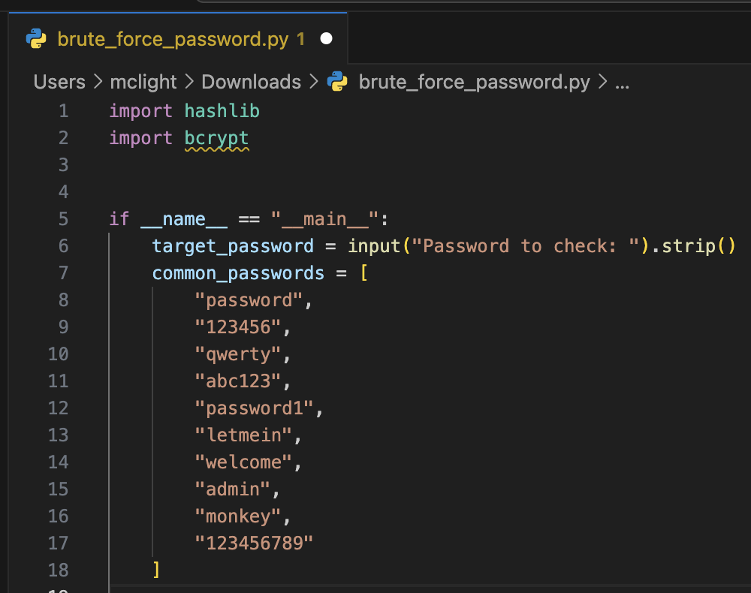
Code:
Algorithm | Output Size | Speed | Security Today | Suitable For
MD5 | 128-bit | Very fast | Broken | Checksums only
SHA-1 | 160-bit | Very fast | Broken | Legacy only
SHA-256 | 256-bit | Fast | Secure | Signatures, blockchains, integrity checks

Slide 5
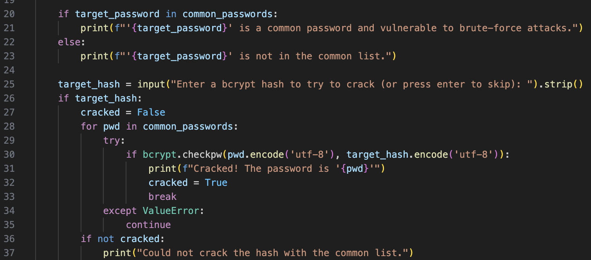
Code:
Does this password match the given bcrypt hash?
Sometimes a hash may be invalid or corrupted.
bcrypt.checkpw() will raise a ValueError, so the except avoids crashing the program.

Slide 6
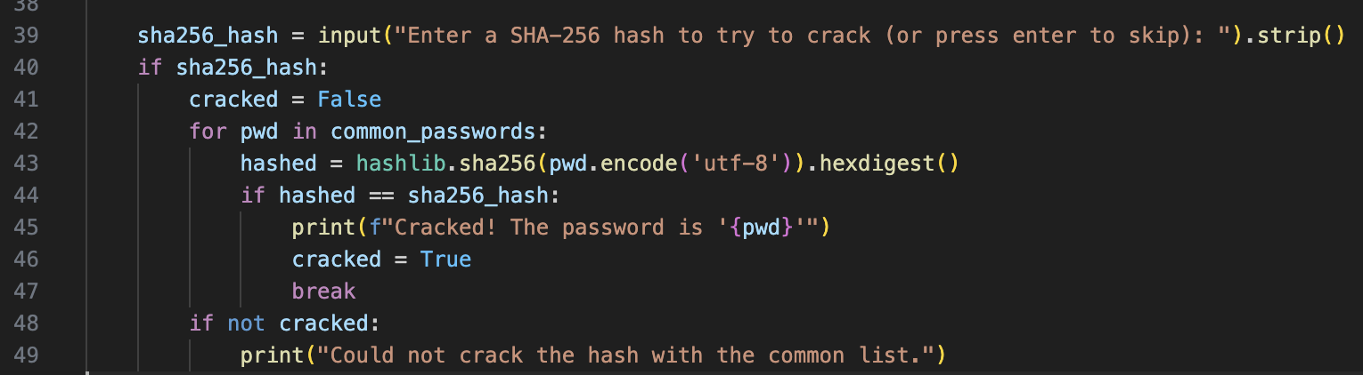
Code:
pwd.encode('utf-8') - converts “qwerty” - bytes
hashlib.sha256(...) - generates a SHA-256 hash object from those bytes
hexdigest() - converts hash bytes → readable hex string

Slide 7
Result
--- $2b$12$D60gK28j.aqTZTiSS0cp0O.K6gcNNc.y37Nvz7K6Eeo9MO1jWr9Je
--- 65e84be33532fb784c48129675f9eff3a682b27168c0ea744b2cf58ee02337c5

Slide 8
Thank you!

