Slide 1

Web Server Programming
Final Examination
Student: Shukirillaev Mukhammadsodik id: 202438379

Slide 2

Questions:
1. Compare synchronous vs. asynchronous communication. When to use AJAX vs WebSockets?
2. Explain how HTTPS secures communication (TLS, certificates, encryption).
3. In ASP.NET Core, what is middleware? Provide two examples.
Coding Questions:
4. Write a JSON response sample for POST /users returning id, name, created_at.
5. Write an SQL query selecting users older than 18, then pseudocode printing usernames

Slide 3

Synchronous vs Asynchronous Communication.
Synchronous communication:
Synchronous communication makes the client wait for the server’s response before continuing, while asynchronous communication lets the client keep working without waiting; AJAX for occasional request-response updates and WebSockets for continuous real-time two-way communication.
Asynchronous communication:
Asynchronous communication is when a client sends a request and continues working without waiting for the server’s response, allowing other tasks to run while the response arrives later.

Slide 4

Synchronous vs Asynchronous Communication.
Differences:
Synchronous is blocking (everything stops until the response comes), while asynchronous is non-blocking (other work continues).
Synchronous can slow down the user experience, while asynchronous improves responsiveness and speed.
Synchronous is simpler but less efficient for long tasks, while asynchronous is better for background operations or tasks that take time.
Synchronous sends a request and waits, while asynchronous sends a request and handles the response later through callbacks, promises, or events.

Slide 5


When to Use AJAX vs WebSockets
AJAX is used when the client needs occasional request–response updates such as form submissions or refreshing data.
WebSockets are used when the application requires continuous real-time two-way communication like chat, live notifications, or live dashboards.

Slide 6

How HTTPS Secures Communication
HTTPS secures communication by using TLS to create a protected channel between the client and server. During the TLS handshake, the server sends a digital certificate issued by a trusted Certificate Authority, and the client verifies that the server is legitimate. Then they perform a secure key exchange to generate a shared session key. After the handshake, all data is encrypted using symmetric encryption, which ensures confidentiality, integrity, and prevents eavesdropping, tampering, or man-in-the-middle attacks.

Slide 7

Middleware in ASP.NET
In ASP.NET Core, middleware is a component in the request pipeline that processes incoming HTTP requests and outgoing responses, either handling them or passing them to the next middleware.
Examples:
- Authentication middleware (handles user identity and tokens)
- Routing middleware (maps requests to the correct endpoint or controller).

Slide 8
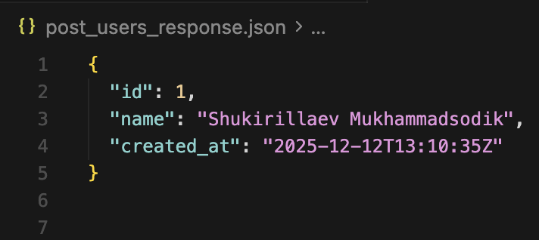
Code: A JSON response for POST/users returning id, name, created_at
ID
name
created_at

Slide 9
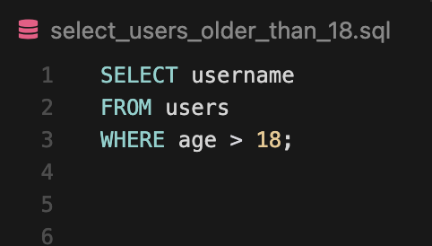
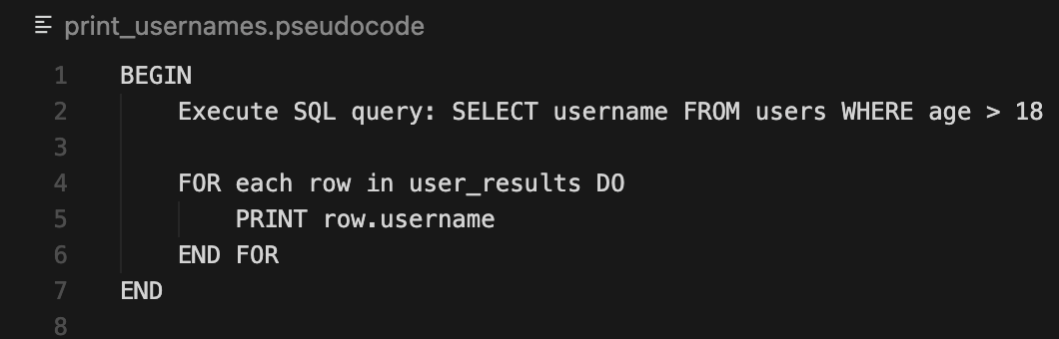
CODE: SQL query selecting users older than 18, than pseudocoding each user
defining the condition of age being older that 18
printing each user in results after assigning

Slide 10
THANK YOU!

