Slide 1
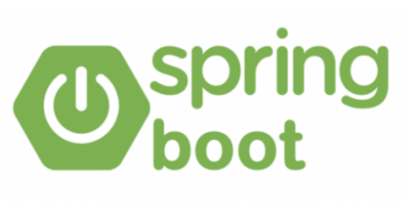
Spring Boot Framework
Student: Shukirillaev Mukhammadsodik ID: 202438379

Slide 2
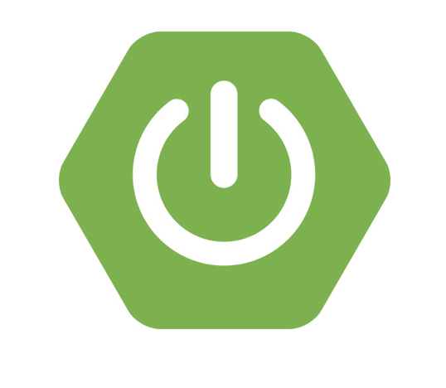
Part 01
What is Spring Boot?
Part 02
Why do we need it?
Part 03
How does it work?
Part 04
Key features
Part 05
Simple example
Part 06
Conclusion

Slide 3
Introduction: What is Spring Boot?

Slide 4

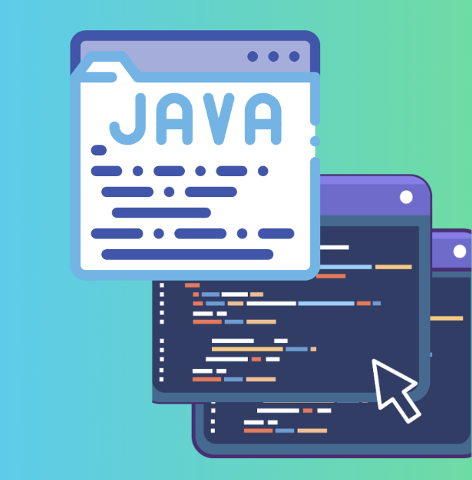
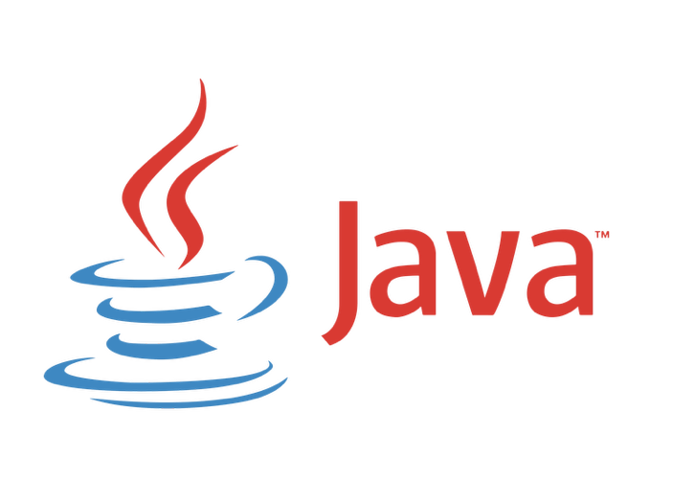
Spring Boot is a framework used to build Java applications easily and quickly.
It`s built on top of the Spring Framework, which is one of the most popular frameworks for enterprise-level Java development.
Notes:
If you`ve ever tried to build a web application in Java, you know it can be complicated too many configuration files and setup steps. Spring Boot solves that by making it super simple to start and run applications
In one word:
Spring Boot helps developers create production-ready applications in minutes instead of days.

Slide 5

Why do we need it?

Slide 6
Why do we need it?
Before Spring Boot, developers had to write a lot of configuration code. You needed to set up web servers, dependencies, databases, and security manually.
Spring Boot removes all of that it gives you a ready-made structure.
1
2
Without Spring Boot: you write 50 lines just to connect to a database.
With Spring Boot: it connects automatically using one line in a application.properties file.
3
4
It’s especially helpful for students and professionals who want to build something that just works ‘fast’.
Notes:
It saves time and reduces errors. With less code comes time efficiency and reduction of errors.
Spring Boot automatically configures your app based on what it finds in your code. It has something called Auto-Configuration.
If it sees you added a web dependency, it automatically starts an embedded web server (like Tomcat).
If you add a database dependency, it automatically connects to it.
Core idea: You focus on what your app does, not how to configure it.

Slide 7
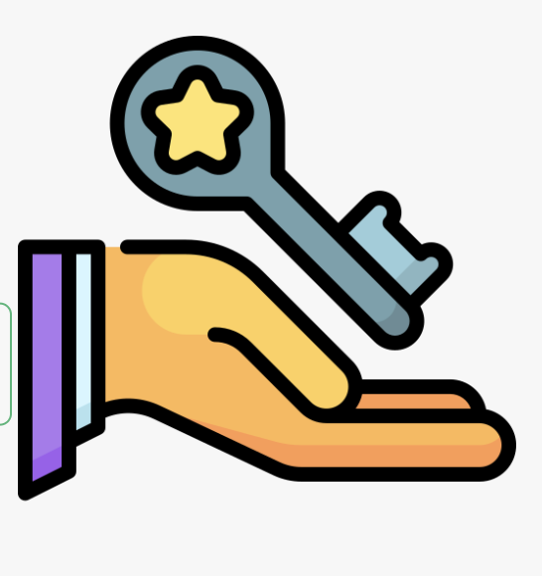
Key Features

Slide 8
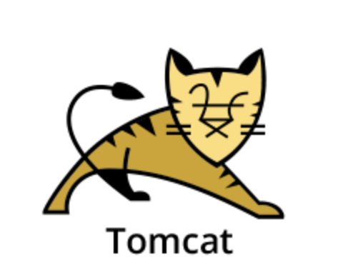
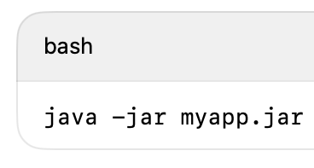

Embedded Servers
1. Embedded servers: You don’t need to install Tomcat or Jetty separately.
2. Auto-configuration: Automatically sets up things for you.
3. Standalone applications: Run your app with one command:
4. Spring Boot Starter dependencies: Pre-packaged sets of dependencies.
Example: spring-boot-starter-web = everything you need for a web app.
5.Actuator: Monitors and manages your app (health, performance, etc.).

Slide 9
Demo

Slide 10
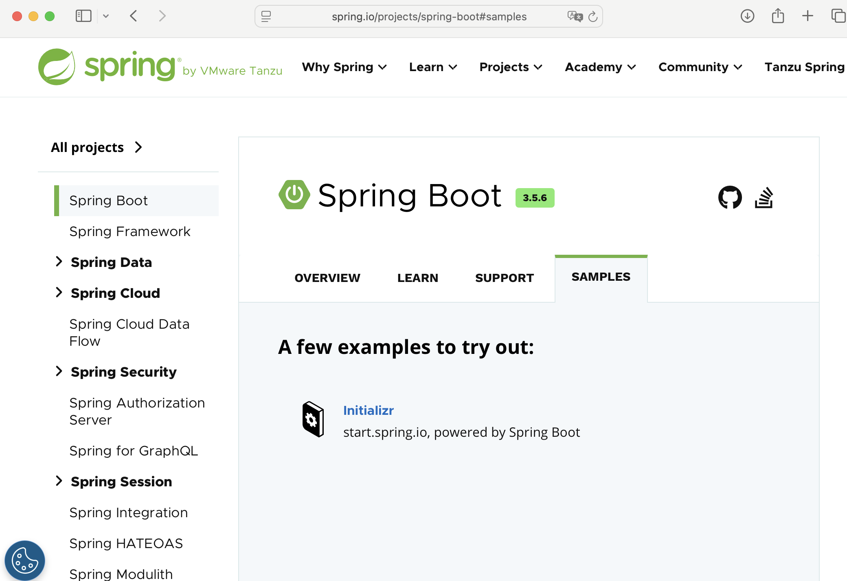
Demo App
Download the ‘demo’app from the web-site

Slide 11
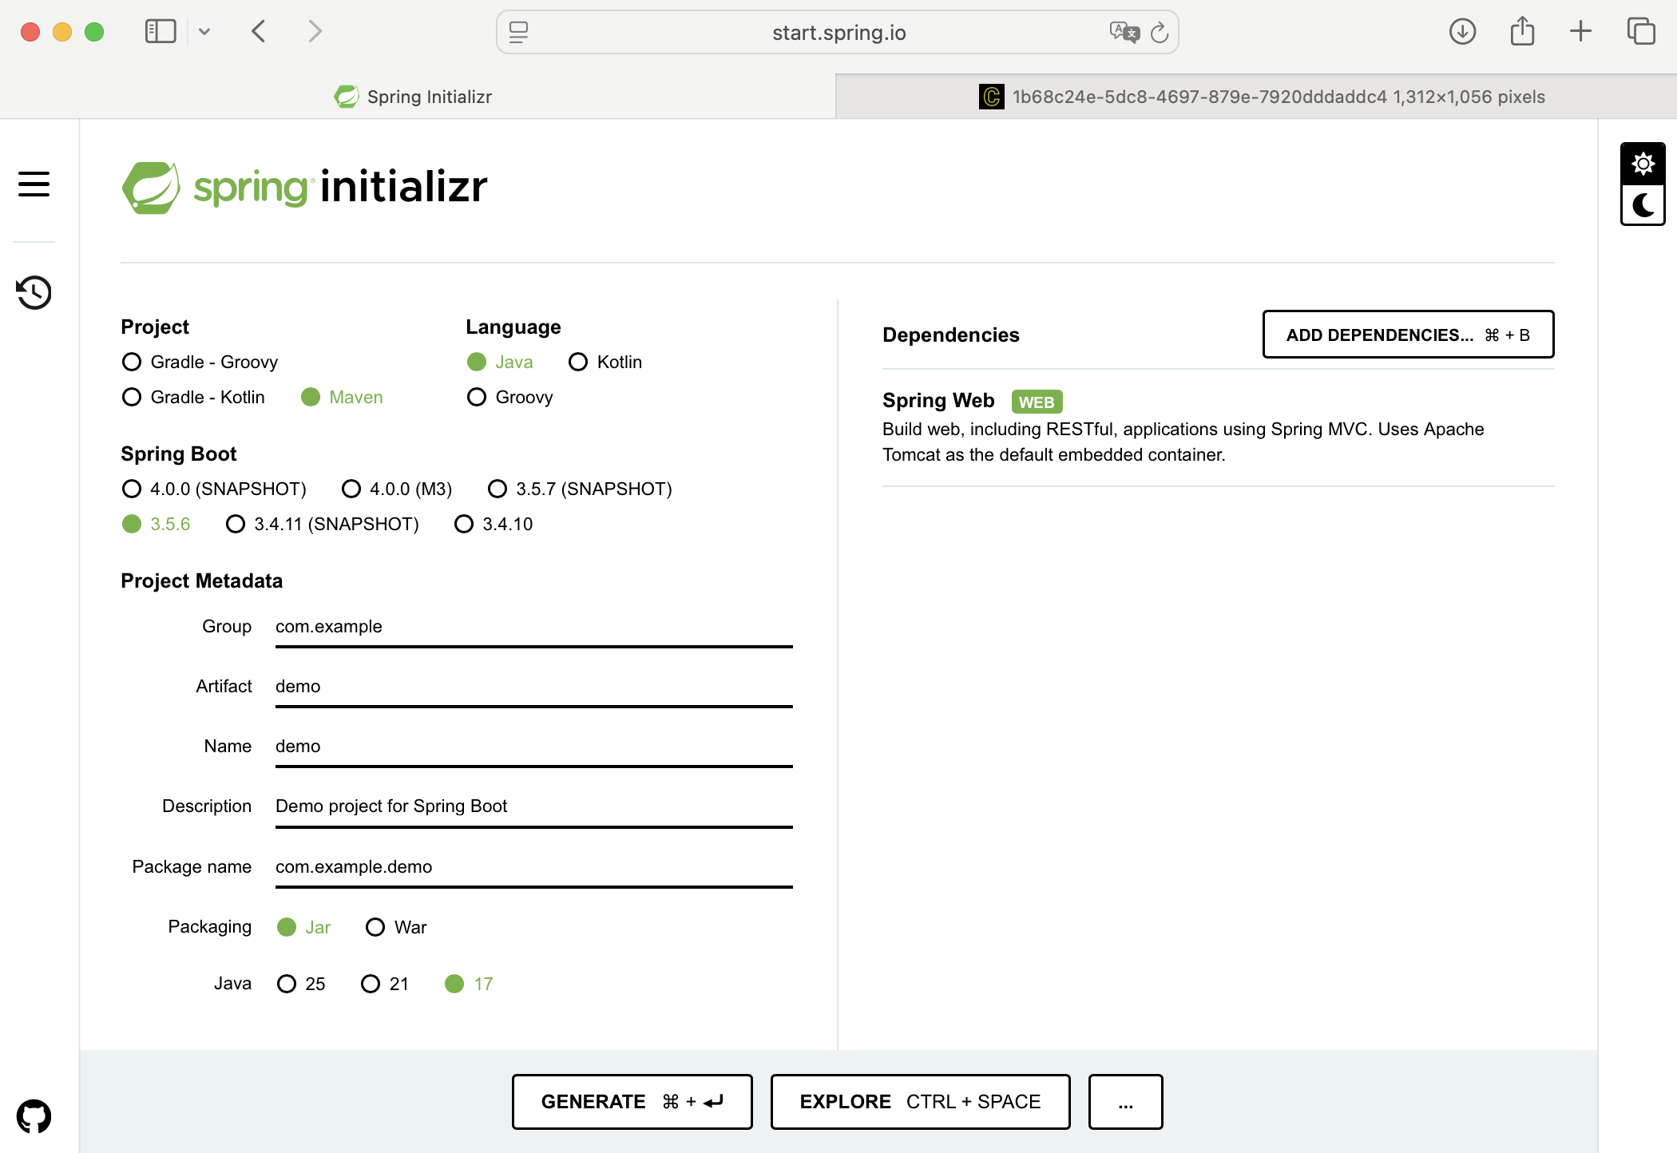
Setting up Spring boot
Spring initializr
Notes:
As you can see it simple and straightforward.

Slide 12
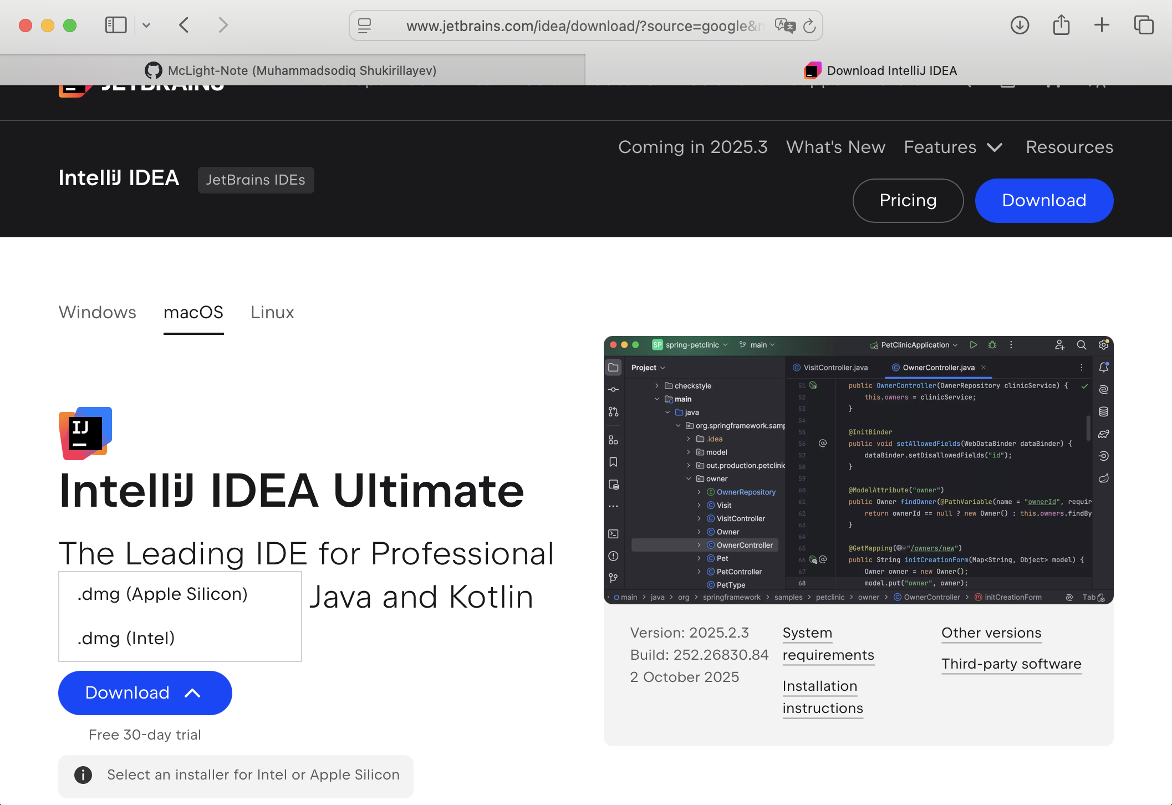
Web-Site
Visit to their official website, download and install

Slide 13
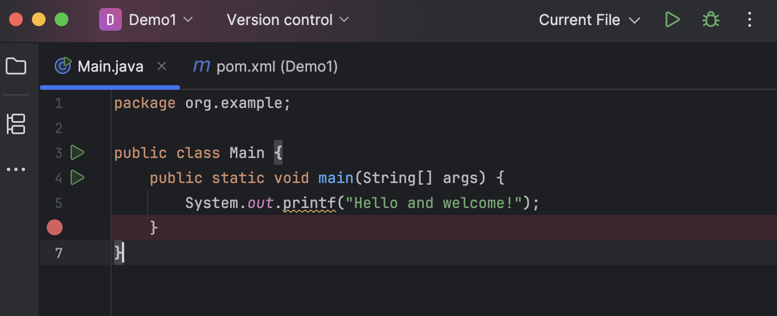
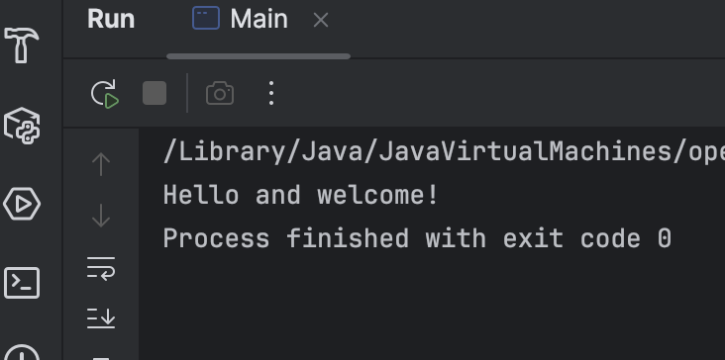
Usage
Start the InteliJ IDEA, open the app and run it
Notes:
As you can see it simple and straightforward.

Slide 14
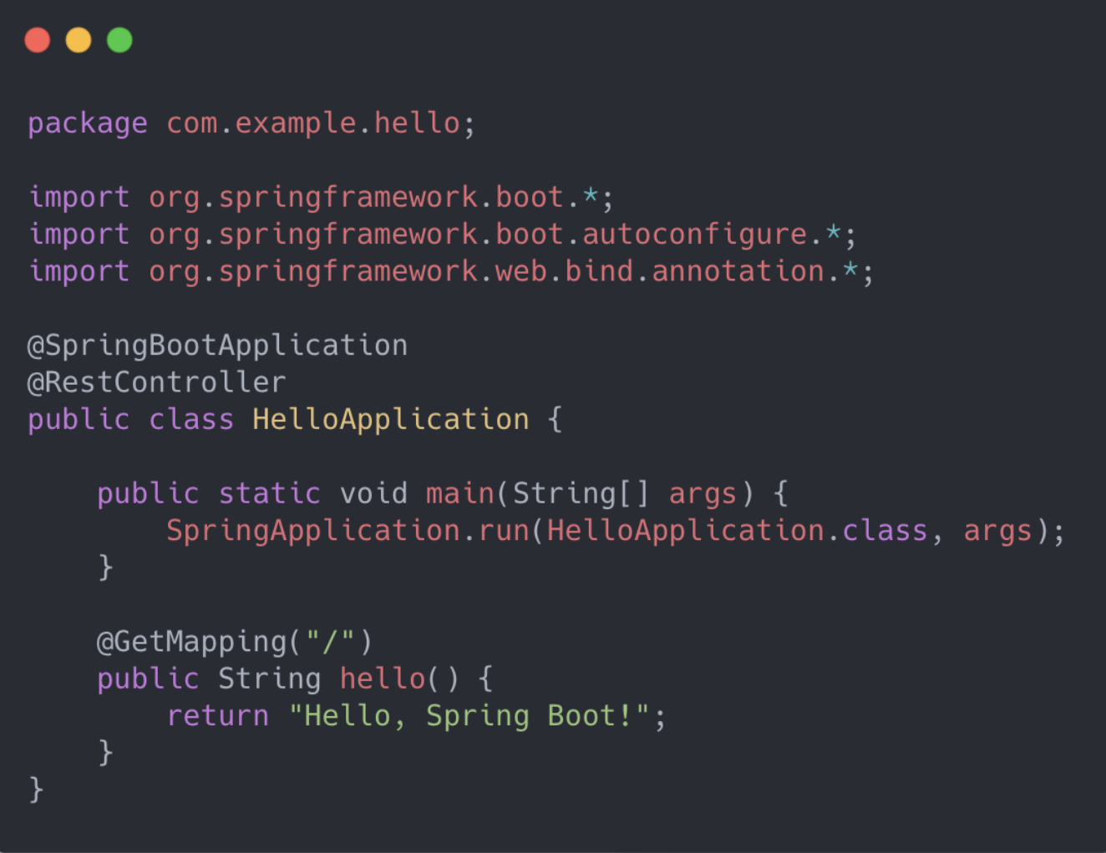

This line defines where this class is stored, like an address for the code.
These are imports, they bring in tools from Spring Boot that we’ll use.
tells Java this is a Spring Boot app
This marks the starting point of our Spring Boot program and also tells it that this class will handle web requests.
allows us to handle web requests
With just one line, this starts a full web server, no setup needed.
This is the controller part (Home Page)
defines what happens when someone visits a URL
Output: Browser shows “Hello, Spring Boot!”
Notes:
And now let’s break down the lines here
This small code creates a complete web server. When someone visits the website, it sends back the message ‘Hello, Spring Boot!’ all with just a few lines. Normally, you’d need hundreds of lines to do this, but Spring Boot makes it automatic.

Slide 15
Conclusion

Slide 16
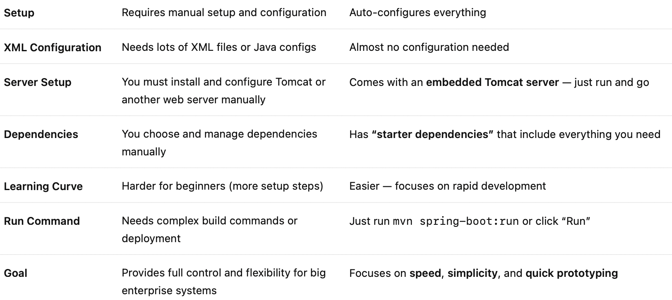
Main Differences
Spring
Spring Boot

Slide 17
Conclusion
Spring Boot makes Java development faster, easier, and more enjoyable.
It removes configuration headaches and allows developers to focus on building features instead of setting up the environment.
That’s why today, most modern Java applications use Spring Boot from small startups to large companies.
Notes:
Spring = Powerful but complex, while Spring Boot = Spring made easy
Spring Boot is used by companies like Netflix, Amazon, and Google

Slide 18
THANK YOU!

