Slide 1

Web Server Programming
Mid-Term

Slide 2
Question 1:
What are the main components of a RESTful architecture? Explain the
principles of REST

Slide 3
Answer
An architectural style for designing networked APIs, not a strict standard. APIs that follow it are "RESTful.
1. Client-Server: Separation of concerns. Client handles UI, server handles data/logic. They evolve independently.
2. Stateless: Every request must contain all info needed to process it. No client session stored on the server.
3. Cacheable: Server responses must say if they can be cached. Improves performance and scalability.
4. Uniform Interface (The Key Principle):
- Resources in URIs: Everything is a resource (e.g., /users/123).
- HTTP Verbs: Use GET (read), POST (create), PUT (update), DELETE.
- Self-Descriptive Messages: Use HTTP status codes (200 OK, 404 Not Found) and headers.
- Responses include links to related actions (e.g., “next_page” URL).
5. Layered System: Architecture can have layers (like load balancers, security). Client doesn't need to know.

Slide 4
Question 2:
Explain the concept of statelessness in HTTP and why it is important in web applications

Slide 5
Answer
Each HTTP request is independent and self-contained. Server doesn't remember anything between requests. Every request must include all necessary information (auth, data, etc.), which are authentication and data management
1. Scalability:
- Easy to add more servers
- Any server can handle any request
2. Reliability:
- No single point of failure
- If one server crashes, others can continue
3. Simplicity:
- Servers don't manage session storage
- Clean, predictable architecture
(Example) handling “state” (like login):
- Tokens (JWT) in headers
- Cookies with session IDs
- Client-side storage

Slide 6
Question 3:
Write a Spring Boot controller that accepts a POST request at /register with a JSON body containing name and email, and returns a confirmation message.

Slide 7
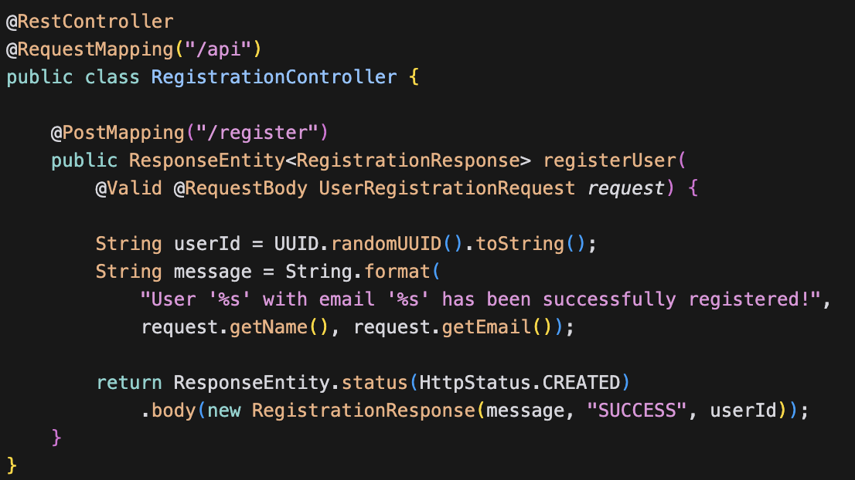
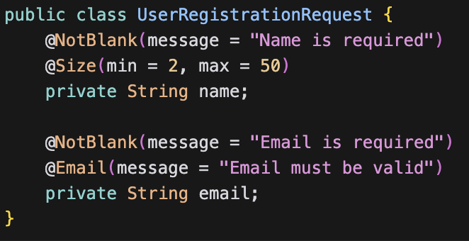
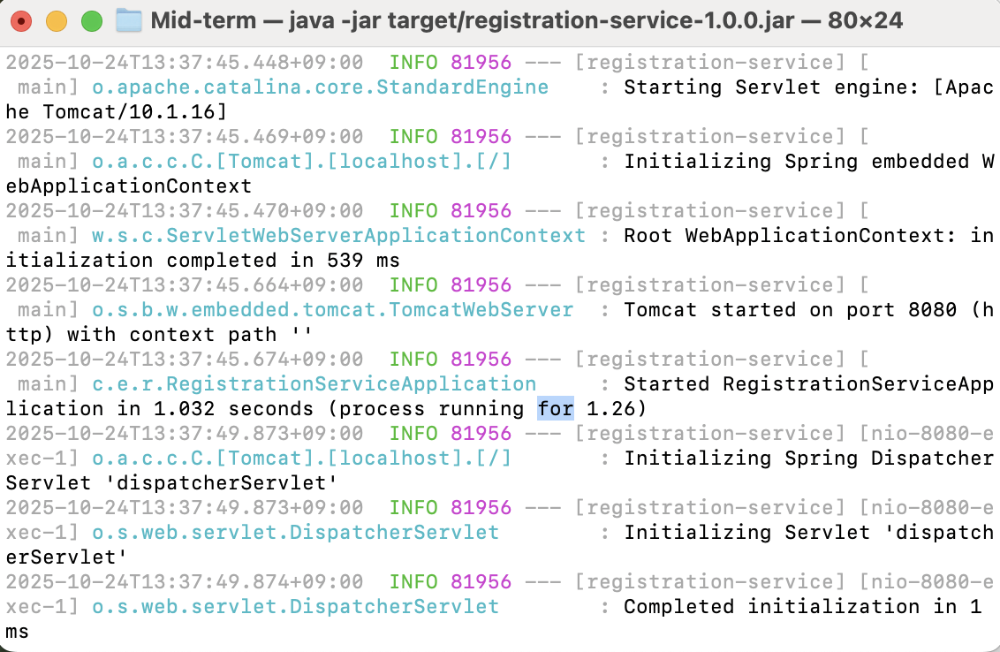
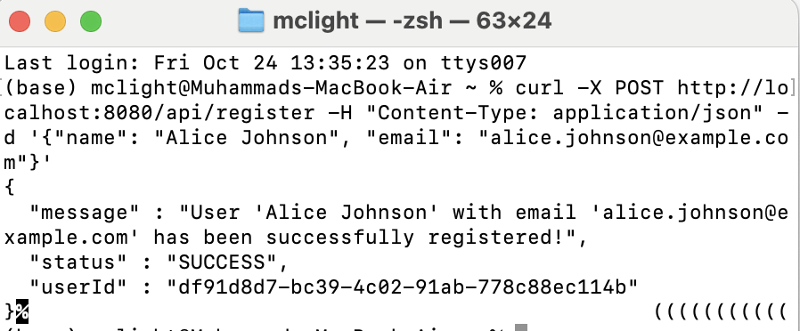
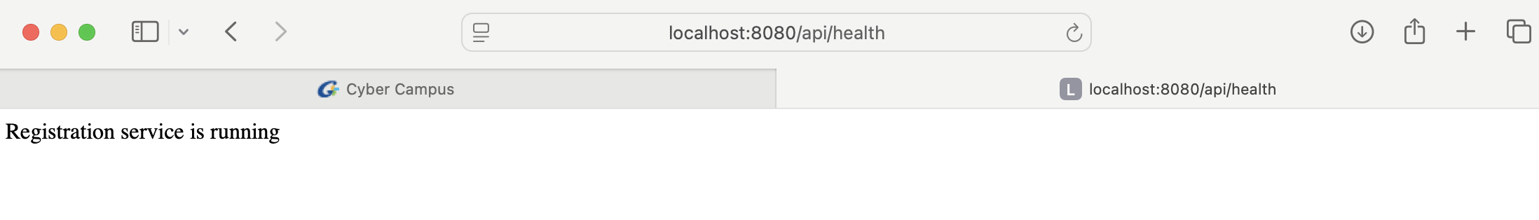
Code
Main controller code:
Request DTO (Input validation)
Here are all the codes for this application: https://github.com/McLight-Note/Web-Server-Programming/tree/main/Mid-term

Slide 8
Design
The program follows 4 main functions:
  A simple layout/mockup is created.
  Components:
      - Patient Registration Form;
      - Appointment Calendar;
      - Dummy Billing Interface

Slide 9
Build Prototype
The program is written in Python and follows these steps:
  - A working demo is coded (in Python).
  (Used Libraries: FastAPI, PyDantic, SQLAlchemy)
  - No real database or final design — just enough to test key functionality.

Slide 10
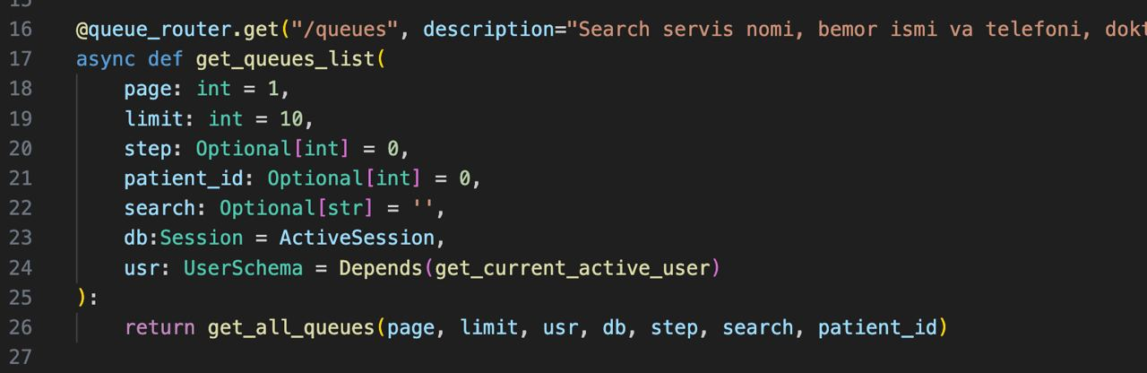
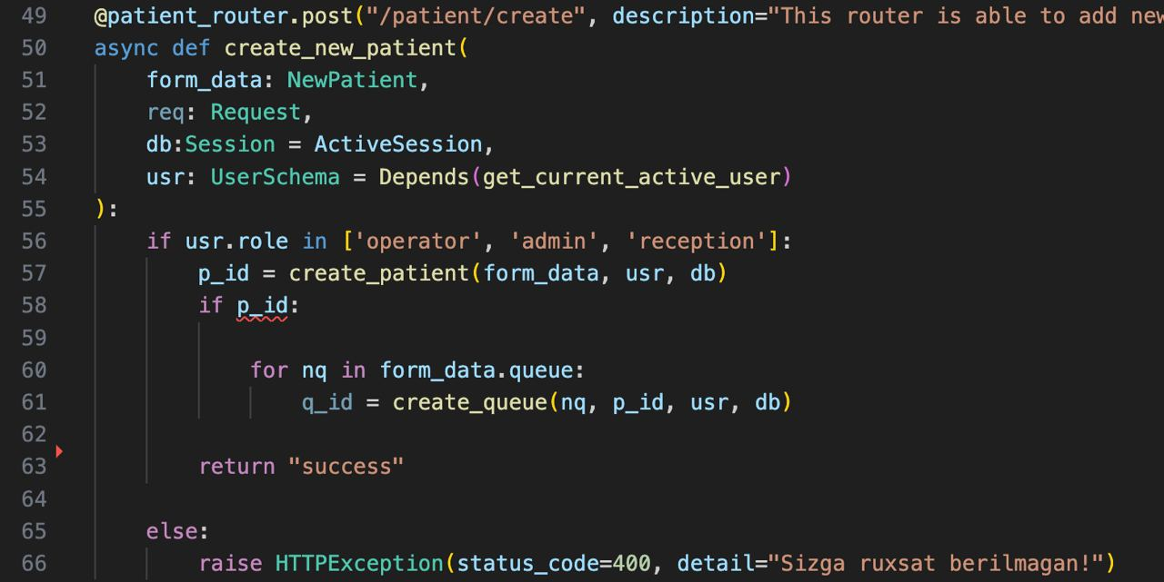
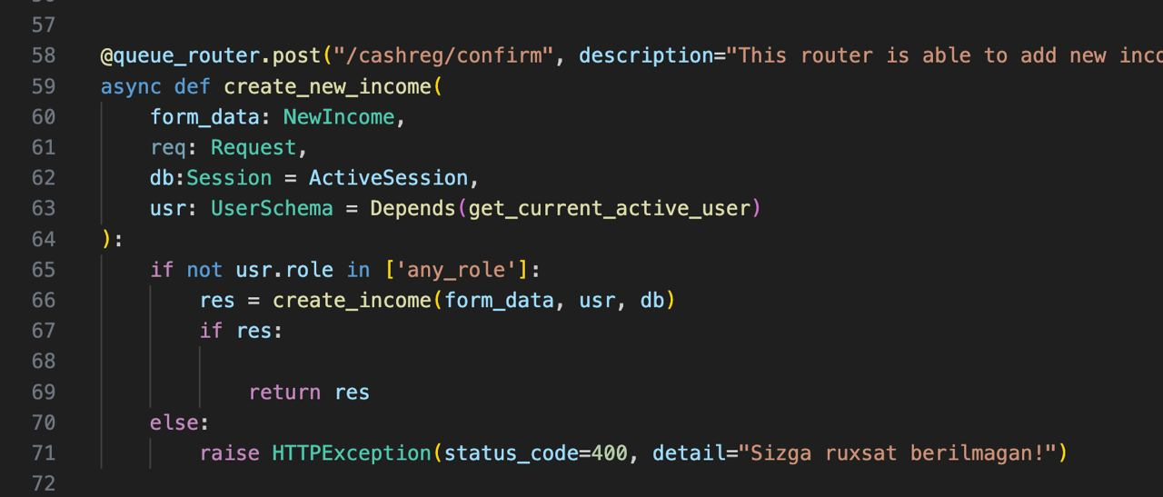
CODE: INPUT
Adding Patients
Patient Registration
Confirmation of appointment

Slide 11
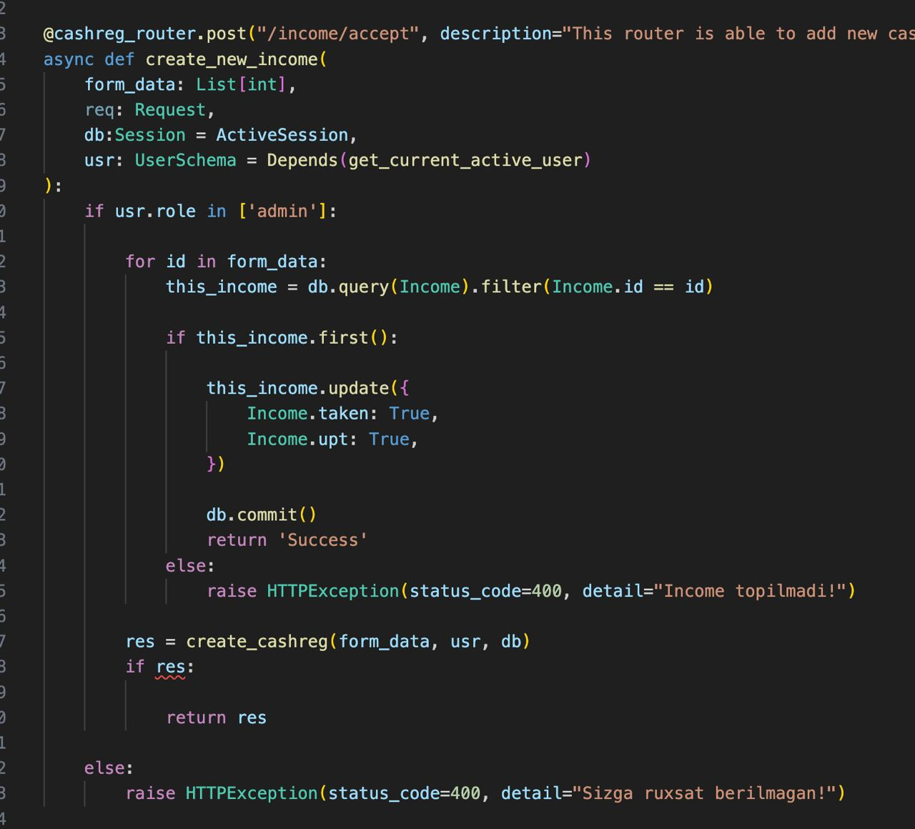
CODE: INPUT
Billing confirmation

Slide 12
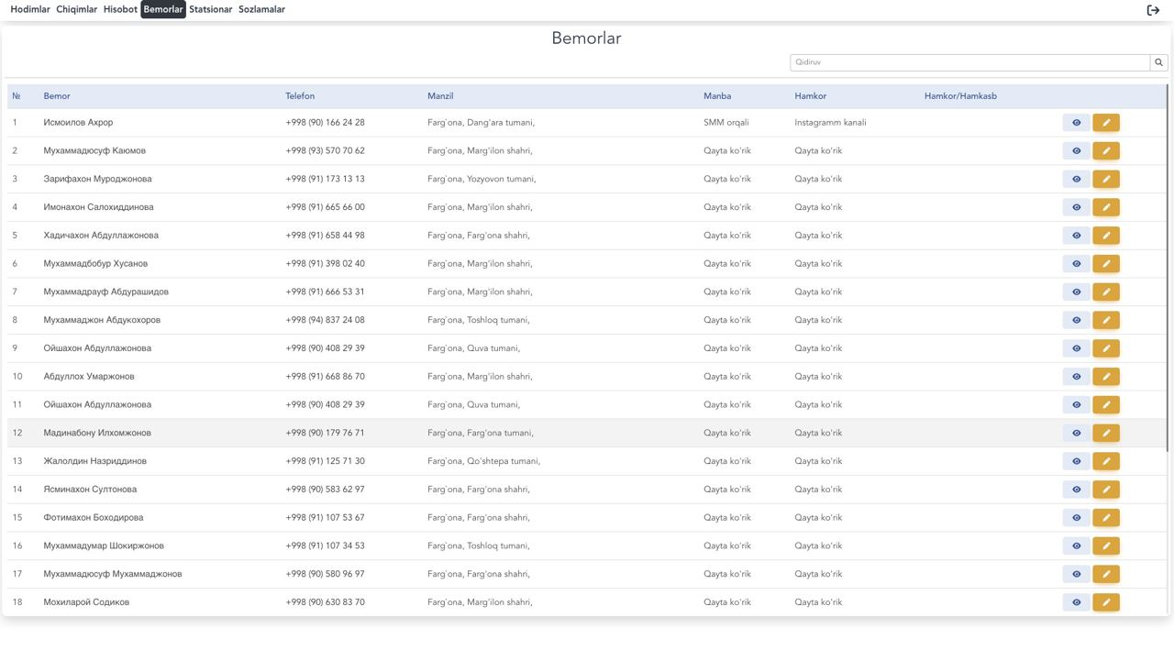
CODE: OUTPUT

Slide 13
User Evaluation
  The prototype is demonstrated to the real users — doctors, nurses, and administrative personnel — for practical testing. They work with the system, test its features, and offer insightful feedback based on their everyday workflow and real-world requirements. This feedback is essential because it identifies what is good and what should be changed.

Slide 14
Refinement
  Developers come back with the feedback and make changes to the prototype. This could include fixing usability issues, adding new features, or removing unnecessary ones. This can happen several times within a cycle until users are satisfied with the functionality and design. Every iteration brings the final system nearer.

Slide 15
Final Product
  Once all the issues in the feedback are addressed and the prototype has lived up to expectations, the team proceeds with creating the final system. The final system includes all the technical requirements like a secure database, interface-friendly interface, and full functionality. The final product is now ready to be fully deployed in the hospital environment to enhance patient care and administrative effectiveness.

Slide 16
Conclusion
Using the Prototype Model helped the team quickly build a basic hospital system with patient registration, appointment scheduling, and billing features. Doctors, nurses, and admin staff tested it and gave feedback early on. Thanks to their suggestions, the system could be improved before making the final version. This way, the developers made sure the system fits real hospital needs and avoided bigger problems later.
The Prototype Model made the whole process smoother and helped create a system that’s more useful and ready for real use.

Slide 17
THANK YOU!

