Slide 1
Week 2. Web Server Fundamentals
Lecturer: Shakhnoza Muksimova
19.09.2025

Slide 2
Content
Web servers (Apache, Nginx, IIS)
Static vs Dynamic content
Installing and configuring a local development server

Slide 3
Web servers
A web server is basically any hardware or software that uses Hypertext Transfer Protocol) HTTP and other protocols to transmit the requested web content over the Internet. Its main job is to deliver the website content such as images, texts and videos to users online.
The hardware component of a web server stores the website data while the software is responsible for processing requests and providing content such as HTML pages, images, and scripts.
In the context of web hosting, web servers are highly important as they store and process files required to make websites accessible.

Slide 4
How Does Web Server Work?
Web servers have a structured process for data exchange. This is how they work:
Receive the Request: Firstly, the web server receives a user request, in the form of HTTP or HTTPS protocols.
Process the Request: It identifies the requested file or resource and retrieves it from the stored data.
Deliver the Content: Finally, the web server sends the requested data back to the user’s browser, allowing them to view the webpage.
The best part is, the entire process takes place in milliseconds, allowing users to browse websites within flash.

Slide 5
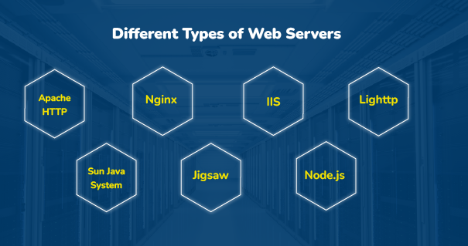

Slide 6

Apache Web Servers
Apache is one of the most widely used web servers across the globe. It’s famous for flexibility and features that are abundant in this software.
Apache supports Windows, Linux, and macOS. Being an open-source software, Apache offers maximum flexibility and can be easily customized to fit the needs of developers.

Slide 7
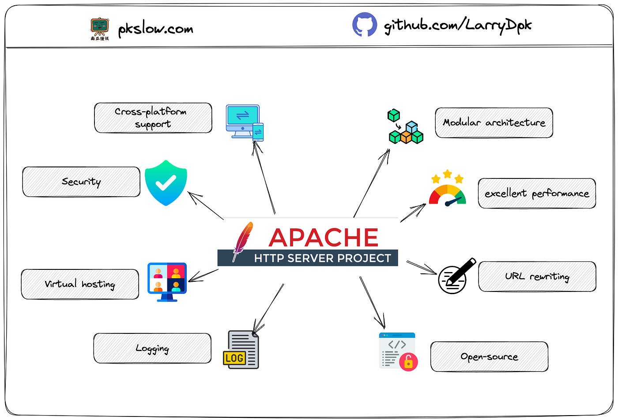
Apache is designed to run on various operating systems including Windows, Linux, macOS, and Unix-based systems.
Modular architecture: Apache's modular architecture allows developers to add or remove functionality as needed. This makes it highly flexible and extensible.
Security: Apache provides a range of security features including SSL/TLS encryption, IP-based access control, and password authentication. It also has a robust set of security modules to help protect against common attacks such as DoS attacks and SQL injection.
Performance: Apache is known for its excellent performance and scalability. It supports various caching mechanisms, including reverse proxy caching, to help speed up content delivery.
Apache supports virtual hosting, which allows multiple websites to be hosted on a single server.
Apache provides powerful URL rewriting capabilities, which allow developers to modify the URLs of incoming requests before they are processed by the server.
Apache provides extensive logging capabilities, which allow developers to track and analyze server activity.
Apache is an open-source software, which means that it is free to use and can be modified and distributed by anyone. This makes it a popular choice for businesses and developers who want to avoid vendor lock-in.

Slide 8

Nginx Web Servers
Often considered the second web server after Apache, Nginx is great in terms of performance, scalability, and efficient usage of resources.
It basically works on an event-driven architecture to make it work best for handling more than one request at a given time with fewer memory consumptions. This feature makes it a go-to choice for hosting high-traffic websites and applications.

Slide 9
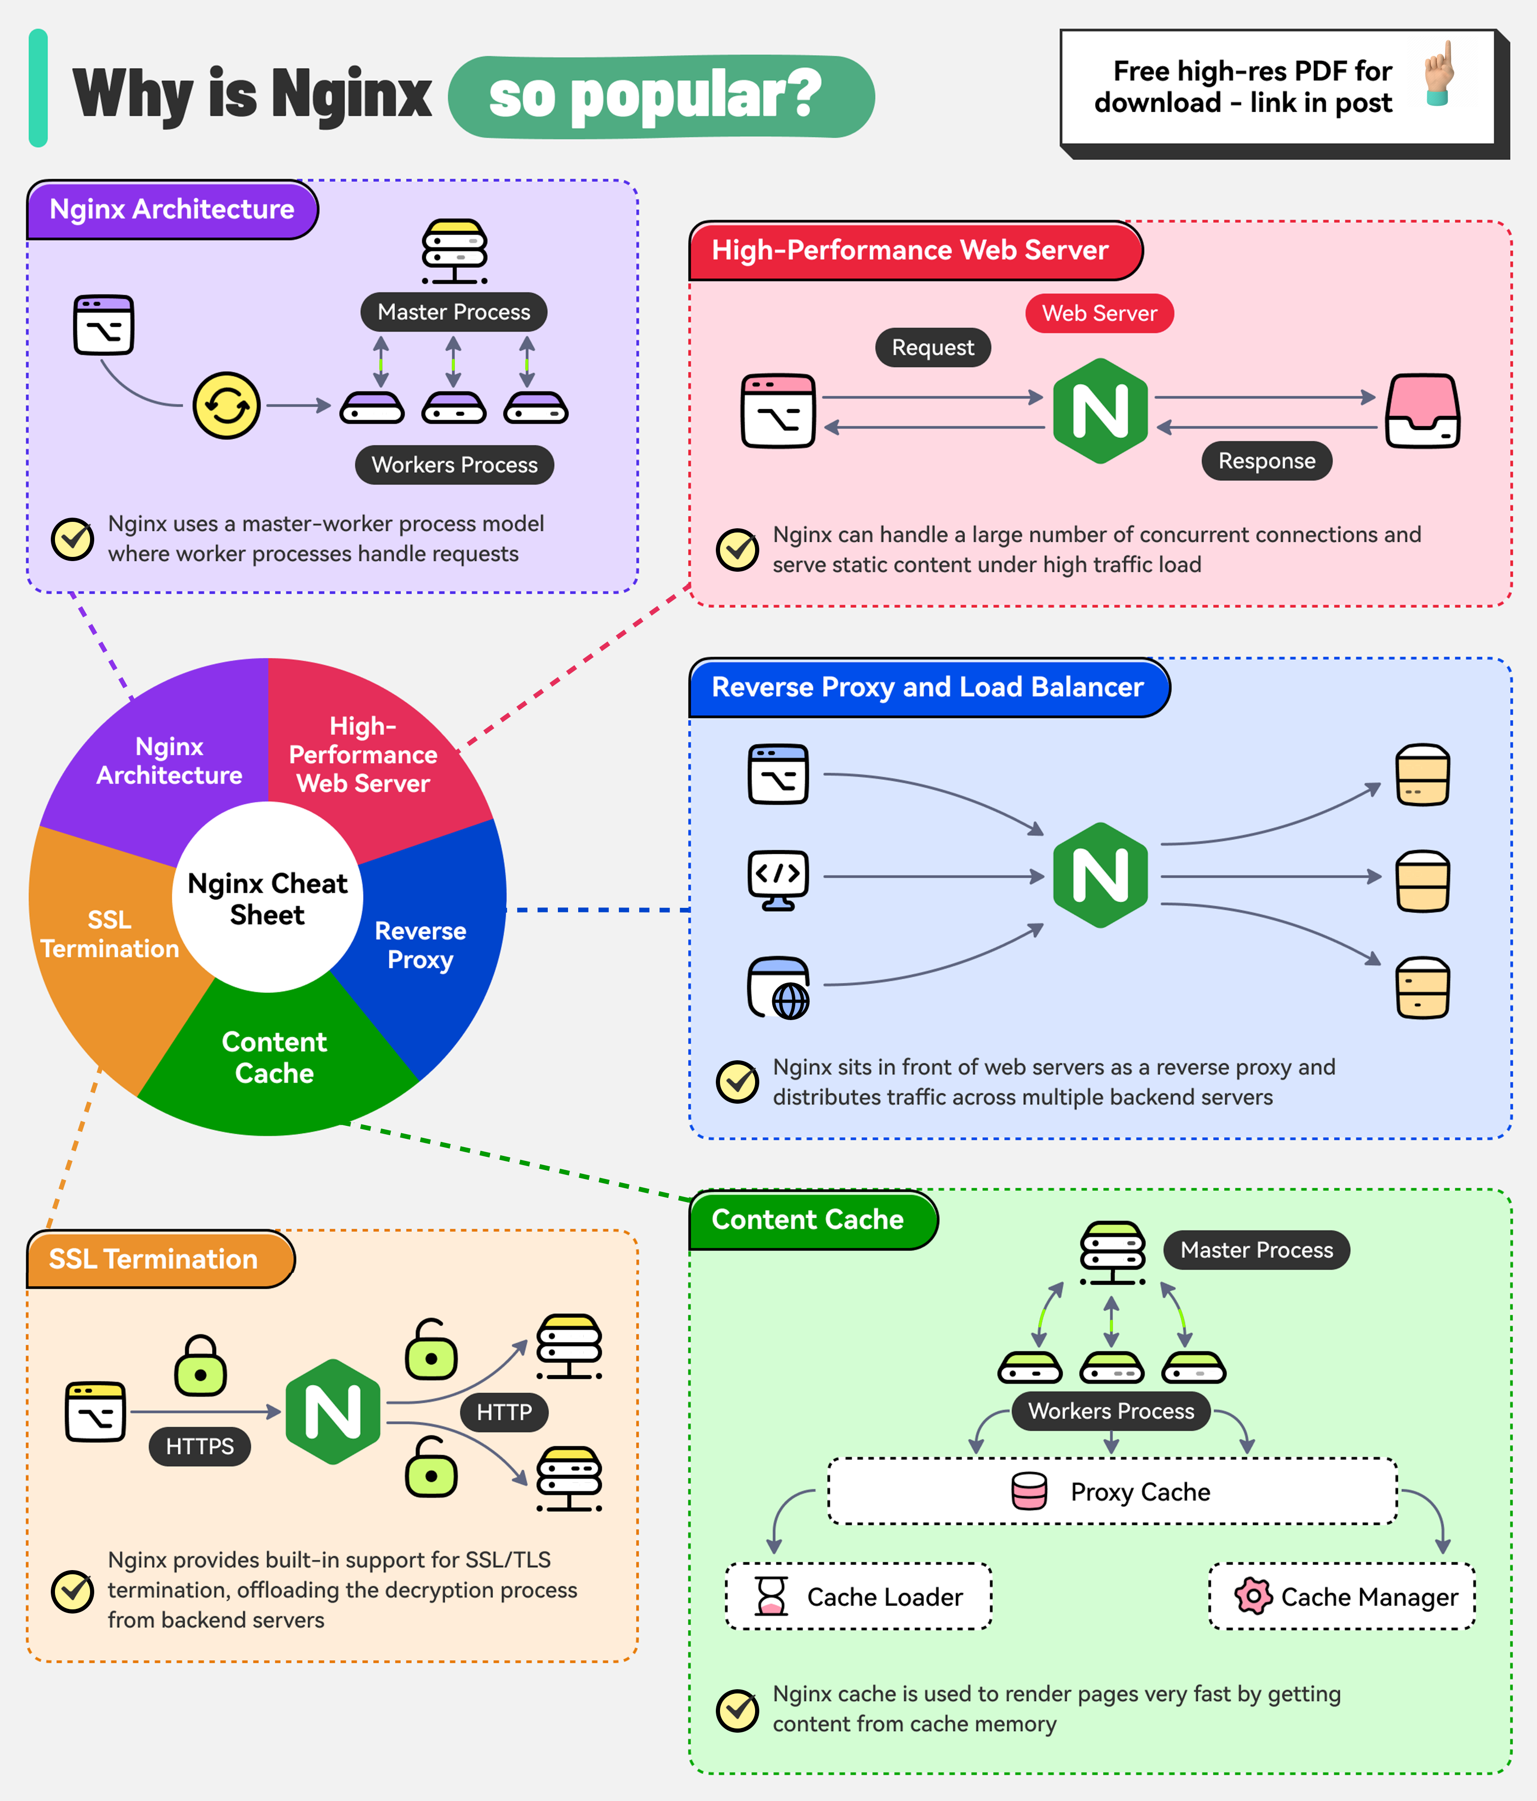

Slide 10

Microsoft Internet Information Services (IIS) Web Servers
IIS is a web server developed by Microsoft, known for its good performance and complete integration with the Windows operating system.
Although the customer support is excellent, and it’s easy to use, IIS is proprietary, meaning that the code of this software isn’t open to modification. Even so, IIS is an excellent choice to host applications using the Windows OS.

Slide 11

Lighttp
Lighttp, is a lightweight web server known for speed, security, and low CPU usage. It is especially popular among developers who seek an efficient solution for hosting websites on devices with limited resources.

Slide 12

Sun Java System Web Server
This server from Sun Microsystems boasts of being extremely powerful in its performance.
Additionally, the product supports other technological innovations, for example, JSP (JavaServer Pages), and Server-Side JavaScript, which it incorporates into it. It has also seen extensive application within medium and large-scale sites that are noted to be extremely reliable and scalable.

Slide 13

Node.js Web Server
Node.js is a runtime environment where developers can create network applications using JavaScript.
Node.js Web Server is popular for its event-driven architecture and asynchronous I/O capabilities, which makes it highly efficient in real-time communication and browser-based applications like games and chat systems.

Slide 14

Jigsaw Web Server
Jigsaw, a web server experiment developed by the World Wide Web Consortium, or W3C, was implemented in Java with advanced architecture.
As a project that was once a test environment for new web technologies, it is now becoming a full-featured web server that offers interesting features and flexibility

Slide 15
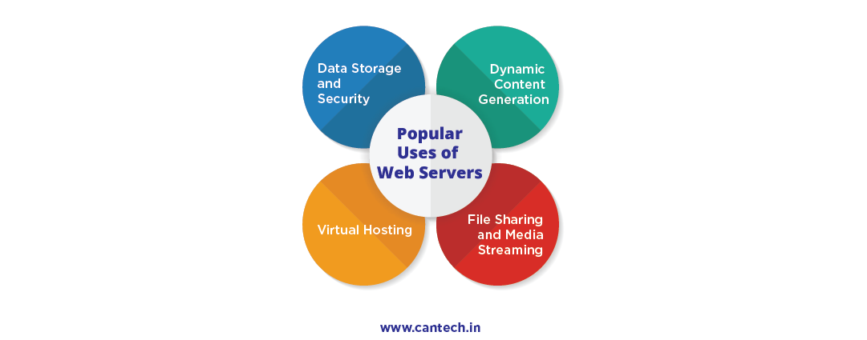
Web servers perform a range of functions beyond simply hosting websites.
Some of their key uses include:
1. Data Storage and Security
Security is paramount when it comes to websites. Web servers securely store website data, keeping sensitive information protected from unauthorized access.
2. Dynamic Content Generation
Web servers are mainly used to develop dynamic web pages with the help of scripting languages like PHP, Python, and Ruby. This creates interactive features for websites, offering personalized content.
3. Virtual Hosting
One of the most important advantages of web servers is that they can host multiple websites on a single server.
This feature, known as virtual hosting, is particularly useful for businesses and individuals looking to save on hosting costs while maintaining multiple online properties.
4. File Sharing and Media Streaming
Web servers play a key role in file sharing and streaming media services. Online video sites, such as YouTube, Netflix, and Spotify, depend on web servers to deliver content to audiences across the globe.

Slide 16

What is Website?
Website is the collection of web pages, different multimedia content such as text, images, and videos which can be accessed by the URL which you can see in the address bar of the browser. For example: https://www.geeksforgeeks.org/

Slide 17
How to access Websites?
When we type a certain URL in a browser search bar, the browser requests the page from the Web server and the Web server returns the required web page and its content to the browser. Now, it differs how the server returns the information required in the case of static and dynamic websites.

Slide 18
Types of Website:
Static Website
Dynamic Website

Slide 19
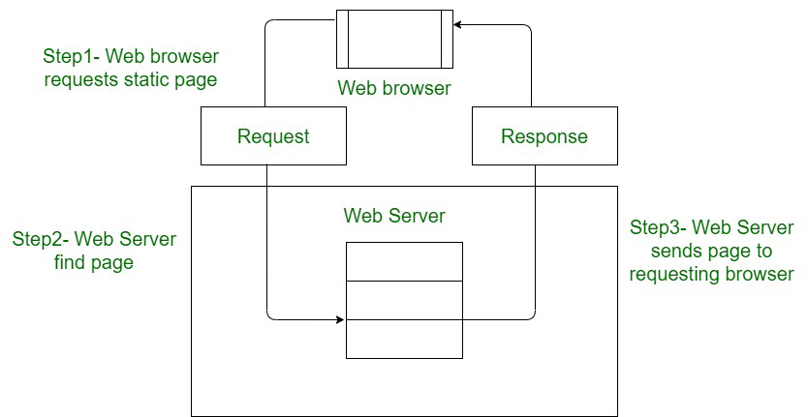
Static Website:
In Static Websites, Web pages are returned by the server which are prebuilt source code files built using simple languages such as HTML, CSS, or JavaScript. There is no processing of content on the server (according to the user) in Static Websites. Web pages are returned by the server with no change therefore, static Websites are fast. There is no interaction with databases. Also, they are less costly as the host does not need to support server-side processing with different languages.

Slide 20
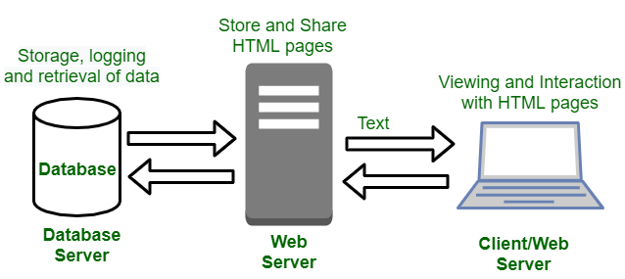
Dynamic Website:
In Dynamic Websites, Web pages are returned by the server which are processed during runtime means they are not prebuilt web pages but they are built during runtime according to the user's demand with the help of server-side scripting languages such as PHP, Node.js, ASP.NET and many more supported by the server. So, they are slower than static websites but updates and interaction with databases are possible.
Dynamic Websites are used over Static Websites as updates can be done very easily as compared to static websites (Where altering in every page is required) but in Dynamic Websites, it is possible to do a common change once and it will reflect in all the web pages.

Slide 21
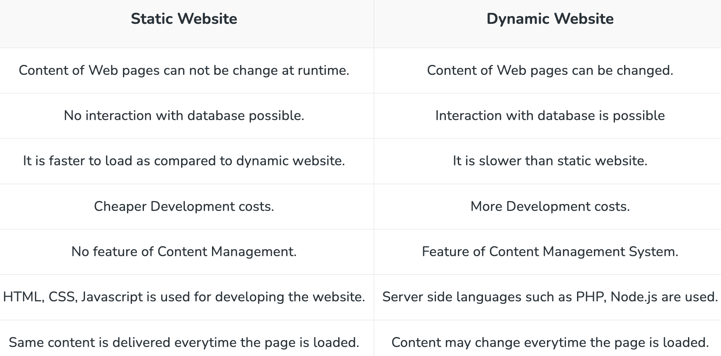
Difference Between Static and Dynamic Websites:

Slide 22
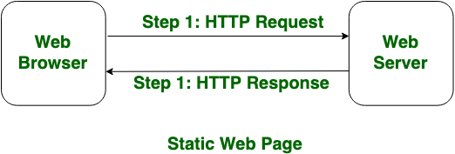
What are Static Web Pages?
Static Web pages are very simple. It is written in languages such as HTML, JavaScript, CSS, etc. For static web pages when a server receives a request for a web page, then the server sends the response to the client without doing any additional process. These web pages are seen through a web browser. In static web pages, Pages will remain the same until someone changes it manually.

Slide 23
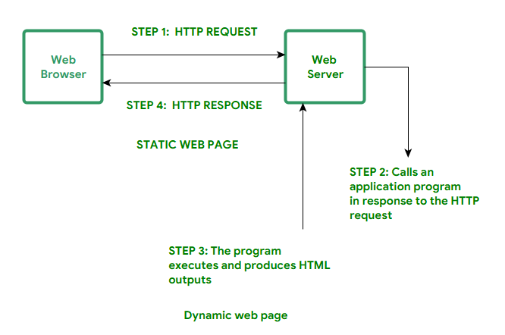
What are Dynamic Web Pages?
Dynamic Web Pages are written in languages such as CGI, AJAX, ASP, ASP.NET, etc. In dynamic web pages, the Content of pages is different for different visitors. It takes more time to load than the static web page. Dynamic web pages are used where the information is changed frequently, for example, stock prices, weather information, etc.

Slide 24
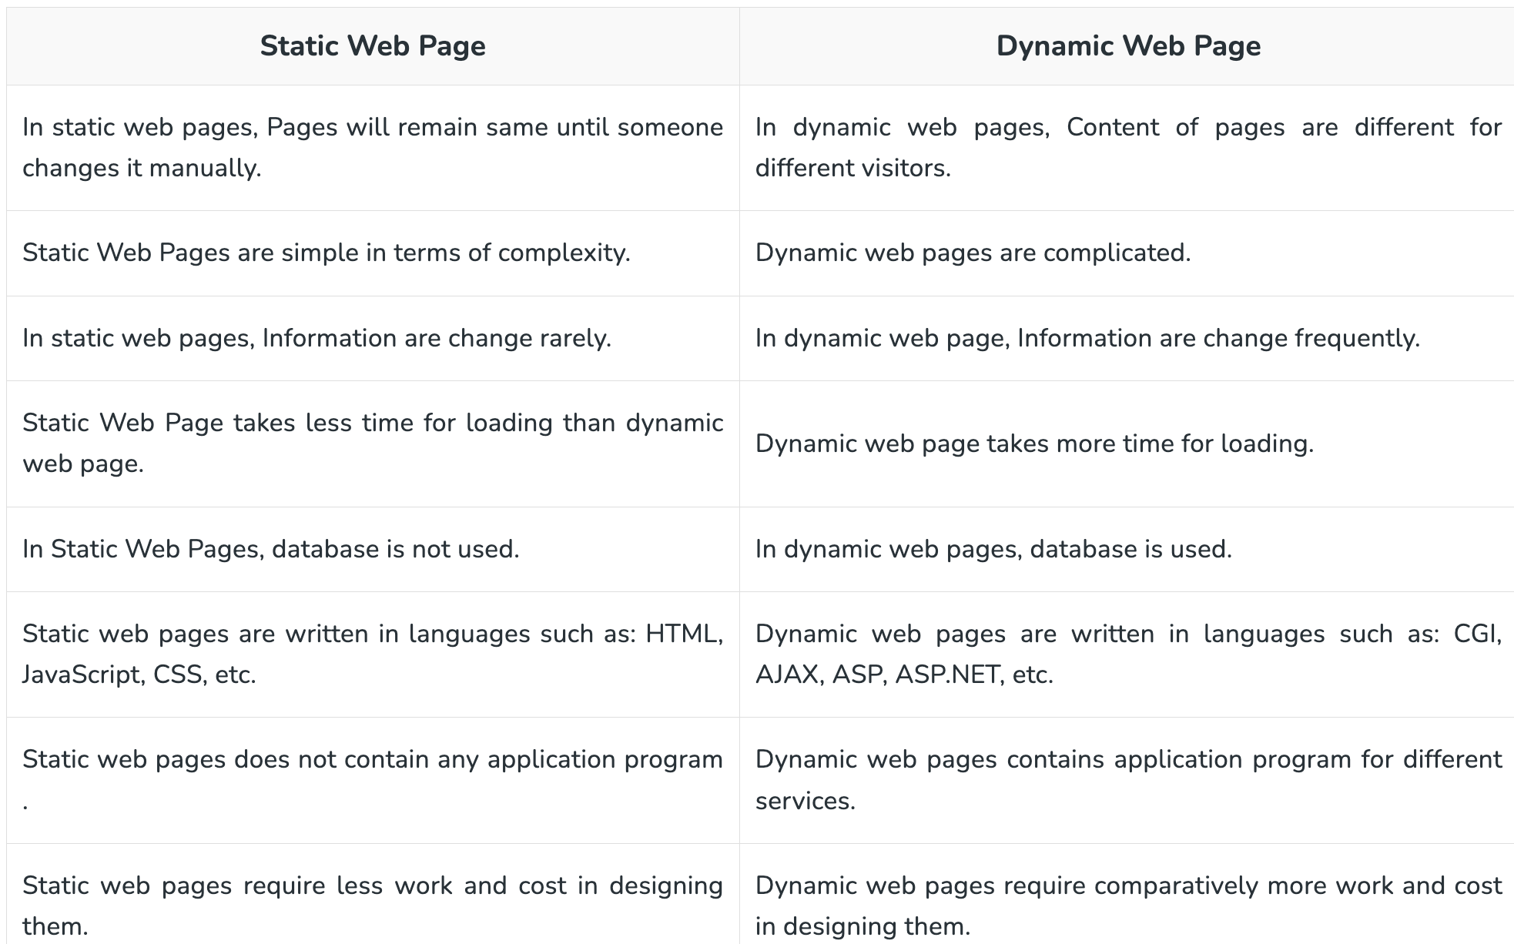
Difference Between Static and Dynamic Web Pages

Slide 25
What is a local development server?
You can run, test, and debug your applications on a local development server, which is an environment you set up on your own computer. It creates the actions of the real production server, helping you to:
Identify and resolve issues early.
Develop applications without internet connectivity.
Test configurations safely before going live.
For instance, while developing a web application, using a local server enables you to render pages dynamically, process backend scripts, and test application logic in a controlled setup.

Slide 26
Why Setting Up a Local Dev Server is Essential
Developers use local servers for several practical reasons:
Improved Workflow: Test code changes in real-time without delays.
Consistency Across Environments: Ensure the app works the same way locally as it will in production.
Faster Debugging: Quick identification and resolution of issues.
Enhanced Collaboration: Share your development setup with team members for synchronized development.

