Slide 1
Week 3. HTTP in Depth
Lecturer: MuksimovaShakhnoza
26.09.2025

Slide 2
Content
HTTP methods (GET, POST, PUT, DELETE)
Status codes
Headers, cookies, sessions
HTTPS and SSL basics

Slide 3

HTTP stands for Hypertext Transfer Protocol, and it’s the system that allows communication between web browsers (like Google Chrome or Firefox) and websites. When you visit a website, your browser uses HTTP to send a request to the server hosting that site, and the server sends back the data needed to display the page.
Think of HTTP as a set of rules or a language used by your browser and the web server to talk to each other, ensuring that websites load properly when you type in their URLs.

Slide 4
How HTTP Works:
Open Web Browser: First, you open your web browser and type a website URL (e.g., www.example.com).
DNS Lookup: Your browser asks a Domain Name System (DNS) server to find out the IP address associated with that URL. Think of this as looking up the phone number of the website.
Send HTTP Request: Once the browser has the website’s IP address, it sends an HTTP request to the server. The request asks the server for the resources needed to display the page (like text, images, and videos).
Server Response: The server processes your request and sends back an HTTP response. This response contains the requested resources (like HTML, CSS, JavaScript) needed to load the page.
Rendering the Web Page: Your browser receives the data from the server and displays the webpage on your screen.

Slide 5
What is HyperText?
HyperText is a way of structuring text so that it can contain links (called "hyperlinks") to other documents or resources. When you click on a link in a webpage, you are typically directed to another page or resource on the internet. HTML (HyperText Markup Language) is used to create and format this type of text for web pages.
HTTP is the protocol used to transfer this hypertext between the web browser and the server, allowing you to click links and move around the web.

Slide 6
HTTP methods (GET, POST, PUT, DELETE)
HTTP Protocol is necessary for data communication. In the context of the World Wide Web, an HTTP method is a request method that a client (e.g. a web browser) can use when making a request to a server (e.g. a web server). There are several HTTP methods that a client can use when making a request. In Flask, there are different methods to handle HTTP requests. e.g GET, POST, PUT, DELETE, HEAD. These methods are used to Send, Request, and Modify data on the server.

Slide 7
The GET Method
GET is used to request data from a specified resource.
Note that the query string (name/value pairs) is sent in the URL of a GET request:
/test/demo_form.php?name1=value1&name2=value2
Some notes on GET requests:
GET requests can be cached
GET requests remain in the browser history
GET requests can be bookmarked
GET requests should never be used when dealing with sensitive data
GET requests have length restrictions
GET requests are only used to request data (not modify)

Slide 8
The POST Method
POST is used to send data to a server to create/update a resource.
The data sent to the server with POST is stored in the request body of the HTTP request:
POST /test/demo_form.php HTTP/1.1 Host: w3schools.com name1=value1&name2=value2
Some notes on POST requests:
POST requests are never cached
POST requests do not remain in the browser history
POST requests cannot be bookmarked
POST requests have no restrictions on data length

Slide 9
The PUT Method
PUT is used to send data to a server to create/update a resource.
The difference between POST and PUT is that PUT requests are idempotent. That is, calling the same PUT request multiple times will always produce the same result. In contrast, calling a POST request repeatedly have side effects of creating the same resource multiple times.

Slide 10
The HEAD Method
HEAD is almost identical to GET, but without the response body.
In other words, if GET /users returns a list of users, then HEAD /users will make the same request but will not return the list of users.
A HEAD request is useful for checking what a GET request will return before actually making a GET request - a HEAD request can read the Content-Length header to check the size of the file, without actually downloading the file.

Slide 11
What are HTTP Status Codes ?
The HTTP status code is a response made by the server to the client's request. These are three-digit codes. There are over 60 status codes, but they fall into five main categories:
HTTP Protocol is used everywhere from the server page to each service communication, deploying service to monitoring service. HTTP codes give an extension of HTTP protocol to debug network problems using curl, telnet able to check server availability, service responses
HTTP status code is used for search engine optimization of how your pages get indexed, as well as how search engines perceive the performance of your site.

Slide 12
HTTP Response Status Codes
1xx - Informational Response (These status codes are all about the information received by the server when a request is made).
2xx - Success (This status code depicts that the request made has been fulfilled by the server and the expected response has been achieved).
3xx - Redirection (The requested URL is redirected elsewhere).
4xx - Client Errors (This indicates that the page is not found).
5xx - Server Errors (A request made by the client but the server fails to complete the request).

Slide 13
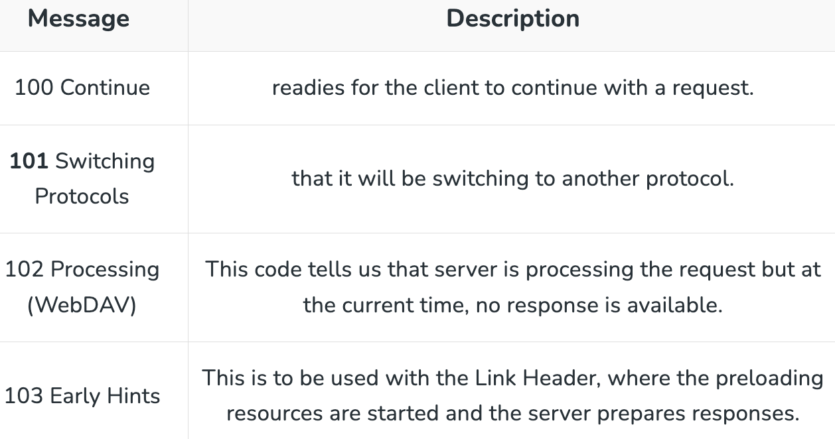
Informational Responses

Slide 14
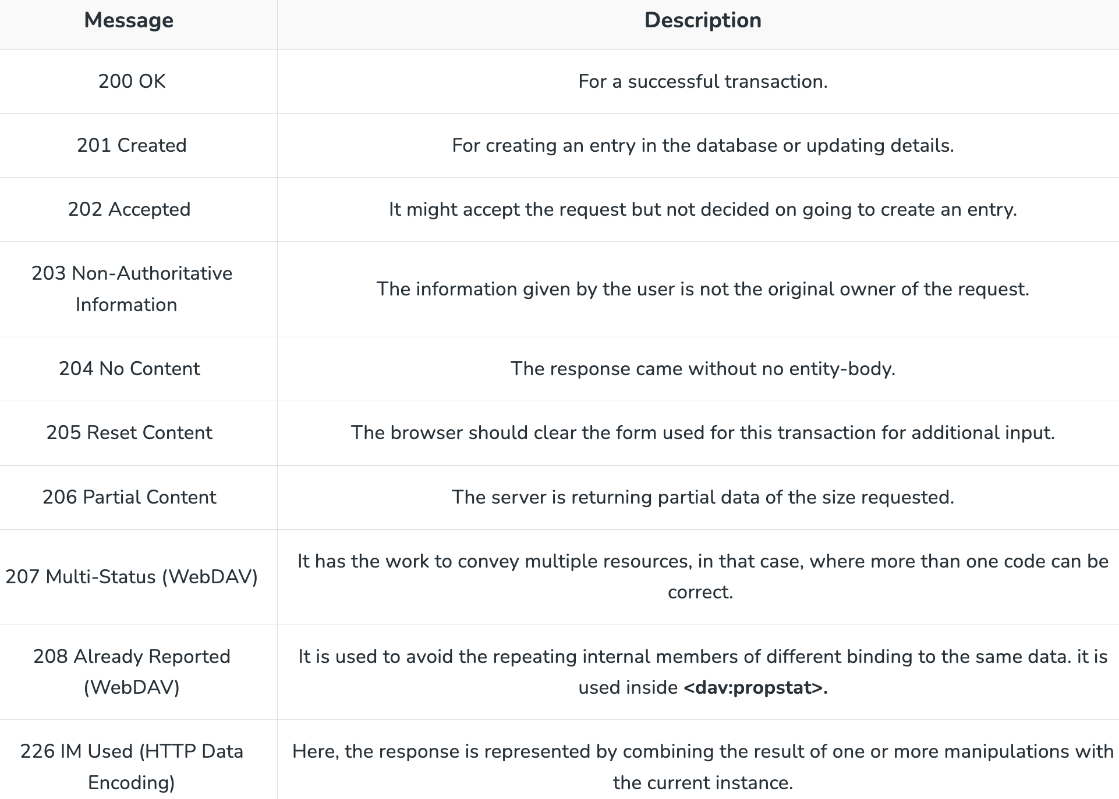
Success Response

Slide 15
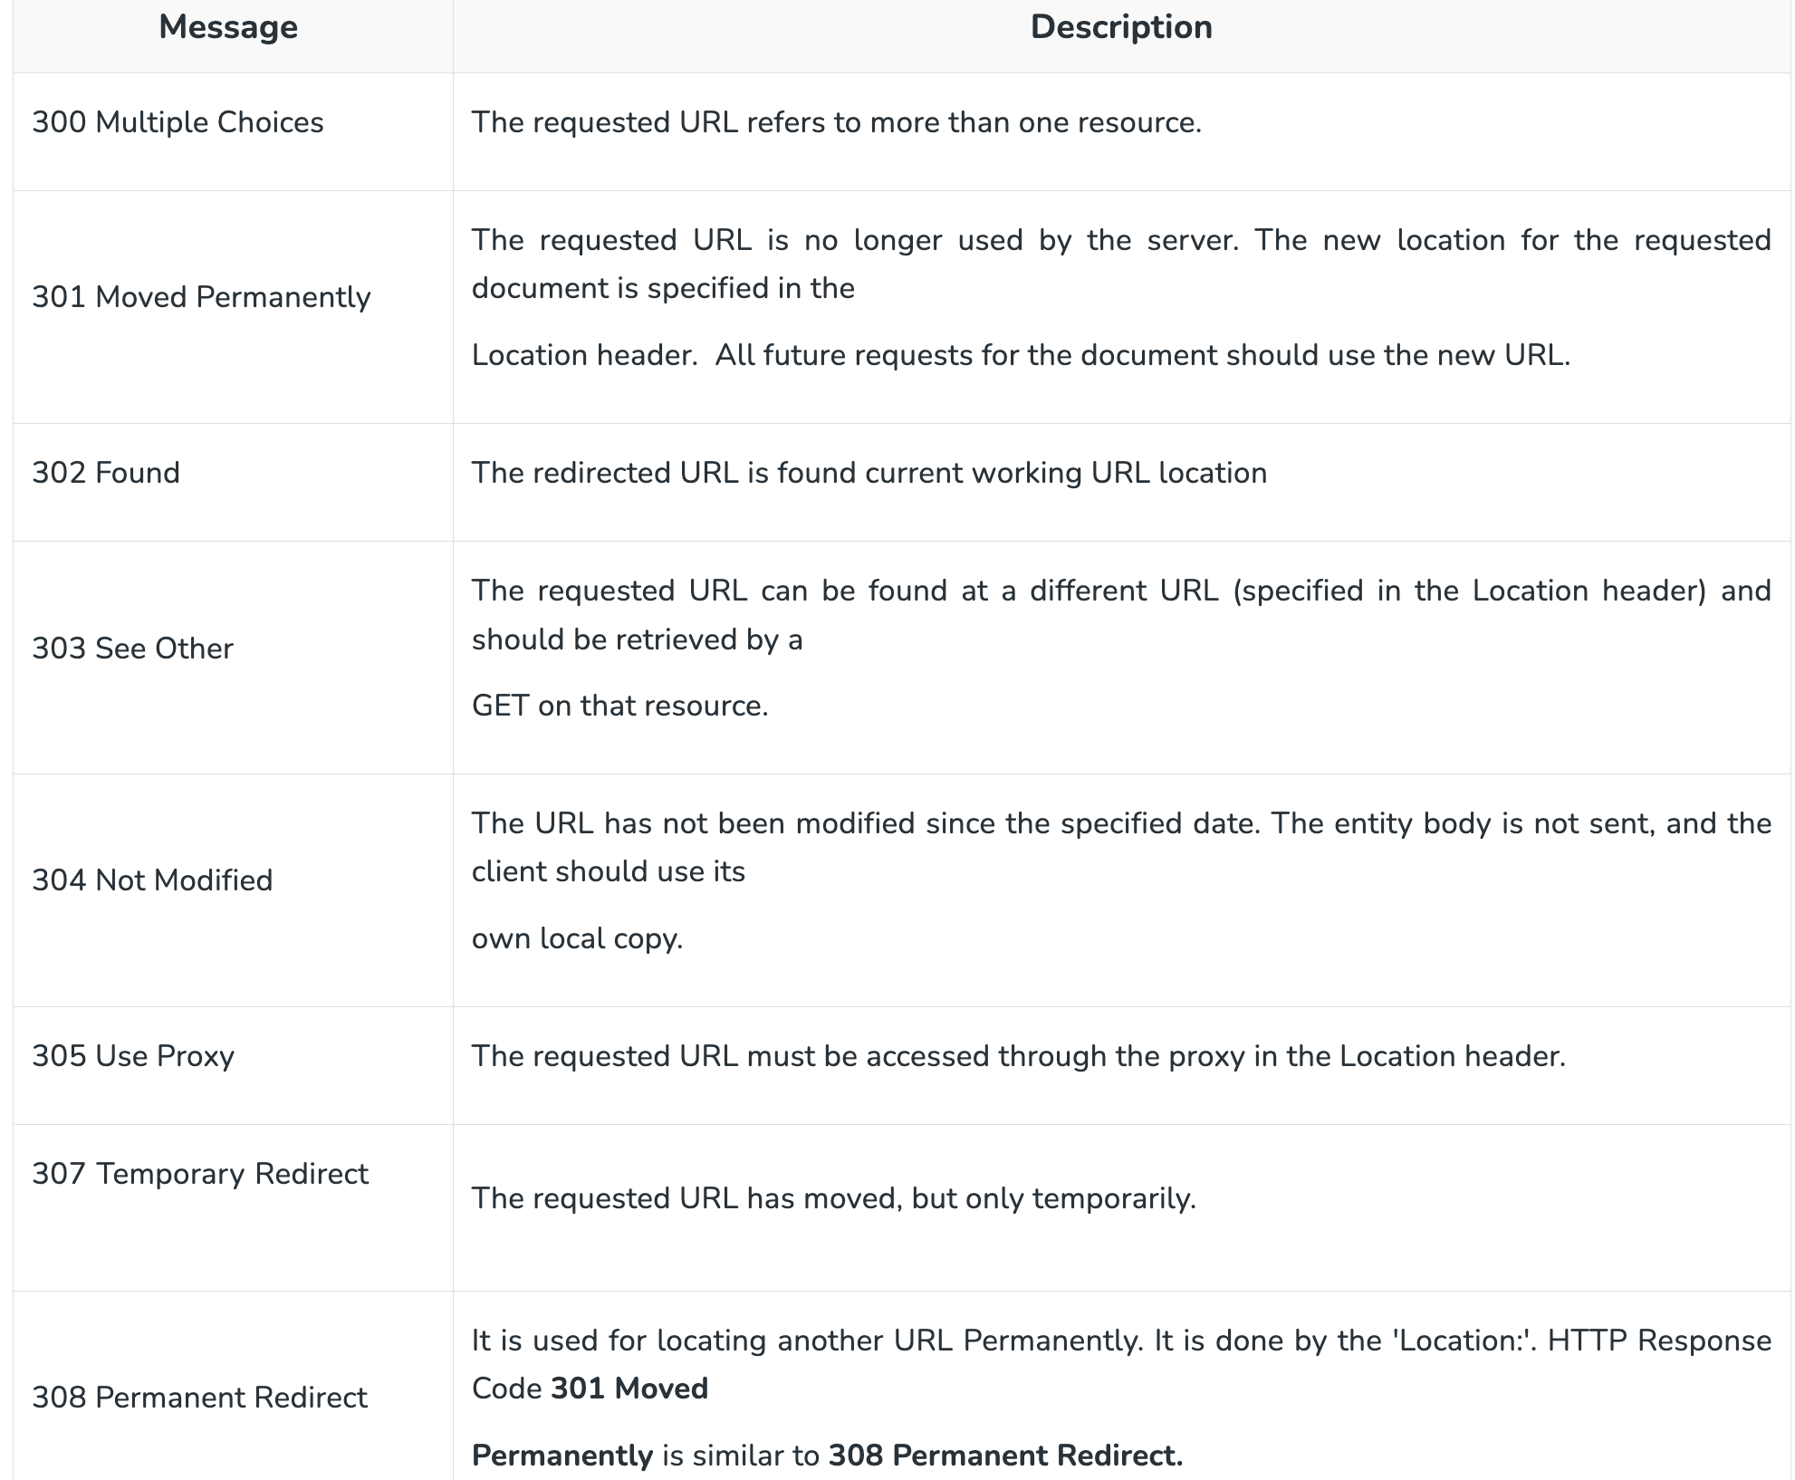
Redirection Messages

Slide 16
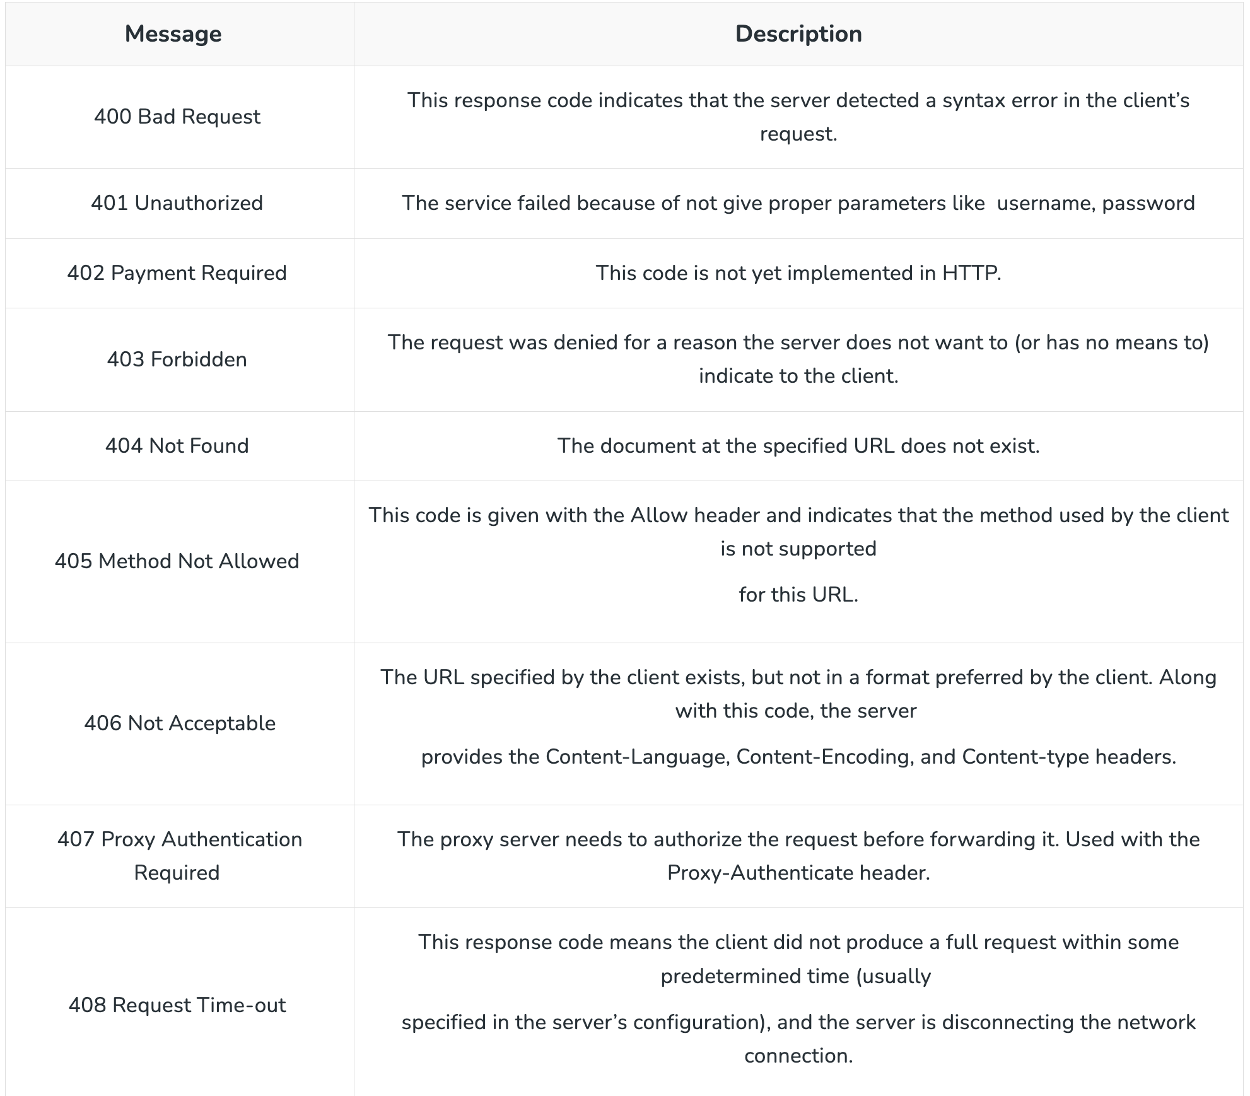
Client Error Responses

Slide 17
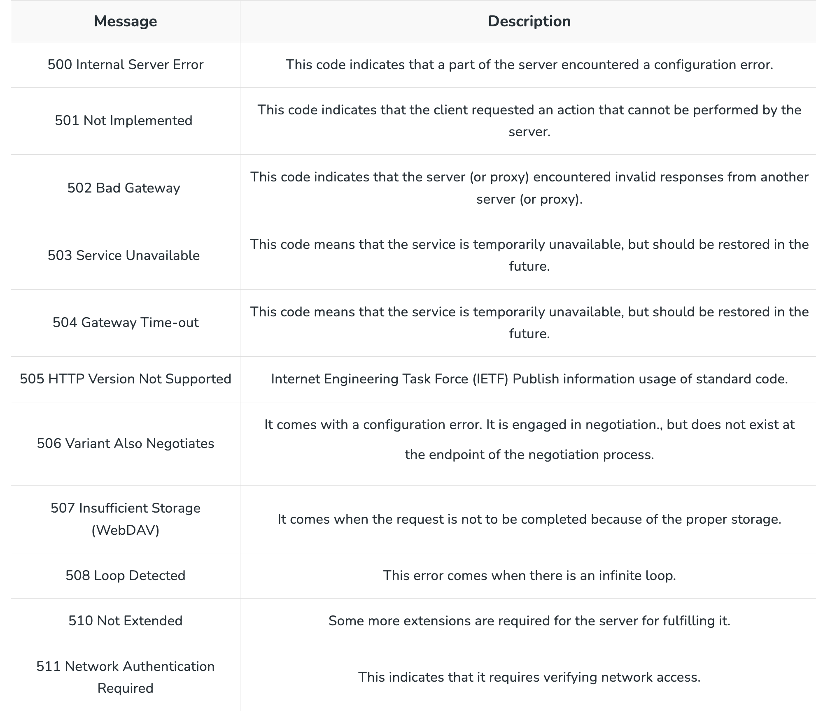
Server Error Responses

Slide 18
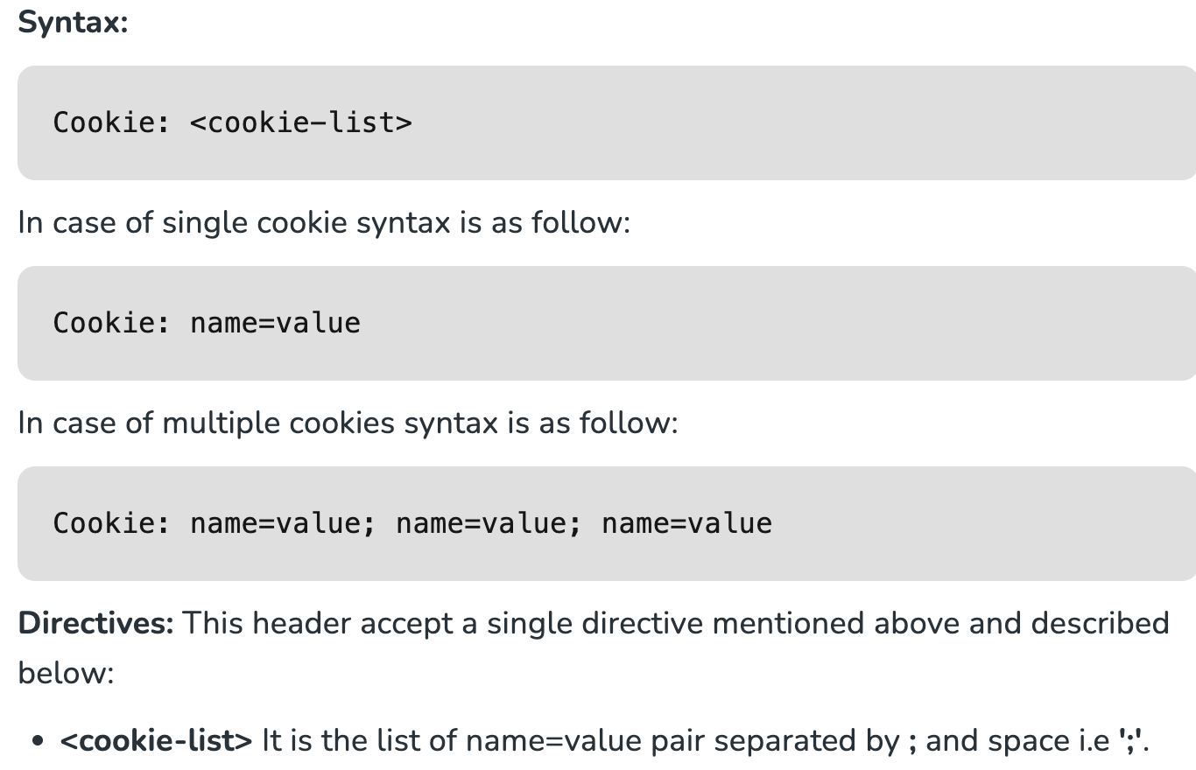
HTTP headers | Cookie
HTTP headers are used to pass additional information with HTTP response or HTTP requests. A cookie is an HTTP request header i.e. used in the requests sent by the user to the server. It contains the cookies previously sent by the server using one or more set-cookie headers. It is an optional header.

Slide 19
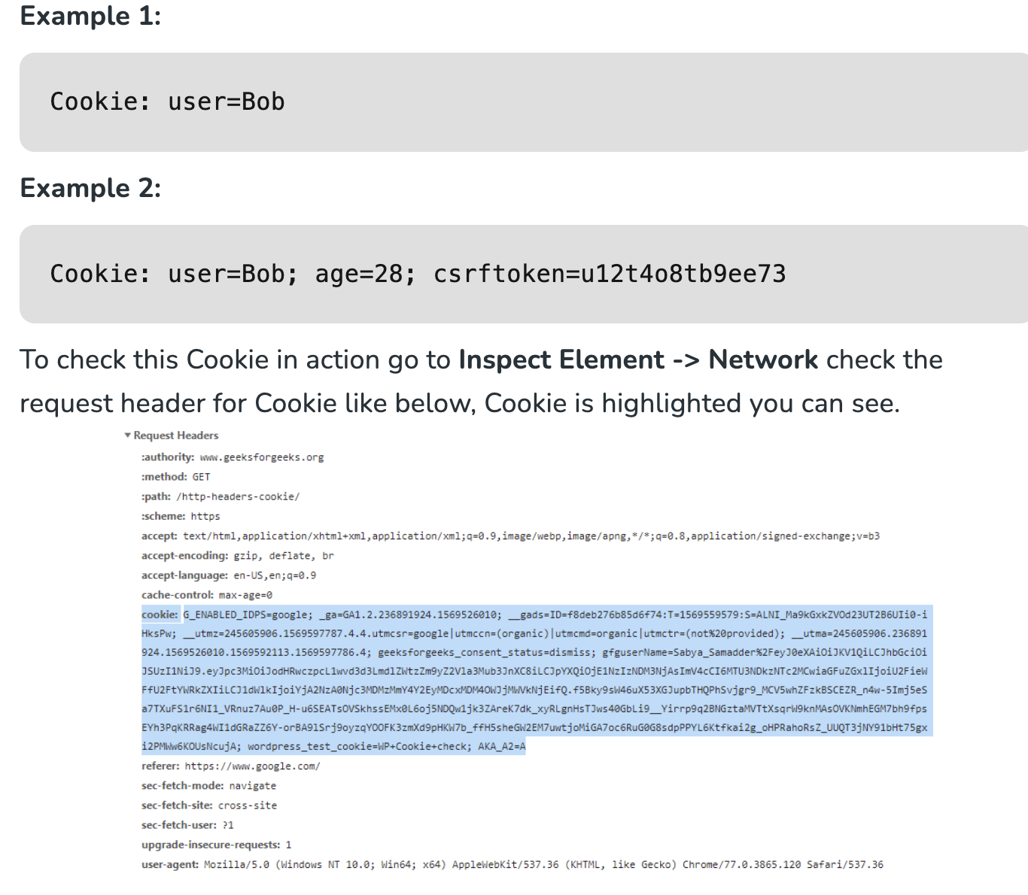

Slide 20
SSL vs HTTPS - Which One is More Secure? HTTPS
HTTPS stands for Hypertext Transfer Protocol Secure. It is the basic Internet protocol used by websites on web browsers. HTTPS is the secure version of the HTTP protocol. It is encrypted so it keeps all data transferred with the protocol completely safe. The HTTPS protocol is highly useful in places like logging in to a personal account or using banking credentials for a financial platform. HTTPS enables the information transferred between the web browser and the server to be confidential, and it can only be viewed by authorized users only. In the normal HTTP protocol, the information between the browser and the server is divided in the form of data packets and then transferred, so it becomes easy for attackers to sniff these data packets and then read out the sensitive information. But this cannot take place in HTTPS protocol.

Slide 21
SSL
The SSL stands for secure socket layers. SSL is basically a part of HTTPS protocol which is responsible for the encryption of the Internet security protocol. It is responsible for the integrity of data, the confidentiality of data, and its availability to authorized users only. SSL is the main protocol that performs the encryption task in HTTPS protocol to convert it into a random string of alphabets and numbers. SSL has a popular handshake authentication procedure where it authenticates and only allows authorized devices to perform the communication over the Internet. SSL also performs digital signatures on each of the conversations that take place over the Internet.

Slide 22

SSL or Https Which Is More Secure?
Both HTTPS and SSL perform the same thing of making the online transactions and conversations to be more secure and encrypted over the Internet. HTTPS and SSL are similar things but not the same.
HTTPS basically a standard Internet protocol that makes the online data to be encrypted and is a more advanced and secure version of the HTTP protocol.
SSL is a part of the HTTPS protocol that performs the encryption of the data.
HTTPS uses a combination of technologies like HTTP and SLL/TLS together to perform the encryption whereas the SSL protocol is a cryptographic protocol that will encrypt online communication.
HTTPS and SSL are fundamentally and structurally similar things and they perform operations but they are quite different in their approach.
SSL is a secure protocol that provides safer conversations between two or more parties across the internet. It works on top of the HTTP to provide security. In terms of security, SSL is more secure than HTTPS.

