Slide 1
Maps, views and algorithms

Slide 2
Maps – associative arrays
A file contains names and addresses of companies
Our application should enable quick search for company address based on its name
Map<String, String> map = new HashMap<>();
Scanner scan = new Scanner(new File("companies.txt"));
String companyName;
String address;
while (scan.hasNextLine()) {
companyName = scan.nextLine();
address = scan.nextLine();
map.put(firmName, address);
}

Slide 3
Maps – associative arrays
Naive implementation of a simple expert recommendation solution
switch(symptom) {
case "Symptom 1" :
showMessageDialog(null, "Do action A");
break;
case "Symptom 2" :
showMessageDialog(null, "Do action ABC");
break;
// ... case "Symptom 100" :
showMessageDialog(null,"Do action XYZ");
break;
default:
showMessageDialog(null, "Unknown symptom – no recommendation");
}
The presented approach is very poor and inflexible – lengthy algorithm for actually very simple feature – mapping symptom to recommendation
Support for next symptoms requires modification of algorithm and as the result consecutive deployment of the solution

Slide 4
Maps – associative arrays
A flexible solution can be based on maps – associative arrays which enable quick search for values based on keys
Map<String, String> diagMap = new HashMap<>();
for (Scanner sc = new Scanner(new File("diagnose.txt")); sc.hasNextLine(); ) {
diagMap.put(sc.nextLine(), sc.nextLine());
}
String symptom = showInputDialog("Give symptom");
String act = diagMap.get(symptom);
if (act == null) {
act = "Unknown recommendation";
}
showMessageDialog(null, act);

Slide 5
Maps – implementations
Java provides two basic Map<TKey, TValue> implementations:
HashMap<TKey, TValue> – implementation based on hash table
TreeMap<TKey, TValue> – implementation based on red-black tree
IMPORTANT NOTICE
HashSet and TreeSet implementation are based on HashMap and TreeMap correspondingly

Slide 6
Maps – implementations
Other – less commonly used – Map<TKey, TValue> implementations include:
LinkedHashMap<TKey, TValue> – preserves order the items are added to the collection
WeakHashMap<TKey, TValue> – based on hash map – enables garbage collecting no longer used entries (i.e. when key for entry is no longer in ordinary use)
IMPORTANT NOTICE
HashMap, TreeMap, LinkedHashMap and WeakHashMap:
do not ensure synchronized access
support null as key
support null as value
Hashtable<TKey, TValue> implementation of Map:
does not allow nulls
ensures synchronized access

Slide 7
Map – general operations
method name | provided feature
void clear() | removes all elements - optional
boolean containsKey(Object) | checks whether Map contains given key
boolean containsValue(Object) | verifies whether Map contains given value
Set<Map.Entry<TKey, TValue>> entrySet() | returns a set of entries – i.e. key-value pairs
TValue get(Object) | gets a value for the given key
boolean isEmpty() | checks whether Map is empty
Set<TKey> keys() | returns keys (unique) for the map
TValue put(TKey, TValue) | inserts a value for the given key – replaces existing mapping if given key already exists
void putAll(Map<TKey, TValue>) | inserts all elements of the given map
TValue remove(Object) | removes entry for the given key
int size() | returns number of contained items
Collection<TValue> values() | return values (non-unique) stored in map

Slide 8
Map – view methods
IMPORTANT NOTICE
View methods:
keys()
values()
entrySet()
do not create independent copies but refer to the original map – i.e. in case we somehow modify views we actually operate on the original map
Map.Entry type extending Set provides methods:
TKey getKey() – gets key for the entry
TValue getValue() – gets value of the entry
Tvalue setValue(TValue) – replaces old value with new and returns the replaced old value

Slide 9
Map – view methods – example
Map<String, Integer> map = new HashMap<>();
MapUtils.fill(map, "A", 1, "B", 2, "C", 3, "D", 100);
System.out.println(map);
Set<String> kset = map.keySet();
Collection<Integer> vcol = map.values();
Set<Map.Entry<String, Integer>> eset = map.entrySet();
kset.remove("A");
System.out.println(map);
vcol.remove(2);
System.out.println(map);
List<Map.Entry<String, Integer>> elist = new ArrayList<>(eset);
Map.Entry<String, Integer> entry = elist.get(0);
String key = entry.getKey();
Integer oldVal = entry.getValue();
entry.setValue(oldVal + 10);
System.out.println( "The value under key “ + key
+ " was " + oldVal + ", now increased by 10" );
System.out.println(map);
System.out.println(elist);
elist.remove(1);
System.out.println(elist);
System.out.println(map);
{A=1, B=2, C=3, D=100}
{B=2, C=3, D=100}
{C=3, D=100}
The value under key C was 3, now increased by 10
{C=13, D=100}
[C=13, D=100]
[C=13]
{C=13, D=100}

Slide 10
MapUtils – custom utility class
public class MapUtils {
/**
* Fills map with key-value pairs
* All keys must be of type K
* All values must be of type V
*/
static <K, V> Map<K,V> fill(Map<K,V> map, Object... kvPairs) {
check(map, kvPairs);
for (int i = 0; i < kvPairs.length; i+=2) {
map.put((K) kvPairs[i], (V) kvPairs[i+1]);
}
return map;
}
/**
* checks whether all keys are of type K and all values are of type V
*/
private static <K, V> void check(Map<K,V> map, Object... kvPairs) {
if (kvPairs.length % 2 != 0) {
throw new IllegalArgumentException("MapUtils.fill: invalid args size");
}
for (int i = 0; i < kvPairs.length-2; i++) {
if (kvPairs[i].getClass() != kvPairs[i+2].getClass()) {
throw new IllegalArgumentException("MapUtils.fill: invalid args types");
}
}
}
}

Slide 11
Map views are regular collections
Map<String, Integer> map = new HashMap<>();
MapUtils.fill(
map,
"A", 11,
"B", 2,
"C", 3,
"D", 100,
"E", 10);
System.out.println(map);
map.entrySet()
.removeIf(e -> e.getValue() < 10);
System.out.println(map);
{A=11, B=2, C=3, D=100, E=10}
{A=11, D=100, E=10}

Slide 12
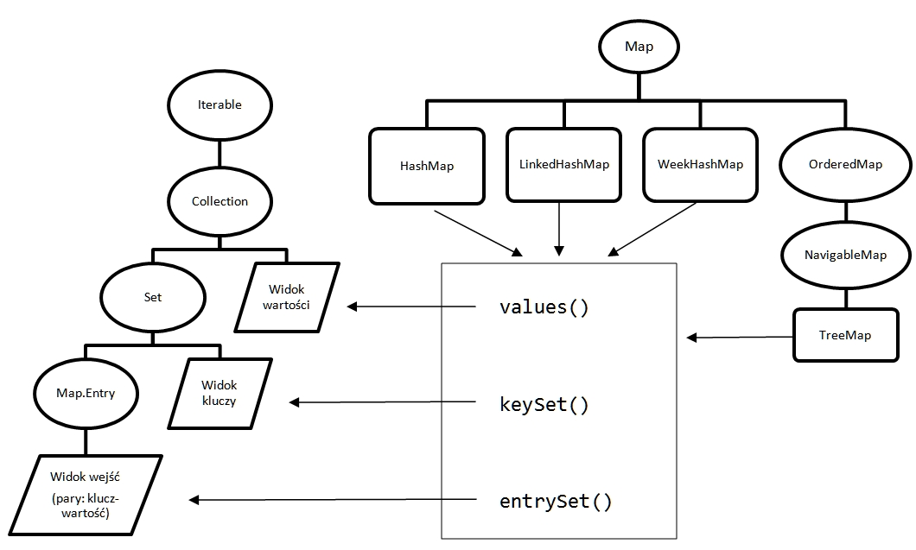
Map interfaces and implementations vs. collections

Slide 13
Iterating over maps
Maps do not implement either Collection or Iterable
Therefore we cannot directly iterate over maps
But we may iterate over map views
Map<String, Integer> map = new HashMap<>();
MapUtils.fill(
map,
"Ala", 1111,
"Asia", 3222,
"Jan", 3333,
"Lech", 2222
);
Map<String, Integer> backmap = new HashMap<>(map);
for (String name : map.keySet()) {
System.out.print(name + " ");
}
int sum = 0;
for (Integer p : map.values()) {
sum += p;
}
System.out.println("\n" + sum);

Slide 14
Iterating over maps
for (Iterator<String> it = map.keySet().iterator(); it.hasNext(); ) {
String key = it.next();
if (!key.startsWith("A")) {
it.remove();
}
}
System.out.println(map);
map = new HashMap<>(backmap);
for (Iterator<Integer> it = map.values().iterator(); it.hasNext(); ) {
Integer val = it.next();
if (val < 3000) {
it.remove();
}
}
System.out.println(map);
map = new HashMap<>(backmap);
for (Iterator<Map.Entry<String,Integer>> it = map.entrySet().iterator();
it.hasNext(); )
{
Map.Entry<String, Integer> entry = it.next();
Integer val = entry.getValue();
if (entry.getKey().startsWith("A")) {
entry.setValue(val+100);
}
}
System.out.println(map);

Slide 15
Iterating over maps
map = new HashMap<>(backmap);
for (Iterator<Map.Entry<String,Integer>> it = map.entrySet().iterator();
it.hasNext(); )
{
Map.Entry<String, Integer> entry = it.next();
Integer val = entry.getValue();
if (entry.getKey().startsWith("A")) {
entry.setValue(val + 100);
}
}
System.out.println(map);

Slide 16
Iterating over maps
for (String key : map.keySet()) {
Integer val = map.get(key);
System.out.println("Key = " + key + ", Val = " + val);
}
ineffective!
much better
for (Map.Entry<String, Integer> e : map.entrySet()) {
String key = e.getKey();
Integer val = e.getValue();
System.out.println("Key = " + key + ", Val = " + val);
}

Slide 17
Map – default methods
method name | provided feature
void forEach( BiConsumer<? super K,? super V> action) | invoke action for each element
TValue putIfAbsent(TKey key, TValue value) | inserts entry if there is no value under key
boolean remove(TKey key, TValue value) | removes mapping key -> value – standard remove() deletes entry under key
TValue getOrDefault( TKey key, TValue defaultValue) | tries to get value under key – returns defaultValue if there is no entry under key
boolean replace(TKey key, TValue value) | replaces entry for key with value
boolean replace( Tkey key, TValue oldValue, TValue newValue) | replaces entry for mapping key -> oldValue with key -> newValue
boolean replaceAll( BiFunction<? super Tkey, ? Super TValue, ? extends TValue> function) | replaces each entry with the result computed for each entry key and value

Slide 18
Map – default methods
method name | provided feature
TValue compute( TKey key, BiFunction<? super TKey, ? super TValue, ? extends TValue> remappingFunction) | More sophisticated version of replace Attempts to compute a mapping (i.e. new value) for specified key and its current mapped value (or null if there is no such mapping)
Usage example
map.compute(key, (k, v) -> (v == null) ? msg : v.concat(msg));
Method compute either
replaces current mapping
or creates new mapping in case no mapping exists
but unlike replace method it computes new value based on the current one instead of putting value provided by the user

Slide 19
Map – default methods
Default implementation of compute method entails the following steps
V oldValue = map.get(key);
V newValue = remappingFunction.apply(key, oldValue);
if (oldValue != null) {
/// computeIfPresent implementation
if (newValue != null) {
map.put(key, newValue);
} else {
map.remove(key);
}
} else {
/// computeIfAbsent implementation
if (newValue != null) {
map.put(key, newValue);
} else {
return null;
}
}

Slide 20
Map – default methods
method name | provided feature
TValue computeIfAbsent( TKey key, Function<? super TKey, ? extends TValue> mappingFunction) | compute value to be mapped for key if there is no value and inserts it unless computed value is null Part of compute method implementation highlighted with red on the previous slide
TValue computeIfPresent( TKey key, BiFunction<? super TKey, ? super TValue, ? extends TValue> remappingFunction) | compute value to be mapped for key if value already exists and inserts it unless computed value is null Part of compute method implementation highlighted with orange on the previous slide
TValue merge( TKey key, TValue value, BiFunction< ? super TValue, ? super TValue, ? extends TValue> remappingFunction) | if either there is no key -> value mapping or key is mapped to null, key will be mapped to result of remappingFunction

Slide 21
Map – forEach() default method
Instead of
for (String key : map.keySet()) { Integer val = map.get(key); System.out.println("Key = " + key + ", Val = " + val);
}
or more effective but still verbose
for (Map.Entry<String, Integer> e : map.entrySet()) {
String key = e.getKey();
Integer val = e.getValue();
System.out.println("Key = " + key + ", Val = " + val);
}
we can use more convenient and concise
map.forEach( (key, val) -> System.out.println("Key = " + key + ", Val = " + val) );

Slide 22
Map – forEach() default method
We can quite easily create two maps out of single initial map
Map<String, Integer> map = new HashMap<>();
MapUtils.fill(
map,
"Ala", 1111,
"Asia", 3222,
"Jan", 3333,
"Lech", 2222
);
Map<String, Integer> lowMap = new HashMap<>();
Map<String, Integer> highMap = new HashMap<>();
Integer threshold = 3000;
map.forEach(
(k, v) -> {
if (v > threshold) {
highMap.put(k, v);
} else {
lowMap.put(k, v);
}
}
);
System.out.println(lowMap);
System.out.println(highMap);
{Ala=1111, Lech=2222}
{Asia=3222, Jan=3333}

Slide 23
Map – forEach() default method
List<String> words = Arrays.asList(
"ala", "kot", "pies", "ala", "kot", "ala”
);
Map<String, Integer> freq = new HashMap<>();
for (String w : words) {
Integer n = 0;
if (freq.containsKey(w)) {
n = freq.get(w);
}
freq.put(w, n + 1);
}
System.out.println(freq);
equivalent but much shorter version based on getOrDefault() method
Map<String, Integer> fr = new HashMap<>();
words.forEach ( w -> fr.put(w, fr.getOrDefault(w, 0) + 1));
System.out.println(freq);

Slide 24
Map – replace() default method
String[] anim = {
"cat", "dog", "hamster", "hedgehog"
};
Map<String, String> clinic = new LinkedHashMap<>(); for (String a : anim) {
clinic.put(a, "sick");
} clinic.forEach((k, v) -> System.out.println(k + " - " + v)); Set<String> cured = new HashSet<>(
Arrays.asList("dog", "hedgehog") ); clinic.forEach(
(k, v) -> { if (cured.contains(k)) {
clinic.replace(k, "cured");
} else {
clinic.replace(k, "treated");
} }
); clinic.forEach(( k, v) -> System.out.println(k + " - " + v) );
cat - sick dog - sick hamster - sick hedgehog - sick cat - treated dog - cured hamster - treated hedgehog - cured

Slide 25
Map – replaceAll() default method
String[] anim = {
"cat", "dog", "hamster", "hedgehog"
};
Map<String, String> clinic = new LinkedHashMap<>(); for (String a : anim) {
clinic.put(a, "sick");
} clinic.forEach((k, v) -> System.out.println(k + " - " + v)); Set<String> cured = new HashSet<>(
Arrays.asList("dog", "hedgehog") );
clinic.replaceAll (
(k, v) -> cured.contains(k) ? "cured" : "treated“
); clinic.forEach(
(k, v) -> System.out.println(k + " - " + v)
);
cat - sick dog - sick hamster - sick hedgehog - sick cat - treated dog - cured hamster - treated hedgehog - cured

Slide 26
Map – compute() default method
System.out.println("Condition after first treatment stage:");
clinic.forEach( (k, v) -> System.out.println(k + " - " + v) );
Set<String> stayForObservation = new HashSet<>(Arrays.asList("dog"));
new HashSet<>(clinic.keySet())
.forEach(p -> clinic.compute(p,
(k,v) -> {
if (stayForObservation.contains(k)) {
return v + ", observation recommended";
}
if (v.equals("cured")) {
return null;
}
if (v.equals("treated")) {
return "cured";
}
return "unknown condition";
}
)
);
System.out.println("which animal stays in clinic and what is its condition:");
clinic.forEach( (k, v) -> System.out.println(k + " - " + v) );

Slide 27
Map – default methods and concurrent processing
IMPORTANT NOTICE
All discussed default methods are not thread safe – access to map is not synchronized
Accessing map via its synchronized views provided by Collections utility class does not solve the problem, either
To ensure thread safe Map processing we need to use java.util.concurrent.ConcurrentHashMap implementation

Slide 28
TreeMap – sorted keys
TreeMap stores entries sorted by key
either based on natural order (Comparable<T> implementation)
or based on Comparator<T> provided as constructor argument

Slide 29
TreeMap – sorted keys - example
List<String> words = Arrays.asList(
"ala", "kot", "ćwiek", "pies", "ala", "kot", "ala"
);
Map<String, Integer> fr = new LinkedHashMap<>();
words.forEach ( w -> fr.put(w, fr.getOrDefault(w, 0) + 1));
System.out.println(fr);
Map<String, Integer> st = new TreeMap<>(
(k1, k2) -> k1.compareTo(k2)
);
st.putAll(fr);
System.out.println("Sorted1: " + st);
st.clear();
st = new TreeMap<>(
Collator.getInstance(new Locale("pl"))
);
st.putAll(fr);
System.out.println("Sorted2: " + st);
{ala=3, kot=2, ćwiek=1, pies=1}
Sorted1: {ala=3, kot=2, pies=1, ćwiek=1}
Sorted2: {ala=3, ćwiek=1, kot=2, pies=1}

Slide 30
TreeMap – sorted keys - example
System.out.println(
"Below 'kot' disappeared,“
+ "'ala' presents 'kot' occurrence count:");
st.clear();
st = new TreeMap<>( // 'kot‘ occurrence count replaced occurrence count for 'ala'
(k1, k2) -> k1.length() - k2.length()
);
st.putAll(fr);
System.out.println("Sorted3: " + st);
st.clear();
st = new TreeMap<>(
(k1, k2) -> {
int r = k1.length() - k2.length();
if (r == 0) {
return 1;
}
return r;
}
);
st.putAll(fr);
System.out.println("Sorted4: " + st);
Map<String, Integer> last = st;
words.forEach ( w -> System.out.print(last.get(w) + " "));
Below 'kot' disappeared, 'ala' presents 'kot' occurrence count:
Sorted3: {ala=2, pies=1, ćwiek=1}
Sorted4: {ala=3, kot=2, pies=1, ćwiek=1}
null null null null null null null

Slide 31
TreeMap – sorting values
public static <K,V> Map<K, V> sortMapBy(
Map<K,V> srcMap, Comparator<Map.Entry<K,V>> comp)
{
List<Map.Entry<K,V>> entries = new ArrayList<>(srcMap.entrySet());
entries.sort(comp);
LinkedHashMap<K,V> resMap = new LinkedHashMap<>();
entries.forEach(
e -> resMap.put(e.getKey(), e.getValue())
);
return resMap;
}
public static void main(String[] args) {
Map<String, Integer> map = new HashMap<>();
MapUtils.fill(
map,
"AAA", 10,
"CCCCC", 7,
"BB", 2);
System.out.println(map);
map = sortMapBy(
map,
(e1, e2) -> e1.getValue() - e2.getValue());
System.out.println(map);
}
{BB=2, AAA=10, CCCCC=7}
{BB=2, CCCCC=7, AAA=10}

Slide 32
TreeMap – sorting values using Map.Entry interface features
method name | Provided feature
comparingByKey() | compares keys based on natural key ordering
comparingByKey(Comparator) | compares keys based on provided comparator
comparingByValue() | compares values based on natural value ordering
comparingByValue(Comparator) | compares values based on provided comparator
// instead of
map = sortMapBy( map, (e1, e2) -> e1.getValue() - e2.getValue() );
// we could achieve the same result with
map = sortMapBy( map, Map.Entry.comparingByValue() );

Slide 33
Collections utility class
method name | Provided feature
static int binarySearch( List<…> list, K key) | searches for the given key – returns index of element or -(index + 1) if element does not exist binarySearch enables us to insert new item to the collection so that it still remains sorted
static int binarySearch( List<…> list, K key, Comparator<…> c) | the same as above but using comparator instead of natural order
static void sort(List<T> list) | sorts elements based on natural order
static void sort( List<T> list, Comparator<…> c) | the same as above but using Comparator instead of natural order

Slide 34
Collections utility class – unmodifiable collection views
method
public static Collection unmodifiableCollection(Collection c)
public static Set unmodifiableSet(Set s)
public static List unmodifiableList(List list)
public static Map unmodifiableMap(Map m)
public static SortedSet unmodifiableSortedSet(SortedSet s)
public static SortedMap unmodifiableSortedMap(SortedMap m)

Slide 35
Collections utility class – synchronized collection views
method
public static Collection synchronizedCollection(Collection c)
public static Set synchronizedSet(Set s)
public static List synchronizedList(List list)
public static Map synchronizedMap(Map m)
public static SortedSet synchronizedSortedSet(SortedSet s)
public static SortedMap synchronizedSortedMap(SortedMap m)
IMPORTANT NOTICE
Synchronized view is only a wrapper for the original collection – we actually access the same collection
List list1 = new ArrayList();
List list2 = Collections.synchronizedList(list1); // wrapper to original
// collection is created

Slide 36
Iteration over synchronized collection views
Synchronized collection views do not ensure synchronized iteration – only particular collection methods are executed atomically
Iteration includes invocation of multiple operations of a collection so we need to provide atomicity ourselves
Collection c = Collections.synchronizedCollection(collection);
synchronized(c) {
Iterator i = c.iterator();
while (i.hasNext()) {
// ... i.next()
}
}
In case you want all Map operations to be synchronized and do not ensure atomicity by your own use ConcurrentHashMap

Slide 37
Iteration over synchronized maps
Map map = Collections.synchronizedMap(new HashMap());
// ...
Set keys = map.keySet(); // getting key set does not to be synchronized
//...
synchronized(map) { // map synchronization
Iterator i = keys.iterator();
while (i.hasNext()) {
// ... i.next()
}
}

Slide 38
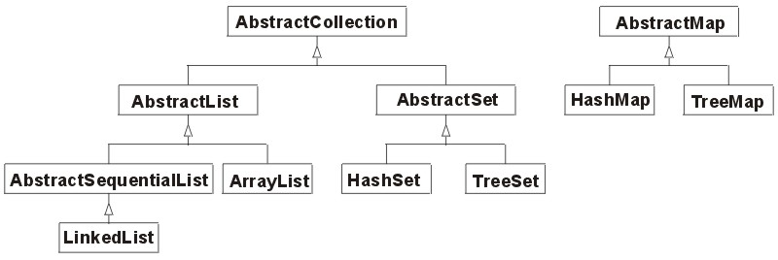
Custom collection implementation
CustomList
CustomHashSet
CustomCollection

