Slide 1
Design Patterns

Slide 2
What are design patterns?
Design patterns – used on multiple occasions and positively verified in practice solution schemes for frequently encountered problems in software design
Design patterns apply to design of a component of an application – not a single class
Design pattern is not a one-off solution to some specific problem but constitutes an approach a software developer can repeatably apply to commonly met issues
Design patterns should not be confused with application frameworks (e.g. Java Collections Framework) developed for particular software platforms
Design patterns are more general – they abstract from technical details and peculiarities attributed to particular platform

Slide 3
Why should we apply design patterns?
Design patterns facilitate development of more effective, scalable and robust applications
Design patterns are good and proven practices to be followed
But we should use particular patterns only if they are applicable
We should not redesign the software architecture only because we want to use design patterns

Slide 4
Common issues encountered in OO-based solutions
During development of solutions based on object oriented design one commonly encounters the following issues
overriding equals() method
reuse and encapsulation based on inheritance and/or composite
polymorphism and composition – delegating implementation of interfaces
copying (or cloning) instances
making instances immutable

Slide 5
Overriding equals() method
Overriding equals() makes sense only if content (i.e. properties) of particular instances could be compared
While defining universal classes to be reused on multiple occasions we should always take into account overriding equals() method
We shall consider overriding equals() in classes whose instances could be compared based on properties even if at particular moment such feature seems redundant
Obviously it frequently happens that developer does not know whether given class could be reusable and need for reuse could arise at maintenance stage

Slide 6
Overriding equals() method
Inexperienced Java developers often implement equals() by defining some specific type of argument – e.g. Vehicle or Car
Such implementation is based on overloading – not overriding
It is unusable in case elements of collections are compared when objects are converted to java.lang.Object
In such cases annotation @Override becomes handy – the compiler will verify whether our implementation actually overrides equals() delivered by the super classes

Slide 7
Overriding equals() method
In general we could enumerate a set of rules for defining equals()
equals() returns true in case method parameter refers to the current instance (this) – i.e. this == object
In case equals() method parameter value is null – equals() method should always return false
equals() should not raise any exception unless comparing two objects should never occur – then UnsupportedOperationException should be raised

Slide 8
Overriding equals() method
Developers frequently have dilemma how to compare instances of classes along the inheritance classes – e.g. instance of class Person against instance of Worker extending Person
Comparing instance of Person class against instance of Worker class which extends Person is very often not that trivial as it could seem at first glance
equals() implementation should enforce equivalence relationship which implies
symmetry – i.e. x.equals(y) == y.equals(x)
transitivity – i.e. x.equals(y) && y.equals(z) → x.equals(z)

Slide 9
Overriding equals() method
Inexperienced developers check whether parameter value is instance of the given class based on instanceof operator
class Person {
...
@Override
public boolean equals(Object object) {
...
if (!(object instanceof Person)) {
return false;
}
Person person = (Person)person;
...
// part which compares properties of Person
}
}

Slide 10
Overriding equals() method
The corresponding equals() defined in Worker subclass
class Worker extends Person {
...
@Override
public boolean equals(Object object) {
...
if (!(object instanceof Worker)) {
return false;
}
Worker worker = (Worker)object;
...
// part which compares properties of Worker
}
}

Slide 11
Overriding equals() method
Such an approach does not provide equivalence relationship because it does not ensure symmetry
Person person = new Person(...);
Worker worker = new Worker(...);
boolean personAgainstWorker = person.equals(worker); // true
boolean workerAgainstPerson = worker.equals(person); // false

Slide 12
Overriding equals() method
We could ensure symmetry relationship by modifying equals() overridden in class Worker
class Worker extends Person {
...
@Override
public boolean equals(Object object) {
...
if (!(object instanceof Person)) {
return false;
}
if (!(object instanceof Worker)) {
return super.equals(object);
}
Worker worker = (Worker)object;
...
// part which compares properties of Worker
}
}

Slide 13
Overriding equals() method
However the requirement for transitivity is still not met
Person person = new Person("John");
Worker worker1 = new Worker("John", 1000);
Worker worker2 = new Worker("John", 2000);
person.equals(worker1); // true
person.equals(worker2); // true
worker1.equals(worker2); // false --- the second property (salary) differs
// it was not taken into account while comparing
// worker against person

Slide 14
Overriding equals() method
The conservative – and very pragmatic solution could be exact comparing types of two instances
class Person {
...
@Override
public boolean equals(Object object) {
...
if (this.getClass() != object.getClass()) {
return false;
}
...
// part which compares properties of Person
}
}
This is a very common approach which is by default supported by IDEs (e.g. Eclipse)

Slide 15
Overriding equals() method
Exact comparing types of two instances suffices in most cases
However in particular cases it may appear inadequate
For instance in case we override equals() for class hierarchy of JPA entities – i.e. when we map inheritance to particular relational representation
In such cases comparing instance types may not be so important as comparing primary key values

Slide 16
Inheritance vs. composite
Inheritance is a very powerful feature enabling reuse of implementation
Many software developers either forget or may be not quite aware that inheritance could also be replaced with composite
Composite is an alternative to regular inheritance which allows us to avoid problems which arise because of inheritance constraints
However composite usage is explicit and so requires writing more code – unlike inheritance which is a built-in feature

Slide 17
Inheritance vs. composite
A skillful usage of composite and interfaces enables us to bypass the single-inheritance constraint enforced by both Java as well as Microsoft .NET platforms
interface IWorker {
BigDecimal salary();
}
interface IParent {
int childrenCount();
}
class Worker implements IWorker {
Person _person;
Worker(Person person) { _person = person; }
}
class Parent implements IParent {
Person _person;
Parent(Person person) { _person = person; }
}

Slide 18
Inheritance vs. composite
class Person implements IWorker, IParent {
IWorker _worker;
IParent _parent;
Person() {
_worker = new Worker(this);
_parent = new Parent(this);
}
public BigDecimal salary() {
return _worker.salary();
}
public int childrenCount() {
return _parent.childrenCount();
}
}

Slide 19
Inheritance vs. composite
In general inheritance is considered to be very attractive approach for reuse
However inheritance imposes single-inheritance – which may entail undesirable restrictions on object features
Sometimes we want our data structure to better reflect that object may either (1) take or (2) give up certain roles during its life-cycle
Inheritance assumes rigid connection between object and its features
In particular cases some of the features require allocation of additional resources – esp. scarce ones such as file descriptors (handles)
In such cases lazy initialization may be good choice

Slide 20
Inheritance vs. composite
In the enumerated cases composite may appear much better and more intuitive choice compared to inheritance
In case multi-inheritance is required – composite combined with interfaces is the only feasible option then

Slide 21
Copying (cloning) instances
Very often creating another reference to the object does not suffice and we need to create an object of the same properties as the existing one
For instance we want to transfer the object over the network
Obviously it is infeasible to directly refer to an object hosted by the other node (or actually JVM instance)

Slide 22
Copying (cloning) instances
Since the very beginning Java supports object cloning
java.lang.Object provides protected method clone() which copies properties of the original instance
clone() implementation creates a shallow copy
Fields of the reference types (interfaces of classes) refer to the same objects as corresponding fields of original instance

Slide 23
Copying (cloning) instances
Very often – for instance if we want to transmit instance over the network – default clone() implementation is not satisfactory
It seems natural that in such cases we could override clone() so that it is more adequate for the specific needs

Slide 24
Copying (cloning) instances
Since clone() is a method delivered by java.lang.Object we can create a shallow copy of any reference type instance
Such feature does not always seem to be particularly desirable
Therefore Java defines Cloneable marker interface to distinguish types which should support cloning
In case we call clone() on instance of type not marked with Cloneable interface exception CloneNotSupportedException is raised
CloneNotSupportedException is a checked exception and so we need to handle it regardless whether the class has been marked with Cloneable or not

Slide 25
Copying (cloning) instances
Unnecessary handling checked CloneNotSupportedException is not the only problem in case we decide to use clone()
Another issue is the fact that clone() method is protected – therefore we can encounter the problem in case we want to implement deep copy of classes not defined in the same package
Therefore overriding clone() in custom classes usually does not make much sense
It poses more difficulties than it solves
Obviously one could bypass the discussed constraints with reflection but it will negatively impact the performance

Slide 26
Copying (cloning) instances
Defining custom interface ICloneable which uses default clone() implementation if applicable seems a better option

Slide 27
Immutable instances
Making an instance immutable is one of the most important concept in object-oriented design
By definition an immutable object MUST DISALLOW ANY CHANGES AFTER IT HAS BEEN INSTANTIATED

Slide 28
Immutable instances
Making object immutable affects many aspects of its usage – esp. the ones which are related to performance
First of all we do not need to validate changes made on immutable objects
We are always certain that immutable instances remain consistent during entire life-cycle
In addition we do not need to synchronize multiple threads accessing an immutable object

Slide 29
Immutable instances
Also while defining a constructor which initializes the object we should always consider what properties of the given instance should remain unmodified for the entire life-cycle
This enables verification whether we do not modify the read-only property with a compiler
Harnessing compiler to avoid diagnosing some issues which could be detected during runtime saves our time and improves robustness of the solution

Slide 30
Gang of Four (GoF) design patterns
In 1994 Erich Gamma, Richard Helm, Ralph Johnson and John Vlissides published a book covering 23 different design patterns illustrated by samples in Smalltalk and C++
Because of number of authors – i.e. four – the authors are commonly referred as the Gang of Four
Book titled “Design Patterns: Elements of Reusable Object-Oriented Software” is considered as one of the most influential books in the field of software engineering

Slide 31
Gang of Four (GoF) design patterns
GoF distinguished three different types of design patterns
Creational design patterns are responsible for instantiating objects
Creational design pattern encapsulate creating objects so that API responsible for creating objects is more flexible way than directly by calling constructors
Structural design patterns enable building new features founded on standard object-oriented measures such as inheritance and interfaces
Behavioral design patterns are concentrated on communication between objects

Slide 32
Creational design patterns
Name | Application | Often combined with design patterns | Similar design patterns
Factory Method | Creating instance | Template Method | Abstract Factory Template Method Prototype
Abstract Factory | Creating instance | Factory Method Prototype Singleton + Facade | Factory Method Prototype Singleton
Singleton | Controlling access to objects |  | Abstract Factory Builder Prototype

Slide 33
Creational design patterns
Name | Application | Often combined with design patterns | Similar design patterns
Builder | Creating object – builder object holds initialization parameters Resolves telescoping constructor anti-pattern |  | Abstract Factory Composite
Prototype | Creating instance – prototypical instance is used for cloning objects |  | Composite Decorator
Telescoping constructor anti-pattern – increasing number of parameter combinations exponentially raises number of constructors

Slide 34
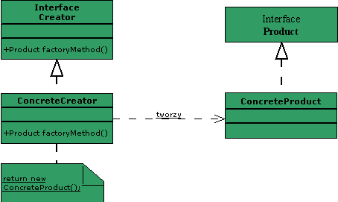
Factory Method
Factory method defines a standard manner for creating objects regardless of their type

Slide 35
Factory Method
interface MsgDisplay {
void show(String msg);
}
// And two different implementations
class ConsoleDisplay implements MsgDisplay {
public void show(String s) {
System.out.println(s);
}
}
class DialogDisplay implements MsgDisplay {
public void show(String s) {
JOptionPane.showMessageDialog(null, s );
}
}

Slide 36
Factory Method
Instead of directly instantiating concrete implementation
MsgDisplay msg = new ConsoleDisplay(); // potentially may be used in multiple
// places in our code
// which implicates multiple changes
// if we decide to use some other
// implementation
msg.show("Bad");
We can introduce a factory which encapsulates creating object
class MsgDisplayFactory {
public static MsgDisplay getInstance() {
return new DialogDisplay(); // in case we decide to use different
// implementation the required changes are
// limited only to definition of
// getInstance() method
}
}

Slide 37
Factory Method
Usages of our factory method will remain intact
MsgDisplay msg = MsgDisplayFactory.getInstance(); // there is no need to modify
// usage of encapsulating API
msg.show("Good");

Slide 38
Factory Method
Behaviour of factory method may depend on passed parameters – or in general a context provided during runtime
The piece of code requesting the object – i.e. client – does not bother what type of object should be provided – it assumes a correct instance is provided
We encapsulate entire complexity related with instantiating an object with a simple API

Slide 39
Factory Method
public static Calendar getInstance()
{
Calendar cal = createCalendar(TimeZone.getDefaultRef(), Locale.getDefault());
cal.sharedZone = true;
return cal;
}
private static Calendar createCalendar(TimeZone zone, Locale aLocale)
{
// If the specified locale is a Thai locale, returns a BuddhistCalendar
// instance.
if ("th".equals(aLocale.getLanguage()) && ("TH".equals(aLocale.getCountry()))) {
return new sun.util.BuddhistCalendar(zone, aLocale);
}
// else create the default calendar
return new GregorianCalendar(zone, aLocale);
}

Slide 40
Abstract Factory
Abstract Factory is an extension to Factory Method introducing an abstraction layer in factory creation
Instead of single factory method encapsulating some sophisticated behaviour depending on parameters and context developer may provide different factory objects which behave different in the same context
Abstract Factory enhances Factory Method based on standard inheritance and polymorphism mechanisms provided by object-oriented platforms

Slide 41
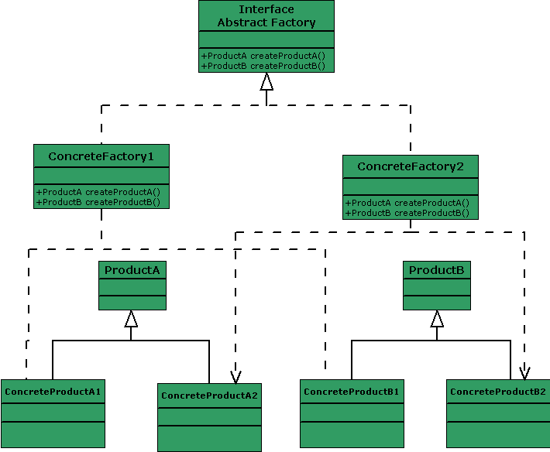
Abstract Factory

Slide 42
Singleton
Singleton – one of the design patterns focused on controlling number of instances of the class
Singleton ensures that there is a single instance of particular class (or interface implementation)
Singleton enables a uniform interface for getting this object or calling its features
Singleton can be also implemented as a class with a private constructor and static methods – then using any kind of polymorphism is not feasible
Singleton object is then not created at all – private constructor disallows instantiating class object externally

Slide 43

Singleton
A classical singleton implementation
public class ClassicSingleton {
private static ClassicSingleton instance = null;
private ClassicSingleton() { // private constructor
... // instantiating object in external code is
} // disallowed
public static ClassicSingleton getInstance() {
if (instance == null) {
instance = new ClassicSingleton(); // lazy instantation – not always
} // needed
// sometimes it is better to have
// a read-only static field
return instance;
}
}

Slide 44
Singleton – concurrency issues
The presented singleton implementation has a very serious drawback
It does not prevent parallel instantiation of singleton in concurrent threads
public static synchronized Singleton getInstance() {
if (obj == null) {
obj = new Singleton();
}
return obj;
}

Slide 45
Singleton – concurrency issues
Note that synchronization is only required when object is instantiated
After object is created synchronization is redundant and unnecessarily slows down accessing singleton object
Therefore this issue can be solved better and more consistently by creating a singleton on class loading and assigning to read-only static field
class Singleton {
private static final Singleton obj = new Singleton();
private Singleton() { ... } // private constructor
public static Singleton getInstance() {
return obj;
}
}
However we still need to remember about synchronizing accessing singleton method in case they change the state of the object

Slide 46
Singleton – different class loaders
In Java a read-only static field is initialized by a class loader
Servlet containers may use different class loaders for different parts of application
This implies that multiple instances of singleton may be created
In such cases we should use JNDI for accessing the singleton

Slide 47
Structural design patterns
Name | Application | Often combined with design patterns | Similar design patterns
Adapter | Adapting API |  | Bridge Decorator Proxy
Composite | Composition/decomposition of more complex objects |  | Decorator Iterator Visitor
Decorator | Facilitated augmenting objects with some additional features |  | Adapter Composite Strategy
Façade | Simplifies accessing object features |  | Abstract Factory Mediator
Flyweight | Sharing resources – limiting memory requirements |  | Singleton State Strategy Shareable

Slide 48
Structural design patterns
Name | Application | Often combined with design patterns | Similar design patterns
Proxy | Controlling access to the feature |  | Adapter Decorator
Bridge | Decouples abstraction (abstract API) from implementation – encapsulated and adapted interface |  | Adapter Abstract Factory

Slide 49
Flyweight
Flyweight is another design pattern aimed at controlling actual number of instances
Logically there are many referred object – but many of those objects are actually the same – i.e. they have the same properties
Flyweight objects should be – most commonly – immutable
Changing object properties may affect other client objects which still assume the given object has old property values
Java enumeration types are specific implementation of Flyweight – instances are not created on-the-fly based on particular parameters but named

Slide 50
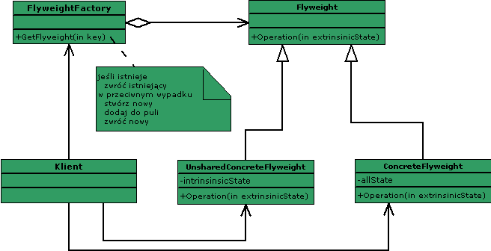
Flyweight

Slide 51
Flyweight
final class Dimension {
private int width;
private int height;
public Dimension(int w, int h) {
width = w;
height = h;
}
public int getWidth() { return width; }
public int getHeight() { return height; }
public String toString() { return width + "x" + height; }
}

Slide 52
Flyweight
class BoxDimensionFactory {
// frequently occurring widths
private int[] widths = { 10, 20, 30, 40, 50, 60, 70 };
// shared (reusable) box sizes
private Dimension[] d = new Dimension[widths.length];
// factory singleton
private static final BoxDimensionFactory bdf;
static {
bdf = new BoxDimensionFactory();
}
public Dimension makeDimension(int w) {
for (int i = 0; i < widths.length; i++) {
if (w == widths[i]) { // if w is one the frequently used widths
if (d[i] == null) {
d[i] = new Dimension(w, 2*w);
}
return d[i];
}
return new Dimension(w, 2*w);
}
}

Slide 53
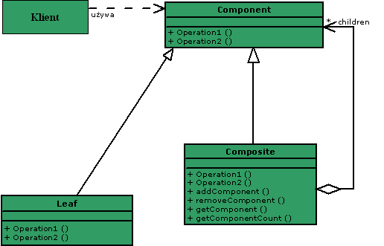
Composite
Composite design pattern builds complex objects so that composite objects and their parts can be submitted to the same type of operations
An example of Composite pattern implementation in Java platform is Swing Container which extends Swing Component

Slide 54
Behavioral design patterns
Name | Application | Often combined with design patterns | Similar design patterns
Command | Separating action |  | Composite Memento Prototype
Iterator | Navigation amongst objects |  | Composite Factory Method Memento
Observer | Communication between objects Components decoupling |  | Mediator Singleton
State | Object state changes |  | Flyweight Singleton
Strategy | Selecting algorithm behaviour during runtime |  | Flyweight State Template Method

Slide 55
Behavioral design patterns
Name | Application | Often combined with design patterns | Similar design patterns
Template Method | Define skeleton of algorithm Certain algorithm steps can be refined in subclasses |  | Composite Memento Prototype
Chain-of-Responsibility | Series of processing objects passing handling request – in case request is not supported it is forwarded to next processor in the chain |  | Composite
Mediator | Encapsulates communication mechanism between objects |  | Façade Observer

Slide 56
Behavioral design patterns
Name | Application | Often combined with design patterns | Similar design patterns
Visitor | Separates processing algorithm from the object it operates on | Composite | Composite Visitor
Interpreter | Used for building Abstract Syntax Tree for the given language Based on idea that particular class should represent a terminal or non-terminal of a language grammar |  | Composite
Memento | Enables restoring object to its previous state – i.e. undo changes |  | Command Iterator

Slide 57
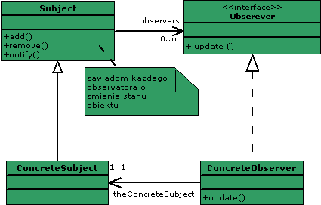
Observer
Observer defines dependencies between objects
Observer objects are notified each time when observed objects change their status

Slide 58
Observer
Observer facilitates decoupling objects by enabling communication between unbound objects
Java delivers interface Observer and Observable class
However these types are rarely used because object to be observed must extend Observable class which is inconvenient and imposes unnecessary constraints
In Java Observer design pattern implementations are called simply listeners – e.g. ActionListener, ListSelectionListener etc.

Slide 59
Visitor
Visitor defines operations to be run on objects – either simple or composite ones
Separating operations from visited objects enables introducing new features – i.e. operations – without modifying the objects to be processed

Slide 60
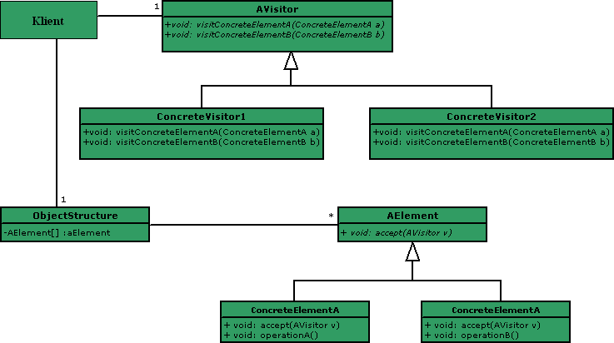
Visitor

Slide 61
Visitor
interface Visitor {
public void visit(HasHeadAche p);
public void visit(HasStomachAche p);
public void visit(HasPainInLeg p);
}
class Treatment implements Visitor {
public void visit(HasHeadAche p) {
System.out.println(p);
System.out.println("Takes aspirin");
}
public void visit(HasStomachAche p) {
System.out.println(p);
System.out.println("Takes activated carbon");
}
public void visit(HasPainInLeg p) {
System.out.println(p);
System.out.println("Has orthopedic cast put on broken leg");
}
}

Slide 62
Visitor
class DischargeFromHospital implements Visitor {
public void visit(HasHeadAche p) {
System.out.println(p);
System.out.println("May leave hospital");
}
public void visit(HasStomachAche p) {
System.out.println(p);
System.out.println("May leave hospital, but must be on a strict diet");
}
public void visit(HasPainInLeg p) {
System.out.println(p);
System.out.println("Must be transported home");
}
}

Slide 63
Visitor
abstract class Patient {
public abstract void accept(Visitor v);
}
class HasHeadAche extends Patient {
...
public void accept(Visitor v) {
v.visit(this);
}
}
class HasStomachAche extends Patient {
...
public void accept(Visitor v) {
v.visit(this);
}
}
class HasPainInLeg extends Patient {
...
public void accept(Visitor v) {
v.visit(this);
}
}

Slide 64
Visitor
public static void main(String[] args) {
List<Patient> patients = new ArrayList<Patient>();
patients.add(new HasHeadAche("John Smith"));
patients.add(new HasStomachAche("Steve Blake"));
patients.add(new HasPainInLeg("Jack Strong"));
Visitor v1 = new Treatment();
for (Patient p : patients) {
p.accept(v1);
}
Visitor v2 = new DischargeFromHospital();
for (Patient p : patients) {
p.accept(v2);
}
}

Slide 65
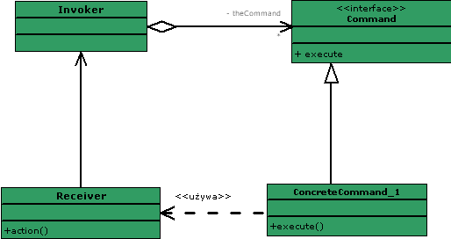
Command
Command design pattern encapsulates operation in a class implementing particular interface
Command pattern decouples logic of the operation from how they are called

Slide 66
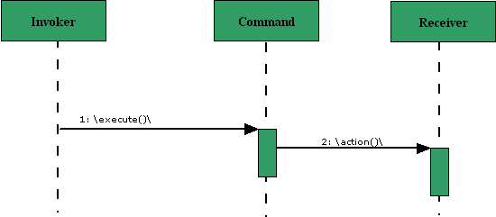
Command
Command implementation usually entails providing single – usually parameterless – method execute()
Call parameters – i.e. call context – are usually provided externally at runtime or – most commonly – are defined as fields/properties of the command object

