Slide 1
PROJECT REPORT CMPS 470/570
TEAM: Space Something or Other

Slide 2
TEAM MEMBERS & ROLES
Brooks Schafer:
-Coding, emotional support
Melinda McElveen:
-Coding, emotional support

Slide 3
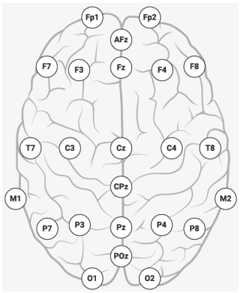
DESCRIPTION OF THE PROJECT
Goal: Identifying subjects using EEG streams by means of ML algorithms ANN, SVM, DT, and K-NN.
Tasks:
Visualize signals
Preprocess signals
Design representation
Extract features
Explore feature distributions
Design and create the model
Conduct model assessment
Display results

Slide 4
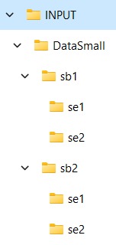
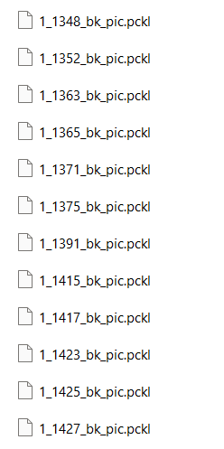
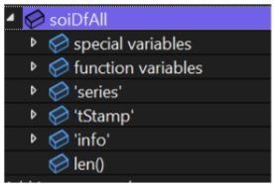
DESCRIPTION OF THE RAW DATA
Data source: DataSmall folder with .pckl files of EEG recordings provided by professor
Attributes and their types:
Attribute | ‘series’ | ‘tStamp’ | ‘info’ | ‘effective_srate’
Data Type | float32 2d array | float64 array | dictionary | float64

Slide 5
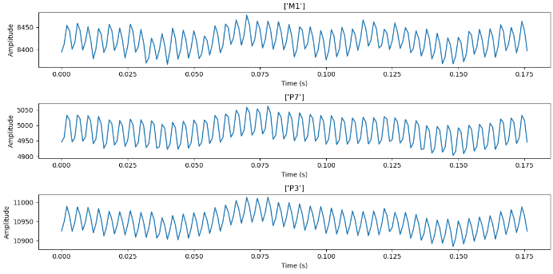
DESCRIPTION OF THE RAW DATA
Distribution of values examples:

Slide 6

PREPROCESSING
For preprocessing the data, we first apply a notch filter at 60, 120, 180 and 240 Hz
Next, we apply impedance filter at 125±1
Next, a bandpass filter at [0.5, 32]
Finally, we apply rereferencing to the data

Slide 7
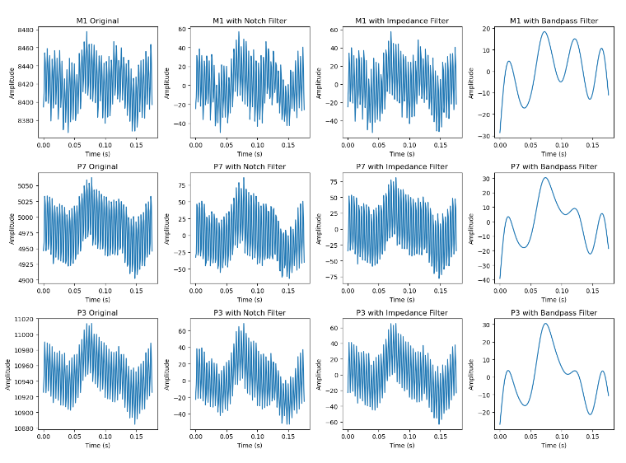
PREPROCESSING
Raw vs Processed Data:

Slide 8
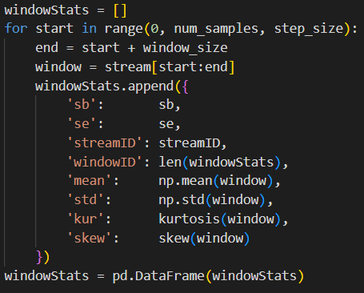
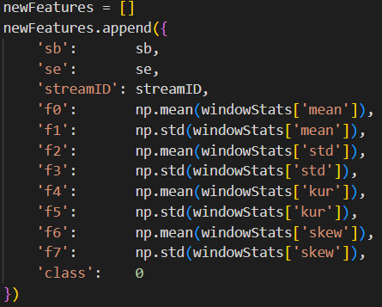
FEATURE EXTRACTION
For feature extraction, we iterate through our streams. We split each stream into windows and get statistics from each window, then we calculate the mean and standard deviation of each stat across all the windows from that particular stream. This gives us our stream features.

Slide 9
DESCRIPTION OF THE FEATURE DATA
Features and their types:
Feature | Data type
‘f0’ | float32
‘f1’ | float32
‘f2’ | float32
‘f3’ | float32
‘f4’ | float32
‘f5’ | float32
‘f6’ | float32
‘f7’ | float32
‘class’ | float32
Mean of means
Std dev of means
Mean of std devs
Std dev of std devs
Mean of kurtosis
Std dev of kurtosis
Mean of skews
Std dev of skews
Class label (sb1=0, sb2=1)

Slide 10
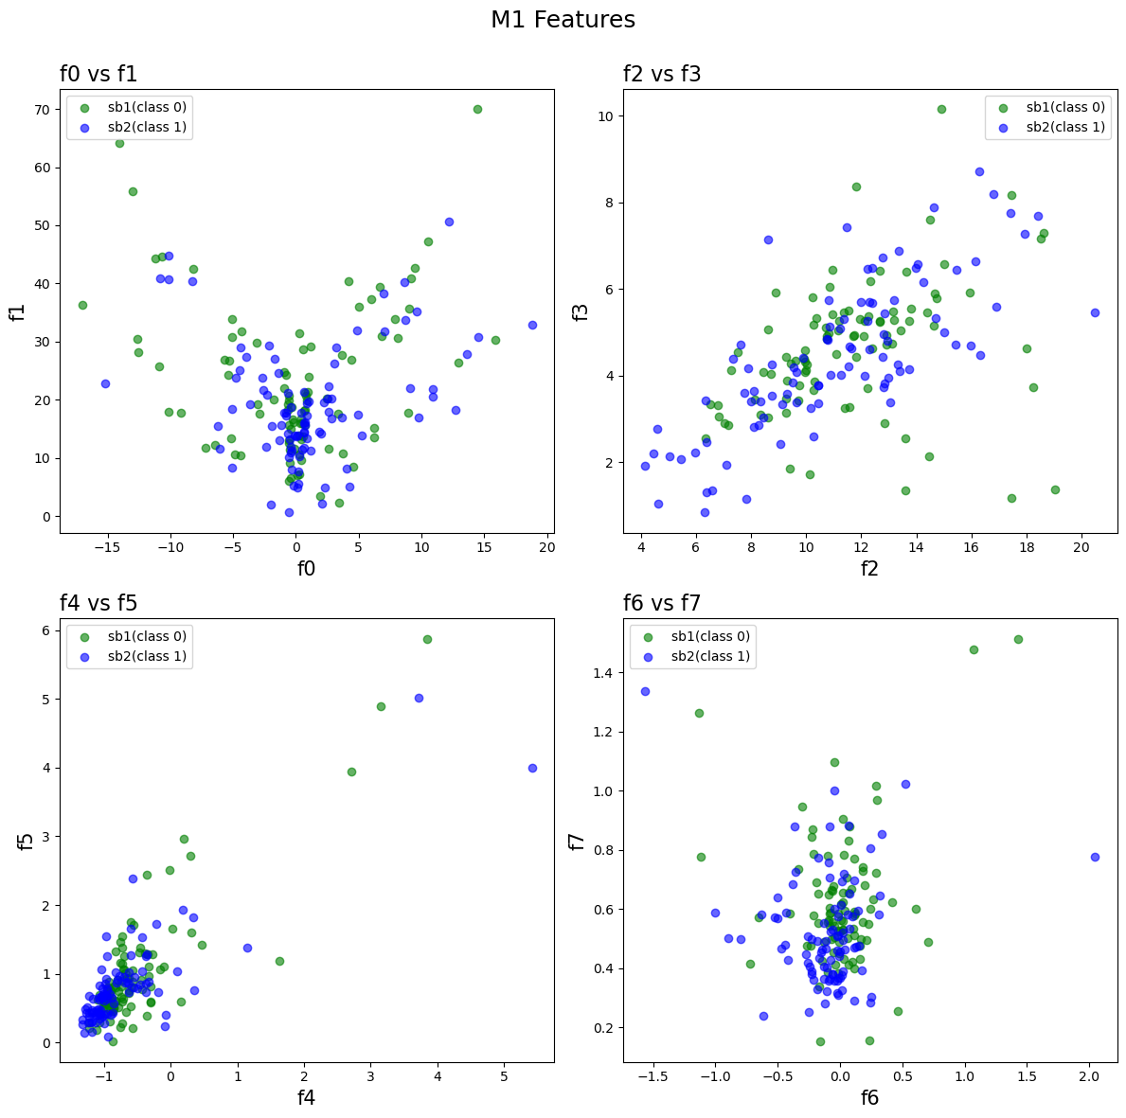
DESCRIPTION OF THE FEATURE DATA
Distribution of features:

Slide 11
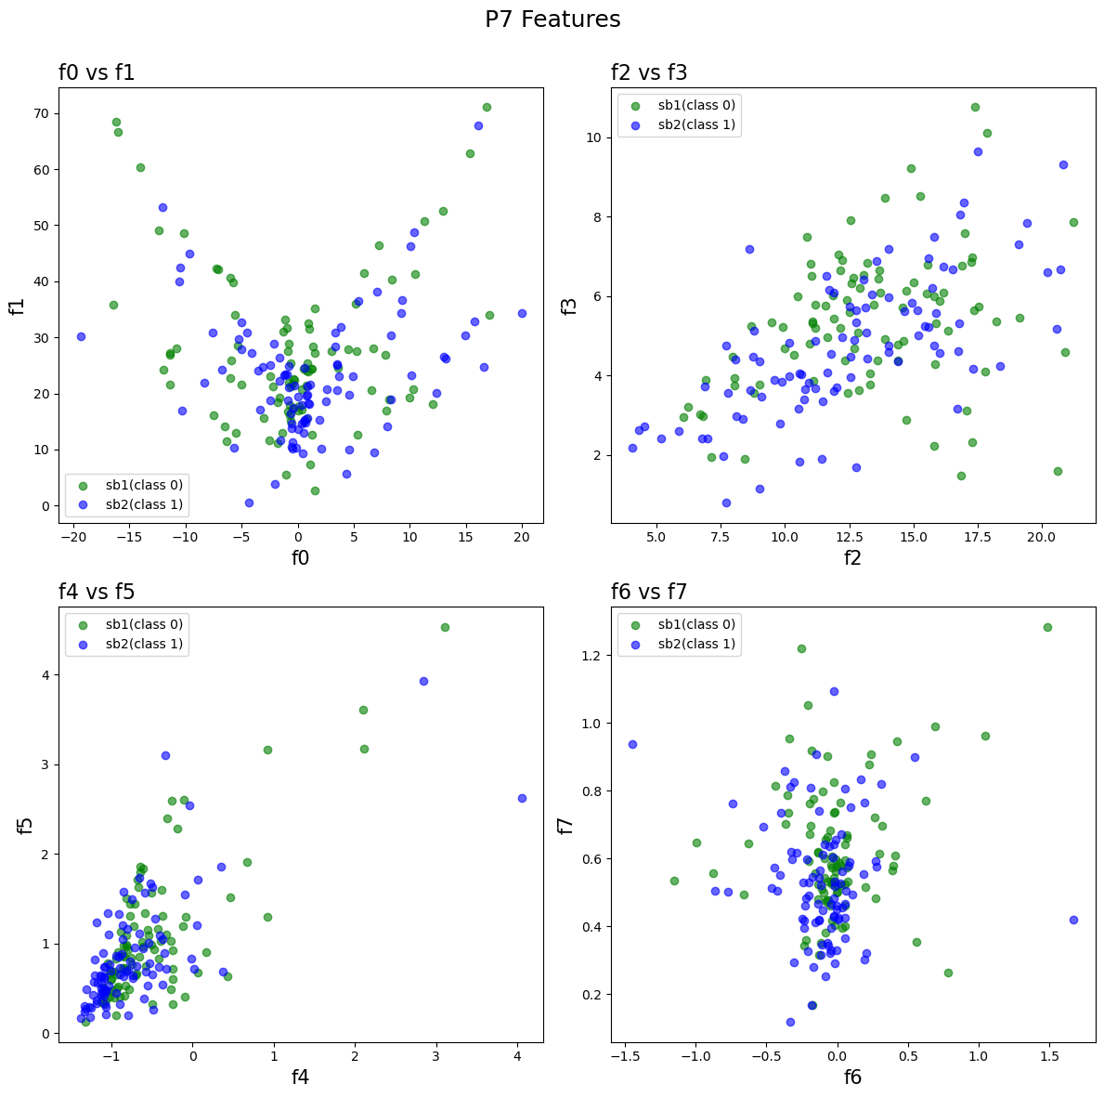
DESCRIPTION OF THE FEATURE DATA
Distribution of features:

Slide 12
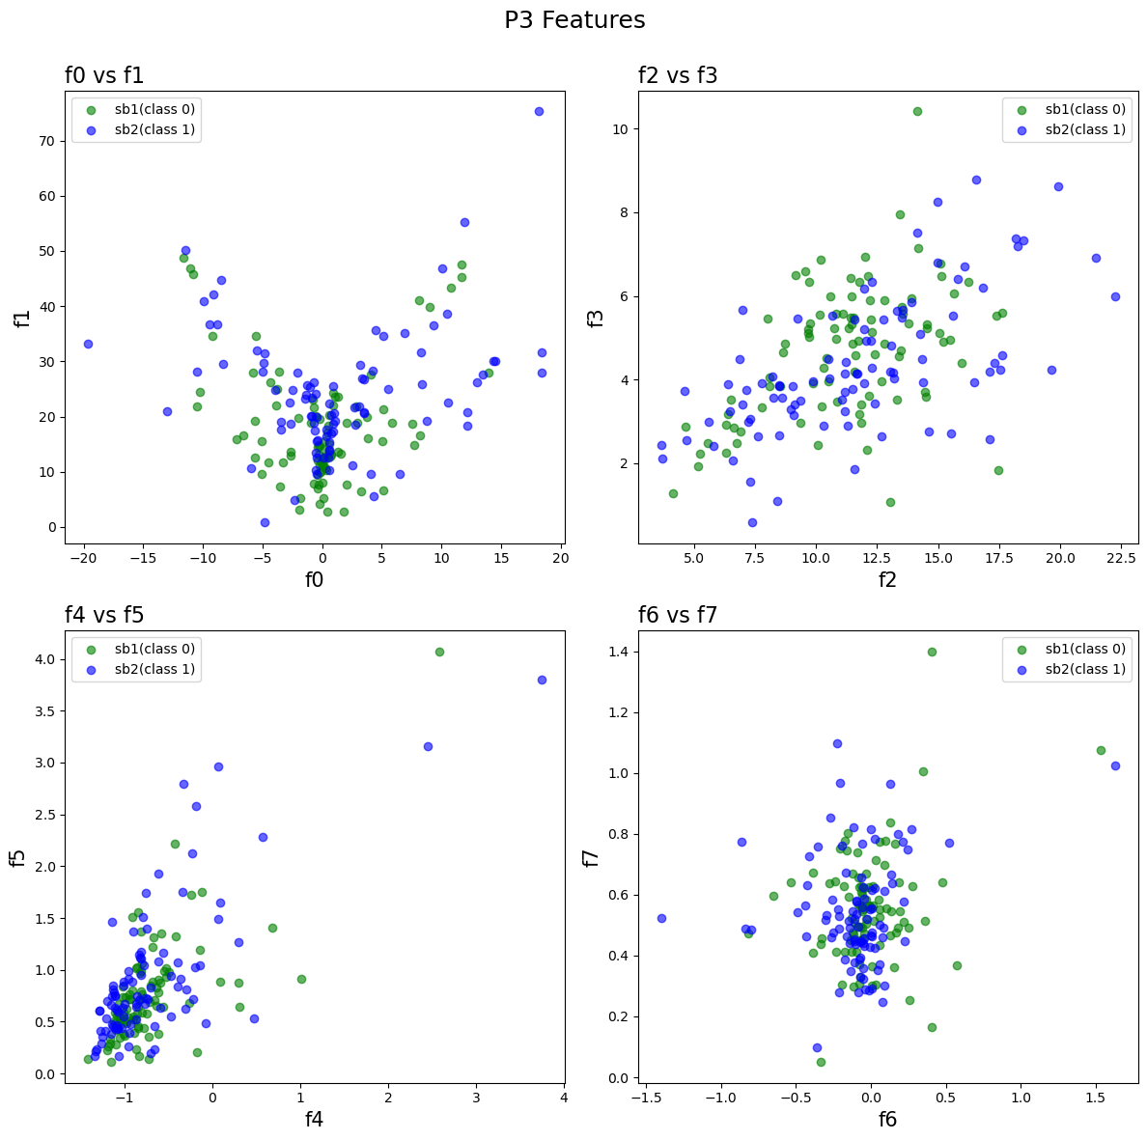
DESCRIPTION OF THE FEATURE DATA
Distribution of features:

Slide 13
DESCRIPTION OF THE MODEL
Describe parameters of the model.
Use a search algorithm to find the best model parameters [MS
Students]

Slide 14
PERFORMANCE OF THE MODEL
Plots
Epoch-error curves for training and validation data sets on the same graph.
Distribution of training, validation, test data sets
Performance measures to compare models
Robustness plots
Performance measures
Apply the testing schemes including K-fold cross validation and 3-tier scheme (60, 20, 20).
.
MS students: Use both testing schemes
•
Discuss performance of each model based upon the performance measures of
sensitivity, specificity, accuracy, F1, AUC, and others as appropriate.
•
Plot them on the same figure
•
Robustness of the models [MS Students]
Use the whisker-box plot out of at least 10 random trials

