Slide 1
PA 2.2
Space Something-or-Other
Brooks Schafer + Melinda McElveen

Slide 2
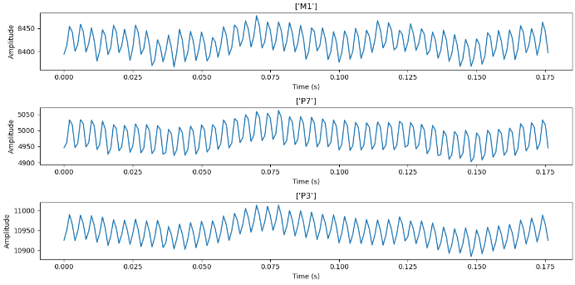
Raw Data

Slide 3
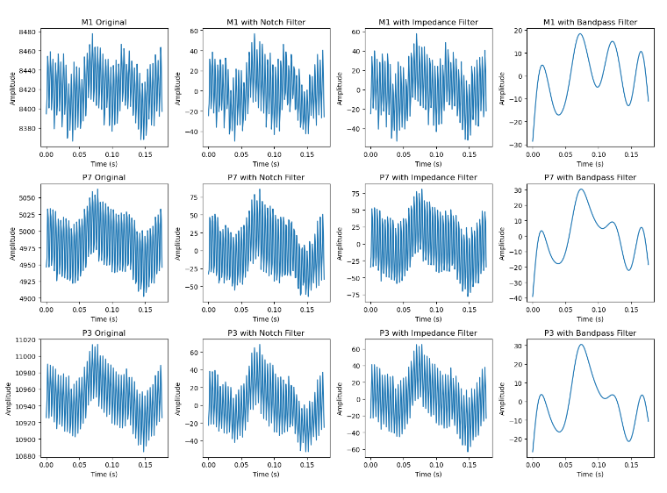
Processed Data

