Slide 1
PA 3
Space Something-or-Other
Brooks Schafer and Melinda McElveen

Slide 2
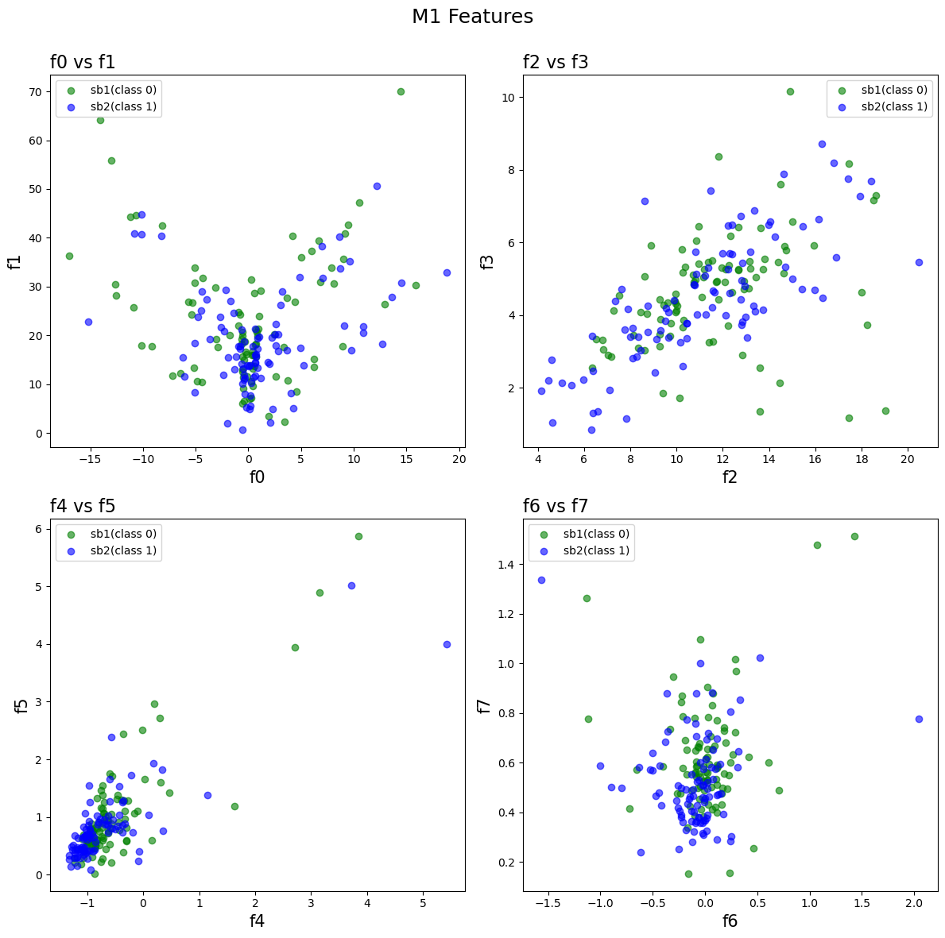
Output

Slide 3
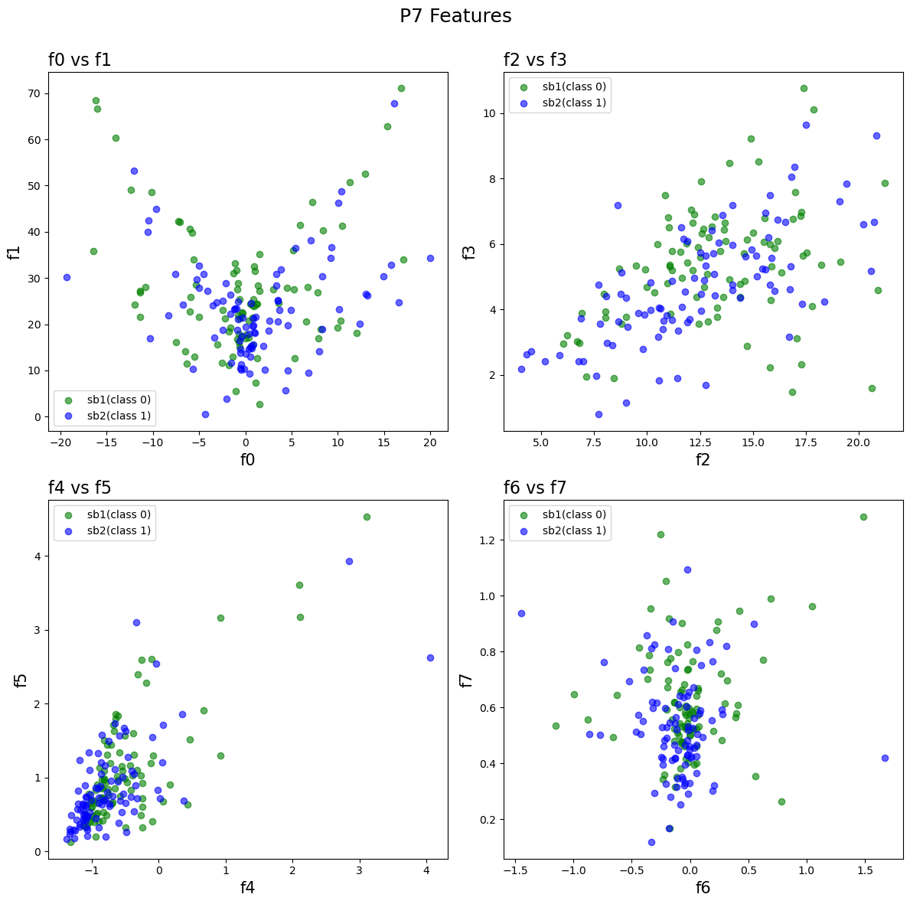
Output

Slide 4
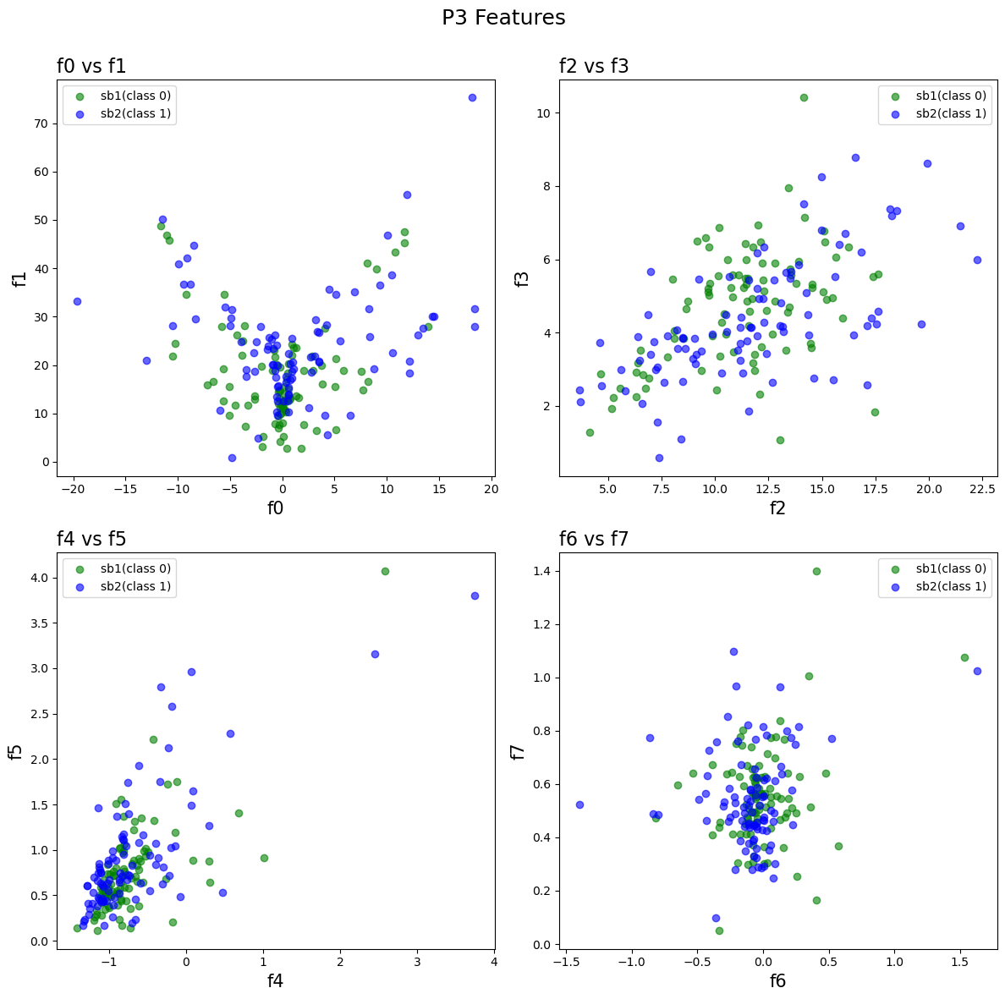
Output

Slide 5
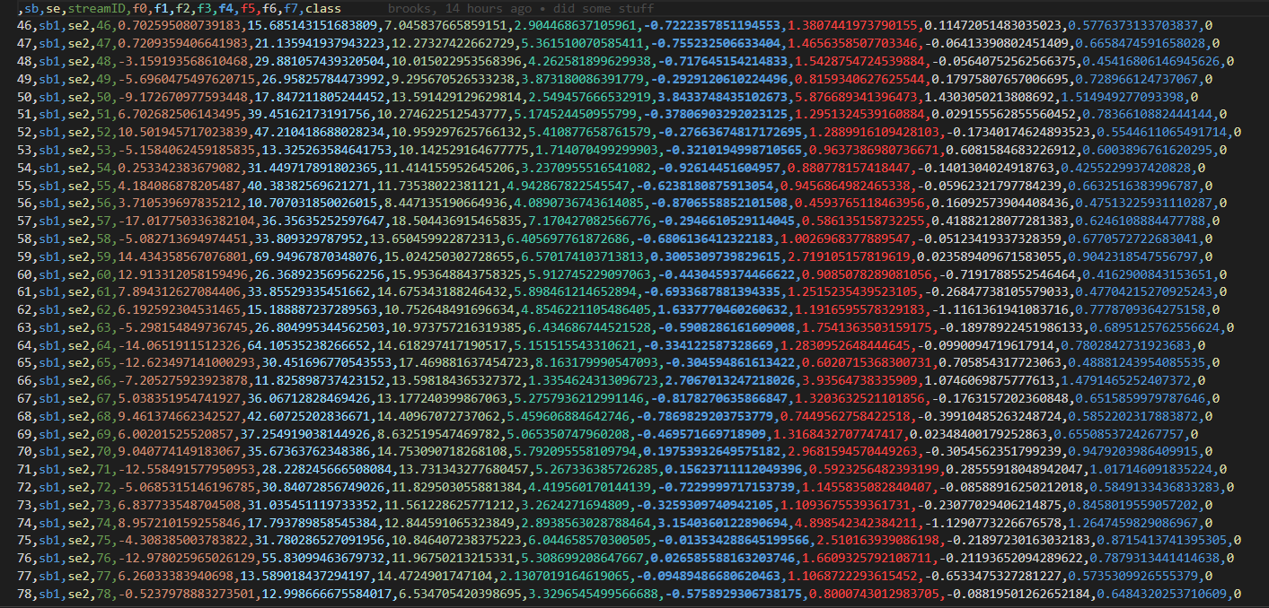
Testing Data

Slide 6
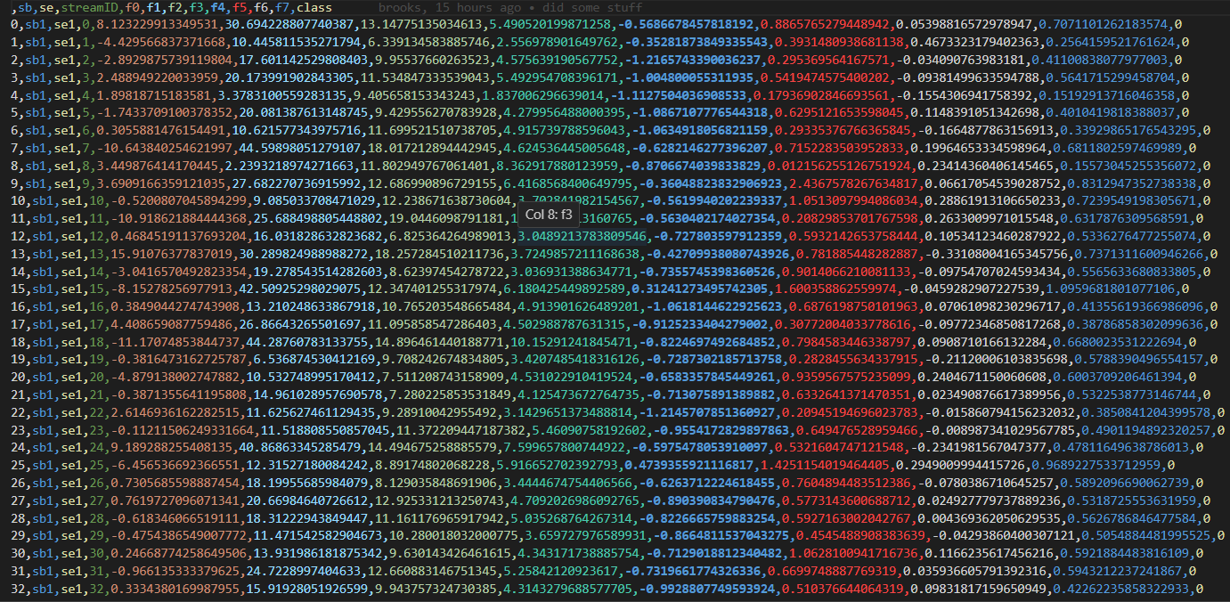
Training Data

