Slide 1
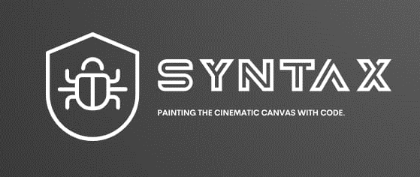
Welcome to Syntax, where data meets insights and insights transform possibilities.
We are cutting edge data science firm dedicated to helping businesses harness the power of data to drive informed decisions, innovation and growth.

Slide 2
ANALYSIS OF NETFLIX DATASET & CREATION OF POSSIBLE PROBLEM STATEMENT FOR PROPERVIEWER ENGAGEMENT
Python presentation

Slide 3
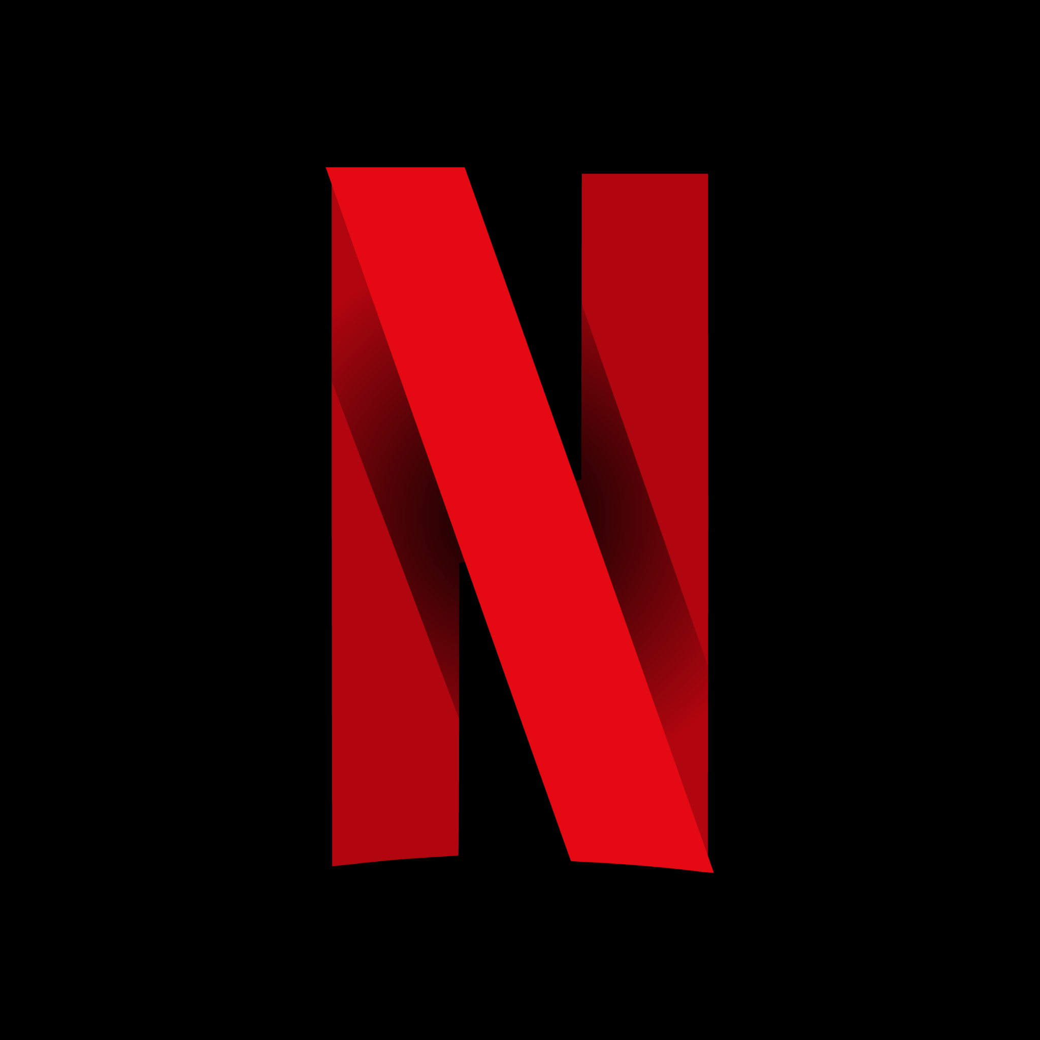

Slide 4
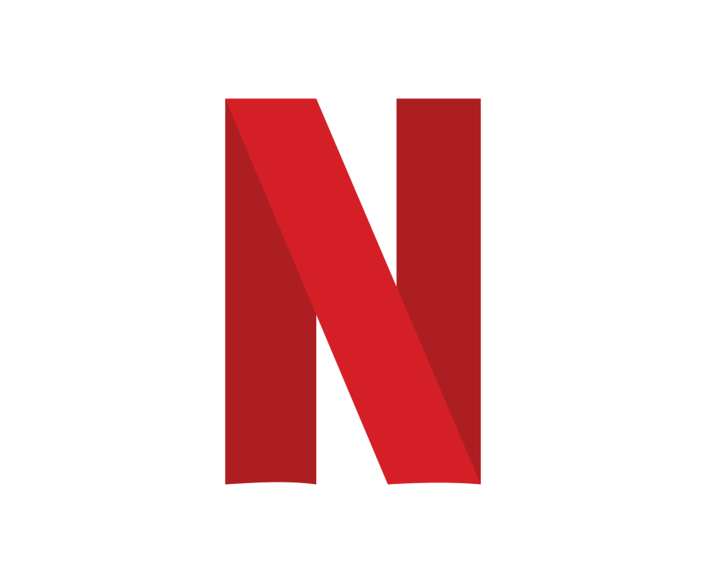

Netflix is a video streaming service known for movies and TV shows as well as kids shows.
It has around 238.4 million subscribers
In order to maintain and gain new subscribers, we have been tasked by Netflix to review their content and notice any attributes that may help them

Slide 5

Analyzing Netflix Movie Durations
Do viewers prefer shorter or longer movies?
Understanding the distribution of movie durations can help Netflix make informed decisions regarding the creation or acquisition of content.
Detecting trends in movie durations over the years can inform content production strategies.
According to our findings, from around the 1940’s till the 1970’s movies saw a steady increase in the duration of it’s movies
Viewer preferences suggest the durations were too long and were then reduced till currently as visualized in the following graphs

Slide 6
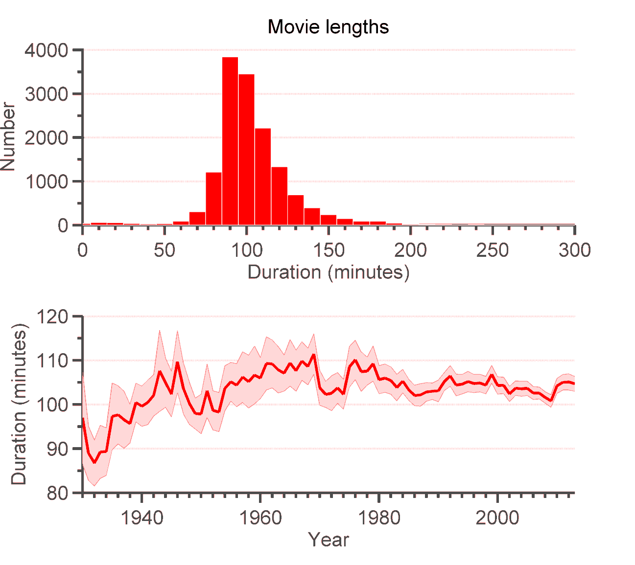

Slide 7
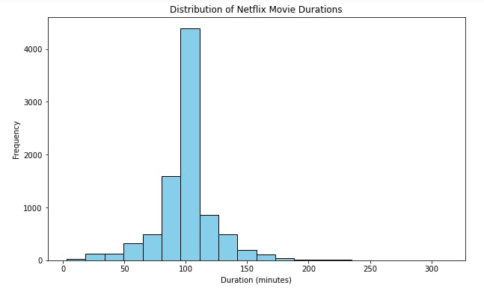
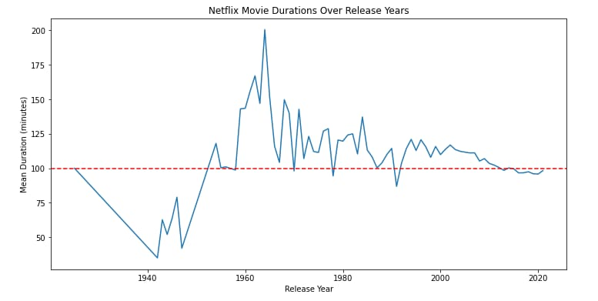

Slide 8
Summary Statistics
Mean Duration: 99.7 minutes (100)
Median Duration: 100.0 minutes (100)
Standard Deviation: 23.6 minutes (24)
Insights
The most common duration range is between 309 minutes.
There are about 5 outliers in the movie durations (with duration excessively longer than others).
The distribution is skewed to the left, indicating the median is closer to the third quartile thus being larger than the mean.

Slide 9

Analyzing Netflix Content by Genre and Cast
Determine whether viewers to watch TV shows/movies that have certain casts.
Are these casts consecutive/ appear in more than one show?
Do viewers prefer a certain genre because of certain cast members?

Slide 10

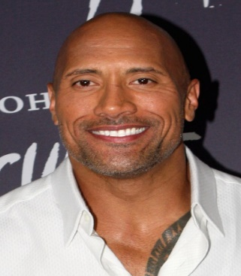
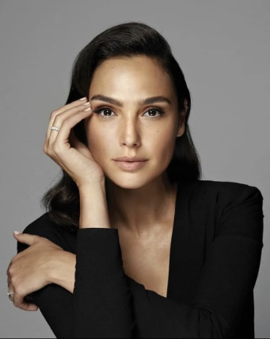

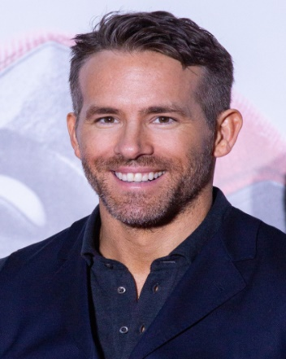
Popular Cast Members
.
Dwayne Johnson Kevin Hart
Gal Gadot
Chris Hemsworth . Ryan Rynolds

Slide 11
FINDINGS
According to our findings, we have noticed that genres have specific cast members that they work well with.
This is especially the case when it is a show or movie about fictional characters.
As well as the kind of acting the cast member is known for
We noticed a trend where by certain cast members stick to roughly the same genre.
Meaning a comedy actor wouldn’t be cast for an action movie but something family orientated.
This in turn means that the viewers gravitate toward the certain cast member and will watch the show just to watch them.

Slide 12
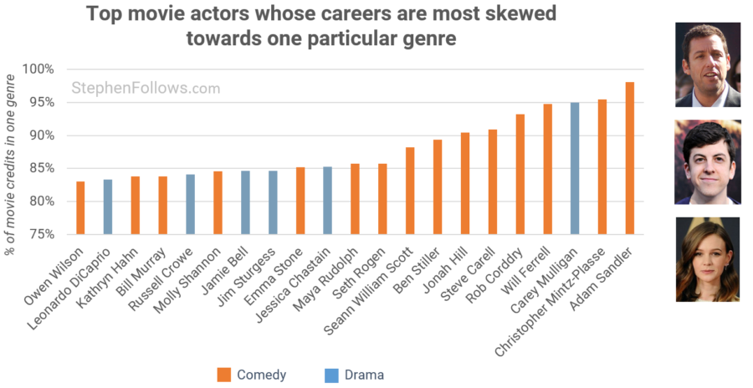

Slide 13
Recommendations
Diversify Movie Durations: Given the trend of decreasing movie durations over the years, consider diversifying your movie portfolio by including both shorter and longer films. This can cater to a wider audience with varying preferences for movie length.
Audience Segmentation: Analyze your audience demographics and preferences. Some audiences may prefer shorter movies for quick entertainment, while others may enjoy longer, immersive experiences. Tailor your content to these segments.
Content Optimization: Optimize your content to fit the desired duration range. Avoid unnecessary padding or cutting that might compromise the story's quality. Ensure that the duration aligns with the story's natural flow.
Experiment with New Formats: Explore innovative formats such as short series, mini-documentaries, or interactive storytelling. These formats can engage viewers differently and cater to changing viewing habits.

Slide 14
Summary of the key findings of the analysis.
Changing Trends: The analysis shows a significant shift in movie duration trends. While earlier years featured longer films, recent years have seen a preference for shorter movies. This shift may reflect changing audience attention spans and viewing habits.
Average Duration: The average movie duration in the dataset is approximately 100 minutes. This average provides a baseline for understanding the typical length of movies on Netflix.
Flexibility Is Key: Netflix's success has been attributed to its flexibility in content delivery. By offering a wide range of durations, Netflix can continue to adapt to evolving viewer preferences.
Data-Driven Decisions: Netflix's ability to analyze viewer data and adjust content accordingly has been a key driver of its success. Continue leveraging data analytics to inform content creation and acquisition decisions.

Slide 15

Conclusion
In conclusion, Netflix should embrace the evolving landscape of movie durations and tailor its content strategy to meet the diverse preferences of its global audience. By staying data-driven and flexible, Netflix can continue to provide captivating and enjoyable content for its subscribers.
As well as looking for cast members that
have an impact on the genre in addition to being popular with the
viewers.
Netflix should embrace the evolving landscape of movie durations and tailor its content strategy to meet the diverse preferences of its global audience.
With all these taken into consideration, Netflix will definitely gain new subscribers.

