Slide 1

Note: The data and information in this document is reflective of a hypothetical situation and client. This document is to be used for KPMG Virtual Internship purposes only.
Sprocket Central Pty Ltd
Data analytics approach
[Division Name] - [Engagement Manager], [Senior Consultant], [Junior Consultant]

Slide 2
Note: The data and information in this document is reflective of a hypothetical situation and client. This document is to be used for KPMG Virtual Internship purposes only.
Agenda
Introduction
Data Exploration
Model Development
Interpretation

Slide 3

Note: The data and information in this document is reflective of a hypothetical situation and client. This document is to be used for KPMG Virtual Internship purposes only.
Introduction
Focus was on the new customer list dataset with an attempt to gain insight based on the various attributes and develop Models all of which will ultimately provide foundation for data driven decisions.
In addition, the project seek to result in;
Data Quality Assessment
Feature Selection
Efficiency and Automation
Improved Accuracy
Continuous Learning and Adaptability
Place any supporting images, graphs, data or extra text here.
Notes:
The analysis primarily focused on the new customer list dataset, aiming to extract valuable insights from its diverse attributes. The objective was to develop models and analytical approaches that can serve as a basis for making data-driven decisions. By exploring and understanding the dataset's characteristics, patterns, and relationships, the goal was to uncover meaningful information that can inform strategic actions and guide business decisions. Ultimately, the analysis sought to leverage the power of data to drive informed and evidence-based choices, leading to improved outcomes and enhanced decision-making processes.

Slide 4
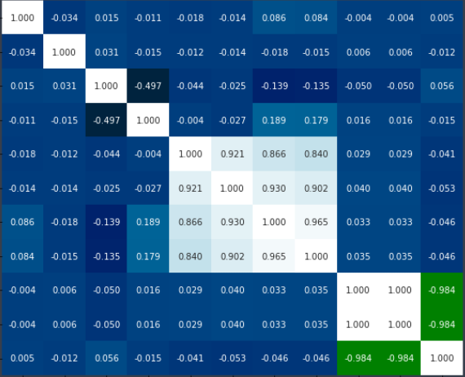
Note: The data and information in this document is reflective of a hypothetical situation and client. This document is to be used for KPMG Virtual Internship purposes only.
Data Exploration
This essential step entailed gaining a better understanding of the new customer list dataset. As a result patterns, trends, outliers, and the overall structure of the data were identified.
The various techniques that were applied are:
Inspecting the data
Summary statistics
Data Profiling
Visualization
Feature Engineering
Place any supporting images, graphs, data or extra text here.
Notes:
Inspecting the data involves examining its structure, dimensions, and basic properties to gain initial insights. It includes assessing the number of rows and columns, data types, and detecting missing values. Summary statistics provide a high-level understanding of the numerical variables, such as mean, median, standard deviation, and minimum/maximum values, offering insights into data distributions and potential outliers. Data profiling involves a comprehensive examination of individual variables, analyzing distributions, identifying unique values, and exploring correlations. Visualization techniques, such as histograms, scatter plots, and box plots, help in visualizing relationships, patterns, and trends. Feature engineering involves creating new features or transforming existing ones to capture underlying data patterns and improve model performance. Together, these steps facilitate a comprehensive understanding of the dataset and enable informed data-driven decisions.

Slide 5
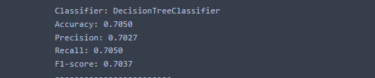
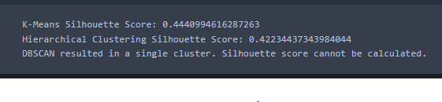
Note: The data and information in this document is reflective of a hypothetical situation and client. This document is to be used for KPMG Virtual Internship purposes only.
Model Development
Both Supervised and Unsupervised models were employed
Supervised Models
For the supervised learning model, wealth segment was our target variable. We wished to determine if it was possible to identify the various wealth classes based on the customers demographic. The decision tree Model performed best with an accuracy score of 71 which beat Random Forest, Logistic Regression and SVC’s score.
Unsupervised Learning
Here the silhouette score for both k means and Agglomerative Clustering were 0.444 and 0.422 respectively which suggest overlapping or ambiguous clusters meanwhile the score for DBSCAN model was inconclusive.
Place any supporting images, graphs, data or extra text here.

Slide 6
Note: The data and information in this document is reflective of a hypothetical situation and client. This document is to be used for KPMG Virtual Internship purposes only.
Interpretation
Data Visualization
Majority of the new customers are female, thus coming up with product that suits the female will translate to higher sales. Therefore, it suggests that focusing on developing and marketing products that cater to the needs and preferences of females can potentially lead to increased sales
Most customers fall in age bracket C( 40 – 49) Understanding the preferences, purchasing behavior, and specific needs of this age group can help in tailoring marketing strategies and product offerings to effectively target this segment.
Customers from NCS state are twice as much as those from either OLD or VIC states. NCS state is a significant market segment due to its larger customer base. as more emphasis may be placed on targeting and serving customers from the NCS state.
Majority of the new customers falls under the Mass Customer class in the wealth segmentation demographic. Understanding the characteristics, preferences, and buying behaviors of this segment can assist in developing appropriate marketing and pricing strategies to effectively serve this customer group.

Slide 7
Note: The data and information in this document is reflective of a hypothetical situation and client. This document is to be used for KPMG Virtual Internship purposes only.
Appendix

