Slide 1
Zowe CICS Workshop
Automate Mainframe Apps with Jenkins and Zowe

Slide 2
Goals
Write automation scripts for mainframe app to build and deploy
Write automated tests for mainframe apps using open testing frameworks
Build a Jenkins CI/CD pipeline for mainframe app

Slide 3
Accessing your Workshop Environment

Slide 4
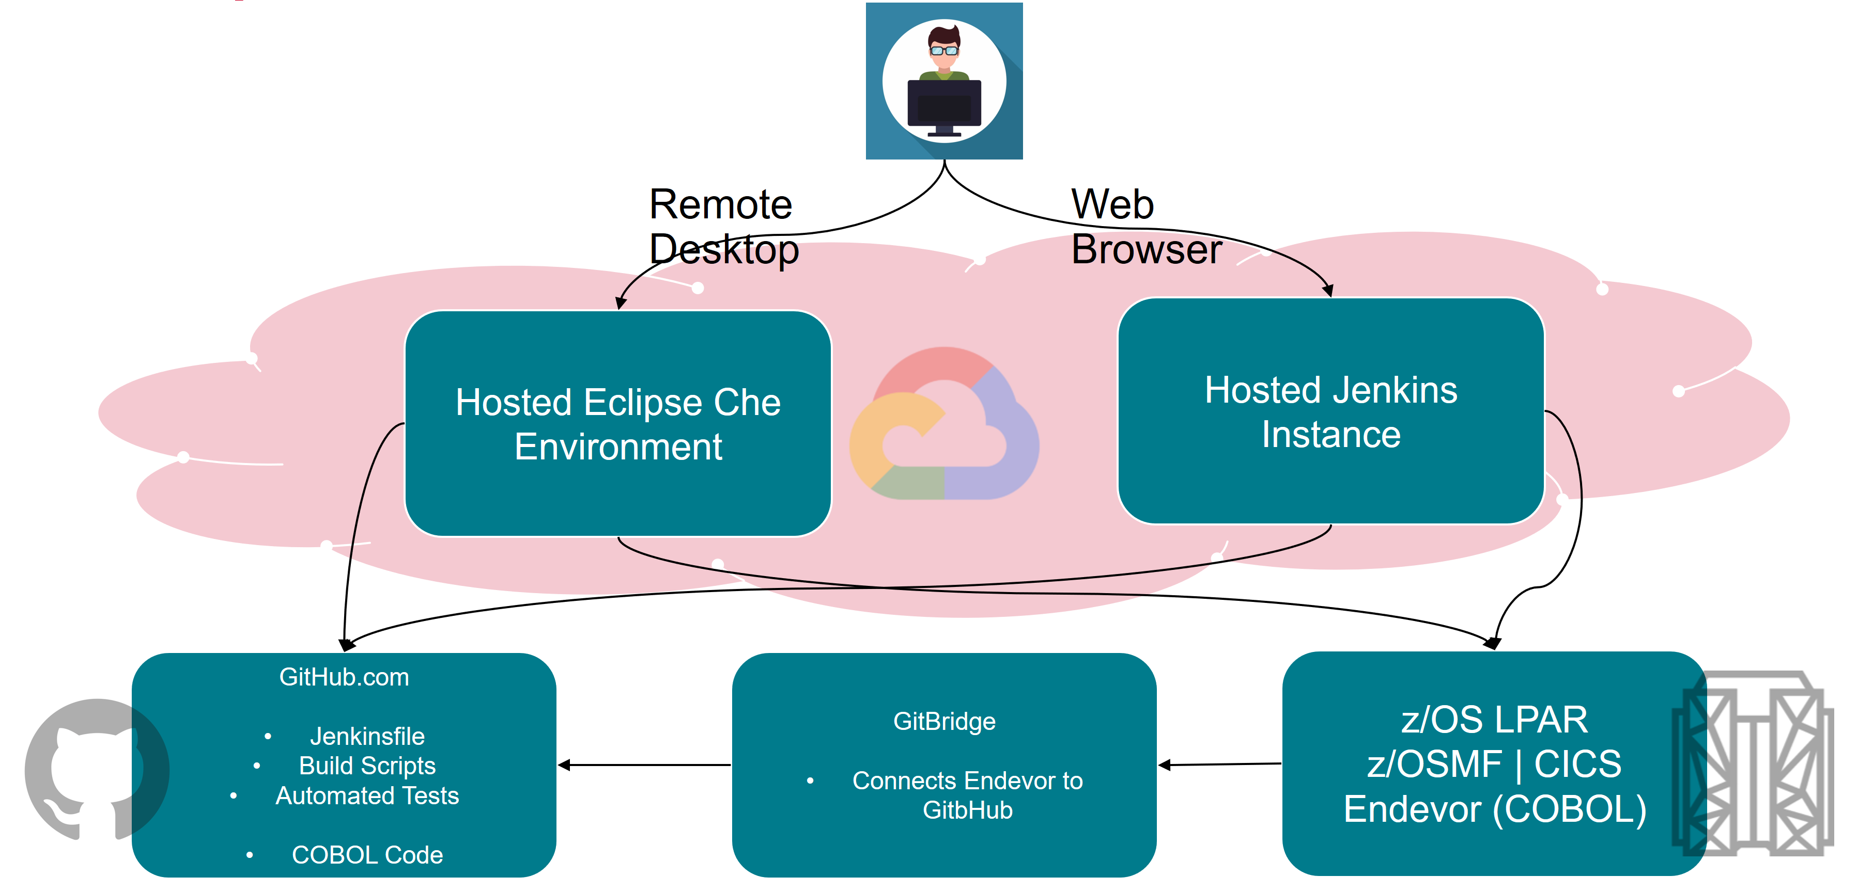
Workshop Environment

Slide 5
z/OS Services
You have been assigned a single set of login credentials for accessing all of the Mainframe resources on a remote z/OS LPAR which is hosted by Broadcom, including TSO, z/OSMF,CICS, Db2 and CA Endevor SCM.
Your userid is MAINFRAME_USER.
Your password MAINFRAME_USER.
Service | Connection Information (Host:Port)
z/OSMF | MAINFRAME_HOST:ZOSMF_PORT
CICS | MAINFRAME_HOST:CICS_PORT
CA Endevor | MAINFRAME_HOST:ENDEVOR_PORT
DB2 | MAINFRAME_HOST:DB2_PORT

Slide 6

Marbles

Slide 7
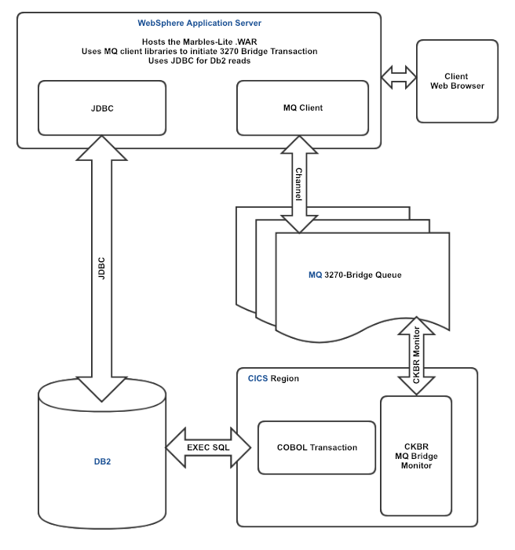
Marbles App

Slide 8
Demo

Slide 9
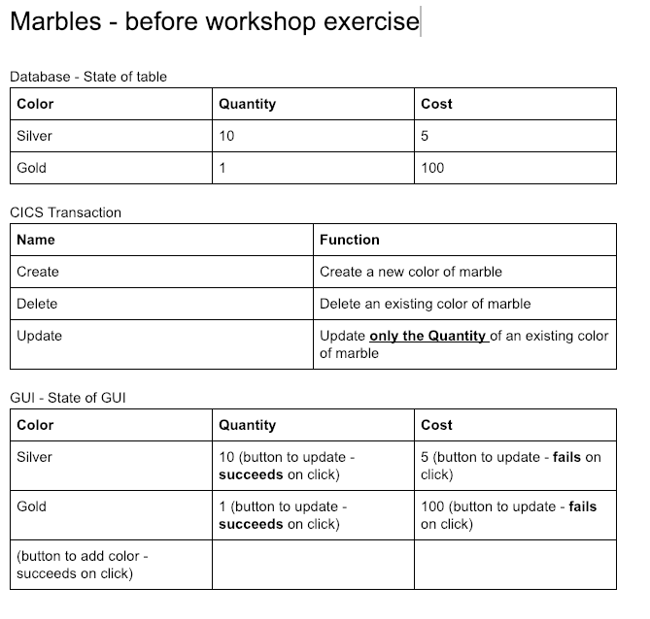
State of Marbles App - Before Workshop

Slide 10
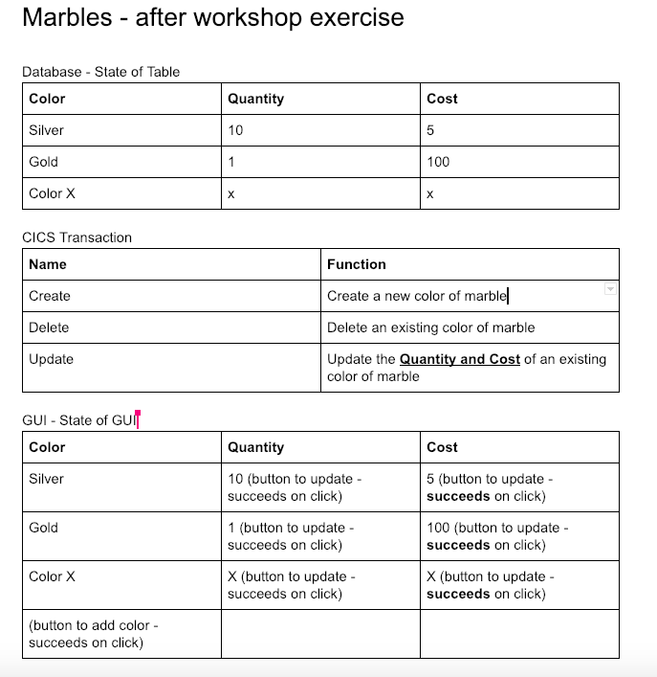
Desired State of Marbles App - After Workshop

Slide 11
Sample CI Pipeline

Slide 12
Simple Pipeline Demo
CI/CD orchestrator
Process automation scripts to perform mainframe actions
Scripts call Zowe CLI commands

Slide 13
Section I:
Overview and Environment Setup

Slide 14
Steps for Section I
Currently the CICS transaction is able to update the quantity of a marble. We want to enhance this transaction to be able to update the cost of a marble in addition to its existing functionality.
Steps:
Download the COBOL transaction code to your remote desktop from Endevor
Edit the code in Eclipse Che
Upload the code to Endevor
Build (generate) the code on Endevor
Note: all the following steps should be performed from your assigned remote Eclipse Che environment.

Slide 15
Developer Environment
Open your remote desktop application
Che Desktop URL: CHE_URL
Login is CHE_USER
Password is CHE_PASS
Open command prompt
Issue "zowe --h"
Issue "zowe plugins list"
Issue "npm -h"
Issue "git help"

Slide 16
Profiles
Created to access different environments on the mainframe
Can connect to multiple LPARS with different usernames and passwords and ports
Multiple profiles can be created for an application
We have created a script to help you create your profiles. Access it through the terminal with the following commands:
cd /projects/GITHUB_PROJ
gulp setupProfiles
You will be prompted for the
IP Address: MAINFRAME_HOST
Username: MAINFRAME_USER
Password: MAINFRAME_USER
To view profiles, run a command like this:
zowe profiles list endevor
If you needed to create a profile manually, it could be done by a command like this (Note: this has been already performed):
zowe profiles create endevor MAINFRAME_LPAR-MAINFRAME_USER --host MAINFRAME_HOST --port ENDEVOR_PORT --user MAINFRAME_USER --password MAINFRAME_USER --ru false --protocol

Slide 17
Section II:
Modify Cobol Code

Slide 18
Download the element from Endevor - Step 1
Now that we've identified the element we know we need to change, let's download to our remote desktop using another command.
Note: The command below uses options provided in the command which take precedence over your default profile from Step 1. This includes the Endevor system, subsystem, etc.
Position your terminal to the folder where you want the file downloaded to.
Download element:
zowe endevor retrieve element MARBLE_NUM --type COBOL --to-file MARBLE_NUM.cbl --override-signout

Slide 19
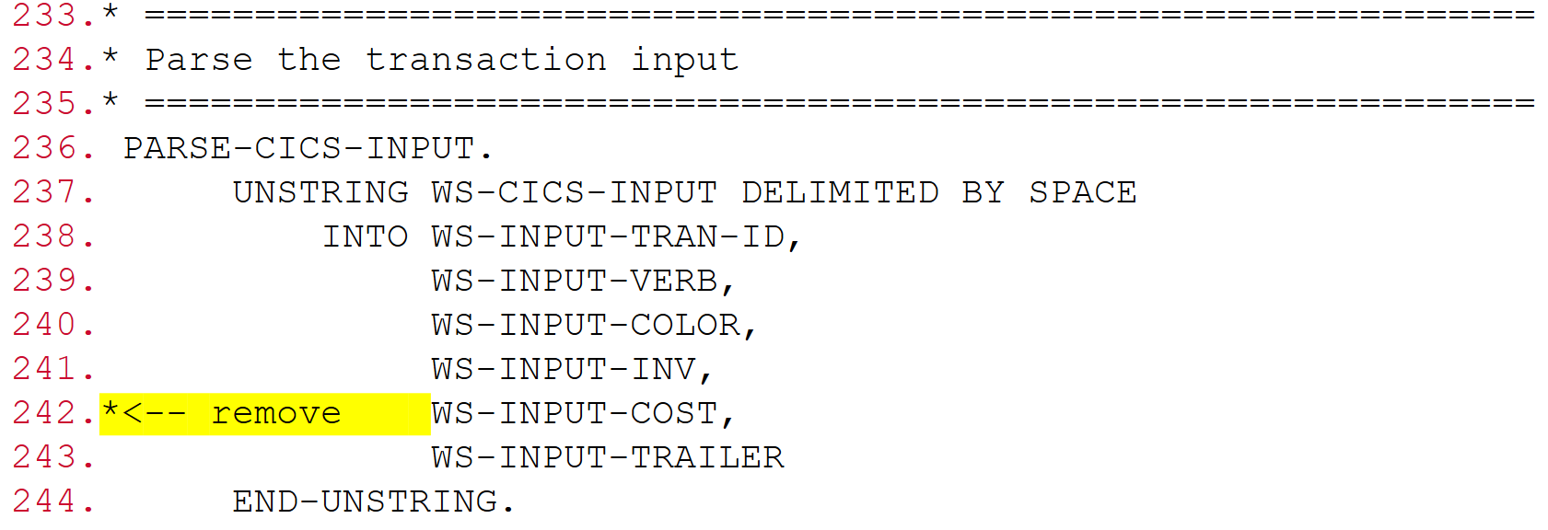
Edit the source code - Step 2
We are now ready to make the code updates to implement the ability to change the cost of a marble using a CICS transaction.
Open your source code using the explorer view (Upper Left Corner)
Find the following code sequence and remove the highlighted text andSave the changes locally:

Slide 20
Upload the element to Endevor - Step 3
After making the code changes locally, we need to upload the element to Endevor in order to perform a build.
Ensure your terminal is positioned to the folder that contains the source file.
Upload element:
zowe endevor update element MARBLE_NUM --type COBOL --os --ff MARBLE_NUM.cbl
This command provides help on how to upload an element to Endevor:
zowe endevor update element -h

Slide 21
Generate the code

Slide 22
Generate the elements
Now that our code changes have been uploaded to Endevor, we can compile it using an Endevor generate action to see if there are any errors.
Generate element.
There are two --type of elements you want to generate, COBOL and LNK.
zowe endevor generate element MARBLE_NUM --type COBOL --os
zowe endevor generate element MARBLE_NUM --type LNK --os
HINT: Use your up arrow key and just change the type.
Ensure that the generate actions are successful:
You should see text similar to GENERATE of MARBLE_NUM.COBOL finished with 0000 in the output.

Slide 23
Section III:
Deploy Marbles Application Manually

Slide 24
Deployment - Introduction
Deployment is another step that is commonly automated. Once you've built your code and binary artifacts like load modules are ready, you may want to copy these artifacts to a system where you can run the program.
Identify deployment steps
Identify requirements for parametrization in deployment
Do the build artifacts come from a different location depending on whether it's a dev build or a team build?
Does the deployment system vary depending on the stage?
Automate the deployment
Note: Deployment scripts should be written in a parameterized fashion so that the same script can be used to deploy for devtest, QA, system-test or even production.

Slide 25
Steps for Section III
Deployment for marbles requires us to copy the load modules, and activate the changes in the target CICS environment.
Deploy manually using CLI commands
Create and implement a Deploy gulp task
Test the deployment

Slide 26
Deploy manually
When we generated the LNK element in Endevor in previous sections, Endevor created load modules. We can deploy these load modules to the proper dataset location that CICS is using and refresh CICS to pick up the changes.
Confirm that the load modules exists in the dataset
We can now proceed to list the members in our LOADLIB and DBRMLIB to ensure our MARBLE entry exists.
zowe files list all-members "PRODUCT.NDVR.MARBLES.MARBLES.D1.LOADLIB"
zowe files list am "PRODUCT.NDVR.MARBLES.MARBLES.D1.DBRMLIB"

Slide 27
Deploy manually
Copy the LOADLIB and DBRMLIB modules to the desired location
There are multiple ways to copy load modules using Zowe. For this workshop, we are going to make use of a job to move the elements.
Now, let's try to copy our MARBLE element from the source libraries to the destination:
zowe jobs submit data-set "MAINFRAME_USER.MARBLES.JCL(MARBCOPY)" --vasc

Slide 28
Deploy manually
Submit JCL to perform the Bind & Grant
zowe jobs submit data-set "MAINFRAME_USER.MARBLES.JCL(MARBIND)" --view-all-spool-content
This function runs the command and returns all the job content
Alternative approach
zowe jobs submit data-set "MAINFRAME_USER.MARBLES.JCL(MARBIND)"
Example returned jobid: JOBXXXXX
zowe jobs view job-status-by-jobid JOBXXXXX
Confirm return code = CC 0004

Slide 29
Deploy manually
Activate the transaction changes on CICS
We will make use of the CICS plugin to refresh our CICS program.
Now, let's try to refresh our CICS program
The program that needs refreshed is named Marble.
zowe cics refresh program MARBLE_NUM

Slide 30
Test manually
Run the command manually:
zowe console issue command "F CICS_REGION,MARBLE_CICS CRE MARBLE_COLOR 1 2" --console-name MAINFRAME_USER
Did you get a +SUCCESS message?
Check the database
zowe jobs submit ds "MAINFRAME_USER.MARBLES.JCL(MARBDB2)" --vasc
Ensure database contains your marble with quantity and cost

Slide 31
Review - What have we learned?

Slide 32
Section III:
Automation Automate the Build

Slide 33
Automate the Code Build - Introduction
Now that you've used the CLI to successfully make code changes and perform generates on Endevor, it's time to automate these steps.
CLI commands can be embedded in scripts that you can run repeatedly from your local machine.
These same scripts can also be called from CI/CD tools like Jenkins
Task Runners are a way to organize and interact with your automation scripts more easily.
We will be using a javascript based Task Runner called Gulp for this section. Task Runners can also be called from CI/CD tools like Jenkins
Note: Task Runners are an abstraction layer over scripts. They are helpful but are not a necessity.

Slide 34
Steps for Section III
Now that you've used the CLI to successfully make code changes and perform generates on Endevor, we want to automate the following:
Generate operations for COBOL and LNK
Build the application
It should generate both the COBOL and LNK elements in a single task
Note: Gulp is a JavaScript based task runner. Other task runners like Gradle use other scripting languages like Groovy.

Slide 35
Starting the Automation
We have performed some functions for you, like downloading the code and getting it ready.
Your code is located in /projects.
When you ran the gulp command earlier, you used that code.

Slide 36
Create a Build Task in Gulp
Generating the source element and the LNK element on Endevor are steps that you'll need to perform every time after making code changes to create the load module. It's a great task to automate, so that you don't have to keep doing it manually. Let's start by reviewing our gulpfile and existing gulp build-cobol task. Then you will create a task in Gulp called build-lnk.
Review gulpfile: A gulpfile is a file in your project directory titled gulpfile.js that automatically loads when you run the gulp command.
At the top of the gulpfile, take note of three packages that we are using:
gulp-help: Adds a default help task to gulp and provides the ability to add custom help messages for gulp tasks. Try issuing gulp help in the terminal at your projects directory.
gulp-sequence: Allows a series of gulp tasks to be run in order
node-cmd: Simple terminal interface that allows cli commands to be run. These commands are run asynchronously.
config: requires a config.json file for all the options

Slide 37
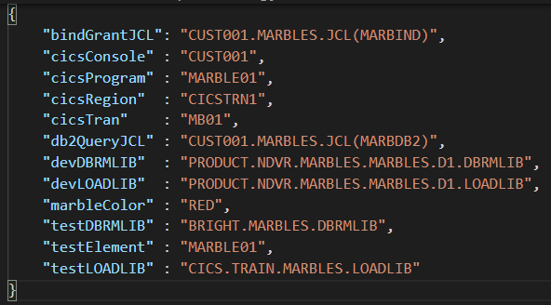
Reusable Code - config.json
Using a configuration file allows the script to remain the same, but passing in variables for the differences.
Here's a file call config.json containingthe values
Instead of hardcoding the values inthe script, the script can read these values.
To use these values, we can use config.testElement and it will read the color from this file and replace it in the code.

Slide 38
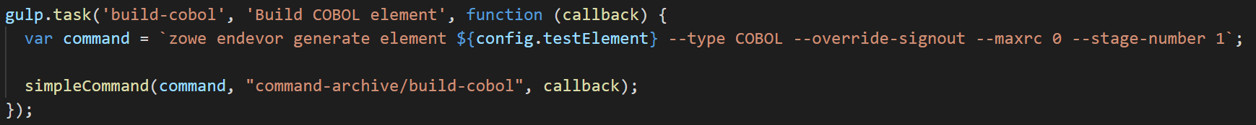
Create a Build task in Gulp
Review build-cobol task
Name of task: build-cobol
Description of task: Build COBOL element
function (callback): function that this gulp task runs. Because node-cmd runs terminal commands asynchronously, we supply a callback which is called upon task completion.
var command = ... : command to run from the command line, passing config.json values
simpleCommand runs the command with all the error checking in another section. This is reused a lot, so a function was created to make the code cleaner. The second option includes archiving the output to a directory.

Slide 39
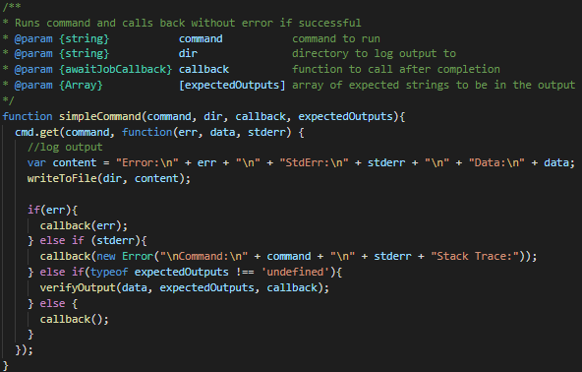
Create a Build task in Gulp
Review simpleCommand task
Name of task: simpleCommand
Description of task: Runs the zowe commmands
cmd.get( : Runs the given command and checks to ensure it ran properly. If an error occurs, the code will immediately exit
It writes the output to the directory specified
If it is successful, the final callback will allow the code to continue executing.

Slide 40
Create a Build task in Gulp
Run gulp build-cobol and verify it completes successfully.
Create a build-lnk gulp task using the build-cobol gulp task as a reference.
Ensure the build-lnk task and description appear when you issue gulp help
Ensure the build-lnk task completes without error when you issue:
gulp build-lnk

Slide 41
Combine Build-Cobol and Build-LNK
Let's take the gulp build-cobol and gulp build-lnk tasks and combine them into a single gulp task. The gulp-sequence package can help us achieve this.
The following gulp task combines the existing build tasks into a single gulp build task:
gulp.task('build', 'Build Program', gulpSequence('build-cobol','build-lnk'));
Ensure the build task and description appear when you issue:
gulp help
Ensure the build task runs both the build-cobol and build-lnk tasks without error when you issue:
gulp build

Slide 42
Completed Build Sequence Command
Completed

Slide 43
Section IV:
Automate Deployment

Slide 44
Create and implement a Gulp Deploy task
Similar to creating the gulp build tasks, we will now create gulp tasks to deploy our changes.
Review copy task
Review the bind-n-grant task
Review the cics-refresh task
Combine individual deploy tasks into one deploy task.

Slide 45
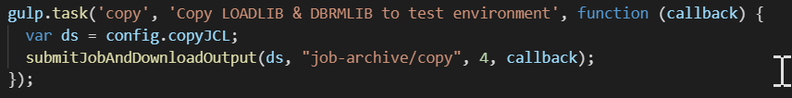
Create and implement a Gulp Deploy task
Review copy task to copy the LOADLIB and DBRMLIB
This task uses a job to copy the lib elements to their destination

Slide 46

Create and implement a Gulp Deploy task
Review bind-n-grant task, which submits a job from a dataset.
The bind-n-grant task to submit MARBIND JCL and verify CC = 0004

Slide 47
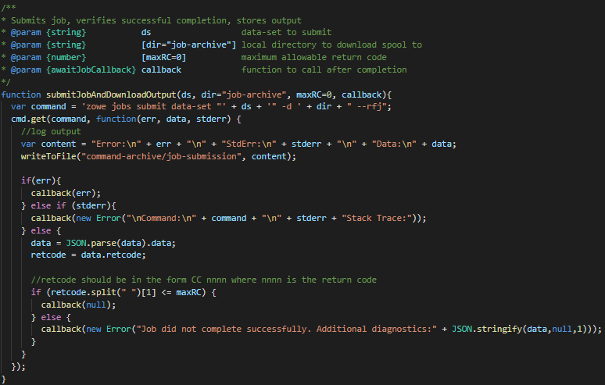
Create and implement a Gulp Deploy task
submitJobAndDownloadOutput submits the dataset
It checks for errors
It executes the job asynchronously
It runs a loop to ensure it completes
If there's an error, that is returned to the calling task
Captures output and writes it to disk

Slide 48
Create and implement a Gulp Deploy task
Review cics-refresh task to refresh the MARBLE PGM
Combine the tasks into a single deploy task using gulpSequence.
Using the code you created to combine the build-cobol and build-lnk tasks into a single build task as a reference, combine the following tasks into a single deploy task that will deploy the program using:
copy
bind-n-grant
cics-refresh
Ensure your task appears when issuing gulp help
Run gulp deploy
Ensure your task completes without error

Slide 49
Completed Deploy Sequence Command
Completed

Slide 50
Review
What have we learned so far?

Slide 51
Section V:
Automate Testing

Slide 52
What is automated testing?
Applications behave in an expected manner. When making code changes, it's common for developers to test the expected behavior many times. This can be time consuming and boring. Developers started to write scripts that automate these repetitive tests so that they can stay focused on writing more code.
Different types of automated testing
Unit Tests
Integration Tests
System Tests
Performance Tests

Slide 53
Types of Automated Tests
Unit Tests
Front-end code (JavaScript)
Web code (Java)
Back-end code (COBOL / CICS)
Integration Tests
UI
Web Server
CICS
Db2
System Tests
Performance Tests

Slide 54
Automating Tests
Automating tests comes down to two choices:
Write scripts in your language of choice and manage them manually.
Choose a scripting framework that suits your needs and skills.
Popular testing frameworks:
Mocha
Robot
Jest
Jasmine
JMeter

Slide 55
Automate Testing of a CICS Transaction

Slide 56
CICS Manual Test
Manually test your deployed program to ensure the MABRLE was successfully created.
Recall that you previously issued the following command to ensure your program was successfully updated and deployed:
zowe console issue command "F CICS_REGION,MARBLE_CICS CRE MARBLE_COLOR 1 2" --console-name MAINFRAME_USER
Now we will run a command to verify the database contains the correct information. Ensure your marble is in the database:
zowe jobs submit ds "MAINFRAME_USER.MARBLES.JCL(MARBDB2) --vasc

Slide 57
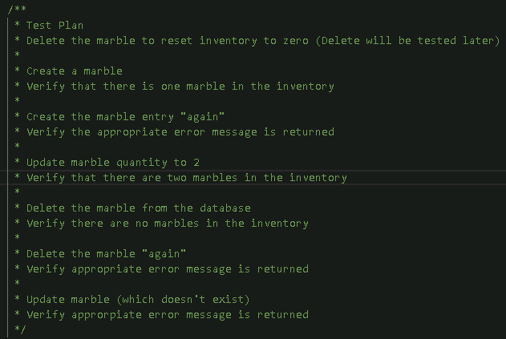
CICS Test Scenario
A framework has been provided that tests that the quantity of marbles in inventory is manipulated appropriately. We will be updating the test plan to account for the cost being updated appropriately as well. The current test plan is as follows:

Slide 58
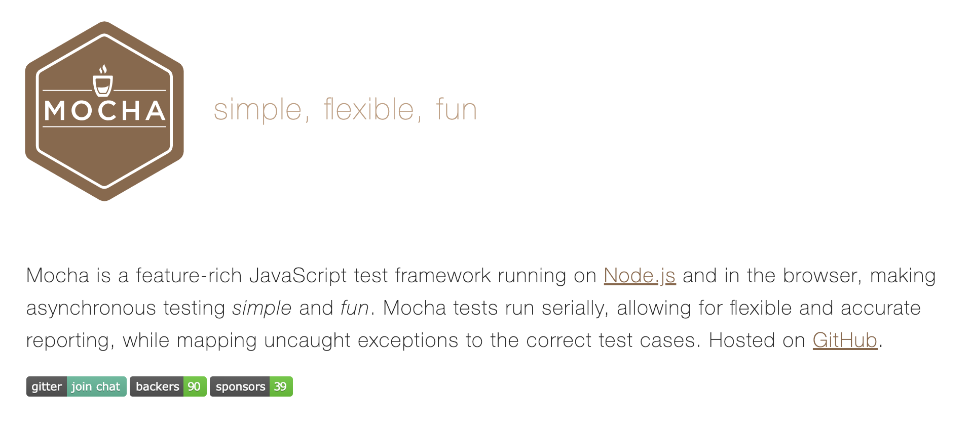
MochaJS

Slide 59
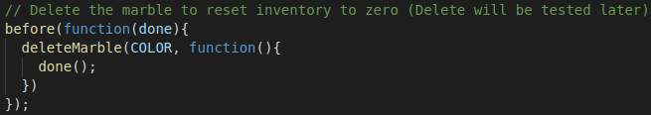
Review Mocha Test File
All tests for this workshop are located in test/test.js.
In test.js find describe('Inventory Manipulation, function () {
This is our initial suite of inventory manipulation tests.
The following snippet simply ensures the marble inventory for our color is reset to zero before we begin testing.

Slide 60
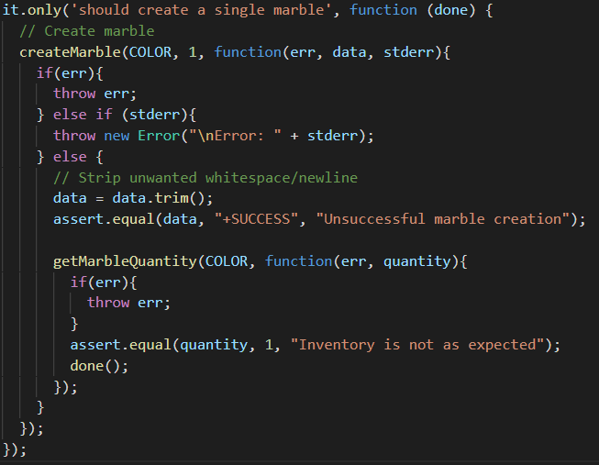
Review Mocha Test File
The following snippet shows the first test. Within the test, a marble is created and the contents of the database are verified, and the tests asserts that 1 marble of the specified color is in the inventory.

Slide 61
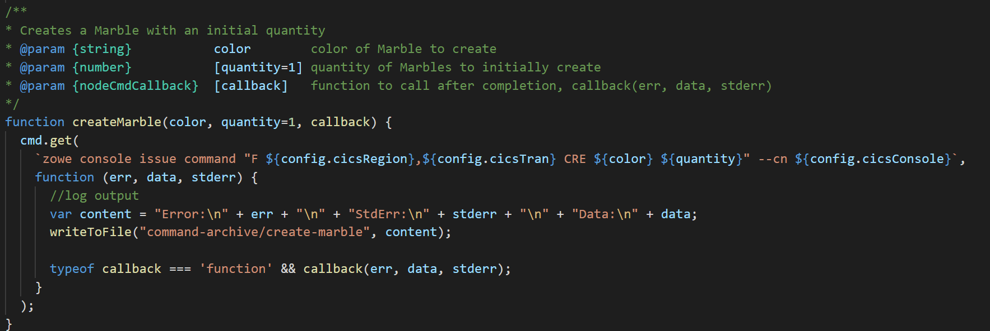
Review Mocha Test File
The createMarble function issues a zowe console command to execute the CICS transaction to create a marble of a specified color with an initial specified inventory.
If the initial inventory is not specified, the function defaults it to 1.
Once the asynchronous command completes, it will call an optional callback.

Slide 62
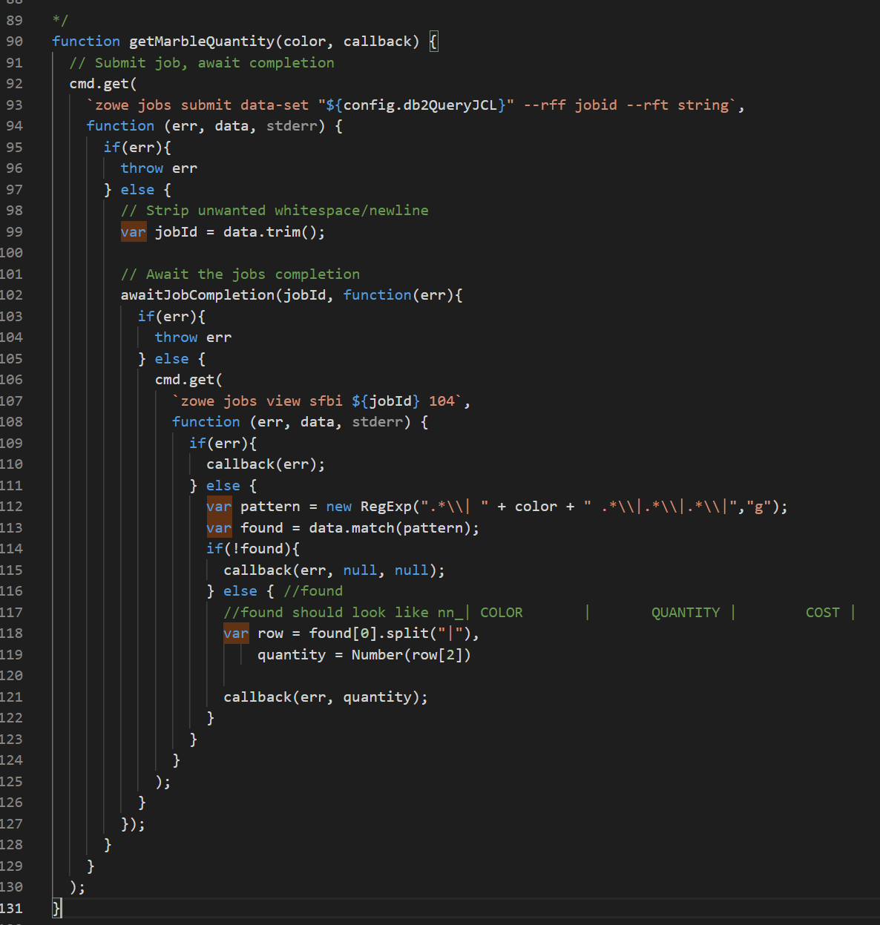
Review Mocha Test File
The getMarbleQuantity function submits a job to query the Marbles table using SQL.
It waits for the job to complete then retrieves the spool file, 104.
It parses the spool output using regular expressions to find the row with the data.
Rows have a specific structure where the columns are separated with a "|"
The data is assigned and the information sent through a callback to the calling function.

Slide 63

Review Mocha Test File
You could run the existing mocha tests and produce a report by issuing mocha --reporter mochawesome.
However, if you look in your package.json at your project's root, you will see a scripts section.
This demonstrates how to set up a test script. This test script can then be run with the npm test from your terminal at your project's root. Run:
npm test
Run the tests and verify they all pass.

Slide 64
Implement New Tests
Now that we have ensured all the existing tests for marble inventory manipulation pass, let's adjust the test case for creating a single marble so that it creates a single marble with a cost of 1.
First, locate the following test and update the title from 'should create a single marble'to 'should create a singlemarble with a cost of 1'
Remove the .only( so it will run all the tests.
Change the createMarble function call to createMarble(COLOR, 1, 1, ...
Also, adjust the createMarble function call in the test case titled: should not create a marble of a color that already exists
Next, we will update the createMarble function to accept a cost parameter.
The function is displayed on the next slide.

Slide 65
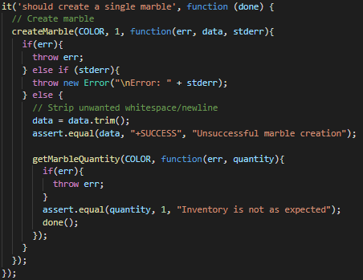
Implement New Tests

Slide 66
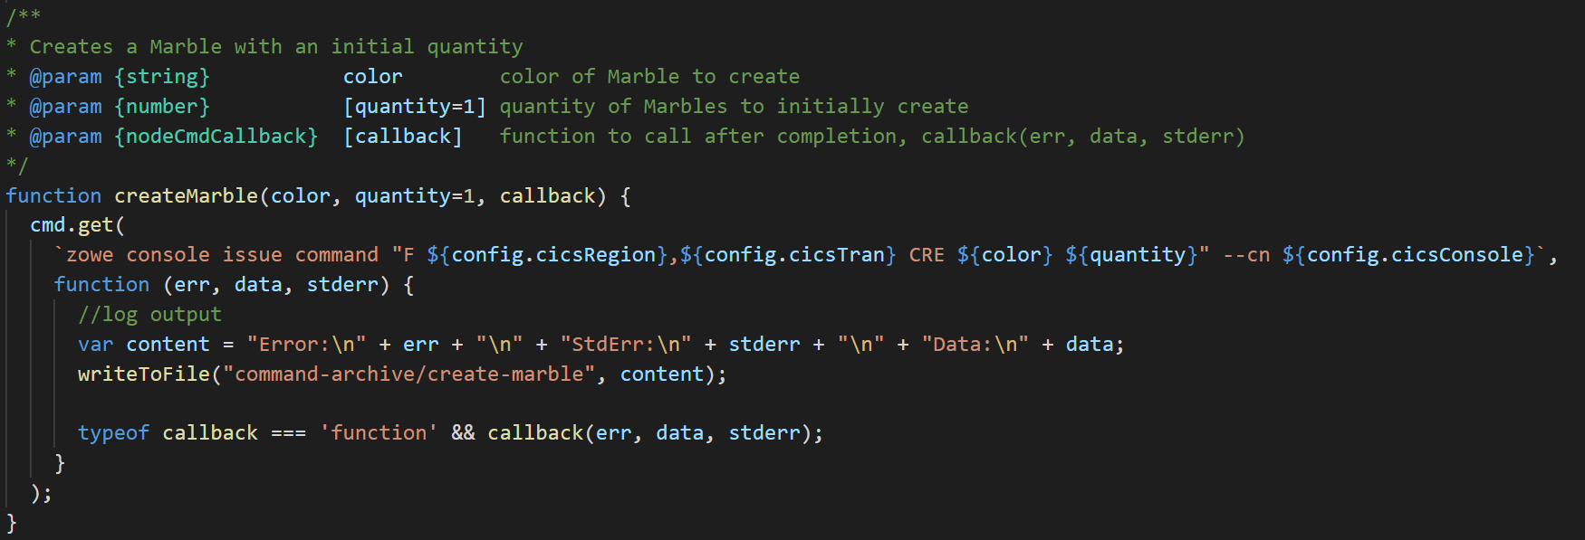
Change createMarble Function
Locate the createMarble() function:
Add another number parameter after quantity called cost with a default value of 1. (Use the quantity parameter as a reference).
Adjust the zowe command being issued to include another space and cost. Next, we will update our function that retrieves the quantity of marbles of a specific color to also retrieve the cost.

Slide 67
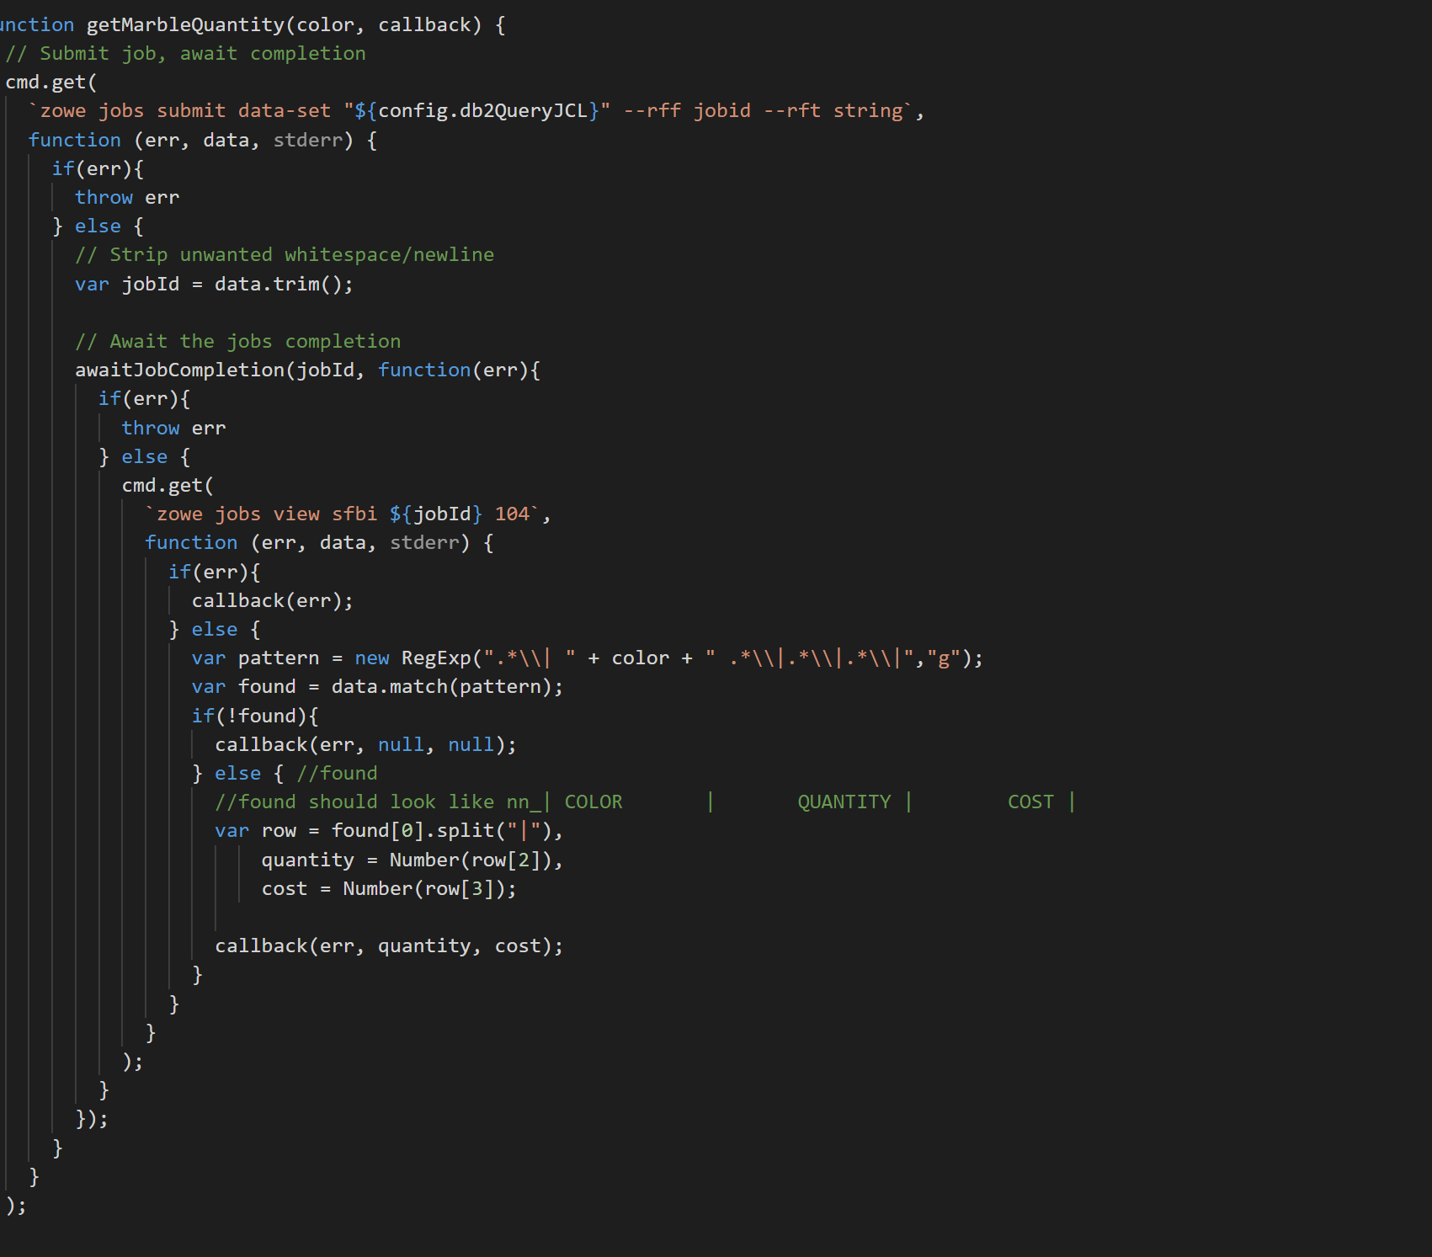
Change getMarbleQuantity function
Locate the getMarbleQuantity function.
In the row section, let's collect the cost and send it through the callback.
Add cost = Number(row3]); and adjust the callback.

Slide 68
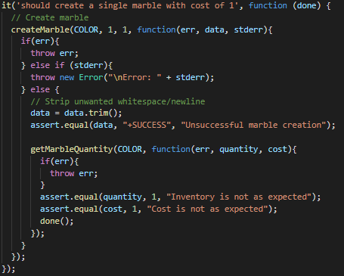
Update the test
Relocate the test we are updating. Finally, add the cost parameter to your getMarbleQuantity callback function and assert that cost is equal to 1. A finished updated test is shown on the next slide.

Slide 69
Run the test
Run npm test verifies the tests all pass.
Work with the facilitator should any issues arise.
A report of your test has been generated. Open the following file from your project's root to view:
mochawesome-report/mochawesome.html

Slide 70
Review
What have we learned?

Slide 71
Section VI:
Add Code Build to Continuous Integration

Slide 72
Workshop Environment

Slide 73
Continuous Integration - Introduction
Task runners help individual developers run their automation scripts easily and avoid wasting time doing mundane tasks. We can take this one step further and allow many of these tasks to be performed by CI orchestrators when code changes occur in a shared team repository.
Identify tasks that need to be performed after code changes are made at a shared level.
Create stages in CI orchestrators for these tasks
Call automated scripts from these stages
Note: In addition to automating these steps from CI, you will likely want to automate the trigger of the CI process from the shared code repository when code changes occur.

Slide 74
Steps for Section VI
In our case, the build step is a common one that could be performed from CI once a code change is made in Endevor. Let's add it to a Jenkins pipeline.
Log in to Jenkins, view JENKINS_PROJ project, and verify pipeline runs.
Review Jenkinsfile
Enhance Jenkinsfile to build project
Enhance build stage in Jenkinsfile to run gulp build, gulp deploy and npm test
Add Environment variables to supply connection and project details.
Manually kick off the pipeline to test

Slide 75
Jenkinsfile Overview Terms
Pipeline - defines the overall pipeline structure
Agent - defines where the code will execute
Environment - defines the environment variables for use in other commands
Stages - defines the start of the stages
Stage - defines each stage
Post - performed after running the stages section

Slide 76
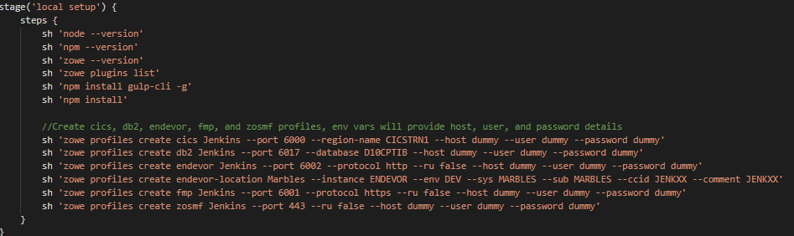
Jenkinsfile
To ease troubleshooting and ensure everything is set up, local setup does the following:
Verifies version of node, npm, zowe, zowe plugins
Installs gulp-cli
Installs npm dependencies
This ensure all thecomponents are available.
It then creates dummy profiles, so the code is cleaner. These profiles are destroyed when the run finishes. This provides cleaner code, but still has security as usernames, passwords and hostnames are obfuscated.

Slide 77

Log in to Jenkins
Jenkins is a hosted application running on a web server. You can access it from most web browsers.
Log in to Jenkins: JENKINS_URL
Username: JENKINS_USER
Password: JENKINS_PASS
Verify that the environment is in the right starting state
Click on the name of your project (JENKINS_PROJ)
Select the master branch
Click Build Now in the left side menu and verify the project builds successfully.
Build Now icon is shown below.

Slide 78
Review Jenkinsfile
A Jenkinsfile is a text file that contains the definition of a Jenkins Pipeline and is checked into source control. Using a Jenkinsfile, which is checked into source control, enables
Code review/iteration on the pipeline
Audit trail for the pipeline
Single source of truth for the pipeline
More detailed information is available at https://jenkins.io/doc/book/pipeline/jenkinsfile/

Slide 79
Review Jenkinsfile
Reviewing the Jenkinsfile in our project's root directory, the agent directive instructs Jenkins to allocate an executor and workspace for the pipeline. In our workshop, we use the label zowe-agent to instruct Jenkins to execute the tasks in a docker container that contains Zowe Community Edition and is being pulled from Docker Hub.
Environment variables can be declared within an environment directive or with a withEnv step.
An environment directive in the top-level pipeline block applies to all steps within the pipeline
An environment directive within a stage will only apply those variables to that stage.
The stages directive contains various pipeline stages and the steps directive provides the tasks for each stage.

Slide 80
Updating the Jenkinsfile
Implement the Build stage by calling the Build gulp task.
Locate the build stage in your Jenkinsfile
Remove the following line of code which simply echoed out a statement:
sh "echo build"
Uncomment the ensuing withCredentials code block.
Inside this block, we will have access to eosCreds. It is defined in Jenkins.
We define the user environment variable to be ZOWE_OPT_USER and the password to be ZOWE_OPT_PASSWORD because Zowe can be influenced by environment variables.
Let's take a moment to discuss command line precedence.

Slide 81
Zowe Command Line Precedence
You can specify any option on any command through the use of environment variables using the prefix ZOWE_OPT_.
For example, you can specify the option --host by setting an environment variable named ZOWE_OPT_HOST to the desired value.
For more information on defining environment variables, please reference:https://docs.zowe.org/stable/user-guide/cli-configuringcli.html#defining-environment-variables
When a Zowe command is run, the order of precedence for determining the option values to use is:
Command line arguments
Environment variables
Profile settings
Default values

Slide 82
Updating the Jenkinsfile
Add the following command inside the withCredentials block to instruct Jenkins to run the gulp build task you created as part of build stage:
sh 'gulp build'

Slide 83
Enhance Jenkinsfile for Deploy
Deployment for marbles requires us to copy the load modules, and activate the changes in the target CICS environment.
Deploy manually using CLI commands
Create and implement a Deploy gulp task
Create and implement a Deploy Jenkins stage

Slide 84
Create and implement a Deploy Jenkins stage - Step 4
Implement Deploy stage
Uncomment withCredentials block
Call the gulp deploy task that you created. This will need placed inside the inner withCredentials block.
Note: Plugins also inherit the ZOWE_OPT_ vars, but can be overridden on the command line.

Slide 85
Section VII:
Add Automated Testing to Continuous Integration

Slide 86
Testing Step in CI - Introduction
Testing is another step that is commonly automated. Once you've built up a suite of automated tests, you may want to integrate them into your CI process. Running these tests on every CI run is crucial as passing tests increase your confidence in the code changes and the automation.
Identify set of tests that are worth running in every CI run. You may want to avoid time-consuming performance tests for a stage further down the pipeline such as before deploying to production. All of the tests invoked by npm test are system tests that we want to include.
Create a stage in Jenkins to invoke these tests after code is checked in, built and deployed.
Note: Consider exploring code coverage tools to obtain metrics of code that is tested by your automated tests.

Slide 87
Create Test stage
We've already built an automated test using Mocha. Let's implement a test stage in Jenkins to call it.
Remove the call to the Test script and the TEST ENV var under the environment directive.
Uncomment withCredentials block in the 'test' stage
Call the npm test command that runs your test suite.

Slide 88
Run the pipeline
After adding the Test stage, test out the pipeline by pushing your changes and running it manually.
We need to:
Commit and Push Code to GitHub
Log in to Jenkins and build your project
Debug any issues that may arise. Reach out to facilitator for guidance if needed.

Slide 89
Commit and push changes to GitHub
To Review the files you have changed before committing:
git status
There may endevor reports you wish to delete, commit or only keep locally.
If you wish to only keep them locally, add endevor-report*.txt to your .gitignore file in your project's root directory. You can run git status again to verify you no longer see the endevor-report files.
Commit your changes when satisfied:
git commit -a -m "Add gulp build tasks"

Slide 90
Commit and push changes to GitHub
Push your changes to GitHub:
git push
If you are prompted for your username and password:
Username: GITHUB_USER
Password: GITHUB_PASS

Slide 91
Log in to Jenkins
Jenkins is a hosted application running on a web server. You can access it from most web browsers.
Log in to Jenkins: JENKINS_URL
Username: JENKINS_USER
Password: JENKINS_PASS
Verify that the environment is in the right starting state
Click on the name of your project (JENKINS_PROJ)
Select the master branch
Click Build Now in the left side menu and verify the project builds successfully.

Slide 92
Share the Test stage output with the Facilitator
Now that you've created and run the pipeline in Jenkins with the Test stage, it's time to share this with the facilitator.
Find the URL of your successful run with the Test stage.

Slide 93
Review - What have we learned?

Slide 94
Section X (optional):
Archive Artifacts in Jenkins

Slide 95
Archive Artifacts
For audit purposes, you may want to archive build/test results for each pipeline run.
Uncomment the post section of the Jenkinsfile
Commit and Push Code to GitHub
git commit -a -m "Updating"
git push
Log in to Jenkins and build your project
Debug any issues that may arise. Reach out to facilitator for guidance if needed.

Slide 96
Summary
Congratulations on completing the Zowe workshop. You learned about the following topics today:
Automating testing concepts.
Using Mocha to built an integration test for a CICS transaction.
Implementing a Test stage in Jenkins to call automated tests
Making code changes and enjoying your automated build, deploy and test process.

Slide 97
Review - What have we learned?

Slide 98
Thank You

