Slide 1



Powered by McStas technology
"McXtrace: a Monte Carlo software package for simulating X-ray optics, beamlines and experiments", Journal of Applied Crystallography, vol. 46, part 3, June 2013
Peter Willendrup <pkwi@fysik.dtu.dk>
Emmanuel Farhi <emmanuel.farhi@synchrotron-soleil.fr> (and Erik Bergbäck Knudsen)

Slide 2
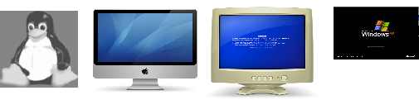

What is it?
Built on proven base of McStas for neutron ray tracing
K. Lefmann and K. Nielsen, Neutron News 10, 20, (1999).
This is Monte-Carlo: we use random numbers to describe particle distributions
Releases 1.7 and 3.0 (GPU support)
Portable code (Unix/Linux/Mac/Windows, 32 and 64 bit support)
Has run on all from iPhone to FERMI (world no. 7)
NVIDIA GPU support from v. 3.0
GPL-license
DSL / Compiler Technology.
Using Lex & Yacc
Modular Open Structure.
Components/devices written in structured ISO-c automatically fits in the system
Dependencies: c-compiler (python3/qt5 or perl/tk for gui).
Permanent staff at DTU Physics and SOLEIL maintaining the code
Project website at
http://www.mcxtrace.org
Project mailing list at
mcxtrace-users@mcxtrace.org
Source code at
https://github.com/McStasMcXtrace/McCode

Slide 3
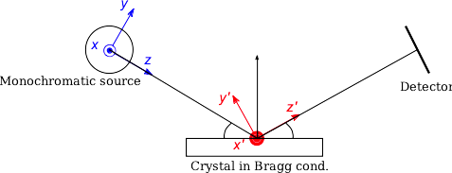
How?
Photon ray/package:
(r,k,φ,t,p,E)
r - spatial coordinates
k - wave vector
φ - phase
t - time
p – photon weight
E - Electrical field polarisation

Slide 4
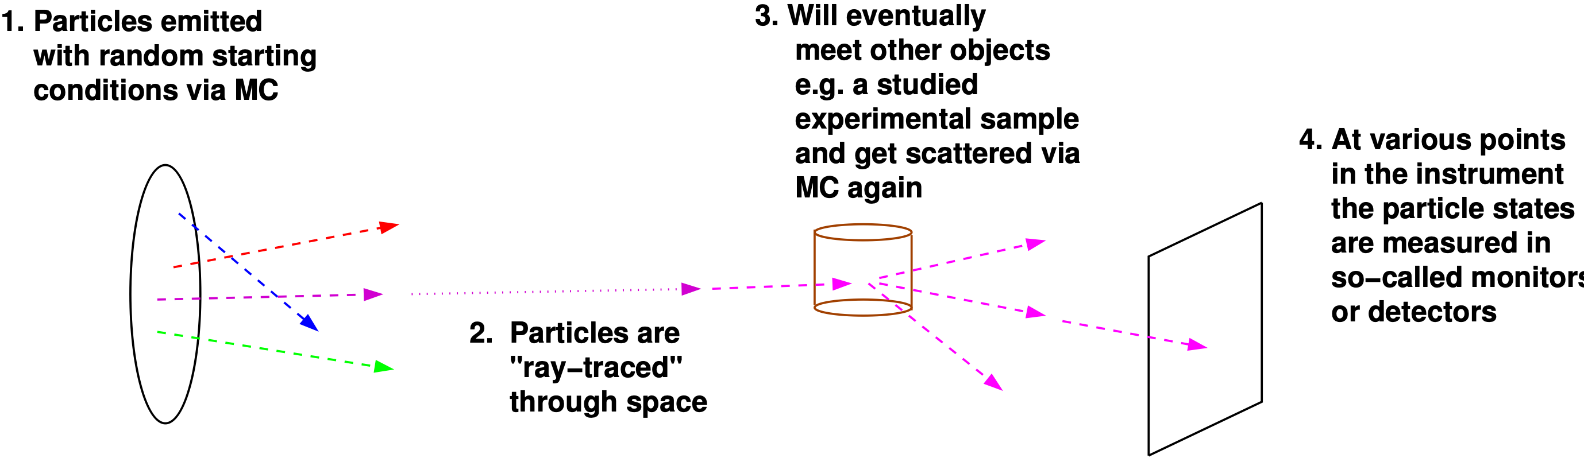
Overall picture: Monte Carlo Ray-Tracing
Important efficiency mechanisms:
“Focusing” - e.g. lab source to first slit (4π vs. limited solid angle only)
Rather vs. single particle description, absorption handled though statistics and downscaling the ray weight

Slide 5
The McXtrace way
Describe your beam-line in the McXtrace language (In a text file).
Automatically convert beam-line into ANSI c
Compile
Run
1.Optimized for your platform
2.Only includes what you use

Slide 6








Code Levels
Instrument/beam-line file – all users
existing examples
user written – GUI assisted
Component files – some users
Short pieces of code
Easy to modify from existing
Kernel code – McXtrace developers
Propagation routines
Intersections
Generated ISO-C code – “no” users
Assembled by code generation
Very low overhead of unneeded code
Includes runtime libs that comps rely on (propagation etc.)
Instrument file (average user, point/click, DSL)
Component (advanced user, modify from existing, c-code)
Kernel (McXtrace team)

Slide 7
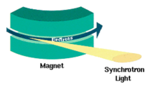
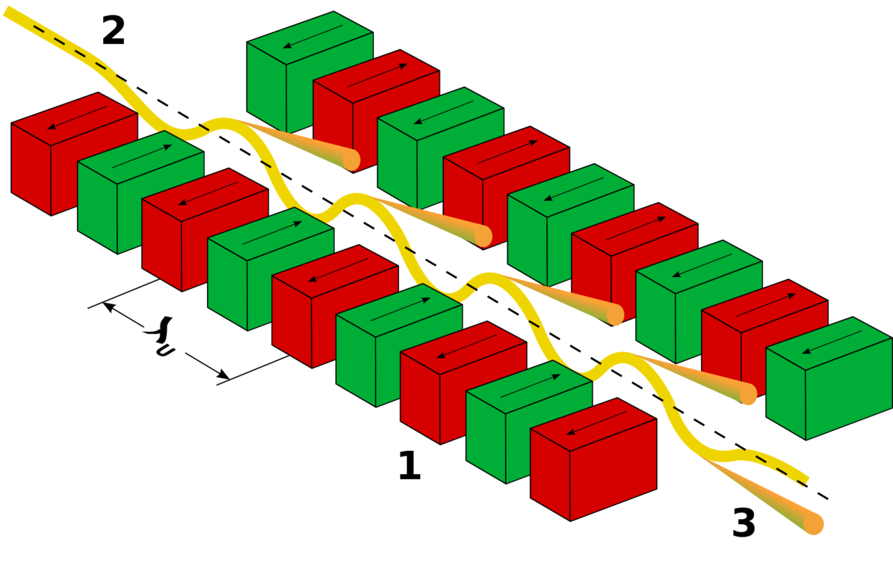
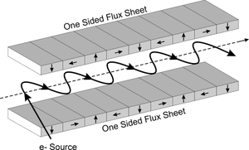
Components: Sources
Synchrotron ID
Bending magnet [B.D. Patterson, Am. J. Phys. 79, 1046 (2011)]
Undulator [K.J. Kim, AIP, conf. proc., 184, 1989]
Wiggler [B.D. Patterson, Am. J. Phys. 79, 1046 (2011)]
Lab/ideal stuff
Laboratory X-ray tube (e.g. rotating anode)
Ideal, point and gaussian
Interfaces with other software
Spectra (R) <http://spectrax.org/spectra/>
Simplex (R) <http://spectrax.org/simplex/index.html >
Genesis (R) <http://genesis.web.psi.ch/>
Shadow (RW) <https://github.com/oasys-kit/shadow3>
MCPL (GEANT4, PHITS, MCNP, SRW) (RW) <https://mctools.github.io/mcpl/>

Slide 8
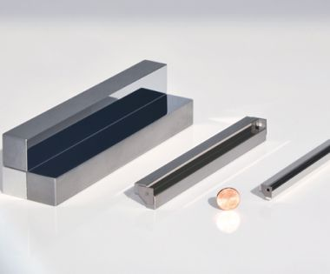
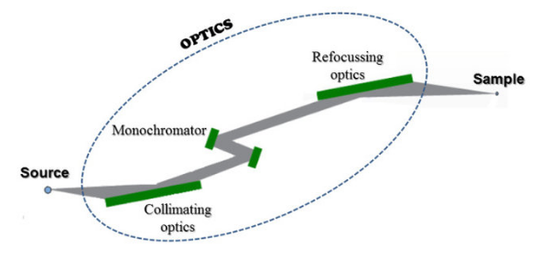
Components: Optics
Enough to start with:
Bragg crystal (monochromator, incl. bent)
Capillary
Filter (absorption and refraction)
Lenses
Mirrors (flat, curved, multi-layers, twin KB multi-layer)
Zone plate
Grating (lamellar, blazed)
Slit, beam-stop, ...
More to come (with your help ?)
Components can be arranged in groups.

Slide 9

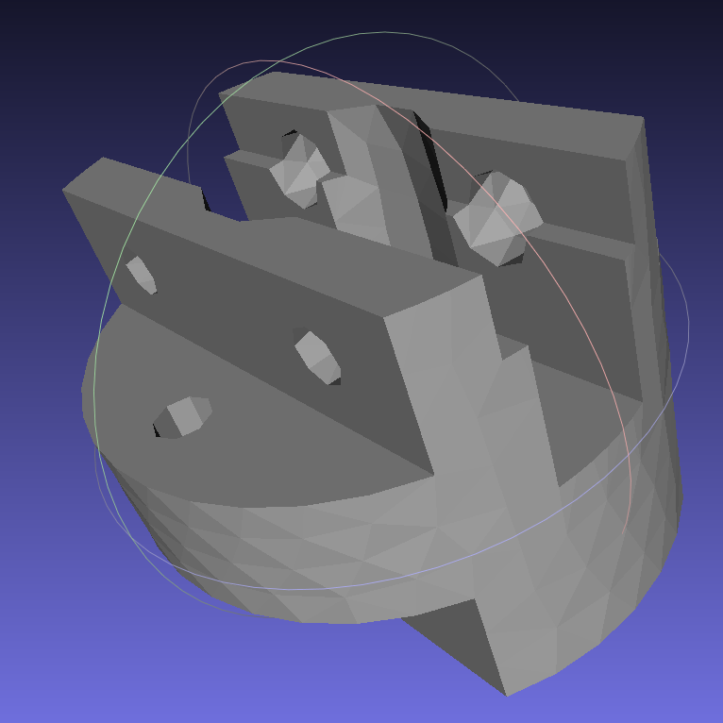
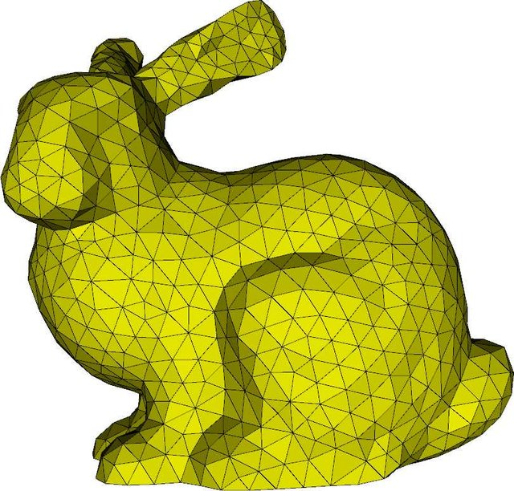
Components: Samples
SAXS sample (60 models from SasView, PDB, Nanodiscs, Liposomes, I(q), …)
Powder (diffraction)
Polycrystal (diffraction)
Pump-probe (2 states) molecule
Single crystal (diffraction)
Absorption (XAS)
WIP: inelastic, fluorescence
All samples can have simple geometric shapes (incl. hollow).
Powder and SX can have any shape (PLY/STL).
Powder sample supports multiple concentric geometries (e.g. for cryostat).
McXtrace comes with a material data base, and can use e.g. NIST files.

Slide 10

Components: Detectors
Currently only record distributions (1D, 2D, event lists, …) for any combination of state parameters (position, divergence, energy, power, phase, E-field, …) → ideal detectors.
Can be adapted to include some more realistic efficiency.
Not satisfactory !
Actual detector efficiency to be added (simple models exist), e.g.
<https://bl831.als.lbl.gov/~jamesh/mlfsom/>

Slide 11
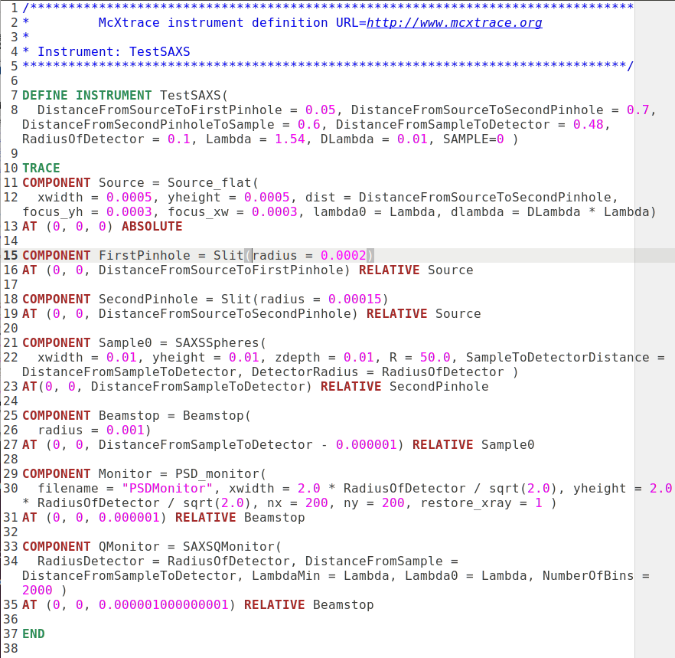
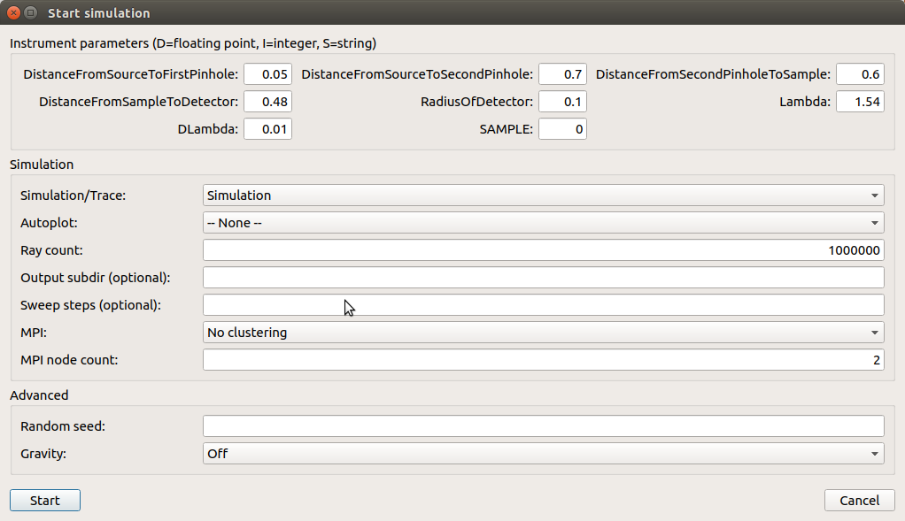
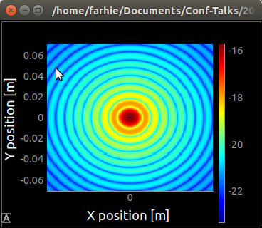
SAXS
11 s
Hard spheres colloid

Slide 12
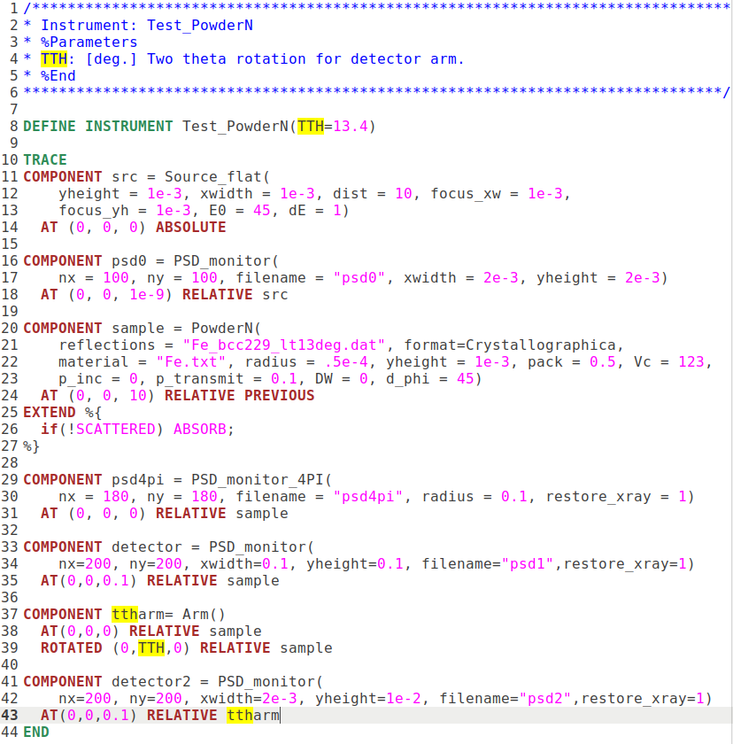
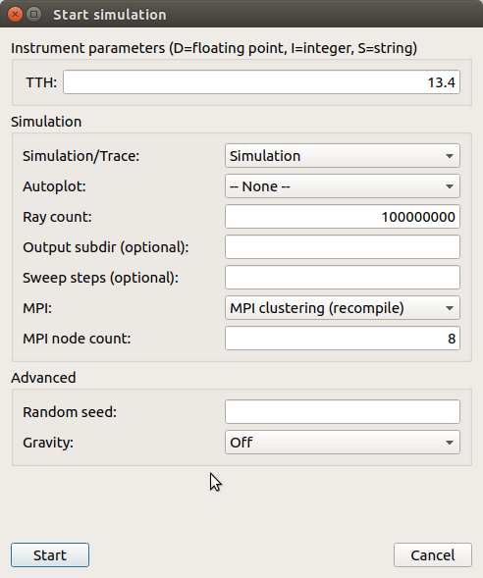
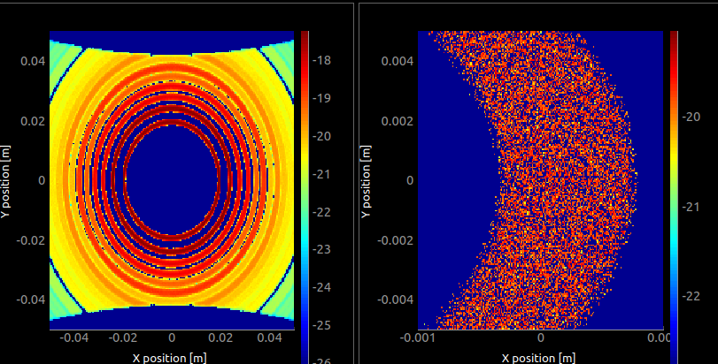
Powder Diff.
6 s
Fe bcc

Slide 13
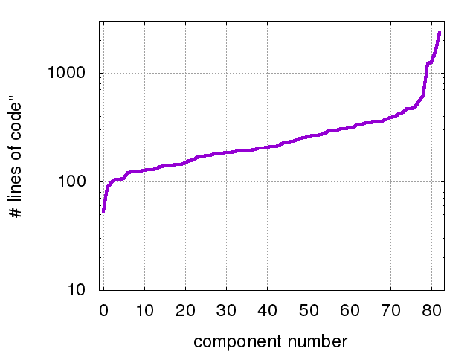
Component size: typically 100-200 LOC
Single_crystal
SasView_model
PSD_monitor
PowderN
Undulator

Slide 14
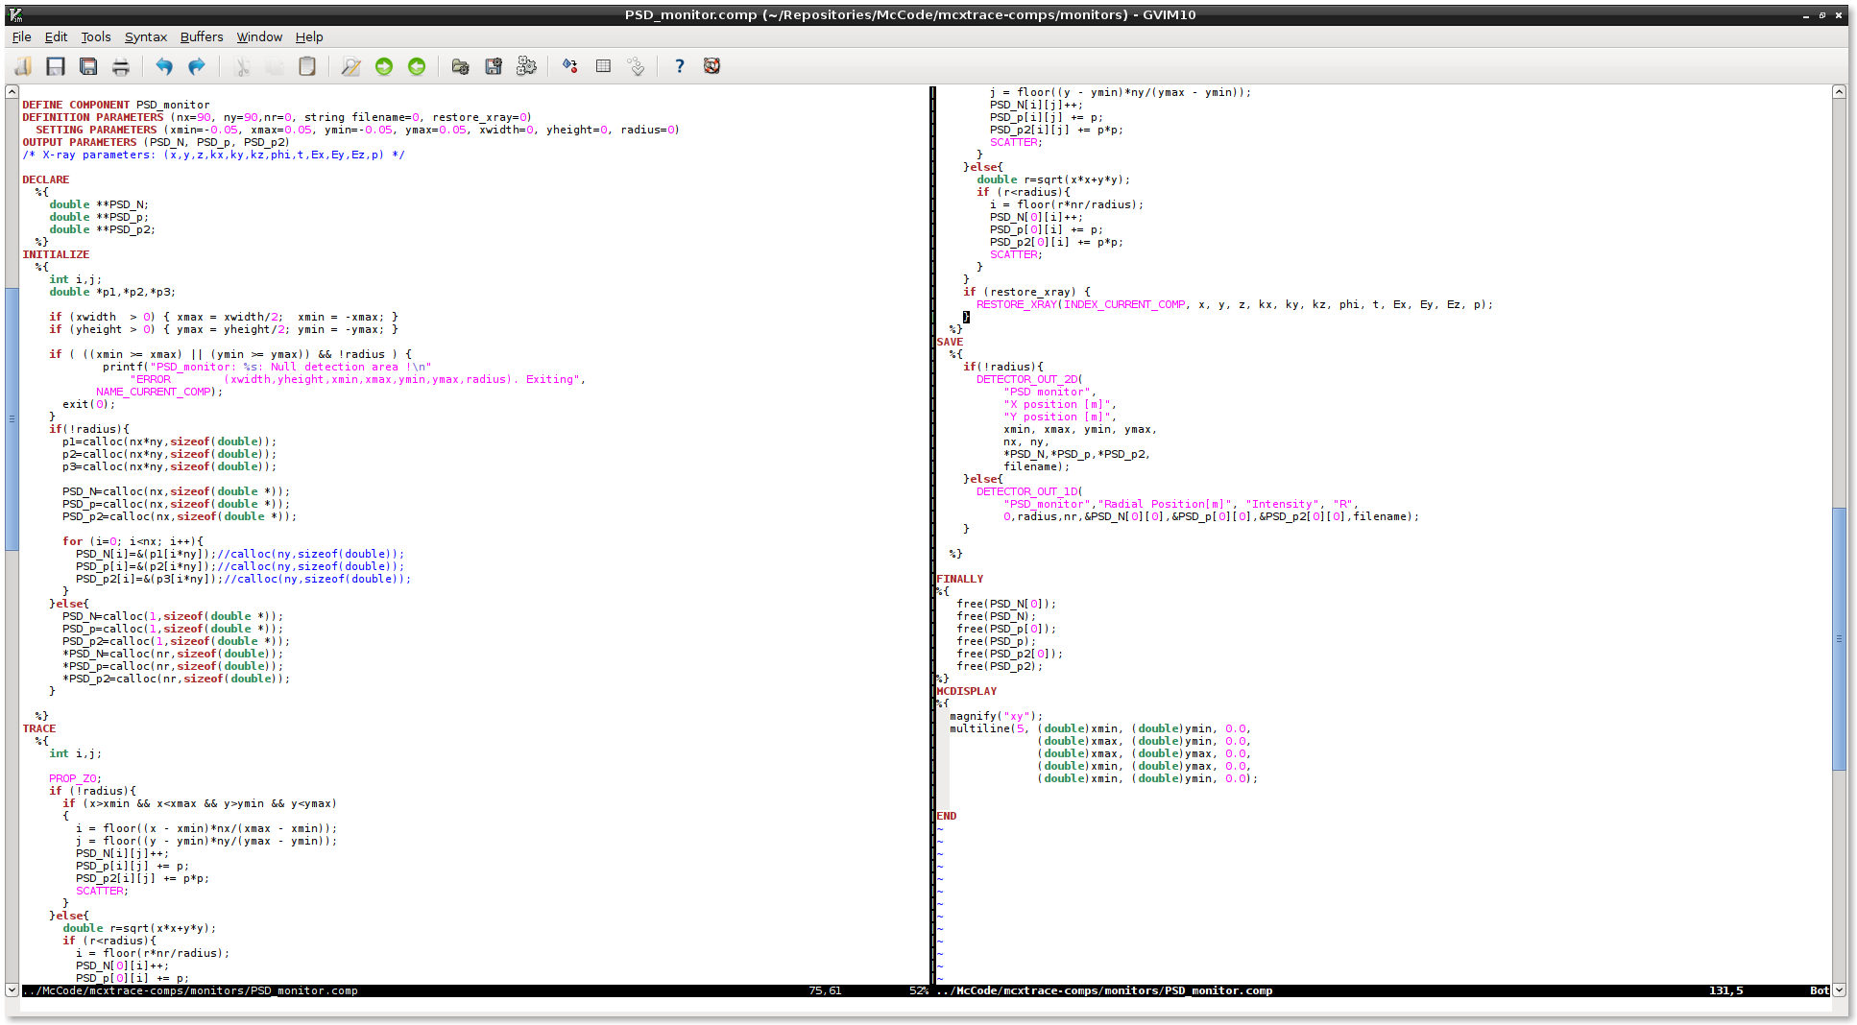
Component file (source, optics, sample, det., ...)

Slide 15
Why simulate a full beam-line ?
Users don’t always have access to synchrotrons
Prospective users may try out experiments.
Teach users how to do experiments.
Understand what is happening along the beam-line.

Slide 16
Why McXtrace ?
Community driven code
Fairly easy to extend – write a new component and it automatically fits into the framework.
Portable (just need a c-compiler).
Several included standard sample models.
Plenty of examples.
Once written, a simulation/beam-line is a real program in itself.
...but...
Use whatever you prefer! XRT, SHADOW, SRW, Ray,...<insert package here>…

