Slide 1






McStas data normalisation
- and other important, not so well known details
Peter Willendrup^{1,5}
Emmanuel Farhi²
Erik Knudsen^{1,5}
Uwe Filges³
Kim Lefmann^{4,5}
¹DTU Physics, Lyngby, Denmark
²Calcul Scientifique, Institut Laue-Langevin (ILL), Grenoble, France
³Niels Bohr Institute, University of Copenhagen, Copenhagen, Denmark
4Paul Scherrer Institut, Villigen, Switzerland
5ESS DMSC, Copenhagen, Denmark

Slide 2
Topics
From the McStas FAQ’s:
Why comps in this order?
Simulation to experiment comparison (Data normalisation)
How to make your McStas more efficient
Other important details

Slide 3
From the “list of frequent questions”
Why do you need to have the components in this order?

Slide 4
Order of components is important
1
3
2
1
2
3
Starting at the source

Slide 5
Order of components is important
1
3
2
1
2
3
Moving to first comp in the list

Slide 6
Order of components is important
1
3
2
1
2
3
Moving to 3rd comp in list requires “moving back in time”.
Default behavior is to ABSORB this type of neutron.
For monitors use restore_neutron=1 in this case.
For homegrown comps use ALLOW_BACKPROP macro.

Slide 7
Further tips 1:
Simulation to experiment comparison

Slide 8
What is really the information content…?
McStas sources generally provide “intensity” in units of neutrons/s (into a chosen solid angle)
That intensity is carried through the instrument on a discrete set of “neutron rays”

Slide 9

In a histogram sense
Imagine a histogram, e.g. I(λ)
The RMS variance over that set becomes our statistical error bar E
…
…
1
2
3
i
k
In bin i, N events each carrying a fractional intensity pj so that

Slide 10
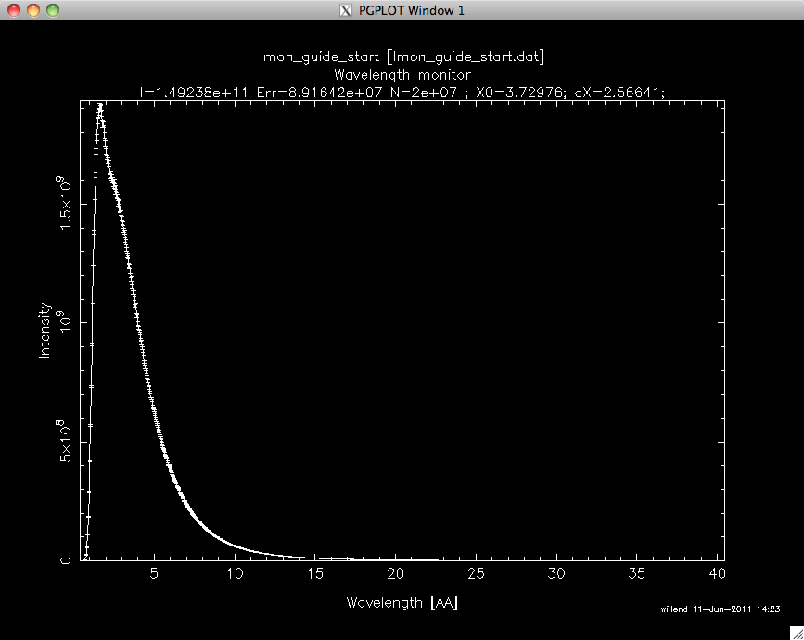
In a histogram sense
Imagine a histogram, e.g. I(λ)
The RMS variance over that set becomes our statistical error bar E
…
…
I
E
N
1
2
3
i
k
In bin i, N events each carrying a fractional intensity pj so that

Slide 11
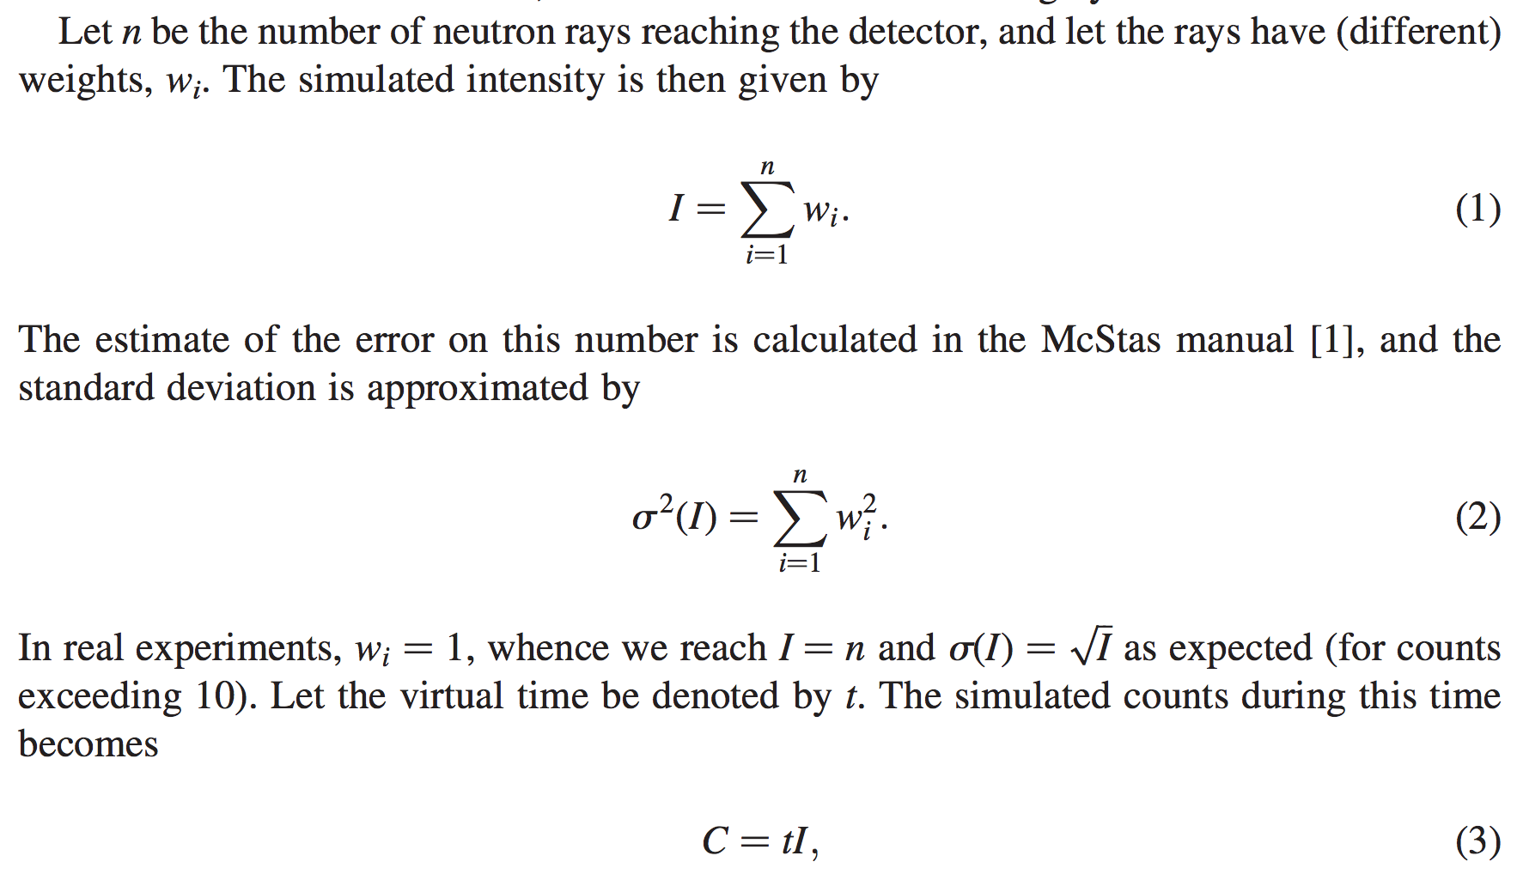
From "Virtual experiments - the ultimate aim of neutron ray-tracing simulations", K. Lefmann et al., Journal of Neutron Research 16, 97-111 (2008)

Slide 12
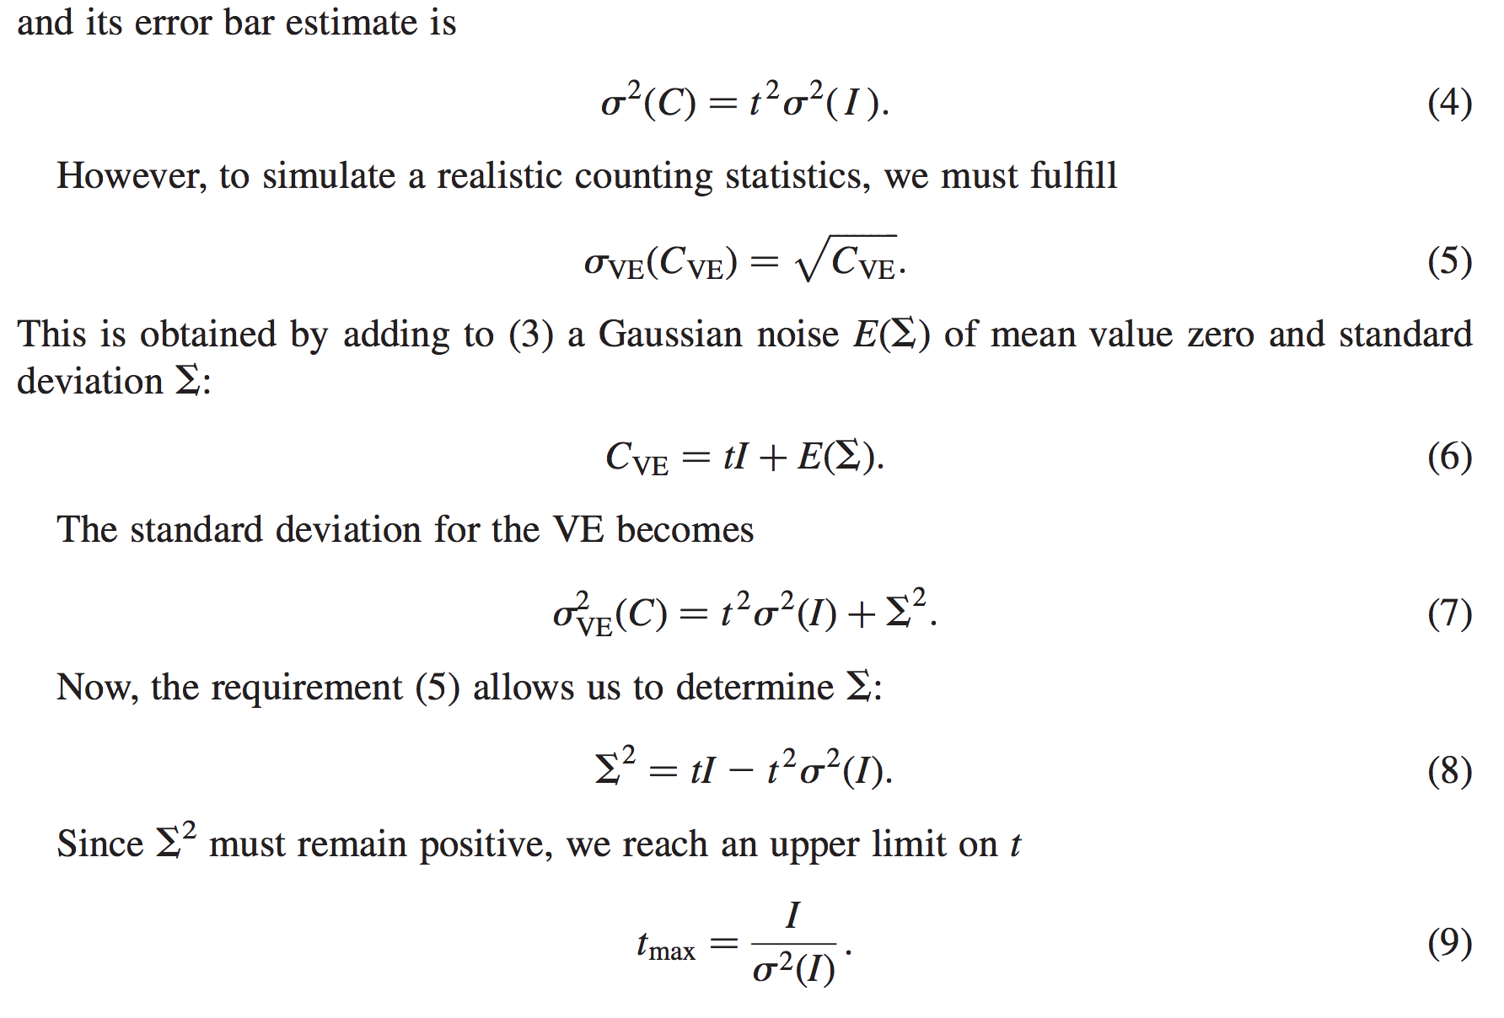
From "Virtual experiments - the ultimate aim of neutron ray-tracing simulations", K. Lefmann et al., Journal of Neutron Research 16, 97-111 (2008)

Slide 13
Sketch of an algorithm…
On a given McStas histogram
For the non-zero bins, calculate
The smallest defines the “maximal counting time” allowed by your statistics
Preferably a “background” should be added - use a “known experimental value” or an estimate…

Slide 14
Important points to remember
Your simulation will only contain elements you provided / defined
… to the precision you defined
Answers the questions you posed
Background essentially only from “sample”, or sample-near objects

Slide 15
Further tips 2:
How to make your McStas more efficient

Slide 16
Onto efficiency…
Apply focusing techniques
At the source (spatially, temporally, in wavelength…)
At the sample, if possible
(carefully!) Apply SPLIT - but only if immediately followed by Monte Carlo choices, e.g. in sample
Alternatively use MCPL o/i which allows repetition - beware of biases!

Slide 17
Onto efficiency…
Apply focusing techniques
At the source (spatially, temporally, in wavelength…)
At the sample, if possible
(carefully!) Apply SPLIT - but only if immediately followed by Monte Carlo choices, e.g. in sample
Alternatively use MCPL o/i which allows repetition - beware of biases!
All of this can be considered “variance reduction”
or biasing

Slide 18
Onto efficiency…
Use MPI parallelisation - included in macOS install from 2.4.1, easy to get on Linux… On Windows McStas uses MS MPI, get it from “extras” folder where you downloaded 2.4.1
The Intel C compiler is known to give ~factor of 2 wrt. gcc in most cases
- Still consider if you are asking the right question if runtimes reach days/weeks…
Sledge-hammer / brute force!

