Slide 1
Further samples…
Peter Willendrup
Slides adapted from Mads Bertelsen, ESS DMSC
Slides adapted from Mads Bertelsen, ESS DMSC

Slide 2
Further samples in McStas
Models for SANS and reflectometry
Inelastic scattering, examples:
Phonon_simple
Isotropic_sqw
McStas performance, TAS / Chopper

Slide 3
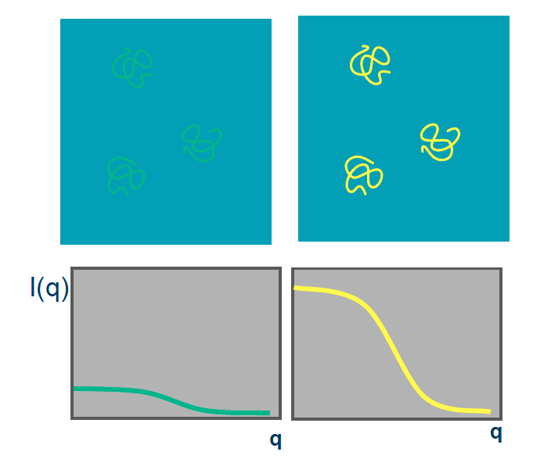
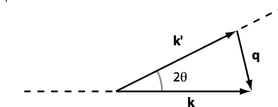
Small angle scattering SANS
SANS method can be used for many types of material
Often: Molecule + Liquid (buffer solution)
Isotropic scattering

Slide 4
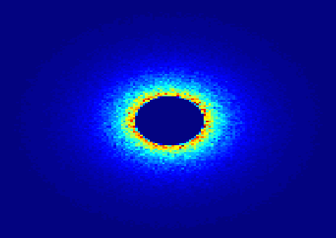

SANS
Small Angle Neutron Scattering
Elastic Scattering
Small angle -> small q -> big r
Gain information on the molecular scale 10-100Å
Low signal to noise
Contrast method
Instrument requirements: good collimation, long flight distance after detector.

Slide 5
McStas has a suite of SANS-models:
Try ellipsoidal and
cylindrical particles
-or-
Elliptic cylinders
Go for Nanodiscs and Liposomes
SANS other samples
SANS_AnySamp.comp
SANS_DebyeS.comp
SANSCylinders.comp
SANSEllipticCylinders.comp
SANSGuinier.comp
SANSLiposomes.comp
SANSNanodiscs.comp
SANSNanodiscsFast.comp
SANSNanodiscsWithTags.
SANSNanodiscsWithTagsFast
SANSPDB.comp
SANSPDBFAST.comp
SANSShells.comp
SANSSpheres.comp
Also – SASmodels from SASview

Slide 6
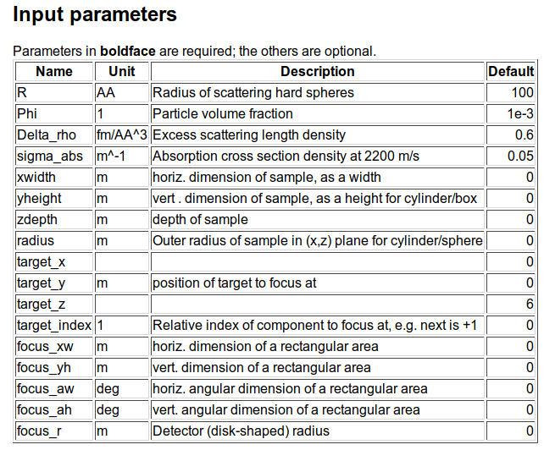
SANS spheres
Dilute, monodisperse, hard spheres in solution, with given contrast and radius

Slide 7
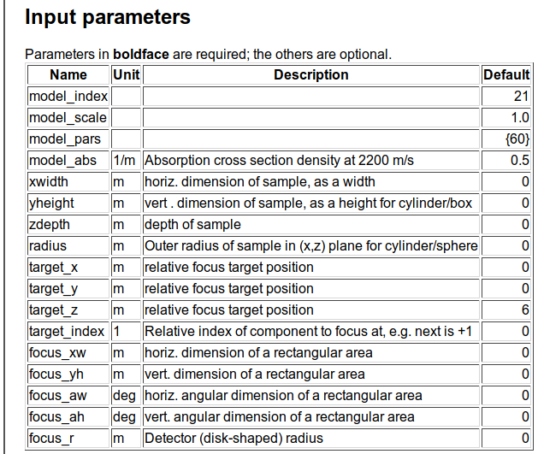
SasView_models

Slide 8
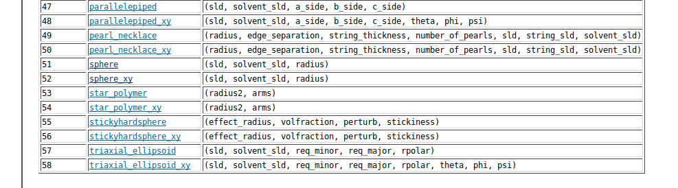
SasView_models

Slide 9
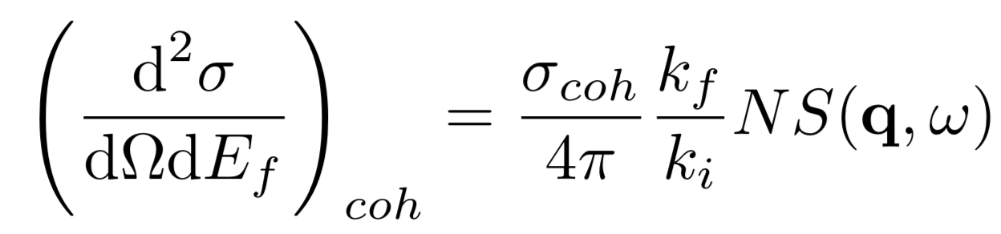
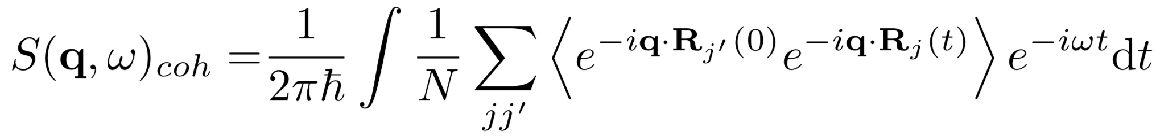
Inelastic scattering S(q,w)
partial differential cross section
Scattering function
Phonons, Spin waves, …

Slide 10
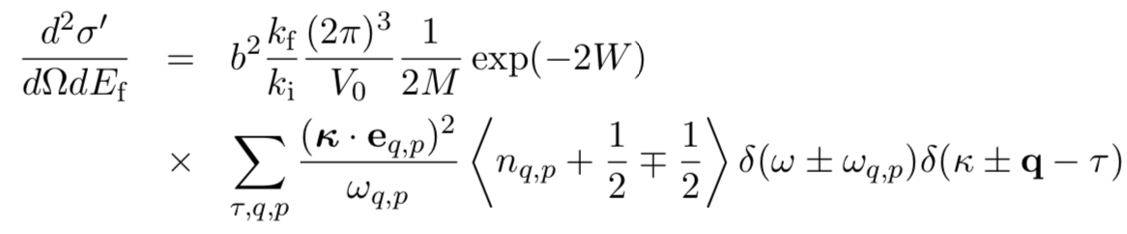



Popular component: Phonon_simple
One isotropic acoustic phonon branch in all Brillouin zones on FCC Bravais single crystal
M - Atomic mass
b – scattering length
n – bose factor
a – fcc lattice spacing
c - speed of sound
𝜿 – measured q vector
q – Phonon scattering vector
Dispersion
For FCC Bravis

Slide 11
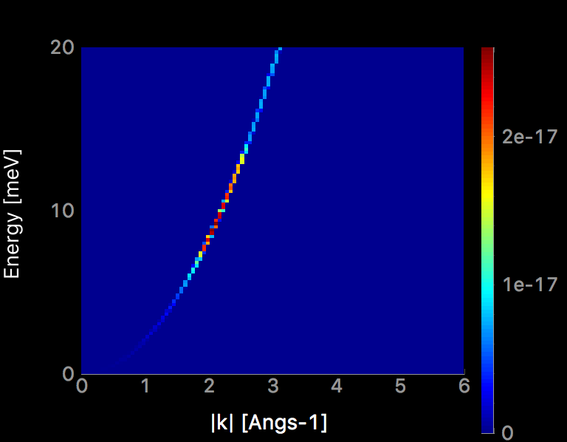
Popular component: Phonon_simple
Dispersion relation, theory and mcstas
⍵
q₀
q

Slide 12
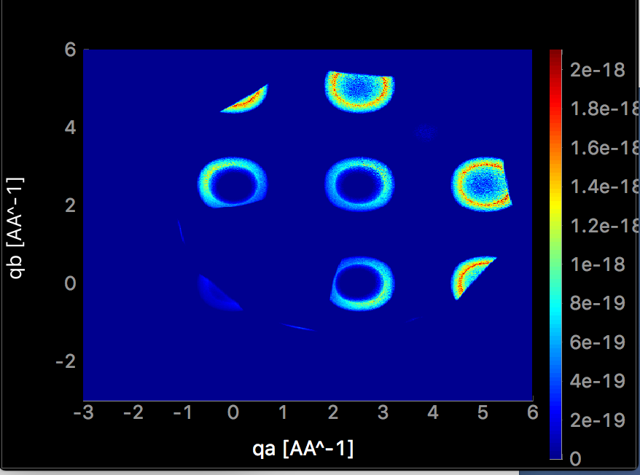
Popular component: Phonon_simple
4 meV energy transfer
Example of the output

Slide 13
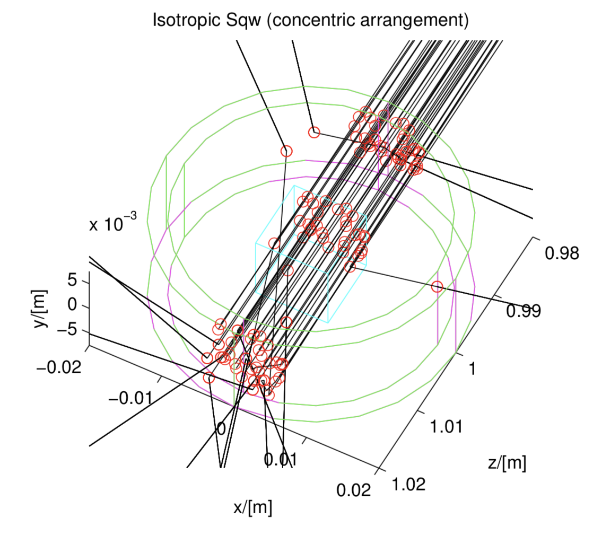
Popular component: Isotropic_sqw
Isotropic processes (powder, liquid, …)
Use data files to describe S(q,w) directly, coherent and incoherent
Supports concentric

Slide 14
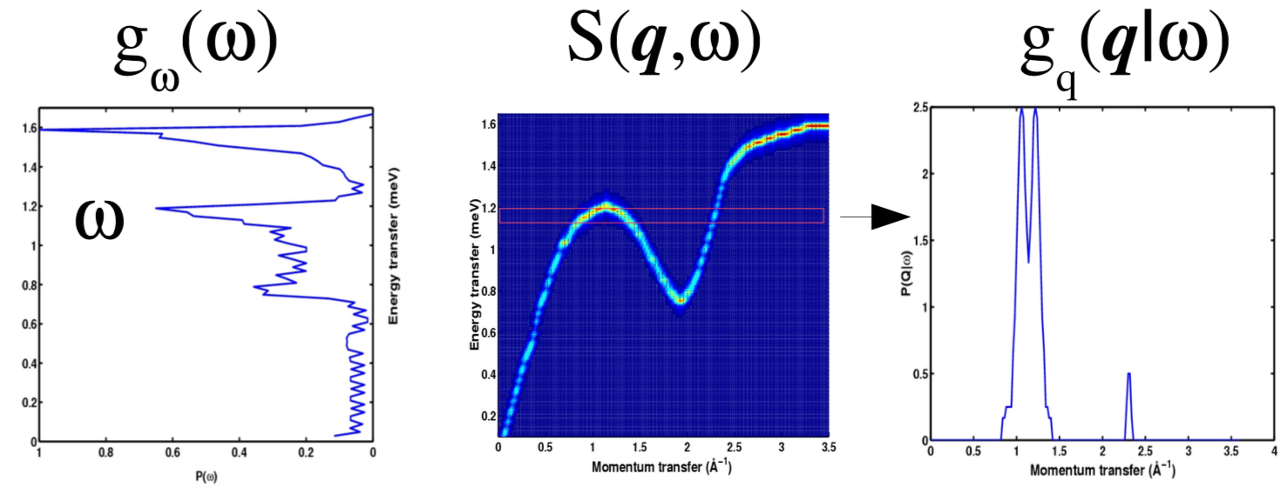
Popular component: Isotropic_sqw
Isotropic processes (powder, liquid, …)
Use data files to describe S(q,w) directly, coherent and incoherent
Supports concentric
P(Q|⍵)
⍵
P(⍵)
q
q

Slide 15
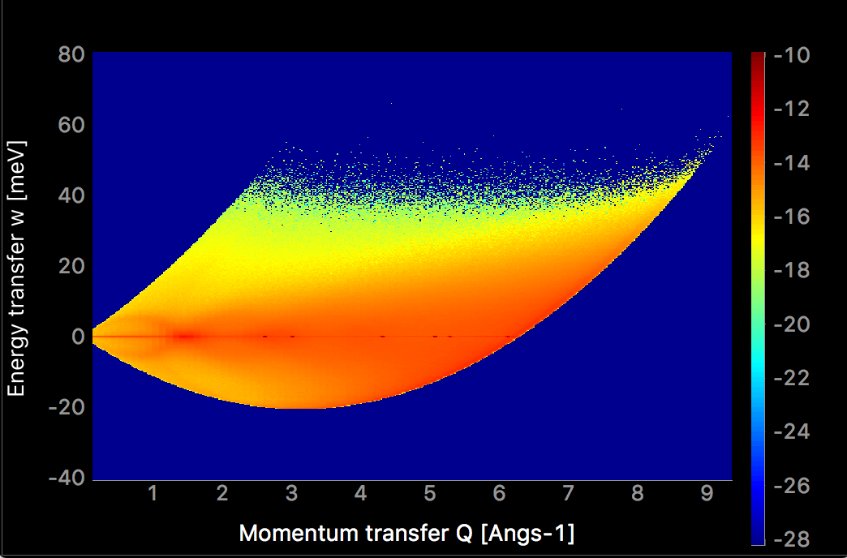
Popular component: Isotropic_sqw
Rb liquid in time of flight
Coherent and incoherent

Slide 16
Inelastic scattering in McStas
Monte carlo sampling issues
Need to sum over large amount of possible final states to find cross section
Need large amount of rays to sample all the options
q_{y}
+d⍵
+⍵
q_{x}
dq_{y}
dq_{x}
dq_{z}
q_{z}

Slide 17
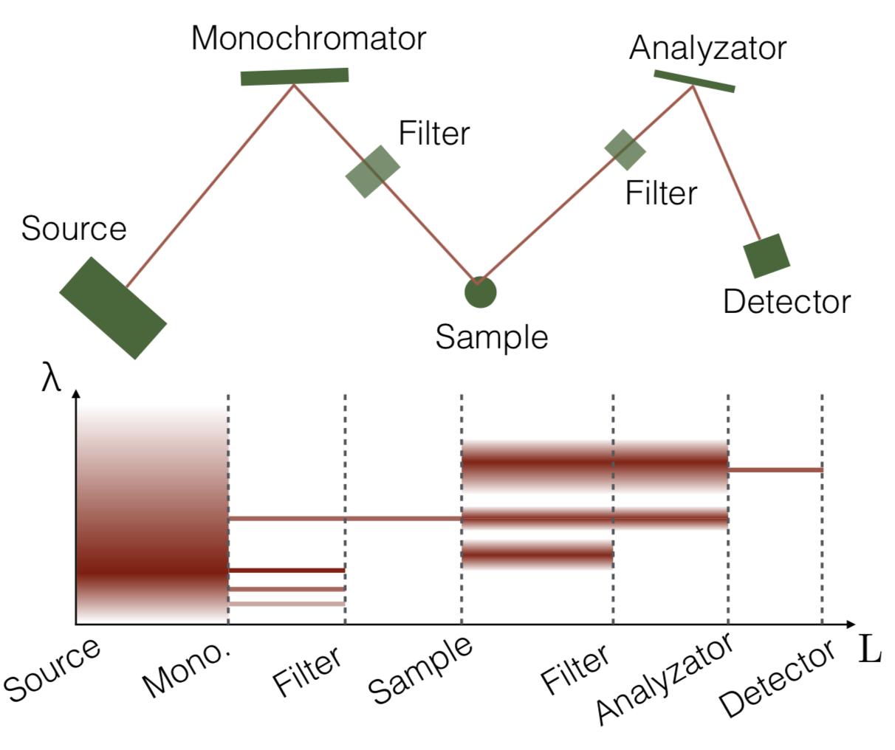
TAS
Only a small fraction of neutrons arrive, most are simulated in vain

Slide 18
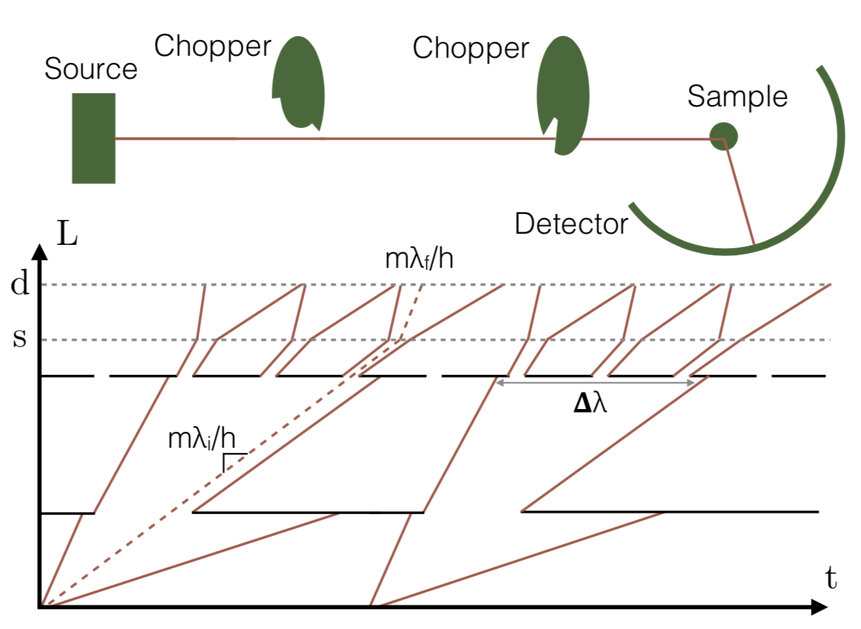
Chopper spectrometers
Only a small fraction of neutrons arrive, most are simulated in vain

Slide 19
Conclusion
Inelastic scattering supported in McStas, but could use more sample components
Longer computational times required
Advantages from simulation especially important for spectroscopy (resolution function)

