Slide 1
Monte Carlo Particle Lists
MCPL

Slide 2
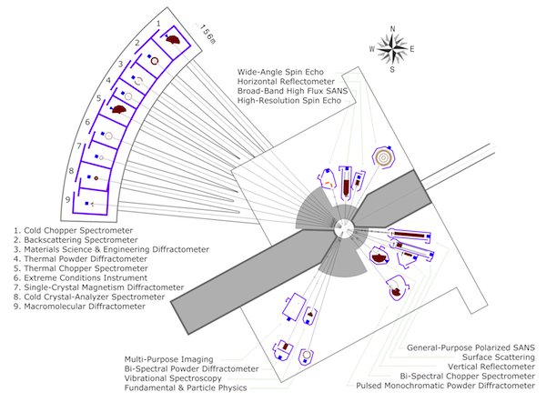
Legacy: 2016 overview
Monte Carlo vs. ray tracing – where are we heading?
MCNP: target, moderator, reflector design
McStas: (+other ray-tracing codes) for instrument design
GEANT4: for shielding and backgrounds
Vitess & NADS & Particle swarms: shielding & optics
- design documentation for the instrument
MCNP: safety, dose-rates (future use of FLUKA or MARS)
GEANT4: detector design
MARS: Accelerator
→ Interfacing is important!
→ MCNP-McStas interface is insufficient
→ A common file format would facilitate
'cradle to grave' simulations, without
intermediate loss of information
(e.g. through fitting etc)
Monte Carlo Particle Lists: MCPL
2

Slide 3



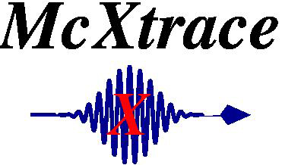
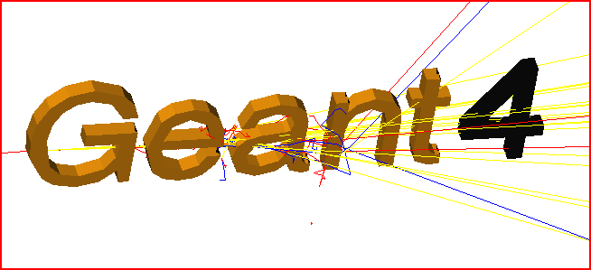
Software integration: MCPL
Mish-mash of converters and ad-hoc solutions of varying quality is what we want to avoid
MCNP5
h

Slide 4
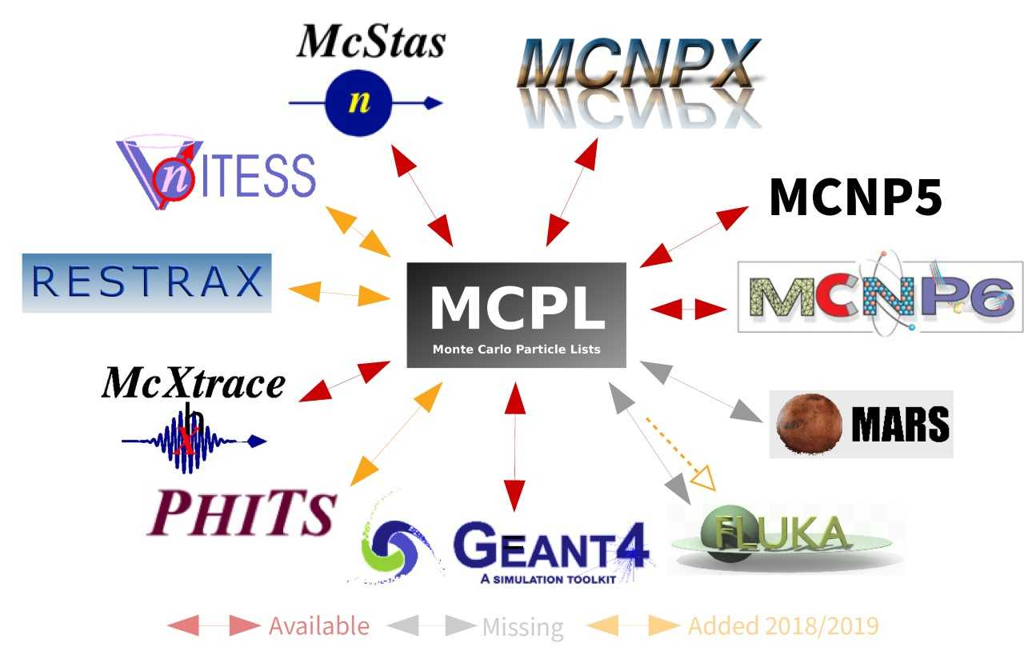
Software integration: MCPL

Slide 5

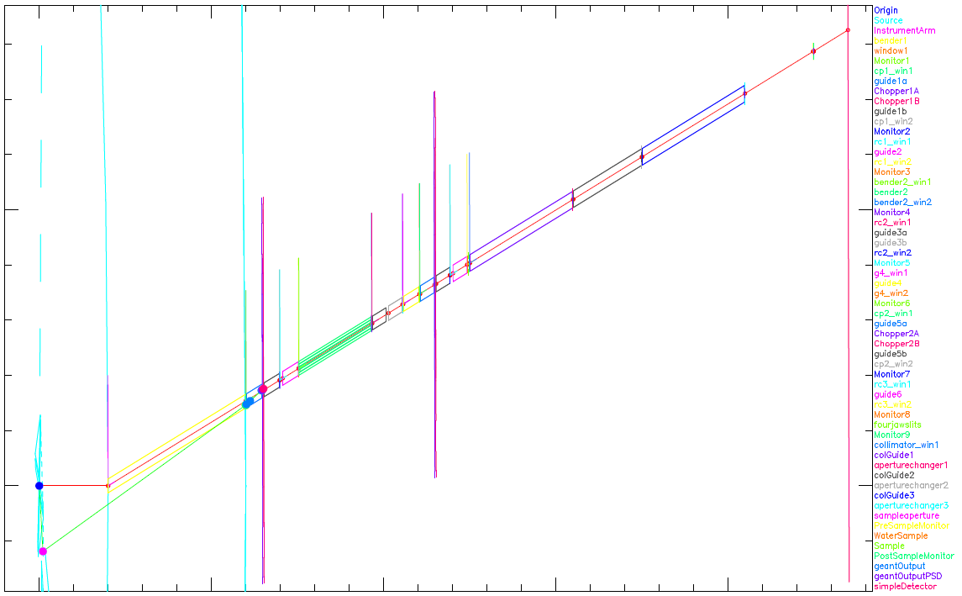
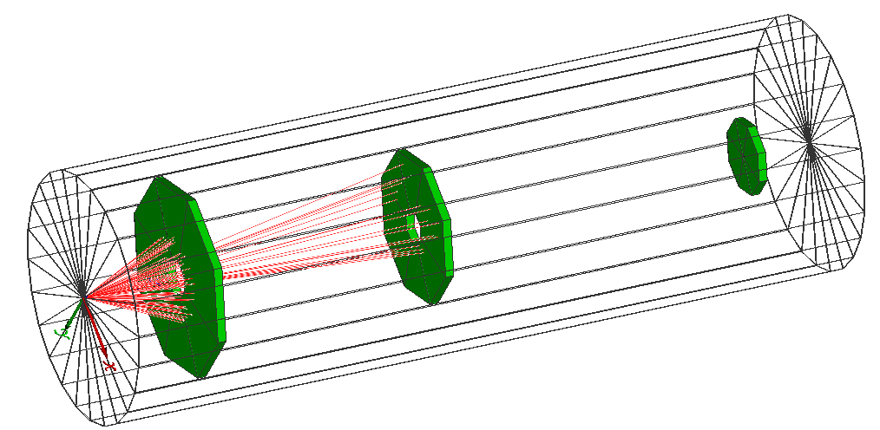
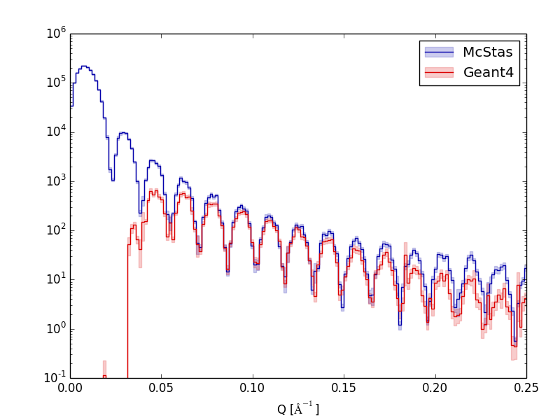

MCPL example use-case Typical MCPL usage in detector studies
First capture output of instrument simulations
- Set up by or with instrument scientist, using dedicated SW like McStas.
- Provides realistic distributions of neutron energies, divergence, etc.
- Might include modeling of representative sample
Or use output from shielding simulations for background studies
Then feed into detailed Geant4-based detector simulation
- Emulate detector response as needed
- Construct realistic high-level observables to study impact of detector
on instrument performance.
- Study other interesting aspects (rates & occupancy, efficiencies, etc.)

Slide 6
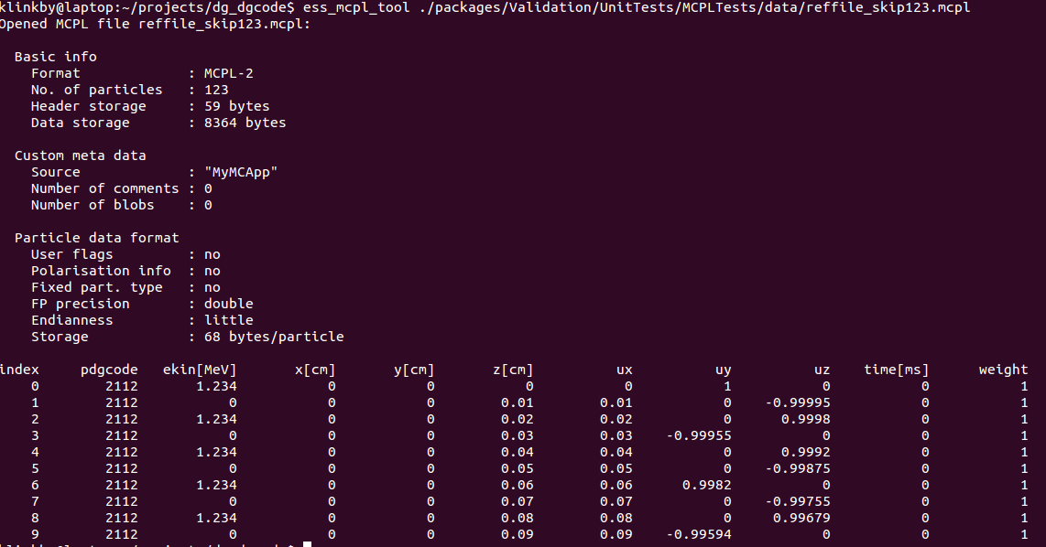
MCPL: hands-on
BB
Developed within the software framework of the ESS Detector Group – Thomas Kittelmann is the main developer
Core software (written in c) is stable and released
Use-cases for McStas-Geant4–MCNPX couplings: arXiv:1509.03036
https://mctools.github.io/mcpl/
https://mctools.github.io/mcpl/mcpl.pdf

Slide 7
MCPL: Coupling MCNP & McStas
One example, of particular interest concerns coupling MCNP and McStas through MCPL, exploiting varience production in MCNP : the DXT sphere.
DXT sphere combined with SSW interface, can be setup to bias simulations toward a given beamline (while conserving neutron weight)

Slide 8
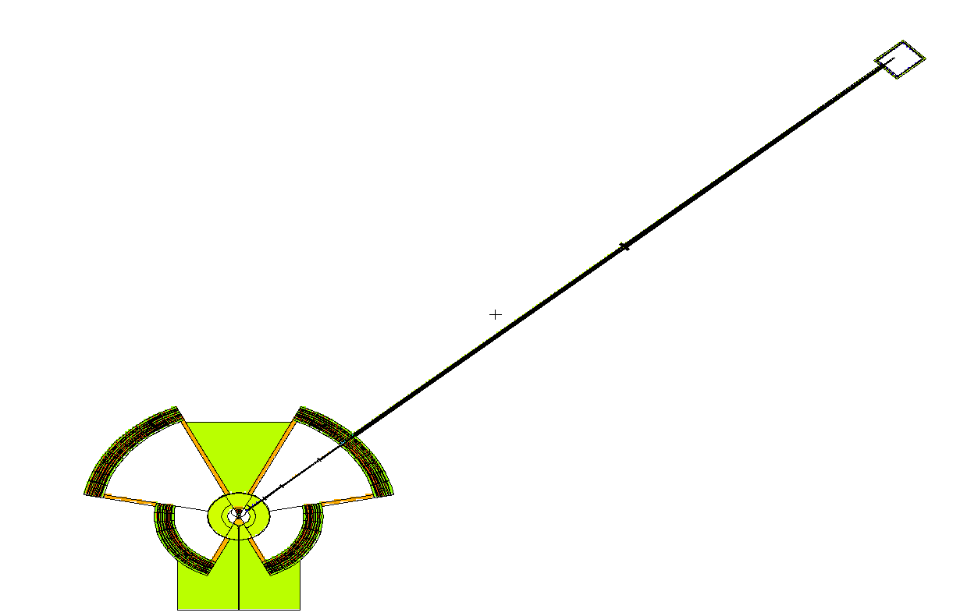
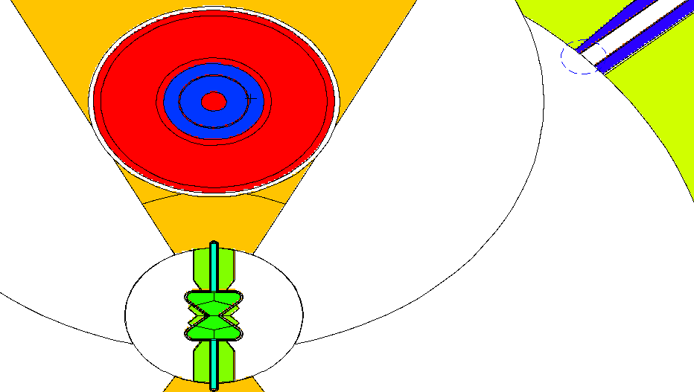
MCPL: Coupling MCNP & McStas
DXT sphere
SSW surface
=>SSW file including: gamma, neutrons at all energies (ie usable for background + signal)
=>convert to MCPL and use MCPL tools to select particles of interest
=>use MCPL file as source in McStas

Slide 9
MCPL: Coupling MCNP & McStas
Some words of caution: MCPL file inherit MCNP coordinate system
Mixture of low weight and high weight neutrons can be confusing
Let’s try it out (tasks are also on GitHub, see link also posted in chat)
1. pick a folder on the cluster to work in
2. Copy one or more MCPL files from either /nfs/www/html/users/willend/MCPL/1e6/ ~ 30 Mb each
/nfs/www/html/users/willend/MCPL/1e7/ ~ 300 Mb each
3. Find the instrument ESS_butterfly_Guide_curved_test.instr via Files, New From Template…, ESS
4. Look in the code for rotations + translations taking you from the MCNP / TCS to the McStas / beamline coordinate system
5. Run the instrument for one or more combinations of Sector= and beamline=, both in ”simulation” and “trace” modes.

