Slide 1
Guides
Mads Bertelsen, ESS DMSC

Slide 2
Overview
Description of phase-space and propagation
Reflectivity
McStas coordinate system
Popular components
Guide_gravity
Elliptic_guide_gravity
Breaking line of sight
Example
Exercise

Slide 3
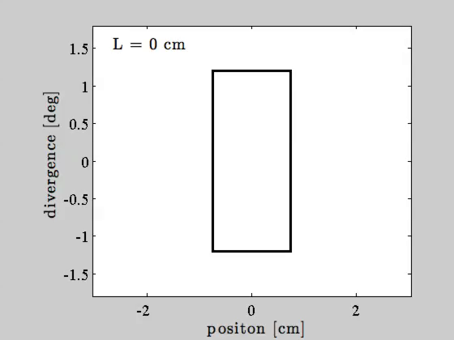
Beam propagation in free space
Divergence
z
v
𝜂x
x

Slide 4
Beam propagation in free space
Divergence
z
v
𝜂x
x

Slide 5

Beam propagation in guide
Divergence
z
v
𝜂x
x

Slide 6
Beam propagation in guide
Divergence
z
v
𝜂x
x

Slide 7
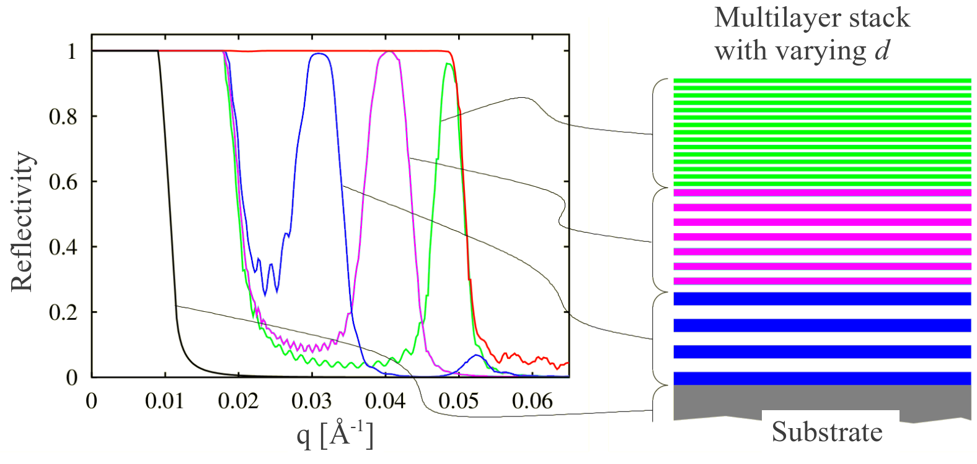
Reflectivity curves
Reflectivity, super mirror, reflectivity curve
ki
q
kf
𝛳
2𝛳

Slide 8


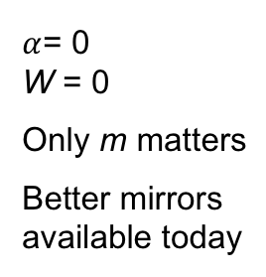
Reflectivity curves in McStas
McStas standard model
McStas fitted model
Slope:$−α$
$α$= 0 W = 0
Only m matters
Better mirrors available today
Cutoff: $\frac{tanh⁡}{W}$

Slide 9
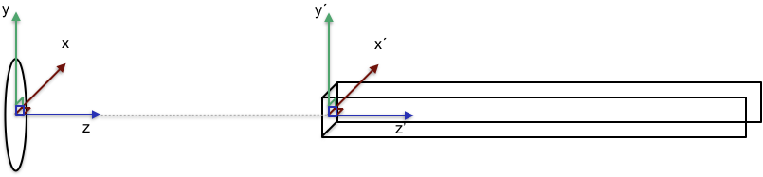
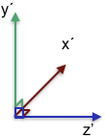
Guide placement in McStas
The center is the front of the guide element
Tip: Insert a guide at the end of the guide
COMPONENT Source AT (0,0,0) ABSOLUTE
COMPONENT Guide(length=A) AT (0,0,2) RELATIVE Source
COMPONENT Arm AT (0,0,A) RELATIVE Guide

Slide 10
Popular guide components: Guide_gravity
Typical guide component with gravity
Many additional features, channels, fermi chopper, …
w1
w2
h1
h2
l

Slide 11
Popular guide components: Guide_gravity
Typical guide component with gravity
Many additional features, channels, fermi chopper, …
w1
w2
h1
h2
l

Slide 12
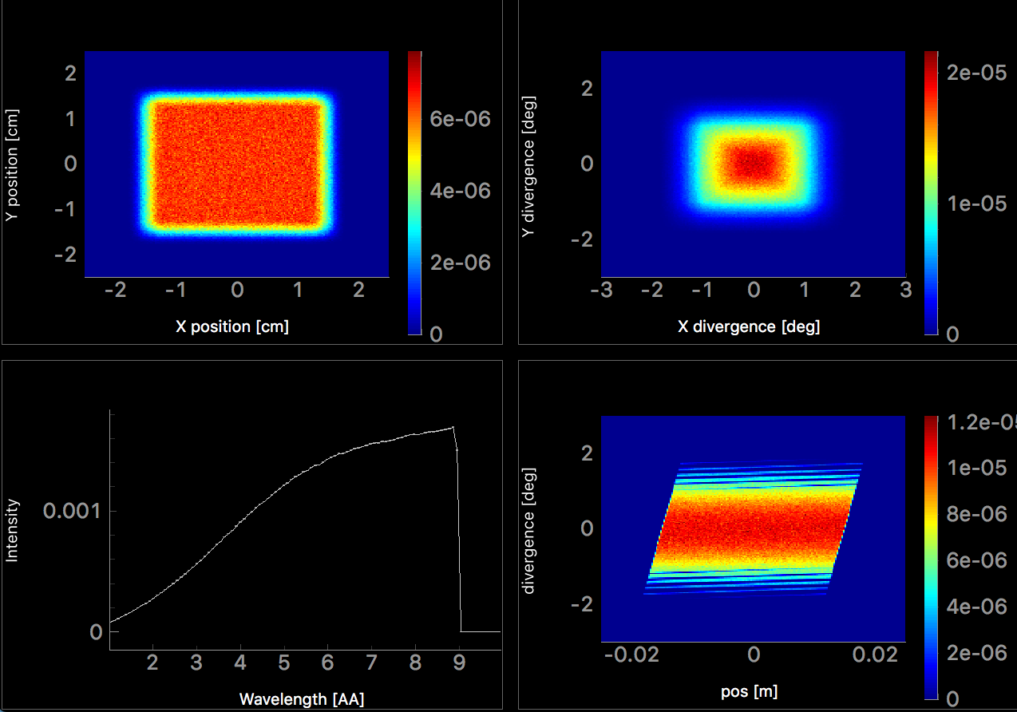
Popular guide components: Guide_gravity
Typical guide component with gravity
Position
Divergence
Wavelength
Position - Divergence

Slide 13
Popular guide components: Elliptical_guide_gravity
Useful for elliptic and parabolic guide geometries, focusing, ballistic, coating distribution, …
xwidth and yheight at DimensionsAt = ”entrace” , ”mid” or ”exit”
linxw linyh
l
loutxw loutyh

Slide 14
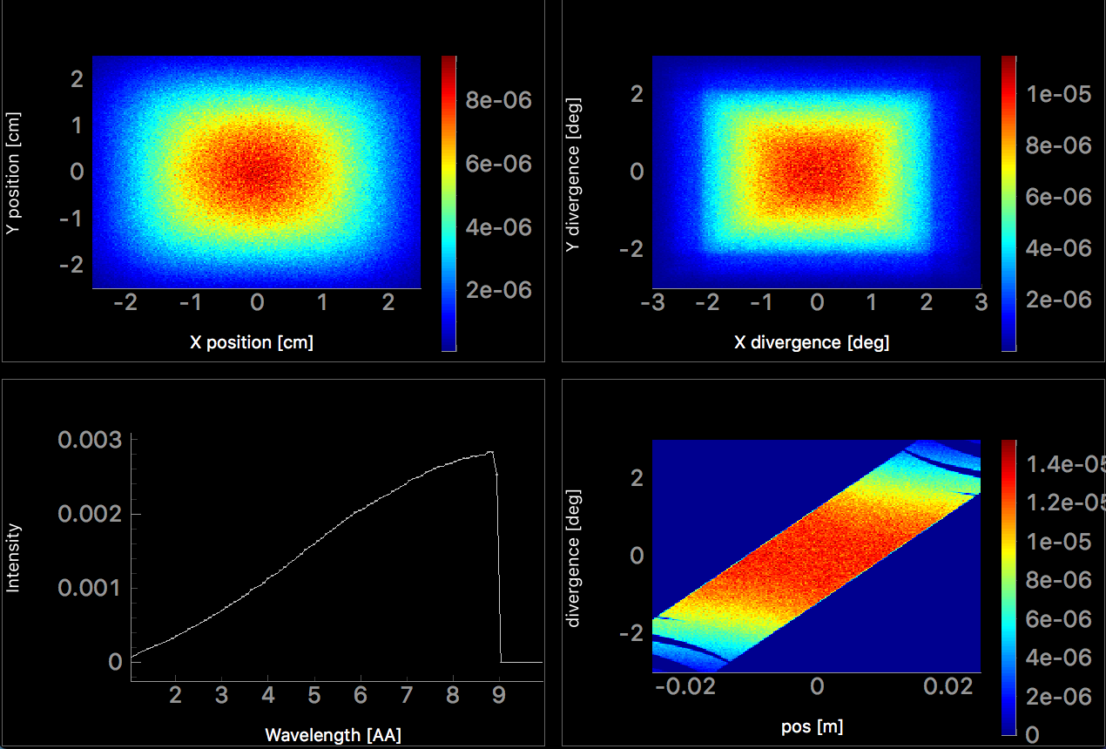
Popular guide components: Elliptical_guide_gravity
Useful for elliptic and parabolic guide geometries, focusing, ballistic, coating distribution, …
Position
Divergence
Wavelength
Position - Divergence

Slide 15
Comparison: Guide_gravity and Elliptic_guide_gravity
Guide_gravity
Elliptic_guide_gravity
Position
Divergence
Position
Divergence
Wavelength
Position - Divergence
Wavelength
Position - Divergence

Slide 16
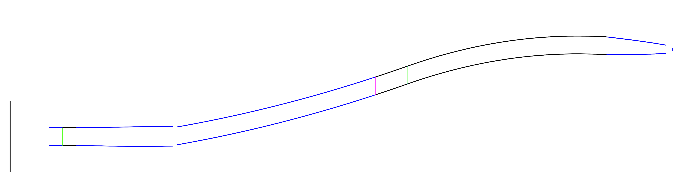
Breaking line of sight
Importance of breaking line of sight, ways of doing so, …

Slide 17


Breaking line of sight
Bender component or many straight sections
Mind the gaps, avoid overlap

Slide 18
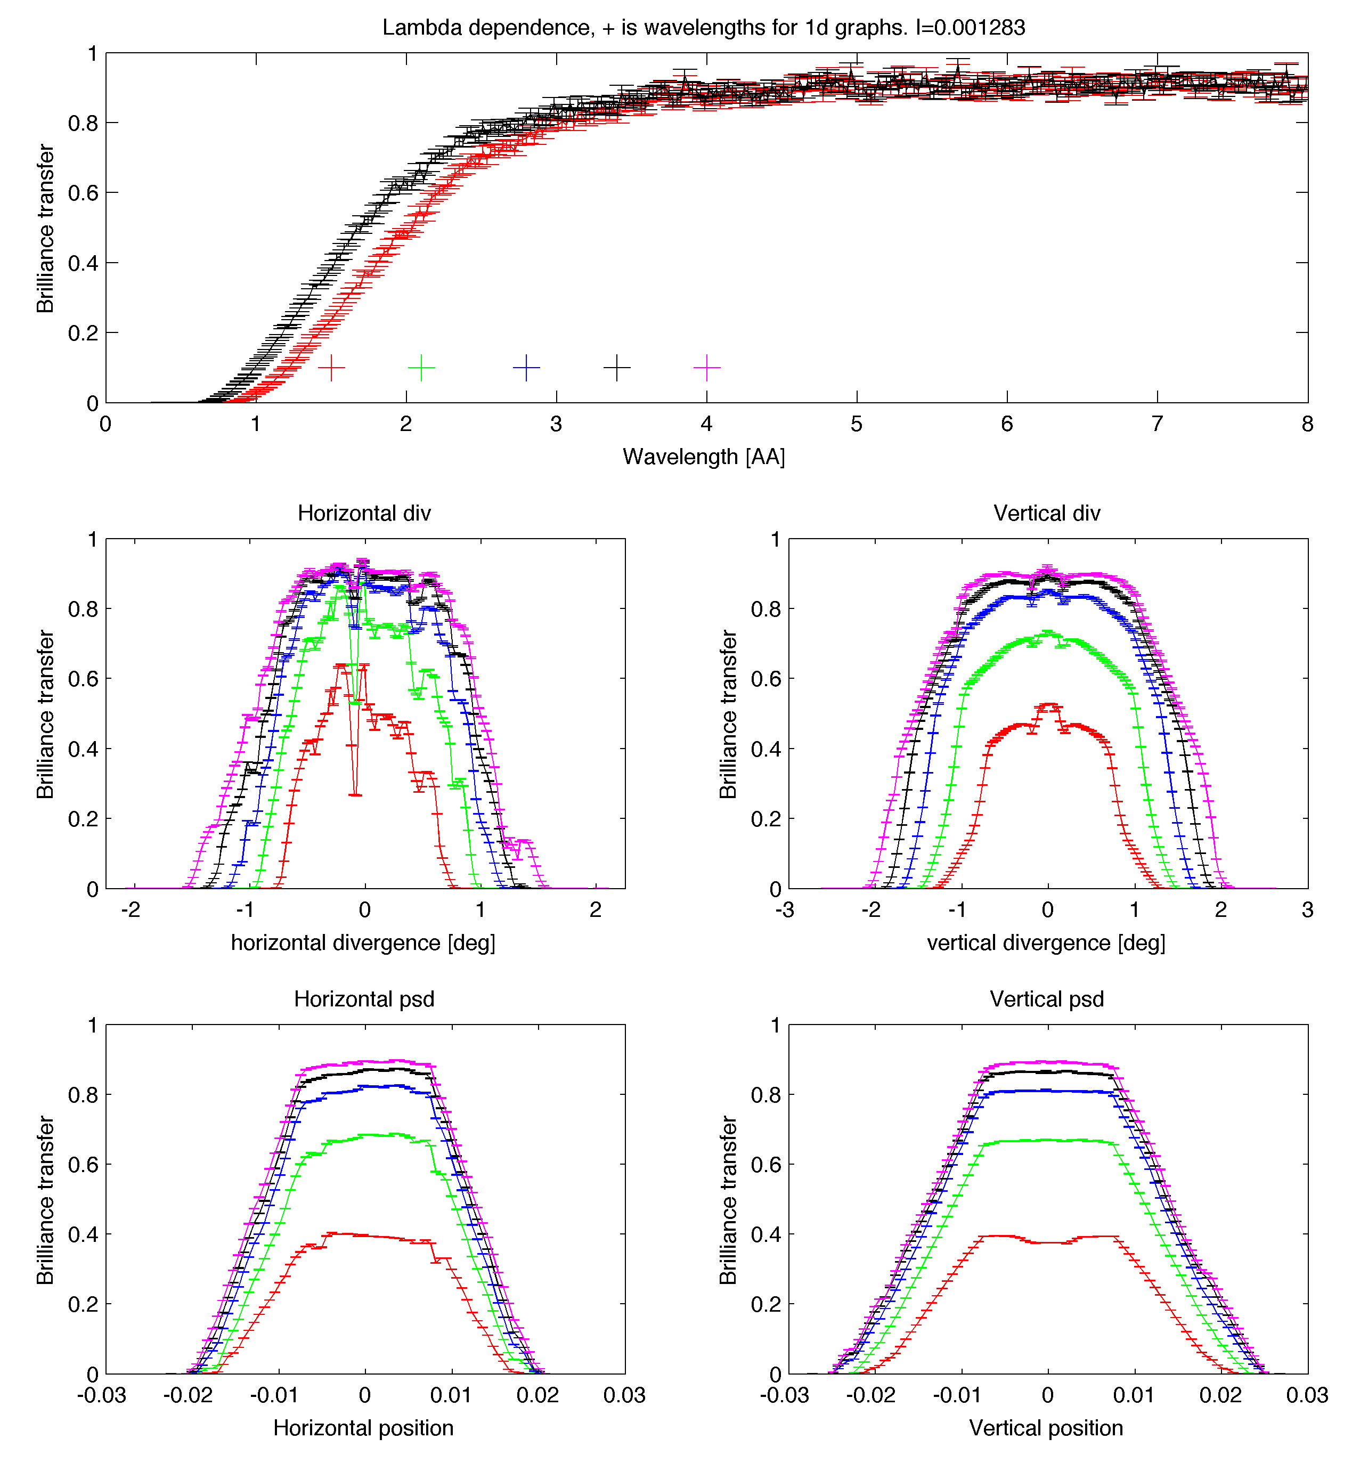
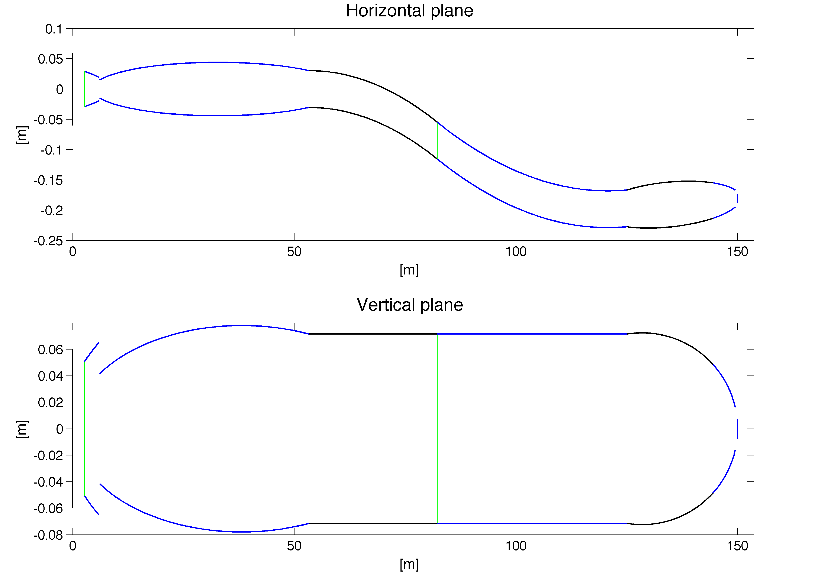
A guide design
To be continued in guide optimization talk

Slide 19
Guide exercise
Solution on github, use if you are stuck
Insert a guide and use a definition parameter to set the length
Use monitors to see the resulting beam
PSD_monitor (spatial distribution)
Divergence_monitor (divergence distribtuin)
L_monitor (wavelength distribution)
Posdiv_monitor (acceptance diagram)
Extra tasks:
Scan guide length
Introduce a gap by using two guide components

