Slide 1
Introducing iFit - a flexible Math framework that plays nicely with McStas

Slide 2
McStas automation: iFit
iFit is a generic infrastructure which gathers data sets handling, fitting, S(q,w) models, and McStas hooks.

Slide 3
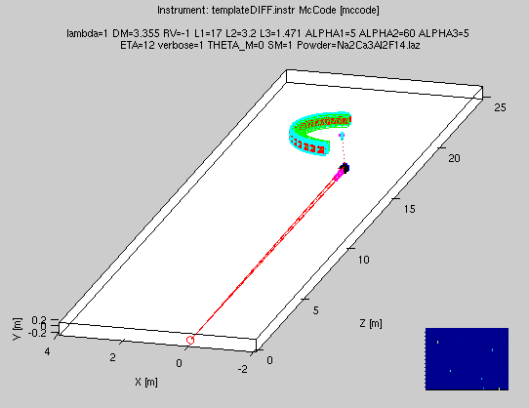
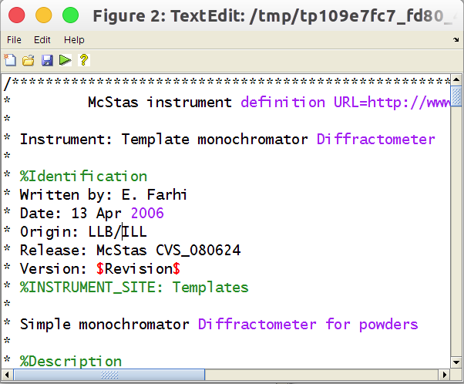
McStas iFit: build
McStas can be controlled from within iFit.
Open Matlab/iFit
Create the McStas model with:
model = mccode(‘instr’)
Plot the geometry with:
plot(model) % has contextual menus
Edit the instrument and re-compile
edit(model)

Slide 4
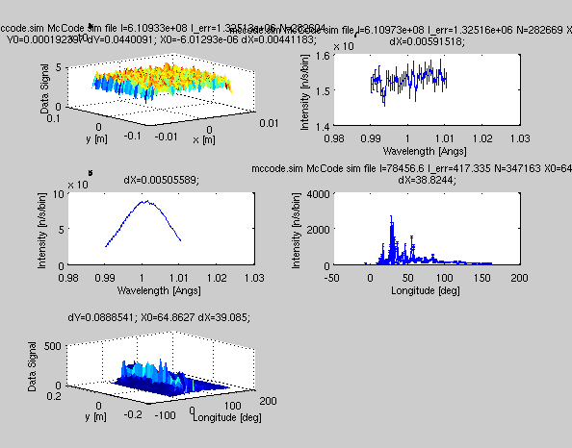
McStas iFit: eval
Run with (default 1e6 event and pars)
data = iData(model, [], nan);
subplot(model) % plot monitors, contextual menus
Specify parameters
data = iData(model, ‘lambda=2.36; coh=Cu.laz’)
Do a scan:
data = iData(model, ‘lambda=[1.2 2.4 3.6]’)
Change neutron events #
model.UserData.options.ncount = 1e7;

Slide 5
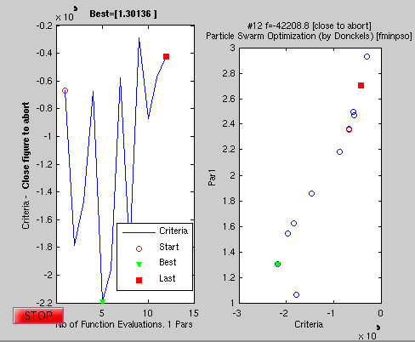
McStas iFit: optim
Fix all parameters but lambda, Maximize model value:
mlock(model, ‘all’); munlock(model, ‘lambda’)
xlim(model, ‘lambda’, [1 3]); % bounds
fmax(model, ‘lambda=2.36’, ‘’, nan)
fmax(model, ‘lambda=2.36’, ‘OutputFcn=fminplot’, nan)

Slide 6
McStas iFit: advanced
You can add McStas models:
model=mccode(‘instr1’)+mccode(‘instr2’) + ...
For instance:
Instr1: structure
Instr2: spin-wave
Instr3: phonons
Instr4: incoherent
The different models can also be assembled as a set of samples chosen at execution in a single McStas instrument.

Slide 7
Exercise:
USB keys also available!
Download and install the binary iFit package using the instructions at http://ifit.mccode.org/Install.html
Launch iFit and load data from one or more of the TOF monitor outputs of the last scans in the TOF spectrometer exercise, e.g.
a=iData(‘folder/5/in5*.t’)
a.error=1
fits(a,’gauss’)
plot(a)
Use the instructions at http://ifit.mccode.org/McStas.html to generate some of the example graphics shown in that page

