Slide 1
Moving Optics
Velocity selector
Disk Chopper
Fermi Chopper

Slide 2
Velocity Selectors
-
Select the neutron energy you want

Slide 3
VELOCITY SELECTORS
absorbing blades

Slide 4
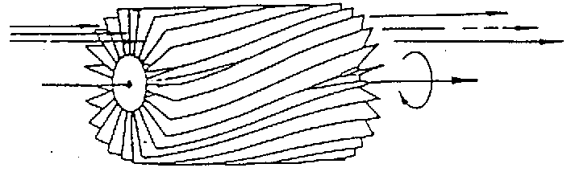
VELOCITY SELECTORS

Slide 5
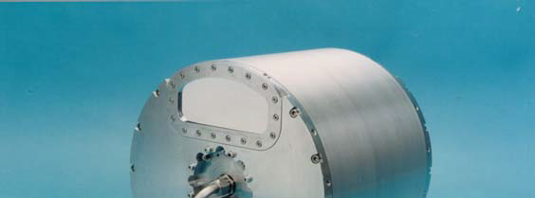
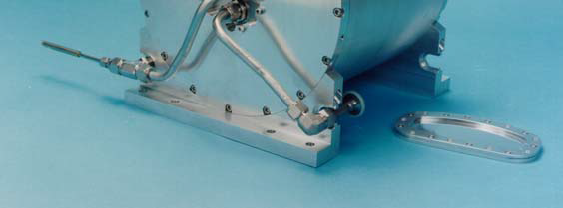
VELOCITY SELECTORS
‘broad’ monochromatization δλ/λ ≈ 10 %
ILL.FR
Astrium

Slide 6
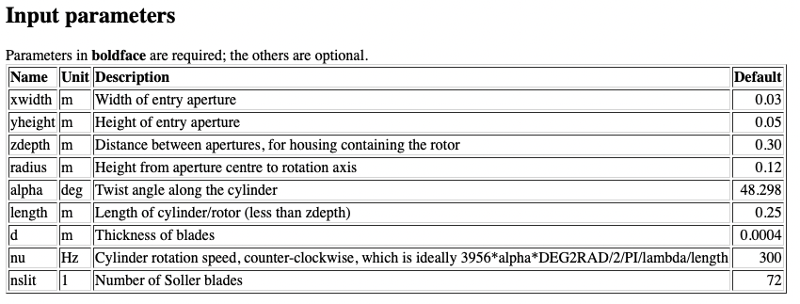
VELOCITY SELECTORS

Slide 7
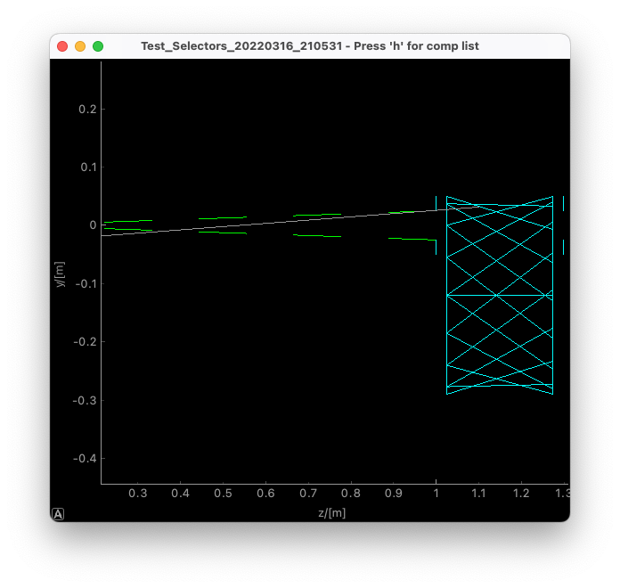
VELOCITY SELECTORS

Slide 8
DISK CHOPPER
Define time structure of the beam
Time Of Flight (TOF) measurements

Slide 9
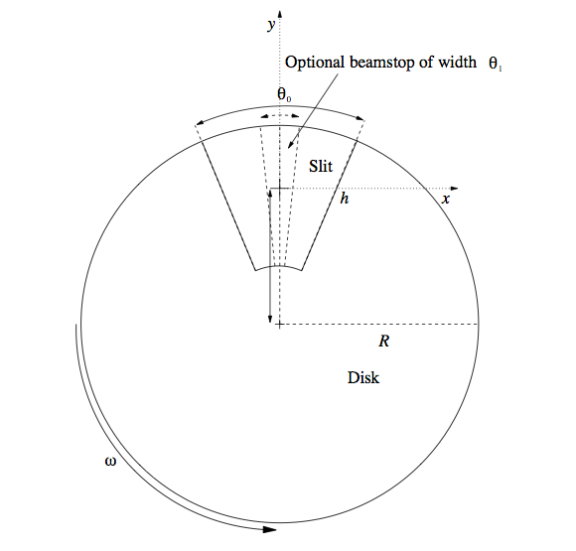
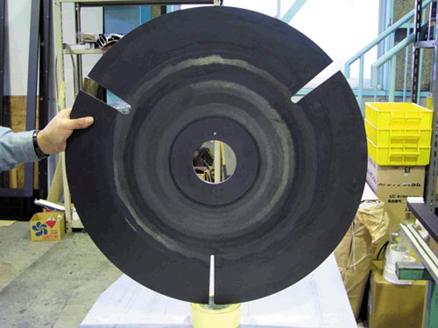
DISK CHOPPER

Slide 10
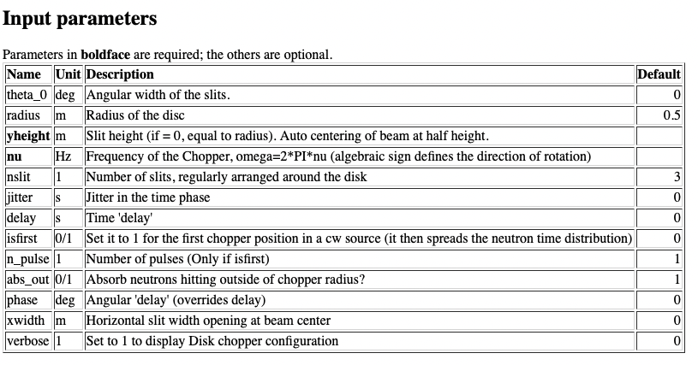
DISK CHOPPER

Slide 11
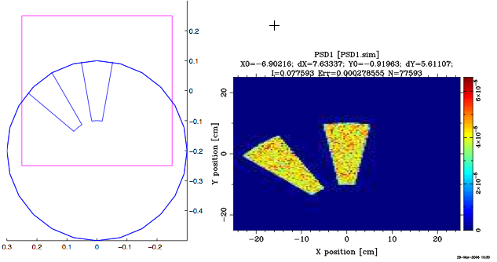
Multiple DISK CHOPPER s or MultiDiskChopper

Slide 12
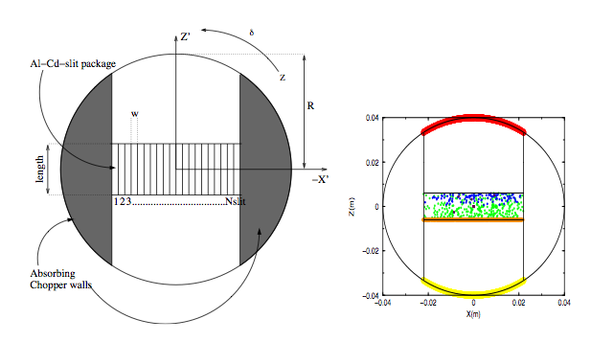
FERMI CHOPPER

