Slide 1
Polarization in McStas
Erik Bergbäck Knudsen

Slide 2
Mcstas “particle” model recap.
“sub ray” level
Neutron ray/package:
Weight: (p) # neutrons left in the package
Position: (x, y, z)
Velocity: (v_{x}, v_{y}, v_{z})
Polarization: (s_{x}, s_{y}, s_{z})
Time: (t)
From G. Williams: “Polarized neutrons”, Oxford Science Publ., 1988
Ray level
Beam level
n

Slide 3
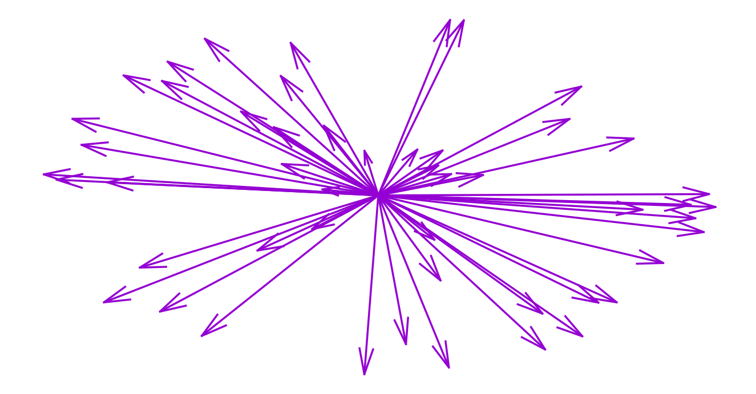
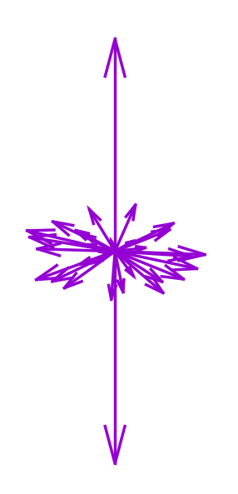
Unpolarized beam
Complete polarization information in each ray

Slide 4
McStas polarization detectors/monitors
Monitoring: How and What do we monitor?
n
n
n
n
n
n
n

Slide 5
Polarization components in McStas 2.7
Magnetic fields:
Pol_FieldBox.comp
Pol_constBfield.comp
Pol_Bfield.comp
Pol_Bfield_stop.comp
Pol_triafield.comp
Optics:
Monochromator_pol.comp
Pol_bender.comp
Pol_guide_vmirror.comp
Pol_mirror.comp
Pol_pi_2_rotator.comp
Transmission_polarisatorABSnT.comp
Pol_bender_tapering.comp
Pol_straight_tapering.comp
He3_cell.comp
RF_flipper.comp
Monitors:
Pol_monitor.comp
MeanPolLambda_monitor.comp
PolLambda_monitor.comp
Contrib:
Foil_flipper_magnet.comp
Single_magnetic_crystal.comp
Idealized components:
PolAnalyser_ideal.comp
Set_pol.comp
Sample:
Single_magnetic_crystal.comp
McStas polarization components

Slide 6



Polarization monitors
Available monitors:
Pol_monitor.comp: 0D
PolLambda_monitor.comp: 2D
MeanPolLambda_monitor.comp: 1D
PolTOF_monitor.comp: 2D
In the repo for next release

Slide 7
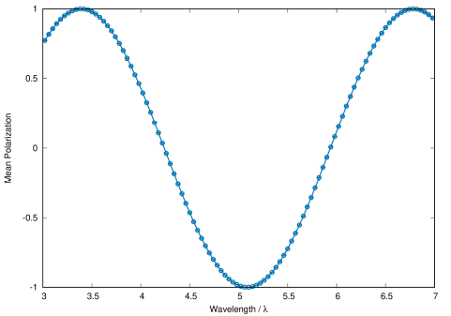
McStas detectors/monitors
Monitoring: How and What do we monitor?
n
n
n
n
n
n
n

Slide 8
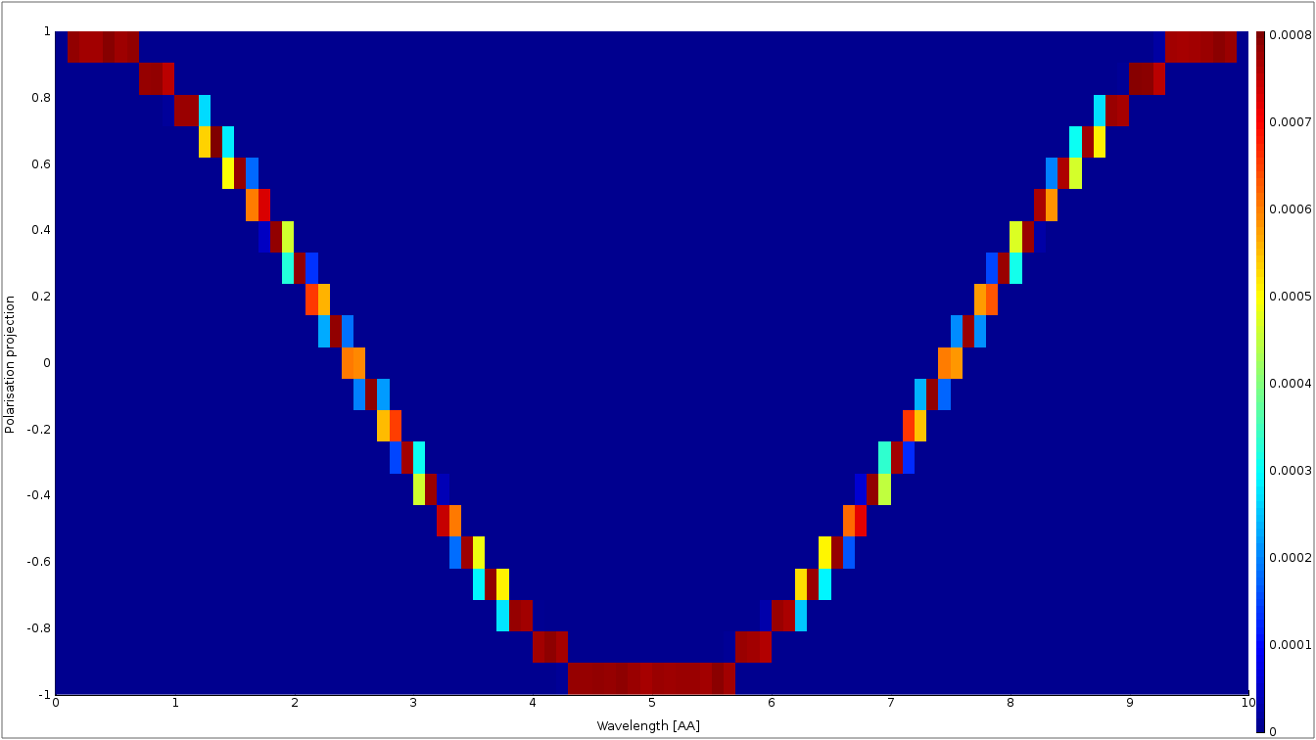
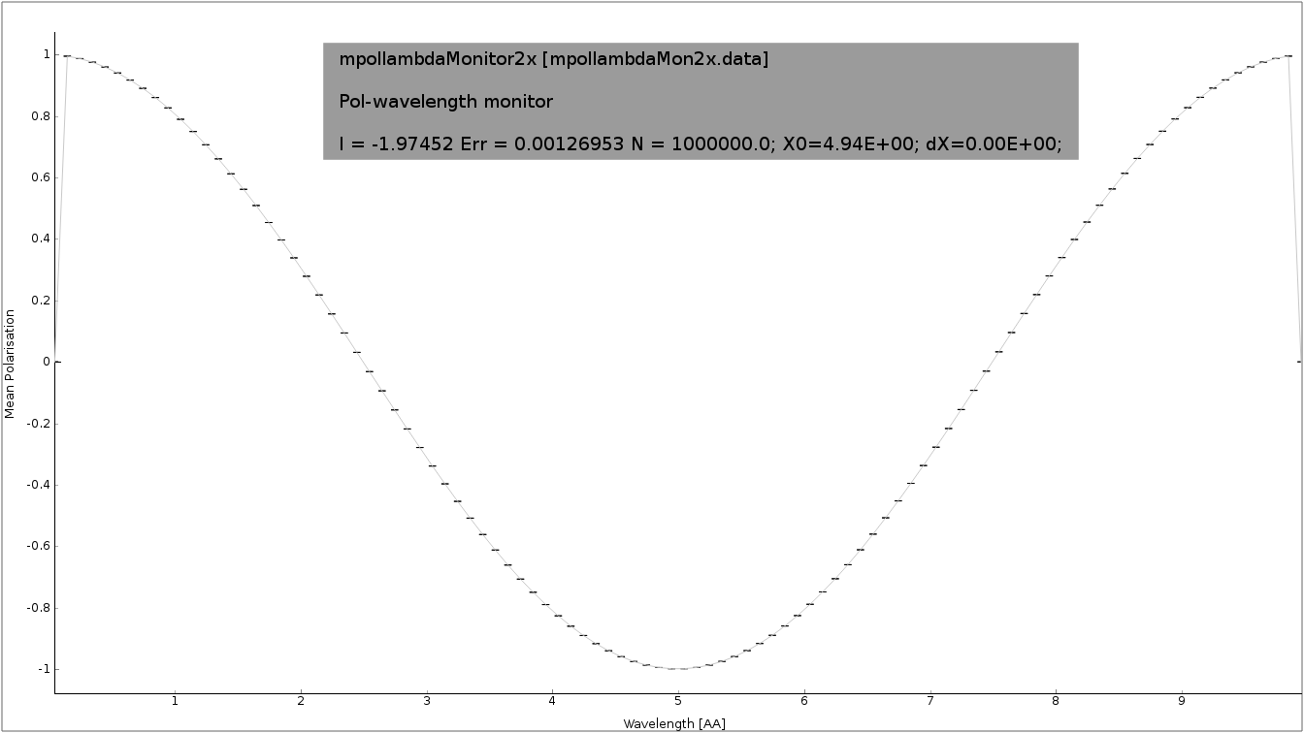
McStas polarization monitors
PolLambda_monitor
MeanPolLambda_monitor
n
n
n
n
n
n
n
Pol_monitor

Slide 9



McStas precession algorithm
Magnetic fields in McStas
The challenge:
  Fast beam/ray transport:
  Unknown magnetic field and field strength
  >1 Magnet → nested fields.

Slide 10
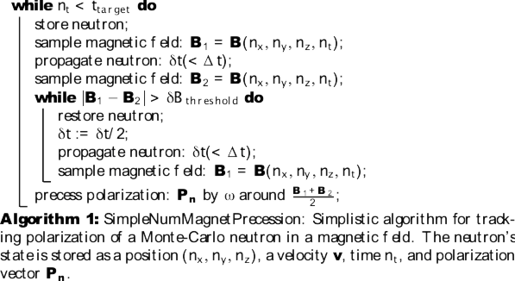
McStas precession algorithm
From: Knudsen et.al., J. Neutron Research, 2014

Slide 11
McStas precession algorithm
B₂
B₁
n

Slide 12
McStas precession algorithm
B₂
B₁
n

Slide 13
McStas magnetic fields
Pol_constBfield.comp
Single constant Magnetic field in a “box”.
- user may specify a wavelength to flip.
- blocking walls

Slide 14
McStas magnetic fields
Pol_FieldBox.comp
Single Magnetic field in a “box”
- optional user supplied field c-function

Slide 15
McStas magnetic fields
Pol_Bfield.comp
Pol_Bfield_stop.comp
  - Entry/Exit contruction allows for nested magnetic field descriptions.
  - Any magnetic fields through user supplied c-function
  - Tabled magnetic fields

Slide 16
Windows can be many shapes
B-Fields: constant, functional, tabled, … in more general shapes

Slide 17
McStas Polarization Capabilities IV
Pol_Bfield.comp
Pol_Bfield_stop.comp
  - Entry/Exit contruction allows for nested magnetic field descriptions.
  - Any magnetic fields through user supplied c-function
  - Tabled magnetic fields

Slide 18
Pol_monitors along the way...

Slide 19
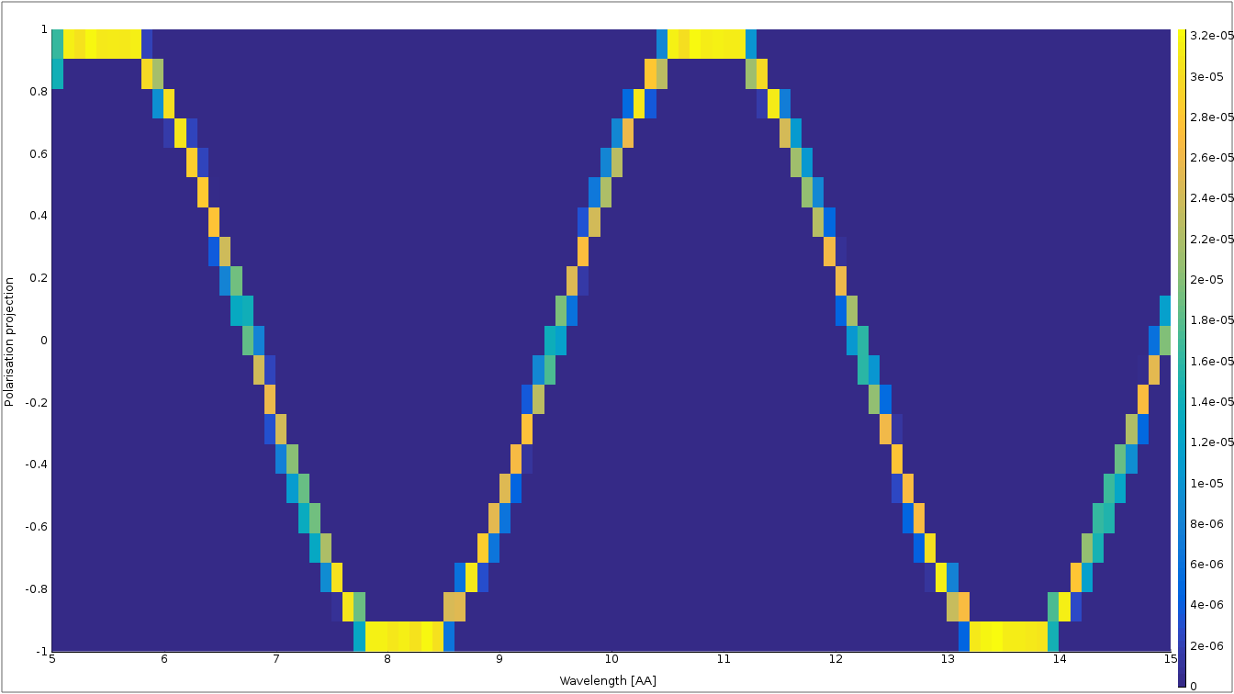
Pol_monitors along the way...
Pol_lambda_mon 1 placeholder

Slide 20
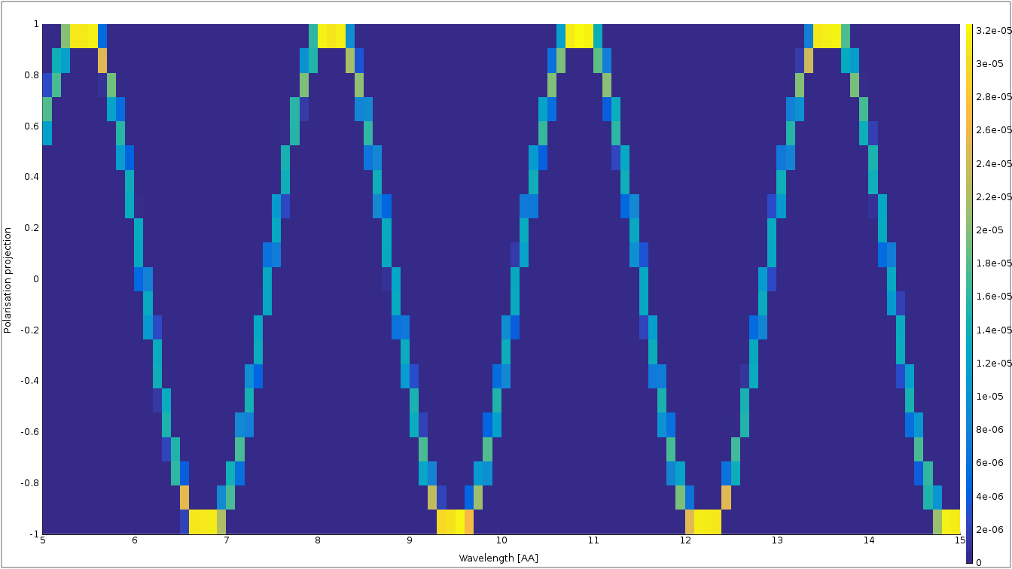
Pol_monitors along the way...

Slide 21
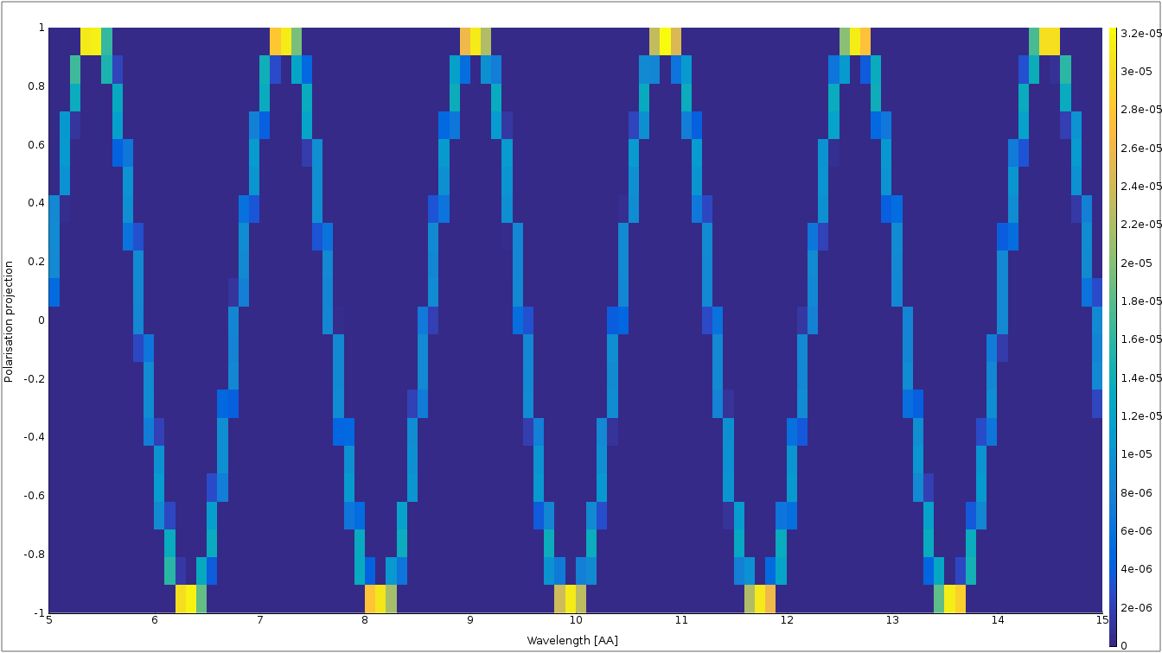
Pol_monitors along the way...

Slide 22
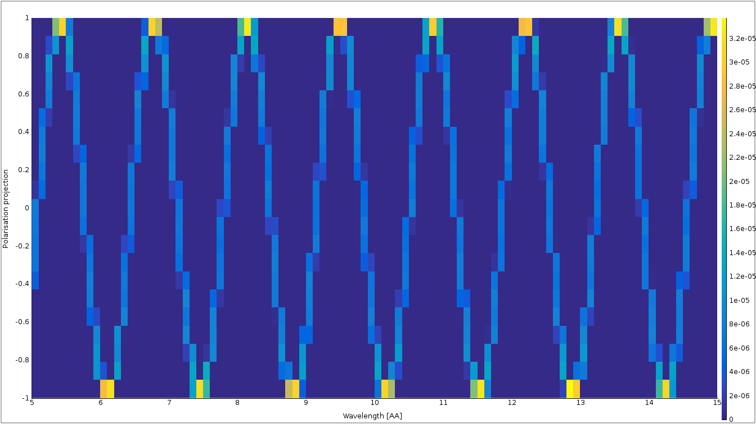
Nested fields

Slide 23
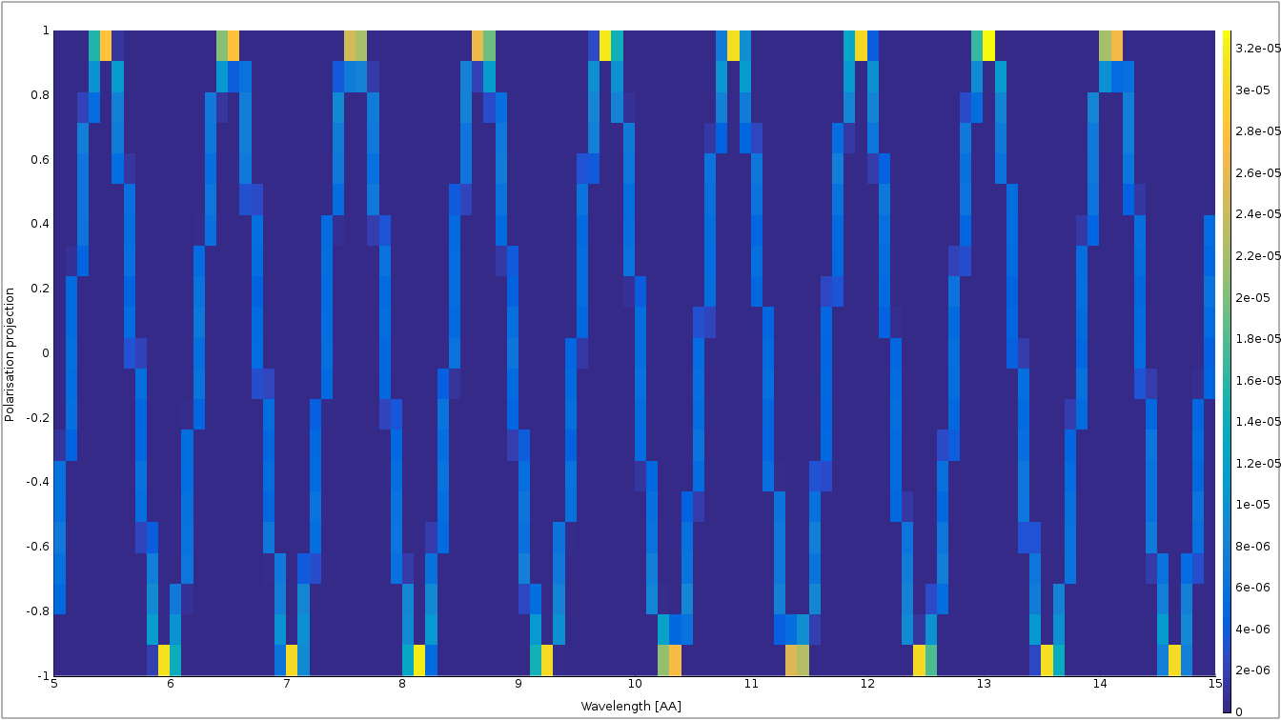
Nested fields

Slide 24
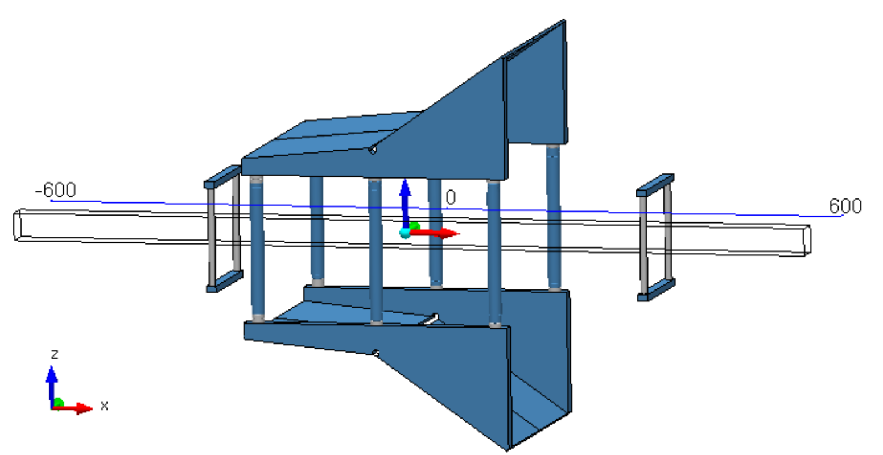
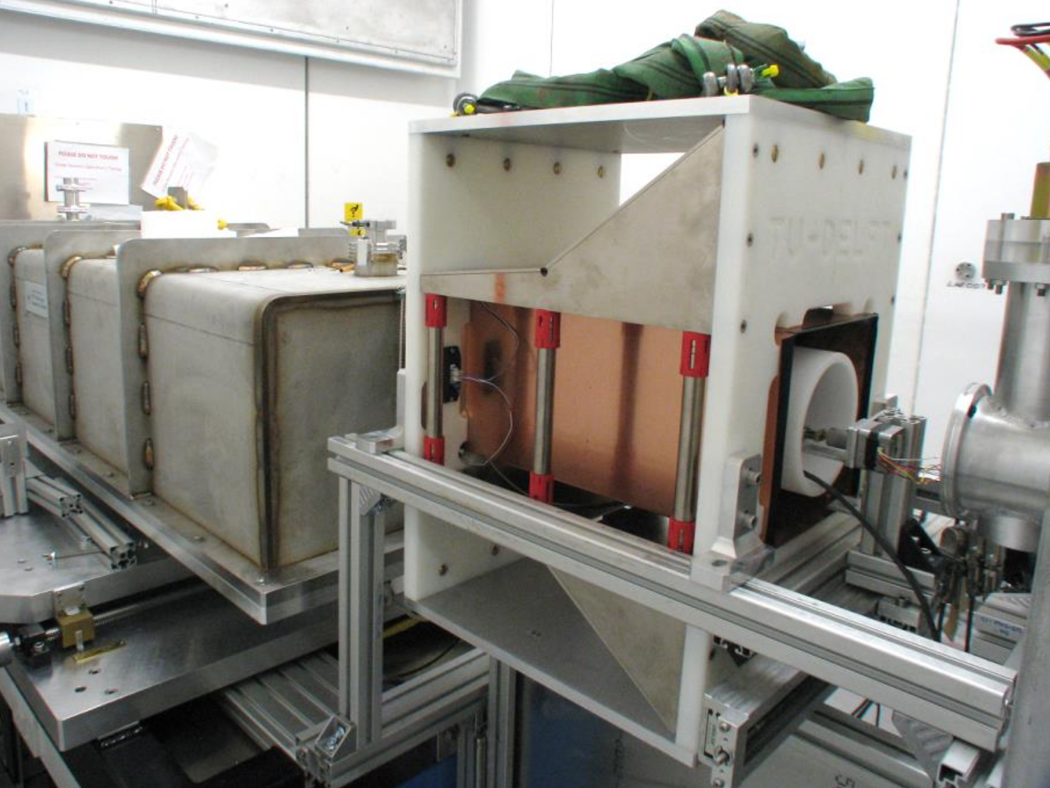
Use of Bfield to build an RF-flipper
Pictures courtesy of J. Plomp & M. Thijs

Slide 25
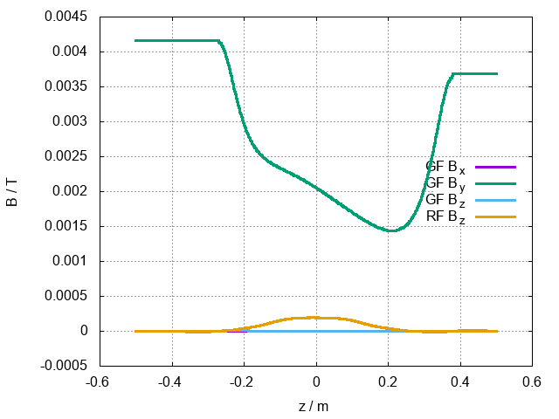
Use of Bfield to build an RF-flipper
Tabled fields where the RF field is a rotating frame.

Slide 26
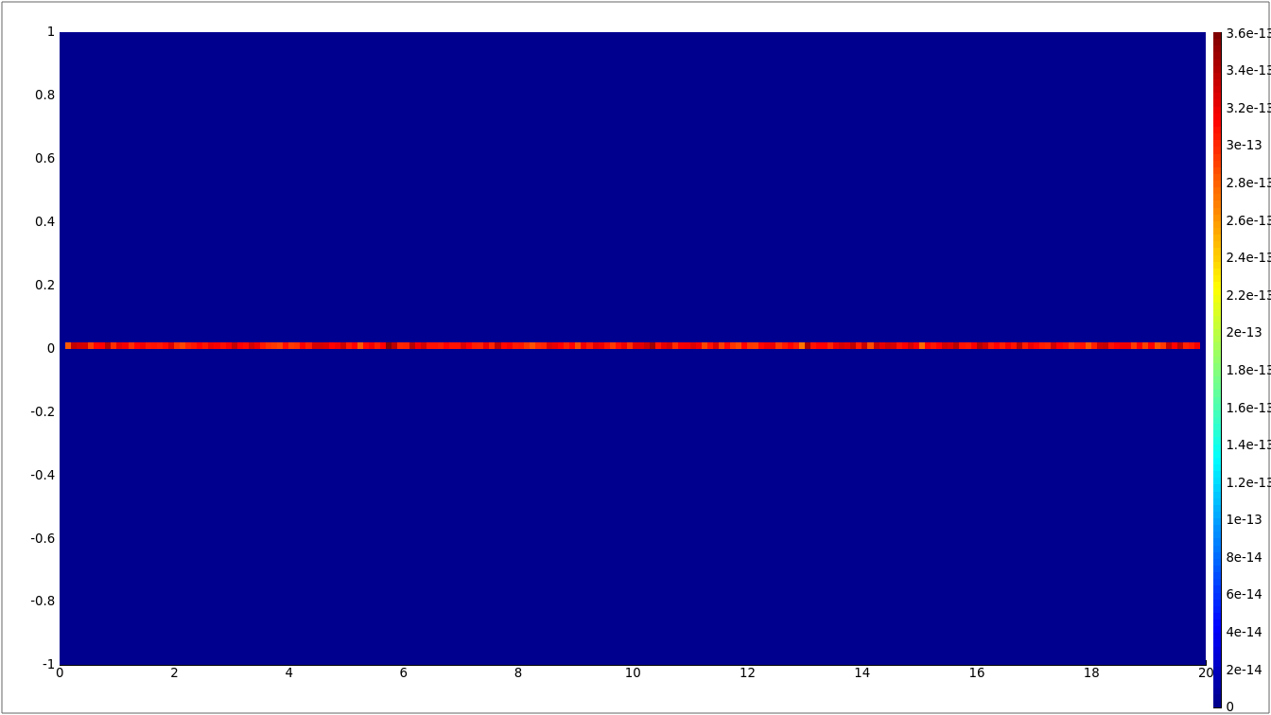
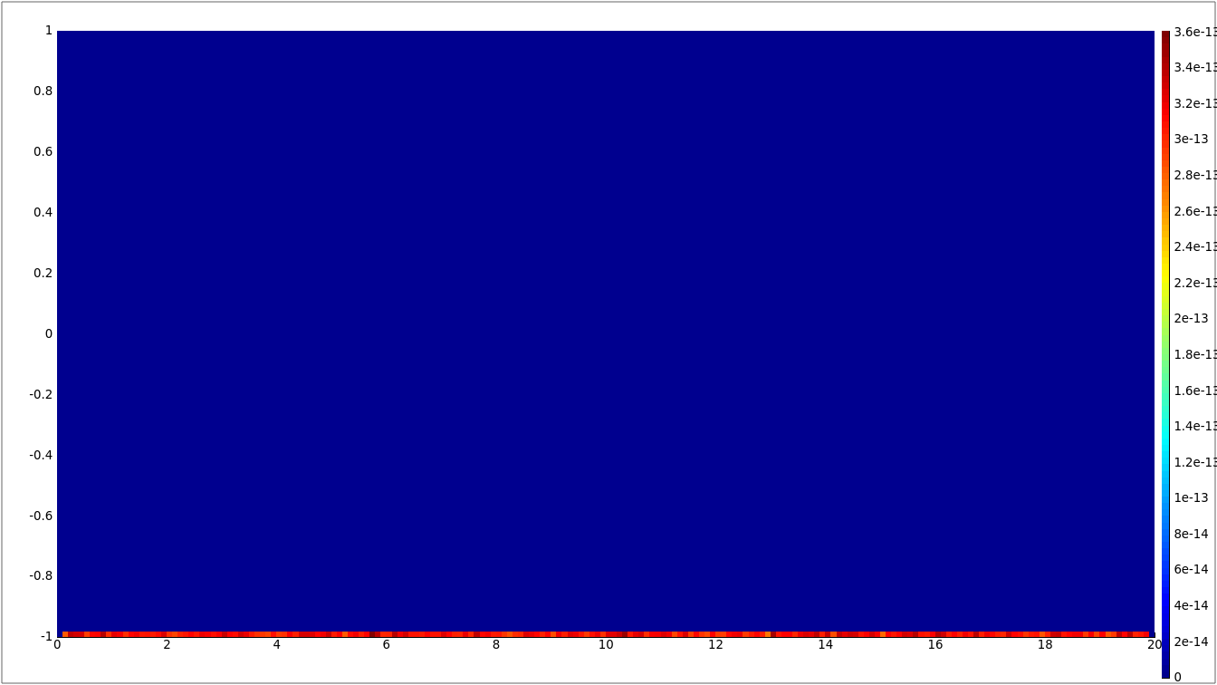
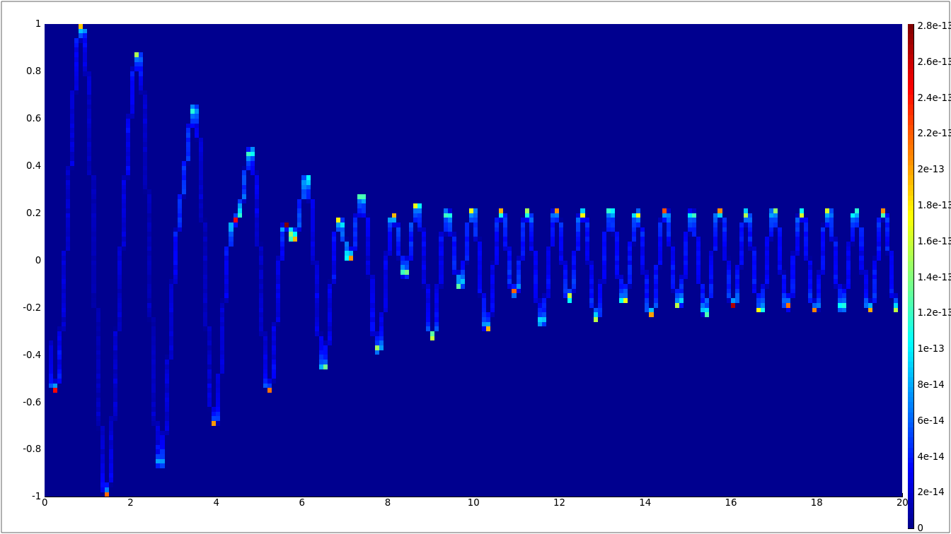
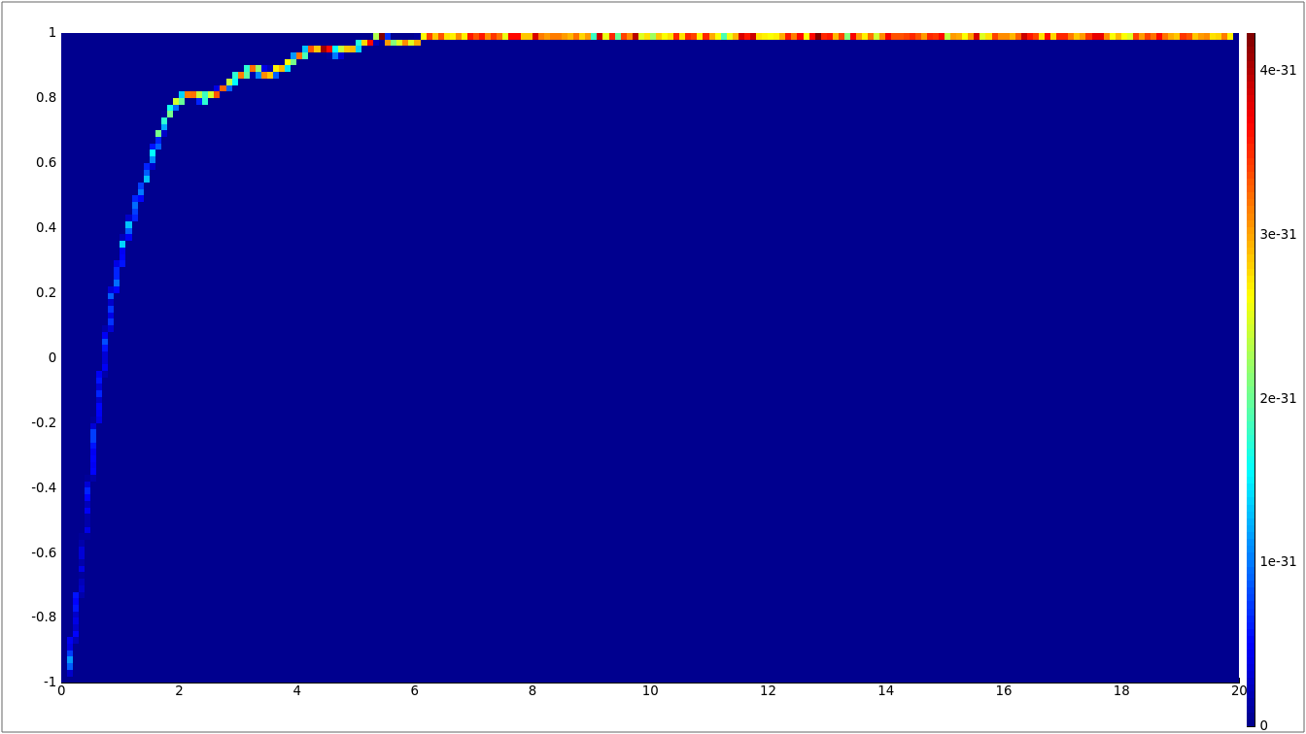
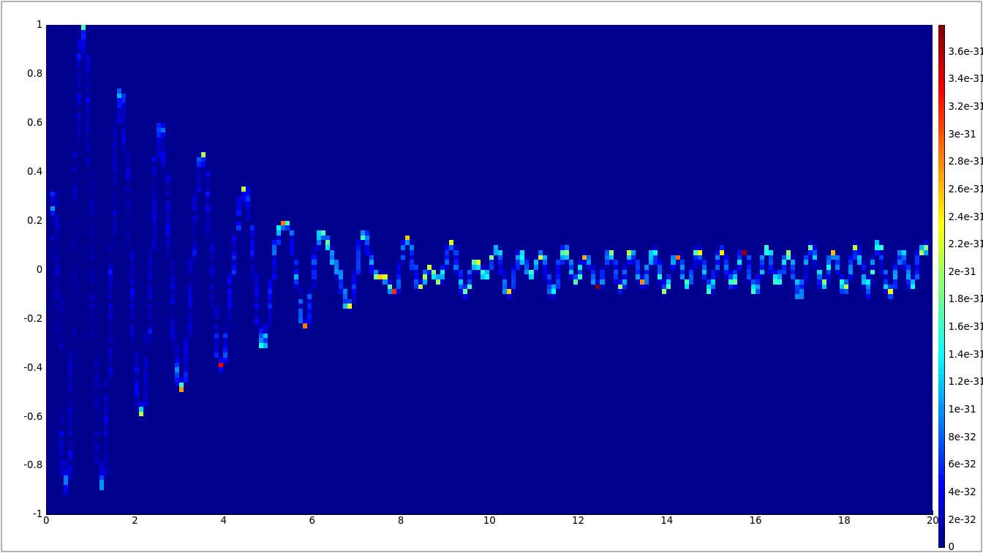
Use of Bfield to build an RF-flipper
Before flipper
After flipper

Slide 27
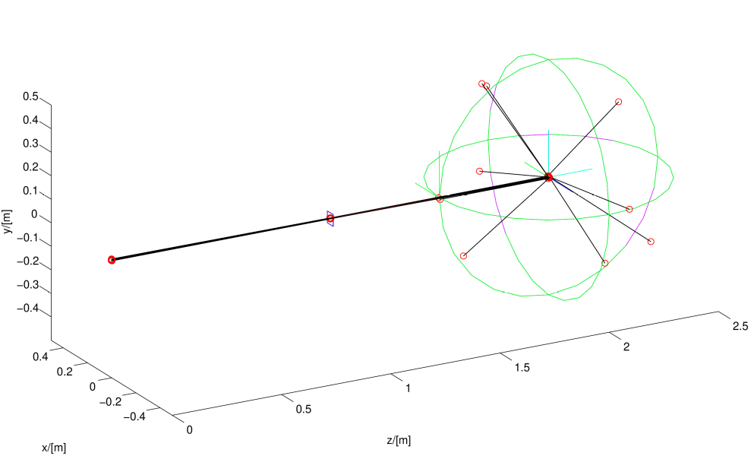
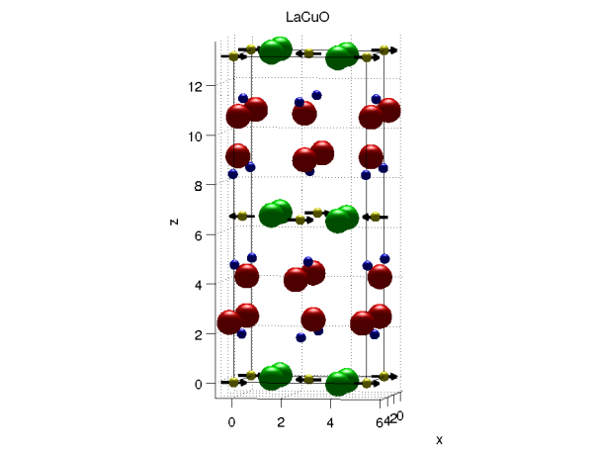

Magnetic Single crystal

Slide 28
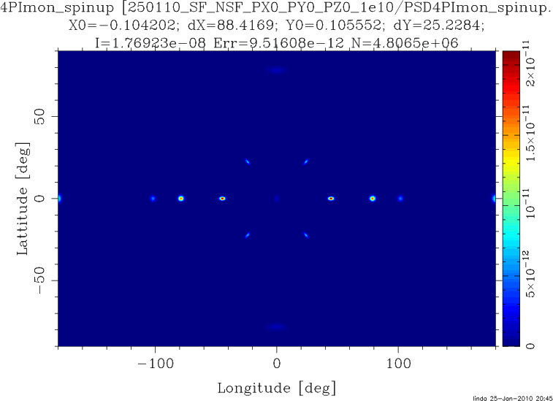
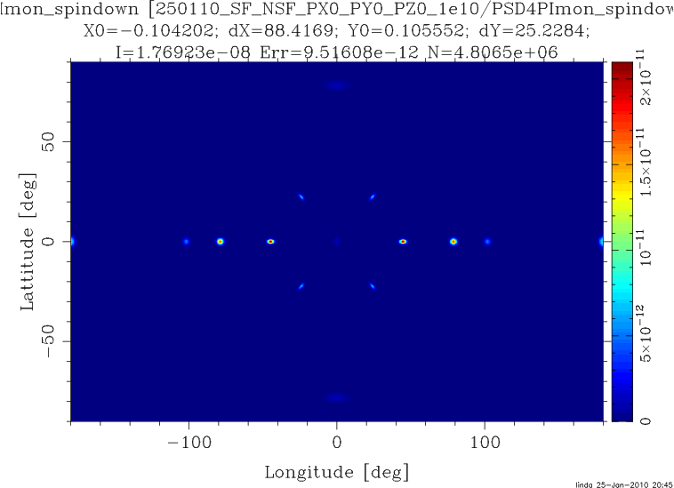
McStas component on the way
Magnetic single crystal – Unpolarized beam

Slide 29
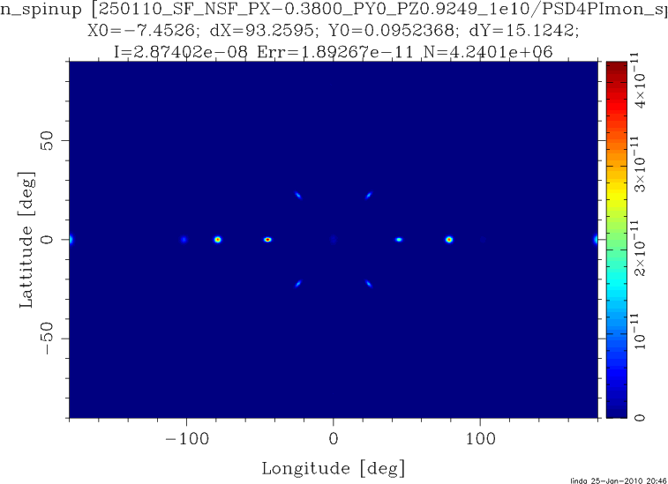
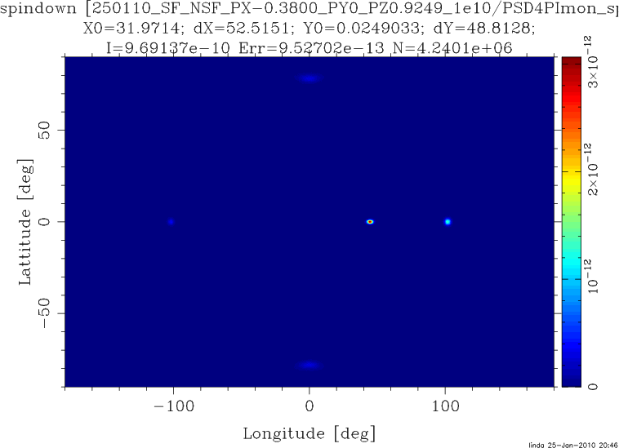
Magnetic Single crystal

