Slide 1
McStas - Mantid
TorbenNielsen
Anders Markvardsen
Peter Willendrup

Slide 2
Neutron Transport
Source
Guide
Sampel
Detector
Reduction
Analysis
Typical McStas Neuron Transport Mantid-McStas focus:
How to analyse McStas data
2

Slide 3

Comparison
Comparison
Classic McStas
Mantid-McStas
Post processing:
iFit/ Matlab/ own code
Post processing:
Mantid algorithms
mcstas - plot
mantidplot
mcstas - transport
mcstas - transport
3

Slide 4
Motivation: new flexible dataflow
1. Combine the reduction framework and the neutron transport
framework
2. Neutron transport, reduction and “analysis” in one go
3. View McStas data in Mantid (histogram data)
4. Import McStas event data to Mantid
5. Use already developed and tested algorithms in Mantid to process
McStas event data (no need to reinvent methods)
6. Advanced use: Use McStas to quantify (perhaps remove)
“spurries” signal on detector (can scatt. –multi. scatt )
4

Slide 5

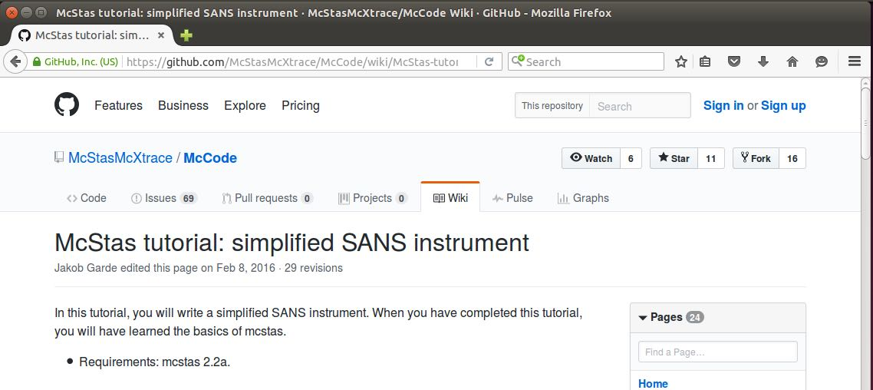
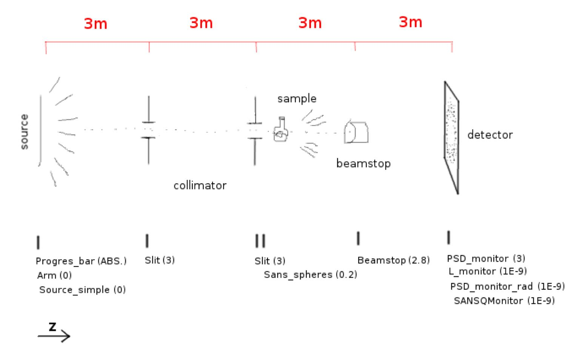
Illustration: simplified SANS instrument
5

Slide 6
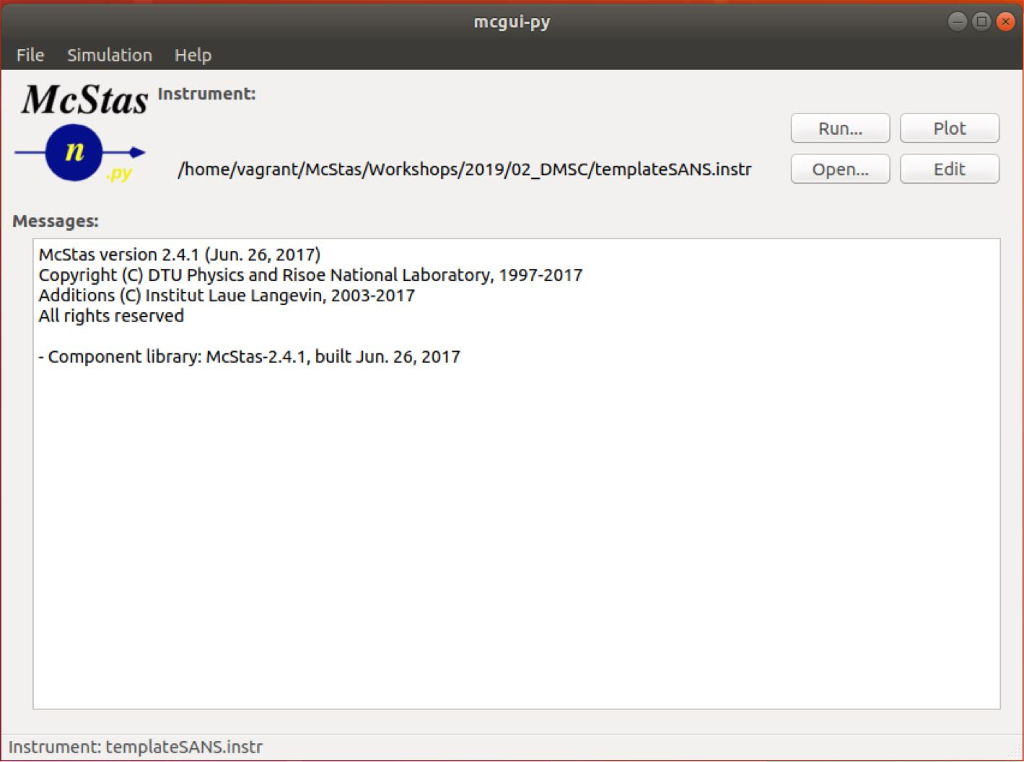
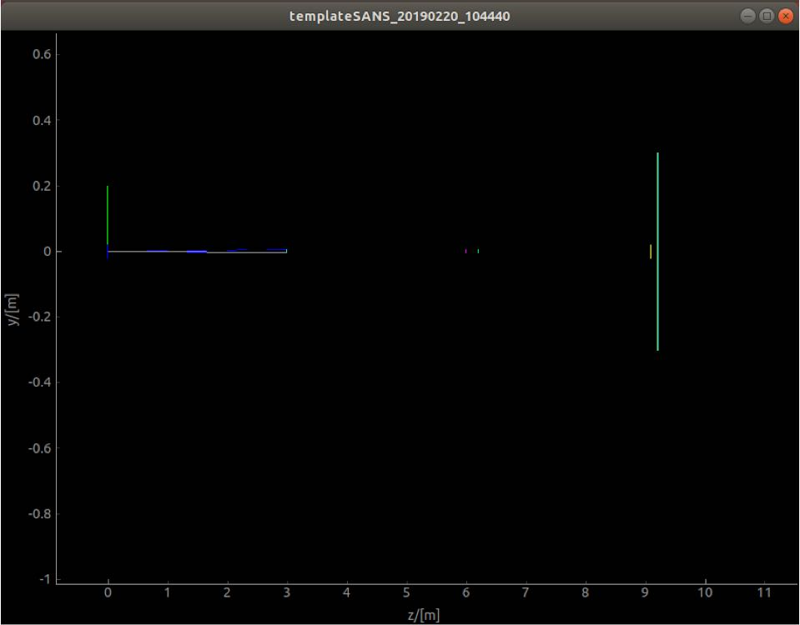
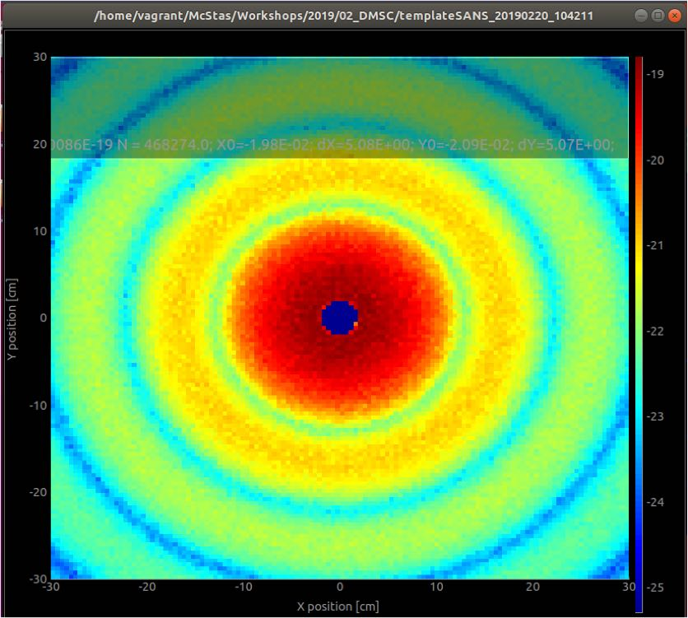
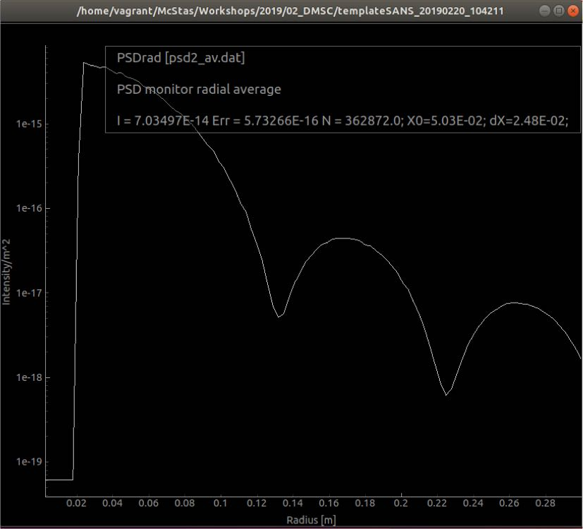
McStas GUI: templateSANS.instr
R=150,phi=0.1, d=1,a=0
6

Slide 7
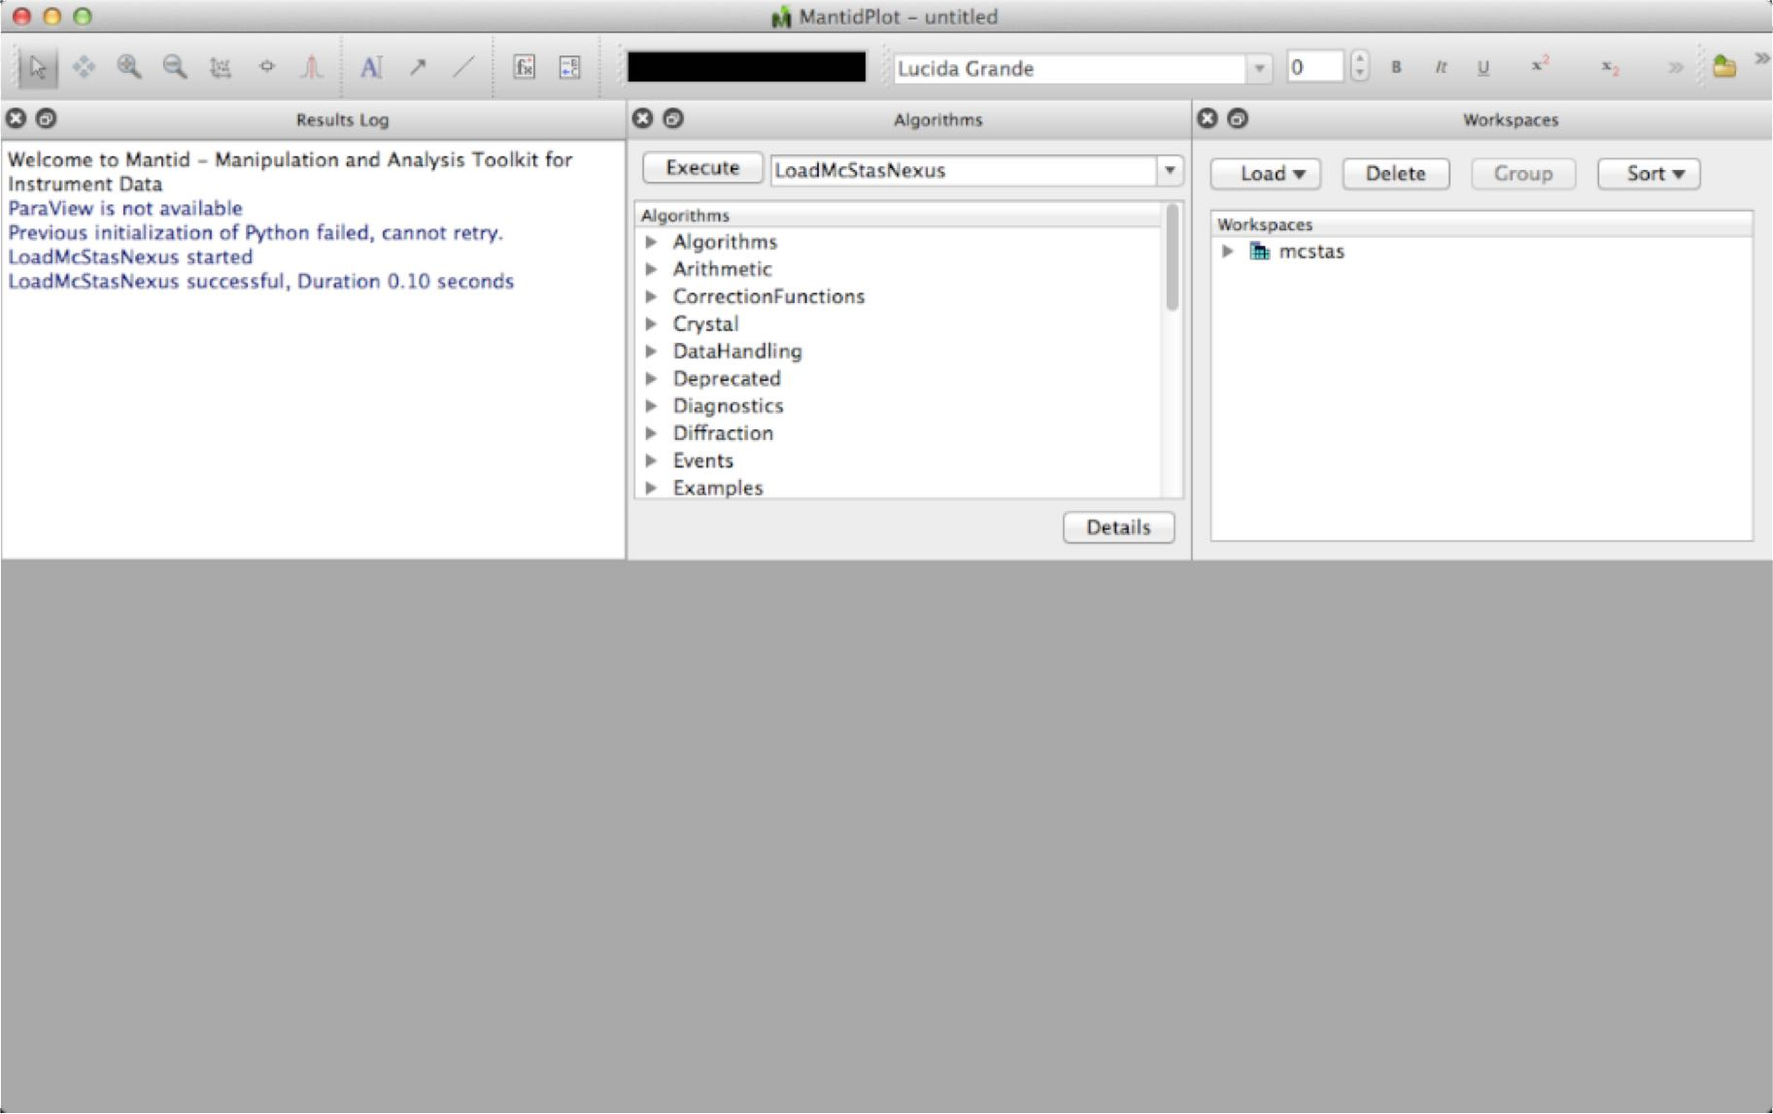
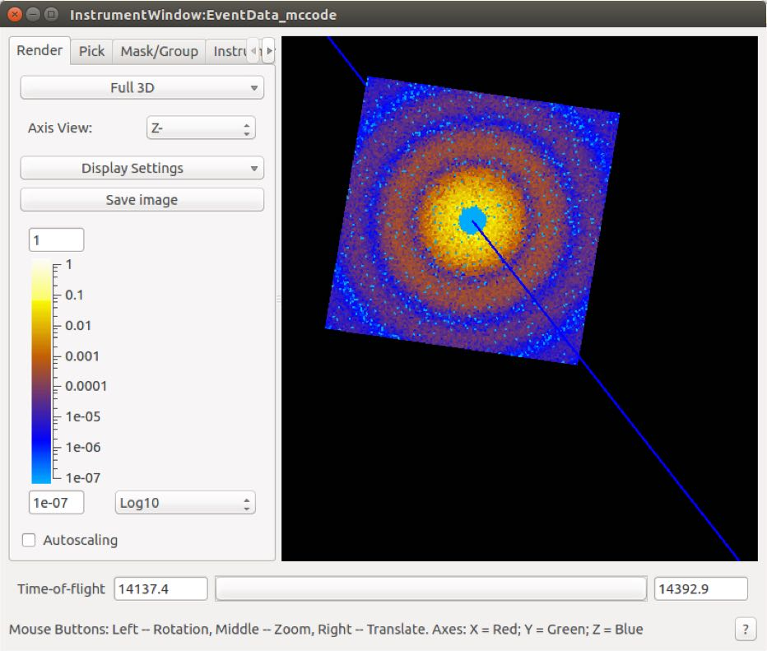
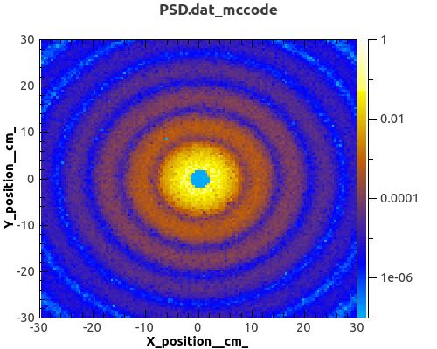
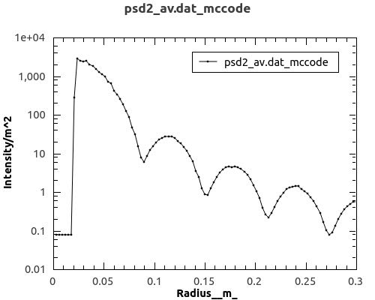
Mantid GUI: templateSANS.instr
7

Slide 8
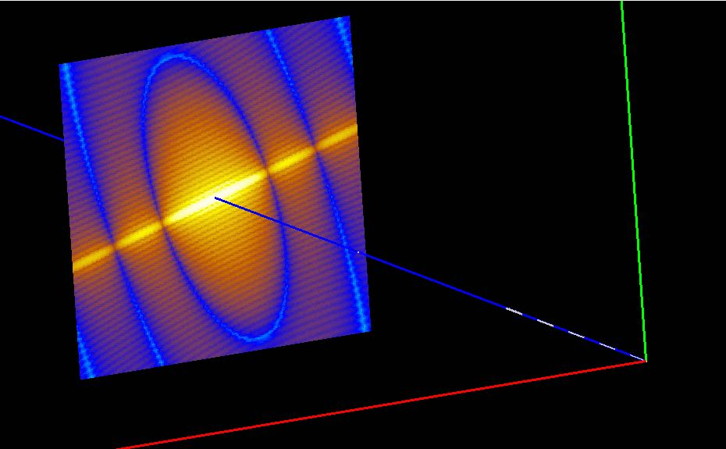
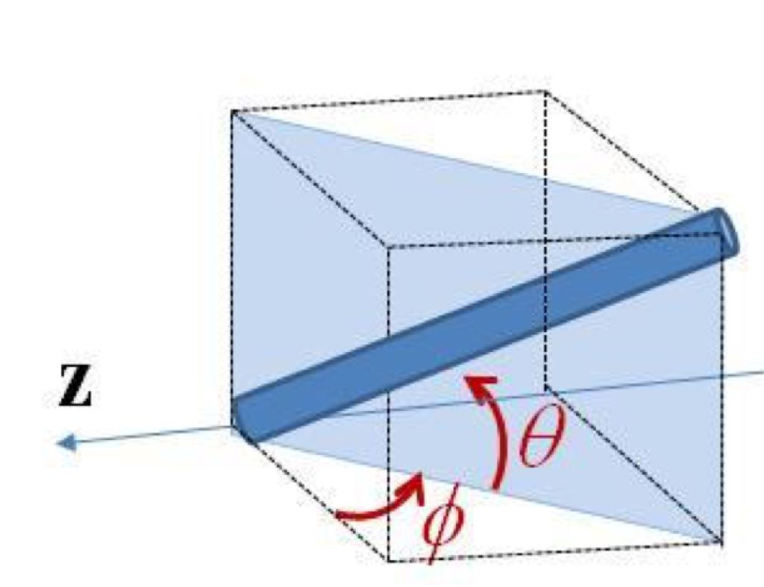
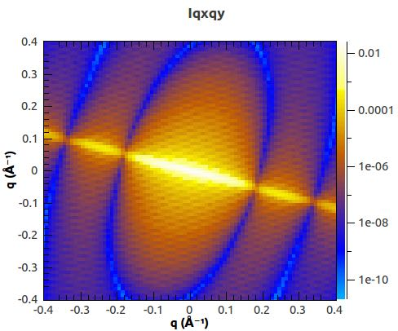
Example: Usage of Mantid algorithms
• McStas –Mantid
• 2D scattering kernel from SasView
• 2D reduction in Mantid: Qxy
• Can be send back to SasViewfitting
8

Slide 9
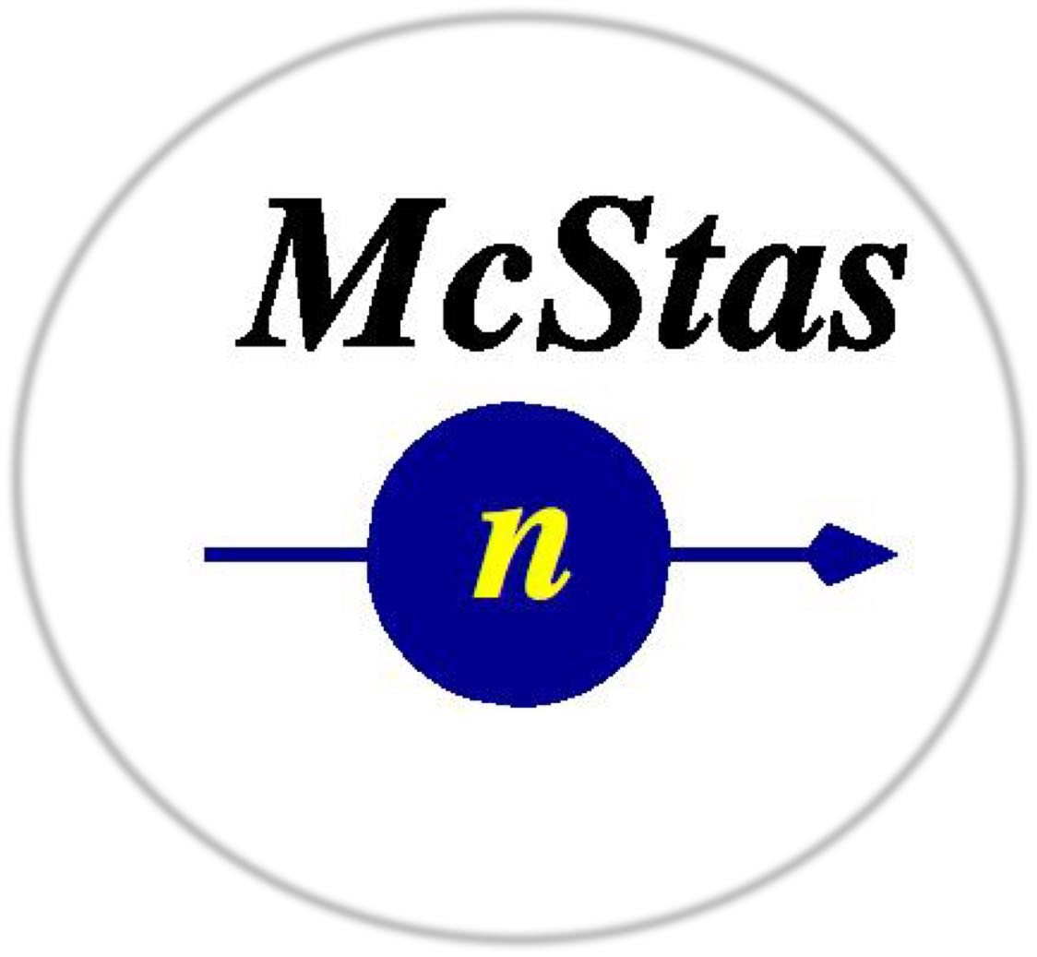




The NeXus file
NeXus file
Mantid
• The McStas Nexus file must contain:
• Event data, i.e. each neutron has a pixel id and a time stamp
• An IDF McStas monitor_nD gives pixel-ID & time for each event
• mcdisplay can auto-generate an IDF
9

Slide 10
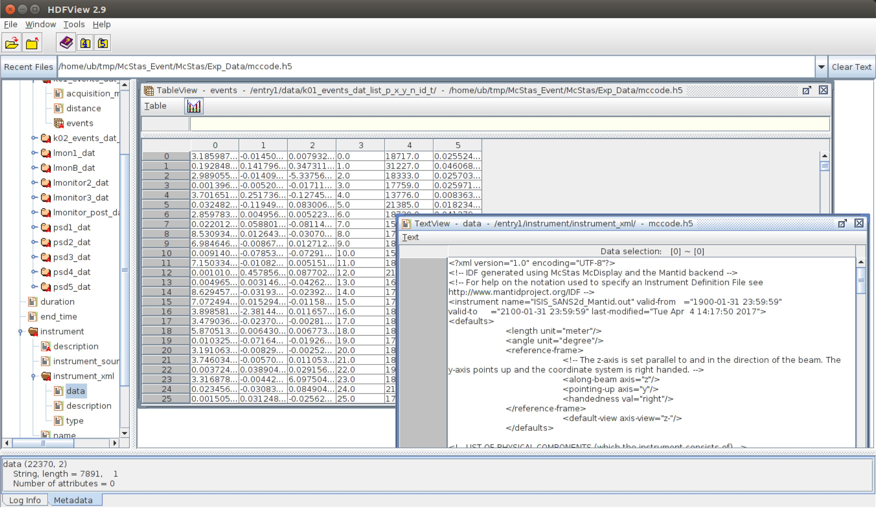
McStas NeXus file
Event data
IDF xml data
10

Slide 11
IDF xml data, TOF and pixel ID’s
•Mantid’s IDF store geometry information use in TOF analysis
•This implies parsing information about:
–where the neutron source is located,
–where the sample is located,
–where each individual detector pixel is located.
In other words:
Establishing ki and kf
11

Slide 12
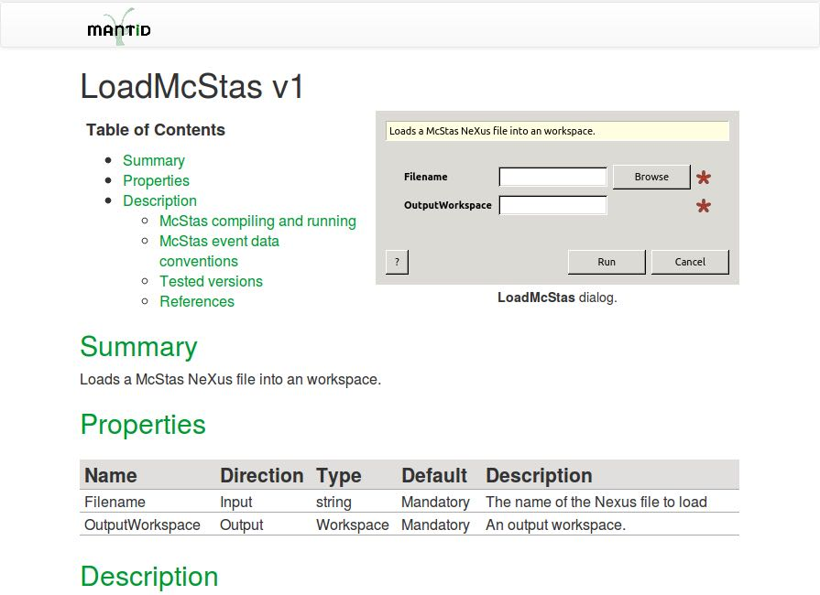
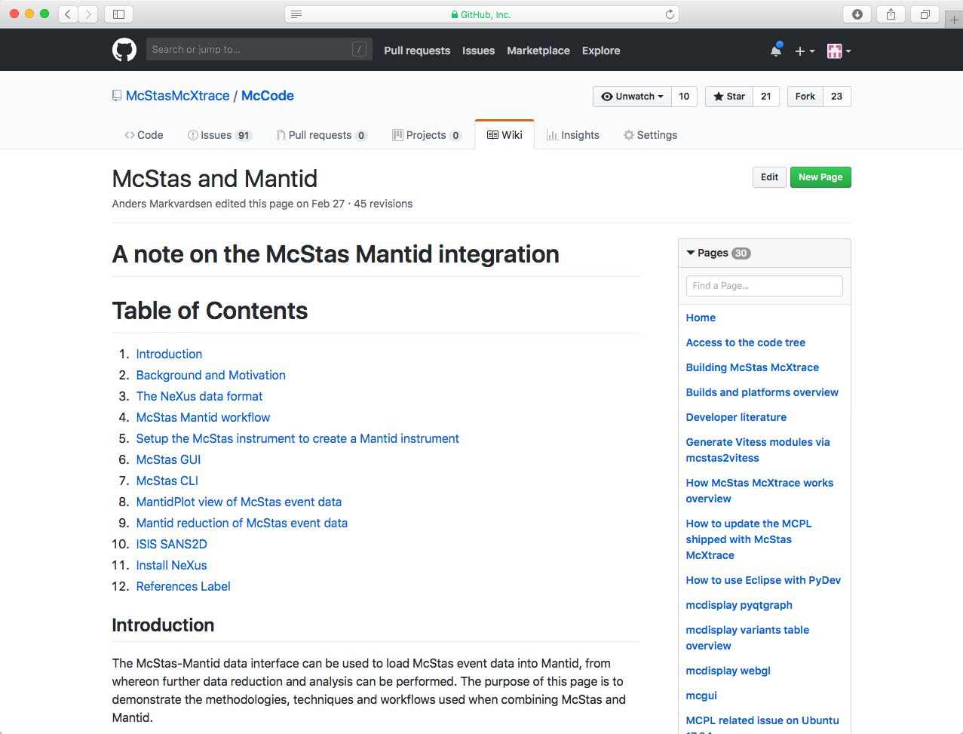
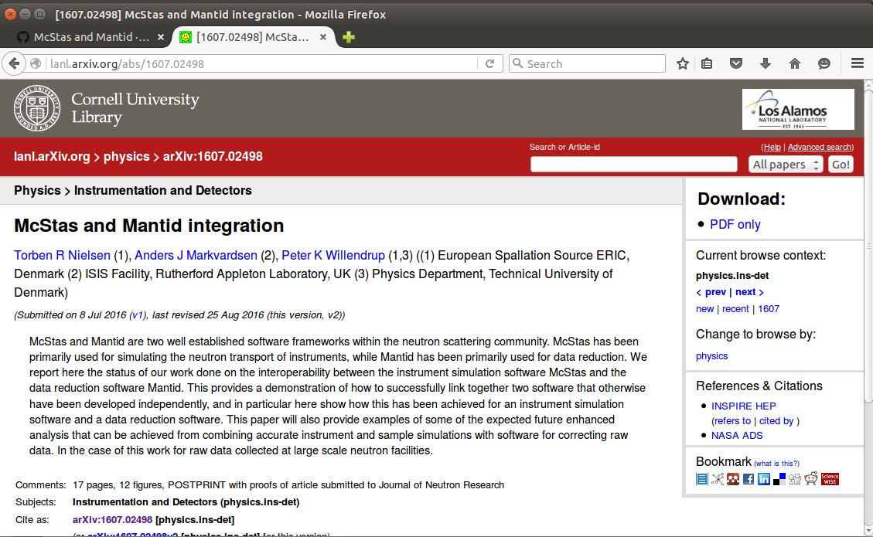
How to use: Online documentation
• Github McStas wiki pages (https://github.com/McStasMcXtrace/McCode/wiki/McStas-and-Mantid#setup-the-mcstas-instrument-to-create-a-mantid-instrument )
• Archive - lanl.arXiv.org
• Built-into Mantid
12

Slide 13
McStas instrument KEYWORDS
McStas instrument file name and the McStas defined name of the instrument must be the same:
• E.g. templateSANS_Mantid.instr and “DEFINE INSTRUMENT templateSANS_Mantid(…. )”
In the McStas instrument file the source must be named “sourceMantid”
• E.g. "COMPONENT sourceMantid= Source_simple(…. )”
In the McStas instrument file the sample must be named “sampleMantid”
• E.g. "COMPONENT sampleMantid= Sans_spheres(…. )"
In the McStas instrument file the event monitors must be named “nD_Mantid_#”
• E.g. "COMPONENT nD_Mantid_1 = Monitor_nD(…. )"
13

Slide 14
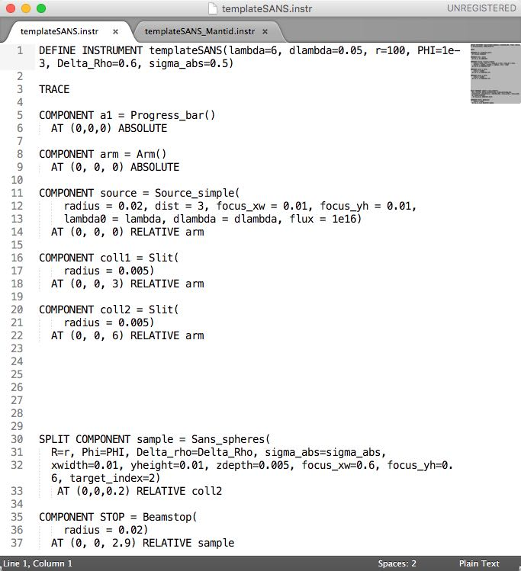
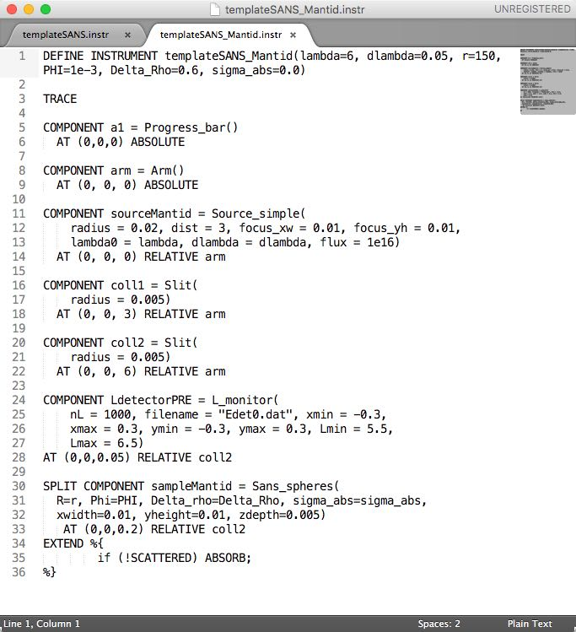
templateSANS.inst vs templateSANS_Mantid.inst
14

Slide 15
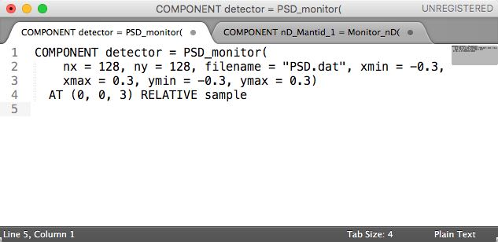
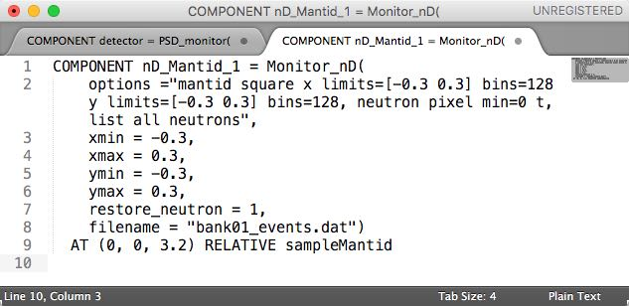
templateSANS.inst vs templateSANS_Mantid.inst
15

Slide 16
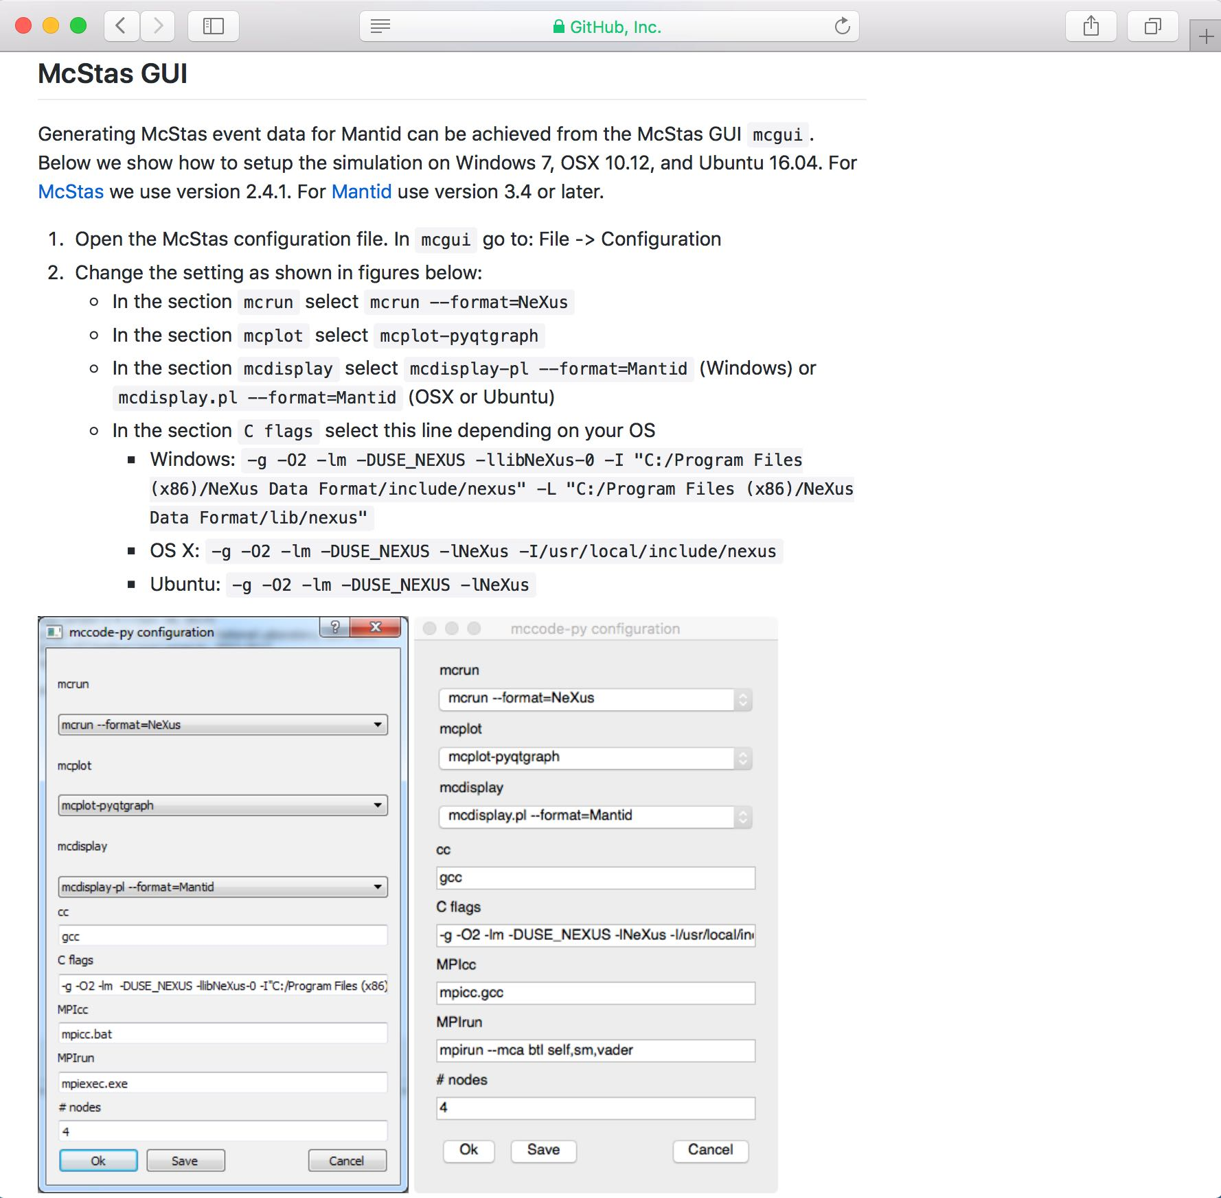
How to run the simulation
Wikipage on GitHub
16

Slide 17
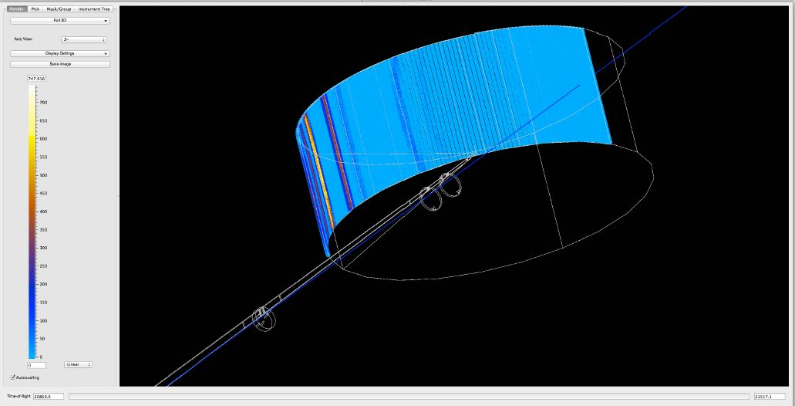
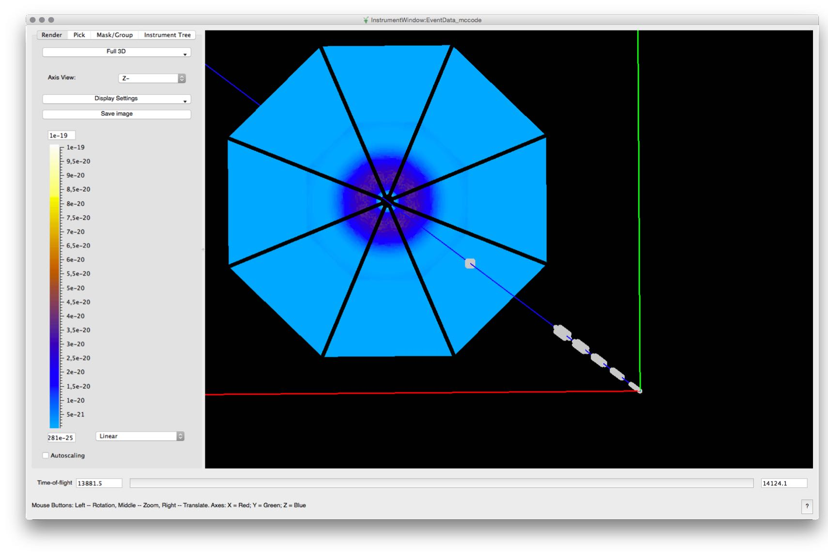
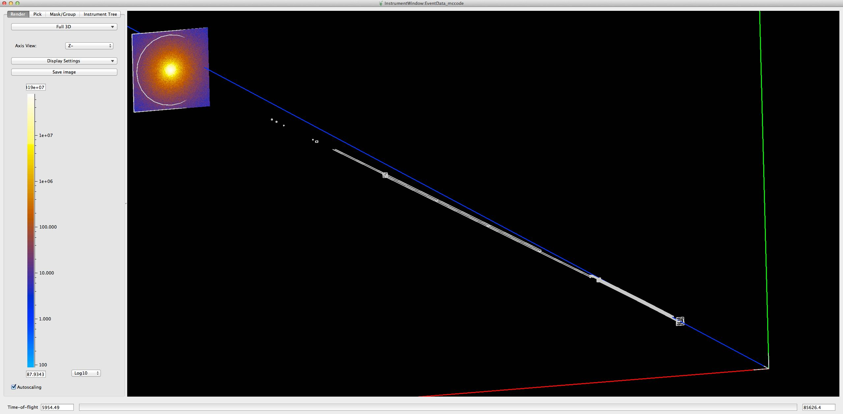
Examples of detectors: IN5 (ILL), LoKI
(ESS), SANS2D (ISIS)
17

Slide 18
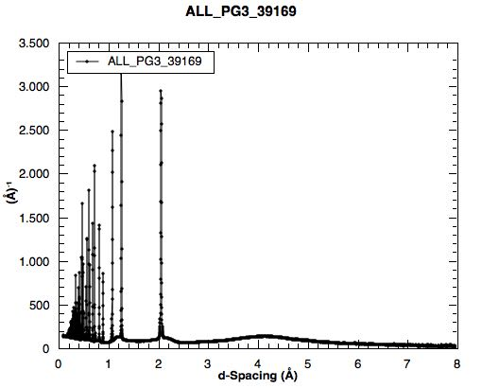
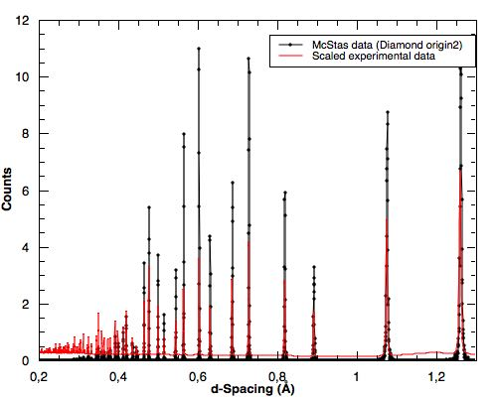
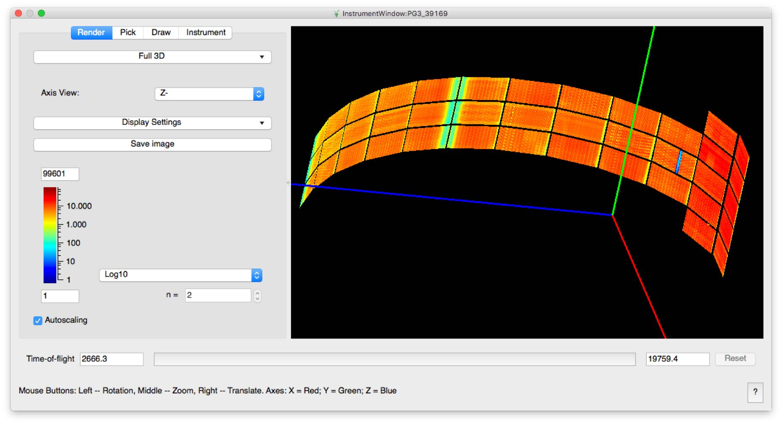
McStas and experimental data: POWGEN
18
By CelineD@ ESS + SNS collaboration

Slide 19
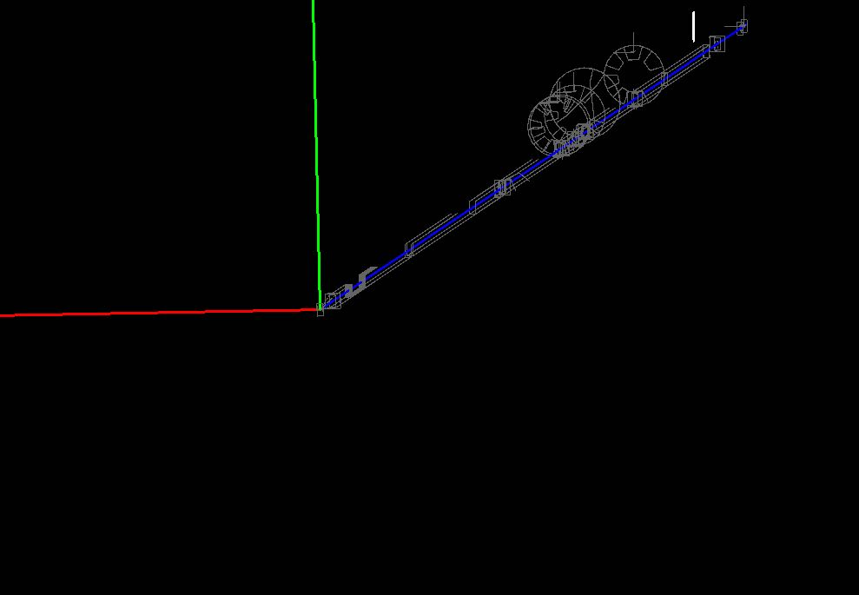
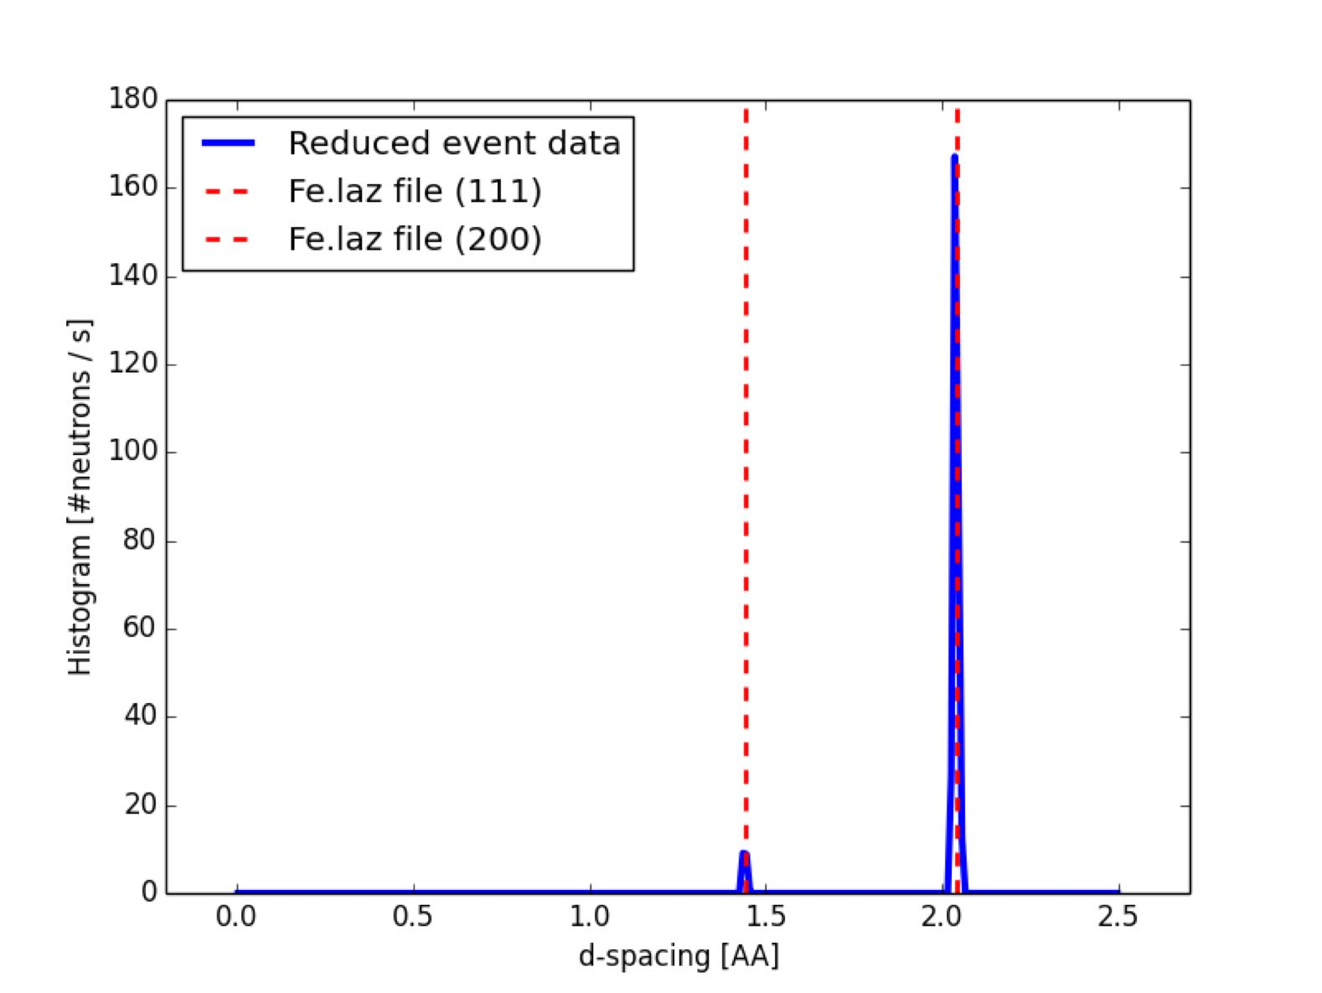
Example –V20 –Powder diffraction Fe
19

Slide 20
Summary
1.Easier to post-process (event) data than making a completely new McStas simulation / component
–E.g.:
–Rebin is needed
–Sum selective over detectors
–Use already developed methods in Mantid
2.Mantid process McStas data as if they were equal to
experimental twin data
20

