Slide 1
The “incoherent approximation”
The “phonon expansion”
Estimate S(q,w) from nearly nothing ?
E. Farhi, ILL.

Slide 2

Background – Old stuff !
Most inelastic neutron scattering fundamental theory was written in the 50’-70’:
→ Sears, Sjölander, Egelstaff, van Hove, Squires, Oskotskii, Sköld, Carpenter, Schober ...
Nothing really new since then.
Remains in the text books, old software is deprecated. Not used much these days.
Let’s recap these concepts...

Slide 3
The “generalised” density of states
The generalised density of states (gDOS) formalism states that it is possible to write an “effective” density of states from a complex material made of d species with “partial” vDOS g_{d}:
It is often named “neutron weighted density of states”
The gDOS (meas. average) is NOT the vDOS.
Reminder: g(w) density of modes in [w,w+dw]

Slide 4
Density of states estimate
Carpenter/Bellisent/Egelstaff:
Cons: Measurement never reaches Q→0, and only use the smallest angle data (low statistics).
Bredov/Oskotskii:
Pros: Use the whole data set, integrated over the instrument dynamic range (higher statistics).
iFit: ‘dos’ method for Sqw2D

Slide 5
The “incoherent approximation”
The integrated ∫dQ or dq incoherent and coherent contributions are roughly equal (apart s).
Consequence: the density of states g(w) can be obtained equally from coherent, incoherent and total scattering. Better use “Bredov”.
Limitation: Exact for cubic monoatomic systems, can be extended to isotropic density materials (see gDOS).
See: Oskotskii (1967)

Slide 6
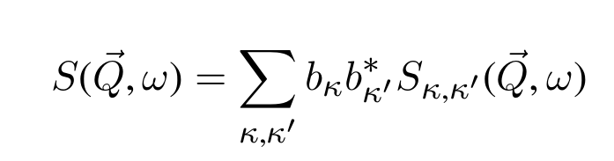
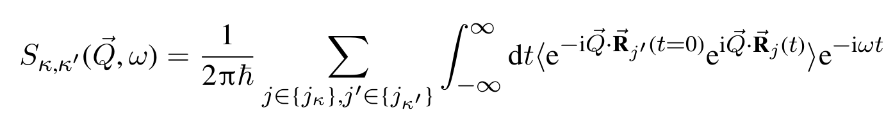
Scattering law, harmonic
The scattering law can be written:
with partials:
Writing R=R₀+u, we can expand S.
s
autocorrelation of displacements
Equil.
Small displ. (harmonic)

Slide 7
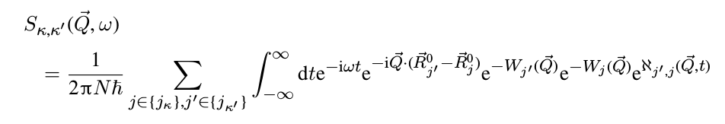



Scattering law, harmonic
Debye-Waller function
Motion correlations:
DON’T PANIC (yet)
Structure
Average
motions
Dynamics

Slide 8

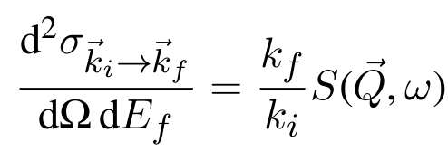
Scattered intensity (interlude)
Of course, the scattered intensity (differential cross section) is as usual:
Monoatomic system: S(Q,w) = s S_{k,k}(Q,w)
We usually only consider the 1st term in À.

Slide 9
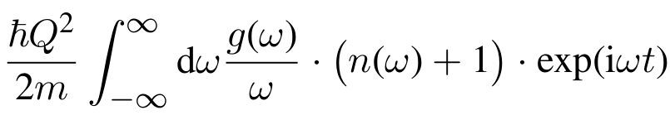
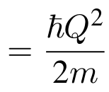


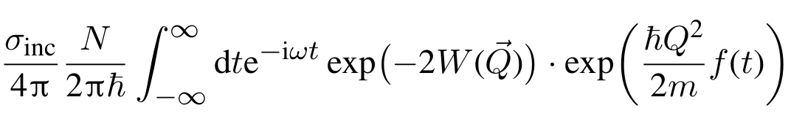

S(Q,w) harmonic isotropic incoherent
For a harmonic isotropic incoherent system:
And:
See: Sjölander (1958)
f(t)
Look at that one
Average
motions

Slide 10
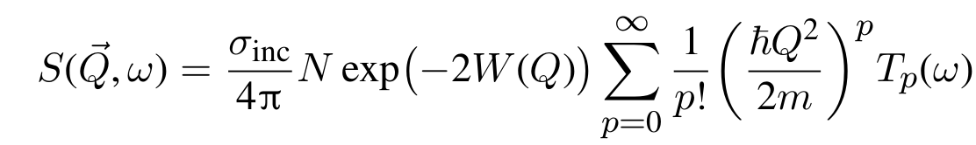

The “phonon expansion”
We develop the last exp[f(t)] term in Taylor series → “phonon expansion”
The “phonon” terminology comes from the fact that initially, the partial S_{K,K’} includes both coherent and incoherent processes, and the high order terms correspond to multi-phonons.
Phonons in an incoherent scatterer is somewhat odd.
T_{p} obtained recursively

Slide 11
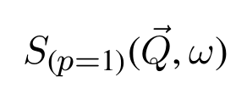
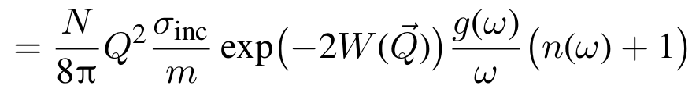
Let’s keep calm
The p=0 term is the Elastic Incoherent Scattering Function (EISF) → DW.
The p=1 term is the one-phonon (incoherent !) response:
2W(Q) = hQ²/2m ∫ T₁(w) dw [often over estimated]
For Q→0, Debye-Waller → 1. As n(w)+1 ~ 1/w we get an estimate of g(w) from S(Q,w):
T₁(w)
[Bellissent-Funel 1991]

Slide 12
How to use this...
Input: s, m, g(w) , [optional: DW]
Output: Debye-Waller estimate 2W(Q), S_{inc}(Q,w)
Multi
Phonons
(inc)
s, m, g(w)
2W(Q), S_{inc}(Q,w)
iFit: ‘incoherent’ method for vDOS
Older code 1D: MUPHOCOR, LAMP

Slide 13
Does it work ?
Monoatomic isotropic material: l-Al
Can simulate liquid dynamics using DFT:
  200 atoms in a box, PAW PBE
  12000 MD steps of 3fs, T=1300 K → R(t)
  Compute S_{inc}(q,w) S_{coh}(q,w) using MDANSE/nMoldyn
  Compute the vDOS g(w) using MDANSE/nMoldyn
Compute the incoherent from the vDOS and compare with the ‘true’ S_{inc}(q,w) from the MD.

Slide 14
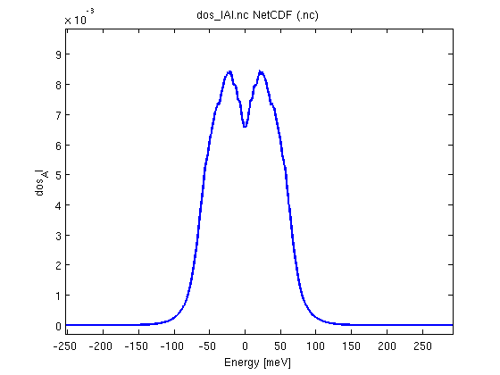
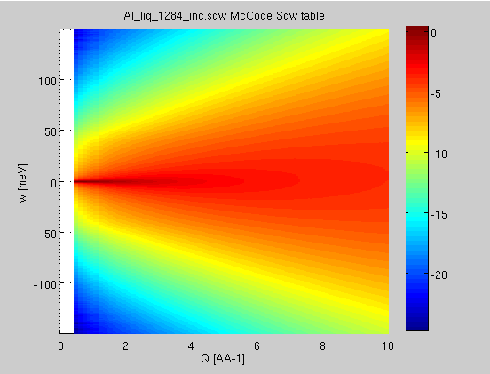
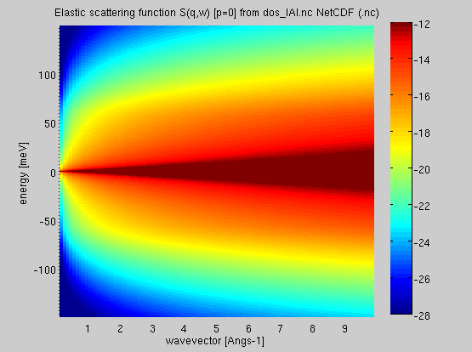
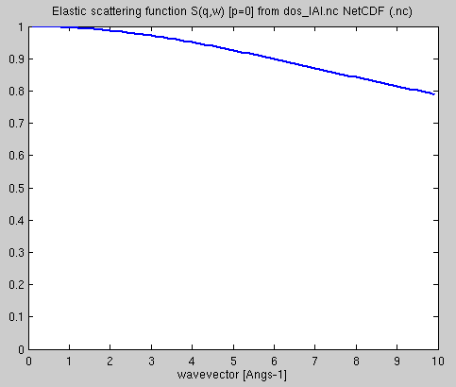
Incoherent liq-Al: approximation
g(w)
l-Al
R(t) → MDANSE → S_{inc}(Q,w)
R(t) → MDANSE → g(w)
iFit:
  g=iData_vDOS(‘dos-lAl.nc’);
  Sinc=plus(incoherent(g,'T',1300,'DW',0.01, ‘m’,27));
R(t) → MDANSE → S_{inc}
_{No DW factor, S(q)=1}
g(w)→S_{inc}
S_{inc}(q) ➘
Not perfect, but ...

Slide 15

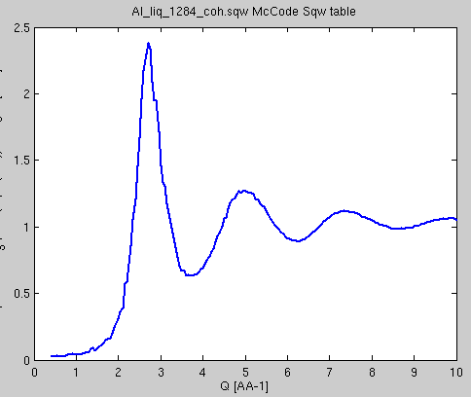
What about the coherent ?
Al is a coherent scatterer
Phenomenological guess [Sköld 1967]
S(Q)
L-Al
From MD
Structure is ‘forced’ in.
Sköld
(coh)
S_{inc}(Q,w), S(Q)
S_{coh}(Q,w)
iFit: ‘coherent’ method for Sqw2D

Slide 16
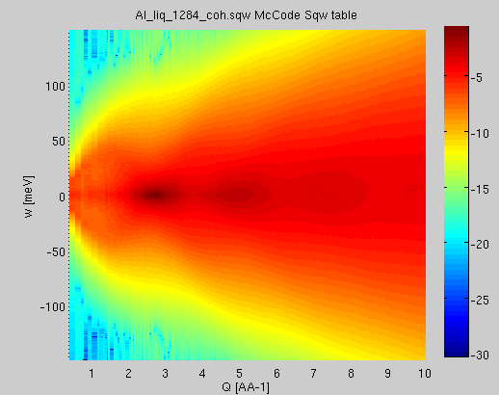
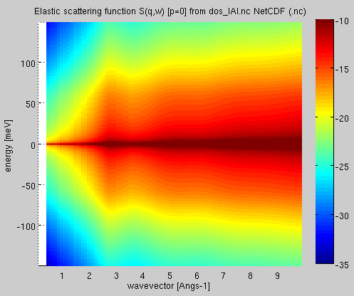
Coherent liq-Al: approximation
R(t) → MDANSE → S_{coh}(Q,w)
R(t) → MDANSE → S(Q) or ∫S_{coh}(Q,w) dw
iFit:
  Sq=iData(‘Sq-lAl.nc’);
  Scoh=coherent(Sinc, Sq);
S(Q)
l-Al
R(t) → MDANSE → S_{coh}
_{No DW factor, S(q)=1}
S_{inc}(Q,w), S(Q)→S_{coh}
Not perfect, but ...
No phonons
(of course)

Slide 17

Partial summary
If we have an estimate for the vDOS, we can compute the S_{inc} with a reasonable agreement.
  This is the foundation for NJOY/LEAPR. g(w) can be estimated from neutron ToF experiment, MD and lattice dynamics (solids). Search literature !
If in addition we have an estimate for the structure S(Q), we can also get S_{coh}.
WARNING: Not perfect, but we get it from very limited information.

Slide 18
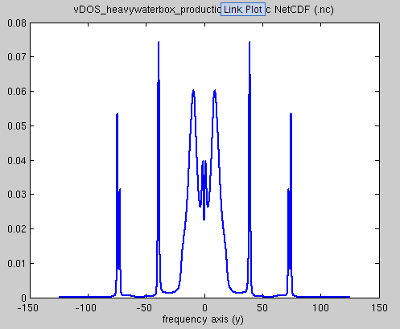
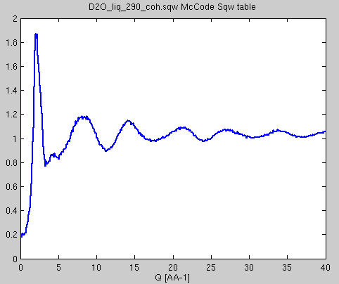
More complex: water (liquid)
GROMACS 4000 D₂O, MD 2500 time steps
R(t)→MDANSE→g(w)→S_{inc}
Compare with S_{inc} from MD
Get S(Q) from MD
Estimate S_{coh} from [S_{inc} and S(Q)]
WARNING: not exact: non monoatomic
g(w) from MD
l-D₂O
293 K
S(Q) from MD
l-D₂O
293 K

Slide 19
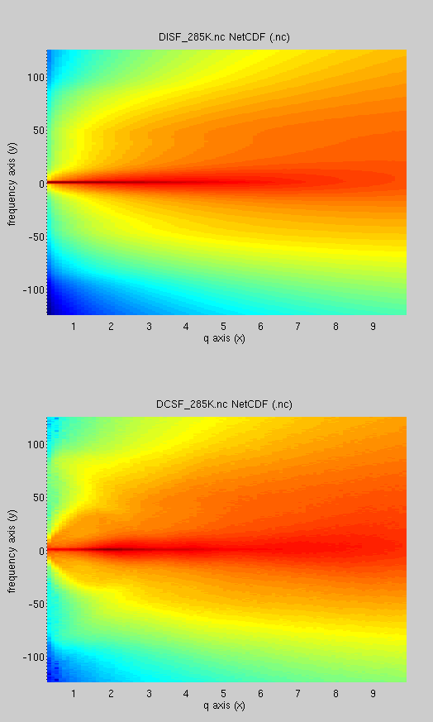
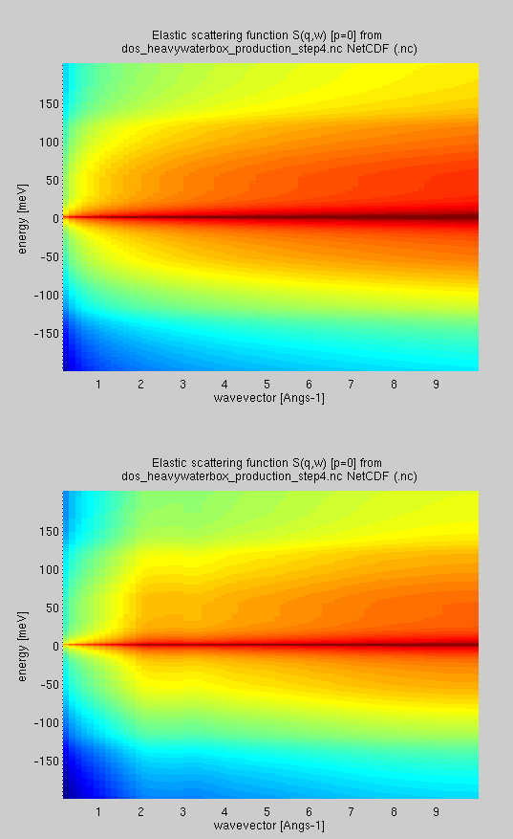
Water (liquid)
R(t) → MDANSE →S_{inc} (MD)
R(t) → MDANSE →S_{coh} (MD)
g(w)→S_{inc} (approx)
S_{inc}(Q,w), S(Q)→S_{coh} (approx)
D₂O 293 K, S(Q,w)
Structure is there

Slide 20
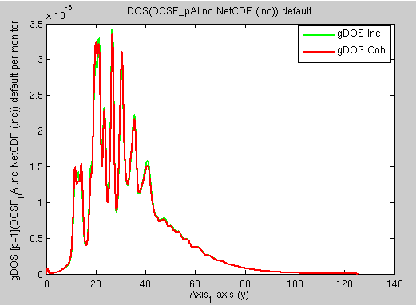
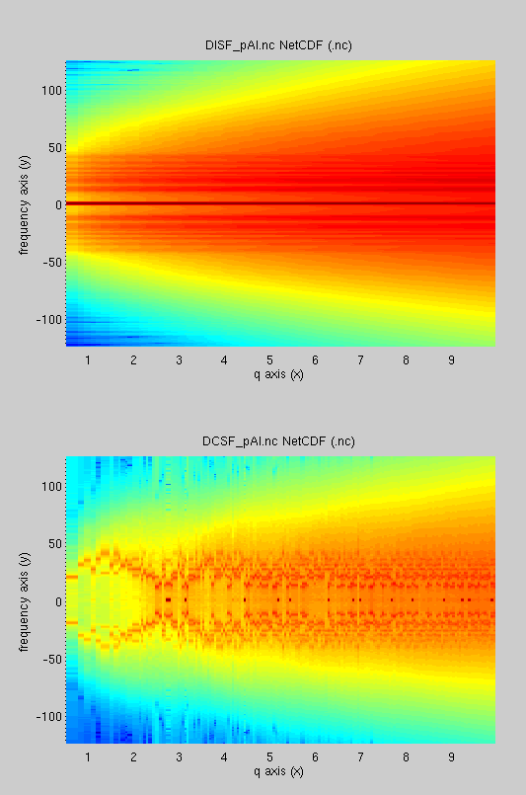
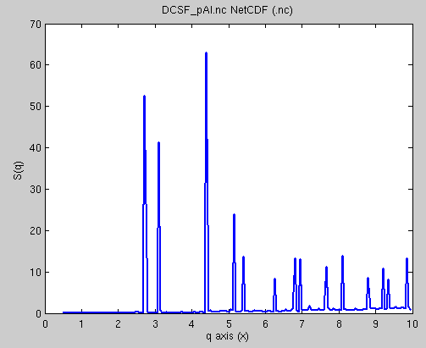
Powders (solid, isotropic)
VASP 200 Al atoms, PAW PBE. MD 300 K.
Check for gDOS: coherent and incoherent estimates are equal (Bredov).
gDOS p-Al
iFit: g = dos(coh);
S_{inc}
MD p-Al, VASP
S_{coh}
S(Q) p-Al
iFit: sq = structure_factor(coh);

Slide 21
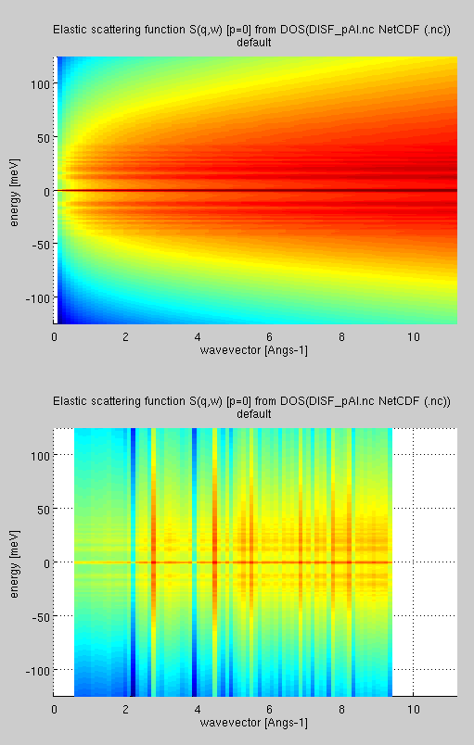
Powder: p-Al
S_{inc}
MD p-Al, VASP
S_{coh}
S_{inc}
g(w) → approx
S_{coh}
Well… that’s the same ?

Slide 22

Validity: Pros
Pros:
  Requires minimal info: g(w), S(q)
  Very fast to compute.
  Applicable to any isotropic material.
  Not meant to be exact (strong hypothesis).
  Acceptable results when nothing else exists: liquids, amorphous, powders, gases

Slide 23

Validity: Cons
Cons:
  Does not reconstruct low Q dynamics (phonons, …).
  Structure is forced in, but does not satisfy De Gennes narrowing (narrow at Bragg peaks).
  Incoherent estimate better than coherent one.
  Would require partial g(w) and S(Q) per atom to improve accuracy.
  Assumes cross terms S_{KK’} are null.

Slide 24
Applicability
Experiments: total = coh+inc
Can estimate incoherent quite well, to e.g. help subtract ‘background’ and better estimate the coherent part.
Can build S(q,w) estimates from very little info.

Slide 25
Nuclear data bases
Some of this is in NJOY/LEAPR module
  Incoherent “phonon-expansion”
  Coherent [Sköld] estimate only used for D₂O
  Contribution is in m^{-p} / !p, usually p=5-10 is enough.
  All materials, including coherent scatterers are assumed incoherent.
  S(a=h²Q²/2mkT,b=-hw/kT) ~ S(Q,w)/Q depends on T, whereas S(Q,w) mostly changes around phase transitions (except for Bose factor).
  Material descriptions in ENDF are few.

Slide 26
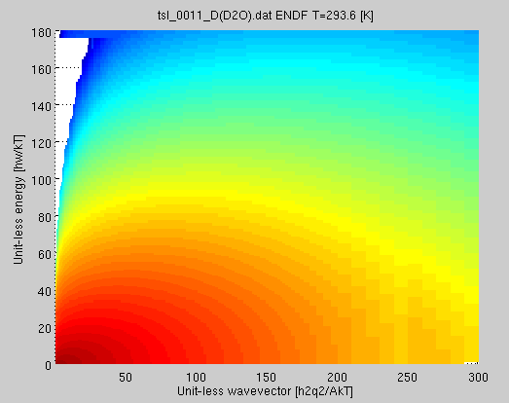
Nuclear data bases: D₂O S(a,b)
Get Bariloche “D in D₂O” ENDF TSL-0011.
iFit: sab=iData(‘tsl_0011_D(D2O).zip'); sab=sab(1); % 293 K
S*(a,b) D₂O 293K (CAB)

Slide 27
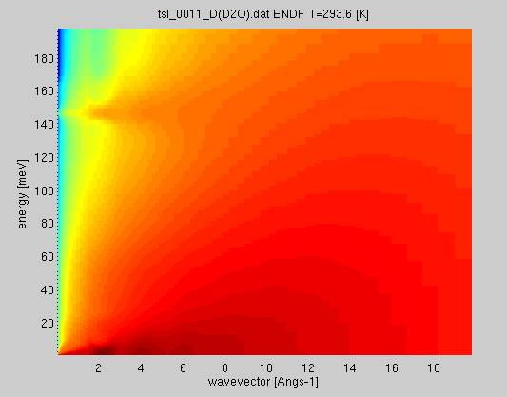
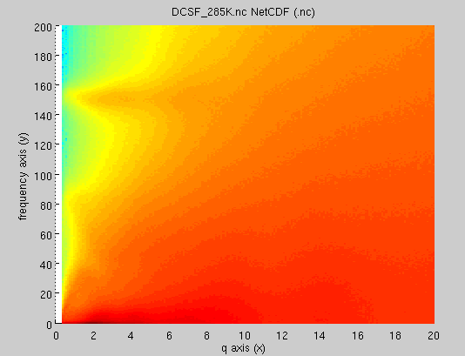
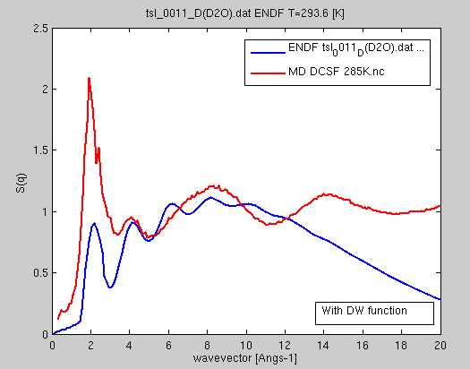
ENDF D₂O S(q,w)
D₂O: S(Q,w) from S(a,b)
GROMACS MD
TIP4P/2005f
coherent
iFit: sqw = Sqw(sab);
CAB model is fair.

Slide 28
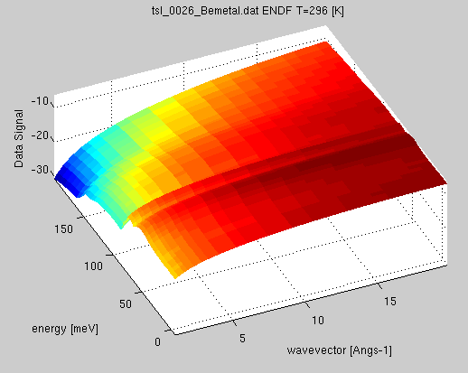
ENDF Be metal
ENDF Be does not contain any structure. Fully incoherent, but this is in fact a pure coherent scatterer.
Some vibrational bands, but there should be phonons…
iFit:
S(Q,w) 293 K from S(a,b) CAB
  iFit:
  Be=iData(‘tsl_0026_Bemetal.zip');
  Be=Be(9); % 293 K
  Sqw = Sqw(iData_Sab(Be));

Slide 29
Using all this in iFit
Load a data set: blah = iData(file);
Make it a vDOS or Sab or Sqw2D
  iData_vDOS(..) iData_Sab(…) iData_Sqw2D(…)
Compute:
  vdos=dos(sqw2d); sqw2d=incoherent(vdos);
  sq=structure_factor(sqw2d)
  sqw2d=coherent(sqw2d, sq);
Convert
  Sqw(sab); Sab(sqw2d);

Slide 30

Conclusion
There are models to get S(q,w) from not much.
Used extensively in ENDF.
Make up your mind about validity.
My advices:
  use it to estimate incoherent when you have a total scattering experiment. Cheaper than polarised beam...
  ENDF: Extend material descriptions with coherent (structure).

