Slide 1
Moving Optics
Velocity selector
Disk Chopper
Fermi Chopper

Slide 2
Velocity Selectors
-
Select the neutron energy you want

Slide 3
VELOCITY SELECTORS
absorbing blades

Slide 4
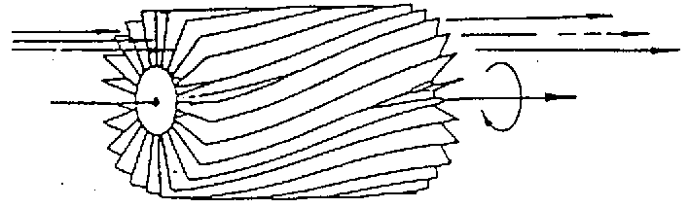
VELOCITY SELECTORS

Slide 5
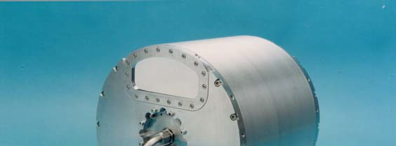
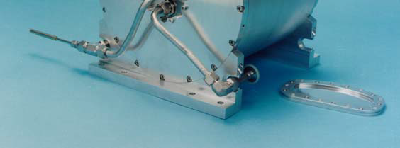
VELOCITY SELECTORS
‘broad’ monochromatization δλ/λ ≈ 10 %
ILL.FR
Astrium

Slide 6
VELOCITY SELECTORS
INPUT PARAMETER
xwidth [m] width entry aperture
yheight [m] height entry aperture
zdepth [m] housing! length
length [m] blade length
d [m] blade thickness
alpha [deg] twisting angle
radius [m] distance rotation axis – aperture centre
nu [Hz] rotation speed, counterclockwise
nslit [] number of blades
housing

Slide 7
DISK CHOPPER
Define time structure of the beam
Time Of Flight (TOF) measurements

Slide 8
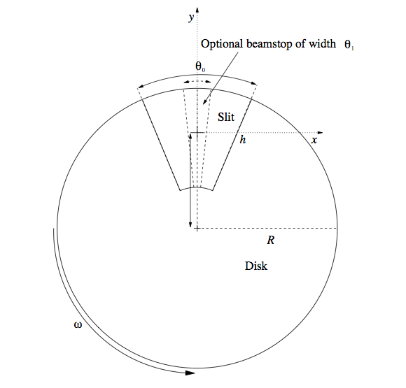
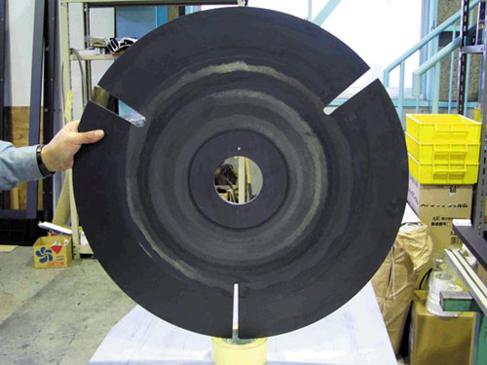
DISK CHOPPER

Slide 9
DISK CHOPPER
INPUT PARAMETER
nu [Hz] frequency
yheight [m] slit height (if 0, yheight = radius)
radius [m] disk radius
theta_0 [deg] angular width of slits
xwidth [m] horizontal slit width opening, beam center
jitter [s] jitter in time phase
delay [s] time delay
phase [deg] angular delay, overrides time
Isfirst [0/1] several choppers, defines first chopper
npulse [1] number of pulses if isfirst=true
verbose [1] display disk chopper config

Slide 10
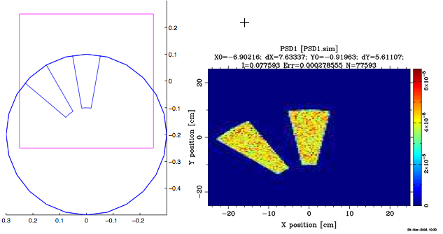
DISK CHOPPER_S

Slide 11
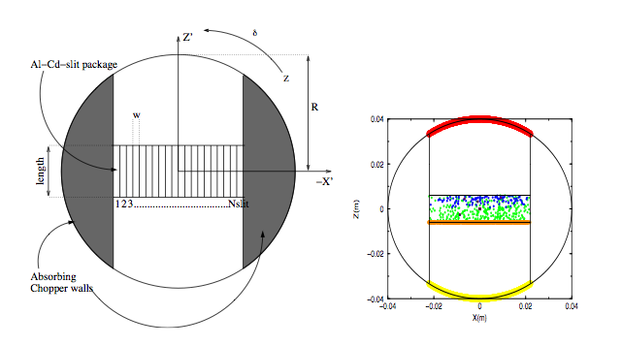
FERMI CHOPPER

