Slide 1





McStas Example Instruments

Slide 2
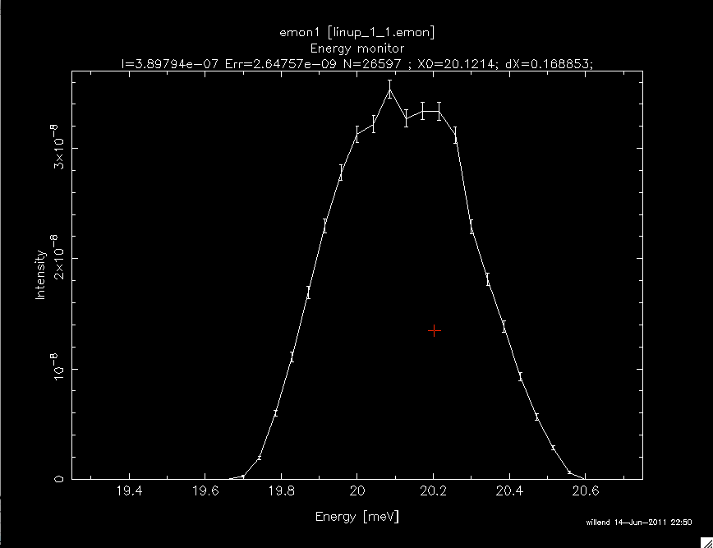
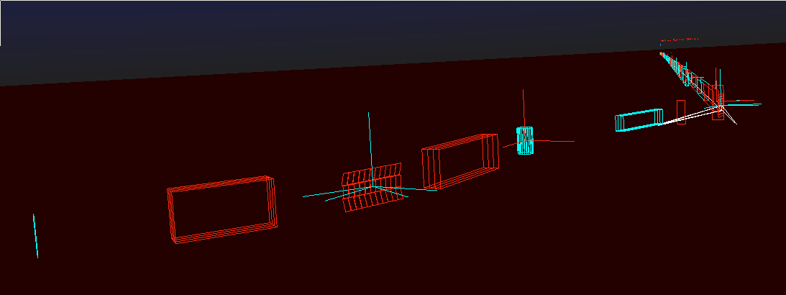
5 TAS (linup-? are all Risø TAS 1):
ILL_H142_IN12.instr
ILL_H25_IN22.instr
h8_test.instr
templateTAS.instr
linup-1.instr
linup-2.instr
linup-3.instr
linup-4.instr
linup-5.instr
linup-6.instr
linup-7.instr

Slide 3
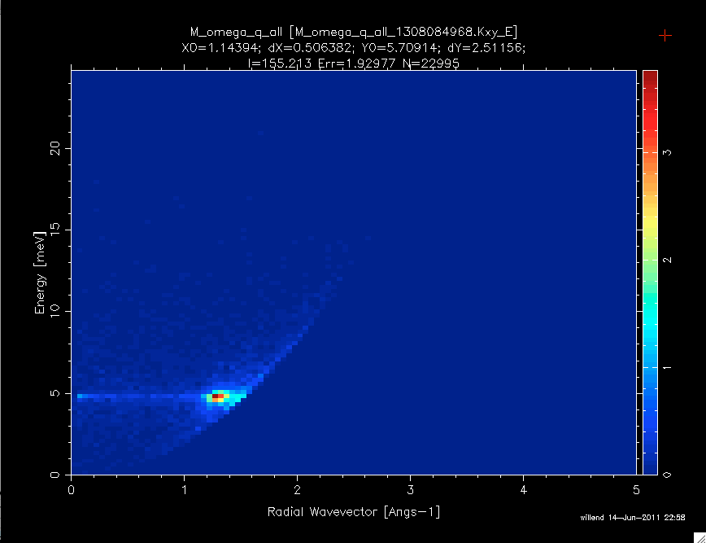
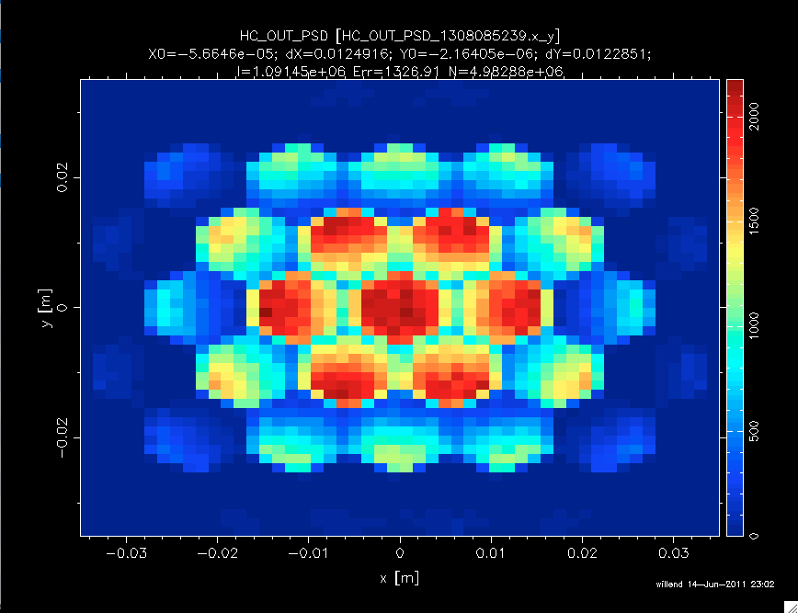
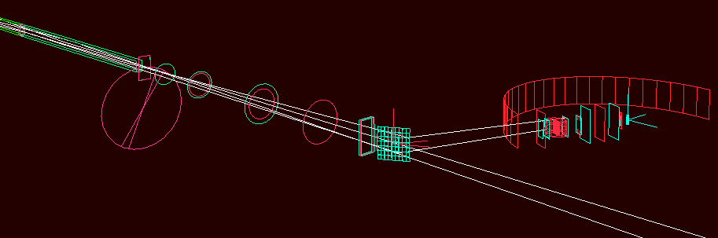
7 TOF spectrometers:
ESS_IN5_reprate.instr
ILL_BRISP.instr (Small-angle)
ILL_H15_IN6.instr
ILL_H16_IN5.instr
ISIS_HET.instr
PSI_Focus.instr
templateTOF.instr

Slide 4
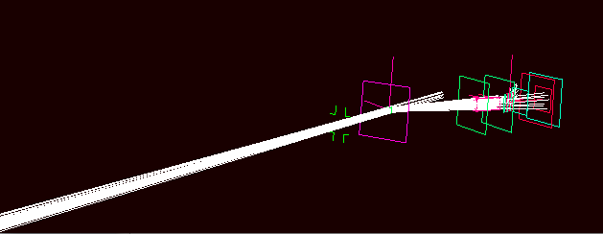
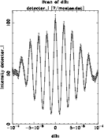
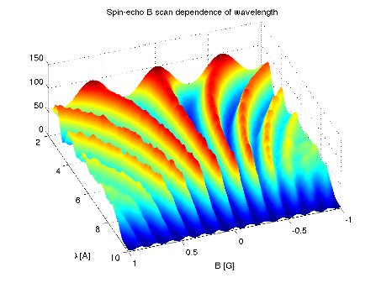
1 Hybrid spectrometer + 1 Spin-echo
1 Hybrid spectrometer:
prisma2.instr
1 Spin-echo (two different implementations, same instr):
SE_example.instr
SE_example2.instr

Slide 5
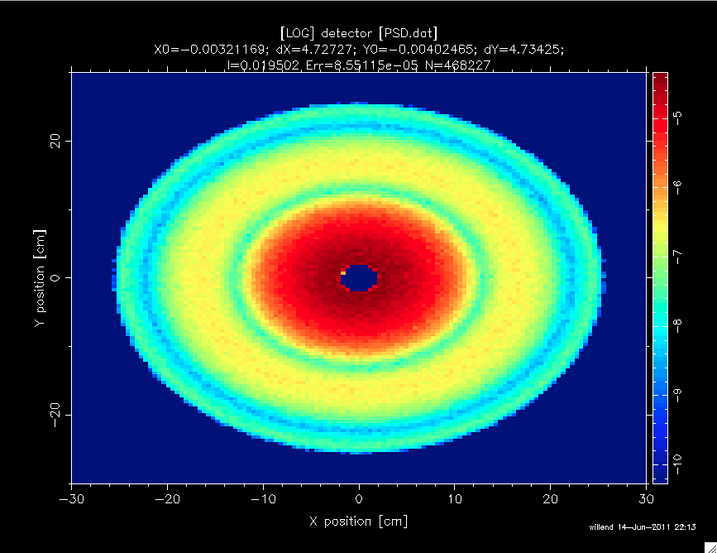
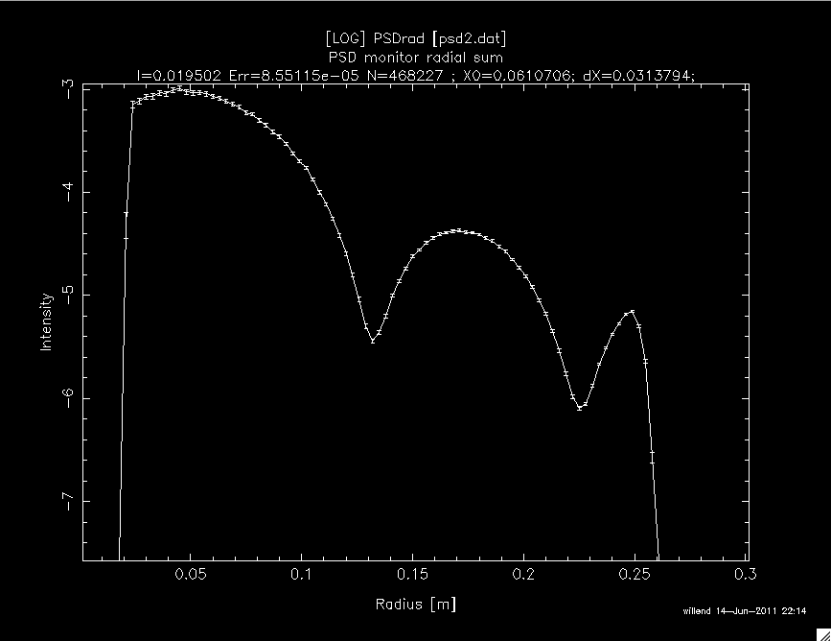
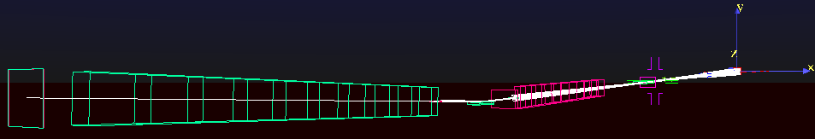
Large scale structures
2 SANS:
FZJ_KWS2_Lens.instr
FZJ_SANS_KWS2_AnySample.instr
FZJ_SANS_KWS2_DebyeS.instr
FZJ_SANS_KWS2_Guinier.instr
FZJ_SANS_KWS2_NoSample.instr
SANS.instr
1 Reflectometer:
ISIS_CRISP.instr (Not an accurate model)

Slide 6
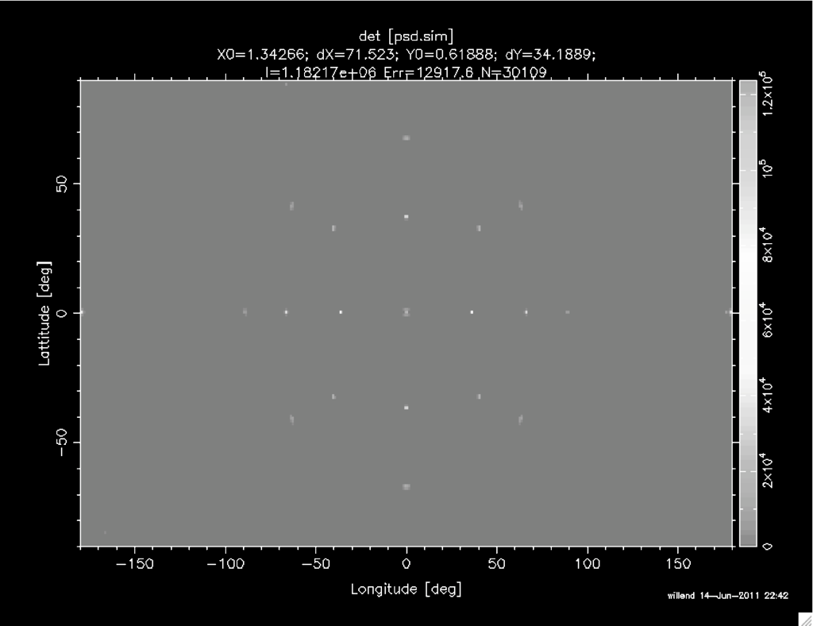
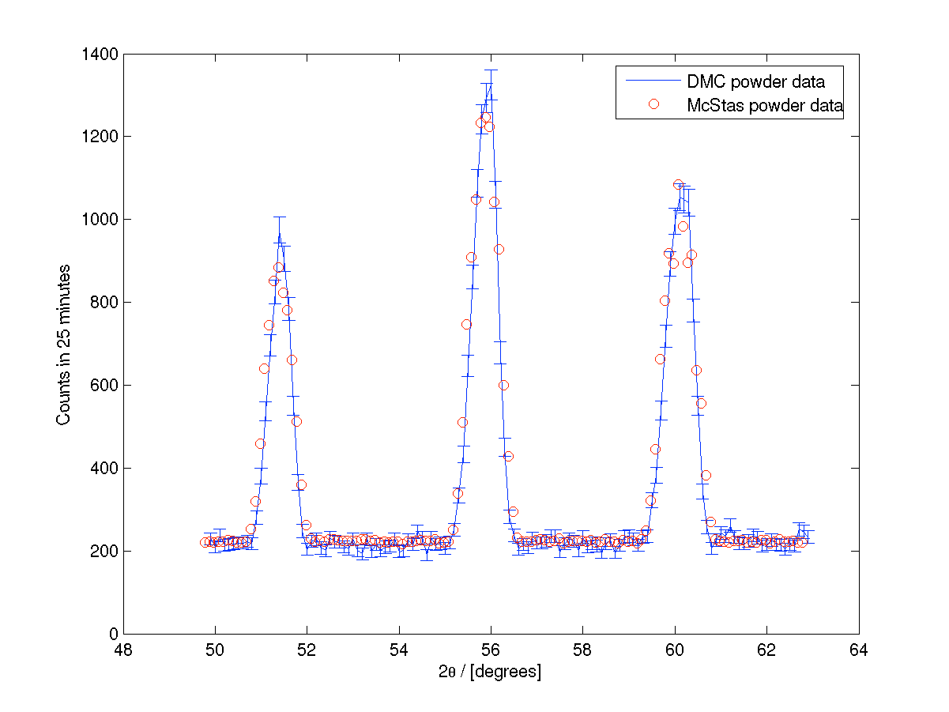
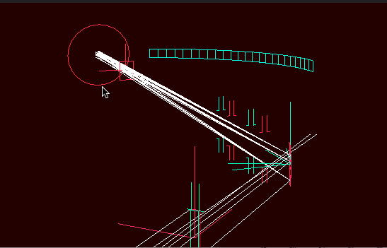
Diffractometers
ILL_D1A.instr
PSI_DMC.instr
templateDIFF.instr
templateLaue.instr

Slide 7
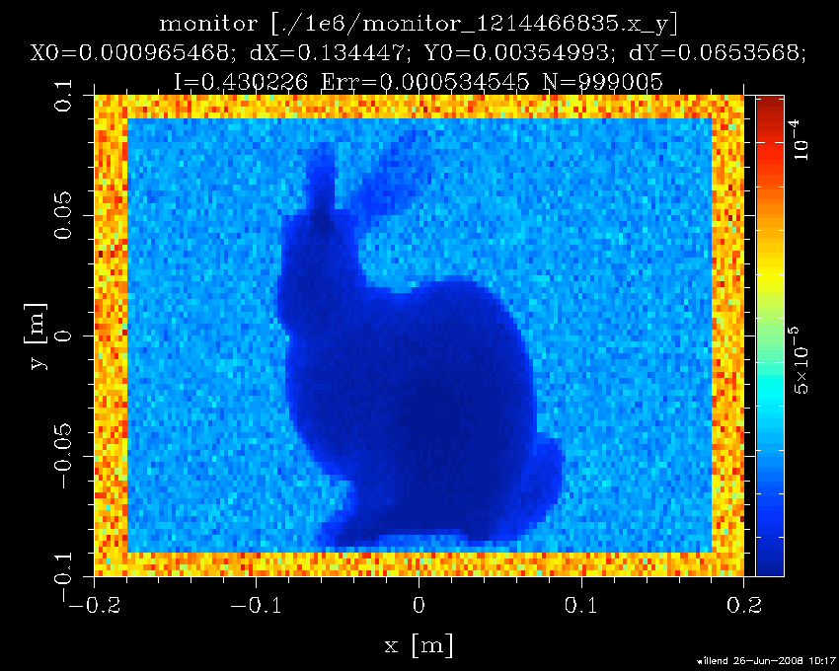
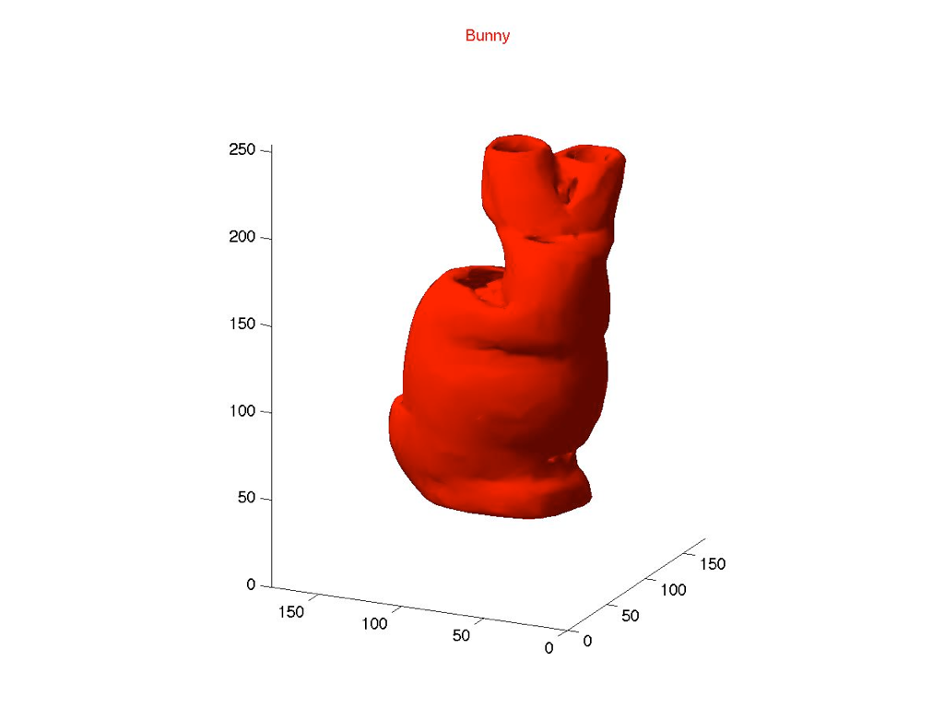
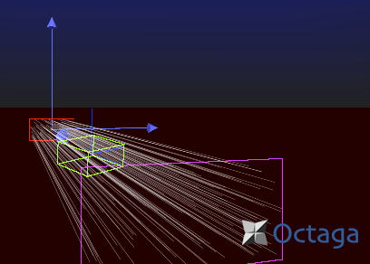
Imaging
Tomography.instr
- comes with simple
filtered backprojection
reconstruction (Matlab)

Slide 8
Histogrammer.instr
Histogrammer.instr
- takes any kind of supported ‘event input file’, e.g. from Vitess. String parameter used as Monitor_nD options, can make all types of histograms from the event file.
(I.e. conversion tool for plotting of data)

