Slide 1





Practical E, Diff., Laue Cam.

Slide 2
First things first
Move the ASE python environment
out of the way
Issue the following command in a terminal
in your home directory.
“mv miniconda3 miniconda3_gone”

Slide 3
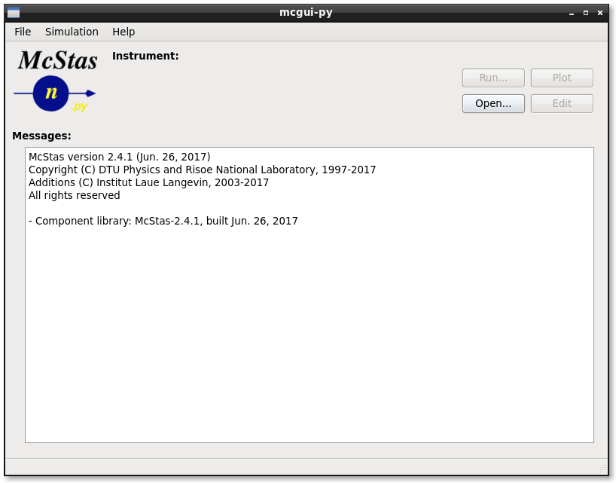
Second things second
Try to run “mcstas-2.4.1-environment” (tab completion works!)
In this new shell run “mcgui”
(tab completion does not work)
You should now have:

Slide 4
Agenda
Laue Camera
  Build along in 4 steps!
Diffractometer
  PSI_DMC
Laue Camera revisited

Slide 5
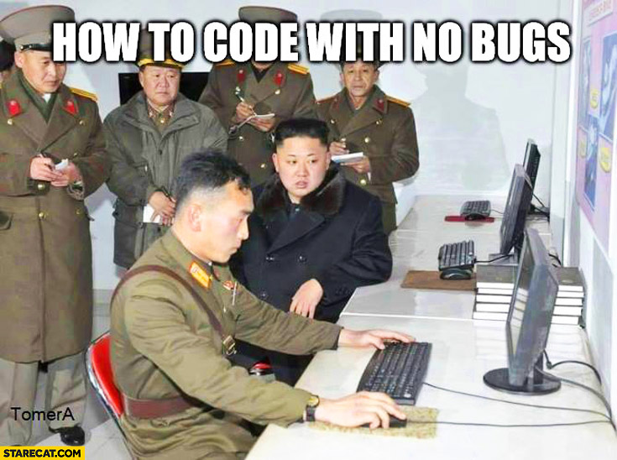
…

Slide 6
Build along Laue Camera
First insert a source
File → New Instrument
Insert → Sources → Source_simple
// insert components here (e.g. Insert -> Source -> ...)
COMPONENT source_simple = Source_simple(
radius=0.05,
dist=5,
focus_xw=0.02,
focus_yh=0.05,
lambda0=2,
dlambda=1.9)
AT (0, 0, 0) RELATIVE PREVIOUS

Slide 7
Build along Laue Camera
Now add a guide
Insert → Optics → Guide
COMPONENT guide = Guide(
w1=0.02, h1=0.05, w2=0.02, h2=0.05, l=20, m=1)
AT(0,0,2) RELATIVE source_simple

Slide 8
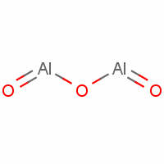
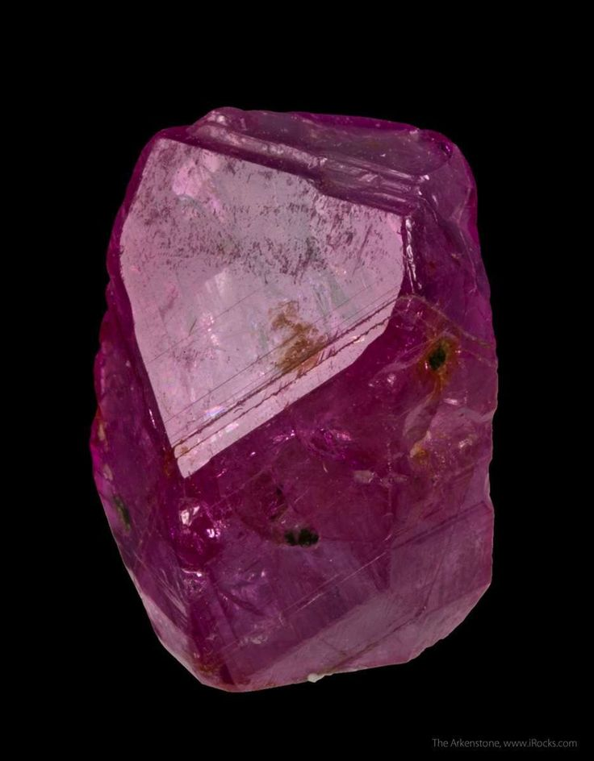
Build along Laue Camera
Add a sample – in this case a standard crystal
Insert → Samples → Single_crystal
COMPONENT single_crystal = Single_crystal(
reflections="Al2O3_sapphire.lau",
yheight=0.05, radius=0.01, mosaic=1, delta_d_d=1e-4,
az=4.757, ay=0, az=0, bx=2.3785, by=0, bz=-3.364,
cx=0, cy=12.9877, cz=0,
p_transmit=0.1)
AT (0, 0, 0) RELATIVE PREVIOUS

Slide 9
Build along Laue Camera
Add the ideal Laue Camera Monitor – covering 4π
Insert → Monitors → PSD_monitor_4PI
COMPONENT fourpi = PSD_monitor_4PI(
radius=1, filename="fourpi.dat", nx=201, ny=201)
AT(0,0,0) RELATIVE PREVIOUS

Slide 10
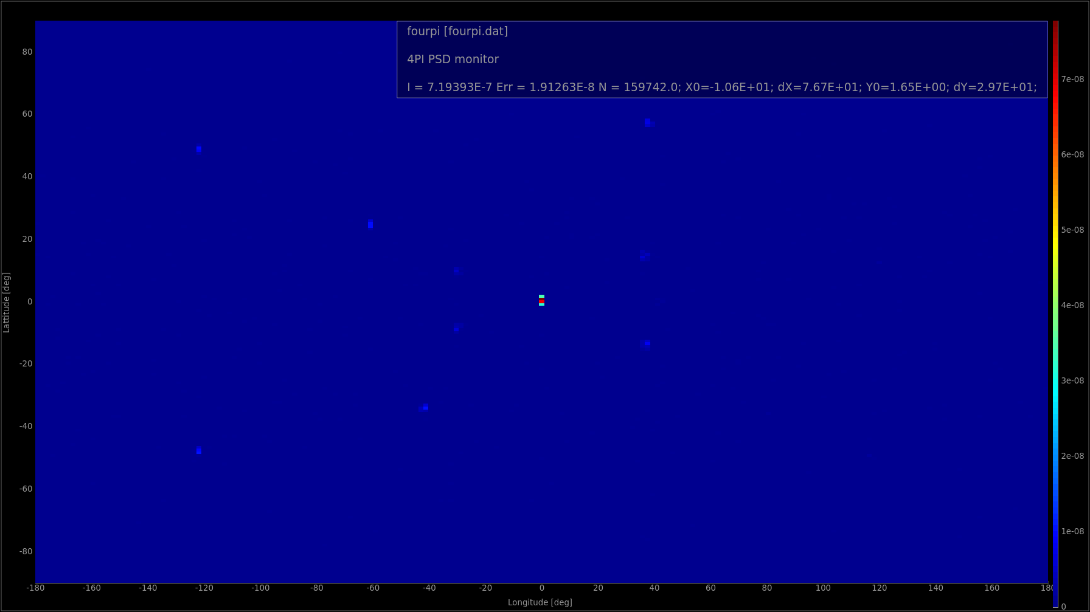
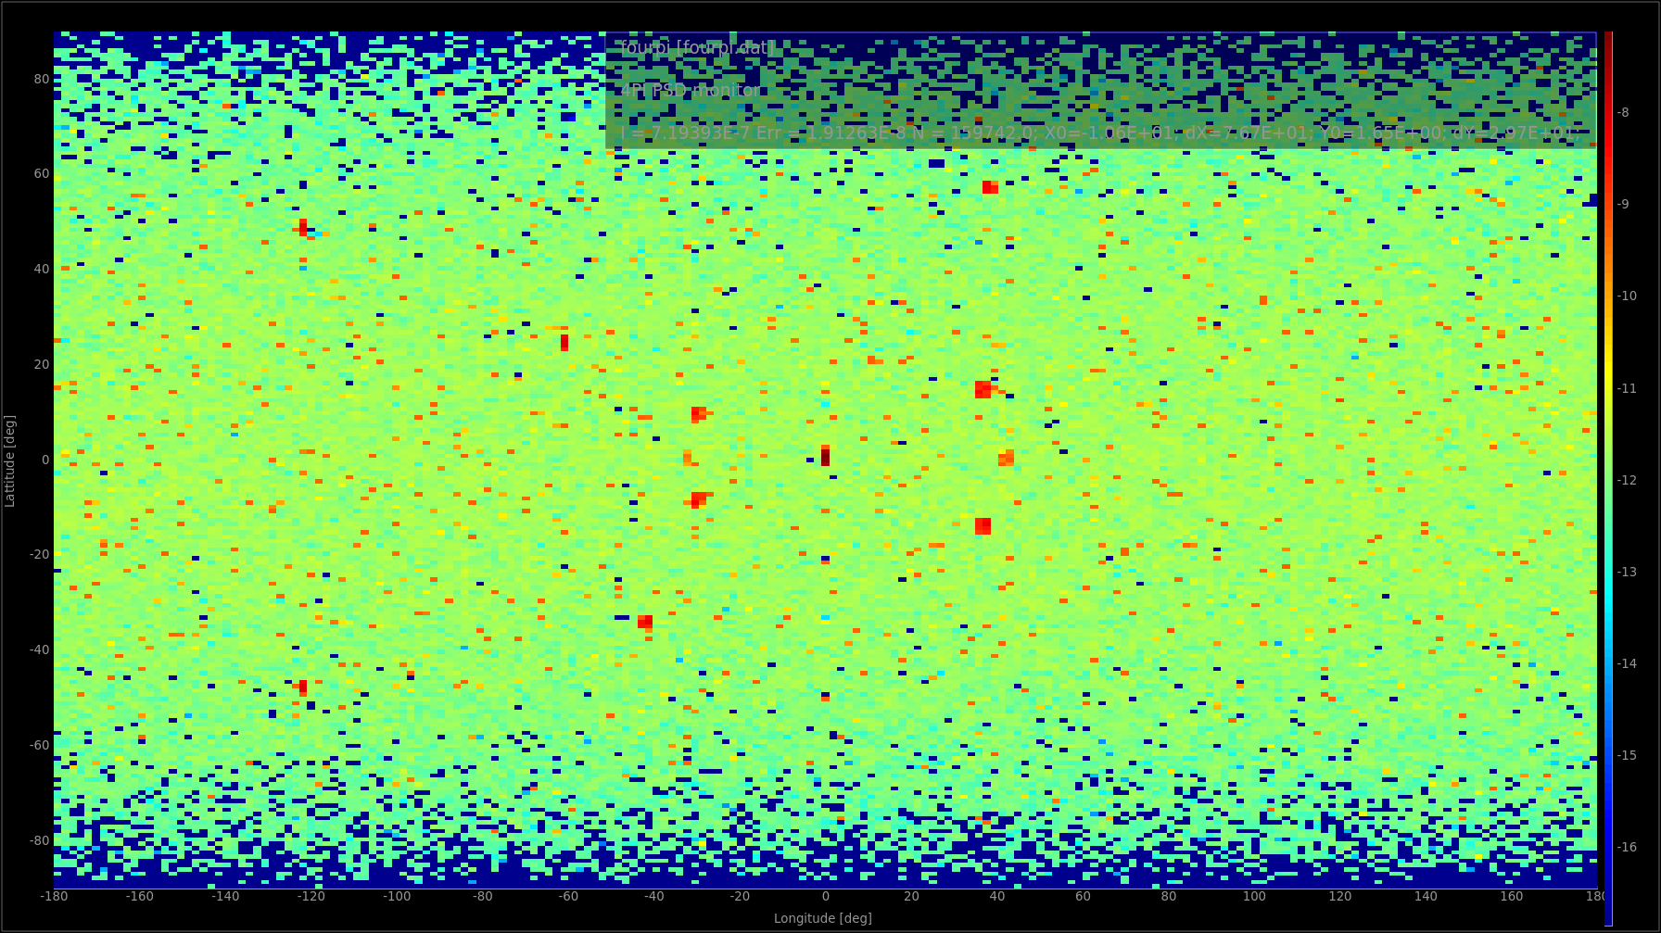
Build along Laue Camera
Run your simulation (you can safely increase the number of rays to 10^7) the ncount) – you should get something like:
Press L for
logarithmic

Slide 11
Build along Laue Camera
Play around with this example instrument:
Add an Arm components before the
sample to allow rotation around the Y-axis.
Add “SPLIT 20” before the sample COMPONENT statement. What happens?
Try to extend this to Y, Z, Y rotation
(Eulerian cradle).
Insert a different crystal instead
e.g. “Al.lau”. i.e. change the crystal unit cell parameters and the reflection list.
Insert a powder sample instead

Slide 12
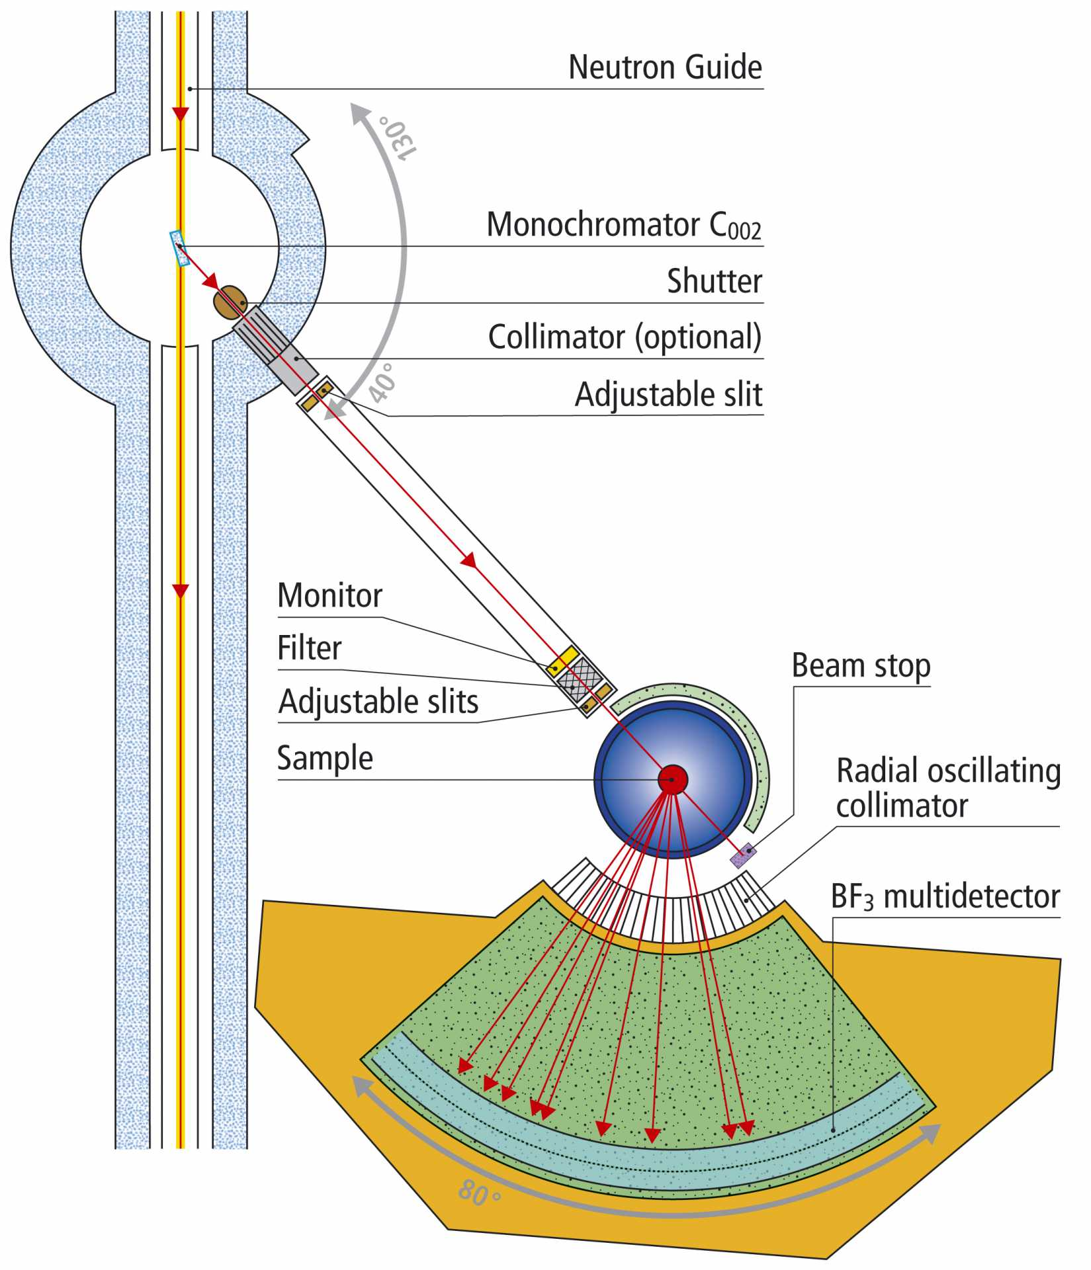
Real Instruments
PSI DMC
File → New from Template → PSI_DMC
Run the instrument with it’s default parameters.
Now we’ll try to insert a Single crystal instead of the default Powder.

Slide 13
Real Instruments
PSI DMC
Increase the height of the detector and make it resolve the signal along y.
Set:
Options="banana, theta y auto limits bins=20", yheight=0.3
In the detector.
...and change the sample to be e.g. an Aluminium crystal.
COMPONENT single_crystal = Single_crystal(
reflections="Al.lau",
yheight=0.05, radius=0.01, mosaic=1, delta_d_d=1e-4,
az=4.0495, ay=0, ax=0, bx=4.0495, by=0, bz=0,
cx=0, cy=4.0495, cz=0,
p_transmit=0.1)
AT (0, 0, 0) RELATIVE PREVIOUS

Slide 14
TOPAZ and SENJU
Take a look at a couple of “real” instrument simulations of Laue Cameras: they both resides in the Dropbox under
“25th_Tuesday/Practical_E_McStas_Diffraction, Laue”
1. SNS TOPAZ
2. J.PARC SENJU (aka. BL18)
Here you need to also copy a datafile for the J-PARC source “source_BL18.txt”
Surgeon General’s Warning:
There are lots of COMPONENTS here

