Slide 1


McXtrace components and instruments
Peter Willendrup (pkwi@fysik.dtu.dk)

Slide 2
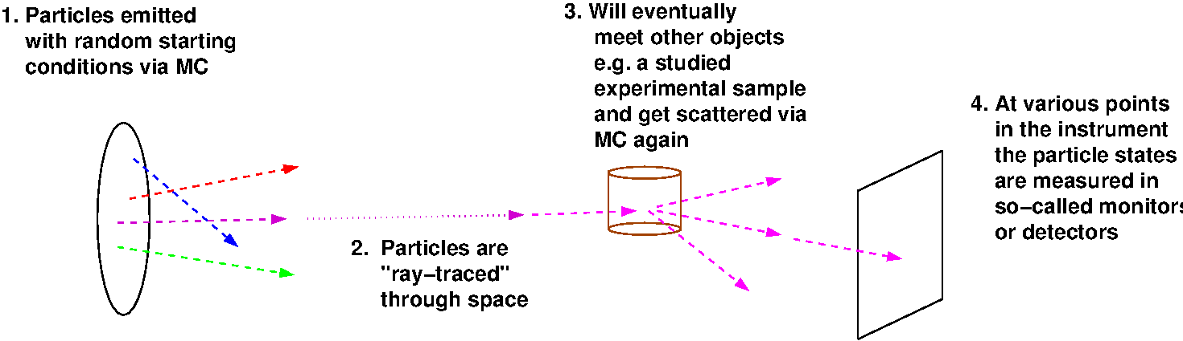
In the big picture, McXtrace is this…

Slide 3
In the big picture, McXtrace is this…
Instrument
The instrument defines our “lab coordinate system”

Slide 4
In the big picture, McXtrace is this…
Instrument
Component
Component
Component
The instrument defines our “lab coordinate system”
The components define devices or features available in our instrument

Slide 5
In the big picture, McXtrace is this…
Instrument
Source
Sample
Monitor
The instrument defines our “lab coordinate system”
The components define devices or features available in our instrument - they have different function

Slide 6
In the big picture, McXtrace is this…
Instrument
Source
Sample
Monitor
X-rays
The instrument defines our “lab coordinate system”
The components define devices or features available in our instrument - they have different function
X-ray photons particles are passed on from one component to the next, changing state under way

Slide 7
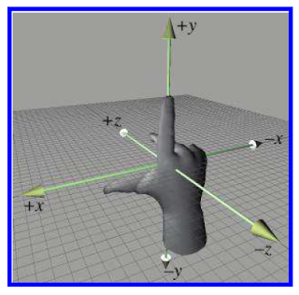
Placing components - source
One of the first components in your instrument is typically a source, which has a coordinate system like this….
z is along X-ray beam direction
y is vertical
x at an angle of 90° wrt. z,y
y
x
z
Right-handed
coordinate system

Slide 8
Placing components - source
Often the source coordinate system coincides with the “lab” coordinate system, denoted ABSOLUTE in McXtrace language, i.e.
COMPONENT Source = Source_flat(…) AT (0,0,0) ABSOLUTE
y
x
z

Slide 9
Placing further components - RELATIVE
Placing further components is done by order of 1. Location, i.e
COMPONENT Source = Source_flat(…) AT (0,0,0) ABSOLUTE
y
y´
x
x´
z
z’
COMPONENT Capillary = Capillary(…) AT (0,0,1) RELATIVE Source

Slide 10
Placing further components - RELATIVE
Placing further components is done by order of 2. Rotation, i.e
COMPONENT Source = Source_flat(…) AT (0,0,0) ABSOLUTE
y
y´
x
x”
x´
z”
z
z’
COMPONENT Capillary = Capillary(…) AT (0,0,1) RELATIVE Source
ROTATED (0,0.1,0) RELATIVE Source
(Reference labels can also be PREVIOUS or PREVIOUS+1 etc.)
Note : AT and ROTATED can refer to different reference points and thus decoupled.

Slide 11
Components often have their origin at the centre of mass, i.e. for samples … but not for e.g. Capillary
Placing further components is done by order of 2. Rotation, i.e
COMPONENT Sample = Some_sample(…) AT (0,0,0) [RELATIVE] ABSOLUTE
y´
y
x
x´
z
z’
Generally speaking, the component author can choose
the meaningful coordinate system for the given problem!
- The McXtrace system takes care of the transformation between them….

Slide 12
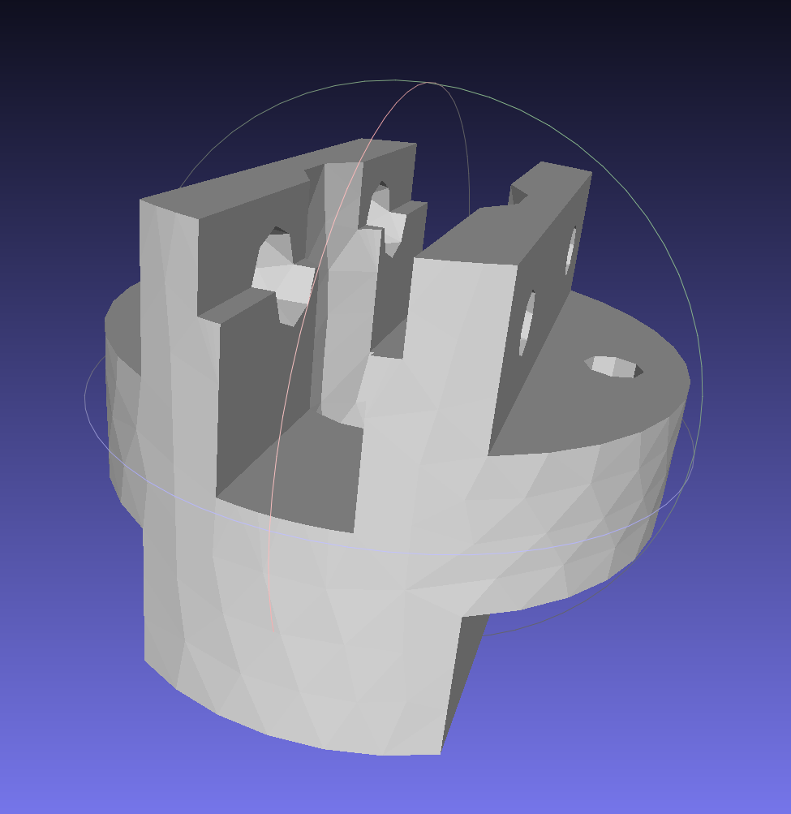
Component geometries are typically simple objects… But some have polygon-description of the surface
2D
3D

Slide 13
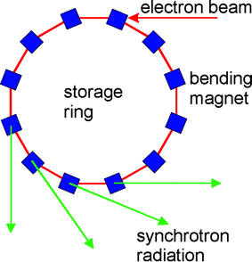
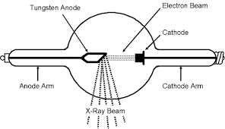
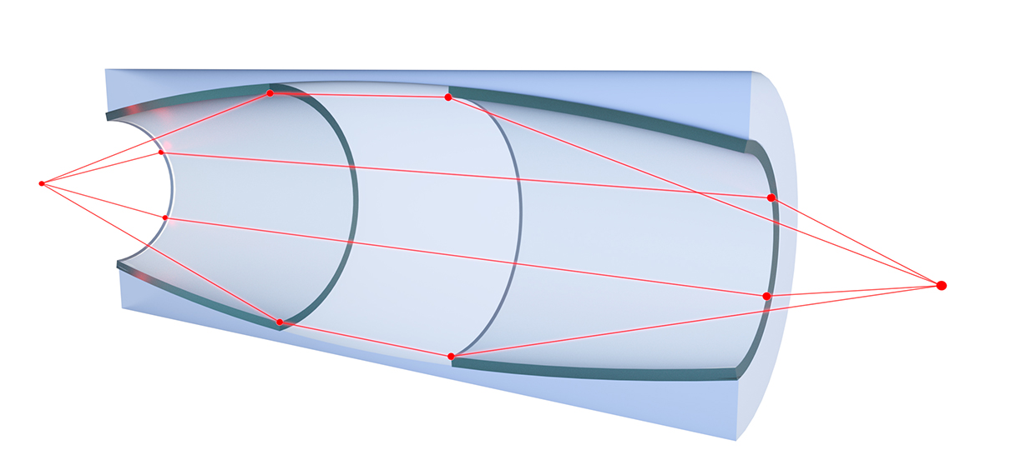
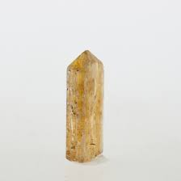
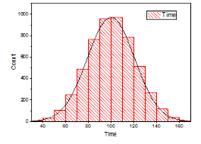


Component classes
Sources - these define MC starting conditions / “inject” rays to our simulation
Optics - used to tailor properties of the X-ray beam
Examples are mirrors, capillaries, lenses, zone-plates, choppers, collimators, slits, …
Samples - “matter” of some form
Powders, single crystals, liquids, micelles in solution, reflecting surfaces…
Monitors - may probe the state of the X-ray beam and store histograms / event lists
Misc, obsolete
“Other stuff” and “Old stuff”

Slide 14
Component classes
Sources - these define MC starting conditions / “inject” X-rays to our simulation
Optics - used to tailor properties of the X-ray beam
Examples are mirrors, capillaries, lenses, zone-plates, choppers, collimators, slits, …
Samples - “matter” of some form
Powders, single crystals, liquids, micelles in solution, reflecting surfaces…
Monitors - may probe the state of the X-ray beam and store histograms / event lists
Misc, obsolete
“Other stuff” and “Old stuff”
Common to all components:
They set, manipulate/interact with
or measure the state of the X-ray (ray)

Slide 15

Sources, e.g. rotating anode
To first order emit uniformly into steradian

Slide 16





Sources, e.g. rotating anode
To first order emit uniformly into steradian
Generally we are intersted in sending the input to an aperture, characterised by a certain solid angle , often corresponding to a rectangle x at a distance from the source

Slide 17

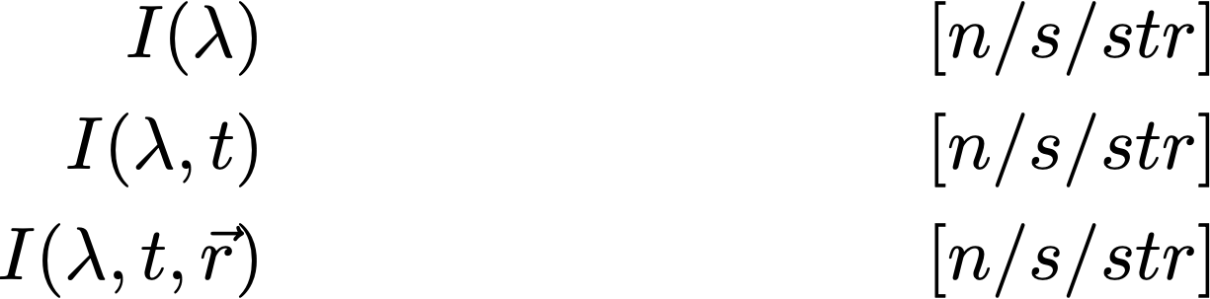
Sources, e.g. rotating anode
The emmission intensity into our chosen solid angle can be a function of wavelength, time (pulsed sources) and possibly point of origin on the source surface (e.g. for partially coherent descriptions).
The emission of particles into the solid angle is in fact an integration and leads to a simulated “intensity” of .
In McXtrace, that integrated intensity is partitioned over a given set of particle rays referred to as ncount, -n or --ncount
The default ncount is 1e6 rays

Slide 18


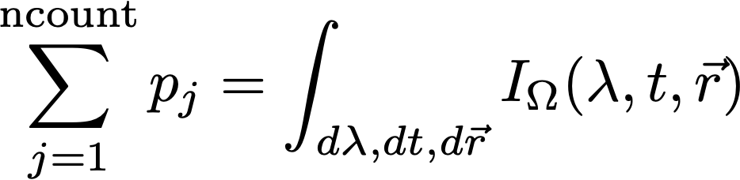
Sources, e.g. rotating anode
Our rays are emitted randomly, sampling and all variables of the source “spectrum”, i.e. wavelength, time and area
assigning ray weights such that

Slide 19



X-ray (rays) in McXtrace - what are they?
X-ray package:
Weight (p), # photons (left) in the package
Coordinates (x,y,z)
Wavevector (kx,ky,kz)
Polarization (Ex,Ey,Ez)
Phase ()
Time(t)
Defining the ray starting conditions imply setting:
The starting point on the surface, i.e. (in the code variables x,y,z)
The direction into and our / k (in the code variables kx,ky,kz)
The starting time (in the code the variable t)
The initial intensity / weight of the X-ray ray (in the code the variable p)
If needed the initial
Electric field polarisation (in the code the variables Ex,Ey,Ez)
X-ray phase (in the code the variable phi)

Slide 20
X-ray / matter interaction 1: reflecting surface
1 starting situation
Mirror surface
X-ray (ray)
(x,y,z,kx,ky,kz,t,Ex,Ey,Ez,phi,p)
0

Slide 21
X-ray / matter interaction 1: reflecting surface
2. Propagate to the mirror surface
Mirror surface
(x,y,z,kx,ky,kz,t,Ex,Ey,Ez,phi,p)
1
X-ray (ray)
(x,y,z,kx,ky,kz,t,Ex,Ey,Ez,phi,p)
0

Slide 22
X-ray / matter interaction 1: reflecting surface
3. Checks (are we on surface, what is probability of reflection etc.)
Mirror surface
(x,y,z,kx,ky,kz,t,Ex,Ey,Ez,phi,p)
1
X-ray (ray)
(x,y,z,kx,ky,kz,t,Ex,Ey,Ez,phi,p)
0

Slide 23
X-ray / matter interaction 1: reflecting surface
4. Reflect
Mirror surface
(x,y,z,kx,ky,kz,t,Ex,Ey,Ez,phi,p)
1
X-ray (ray)
(x,y,z,kx,ky,kz,t,Ex,Ey,Ez,phi,p)
0
Weight of final ray is adjusted according to reflectivity, see next slide
(x,y,z,kx,ky,kz,t,Ex,Ey,Ez,phi,p)
2

Slide 24
X-ray / matter interaction in general
A photon hitting a sample can be:
absorbed, transmitted, or scattered

Slide 25



X-ray / matter interaction in general
Samples
For a non-thin sample the probabilities for absorption, transmission or scattering are given by
t = sample thickness
macroscopic cross section [cm⁻¹]
microscopic cross section [barn/fm²]
number density [atoms/cm³]

Slide 26
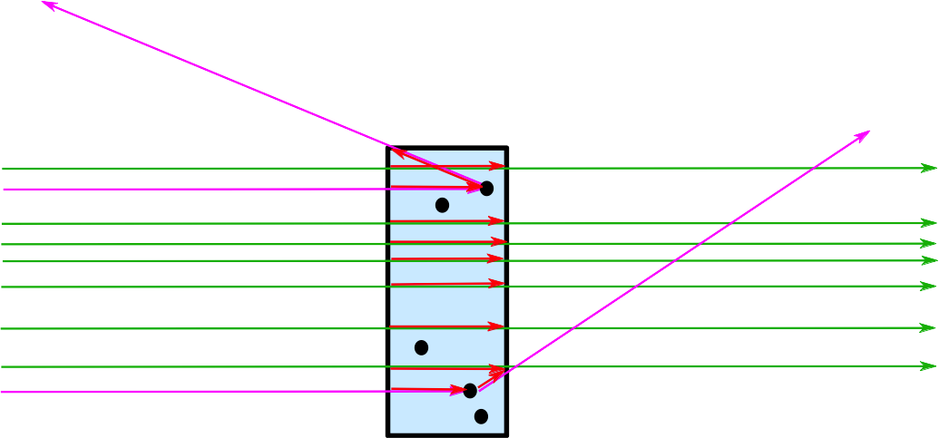
Samples/Matter interaction in General in McXtrace
A photon ray hitting a sample can be:
transmitted+absorption, or scattered+absorption

Slide 27
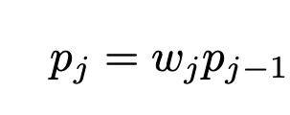







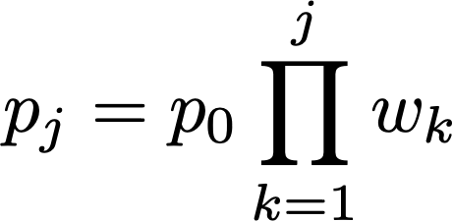
Transport of weight through the instrument…
In a given component, the X-ray intensity is adjusted by a multiplicative factor (probability)
Instrument
Source
Sample
Monitor
The weight multiplier of the j’th component, , is calculated by the probability rule where Pb is the physical probability for the event ”b“, and is the probability that the Monte Carlo simulation selects this event.
In case of “branching”, i.e. multiple outcomes, it is clear that

Slide 28
To first order, McXtrace is linear and follows sequence of components in your file…
1
3
2
1
2
3
Starting at the source

Slide 29
To first order, McXtrace is linear and follows sequence of components in your file…
1
3
2
1
2
3
Moving to first comp in the list

Slide 30
To first order, McXtrace is linear and follows sequence of components in your file…
1
3
2
1
2
3
Moving to 3rd comp in list requires “moving back in time”.
Default behavior is to ABSORB this type of X-ray.
For monitors use restore_xray=1 in this case.
For homegrown comps use ALLOW_BACKPROP macro.

Slide 31
To first order, McXtrace is linear and follows sequence of components in your file…
The order of components is important,
and in general overlaps should be avoided!
1
3
2
1
2
3
Moving to 3rd comp in list requires “moving back in time”.
Default behavior is to ABSORB this type of X-ray.
For monitors use restore_xray=1 in this case.
For homegrown comps use ALLOW_BACKPROP macro.

Slide 32
Monitors: in general
REALITY:
Monitors:
Intensity probe of the beam
Semi-transparent to X-rays → Low Efficiency
Detectors:
Should detect all photons → Efficiency as high as possible
SIMULATIONS (McXtrace):
In McXtrace:
We can program monitors and detectors to behave any way we like. We refer to both of those indistinguishably as ‘monitors’.
E.g. monitor with Efficiency =100% and Transparency=100%

Slide 33
Monitors: Example PSD_monitor

Slide 34
Monitors: Example PSD_monitor
When the simulation has been completed, the detected intensity in pixel (i,j) is:
$$I\left(i,j\right)=\sum_{x_{k},y_{k}∈pixel\left(i,j\right)}{p_{k}};k=raynumber.$$
… during simulation, the pixels are maintained as running sums.

Slide 35
...
TRACE
COMPONENT origin = Progress_bar() AT(0,0,0) ABSOLUTE
COMPONENT src = Source_flat(
radius=0.05, lambda0=2.5, dlambda=1.5,
focus_xw=0.1, focus_yh=0.1, dist=5)
AT(0,0,0) RELATIVE origin
COMPONENT psd = PSD_monitor(xwidth=0.2,
yheight=0.2, filename=”psd.dat”)
AT (0,0,5) RELATIVE src
COMPONENT lm = L_monitor(xwidth=0.2, yheight=0.2,
filename=”lm.dat”,
Lmin=0, Lmax=8)
AT (0,0,5+0.01) RELATIVE src
Monitors: Example PSD_monitor and L_monitor

Slide 36
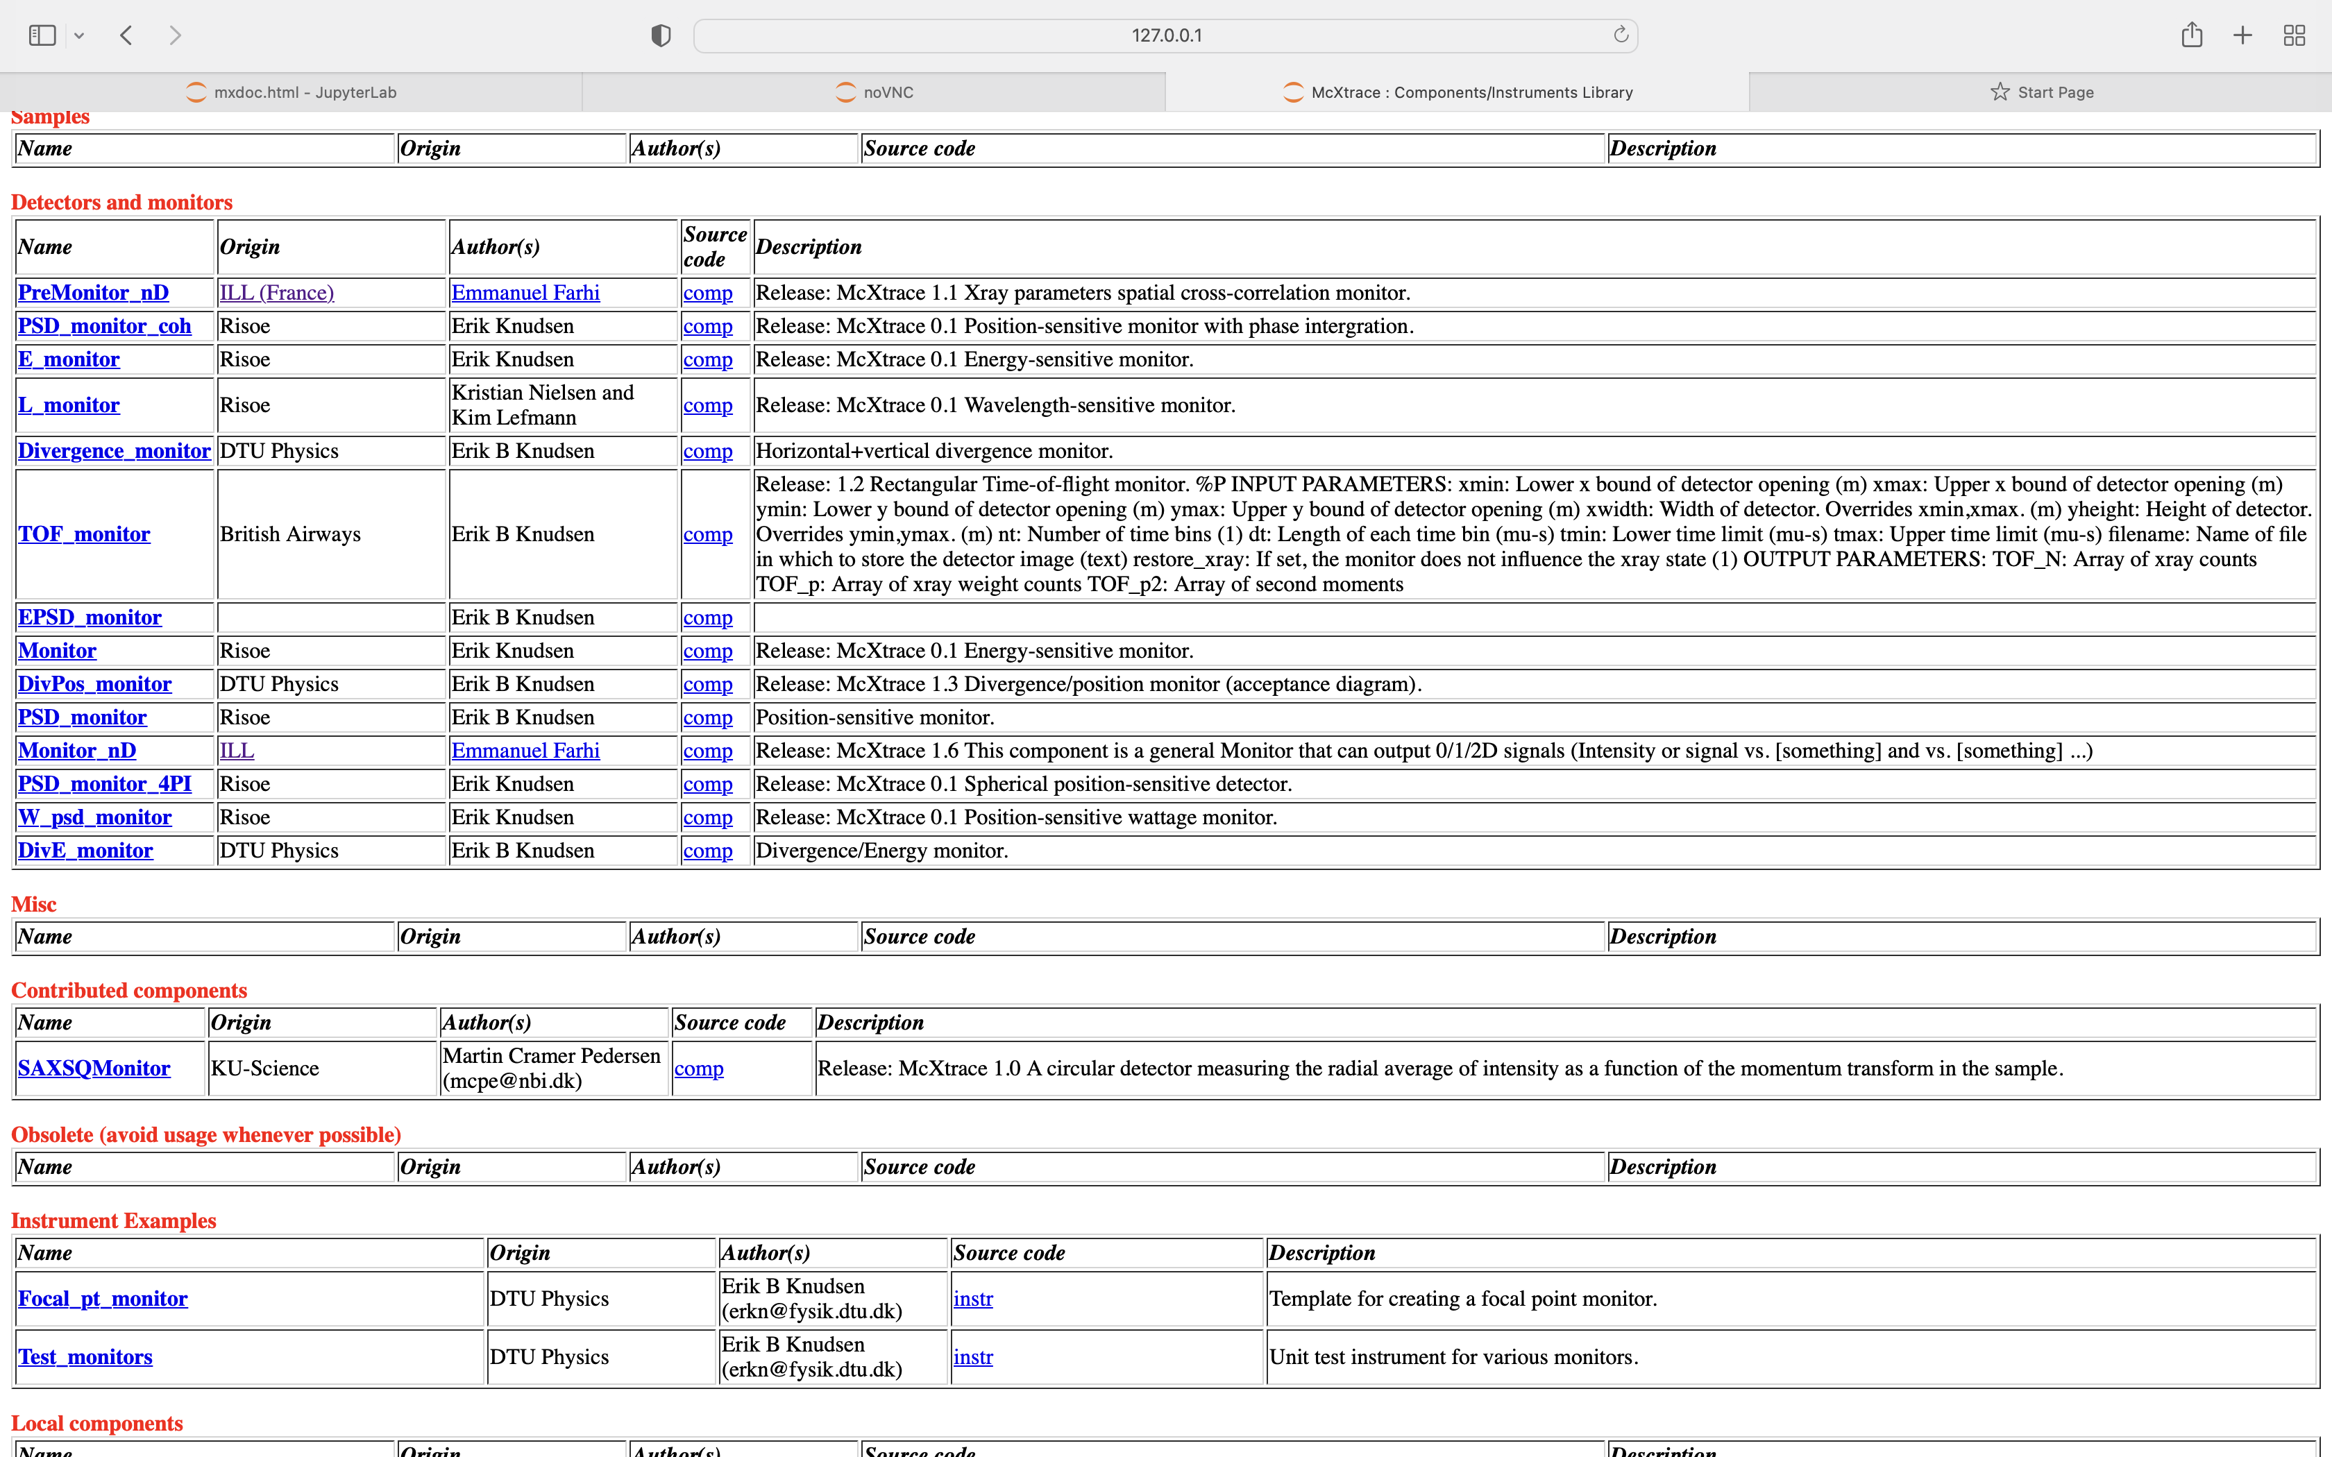
Monitors: what is available
mxdoc monitor from commandline

Slide 37

In a histogram sense
Imagine a histogram, e.g. I(λ)
The RMS variance over that set becomes our statistical error bar E
…
…
In bin i, N events each carrying a fractional intensity pj so that
1
2
3
i
k

Slide 38
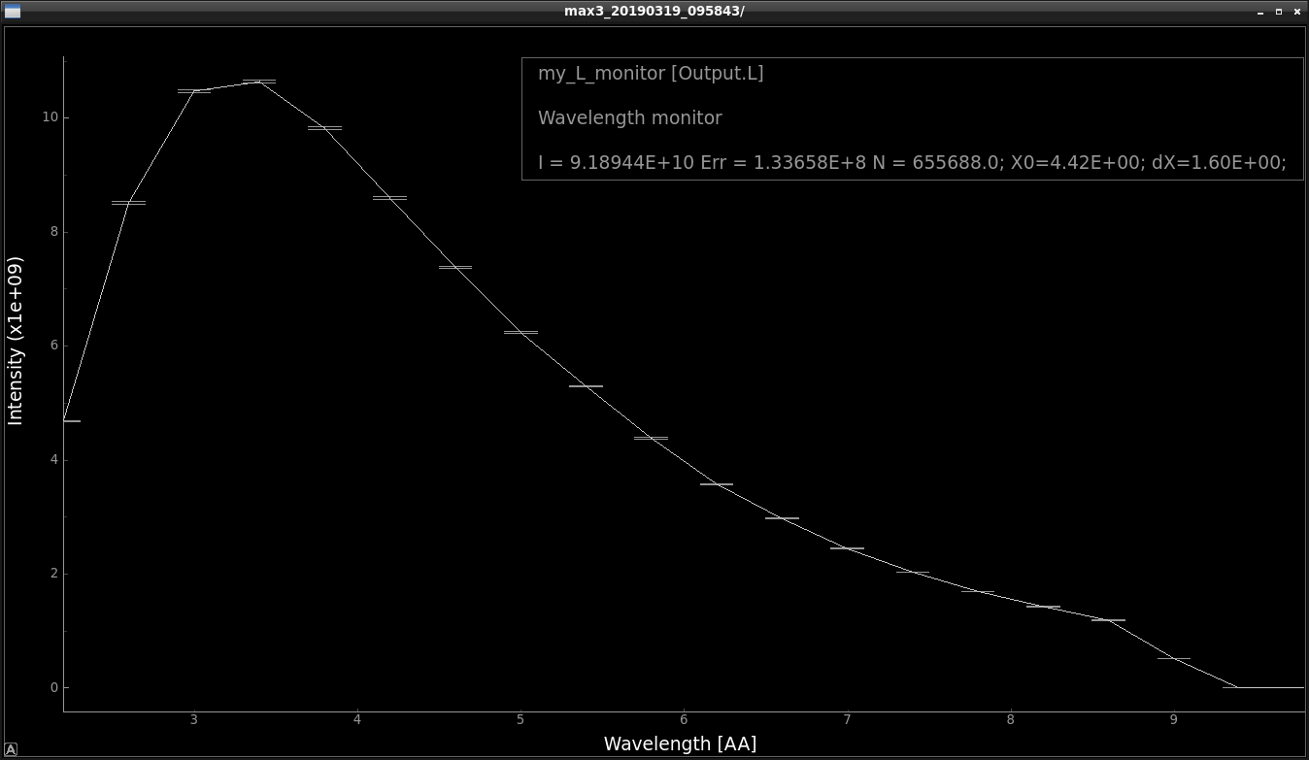
Statistics computed on the fly
In a histogram sense
Monitors: Quick examples
Imagine a histogram, e.g. I(λ)
The RMS variance over that set becomes our statistical error bar E
I
E
N
…
…
In bin i, N events each carrying a fractional intensity pj so that
1
2
3
i
k
# Events
Intensity / n/s
1st and 2nd moments of data
Estimated RMS MC error

Slide 39
Statistics computed on the fly
In a histogram sense
Monitors: Quick examples
Imagine a histogram, e.g. I(λ)
The RMS variance over that set becomes our statistical error bar E
I
E
N
…
…
In bin i, N events each carrying a fractional intensity pj so that
1
2
3
i
k
# Events
Intensity / n/s
1st and 2nd moments of data
Estimated RMS MC error
Statistics also available per bin (inside data file)

Slide 40
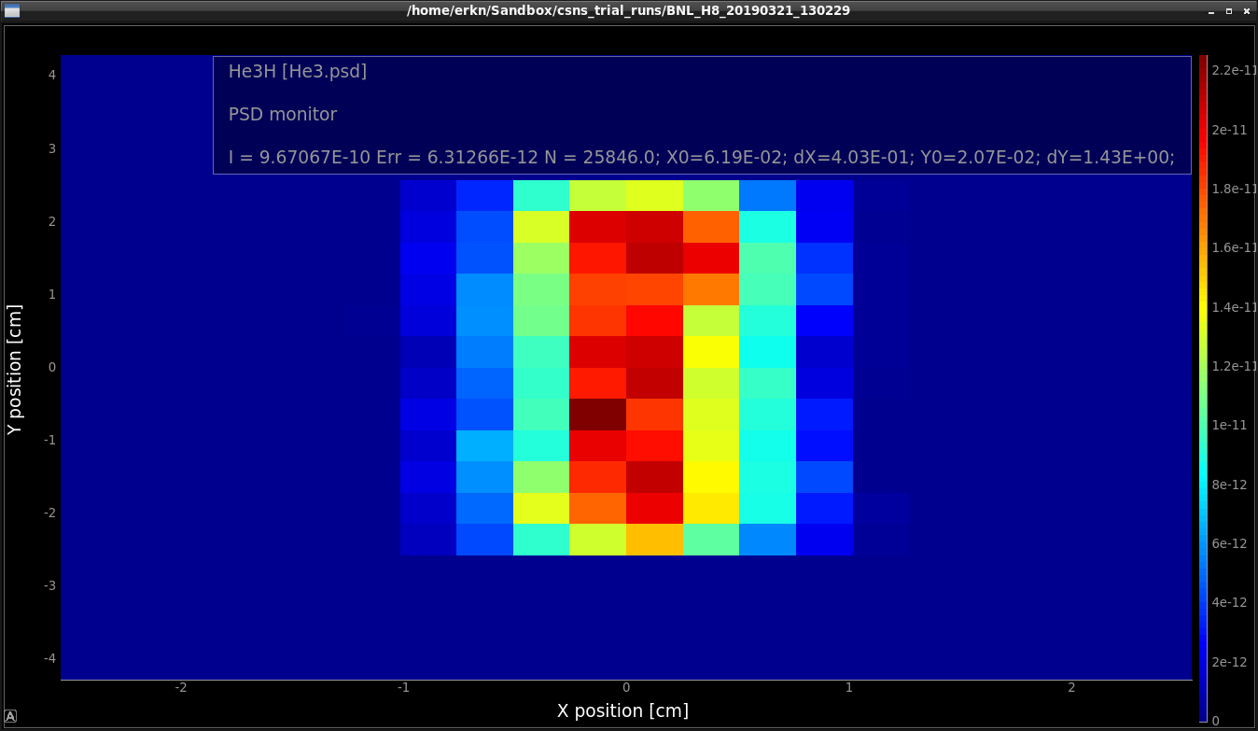
Monitors: Quick examples
In 2D
1st and 2nd moments

Slide 41
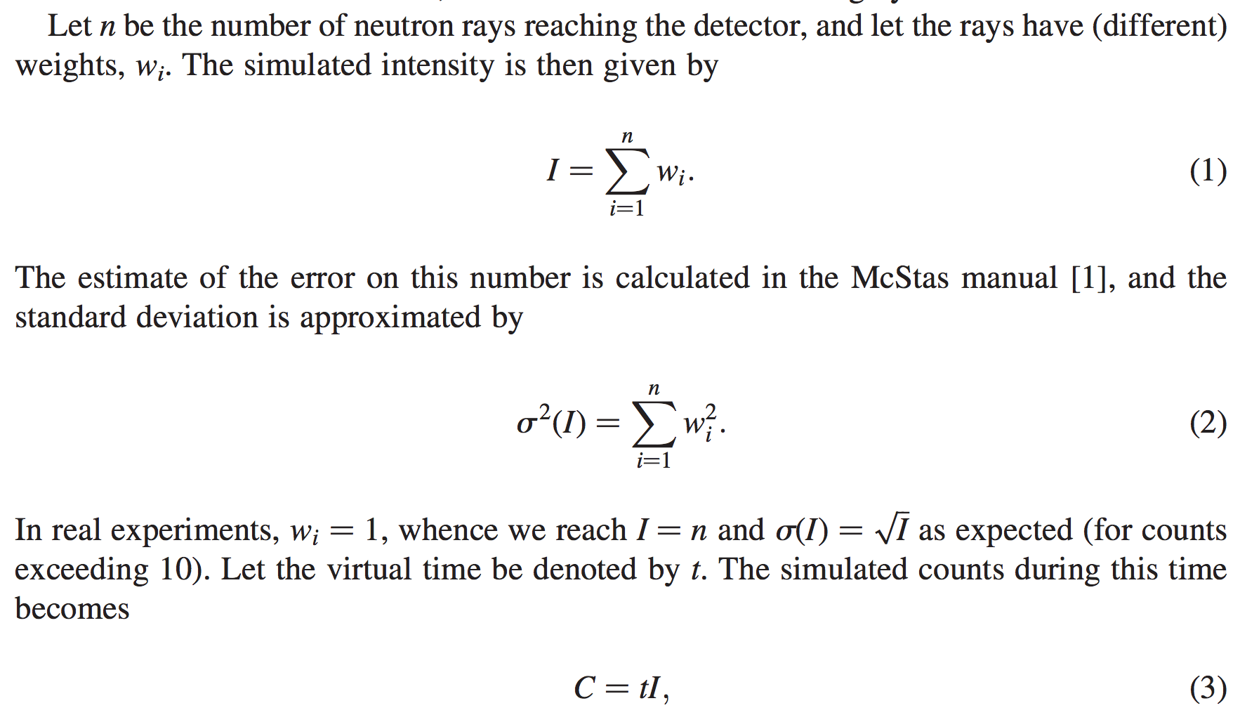
From "Virtual experiments - the ultimate aim of neutron ray-tracing simulations", K. Lefmann et al., Journal of Neutron Research 16, 97-111 (2008)

Slide 42
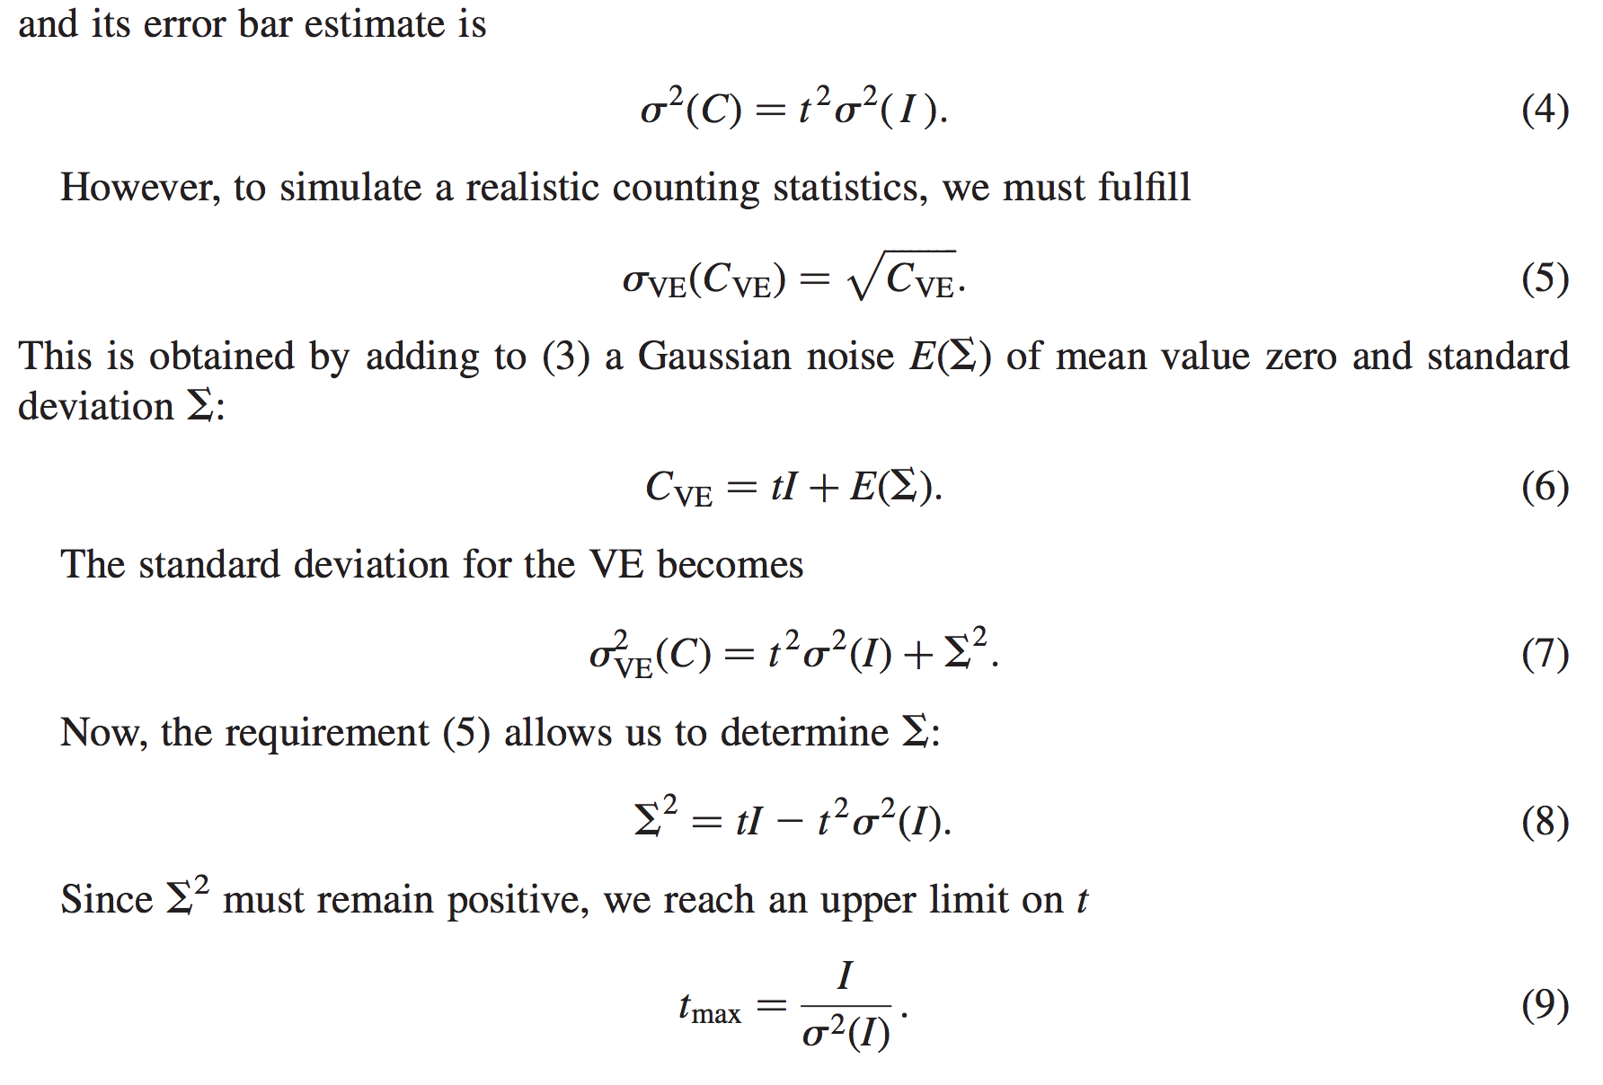
From "Virtual experiments - the ultimate aim of neutron ray-tracing simulations", K. Lefmann et al., Journal of Neutron Research 16, 97-111 (2008)

Slide 43
Sketch of an algorithm…
On a given McXtrace histogram
For the non-zero bins, calculate The smallest defines the “maximal counting time” allowed by your statistics
Preferably a “background” should be added - use a “known experimental value” or an estimate…

Slide 44
A general monitor for 0D/1D/2D records
Monitor_nD
The all-in-one , swiss-army-knife of monitors
Monitor_nD can have almost any shape, and record
any requested standard quantities

Slide 45
A general monitor for 0D/1D/2D records
Monitor_nD
Examples
COMPONENT MyMon = Monitor_nD( xwidth = 0.1, yheight = 0.1, zdepth = 0,
options = "intensity per cm2 angle,limits=[-5 5],
bins=10,with borders, file = mon1")
options = "multiple kx ky kz, auto abs log t, and list all neutrons"
options = "banana, theta limits=[10,130], bins=120, y"

Slide 46
Monitor_nD
… or monitor just about anything:
COMPONENT MyMon = Monitor_nD(xwidth = 0.1, yheight = 0.1,
user1=age, username1="Age of the Captain [years]",
options="user1, auto")

