Slide 1





McStas Advanced Samples

Slide 2
Agenda
Combining a powder sample with a Single Crystal
Polycrystal
The Union concept
External Connections:
  nCrystal, nxs, cif2hkl
  In General: MCPL

Slide 3
Powder SX combination
Use a GROUP!
… but also allow reentry – How?
COMPONENT a1 = Arm()
AT(0,0,0) RELATIVE sample_pos
EXTEND
%{
sample_scatter=0;
%}
COMPONENT pow = PowderN( … )
AT(0,h/2,0) RELATIVE a1
GROUP sample
EXTEND
%{
if(SCATTERED) sample_scatter=1;
%}
COMPONENT sx = Single_crystal( …)
AT(0,-h/2,0) RELATIVE a1
GROUP sample
EXTEND
%{
if(SCATTERED) sample_scatter=1;
%}
COMPONENT a2 = Arm()
AT (0,0,0) RELATIVE a1
WHEN (scatter) JUMP a1
Powder
Single Crystal

Slide 4
Extending that idea
A polycrystal as many Single crystals
The idea: Cheat a single Single_crystal into believing it is many...

Slide 5
Apply translation

Slide 6
Single_crystal as polycrystal
Scattering events happen
in the crystal
neutron exits.
Apply translation

Slide 7
Single_crystal as polycrystal
Apply inverse translation
Scattering events happen
in the crystal
neutron exits.
Apply translation

Slide 8
Single_crystal as polycrystal
Apply inverse translation
Neutron may
enter a new
subcrystal...
Scattering events happen
in the crystal
neutron exits.
Apply translation

Slide 9
Union
Jump to another slideshow

Slide 10
External Connections
McStas can be connected to many things, and in many ways:
  Datafiles:
    VASP/MD > Isotropic_Sqw
    cif2hkl (CrysFML) >Single_crystal & PowderN
    MCNP6, VitESS, GEANT-4 > MCPL
  Code-sharing:
    SasView_models
  Direct compilation linkage
    nCrystal

Slide 11
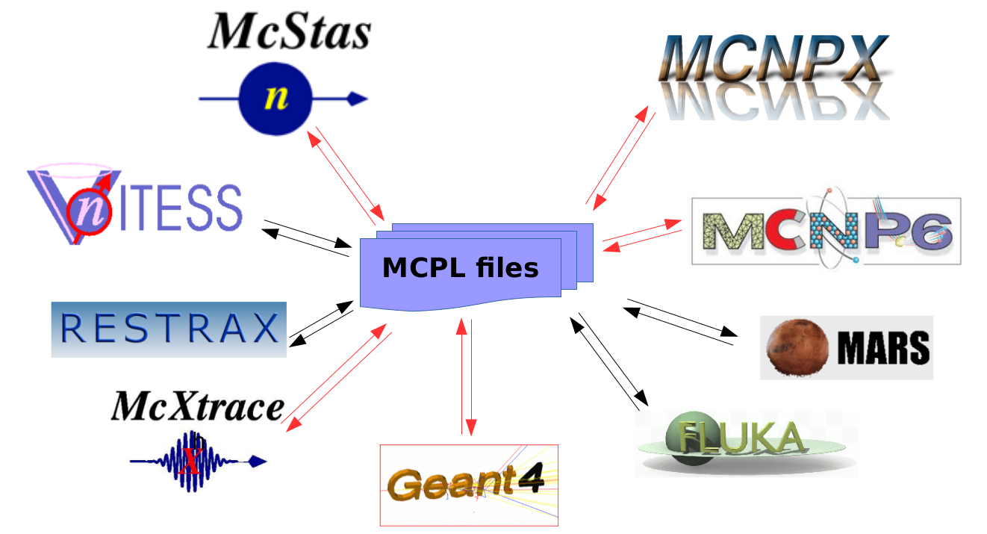
MCPL

Slide 12
MCPL
https://mctools.github.io/mcpl/

